Slide 1

A Prototype of a Machine Learning Workflow to Classify Land Use from the Housing Market Dynamics
MASc final presentation
Presented by: Stepan Oskin
Supervisor: Erik J Miller
Date: 20-Sep-2019
Notes:
Growth centers
West Don Lands
Liberty village
Riverdale
Outline
Deadline to submit thesis
Month-by-month tuition

Slide 2
Section 1:
Background

Slide 3
1. Background
Started my thesis inspired by complexity studies, interested in urban systems
Under the supervision of Eric Miller – became part of the team at the UTTRI
Transportation research models the complex interaction of land use with transportation
With time, IUM models become more stochastic and disaggregated (e.g., microsimulation)
One of the challenges – data hungriness
New data sources (increased digitization of human activity) are also increasingly disaggregate
POLARIS introduced in 1985, Teranet creates an extensive dataset of land registration records
Teranet’s dataset – wealth of housing market data, lack of features...
One of the major missing features – type of property (land use information)
Sources available: DMTI, Department of Geography
Each has its limitations
DMTI is crude and inaccurate
Department of Geography’s land use is labour intensive and was collected once)
10. Proposed solution: ML workflow to classify land use from the housing market dynamics

Slide 4
2.2. Motivation
Disaggregation of models is mirrored by disaggregation of data sources (Census/TTS vs Teranet)
Fine-scale housing market dynamics, heterogeneity of the GTHA housing market
“Lack and abundance” paradox: Teranet’s dataset provides a wealth of data with a lack of features

Slide 5
2.3. Teranet: challenges and opportunities
Challenges:
Size of Teranet’s dataset, computational requirements
Lack of features
No ability of differentiating transactions by property type
Opportunities:
Date and location information allows joining different data sources and engineering new features
Department of Geography has manually collected detailed land use information in 2012 and 2013
Machine learning to classify land use from housing market

Slide 6
Section 2:
Data sources

Slide 7
2.1. Data sources used
Teranet
Select Census variables
Select TTS variables
DMTI land use
Detailed land use (Department of Geography)

Slide 8
3.1 Relationship between datasets
many
fk: pca_id
pk: transaction_id
postal-code-level data
one
many
Census
pk: dauid
fk: dauid
many
fk: csduid
DA-level data
municipality-level data
many
fk: fsa
many
fk: taz_o
Teranet
FSA-level data
TAZ-level data
one
TTS
variables
fk: year
pk: PIN
one
pk: dauid
many
DMTI
Land Use
Geog.
Land Use
time-indexed data
fk: pin_lu
many
Fuel prices
Inflation
coefs.
pk: PIN
one
Parcel-level data
fk: PIN
many
EPOI
one
pk: year

Slide 9
2.2. Spatial units used by different sources
Teranet: point (parcel centroid)
Select Census variables: DA polygon
Select TTS variables: TAZ polygon (2001 zone system)
DMTI land use: parcel
Detailed land use (Department of Geography): parcel

Slide 10
2.3. Matching spatial units
Challenges:
Spatially joining polygon-based data is challenging
Combining sources needs spatial joins to connect primary keys or area weighted spatial interpolation of data to a common unit of analysis
Boundaries may change over time
Proposed solution:
Relate all polygon-based data to time-indexed points
Polygon-based Census and TTS data can be joined to Teranet points with respect to temporal relationships (discussed next)

Slide 11
2.4. Temporal spans of different sources
Teranet: timestamp (date)
Select Census variables: once in 5 years
Select TTS variables: once in 5 years
DMTI land use: 2001-2014, by year
Detailed land use (Department of Geography): 2011-2012

Slide 12
2.4. Temporal spans of different sources
Teranet: (...)1985-2017
Select Census variables: ...2001, 2006, 2011, 2016
Select TTS variables: 1986, ... , 2001, 2006, 2011, 2016
DMTI land use: 2001-2014, by year
Detailed land use (Department of Geography): 2011-2012

Slide 13
2.4. Temporal spans of different sources
DATA SOURCES | 1999 | 2000 | 2001 | 2002 | 2003 | 2004 | 2005 | 2006 | 2007 | 2008 | 2009 | 2010 | 2011 | 2012 | 2013 | 2014 | 2015 | 2016 | 2017
Census
TTS
DMTI land use
DMTI postal codes
DMTI EPOI
EMME network calculations
Teranet
Dept of Geography land use
Fuel price in Toronto

Slide 14
2.5. Matching temporal spans
Challenges:
Discrete vs “continuous” measurements
Census and TTS variables are sampled once every 5 years, while Teranet data is recorded daily
Urban form is continuously evolving
Land use information can become inaccurate with time
Aggregation or interpolation required
Aggregation or interpolation is required to match the different data sources used for longitudinal studies

Slide 15
2.5. Matching temporal spans
Proposed solution (options):
Direct match
Use only subsets of Teranet records for appropriate Census/TTS year
Benefits: precision of measurement
Disadvantages: limited use of Teranet
Interpolate discrete measurements
Census / TTS variables can be turned into continuous via interpolation
Benefits: closest match by time
Disadvantages: more assumptions
Assign Census/TTS temporal spans to Teranet records
Each Census / TTS survey can be assigned a temporal span of 5 years
Benefits: avoid interpolation – less assumptions and preprocessing
Disadvantages: step-change in Census/TTS variables, varying accuracy

Slide 16
2.5. Matching temporal spans
DATA SOURCES | 1999 | 2000 | 2001 | 2002 | 2003 | 2004 | 2005 | 2006 | 2007 | 2008 | 2009 | 2010 | 2011 | 2012 | 2013 | 2014 | 2015 | 2016 | 2017
Census
TTS
DMTI land use
DMTI postal codes
DMTI EPOI
EMME network calculations
Teranet
Dept of Geography land use
Fuel price in Toronto
Each Census / TTS year gets assigned a 5-year span
to match to Teranet records.

Slide 17
Section 3:
Data preparation

Slide 18
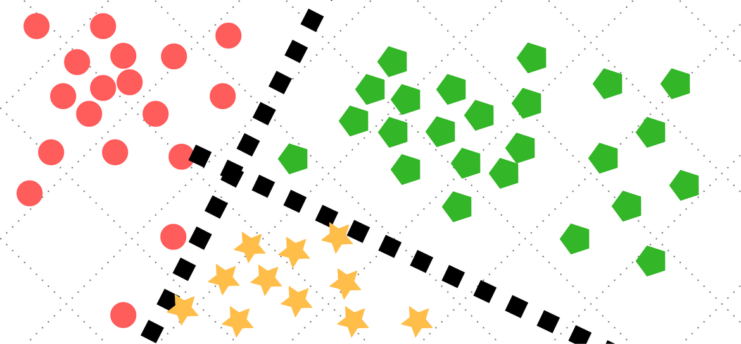
3.1 Data preparation: all data sources
Classification
algorithm
price > 10’000 CAD,
new attributes
Spatial joins
GTHA land use
Correct for
consistency
Convert Hamilton to GTA codes
Spatial joins
GTA + Hamilton
Land use
Tidy
Tidy
Land use
Concat
Teranet dataset
Select Census variables
Select TTS variables
Land use
Land use
GTA land use
Hamilton
land use
Teranet
Census
TTS
DMTI
Geo department
points
DA-level
TAZ-level
parcel-level
parcel-level

Slide 19
3.2. Teranet data preparation
4.
Encode target classes,
join with Census / TTS variables
Classification
algorithm
1.
2.
3.
Add foreign
keys via spatial joins
Correct
for
consist-ency
Add new attributes
0.
Raw
Teranet
data
final
Raw Teranet data:
9,039,241 rows
15 columns
Augmented and filtered
Teranet data:
5,188,513 rows
79 columns
Predicted
land use

Slide 20
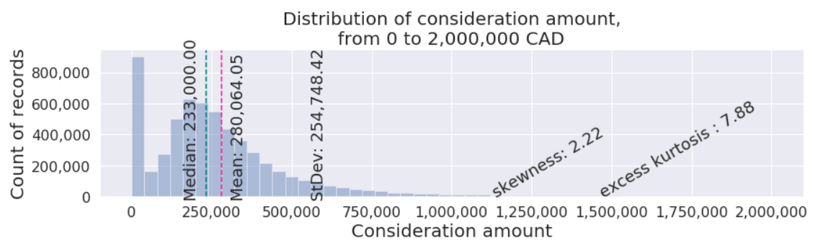
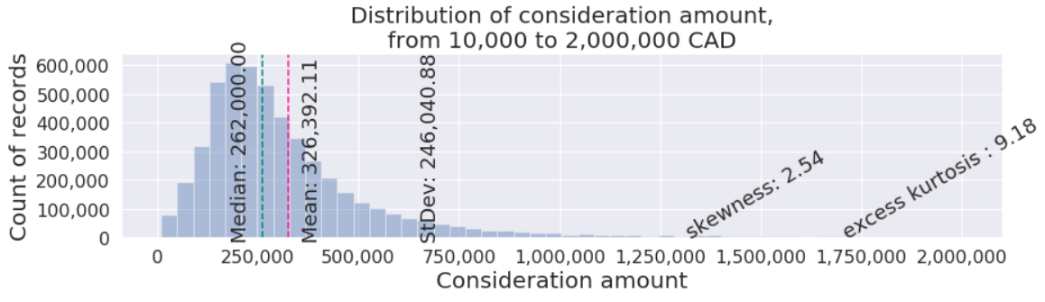
3.3. Outliers
Bottom outliers: records with price < 10’000 CAD removed.

Slide 21
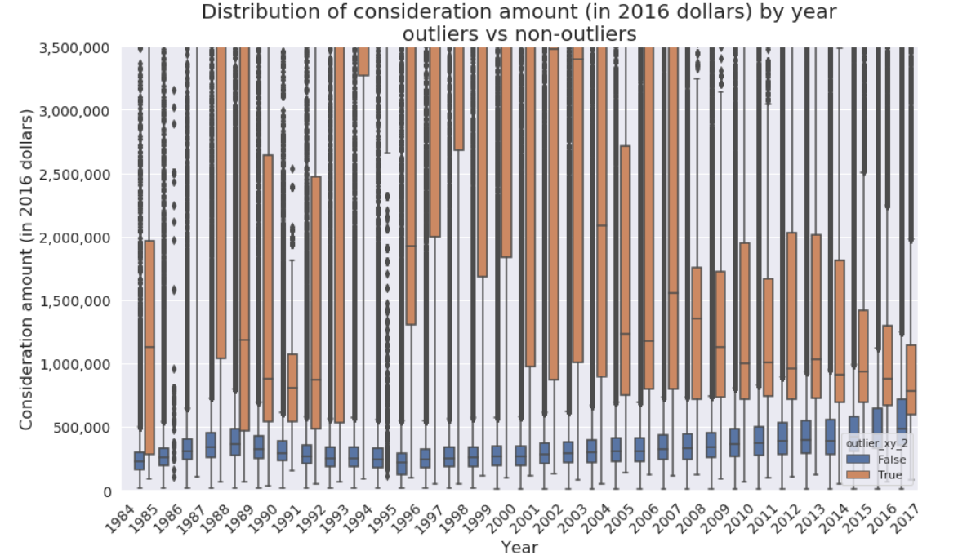
3.3. Outliers
`outlier_xy_2`:
Top outliers “peeled” in layers: 7 different criteria used

Slide 22
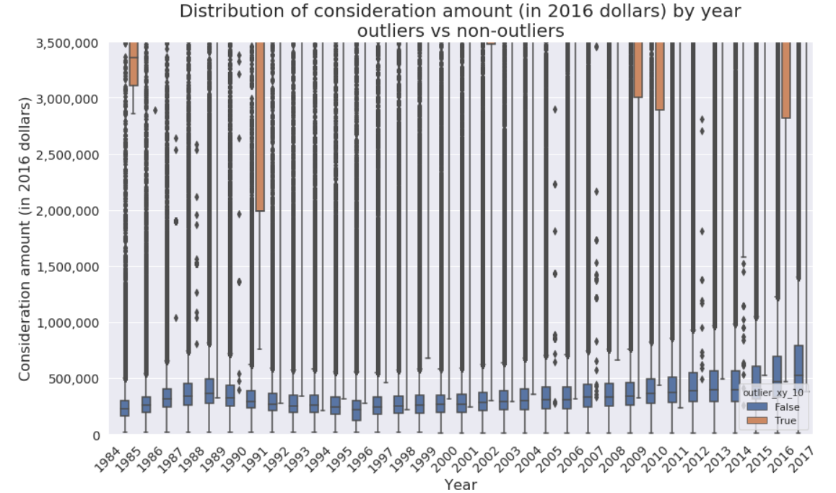
3.3. Outliers
`outlier_xy_10`:
Top outliers “peeled” in layers: 7 different criteria used

Slide 23
Section 4:
Land use classes

Slide 24
4. Land uses classes (target variable)
The top 10 land use categories (by frequency) from detailed land use are regrouped into 4 target classes:
“detached”: Single Detached House
“duplex_townhouse”: Duplex/Semi-Detached or Townhouse
“condo”: Apartments/Condos/Residence or Strata Townhouses
“other”: mixed, commercial, industrial, and everything else

Slide 25
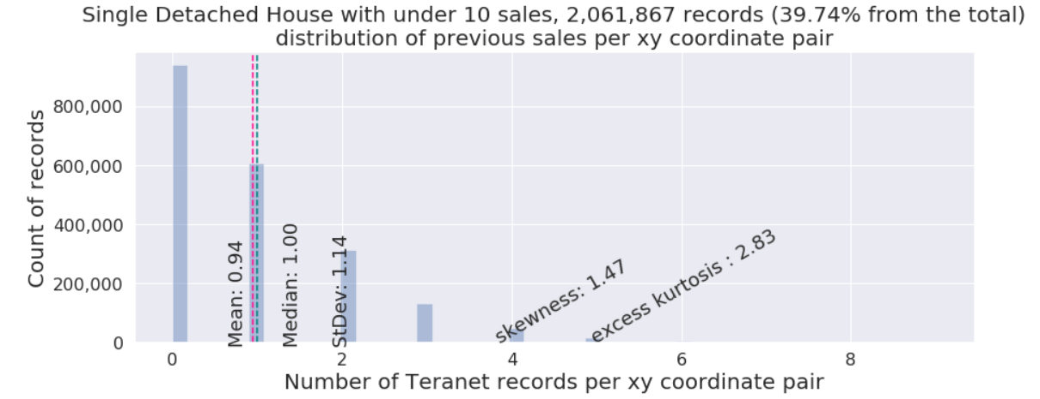
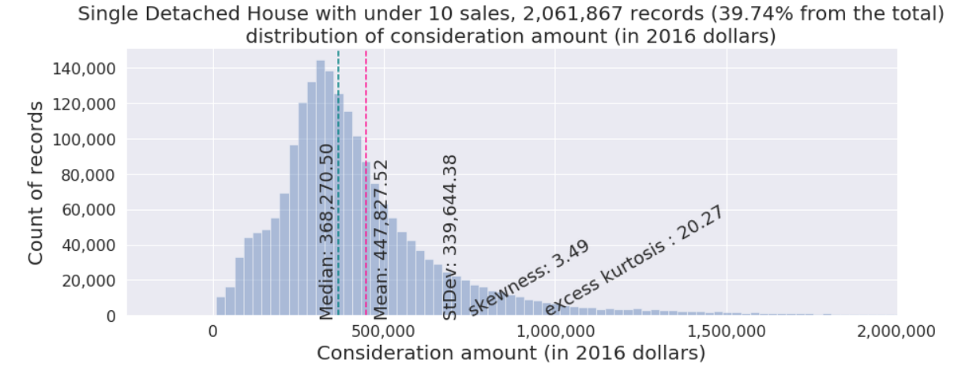
4. Land use class 1: detached

Slide 26
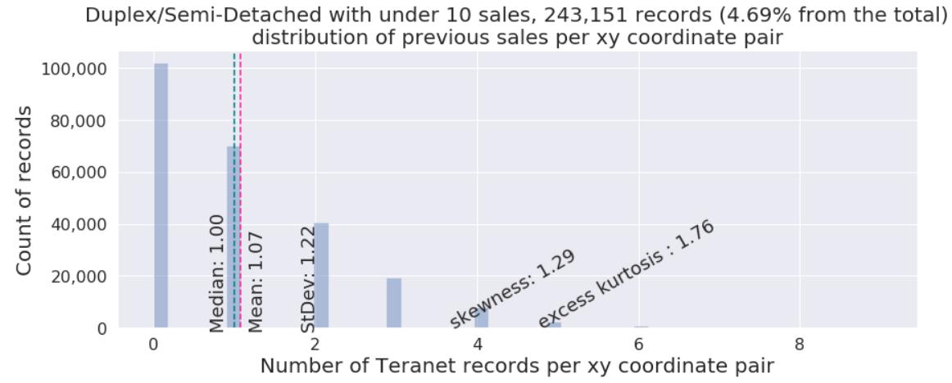
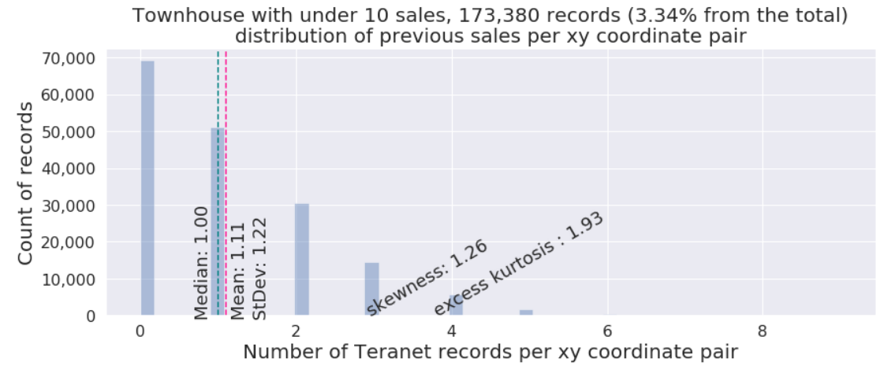
4. Land use class 2: duplex/townhouse

Slide 27
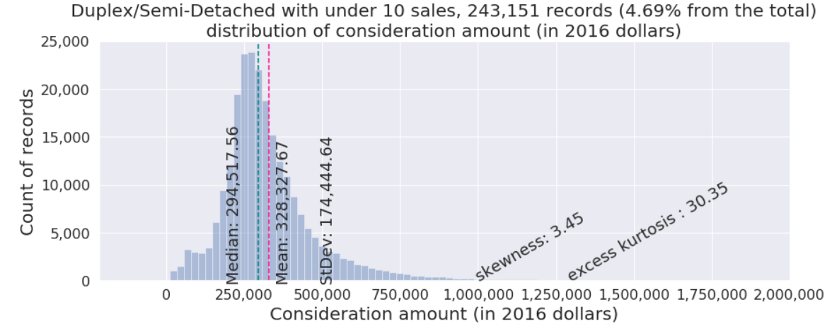
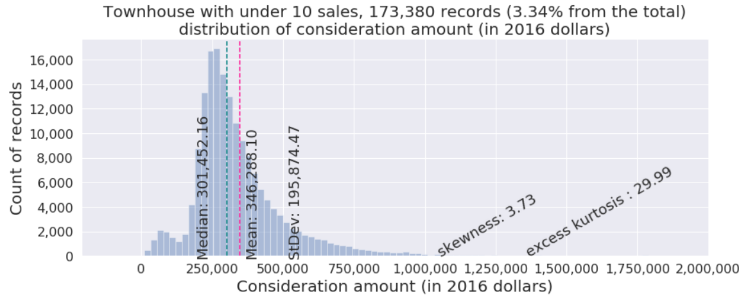
4. Land use class 2: duplex/townhouse

Slide 28
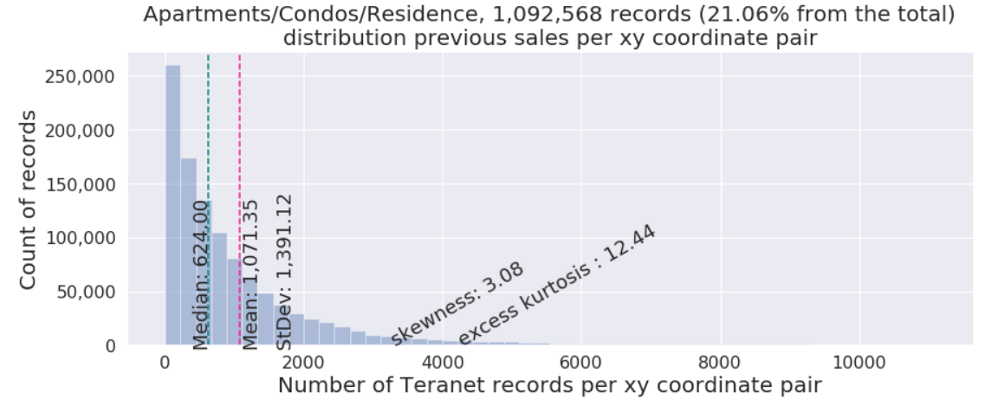
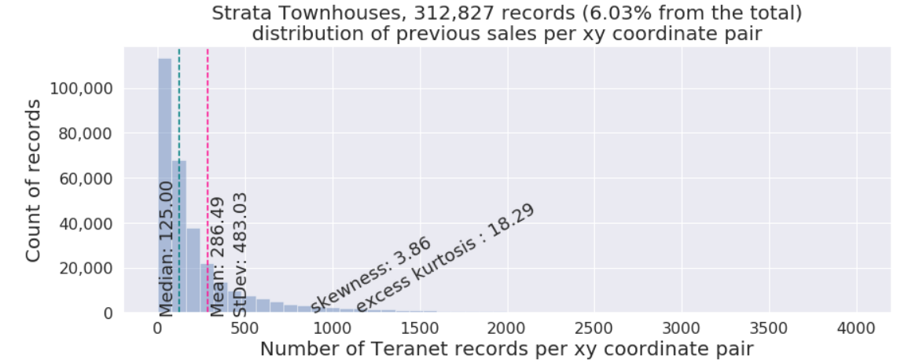
4. Land use class 3: condo / strata

Slide 29
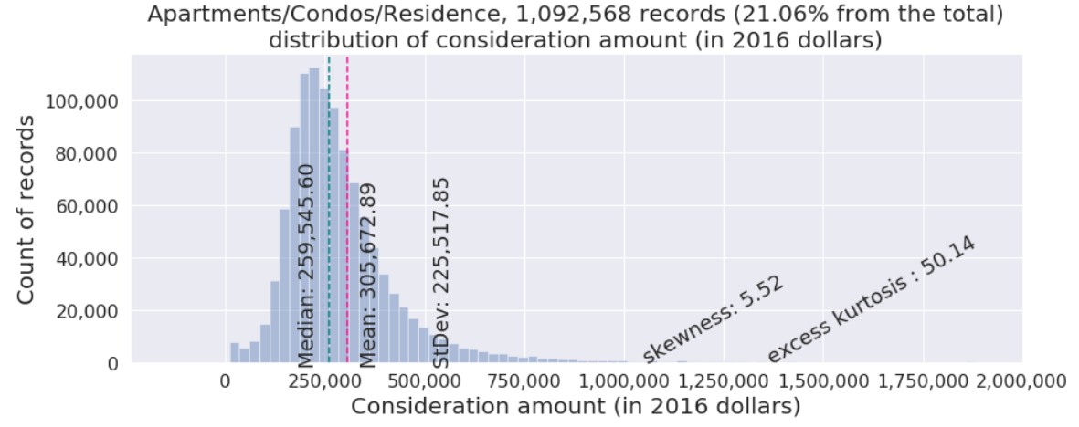
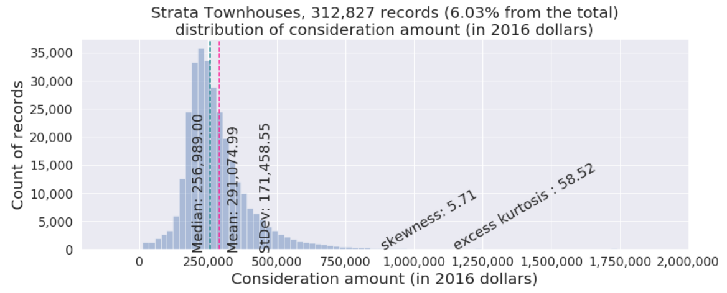
4. Land use class 3: condo / strata

Slide 30
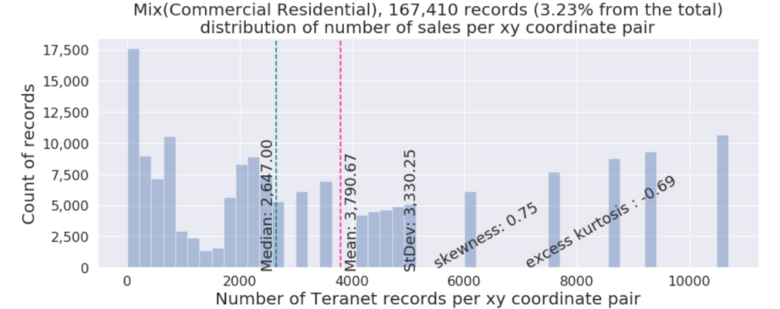
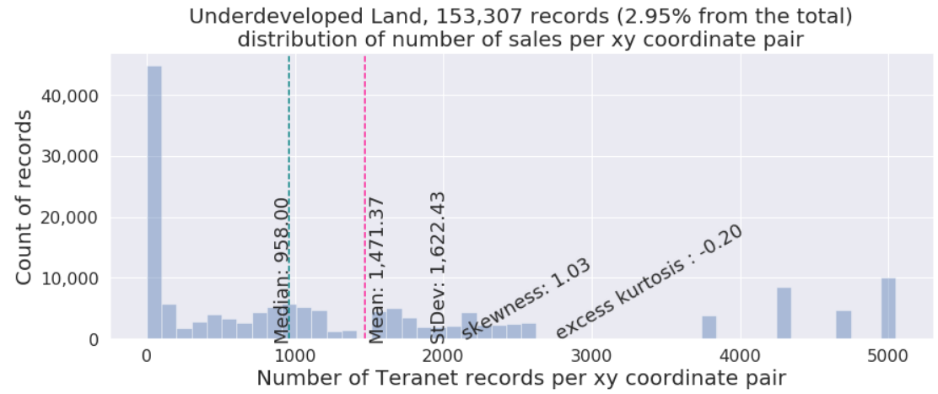
4. Land use class 3: other (examples)

Slide 31
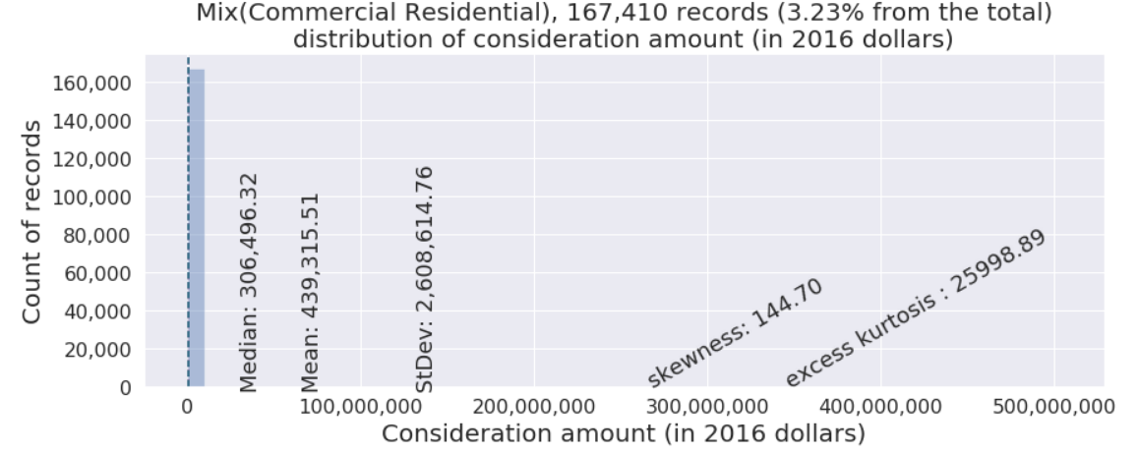
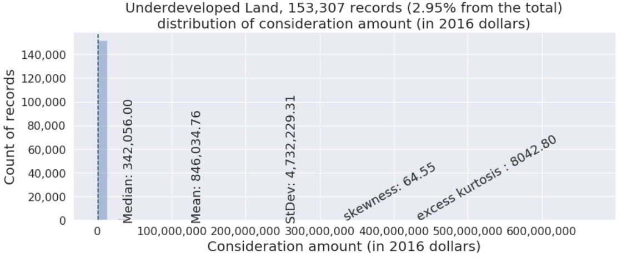
4. Land use class 3: other (examples)

Slide 32
Section 5:
Feature selection

Slide 33
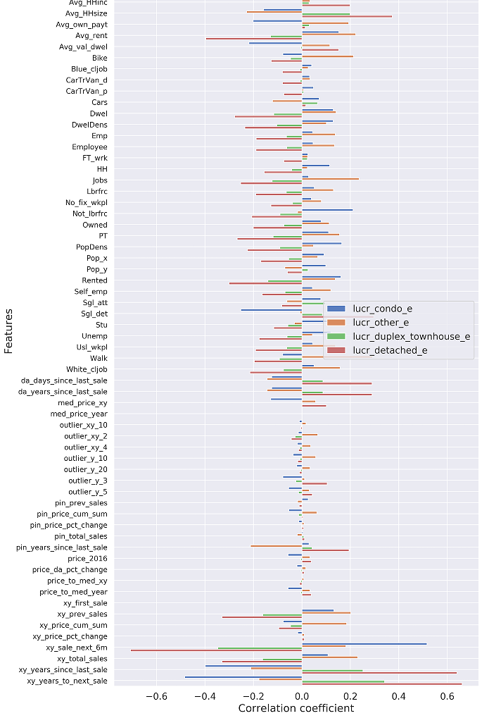
5. Feature selection
Data preparation step
augmented Teranet dataset
from 4 features to 64:
'lro_num’,
'pin', 'consideration_amt', 'registration_date', 'POSTAL_CODE', 'PROVINCE’,
'UNITNO', 'STREET_NAME', 'STREET_DESIGNATION', 'STREET_DIRECTION', 'MUNICIPALITY', 'STREET_SUFFIX', 'STREET_NUMBER’,
'X', 'Y'

Slide 34
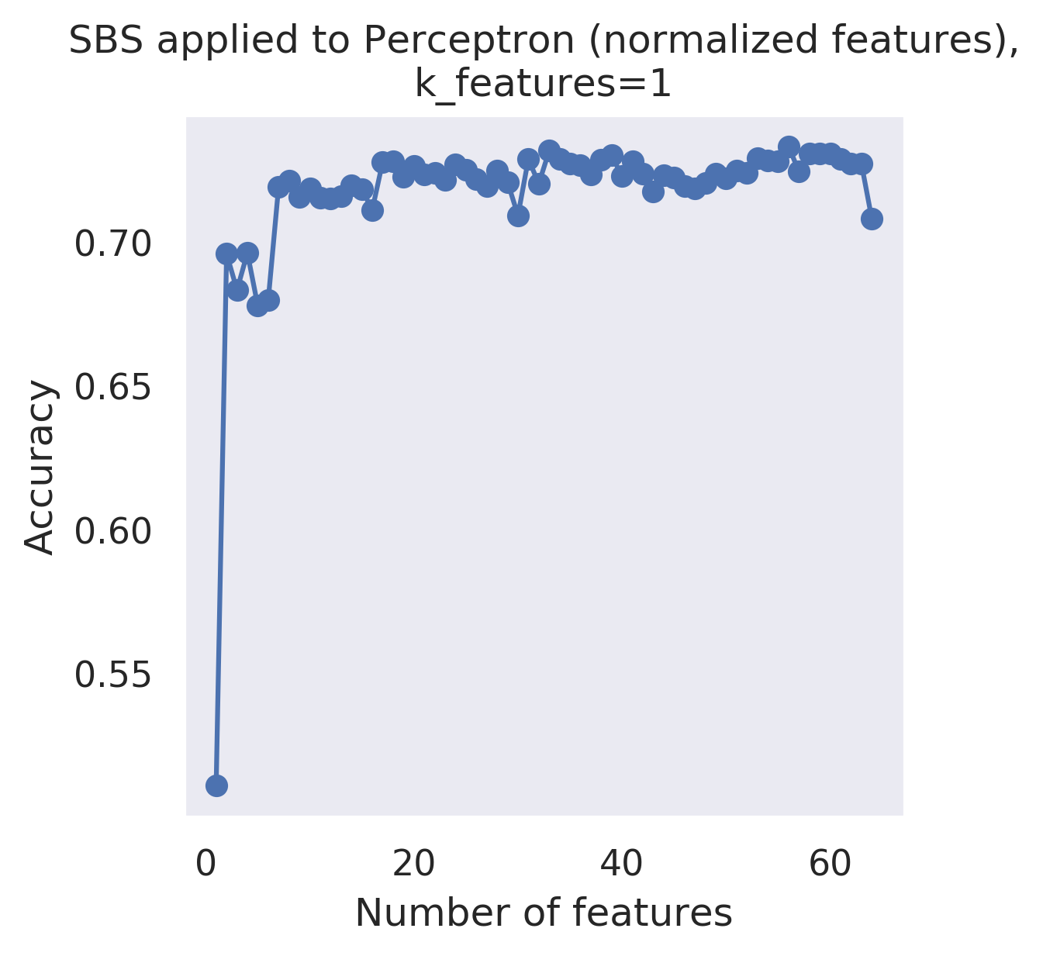
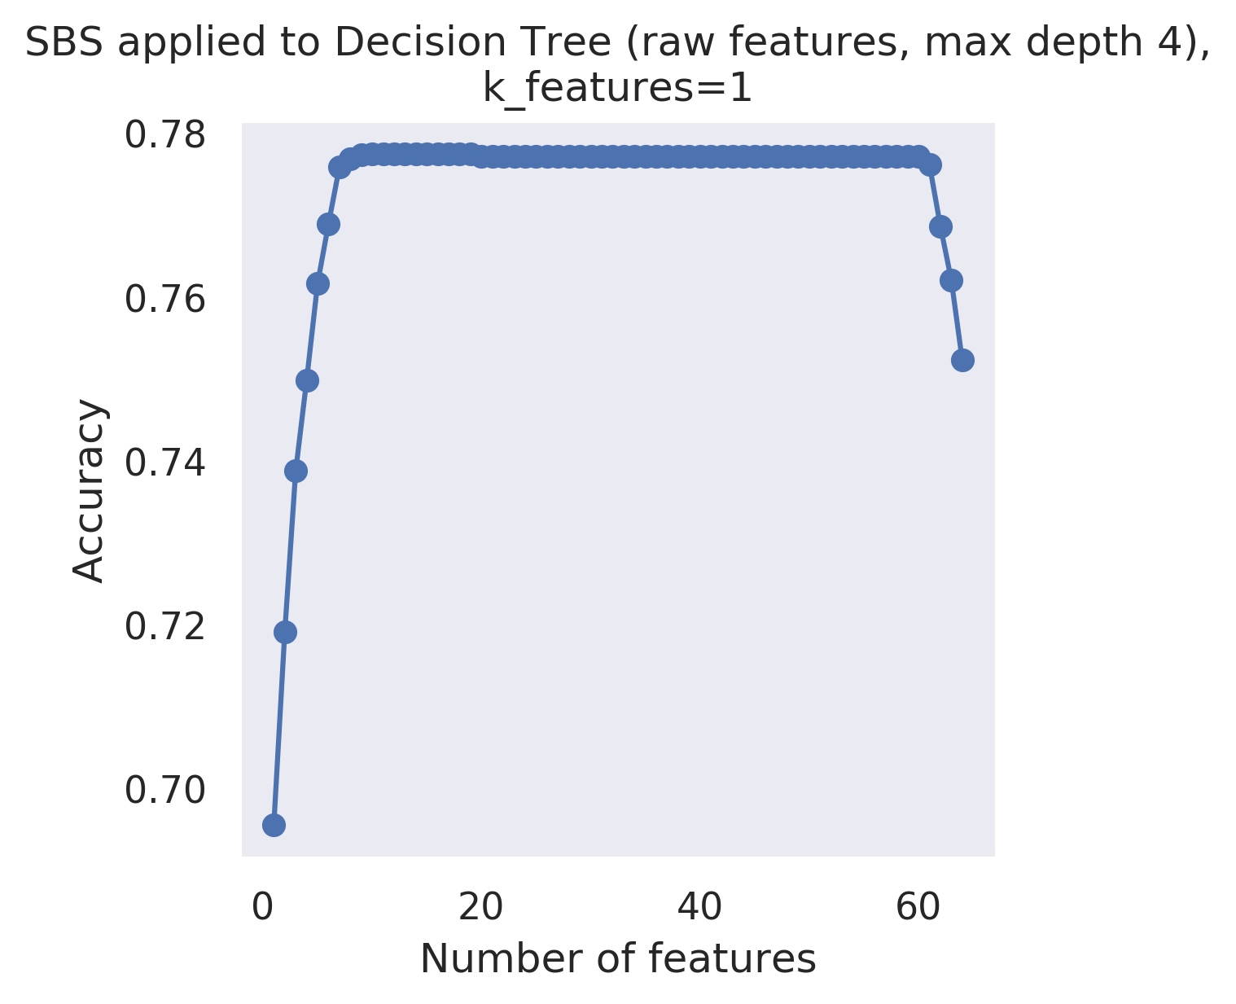
5.1. Feature selection: SBS algorithm
Sequential Backward Selection algorithm
was applied to assess feature importance.

Slide 35
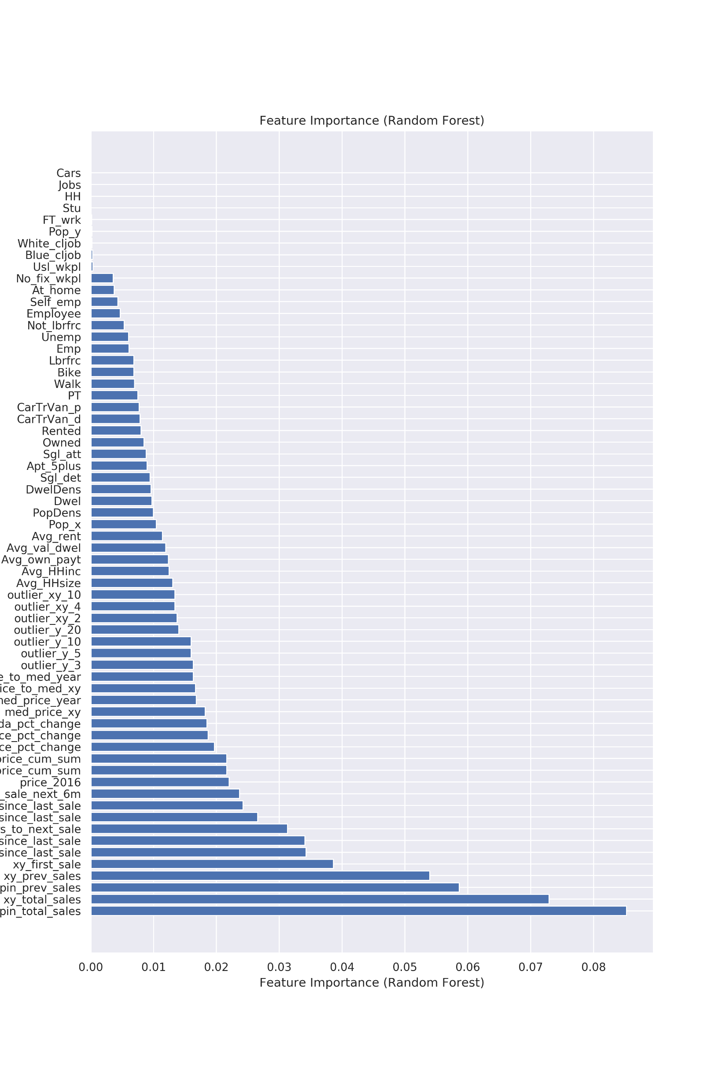
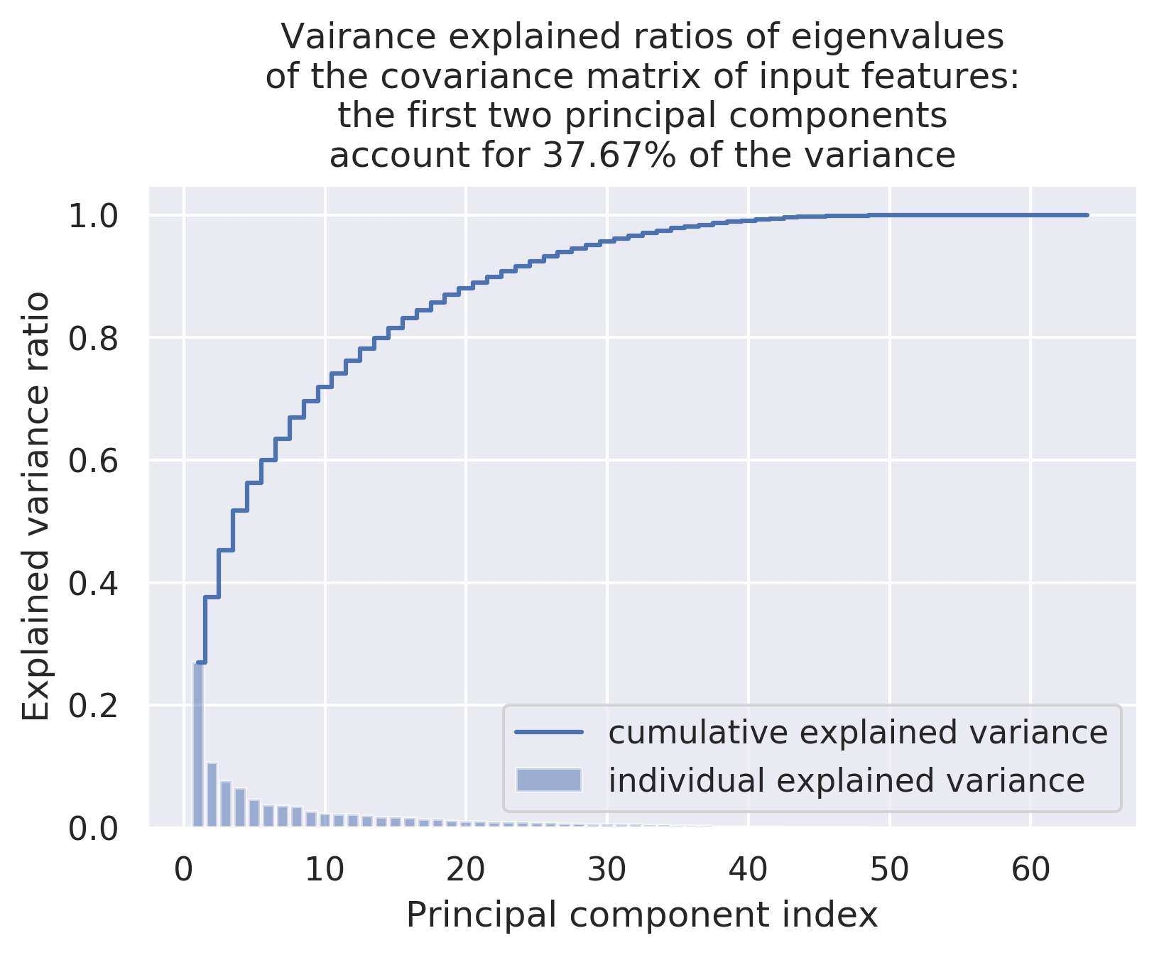
5.2. Feature selection: PCA and Random Forest
PCA:

Slide 36
Section 5:
Interpretation of results

Slide 37
Section 6:
RDBMS design

Slide 38
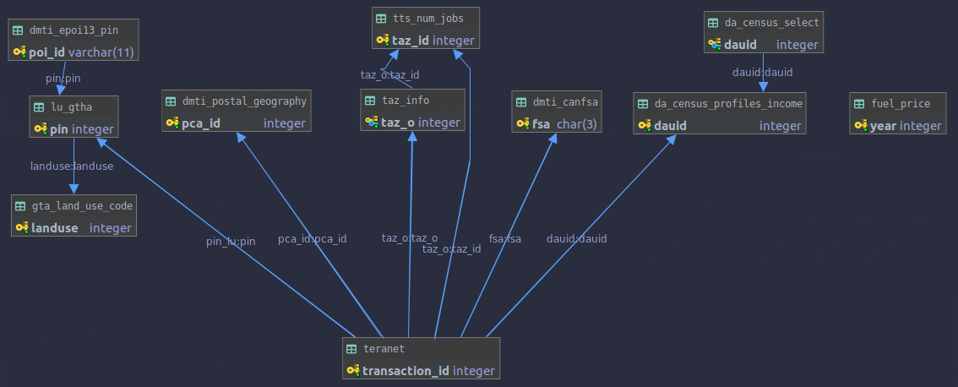
3.2 Entity relationship (ER) diagram
PIN-level data
(e.g., land use,
EPOI, etc.)
DA-level data
(e.g., select
Census variables)
Time-indexed
data
(e.g., fuel prices)
Postal-code
level data
TAZ-level data
FSA-level
data
Teranet dataset is related to multiple groups of datasets
based on different spatial and temporal relationships.

Slide 39
Section 7:
Conclusion

Slide 40
Thank you!
Questions?

Slide 41
Appendix

Slide 42
Received from Teranet
2.1.1_teranet_gtha_da_spatial_join.ipynb
2.1 Teranet Spatial joins
Raw
Teranet dataset
9,039,241 rows
15 columns
points
Teranet
Teranet
data/teranet/1.1_Teranet_DA.csv
Spatial
join #1
how=‘inner’,
op=‘within’
Teranet,
filtered for GTHA,
+DA keys
6,803,691 rows
18 columns
points
data/teranet/HHSaleHistory.csv
(*) https://opendata.arcgis.com/datasets/9d262f8a576842fbb2afbc8c51a64178_1.geojson
2.1.2_teranet_taz_spatial_join.ipynb
da_census_income_obtain.ipynb
Add columns
'DAUID', 'CSDUID', 'CSDNAME'
data/teranet/1.2_Teranet_DA_TAZ.csv
DA-level
Profiles of Income
2016 Census
Esri Open
Data Portal (*)
GTHA
DA-level
Profiles of Income
2016 Census
9,182 rows
218 columns
polygons
Spatial
join #2
how=‘left’,
op=‘within’
Teranet,
filtered for GTHA,
+DA, TAZ keys
6,803,756 rows
19 columns
points
Census
data/da_census/da_census_income.csv
Add column
'TAZ_O'
taz_info_obtain.ipynb
Spatial
join #3.1
how=‘left’,
op=‘within’
GTHA
TAZ geometry and general info
1,716 rows
5 columns
polygons
data/teranet/1.3_Teranet_DA_TAZ_PG_FSA.csv
Transportation
Analysis Zones
(TAZ)
TAZ/TTS
Add column
‘FSA'
Teranet,
filtered for GTHA,
+DA, TAZ,
FSA keys
6,803,756 rows
24 columns
points
2.1.3_teranet_pg_fsa_spatial_join.ipynb
data/da_census/da_census_income.csv
Spatial
join #3.2
how=‘left’,
op=‘within’
DMTI
Download from library website (**)
https://mdl.library.utoronto.ca/collections/geospatial-data/platinum-postal-code-suite-4
Canada
FSA geometry
1,614 rows
4 columns
polygons
6,803,767 rows
27 columns
points
Forward
Sortation Areas
(FSA)
Add columns
‘PCA_ID', ‘postal_code_dmti’,
‘MAF_ID’, ‘DEL_M_ID'
Ontario
Postal Code Geography
555,668 rows
12 columns
polygons
Postal Code
Geography
Spatial
join #4
how=‘left’,
op=‘within’
Teranet dataset,
filtered for GTHA,
+DA, TAZ, FSA, PCA_ID, pin_lu keys
lu_obtain.ipynb
2.1.4_teranet_lu_spatial_join.ipynb
Geography
dept.
GTHA
parcel-level land use
1,664,862 rows
18 columns
polygons
Parcel-level
Land Use
for GTA
and Hamilton
Add columns: ‘pin_lu', ‘LANDUSE', ‘PROP_CODE'
data/teranet/1.4_Teranet_DA_TAZ_FSA_LU.csv

Slide 43
2. Teranet preparation data flow
2.1.1_teranet_gtha_da_spatial_join.ipynb
2.1.2_teranet_taz_spatial_join.ipynb
2.1.3_teranet_pg_fsa_spatial_join.ipynb
2.1.4_teranet_lu_spatial_join.ipynb
2.3_teranet_new_cols.ipynb
2.3_teranet_nonan_new_cols.ipynb
(4.) Remove duplicates
(pending)
2.2_teranet_consistency.ipynb
0.
1.
Correct
for
consistency
Add to the database
Raw
Teranet
data
2.
3.
final
Add foreign
keys via spatial joins
Add new attributes
HHSaleHistory.csv
2_Teranet_consistent.csv
PostgreSQL
1.1_Teranet_DA.csv
1.2_Teranet_DA_TAZ.csv
1.3_Teranet_DA_TAZ_FSA.csv
1.4_Teranet_DA_TAZ_FSA_LU.csv
3_Teranet_new_cols.csv
3_Teranet_nonan_new_cols.csv

