Slide 1
Teranet: aggregating data by Dissemination Areas (DA) with Exploratory Analysis
Prepared by: Stepan Oskin
24-May-2019

Slide 2
Objective
Goal:
sort Teranet transactions for modeling and analysis
Problem:
very little attributes available to categorize transactions
Solution:
infer structure from the data (clustering), identify sub-markets (similar price dynamics)

Slide 3
Issues with clustering points
Can't cluster points directly from Teranet
Very large number of records (75k-150k records per year for GTHA)
only 1 feature (consideration_amt)
pins, coordinates, addresses are useless for clustering neighbourhoods and sub-markets
hard to convert point data to time series
If grouped by point, only few points would have enough records
If grouped by buffer, what buffer size defines similarity?
Need more features (make points “aware” of their surroundings)

Slide 4
Methodology: cluster Teranet at DA level
Produce aggregates from Teranet records to “infuse” DAs
Group Teranet subset by DA and join to DA geometry
Use aggregates to investigate spatial autocorrelation to further “infuse” Das
Result: DA-level spatial time series of Teranet aggregates
Cluster DAs based on the new parameters (spatial, non-spatial)
Add cluster info to DA vars

Slide 5
“Infuse” Teranet points with DA cluster info
Use new DA vars to “infuse” Teranet points
Each point receives DA-level aggregate info (mean, frequency, spatial lag, LISA, cluster)
make Teranet points “aware” of their surroundings)
Cluster infused Teranet points to produce clean sub-market price and volume time series

Slide 6
Data sources
DA geometry for GTHA from York Municipal Government
Profile_of_Income_by_Dissemination_Area__Greater_Toronto_Area_2016_Census.geojson
Available at: https://opendata.arcgis.com/datasets/9d262f8a576842fbb2afbc8c51a64178_1.geojson
Cleaned Teranet data with `da_id` column
`da_id` is renamed from `OBJECTID`
Produced via a spatial join of Teranet points with DA geometry (same as above)
HHSaleHistory_cleaned_v0.9_GTHA_DA.csv

Slide 7
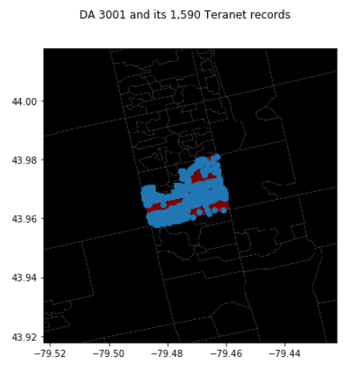
Use `da_id` to avoid spatial join
da_groups = teranet_subset.groupby('da_id’)
mean_price = da_groups['consideration_amt'].mean()
da_gdf = da_gdf.join(mean_price)

Slide 8
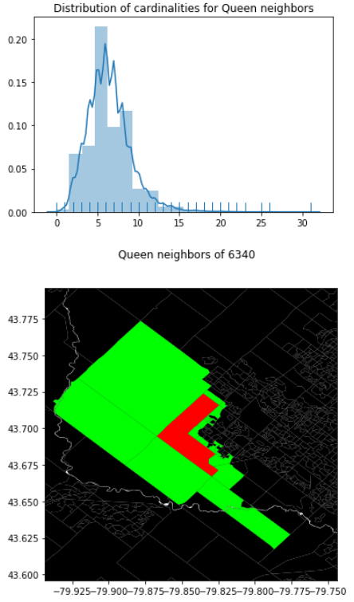
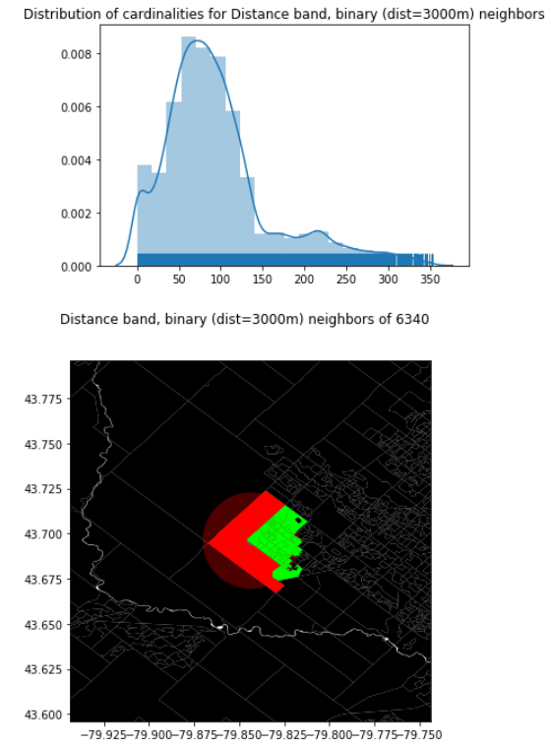
Spatial relationships: from DA geometry
Contiguity (Queen)

Slide 9
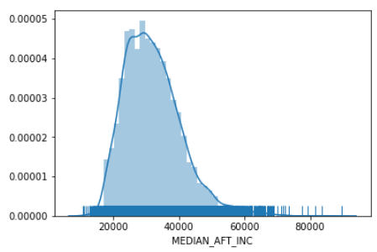
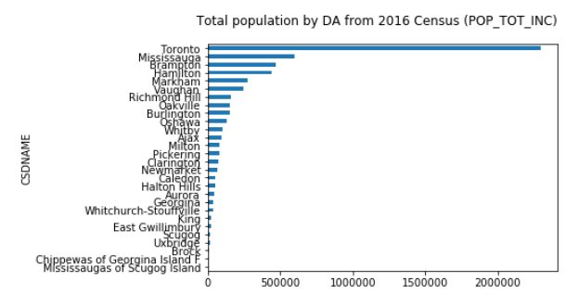
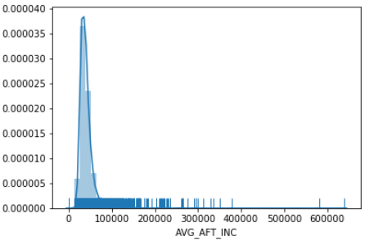
New variables: DA-level census variables
displayed grouped by `CSDNAME`

Slide 10
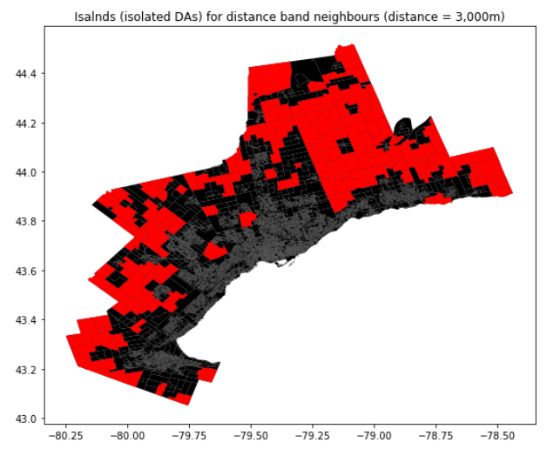
Islands (isolated DAs) from 3km distance band

Slide 11
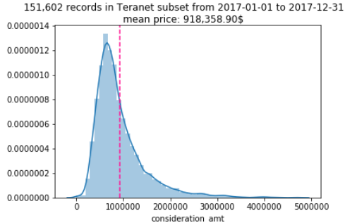
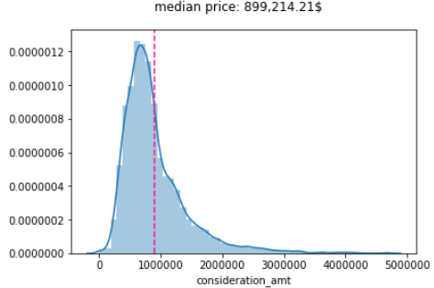
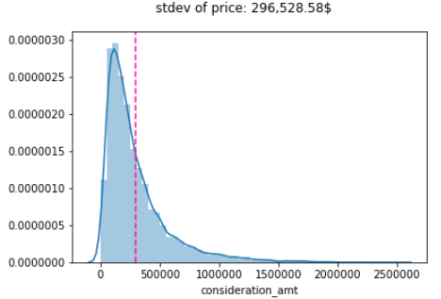
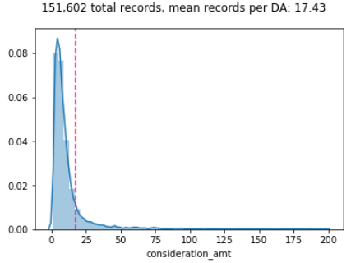
DA-level Teranet aggregates
Mean price
Median price
StDev of price
Record count

