Slide 1
Teranet dataset
EDA results

Slide 2
Large counts of records

Slide 3
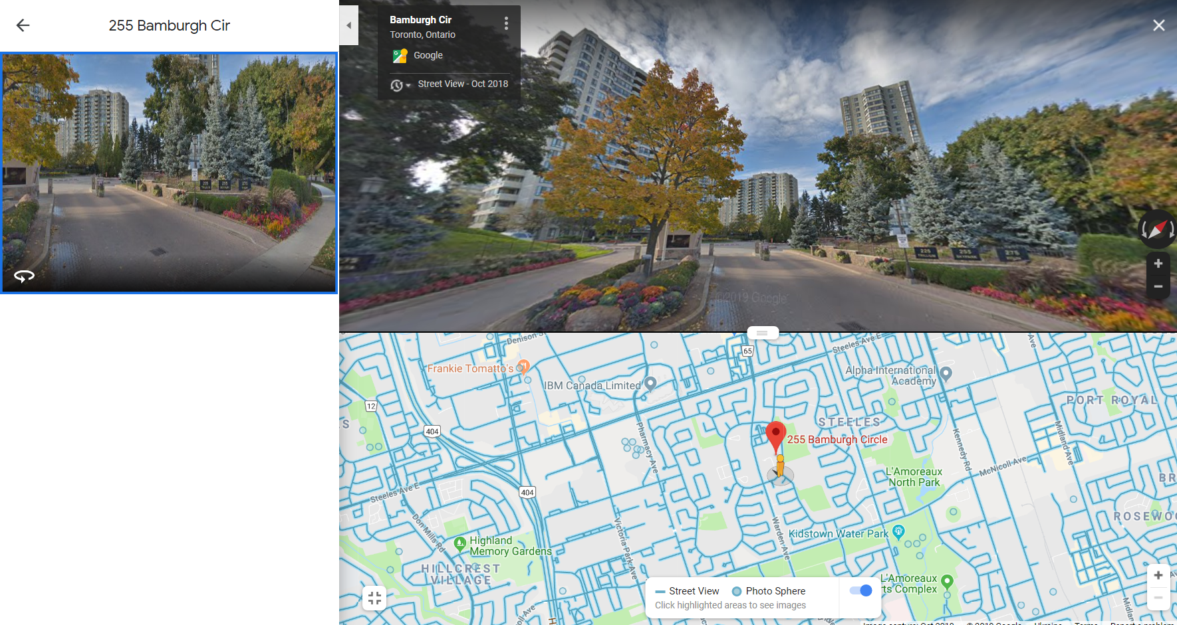
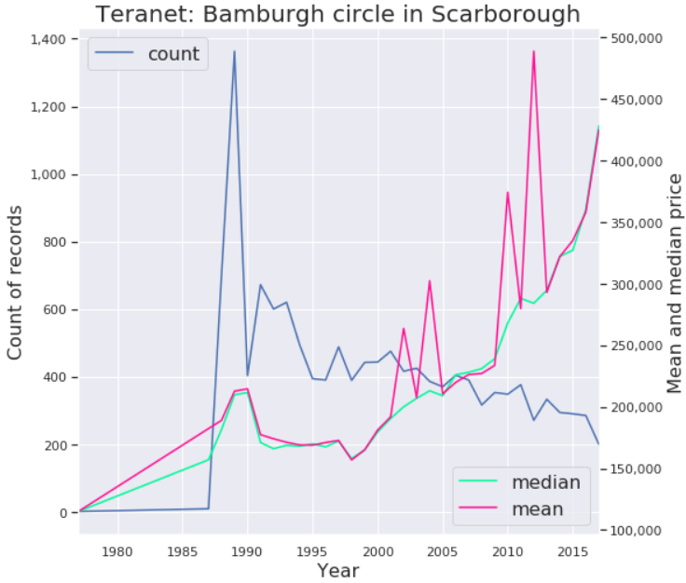
Bamburgh circle in Scarborough

Slide 4
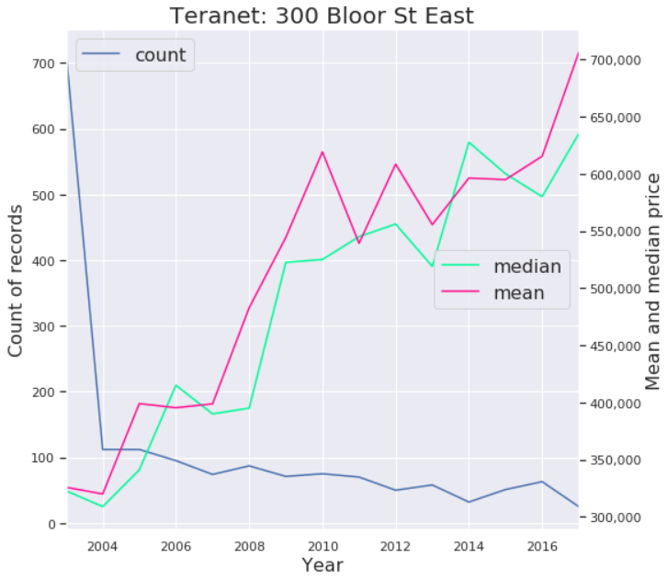
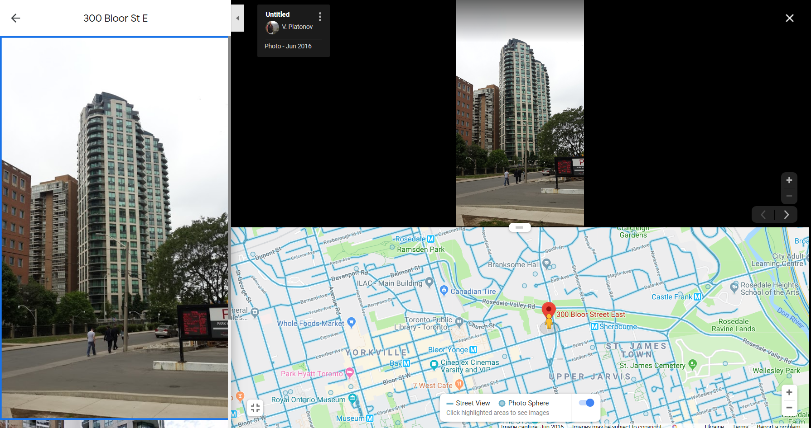
300 Bloor St East

