Slide 1
Teranet dataset
Data quality issues
/

Slide 2
Multiple transactions, same ‘pin’
/

Slide 3
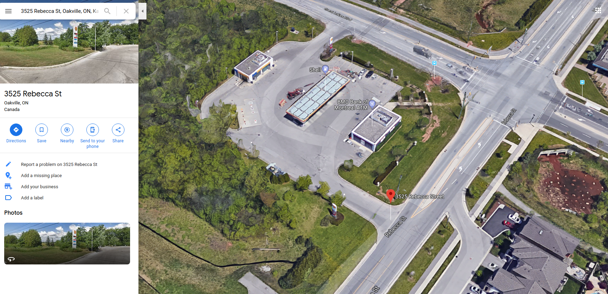
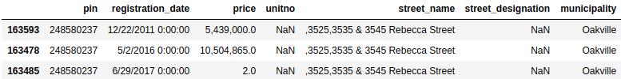
Multiple transactions, same ‘pin’
3535 Rebecca Street
3545 Rebecca Street
3525 Rebecca Street
3535 Rebecca Street
3545 Rebecca Street
Teranet:
/

Slide 4
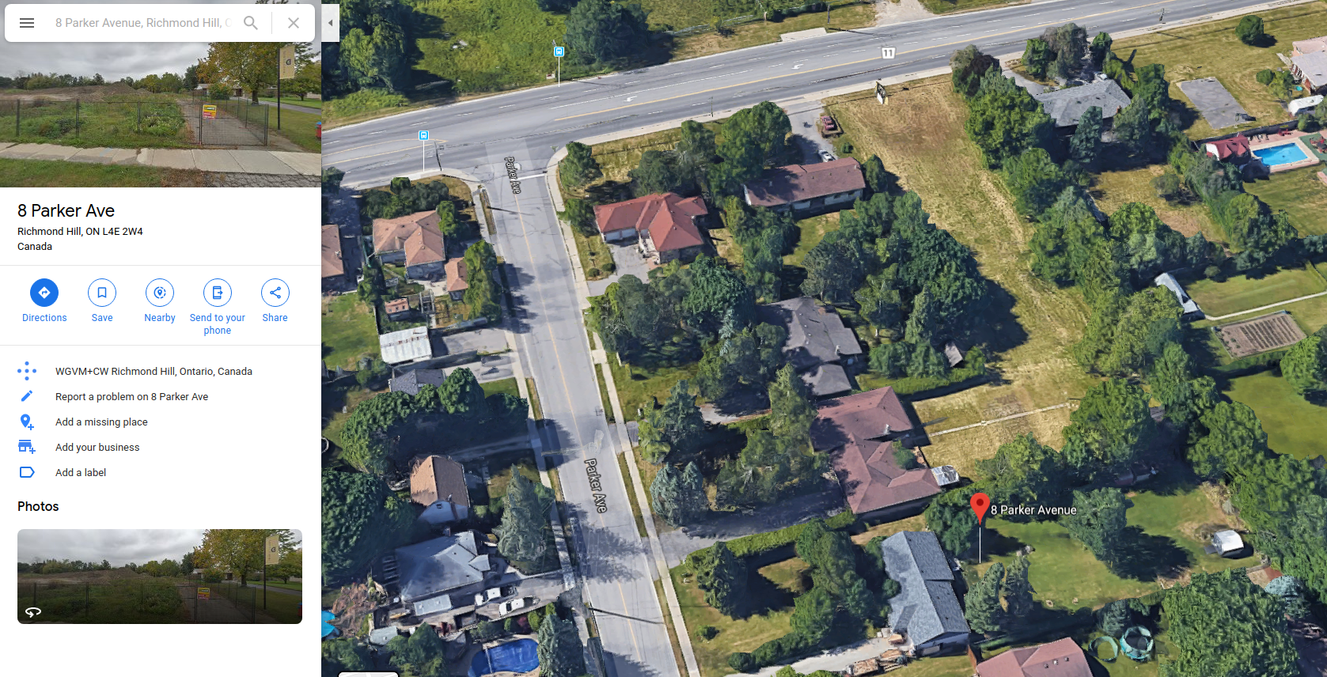
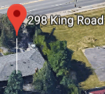
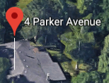
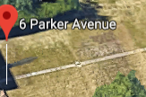
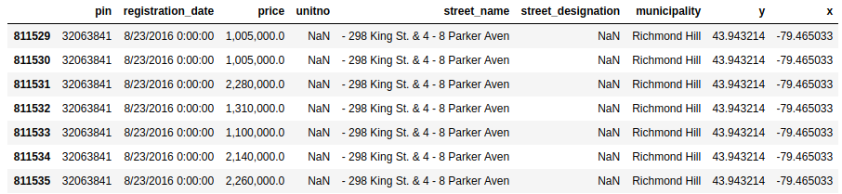
Multiple transactions, same ‘pin’
43.943214 -79.465033
Teranet:
/

Slide 5
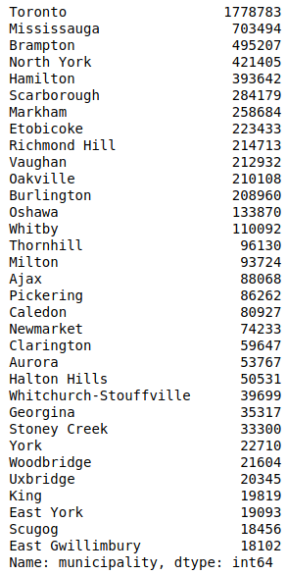
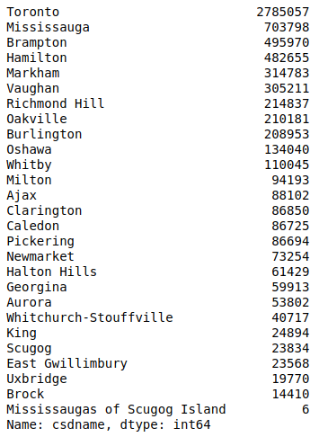
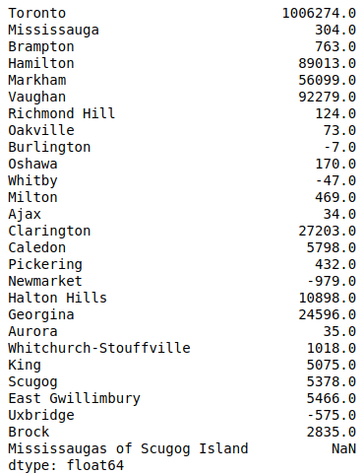
Count of Teranet records by `municipality` and `csdname`
`municipality`
`csdname`
difference
/

Slide 6
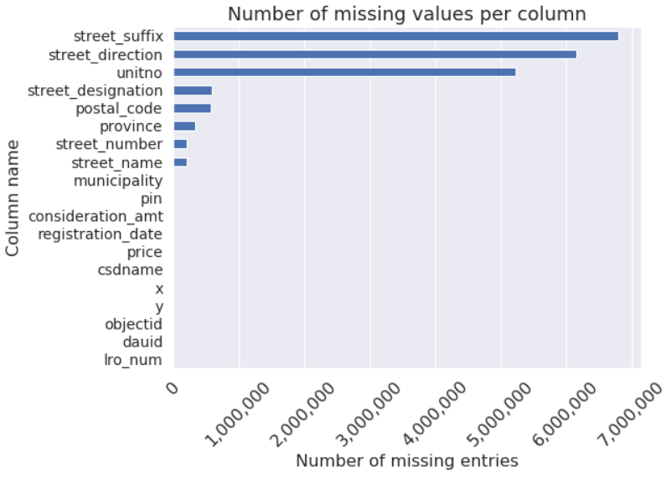
Native Teranet attributes: missing values

Slide 7
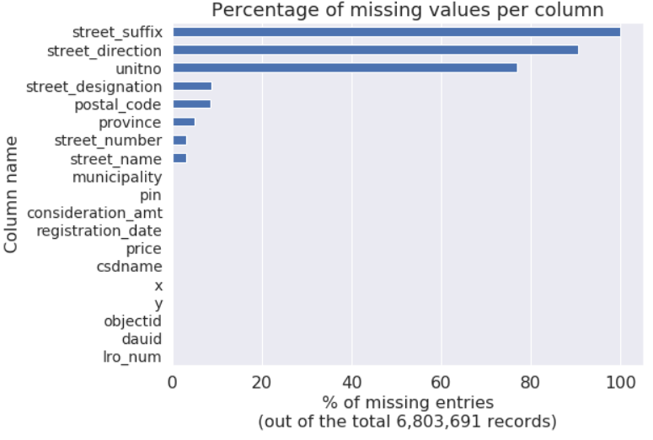
Native Teranet attributes: missing values

