Slide 1

GTHA housing market database
Teranet Exploratory Data Analysis
Future steps
Teranet meeting
16-Aug-2019
Presented by: Stepan Oskin
Photo by: Maarten van den Heuvel

Slide 2
Presentation content
1. Overview of the current state of the project
2. Data flow
3. GTHA housing market database
4. Future steps
5. EDA results

Slide 3
Section 1:
Overview of the current stage of the project

Slide 4
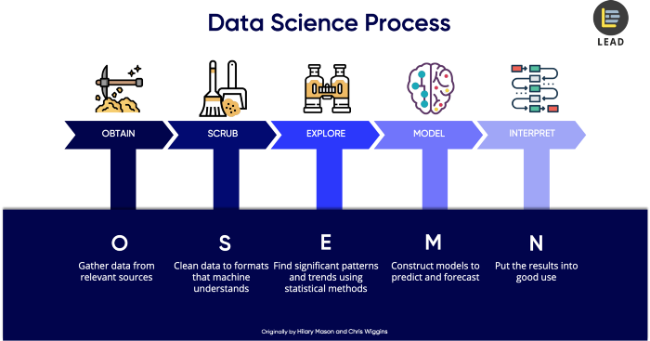
1.1 OSEMN methodology
Originally by: Hillary Mason and Chris Wiggins
Source: Dr. Cher Han Lau, LEAD (https://thelead.io)

Slide 5
1.2 MASc thesis scope
Focus of this master thesis
Future work

Slide 6
1.2 Steps completed
1. Obtain:
Collect data from various sources
Assemble GTHA housing database
2. Scrub:
Clean Teranet dataset
Add necessary attributes
3. Explore:
Explore Teranet dataset
Determine data quality issues

