Slide 1
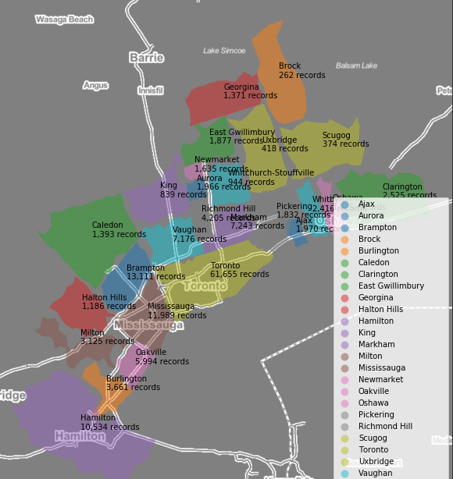
MASc Thesis: GTHA housing market analysis performed on Teranet dataset Scope of work
Meeting of 5-Jul-2019
Prepared by: Stepan Oskin

Slide 2
Questions
Scope of work
Hosting
Deliverable

Slide 3
Section 1: Scope of work

Slide 4
Main purpose
— facilitate future research efforts through exploration and data preprocessing
— give controlled access to Teranet data to a broader (interdisciplinary) group of researchers
— facilitate the ability to conduct easy, effective, in-depth custom inquiries into Teranet, and other, data

Slide 5
Scope of work
— cleaning / assessment of data reliability
— exploration — looking for interesting relationships / potential for ML applications
— feature engineering
— API (Python and / or SQL)

Slide 6
Hosting
— RDBMS
— ReST API
— domain

