Slide 1

A Prototype of a Machine Learning Workflow to Classify Land Use from the Housing Market Dynamics
MASc final presentation
Presented by: Stepan Oskin
Supervisor: Eric J Miller
Date: 20-Sep-2019
Notes:
Growth centers
West Don Lands
Liberty village
Riverdale
Outline
Deadline to submit thesis
Month-by-month tuition

Slide 2
Section 1:
Background

Slide 3
1. Background
Land use and transportation
New data sources – POLARIS, Teranet
Challenges of working with Teranet’s data
Proposed solution

Slide 4
Section 2:
Data sources

Slide 5
Teranet is connected to the following data sources:
DA-level data:
Select census variables
(1971, 1976, 1981, 1986, 1991, 1996, 2001, 2006, 2011 , 2016)
Census tables: 2016 Profiles of Income, etc.
Teranet aggregates grouped by DA
(mean/median/std, spatial lag, etc.)
TAZ-level data:
Select TTS variables
(1986, 1991, 1996, 2001, 2006, 2011, 2016)
Number of jobs
(1991, 1996, 2001, 2006, 2011, 2016), etc.
TAZ info
(length, area, geometry)
1 Data sources

Slide 6
Teranet is connected to the following data sources:
Parcel-level data:
Land use information
Enhanced Points of Interest (EPOI), from DMTI
etc.
Time-indexed data:
Fuel price in Toronto from StatsCan
(1986, 1991, 1996, 2001, 2006, 2011, 2016)
Inflation correction coefficients, etc.
Postal-code-level data:
Municipality-level data:
1 Data sources

Slide 7
Section 3:
Data preparation

Slide 8
2. Teranet preparation data flow
2.1.1_teranet_gtha_da_spatial_join.ipynb
2.1.2_teranet_taz_spatial_join.ipynb
2.1.3_teranet_pg_fsa_spatial_join.ipynb
2.1.4_teranet_lu_spatial_join.ipynb
2.3_teranet_new_cols.ipynb
2.3_teranet_nonan_new_cols.ipynb
(4.) Remove duplicates
(pending)
2.2_teranet_consistency.ipynb
0.
1.
Correct
for
consistency
Add to the database
Raw
Teranet
data
2.
3.
final
Add foreign
keys via spatial joins
Add new attributes
HHSaleHistory.csv
2_Teranet_consistent.csv
PostgreSQL
1.1_Teranet_DA.csv
1.2_Teranet_DA_TAZ.csv
1.3_Teranet_DA_TAZ_FSA.csv
1.4_Teranet_DA_TAZ_FSA_LU.csv
3_Teranet_new_cols.csv
3_Teranet_nonan_new_cols.csv

Slide 9
2.3 General data flow: obtain and prep all data
PostgreSQL
database
new attributes,
filtered for price > 10’000 CAD
GTHA land use converted to GTA codes
Spatial join
corrected for consistency
GTA
+ Hamilton
Land use
Concat
filtered for GTHA,
new keys added via sjoins
Drop duplicated
GTA pins,
column
Teranet dataset
DA-level
Profiles of Income
2016
DA-level
Select Census Variables
TAZ info
TTS Number of Jobs
Canada
FSA geometry
Ontario
Postal Code Geography
EPOI
From DMTI
GTA
Parcel
level land use
Hamilton
Parcel
level land use
Hamilton
Land use codes
conversion
Teranet
Census
TAZ/TTS
DMTI
Geo department

Slide 10
Section 4:
ML workflow to classify land use

Slide 11
Section 4.1:
Land use classes

Slide 12
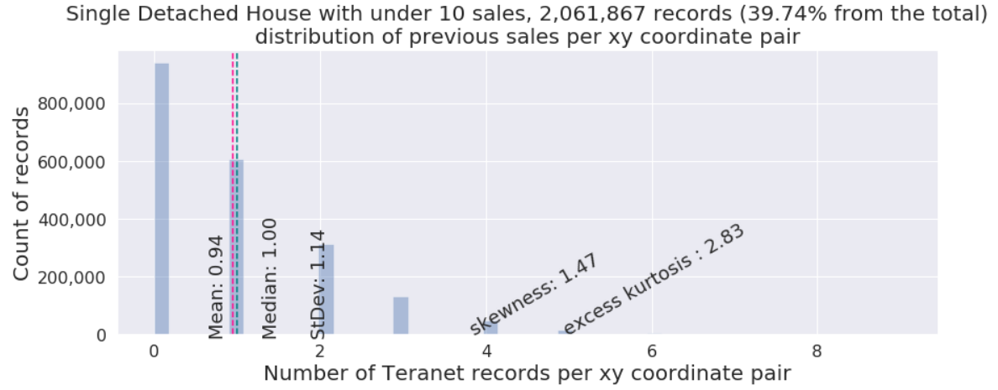
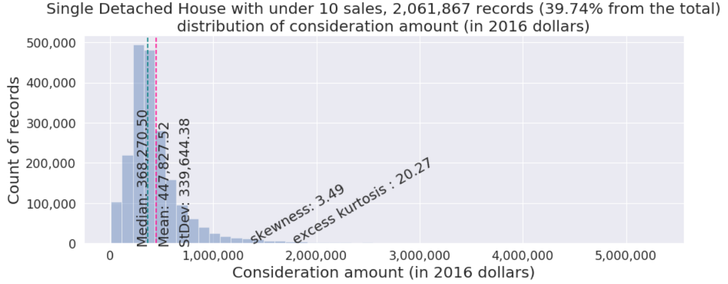
4. Land use class 1: detached

Slide 13
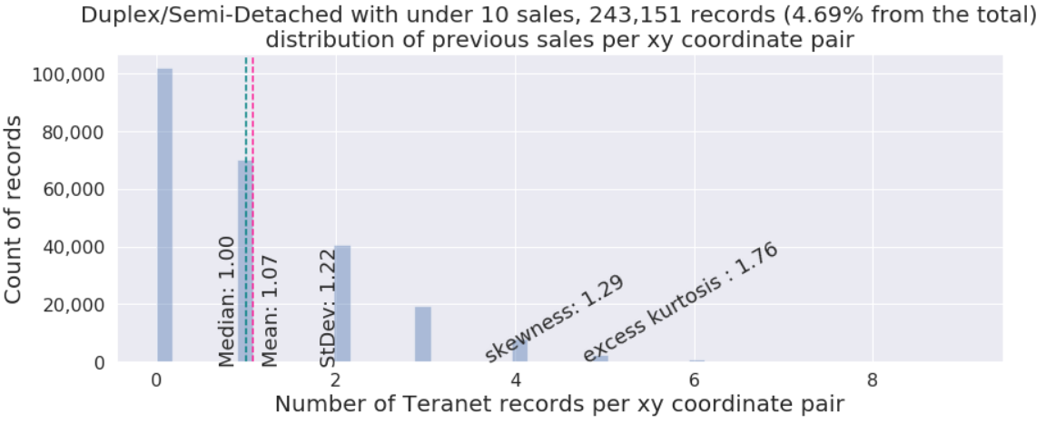
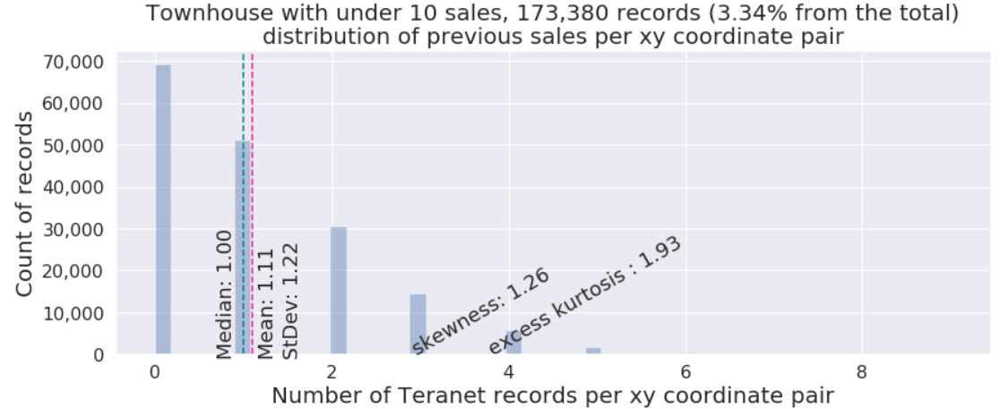
4. Land use class 2: duplex/townhouse

Slide 14
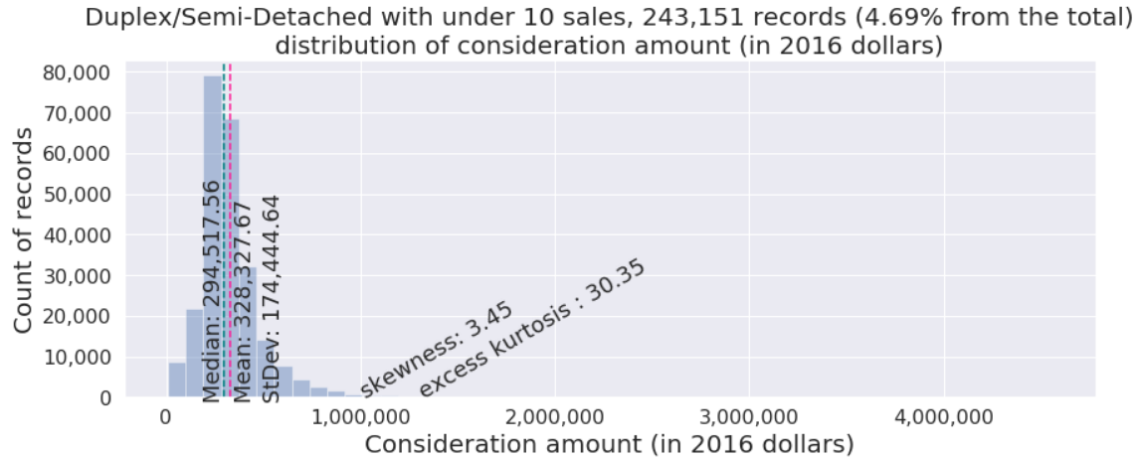
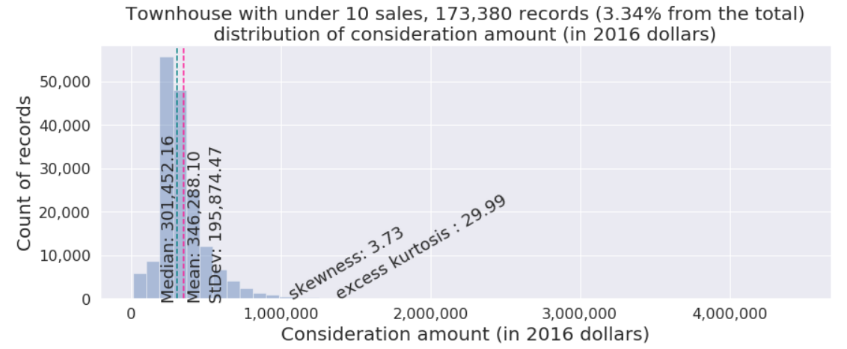
4. Land use class 2: duplex/townhouse

Slide 15
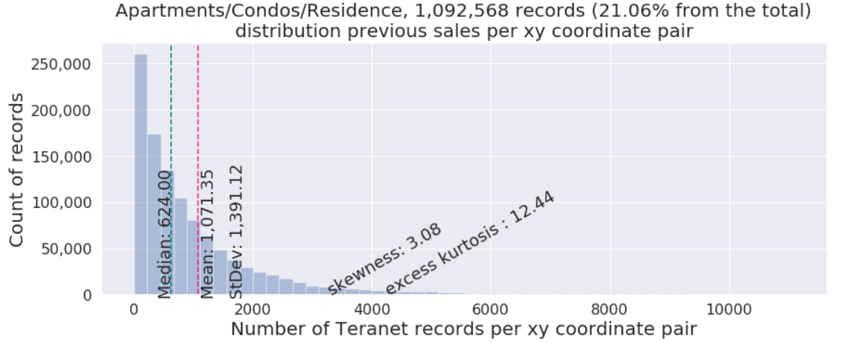
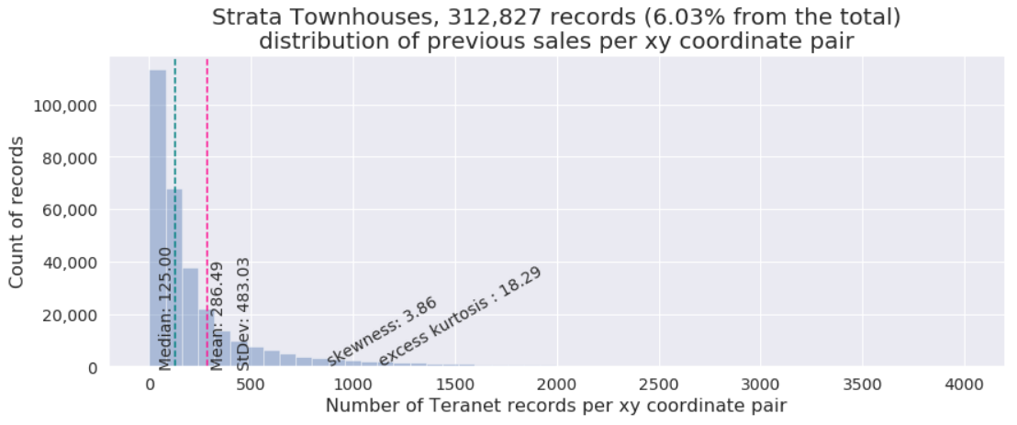
4. Land use class 3: condo / strata

Slide 16
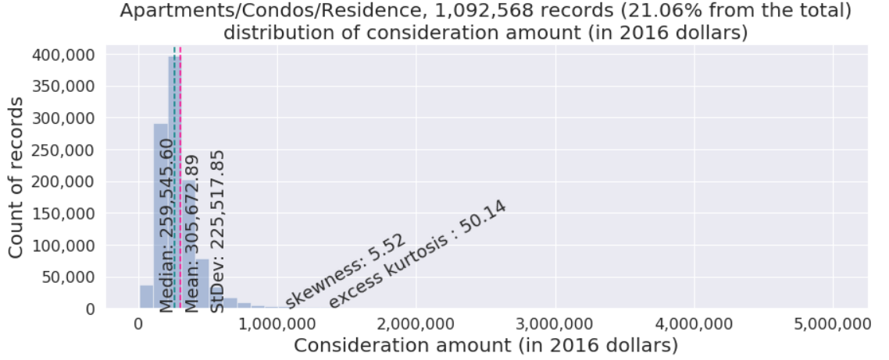
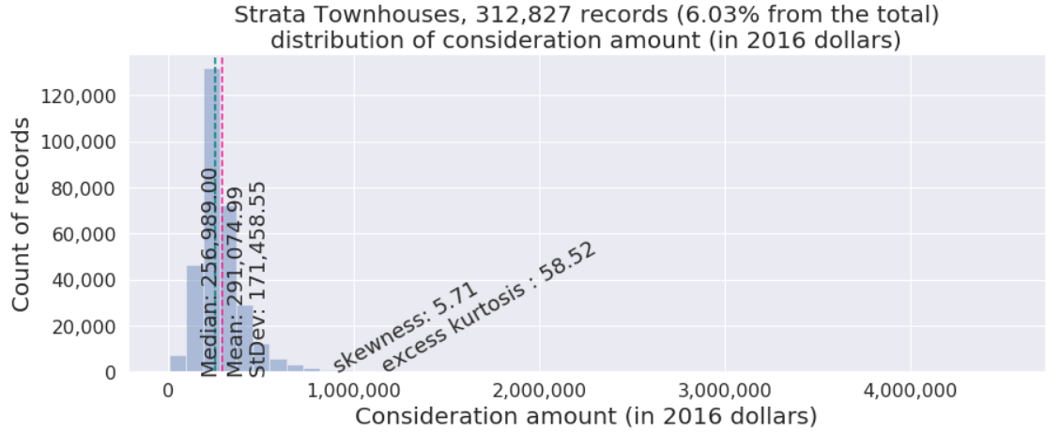
4. Land use class 3: condo / strata

Slide 17
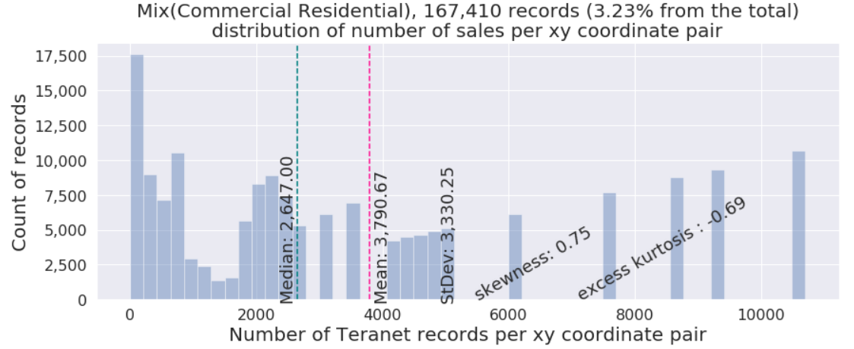
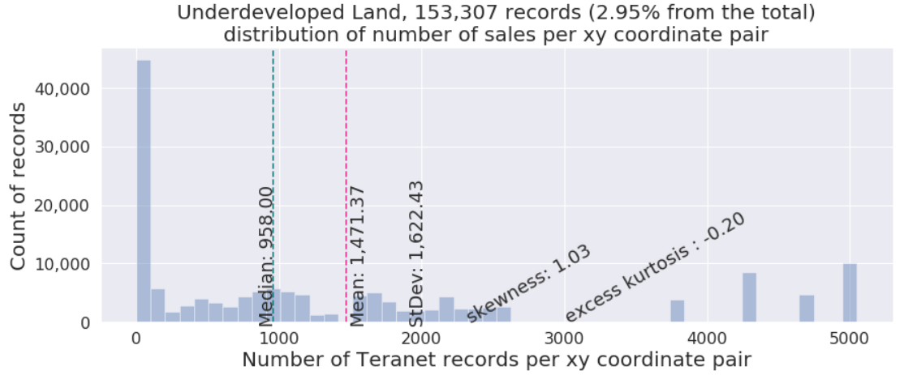
4. Land use class 3: other (examples)

Slide 18
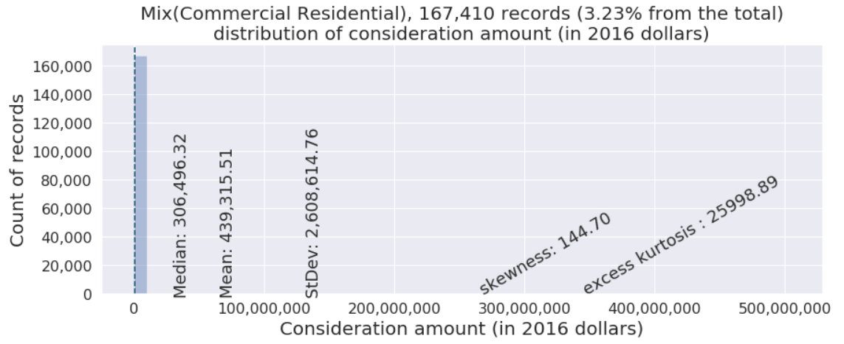
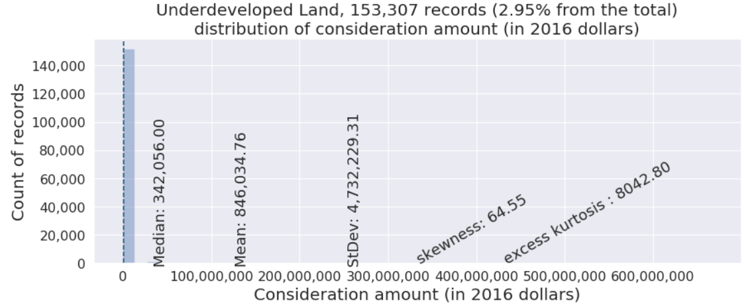
4. Land use class 3: other (examples)

Slide 19
Section 5:
Interpretation of results

Slide 20
Section 6:
RDBMS design

Slide 21
3.1 Relationship between datasets
many
fk: pca_id
pk: transaction_id
postal-code-level data
one
many
Census
pk: dauid
fk: dauid
many
fk: csduid
DA-level data
municipality-level data
many
fk: fsa
many
fk: taz_o
Teranet
FSA-level data
TTS
variables
TAZ-level data
one
pk: PIN
one
pk: dauid
fk: year
Number of jobs
many
Parcel-level
Land Use
fk: pin_lu
many
time-indexed data
pk: PIN
one
Fuel prices
Inflation
coefs.
fk: PIN
many
Parcel-level data
EPOI
one
pk: year

Slide 22
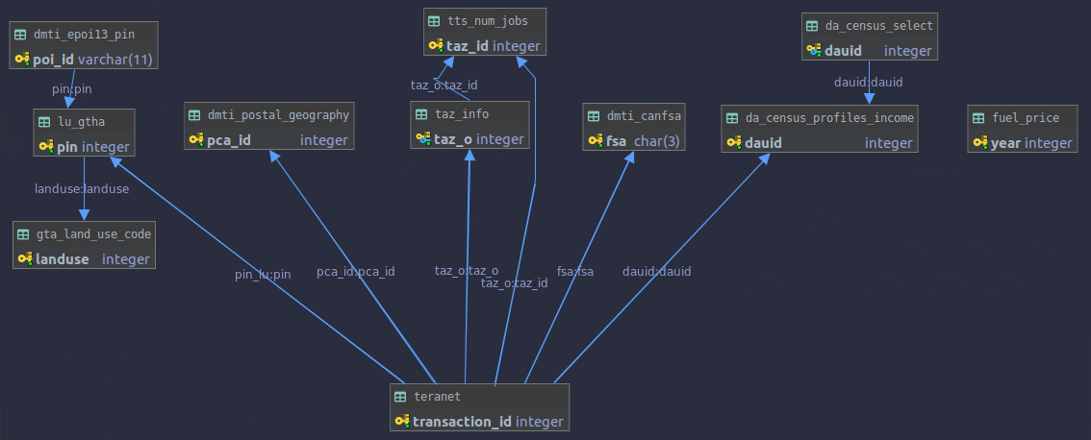
3.2 Entity relationship (ER) diagram
PIN-level data
(e.g., land use,
EPOI, etc.)
DA-level data
(e.g., select
Census variables)
Time-indexed
data
(e.g., fuel prices)
Postal-code
level data
TAZ-level data
FSA-level
data
Teranet dataset is related to multiple groups of datasets
based on different spatial and temporal relationships.

Slide 23
Section 7:
Conclusion

Slide 24
Thank you!
Questions?

Slide 25
Appendix

Slide 26
Received from Teranet
2.1.1_teranet_gtha_da_spatial_join.ipynb
2.1 Teranet Spatial joins
Raw
Teranet dataset
9,039,241 rows
15 columns
points
Teranet
Teranet
data/teranet/1.1_Teranet_DA.csv
Spatial
join #1
how=‘inner’,
op=‘within’
Teranet,
filtered for GTHA,
+DA keys
6,803,691 rows
18 columns
points
data/teranet/HHSaleHistory.csv
(*) https://opendata.arcgis.com/datasets/9d262f8a576842fbb2afbc8c51a64178_1.geojson
2.1.2_teranet_taz_spatial_join.ipynb
da_census_income_obtain.ipynb
Add columns
'DAUID', 'CSDUID', 'CSDNAME'
data/teranet/1.2_Teranet_DA_TAZ.csv
DA-level
Profiles of Income
2016 Census
Esri Open
Data Portal (*)
GTHA
DA-level
Profiles of Income
2016 Census
9,182 rows
218 columns
polygons
Spatial
join #2
how=‘left’,
op=‘within’
Teranet,
filtered for GTHA,
+DA, TAZ keys
6,803,756 rows
19 columns
points
Census
data/da_census/da_census_income.csv
Add column
'TAZ_O'
taz_info_obtain.ipynb
Spatial
join #3.1
how=‘left’,
op=‘within’
GTHA
TAZ geometry and general info
1,716 rows
5 columns
polygons
data/teranet/1.3_Teranet_DA_TAZ_PG_FSA.csv
Transportation
Analysis Zones
(TAZ)
TAZ/TTS
Add column
‘FSA'
Teranet,
filtered for GTHA,
+DA, TAZ,
FSA keys
6,803,756 rows
24 columns
points
2.1.3_teranet_pg_fsa_spatial_join.ipynb
data/da_census/da_census_income.csv
Spatial
join #3.2
how=‘left’,
op=‘within’
DMTI
Download from library website (**)
https://mdl.library.utoronto.ca/collections/geospatial-data/platinum-postal-code-suite-4
Canada
FSA geometry
1,614 rows
4 columns
polygons
6,803,767 rows
27 columns
points
Forward
Sortation Areas
(FSA)
Add columns
‘PCA_ID', ‘postal_code_dmti’,
‘MAF_ID’, ‘DEL_M_ID'
Ontario
Postal Code Geography
555,668 rows
12 columns
polygons
Postal Code
Geography
Spatial
join #4
how=‘left’,
op=‘within’
Teranet dataset,
filtered for GTHA,
+DA, TAZ, FSA, PCA_ID, pin_lu keys
lu_obtain.ipynb
2.1.4_teranet_lu_spatial_join.ipynb
Geography
dept.
GTHA
parcel-level land use
1,664,862 rows
18 columns
polygons
Parcel-level
Land Use
for GTA
and Hamilton
Add columns: ‘pin_lu', ‘LANDUSE', ‘PROP_CODE'
data/teranet/1.4_Teranet_DA_TAZ_FSA_LU.csv

Slide 27
2.3 General data flow: obtain and prep all data
PostgreSQL
database
new attributes,
filtered for price > 10’000 CAD
GTHA land use converted to GTA codes
Spatial join
corrected for consistency
GTA
+ Hamilton
Land use
Concat
filtered for GTHA,
new keys added via sjoins
Drop duplicated
GTA pins,
column
Teranet dataset
DA-level
Profiles of Income
2016
DA-level
Select Census Variables
TAZ info
TTS Number of Jobs
Canada
FSA geometry
Ontario
Postal Code Geography
EPOI
From DMTI
GTA
Parcel
level land use
Hamilton
Parcel
level land use
Hamilton
Land use codes
conversion
Teranet
Census
TAZ/TTS
DMTI
Geo department

