Slide 1
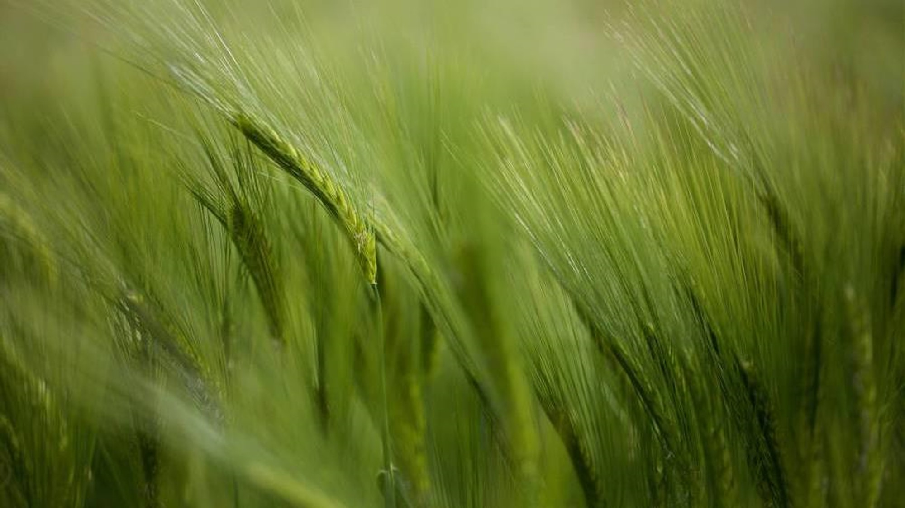
Weather Conditions and Climate Change with ClimateWins
September
2024
Machine Learning with Python
Oksana Stepanova

Slide 2
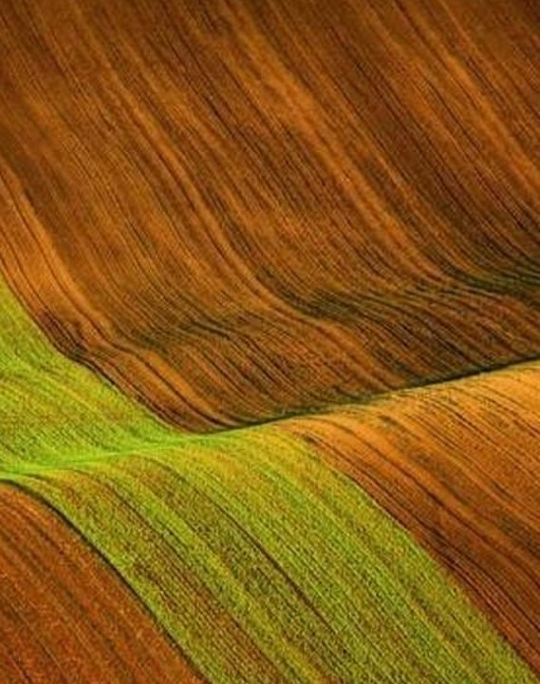
Project objectives
Identify weather patterns outside the regional norm.
Determine trends of unusual weather patterns.
Forecast future weather conditions over the next 25 to 50 years based on current trends.
Determine the safest places for people to live in Europe within the next 25 to 50 years.

Slide 3
Machine Learning Algorithms
Clustering
Finds patterns in the data to assign grouping.
Suggestion to use: Hierarchical Clustering with reduced data after applying PCA.
Random Forest
Predicts the most impactful weather indicators.
Suggestion to use: Random Forest Classifier applying Grid search optimization.
CNN & RNN
Predicts large patterns in weather data.
Suggestion to use: Bayesian optimisation with Keras Model / CNN.
GANs
Predicts weather hazards in short term prospect.
Suggestion to use: CNN as the generator model and a classification type model as the discriminator.

Slide 4
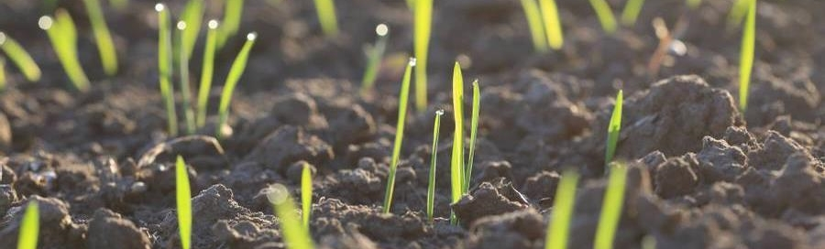
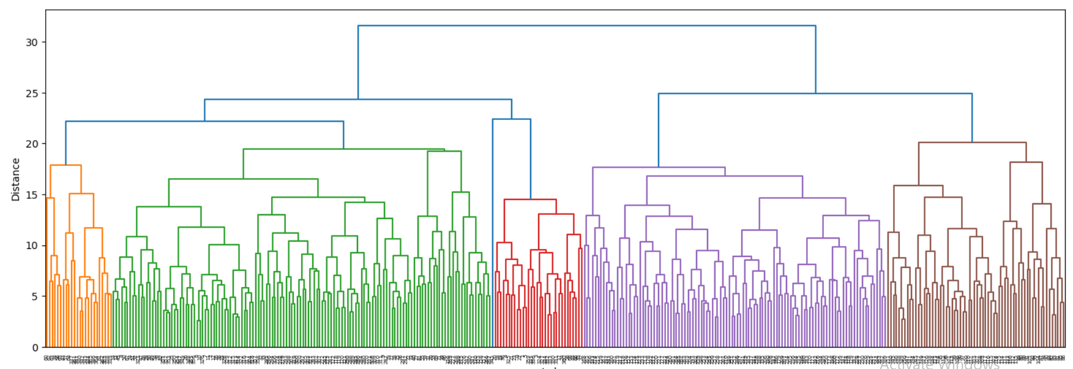
1. Identify weather patterns outside the regional norm
Analysis options: Grouping the data by clusters and analyzing the weather patterns within each group (exploratory analysis, extreme values, the most useful weather indicators)
Data: Historical data of weather indicators observations over 60 years collected from weather stations across Europe.
Algorithms: Hierarchical Clustering algorithm with PCA (Principal Component Analysis) to reduce the number of observations.
CNN or RNN networks to identify larger data patterns.
The clustering looks like the gragh in the dendrogram below. Grouping may be due to seasonal patterns, climate zones, geographic features.
Dendrogram Complete Method

Slide 5
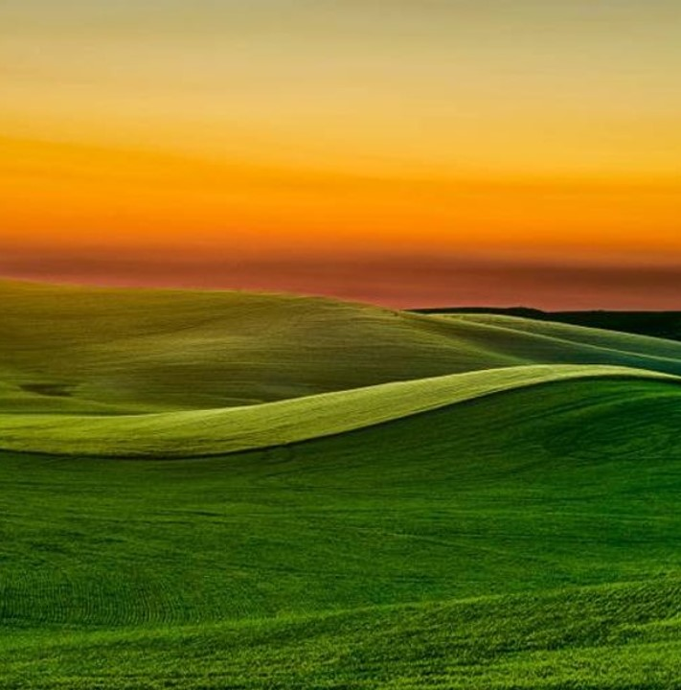
2. Determining trends of unusual weather patterns
Analysis options:
Classify weather data using new answer set, for instance, above or below the average yields in agriculture industry.
Identify the weather indicators that influence most.
Assign new classification to the data, e.g. ‘significant’ and ‘moderate’ change in the most important indicators.
Additionally, analyze the trends in
glacier melting in the highest mountain chains;
changes in water basin level of biggest rivers;
forest areas.
Data:
Historical time-series weather data.
New data: historical data of yields in agriculture (e.g. grains, industrial crops, vineyards etc) and the measurements of river basins.
New data: satellite images of mountains picks and landscape.
Algorithms:
Random Forest Classifier and optimization models (Grid Search or Random Search) to classify the data.
RNN & CNN, GAN to analyze satellite images.

Slide 6
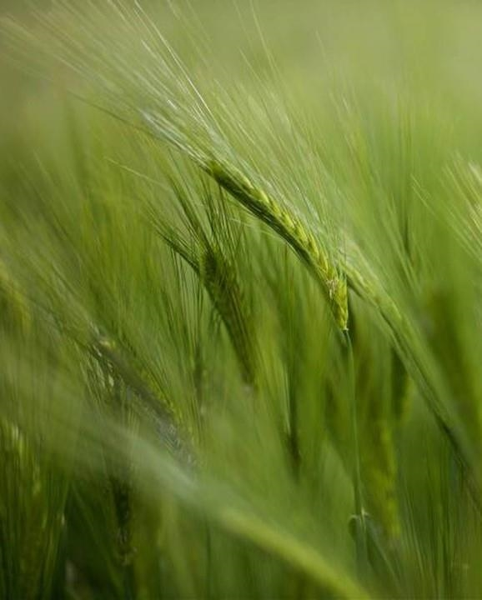
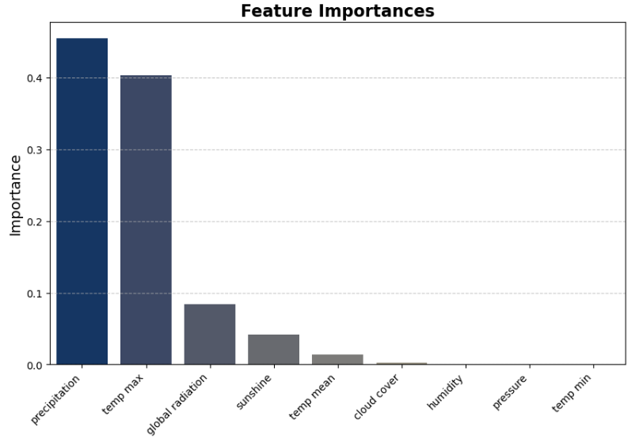
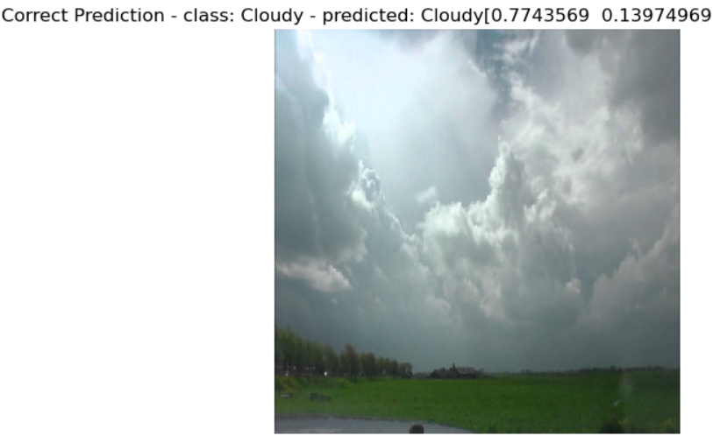
How the results may look like
Classification of the most influential indicators looks like in this plot. The most useful indicators are precipitation and maximum temperature
CNN model can predict images with the accuracy rate of 95%

Slide 7

3. Forecasting future weather conditions and determining the safest places for people to live
Analysis options:
Assess the risk and hazard indicators, for example, the increase in temperature over 1.5 degrees Celsius, decrease in the level of precipitations; additional indicators: melting and evaporating glacier, deforestation.
Classify weather changes by ‘high’ and ‘low’ risk.
Predict the locations where the weather conditions might change significantly assuming that it may have a negative impact on human activity and living conditions.
Categorize the ‘safe’ and ‘unsafe’ areas and create a spatial visualization.
Data:
Historical time-series weather data.
Historical data of yields in agriculture,
Historical data of river basin level.
Landscape images.
Algorithms:
KNN, Random Forest to estimate the risk indicators and classify the data.
RNN & CNN to predict where the weather changes may hazard human activity.

Slide 8
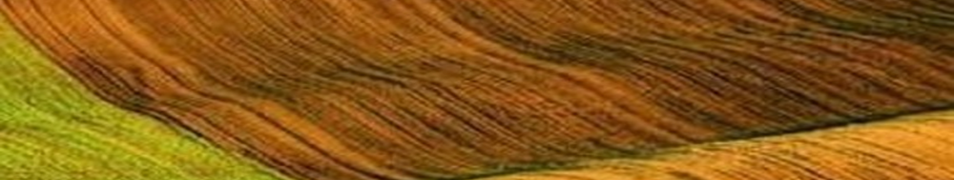
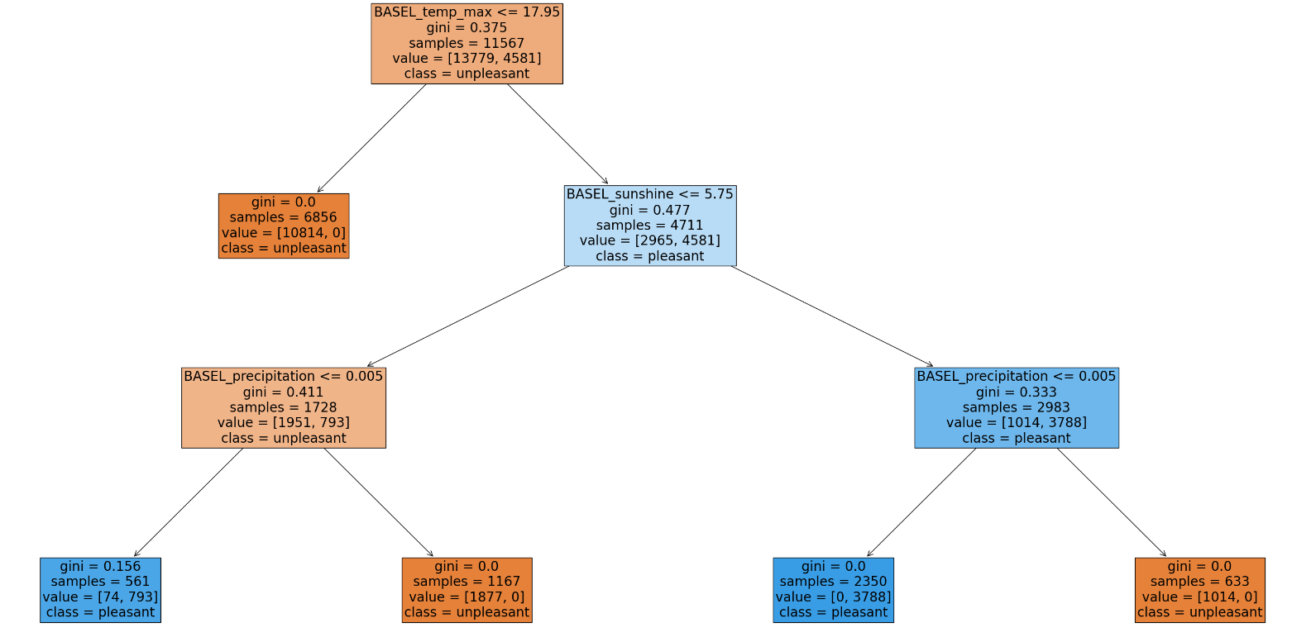
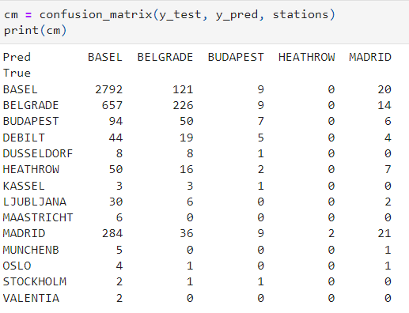
How the results could look like
Classification of pleasant and unpleasant weather in a specific weather station. The output of Random Forest algorithm
We have trained the model to predict the pleasant and unpleasant weather. Confusion matrix derived from CNN model

Slide 9
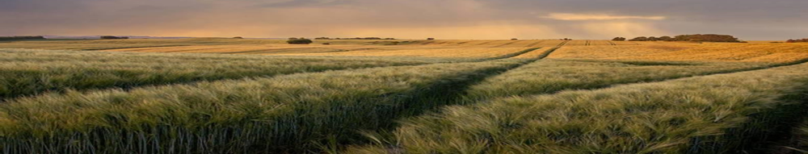
Summary
Data Classification
Hierarchical clustering, complete method provides more clusters than other methods and gives us more information for further investigation into why weather conditions are similar and why certain parameters are unique which may reveal weather anomalies.
Random Forest Algorithm has a high accuracy rate 94%. It is used for classification and to determine the most important indicators for further analysis. At the same time, by removing these indicators, we may reveal weather anomalies.
KNN (K-Nearest Neighbors) algorithm
It shows 90% accuracy rate in classification by predicting the most likely class of pleasant or unpleasant weather.
Weather prediction
CNN (Convolution Neural Network)
This model shows 67% accuracy in weather prediction of pleasant and unpleasant weather and has a better accuracy, 95 % in predicting picture mages.
RNN (Recurrent Neural Network) / LSTM model.
It gives a low accuracy rate of 12%, similar to CNN before optimization. Optimized hyperparameters may improve significantly the model accuracy.
GAN (Generative Adversary Network)
Although we have not applied GAN in this project, this is a powerful machine learning algorithm for probabilistic forecasts of weather hazards and can be useful in short-term forecasting aimed at immediate public safety.

Slide 10
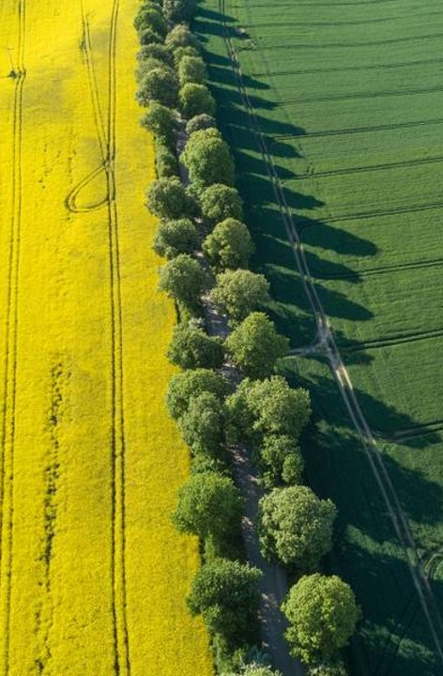
recommendations
Hypnotizing that a temperature rise of 1.5 degrees Celsius would have a significant negative impact on human life and could make some areas unsafe to live in, I recommend
Classify the raw data by using the hierarchical clustering. Further analyze clusters to reveal large weather patterns, while outliers may indicate anomalies and unusual weather conditions.
Categorize the weather conditions and identify the most important weather indicators by applying Random Forest algorithm.
Use the following classification: temperature has a rising trend by > 0.5 degree over the decade is a ‘high risk’; < 0.5 is ‘low risk’.
Predict the probability of increasing temperature by 1.5 degrees by using CNN & GAN models.
Assign safety categories to locations: ‘safe’ if temperature will increase < 0.5 degree, ‘moderate safe’ if increase >= 0.5 and < 1.5 degrees, ‘unsafe’, if temperature will go up by >=1.5 degrees.
Create a spacial map of ‘safe’, ‘moderate’ and ‘unsafe’ locations for humans to live in.

Slide 11
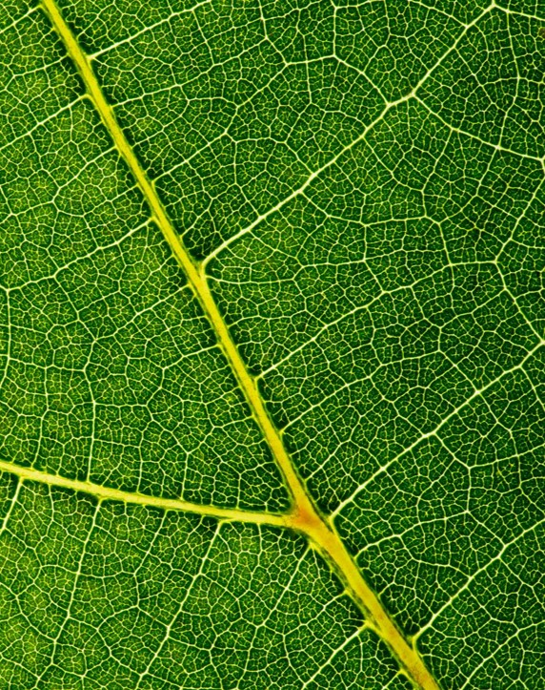



Oksana stepanova
Let’s get in touch​
LinkedIn​
GitHub
Email

