Slide 1
Rockbuster stealth LLC
ONLINE MOVIE STREAMING PROJECT

Slide 2
objective
Rockbuster Stealth LLC is a movie rental company that provides this service across the world.
Now we are looking for the opportunity of launching an online rental service using the existing movie licenses in a competitive environment dominated by streaming giants such as Netflix and Amazon.

Slide 3
Key questions
1
Which movies contributed the most/least to revenue gain?
2
What was the average rental duration for all videos?
3
Which countries are our customers based in? Where are customers with a high lifetime value based?
4
Do sales figures vary between geographic regions?

Slide 4
Data overview
1000
599
108
Movies in Library
Customers
Countries
$61,312
14,596
$4.20
Total Revenue
Sales Transactions
Revenue per transaction

Slide 5
Movie statistics
Category | AVERAGE | MIN | MAX
Rental Duration | 5 days | 3 days | 7 days
Rental Rate | $2.98​ | $0.99 | $4.99
Replacement Costs | $19.98 | $9.99 | $29.99
Movie Length | 115 min​ | 46 min | 185 min

Slide 6
Top-10 movies
Movie | Genre | Rental Rate | Rating | Sales transactions | Revenue
Telegraph Voyage | Music | 4.99 | PG | 25 | 215.75
Zorro Ark | Comedy | 4.99 | NC-17 | 28 | 199.72
Wife Turn | Documentary | 4.99 | NC-17 | 27 | 198.73
Innocent Usual | Foreign | 4.99 | PG-13 | 26 | 191.74
Hustler Party | Comedy | 4.99 | NC-17 | 22 | 190.78
Saturday Lambs | Sports | 4.99 | G | 26 | 190.74
Titans Jerk | Sci-Fi | 4.99 | PG | 27 | 186.73
Harry Idaho | Drama | 4.99 | PG-13 | 27 | 177.73
Torque Bound | Drama | 4.99 | G | 23 | 169.76
Dogma Family | Animation | 4.99 | G | 28 | 168.72

Slide 7
Bottom-10 movies
Movie | Genre | Rental Rate | Rating | Sales transactions | Revenue
Oklahoma Jumanji | New | 0.99 | PG | 6 | 5.94
Duffel Apocalypse | Documentary | 0.99 | G | 6 | 5.94
Texas Watch | Horror | 0.99 | NC-17 | 6 | 5.94
Freedom Cleopatra | Comedy | 0.99 | PG-13 | 5 | 5.95
Young Language | Documentary | 0.99 | G | 7 | 6.93
Rebel Airport | Music | 0.99 | G | 7 | 6.93
Cruelty Unforgiven | Classics | 0.99 | G | 6 | 6.94
Treatment Jekyll | Drama | 0.99 | PG | 6 | 6.94
Lights Deer | Classics | 0.99 | R | 7 | 7.93
Japanese Run | Horror | 0.99 | G | 6 | 7.94

Slide 8
Movies that contribute the most / the least to revenue gain
All the movies from the top-10 list have the highest rental rate of $4.99.
There is no evident predominant genre in the top-10 movie list.
The highest revenue ($215) has been gained by the movie ‘Telegraph Voyage’ from Music film category.
While customers most often rented two other movies ‘Zorro Ark’ and ‘Dogma Family’ listed in Comedy and Animation categories, respectively.
The movies from the bottom list have the lowest rental rate of $0.99.
Horror and Classics films are present in the bottom list. However, these genres do not appear in the top-10 list.
Let’s take a look at where our customers reside

Slide 9
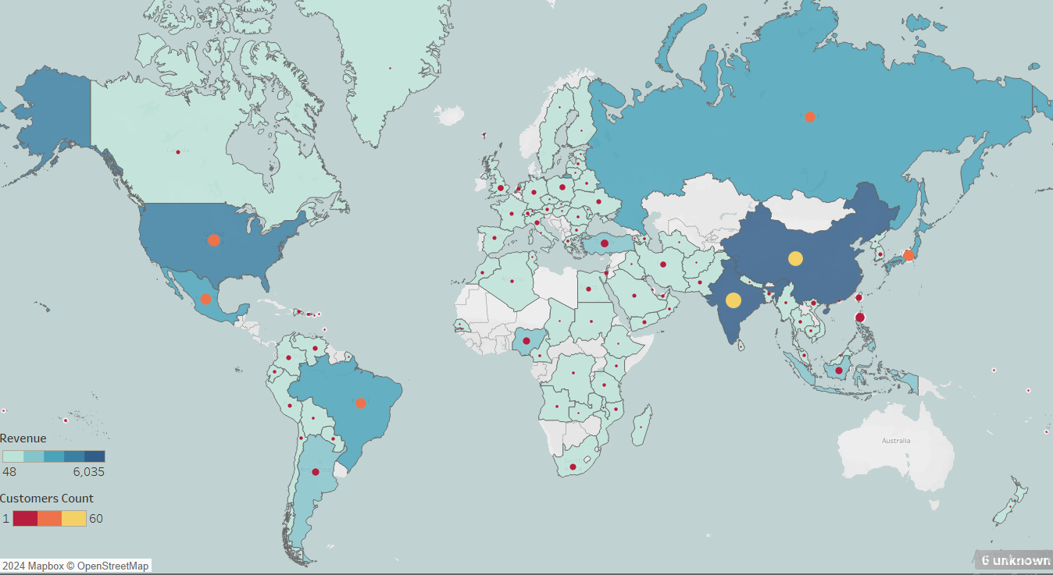
Customers Distribution by country

Slide 10
Countries Where customers with a high lifetime value are based
Country | Customers Count | Revenue | Percentage of Revenue
India | 60 | $6,035 | 9.84%
China | 53 | $5,251 | 8.56%
United States | 36 | $3,685 | 6.01%
Japan | 31 | $3,123 | 5.09%
Mexico | 30 | $2,985 | 4.87%
Brazil | 28 | $2,919 | 4.76%
Russian Federation | 28 | $2,766 | 4.51%
Philippines | 20 | $2,220 | 3.62%
Turkey | 15 | $1,498 | 2.44%
Indonesia | 14 | $1,353 | 2.21%
Customers are located in 108 countries across the world.
More than 50 % of customers are based in Top-10 countries.
Top-10 countries have generated 52% of total revenue accounting for $31,834.
Let’s take a look at the movie preferences of our customers

Slide 11
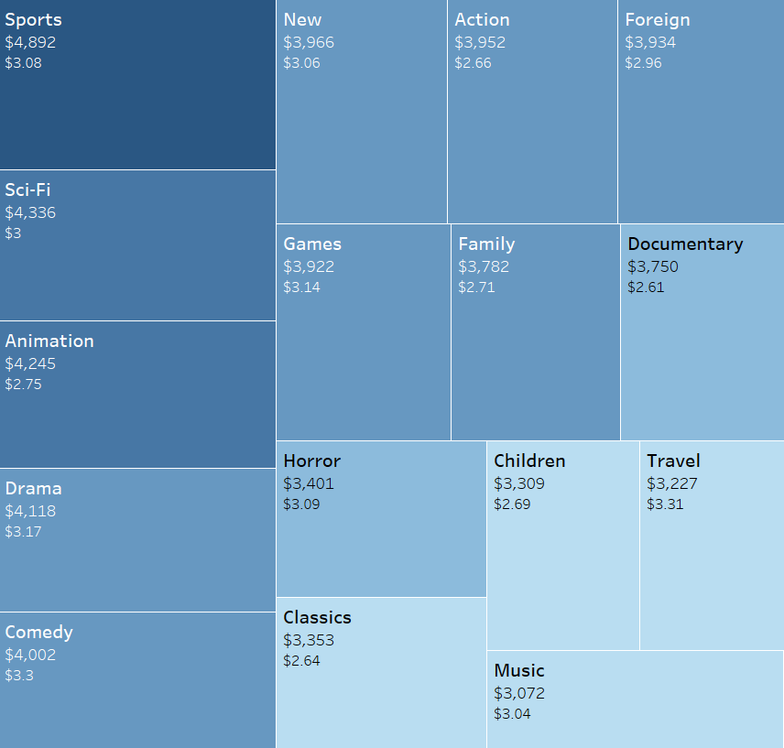
Movie genre by revenue

Slide 12
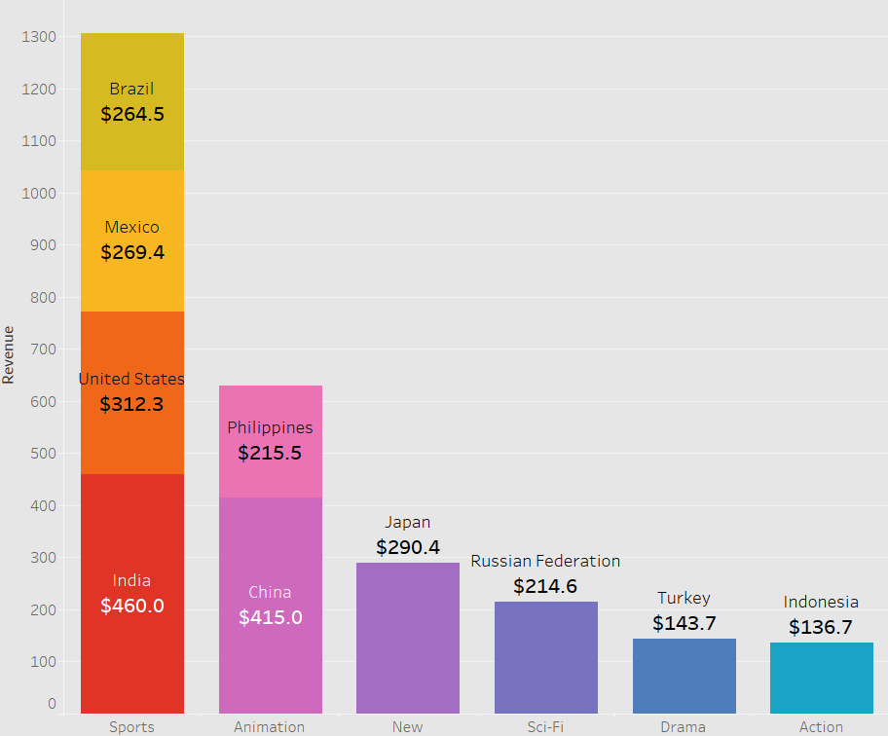
Movie genre in top-10 countries

Slide 13
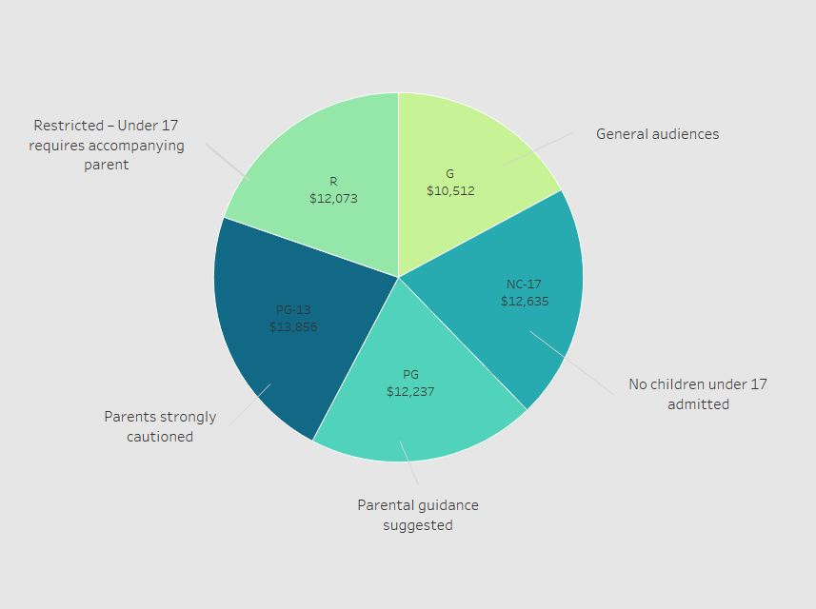
Movie rating by revenue

Slide 14
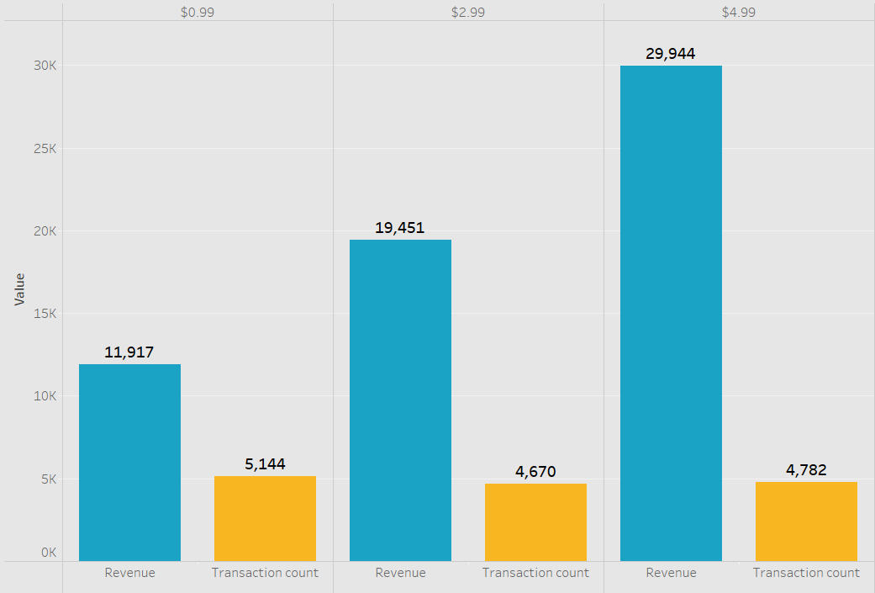
Revenue & transactions by rental rate

Slide 15
Who are our customers and what are their movie preferences
Our clients reside all over the world except Australia.
The top-5 countries are in Asia (India, Chinese and Japan) and America (USA, Mexico)
If we look at the list of top-10 countries, the most part of our customers (89%) are based in non-English speaking countries.
The most popular genres in the top-10 countries are Sport and Animation. These two categories dominate in six of ten countries on the top list (India, China, USA, Mexico, Brazil, Philippines).
The most popular genres across all countries are Sports, Sci-Fi, Animation, Drama and Comedy.
There is no prevailing rating. All five rating categories are relatively equal in terms of revenue generated. Although, four of five ratings are assigned to the movies for the audiences 13 years and older.
Customers rented most frequently the movies at the lowest rate of $0.99. These transactions account for 35% of all sales. However, these sales have generated 20% of revenue.
The sales of movies at the highest rental rate generated almost half of the revenue, e.g. 49%. The movies on the top-10 list are being rented at the highest rate: $4.99.

Slide 16
recommendations
Focus on the opportunity of launching new strategy in the countries from the top list, namely in Asia, Northern and Central America.
Given that the most customers reside in non-English speaking countries, consider offering the movies with the audio in their native languages focusing on the most popular film categories in their geographical regions.
Develop a system for ranking films in the library by genre and film rating. Make decisions about purchasing new licenses based on the rating system, target audiences and their movie preferences.
Review the maturity of license on a regular basis and discontinue those which have not been rented in the last 12 months (43 items on the current list) or the movies that have been purchased less than 10 times in the last 12 months (166 films)
Invent a pricing strategy based on the films’ popularity and move the movies to a lower rental rate category once the number of sales shows a decreasing trend.
Launch reward programs for our most loyal customers based on their tenure and lifetime value.

Slide 17
Thank you!
Oksana Stepanova
To view visualization on Tableau Public:
https://public.tableau.com/app/profile/oksana.stepanova/viz/Rockbuster_17080071102360/Rockbuster?publish=yes

