Slide 1
Auth0 Login for DesignAssist
Prepared for Internal Use
Yun Wang & Kristin Holmbeck

Slide 2
Presentation Outline
Auth0 Overview
User Data
Rules
3rd-Party Email Notification
Approving Users
Wrapping Up

Slide 3
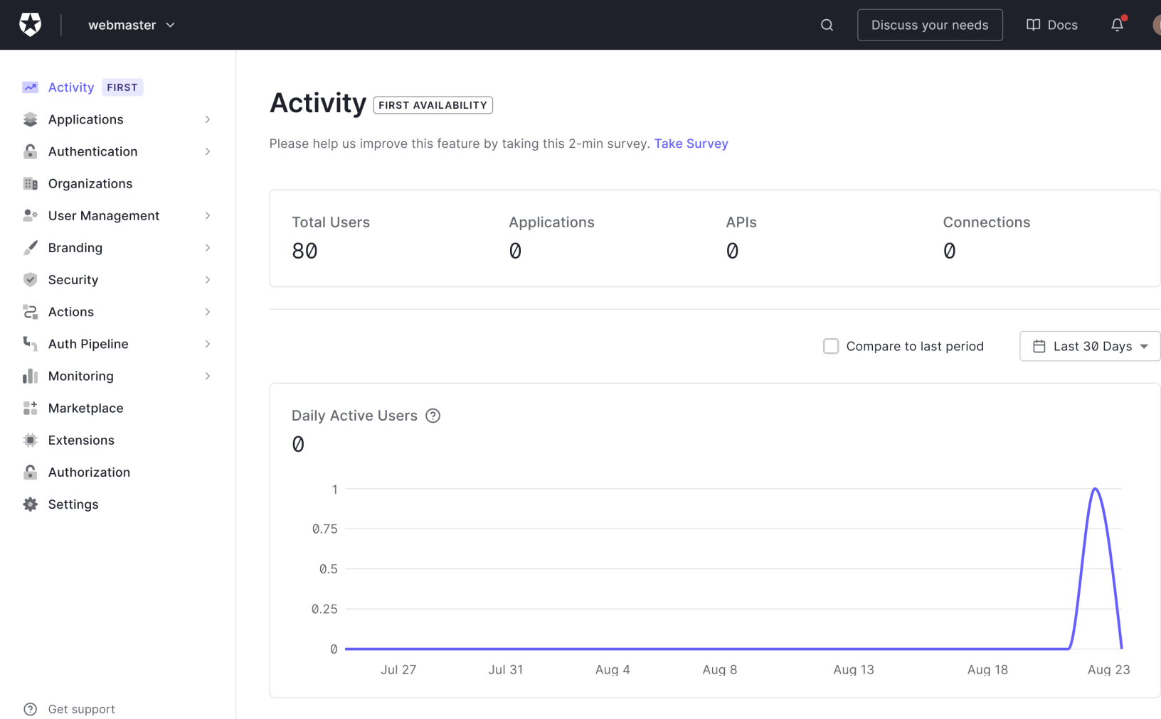
Auth0 Overview
Auth0 is a single sign-on service provider, allowing us to have a user login database for the DesignAssist website.
Many features are included, but the ones we need for now are free!
We setup an Auth0 account through the Google account webmaster@tempest-tech.com. When logged in the Auth0 opens Activity page shown below:

Slide 4
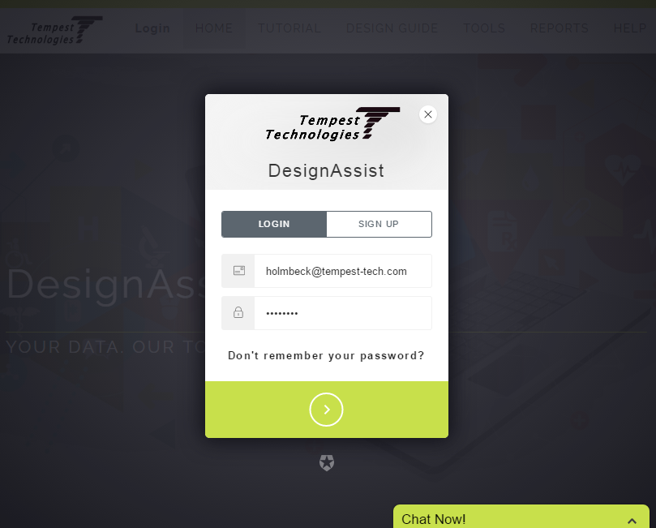
Sign-Up on Design Assist
On the DesignAssist website, we have Auth0 implemented through JSON web tokens and Javascript. (See main.js for how this works.)
For testing purposes, sign-ups were disabled in order to prevent anyone from being able to use the website. This means we must add users manually.
An easier way to do this would be to allow sign-ups, but have a layer of verification on our part before someone can fully use the website.
We will outline how to set up a mostly automatic verification process in the remaining slides.

Slide 5
Presentation Outline
Auth0 Overview
User Data
Rules
3rd-Party Email Notification
Approving Users
Wrapping Up

Slide 6
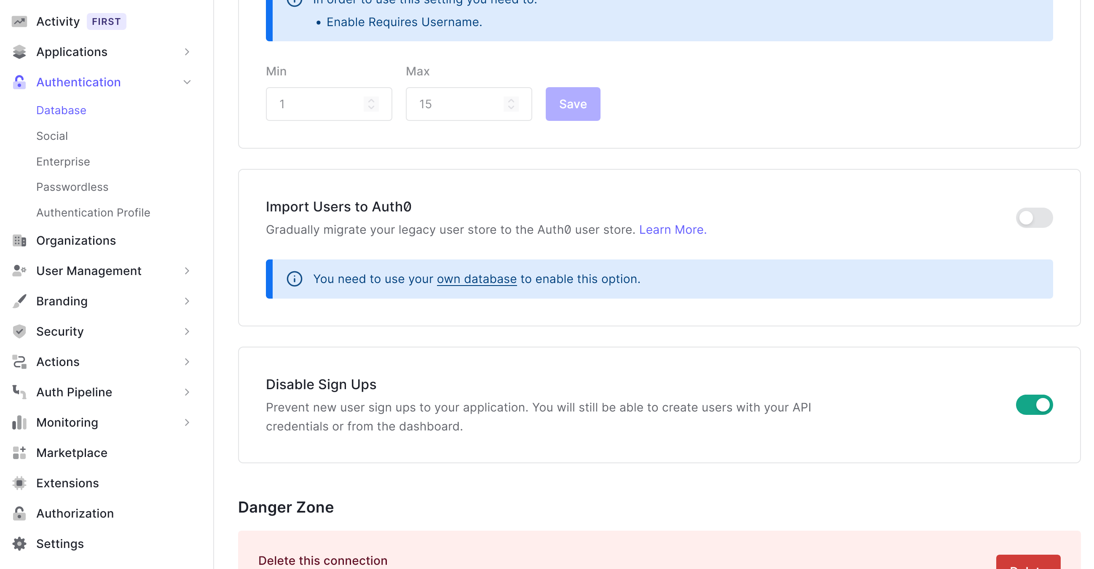
Auth0 Modal Options
First, we must disable sign ups in the Auth0 Dashboard to add verification layer
Turn off the button in: Authentication > Database … Settings > Disable Sign Ups

Slide 7
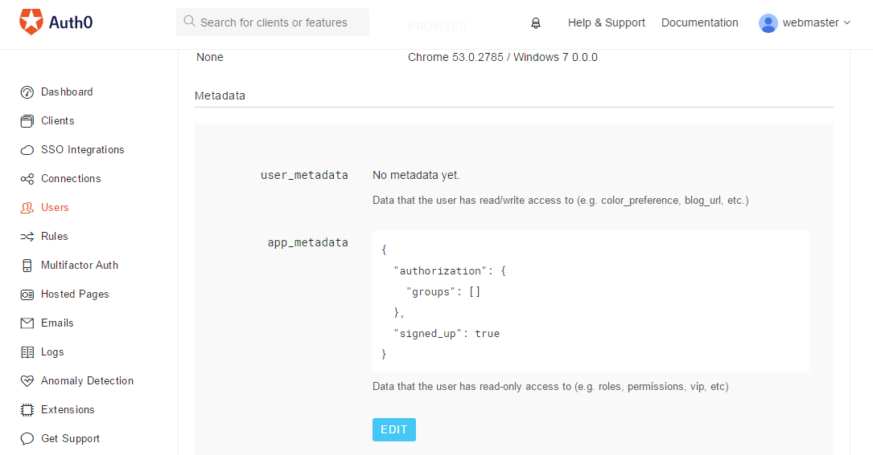
JSON Metadata
Metadata are used to store information. For each user, the access info (permissions, Auth0 plan, etc) is stored in app_metadata, and the user info (user attributes such as preferences) is stored in user_metadata.
The idea is to use a variable in app_metadata to check whether or not a user has been “verified” so that they may use the website.

Slide 8
Presentation Outline
Auth0 Overview
User Data
Rules
3rd-Party Email Notification
Approving Users
Wrapping Up

Slide 9
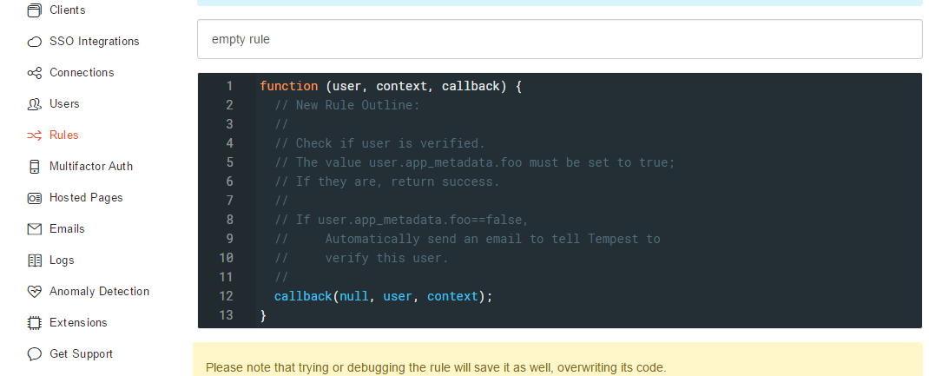
Auth0 Rules
Next, we will explore the Rules section. This defines some operations to perform as the authentication process is underway on the Auth0 side.
Defining a rule, we will determine whether a user is verified by looking at their app_metadata.
If the user has not been verified according to their app_metadata, send an email to Tempest with verification instructions.

Slide 10
Presentation Outline
Auth0 Overview
User Data
Rules
3rd-Party Email Notification
Approving Users
Wrapping Up

Slide 11
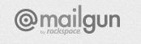
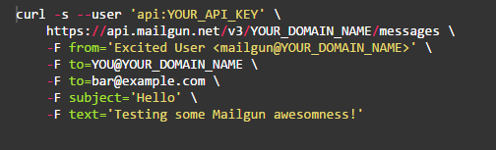
3rd-Party Email Notification
Mailgun.com is one of several options for 3rd party email sending.
This was chosen simply for its free option:
Must be under 10,000 emails per month
Otherwise, pay $0.00050 per email
An example of how to use their service is shown below using the cURL command (Linux).
We can implement this in Javascript with a simple HTTP request.
Note: you cannot simply put any email in the “from” field. Any email here must be verified through Mailgun in order to prevent spam.

Slide 12
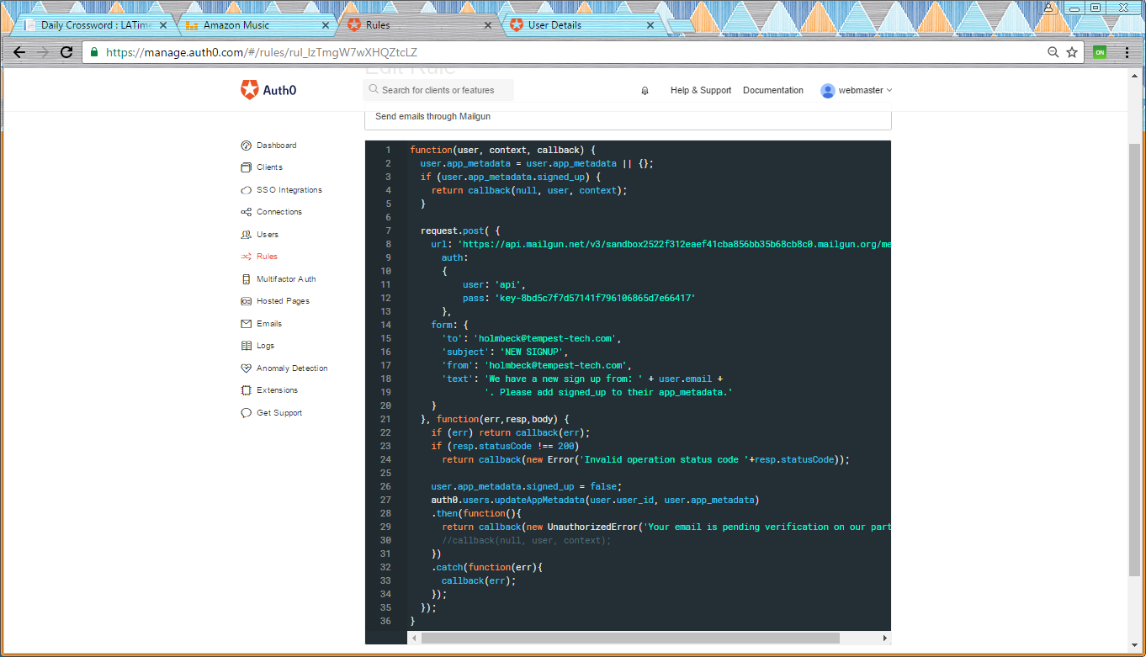
Auth0 Rule with Email Notification
The code here is our fully implemented rule for querying user verification and notifying Tempest if a user needs to be verified.
In the following slides we will explain exactly what this Javascript does.

Slide 13

Auth0 Rule with Email Notification 1
If a user has the field user.app_metadata.signed_up as true, then exit.
Make a POST request to the URL below. This URL can be found on the Mailgun dashboard, along with the value in the pass field.

Slide 14
Auth0 Rule with Email Notification 2
We need a person receiving the email (the to field), and the from field must be an email verified with Mailgun. Again, this is in order to prevent spam.
The request should return a response of 200. Anything other than that indicates an error in the Mailgun parameters above. We will also add the field signed_up to the metadata with a value of false.

Slide 15
Auth0 Rule with Email Notification 3
After setting the signed_up field to false, we will return an error back to the authorization screen. This means the user is signed up, but cannot log in to use password-protected functionality.
The signed_up field must be set to true in order for this user to fully log in.
The non-automated part of Tempest will involve a webmaster manually setting the signed_up field to true through the Auth0 Dashboard.

Slide 16
Presentation Outline
Auth0 Overview
User Data
Rules
3rd-Party Email Notification
Approving Users
Wrapping Up

Slide 17
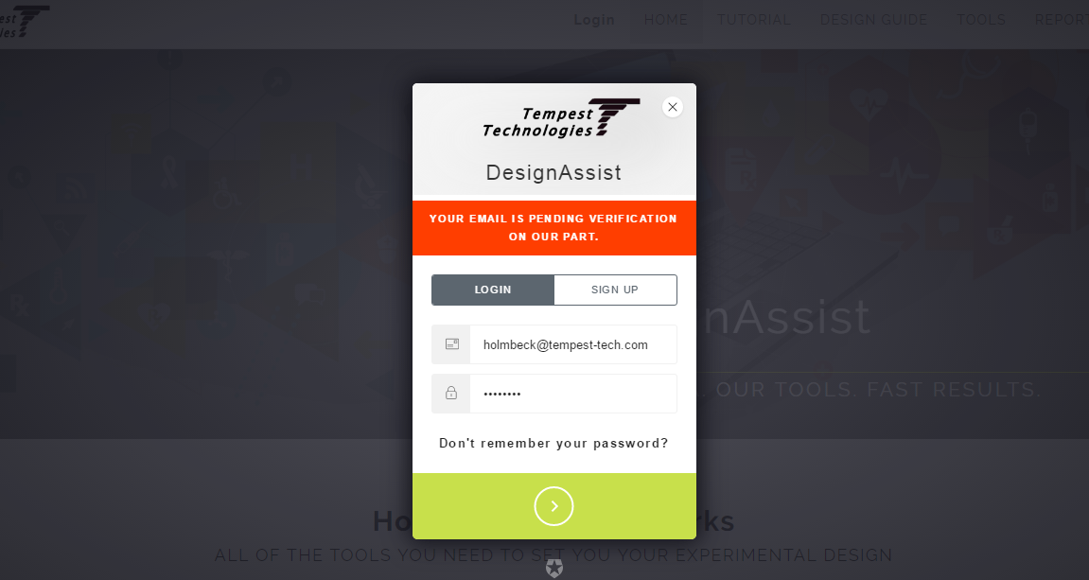
Approving Users
As stated previously, the non-automated part of Tempest will involve a webmaster manually setting the signed_up field to true through the Auth0 Dashboard.
When a user signs up, they will receive the pending verification message shown below.

Slide 18
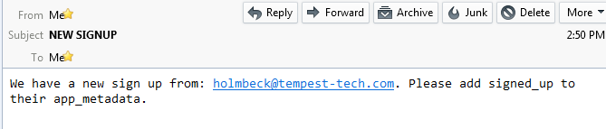
Approving Users
Then, we receive an email notifying us of this new sign up.

Slide 19
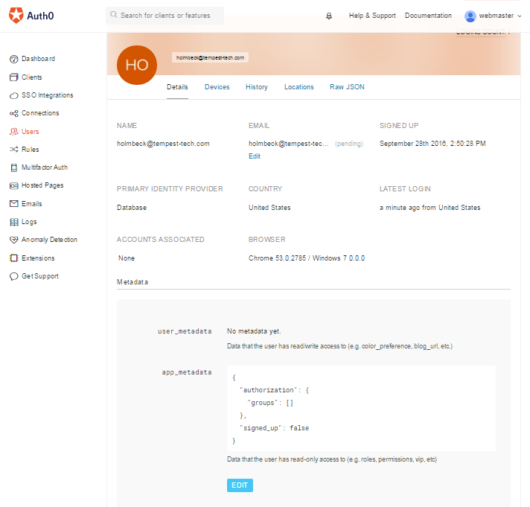
Approving Users
We will click on the “Edit” button to change the signed_up field to true, enabling the user to fully use the website.

Slide 20
Presentation Outline
Auth0 Overview
User Data
Rules
3rd-Party Email Notification
Approving Users
Wrapping Up

Slide 21
Wrapping Up
Our goal was to enable user sign up, but disable immediate login.
This alleviates the burden on Tempest of adding many users manually.
We did this by (1) setting a rule through Auth0, (2) checking for variable value, and (3) using Mailgun to notify us if the value implied that the user needs verification.
Finally, a manual login to the Auth0 Dashboard was required to set the variable to the desired value.

