Slide 1
Bulk Subscription Flow
Prepared for Internal Use
7 August 2018
Kristin Holmbeck
Analyst

Slide 2
Components
A single “master user” pays for a group subscription / license (e.g. lab director)
Sub-users utilize this group license (e.g. postdocs in a lab)
Master user / group admin
Sub-user
Sub-user
Sub-user
Sub-user
Sub-user
Sub-user
Tempest Technologies Proprietary
Slide <number>

Slide 3
Sign-up flow
Master user signs up first, obtains a license key
Sub-user signs up with the license key, which corresponds to a 100% discount for that user
Master user / group admin
payment
License key
Account created
Payment via license key == discount
Sub-user
Account created
Tempest Technologies Proprietary
Slide <number>

Slide 4
License key
The license key is a discount, with a fixed number n associated with it (e.g. 30).
  Only n of this discount can be applied.
  If someone wants to switch accounts (i.e. replace someone in the group with another user), they must contact us directly.
The master user will get an email for every signup under this discount (?)
License key
Stripe discount
Tempest Technologies Proprietary
Slide <number>

Slide 5
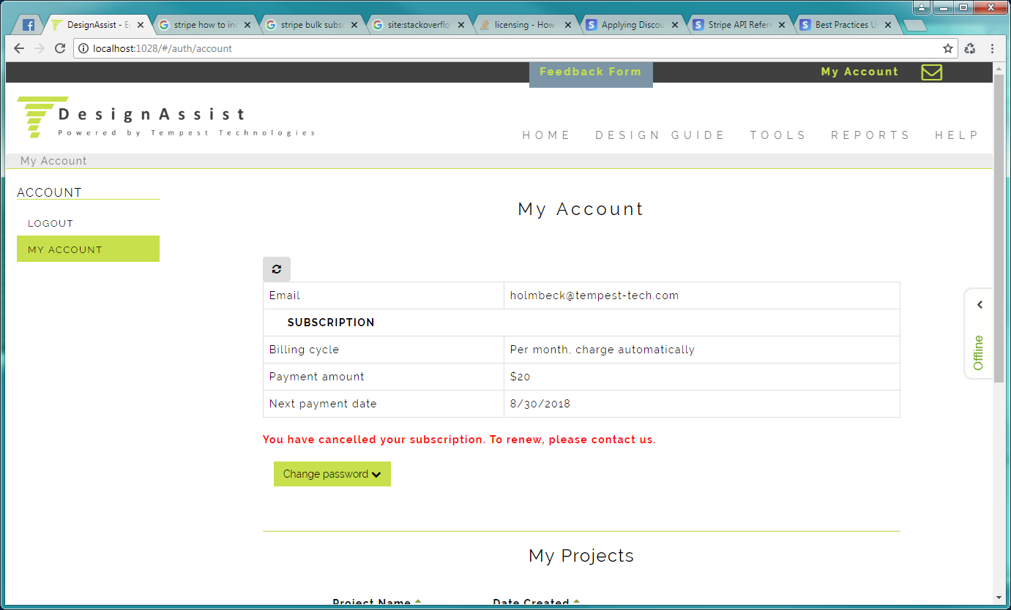
Account page
Will look different depending on sub-user or master user
Master user / group admin
Admin on group license of 30
25/30 licenses used. Click <here> to see license key.
License expires 12/23/2018
Sub-user
User under group license.
Expires 12/23/2018
Contact your group admin for more information.
Tempest Technologies Proprietary
Slide <number>

