Slide 1
DesignAssist Sign-up Flow
Prepared for Internal Use
Kristin Holmbeck
Analyst

Slide 2
Presentation Outline
Components
Stripe
Auth0
Internal Database
Flow Chart
Error Handling

Slide 3
Components
User sign-up requires:
Payment through a third-party service, Stripe
Login credential creation through Auth0
Internal database (loading and saving projects within DesignAssist)
In order to outline the signup flow, we will develop some key details for each authentication step.

Slide 4
Presentation Outline
Components
Stripe
Auth0
Internal Database
Flow Chart
Error Handling

Slide 5
Stripe
Stripe is a third-party service we use for payment.
After creating a product, a payment is created by:
Create a customer with a payment token. This token is a key we send to Stripe to process a payment (so that we do not directly handle any credit card information).
Create a subscription attached to this (newly-created) customer ID.

Slide 6
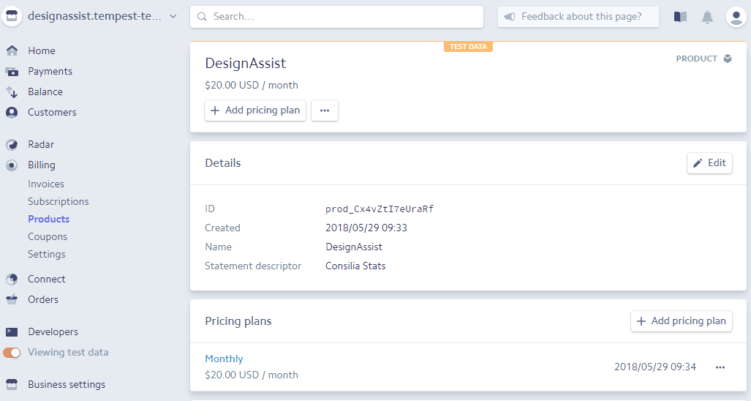
Stripe Product

Slide 7
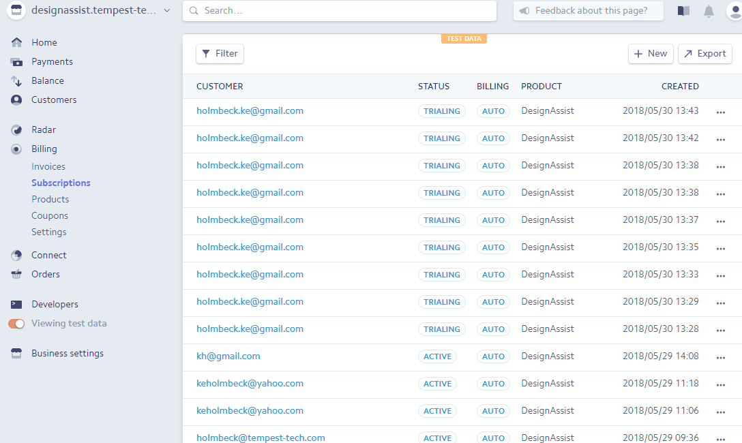
Stripe Subscriptions

Slide 8
Presentation Outline
Components
Stripe
Auth0
Internal Database
Flow Chart
Error Handling

Slide 9
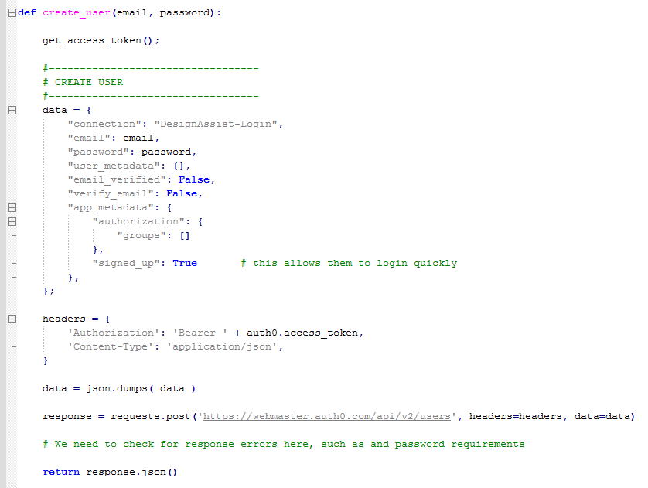
Auth0
Auth0_controller.py
Auth0 is the third-party service we use to handle user login and authentication.
In a previous document, Auth0_VerifyUser.ppt, we outlined the Auth0 “application” creation.
After a customer is successfully created in Stripe, we need to add them to the Auth0 database using a simple API call.
Using this call, we can add any additional custom data to the user to be used later.
The user can be managed directly in the Dashboard.

Slide 10
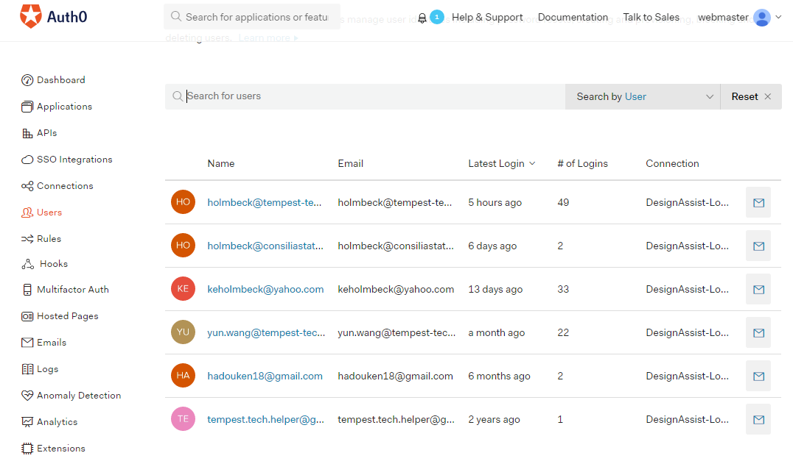
Auth0 Dashboard

Slide 11
Presentation Outline
Components
Stripe
Auth0
Internal Database
Flow Chart
Error Handling

Slide 12
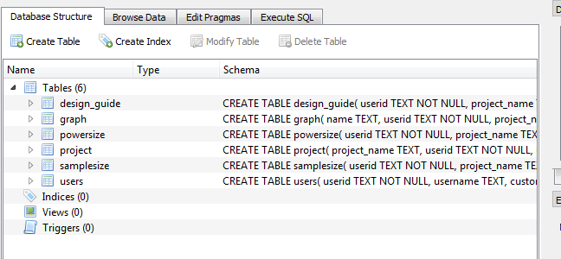
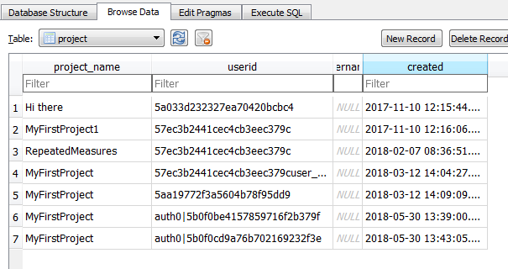
Internal Database
Lastly, we manage an internal database for allowing the user to save their information from DesignAssist in their account.
This database resides on the server, unlike the Auth0 users database.

Slide 13
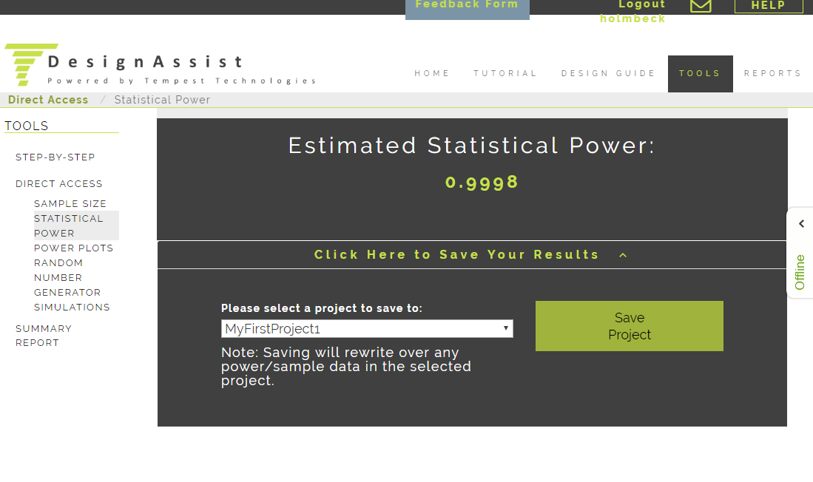
Saving Info to the Internal Database

Slide 14
Presentation Outline
Components
Stripe
Auth0
Internal Database
Flow Chart
Error Handling

Slide 15
Sign-Up Flow
The general flow for a user sign-up is below, and happens only once.
If each step executes successfully, the new user can now use DesignAssist.
Stripe payment
Create Stripe customer and subscription
Auth0: new user
Create a new Auth0 user for login
Database user
Create an internal database user and new project

Slide 16
Presentation Outline
Components
Stripe
Auth0
Internal Database
Flow Chart
Error Handling

Slide 17
Error Handling
If user already exists in Auth0, force them to login to their account instead of making a new payment.
Make sure that the Auth0 credentials are correct, such as password length, email format (with ‘@’ sign), etc.
This needs to be done still.
Error checking for internal database?
Stripe payment
Auth0: new user
Database user
Stripe payment
Auth0: new user
Database user
Stripe payment
Auth0: new user
Database user
10/7/19 yw
May need to fill in more details

