Slide 1

Tensorflow DevSummit
WiFi: Outbox#public
Password: c0cr3@t3With0th3rs
share on twitter: #TFDevSummit
#TFDevSummitKampala
@GCDCKampala

Slide 2
What is TensorFlow?

Slide 3
TensorFlow is an open-source
high-performance library for numerical computation that uses directed graphs

Slide 4
Nodes represent mathematical operations
Edges represent arrays of data

Slide 5
A tensor is an N-dimensional array of data
Dim 0 Tensor scalar
1D Tensor vector
2D Tensor matrix
3D Tensor

Slide 6
TensorFlow graphs are portable between different devices
CPUs
GPUs

Slide 7
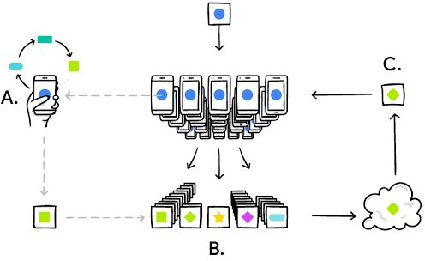
TensorFlow even supports federated learning
https://research.googleblog.com/2017/04/federated-lear ning-collaborative.html

Slide 8
TensorFlow API hierarchy
tf.estimator
High-level API for distributed training
tf.layers, tf.losses, tf.metrics
Components useful when building custom NN models
Core TensorFlow (Python)
Python API gives you full control
Core TensorFlow (C++)
C++ API is quite low level
Cloud ML Engine
CPU
GPU
TPU
Android
TF runs on different hardware

Slide 9
The Python API lets you build and run Directed Graphs
a
b
Tensors
...
c = tf.add(a, b)
Build
add
Operations
session = tf.Session()
Run
c
numpy_c = session.run(c, feed_dict= ….)

Slide 10
Session allows Tensorflow to cache and distribute
computation
Python front end
S..e.ssion
Core TensorFlow Execution System
mul Print reshape GPU Android iOS
Ops
add
...
Kernels
CPU
...

Slide 11
Tensorflow 2.0
Easy model building
Robust model deployment in production on any platform
Powerful experimentation for research
Simplified APIs

Slide 12
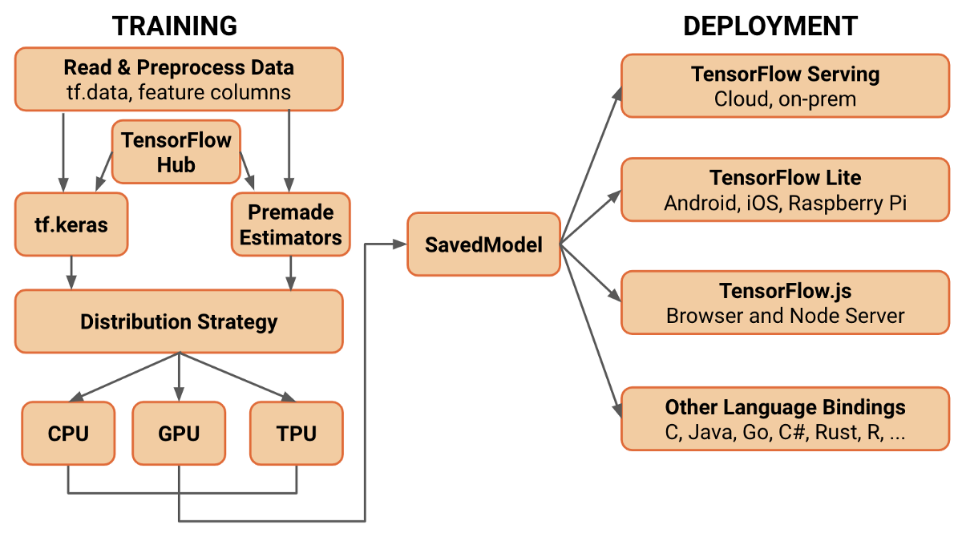
A comprehensive platform that supports ML workflows

Slide 13
LASTLY…
#PoweredByTF DevPost Challenge: build something amazing with TF2.0, share it and win prizes.
Google Summer Of Code: get paid to work on an open source Tensorflow project this summer.
Contribute to the Tensorflow github repository. For more info. Visit www.tensorflow.org

Slide 14
AboutMe: Stephen Mugisha
Twitter_handle: @StephenMugish11

