Slide 1
Hospital-acquired C. difficile Infection Risk Assessment Model
Steph Reynolds, MPH
February 3, 2022

Slide 2
Steps Completed
Literature search for existing CDI risk assessment models
Compiled list of common risk factors / parameters
Parsed the following UCSF EHR data for selected parameters:
Demographics and events table
Med admin table
Cleaned and transformed to create dataset for regression analysis
Ran multivariate logistic regressions to predict HO-CDIF based on:
Age, ABX, PPI, GAS, readmit
Check model assumptions
Evaluated model performance via AIC, R², Brier Score, etc.
Notes:
Hospital

Slide 3
Lit Search & Relevant Parameters
Older age [age_gte_65]
Receipt of antibiotics in last 30 days [ABX]
Limitation: We only have inpatient ABX use
Prior hospital admission in last 30 days [readmit]
Diabetes (or other comorbid conditions) [DBM]
Limitation: Only have DBM diagnoses for Covid + pts
Transfer from ED [ED_dispo]
Receipt of proton pump inhibitor [PPI]
Receipt of gastric acid suppressants, laxatives, etc. [GAS]
NOTE: ABX, PPI, and GAS were coded as receipt up to one day prior to HAI_first_date
Notes:
NOTE: ABX, PPI, and GAS were coded as receipt of these UP TO ONE DAY PRIOR to HAI_first_date (date that culture was ordered – closest indicator of positive test result)
Variable names are in brackets
Lump PPI and GAS?
Hospital acquired CDIF = diagnosed with CDIF >= 48 hours after admission

Slide 4
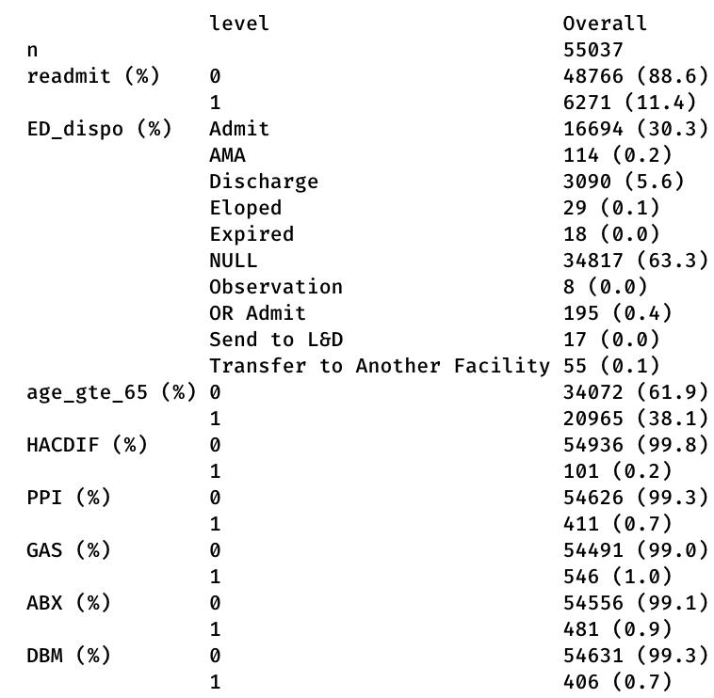
Table One
All data were coded into binary variables, where 1=YES and 0=NO
Notes:
55,037 total patients
Clarify ED_dispo
Discard this variable since 63% is NULL?
Admit vs. discharge? What does this mean?
0.2% of patients diagnosed with HACDIF (hospital-acquired Cdiff)
Does this seem appropriate?
Risk factors include:
Age≥65
Readmission
Receipt of: PPI, GAS, ABX
Comorbid conditions like diabetes
Should we discard this since we only have diabetes info on Covid-positive patients?

Slide 5
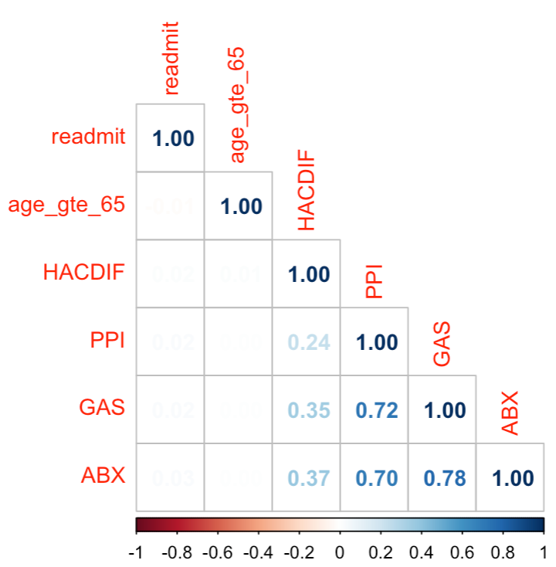
Checking Model Assumptions, Pt. I
Appropriate Outcome Structure – Binary log reg requires DV to be binary. Whether a pt is diagnosed with C diff is binary.
Observation Independence – Observations are independent from each other. Each patient is unique; not matched or repeated measures data.
Absence of Multicollinearity – There should be little or no multicollinearity among IVs. Using a correlation matrix, make sure no 2 vars have a correlation coefficient of > 0.8.

Slide 6
Checking Model Assumptions, Pt. II
Linearity of Independent Variables and Log Odds – Continuous IVs must be linearly related to the logit of the outcome. Since all IVs are binary, can ignore this step.
Large Sample Size – General guideline is to have at least 10 cases with least frequent outcome for each IV/predictor in your model.
Since our model will include 5 predictors and the probability of Cdiff is 0.0018 (101/55037), then we would need a sample size of about 28,000 (10*5/.0018).
If we include ED_dispo and DBM, we would have 7 predictors, and thus, would need a sample size of about 39,000.

Slide 7
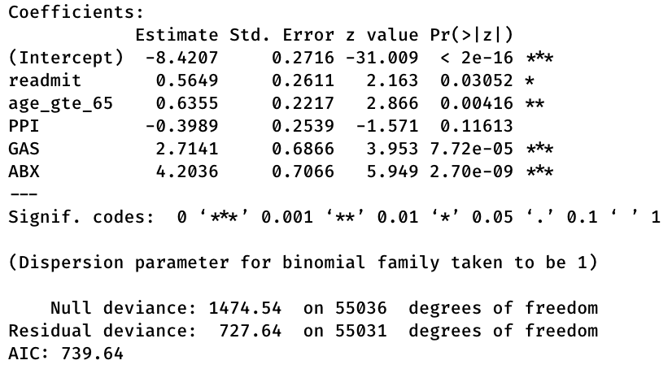
Full Model
HACDIF ~ readmit +
age_gte_65 +
PPI +
GAS +
ABX
Notes:
Regress residuals of GAS onto ABX?

Slide 8
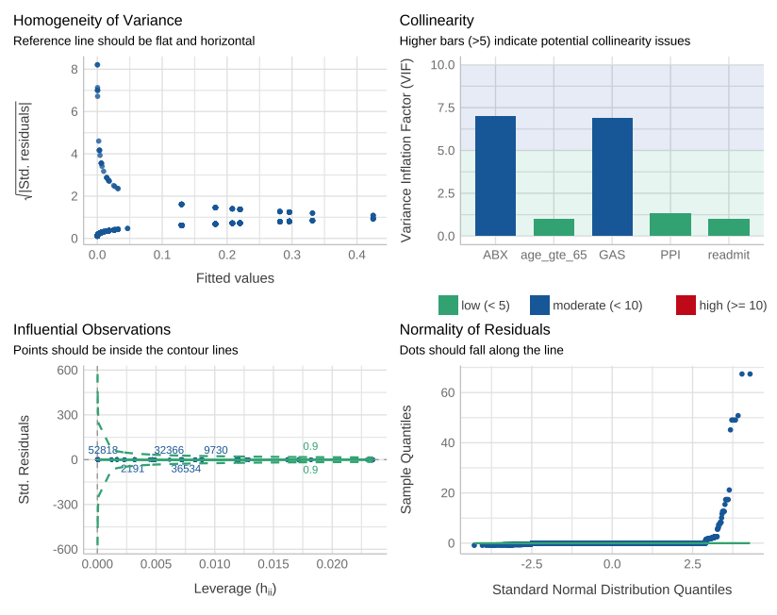
Check Model Assumptions performance package
Singularity
Collinearity
Outliers
Heteroscedasticity
Normality
– not necessary since response variable is binary
Notes:
Check model assumptions using performance package in R
Check for dispersion… df
No outliers
No singularity
Heteroscedasticity – not needed -> EXCLUDE PLOT
Normality – not needed → DO NOT INCLUDE PLOT
Collinearly – moderate correlation between ABX and GAS

Slide 9
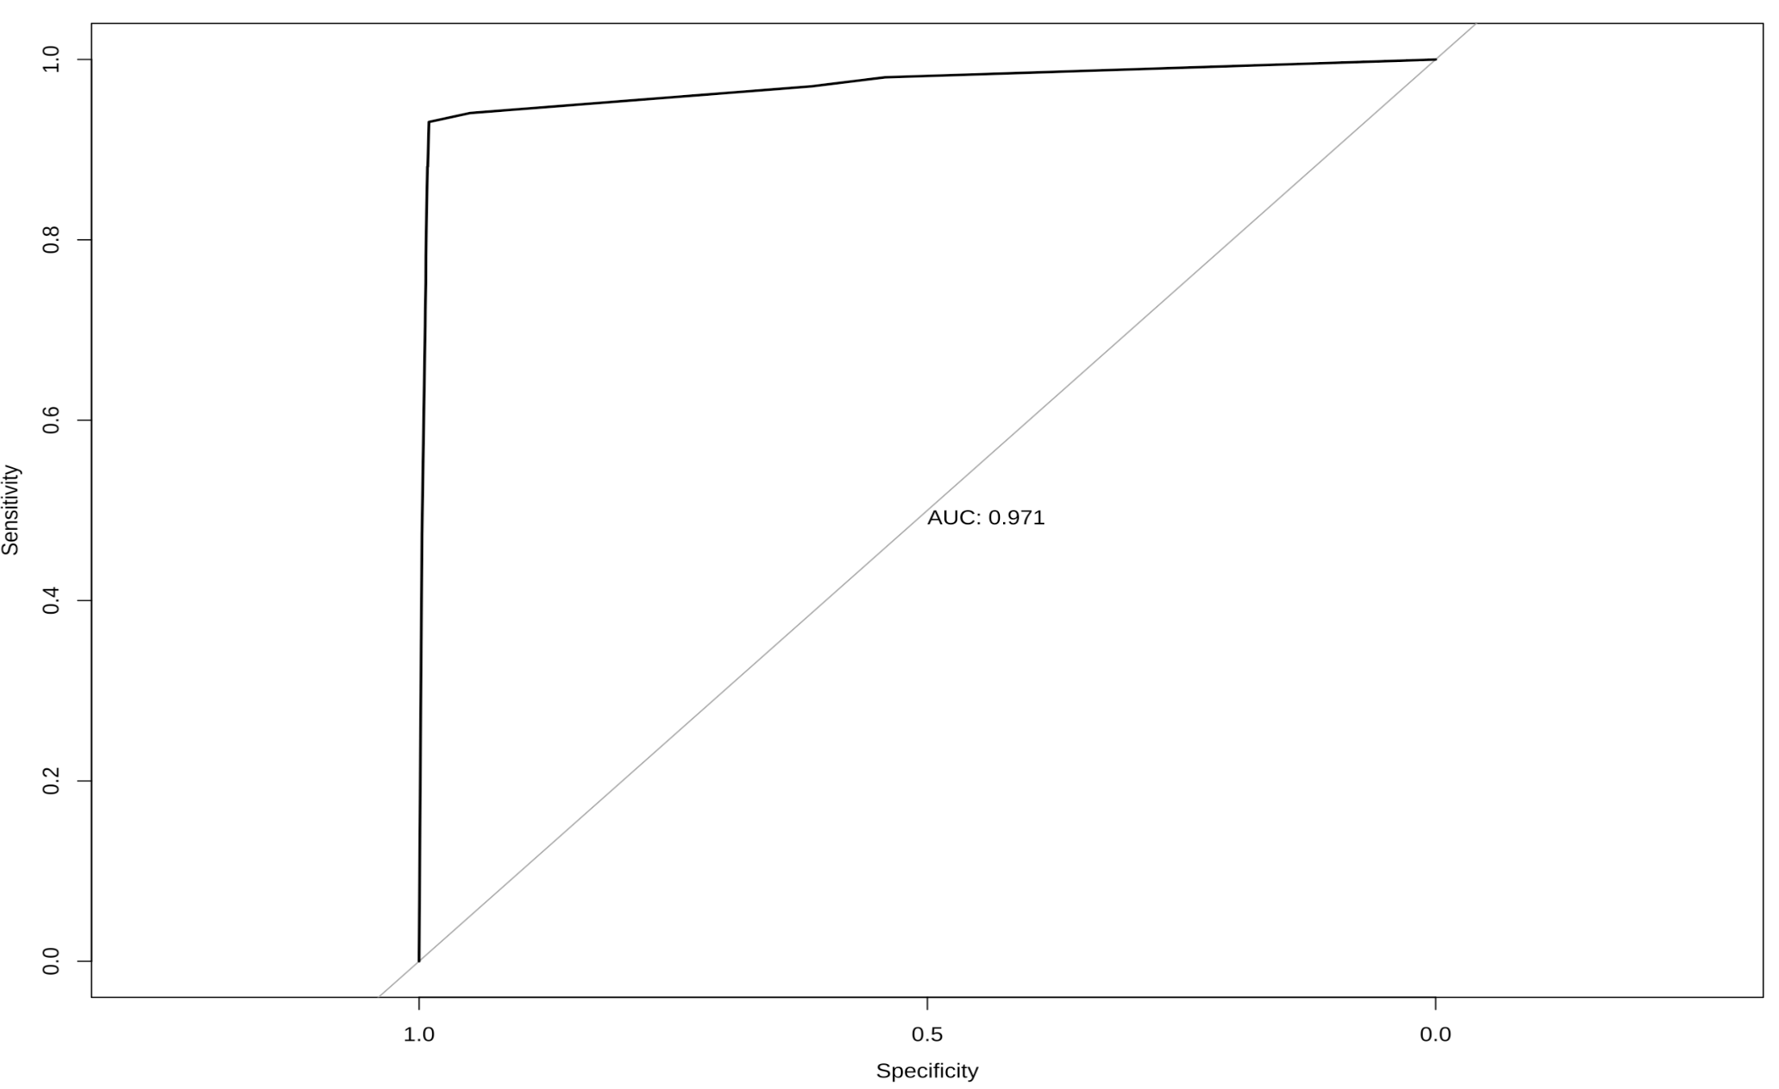
Model Performance: AUROC = 0.97
Notes:
The AUROC is 0.97 which shows that the model is very accurate at predicting whether a patient will be diagnosed with C diff given the following risk factors (age>=65, readmit, received PPI, received gastric acid supp or laxative, received abx).

Slide 10
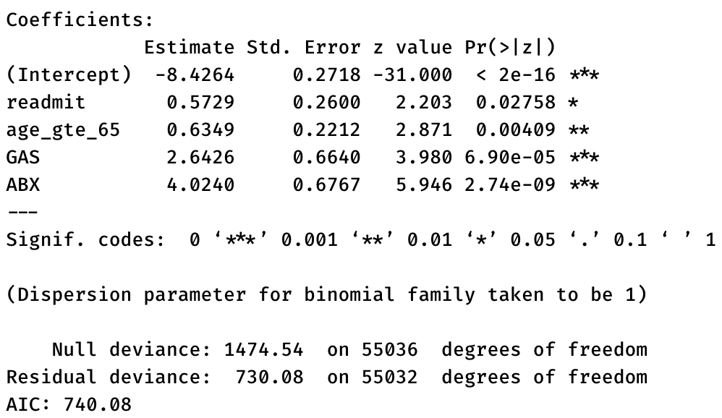
Model 2
HACDIF ~ readmit +
age_gte_65 +
GAS +
ABX
Notes:
m2 <- glm(data = df, formula = HACDIF ~ readmit + age_gte_65 + GAS + ABX, family = binomial)
summary(m2)

Slide 11
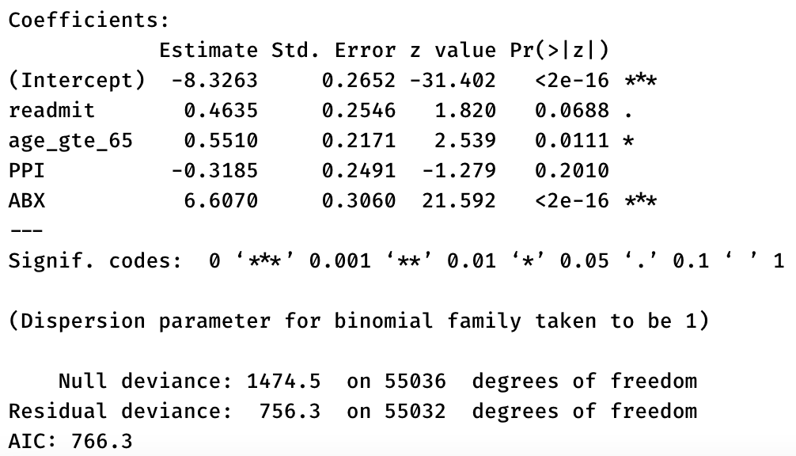
Model 3
HACDIF ~ readmit +
age_gte_65 +
PPI +
ABX
Notes:
m3 <- glm(data = df, formula = HACDIF ~ readmit + age_gte_65 + PPI + ABX, family = binomial)
summary(m3)

Slide 12
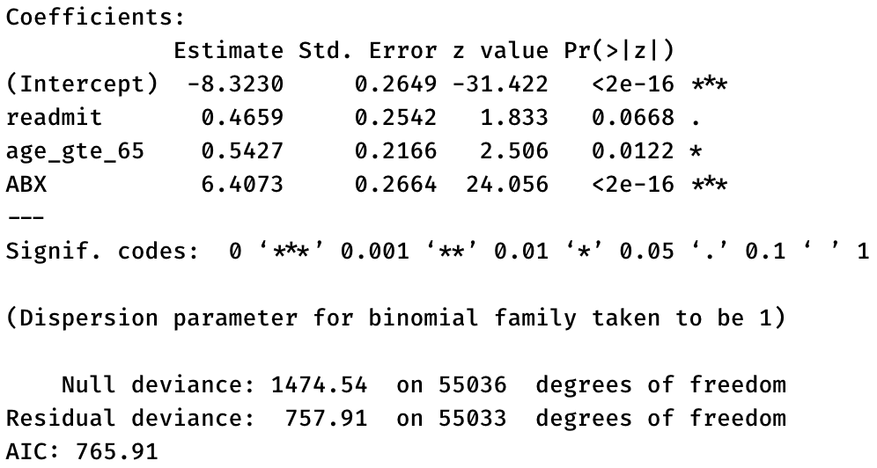
Model 4
HACDIF ~ readmit +
age_gte_65 +
ABX
Notes:
m4 <- glm(data = df, formula = HACDIF ~ readmit + age_gte_65 + ABX, family = binomial)
summary(m4)

Slide 13
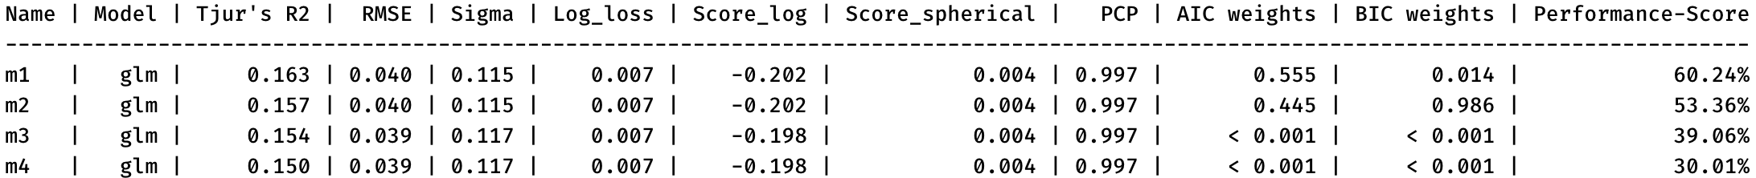
Comparison of Models 1 – 4
Model | Formula | Tjur’s R2 | AIC
m1 | HACDIF ~ readmit + age_gte_65 + ABX + PPI + GAS | 0.163 | 739.6
m2 | HACDIF ~ readmit + age_gte_65 + ABX + GAS | 0.157 | 740.1
m3 | HACDIF ~ readmit + age_gte_65 + ABX + PPI | 0.154 | 766.3
m4 | HACDIF ~ readmit + age_gte_65 + ABX | 0.150 | 765.9
Notes:
Compare model performance using Bayes → Prob of each variable being a RF

Slide 14
Limitations
ABX – Only data on inpatient use
DBM – Only data on Covid-positive patients; excluded from current model
ED_dispo – Excluded from current model since need to clarify what it means and if it’s appropriate to included
GAS and ABX are moderately correlated with each other
Should we exclude GAS (as in m4)?

Slide 15
Next Steps
Does this model seem justified / appropriate?
Validate model
What is the best way to do this?
Compare to existing models in lit?
Quantify model drift – if not feasible, consider adding to manuscript
What would make this publishable?
So what? What value would this paper add?

Slide 17
Extra Slides

Slide 18
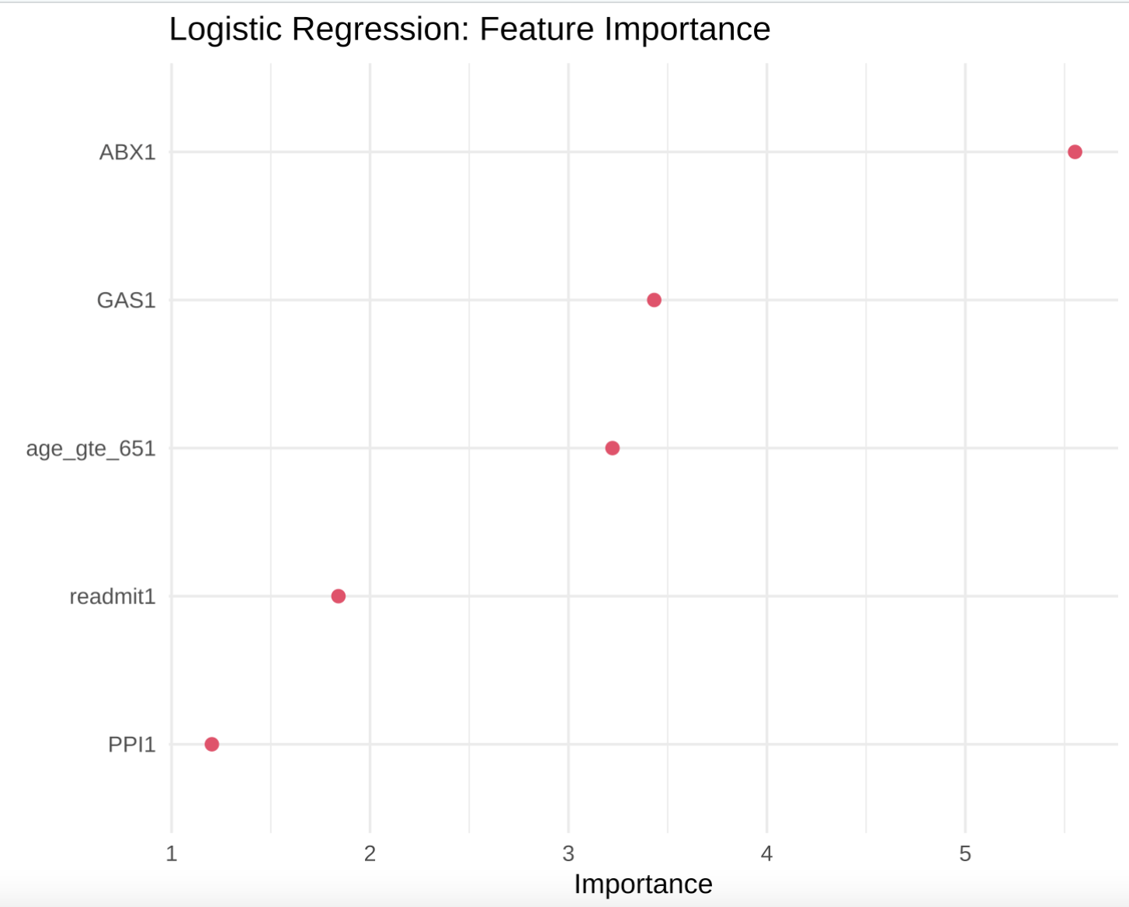
Feature Importance
Notes:
# Feature importance ----
# Visualize most important features
model_fit_glm %>%
vip(num_features = 5,
geom = "point",
aes = list(size = 3, color = '18bc9c')) +
theme_minimal(base_size = 15) +
labs(title = "Logistic Regression: Feature Importance")
# Features with highest importance are: ABX, GAS, AGE

Slide 19
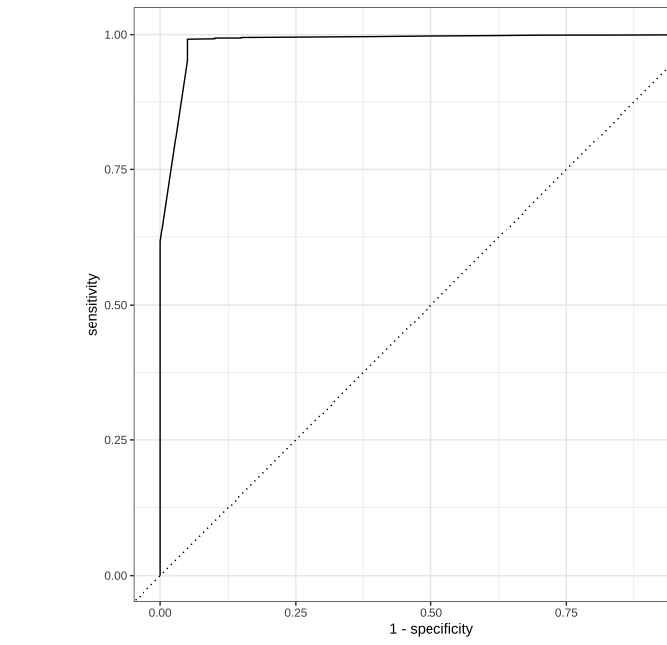
Model Performance
1. Predict class and numeric probabilities on testing data
prediction_class_test <- predict(model_fit_glm, new_data = testing(splits), type = 'class’)
prediction_prob_test <- predict(model_fit_glm, new_data = testing(splits), type = 'prob')
2. Create table that binds predicted class and probs
results_tbl <- bind_cols(prediction_class_test, prediction_prob_test, testing(splits))
3. Evaluate model performance: AUC
results_tbl %>% roc_auc(HACDIF, .pred_0)
4. Visualize ROC
results_tbl %>% roc_curve(HACDIF, .pred_0) %>% autoplot()
AUC = 0.987
Notes:
# Predict class and numeric probabilities on testing data ----
# Predict class (whether or not pt predicted to have cdiff)
prediction_class_test <- predict(model_fit_glm, new_data = testing(splits), type = 'class')
prediction_class_test
# Predict numeric probabilities for each class (Y/N cdiff)
prediction_prob_test <- predict(model_fit_glm, new_data = testing(splits), type = 'prob')
prediction_prob_test
# Create table that binds predicted class and probs
# Will be used to evaluate model in next step
results_tbl <- bind_cols(prediction_class_test, prediction_prob_test, testing(splits))
results_tbl
# Evaluate model performance: AUC and ROC ----
# Plot AUC
results_tbl %>% roc_auc(HACDIF, .pred_0)
# AUC = 0.987
# Visualize ROC
results_tbl %>% roc_curve(HACDIF, .pred_0) %>%
autoplot()

Slide 20
Calculate Brier Score for Models 1 – 4
Brier Score for M1: 0.0016
Brier Score for M2: 0.0016
Brier Score for M3: 0.0015
Brier Score for M4: 0.0016
Notes:
Brier score closest to 0 is best
CODE:
cat("Brier Score for M1:", round(BrierScore(m1), 4))
cat("Brier Score for M2:", round(BrierScore(m2), 4))
cat("Brier Score for M3:", round(BrierScore(m3), 4))
cat("Brier Score for M4:", round(BrierScore(m4), 4))

