Slide 1

The Technology Value Stream
Stephanie Ramos
Module 1.2 Assignment

Slide 2
AGENDA
What is Technology Value Stream?
Defining Lead Time vs. Process Time
The Common Scenario: Deployment Lead Times Requiring Months
Our DevOps Ideal: Development Lead Times of Minutes

Slide 3

What is Technology Value Stream?
According to Helen Beal’s article What is a Value Stream, a value stream represents the end-to-end set of activities required to deliver value to a customer (Beal, 2022). When applied to technology, this includes the full flow from accepting a business idea into development through coding, testing, integration, and deployment into production, where value is realized. The technology value stream recognizes that value is not created during development alone, but when services run reliably in production. By examining both value added and nonvalue added activities across this flow, teams can identify delays, dependencies, and quality risks that increase lead time and slow delivery.

Slide 4

Defining Lead Time vs. Processing Time
Lead time and process time are used to measure performance in value streams.
Lead time starts when the request is made and ends when it is fulfilled.
Process time is only the time work is actively being done. Does not include the time that work is in the queue.
To achieve faster flow and shorter lead time, there needs to be a reduction in the time that the work is waiting in the queue.

Slide 5
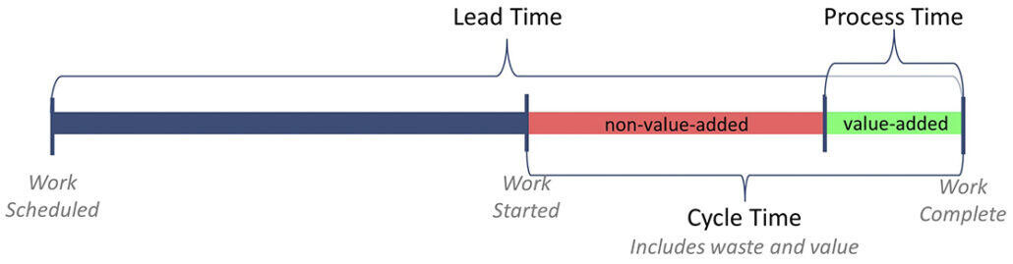
Lead Time vs. Processing Time
This image illustrates the distinction between lead time and process time within a value stream. Lead time encompasses everything from when a request is made to when the work is completed, which includes the time spent waiting in a queue. Process time is significantly shorter because it only reflects the time when work is actively being done and does not include waiting periods. The image makes it clear that most delays happen outside of actual work, reinforcing that reducing queue time is key to improving flow and shortening overall lead time.

Slide 6

The Common Scenario: Deployment Lead Times Requiring Months
It is common for large, complex organizations to have deployment lead times that take months to complete. This is due to monolithic applications, with:
  scarce integration test environments
  long test and production environment lead times
  high reliance on manual testing
  multiple required approval processes.
  This reflects a technology value stream where most time is spent waiting between stages rather than delivering value.

Slide 7
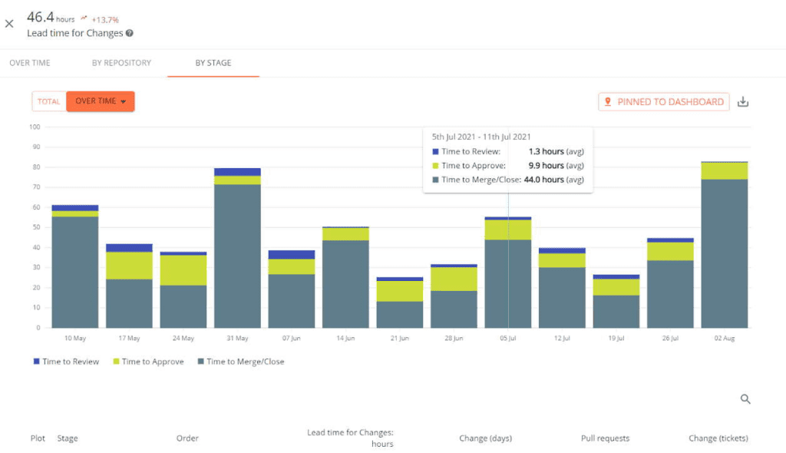
Deployment Lead Times Requiring Months
This chart illustrates how lead time increases as work progresses through various stages of the value stream, including review, approval, and merge or close. While the actual development work may be small, delays caused by approvals, handoffs, and environment constraints add significant waiting time. Large organizations often experience long deployment lead times due to manual processes and dependencies rather than the work itself.

Slide 8

Our DevOps Ideal: Deployment Lead Time of Minutes
Shortening lead time requires addressing delays across the full value stream, not just speeding up development. Erki Arus emphasizes removing waste such as handoffs, approvals, and waiting between stages as key contributors to long lead times (Entigo, n.d.). Practices like fast, continuous feedback, frequent integration of small code changes, and modular, loosely coupled architectures help reduce dependencies that create bottlenecks. Together, these approaches reduce queue time, enhance workflow, and facilitate faster and more consistent delivery of value.

Slide 9
References
Beal, H. (2022, February 3). What is a value stream? Medium. https://medium.com/flowtopia/what-is-a-value-stream-6dd64e5bef3c
Entigo. (n.d.). How to reduce lead time in software development with DevOps and value stream management. https://www.entigo.com/blog/how-to-reduce-lead-time-in-software-development-with-devops-and-value-stream-management
Kim, G., Humble, J., Debois, P., Willis, J., & Allspaw, J. (2016). The DevOps Handbook: How to Create World-Class Agility, Reliability, & Security in Technology Organizations (2nd ed.). IT Revolution Press.

