Slide 1
Security Controls in Shared Source Code
Stephanie Lara
Module 11.2 Assignment

Slide 2
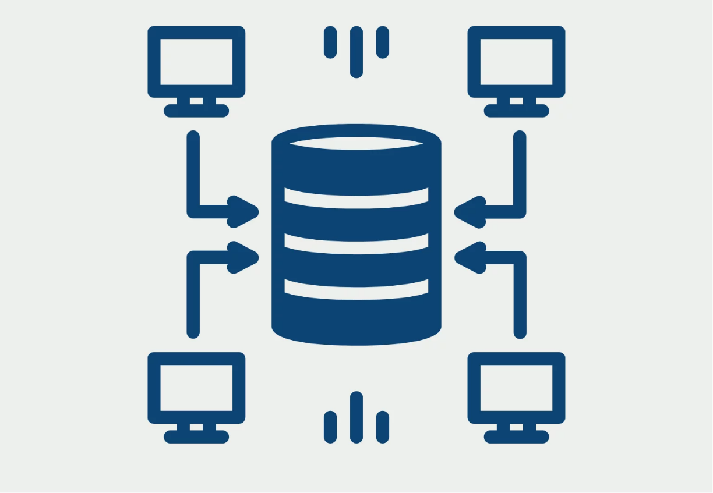
Security Risks in Shared Source Code Repositories
Shared repositories such as GitHub and GitLab allow teams to collaborate on code. However, without security controls, these repositories can expose sensitive information. Security practices help protect software and prevent unauthorized changes (Tal, n.d.).

Slide 3
Repository Security Best Practices
Code Review Before Merge
Changes should be reviewed by another developer before being merged into the main codebase.
Helps identify vulnerabilities and errors early (Rose, 2025).
Branch Protection
Prevents direct changes to critical branches such as main.
Requires approvals and testing before code is merged (Rose, 2025).

Slide 4
Repository Security Best Practices
Pinned Dependencies
Specify exact versions of libraries and packages.
Prevents unexpected updates and supply chain attacks (Rose, 2025).
Use Maintained Dependencies
Use libraries that receive regular updates and security patches.
Reduces the risk of using vulnerable or outdated software (Rose, 2025).

Slide 5
Repository Security Best Practices
Secrets Management
Avoid storing passwords or API keys directly in source code.
Use secure systems to manage sensitive information (Tal, n.d.).
Commit Signing
Cryptographically verify the identity of code contributors.
Ensure the authenticity of code changes (Tal, n.d.).

Slide 6
Repository Security Best Practices
Approve Security Libraries
Shared repositories can include approved security libraries such as authentication, encryption, and logging tools.
This helps developers use secure components that have already been reviewed by security teams (Kim et al., 2021).
Secure Container Registries
Container images should be stored in a secure registry.
Image hashes should be validated to ensure they have not been altered before deployment (Kim et al., 2021).

Slide 7

Why Security Controls Matter
Security controls in shared source code repositories matter because they help protect the code that the organization relies on. Without proper protections, attackers could modify code, introduce vulnerabilities, or gain access to sensitive information. Practices like code reviews, access controls, and security testing help teams catch problems early and keep applications more secure.

Slide 8
References
Kim, G., Humble, J., Debois, P., Willis, J., & Forsgren, N. (2021). The DevOps handbook: How to create world-class agility, reliability, and security in technology organizations (2nd ed.). IT Revolution.
Mitchell, B. (2022, December 19). Top 10 secure coding practices for devs to know. Coding Dojo. https://www.codingdojo.com/blog/secure-coding-practices
OpenAI. (2025). ChatGPT (40 mimi). https://chat.openai.com/chat
Rose, J. (2025, June 11). Repository health monitoring part 2: Essential practices for secure repositories. Checkmarx. https://checkmarx.com/supply-chain-security/repository-health-monitoring-part-2-essential-practices-for-secure-repositories/
Tal, L. (n.d.). Securing source code in repositories is essential: How to get started. Snyk. https://snyk.io/articles/securing-source-code-repositories/
Wulff, T. (n.d.). Repositories in Python. DatabaseCamp. https://databasecamp.de/en/python-coding/repositorys

