Slide 1

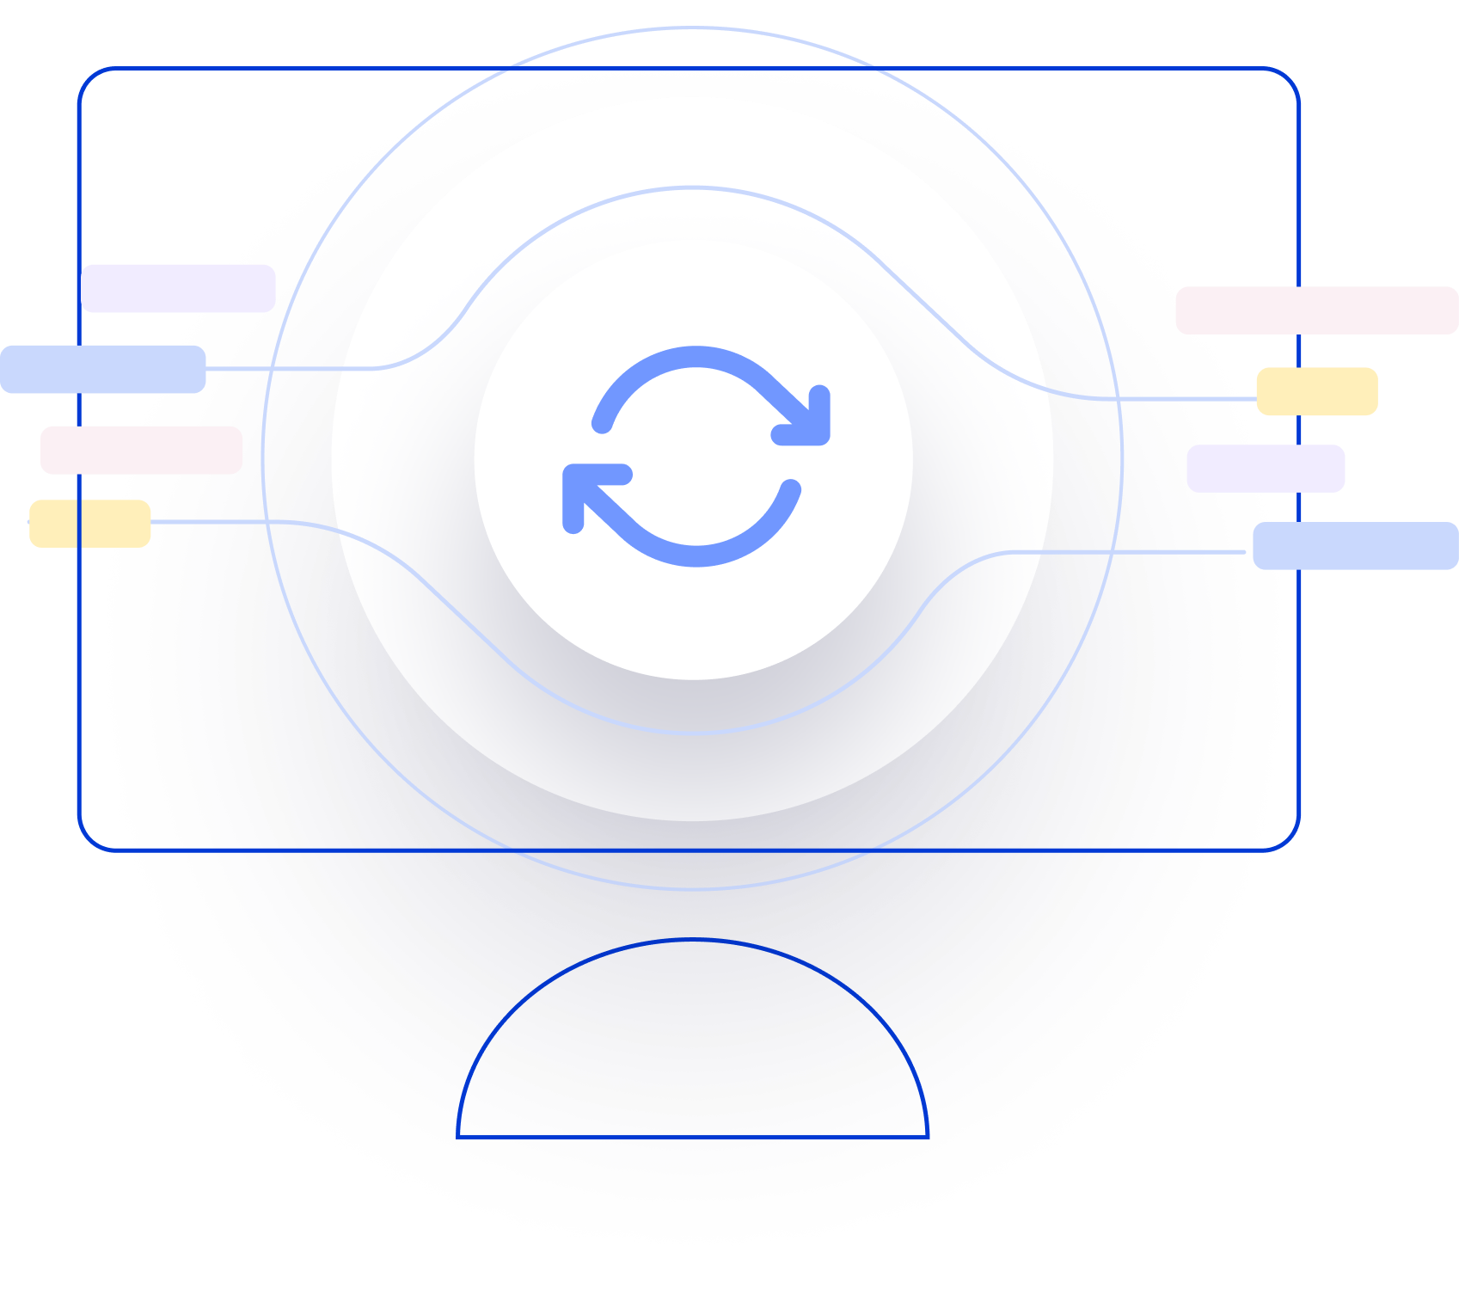
Next Generation AI for Document Automation – Accounts Payables
Weekly Report CW
#placeholder
January 2024

Slide 2


Slide 3
Agenda
RAID (Risks, Actions, Issues & Decisions) Follow-up
Project Status & Timeline Review
Highlight Topics

Slide 4
Risks – Focus on Open / In Response
RAID (Risks, Actions, Issues & Decisions) Follow-up
Status | Open at | Id | Description | Priority | Action Id | Action Description | Action Responsible | Action Status
Open | 2024-09-01 | R001 | Data Acquisition dependent on SAP addon release and installation - could break project timeline | High | A001 | LOH SAP DEV Team onboarding for integration implementation. LOH PM to raise ressource request to the respective team and actively following up. |  | Open
Open | 2024-09-01 | R002 | AFI integration might take more ressources than expected | High | A002 | Discuss Integration Design extensively and support if needed |  | Open
 | 2024-09-01 |  |  | High | A003 | Hypatos x LOH to revisit Integration and Project Timelines based on resource onboarding. Dependent on A001. Bi-Weekly follow ups.
 | 2024-09-01 |  |  | High | A004 | Allow a buffer for SIT
Open | 2024-09-01 | R003 | TBD | High | A005 | TBD |  | Open
Open | 2024-09-01 | R004 | TBD | High | A006 | TBD |  | Open
Open | 2024-09-01 | R005 | Scope of Implementation not clear - expectations are not aligned with HY | High | A007 | Create and Sign SoW |  | Open
Open | 2024-09-01 | R006 | Projekt Closing Date not able to achieve due to vacation of important stakeholders | Medium | A008 | Create Absence Planning and Backups for PMs and Key Stakeholders |  | Open
* Update since last week Live Update

Slide 5
Issues
RAID (Risks, Actions, Issues & Decisions) Follow-up
Status | Opened at | Closed at | Id | Description | Priority | Risk Id | Risk Description | Action Id | Action Description | Action Status
* Update since last week Live Update

Slide 6
Decisions
RAID (Risks, Actions, Issues & Decisions) Follow-up
Id | Decision Detail | Decision Impact | Decision Date | Proposed by | Approved by | Alternatives Considered
D001​
D002​
D003​
D004​
* Update since last week Live Update

Slide 7
Agenda
RAID (Risks, Actions, Issues & Decisions) Follow-up
Project Status & Timeline Review
Highlight Topics

Slide 8


Weekly Report –
Projects Status & Timeline Review
#CWPlaceHolder
-
G
Achievements
Next Steps
…
…

Slide 9
Indicative Timeline to evaluate Hypatos AccountingGPT potential with target Go Live in Q4 2024
Aug
Sep
Oct
Nov
Dec
Jan
Activity
35
36
37
38
39
40
41
42
43
44
45
46
47
48
49
50
51
52
01
02
03
Responsible
Initiate & Plan
User Training
User Training Completed
CUS, HY
Project Management
CUS, HY
Assess & Design
Assessment (Requirement + Data Gathering)
Training Data Confirm.
CUS, HY
Design (Technical+Functional)
SoW & Solution Design Sign-off
CUS, HY
Implement & Test
Machine Learning ( Model training + Optimization)
HY
Application Implement (Studio Config.)
HY
Integration Implementation
CUS, HY
Testing (FT & SIT & UAT)
CUS, HY
Deploy & Roll-out
Delivery (GoLive & Hypercare)
UAT approved & Go Live decision
CUS, HY
Wave 1,2,n (CompCode xx-xx)
Hypercare Closing & Handover Cus. Care
CUS, HY
Kickof WS
Ass. WS
Tech.WS
26.9.24
Solution D.WS
Workshop
SOW = Statement of Work FT= Functional Testing
SIT= System Integration Testing
UAT= User Acceptance Testing
SteerCo Meeting
Project Milestone
Timeline subject to change – Assuming that Machine Learning Trainingdata is available on time.
Go Live

Slide 10
Agenda
RAID (Risks, Actions, Issues & Decisions) Follow-up
Project Status & Timeline Review
Highlight Topics

Slide 11

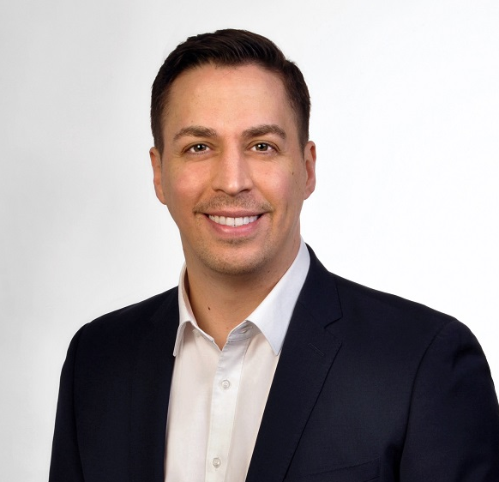
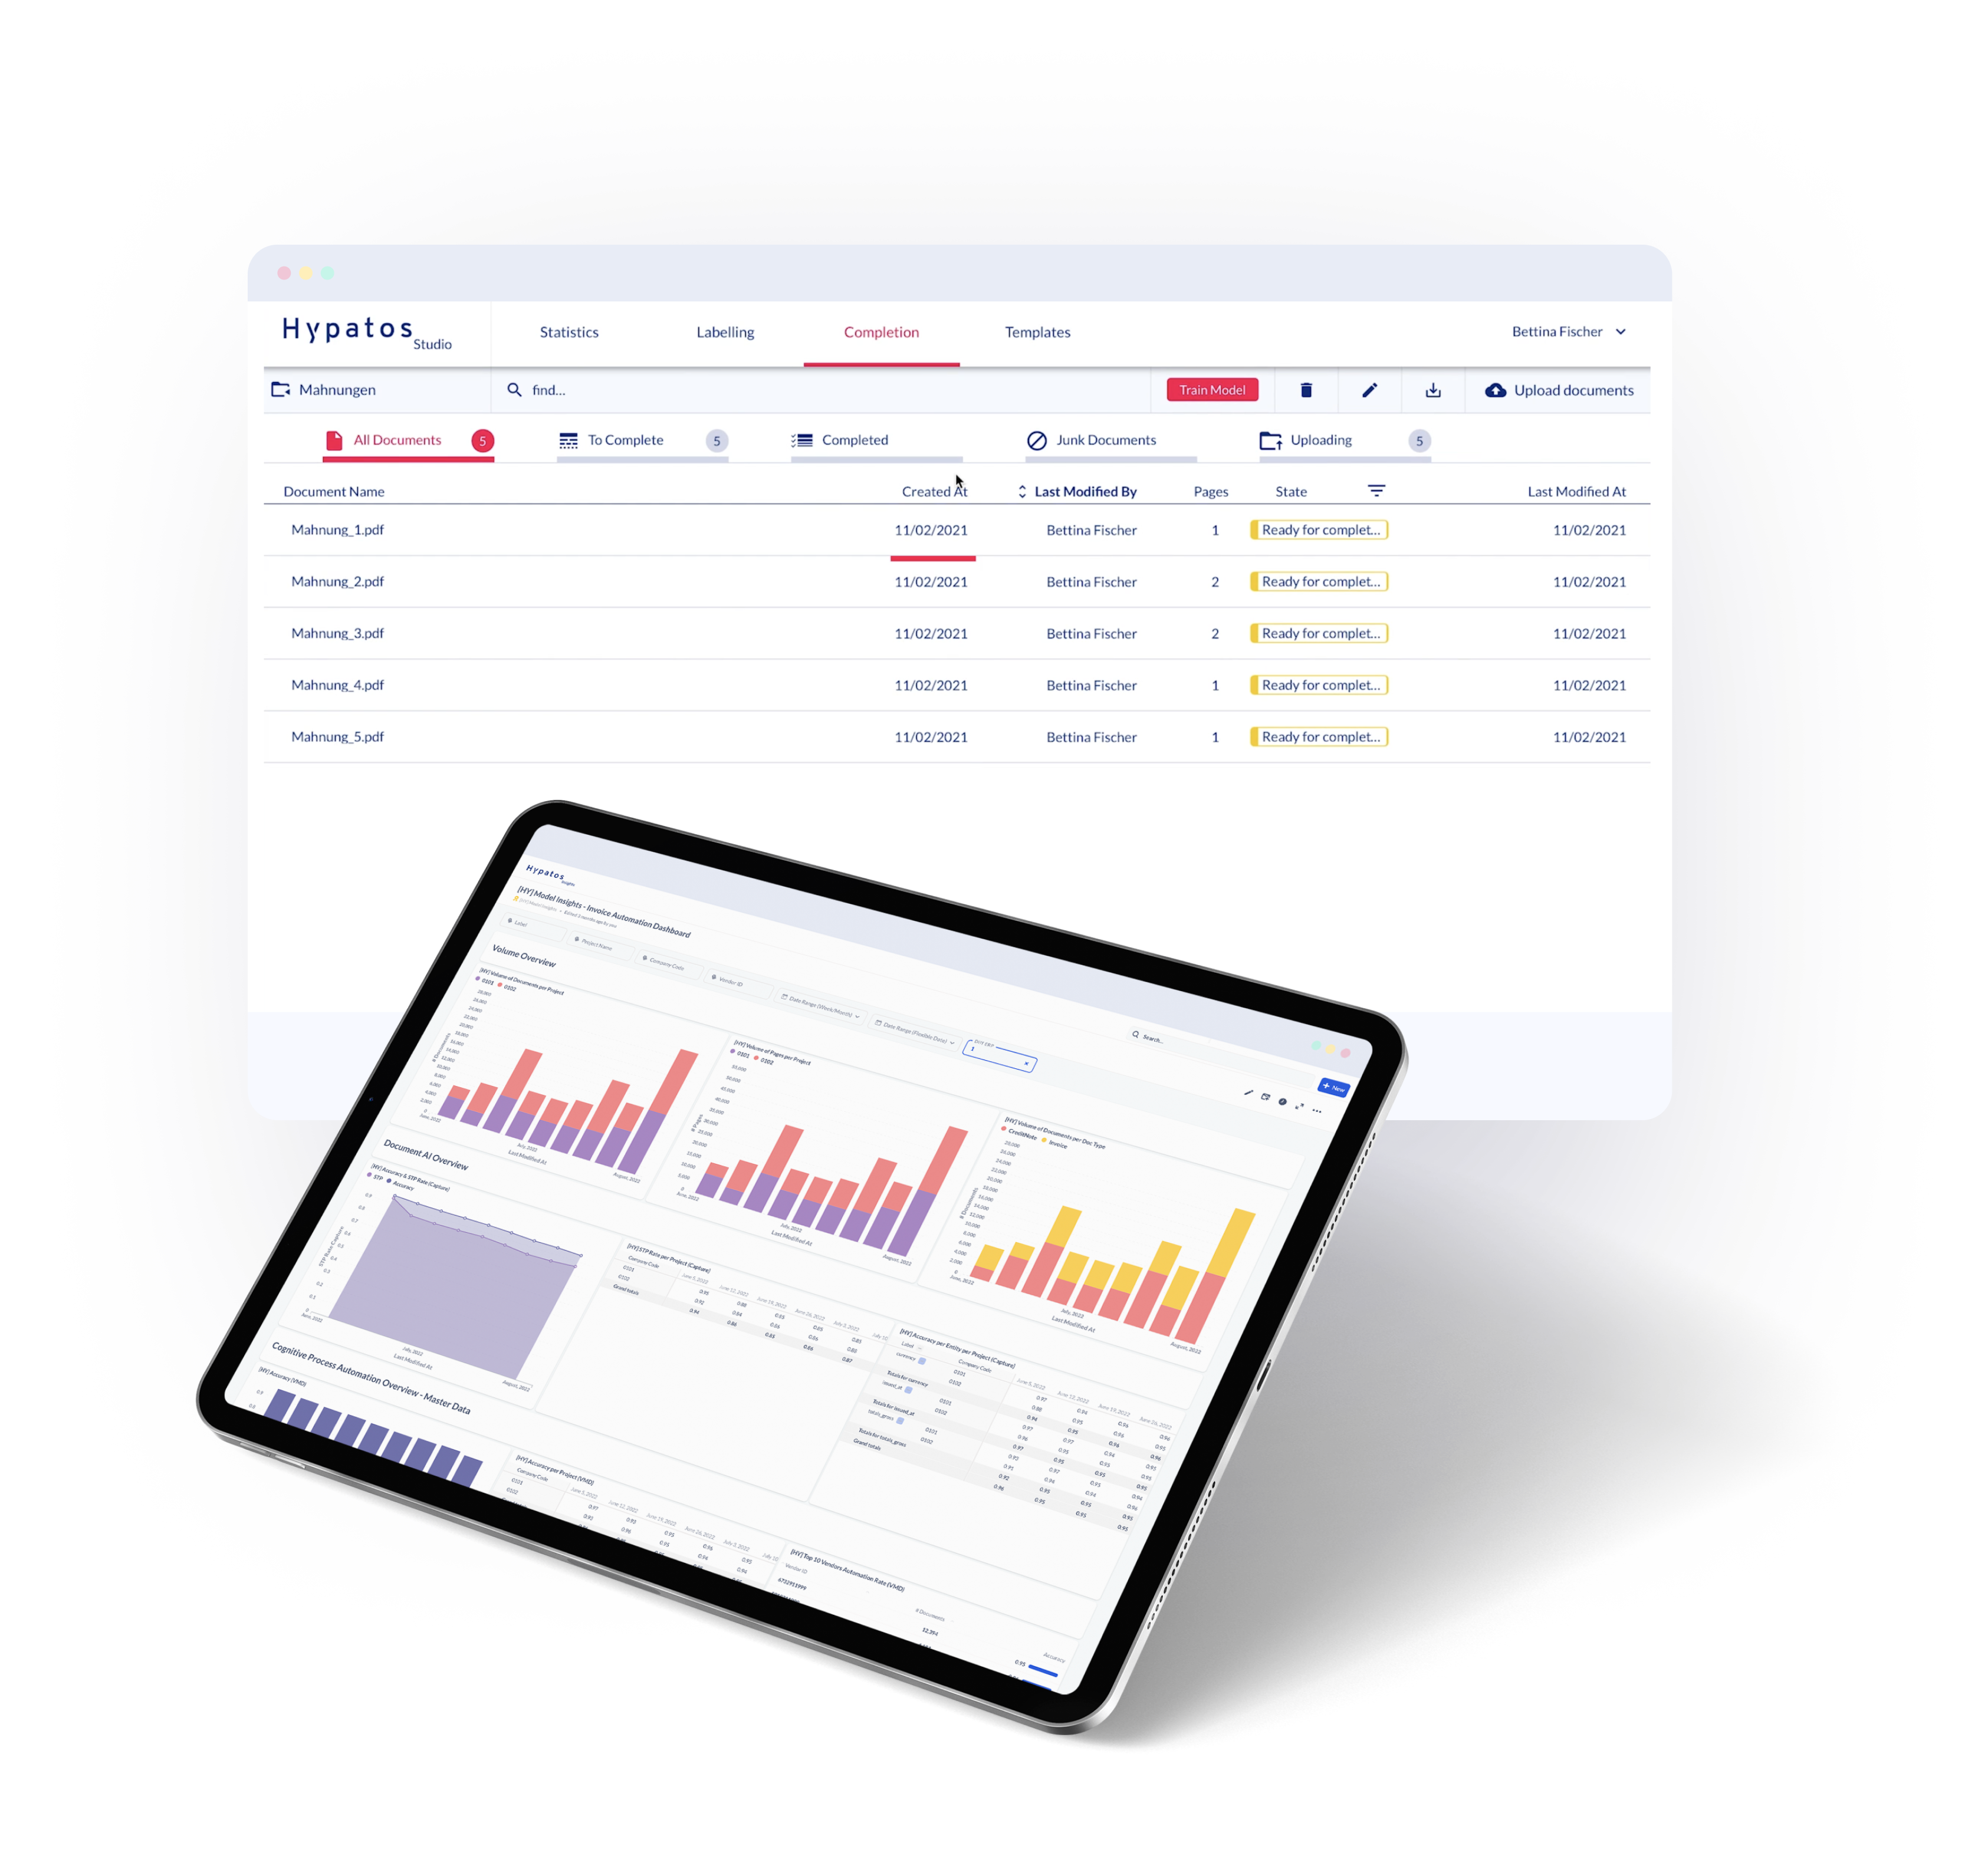
Thank you
Stephan Kuche
Sr. Implementation Manager
stephan.kuche@hypatos.ai
+49 (0) 179 340 36 49
hypatos.ai
Andreas Mösinger
Project Manager
andreas.moesinger@de.ey.com
+49 (0) 160 939 21104

