Slide 1

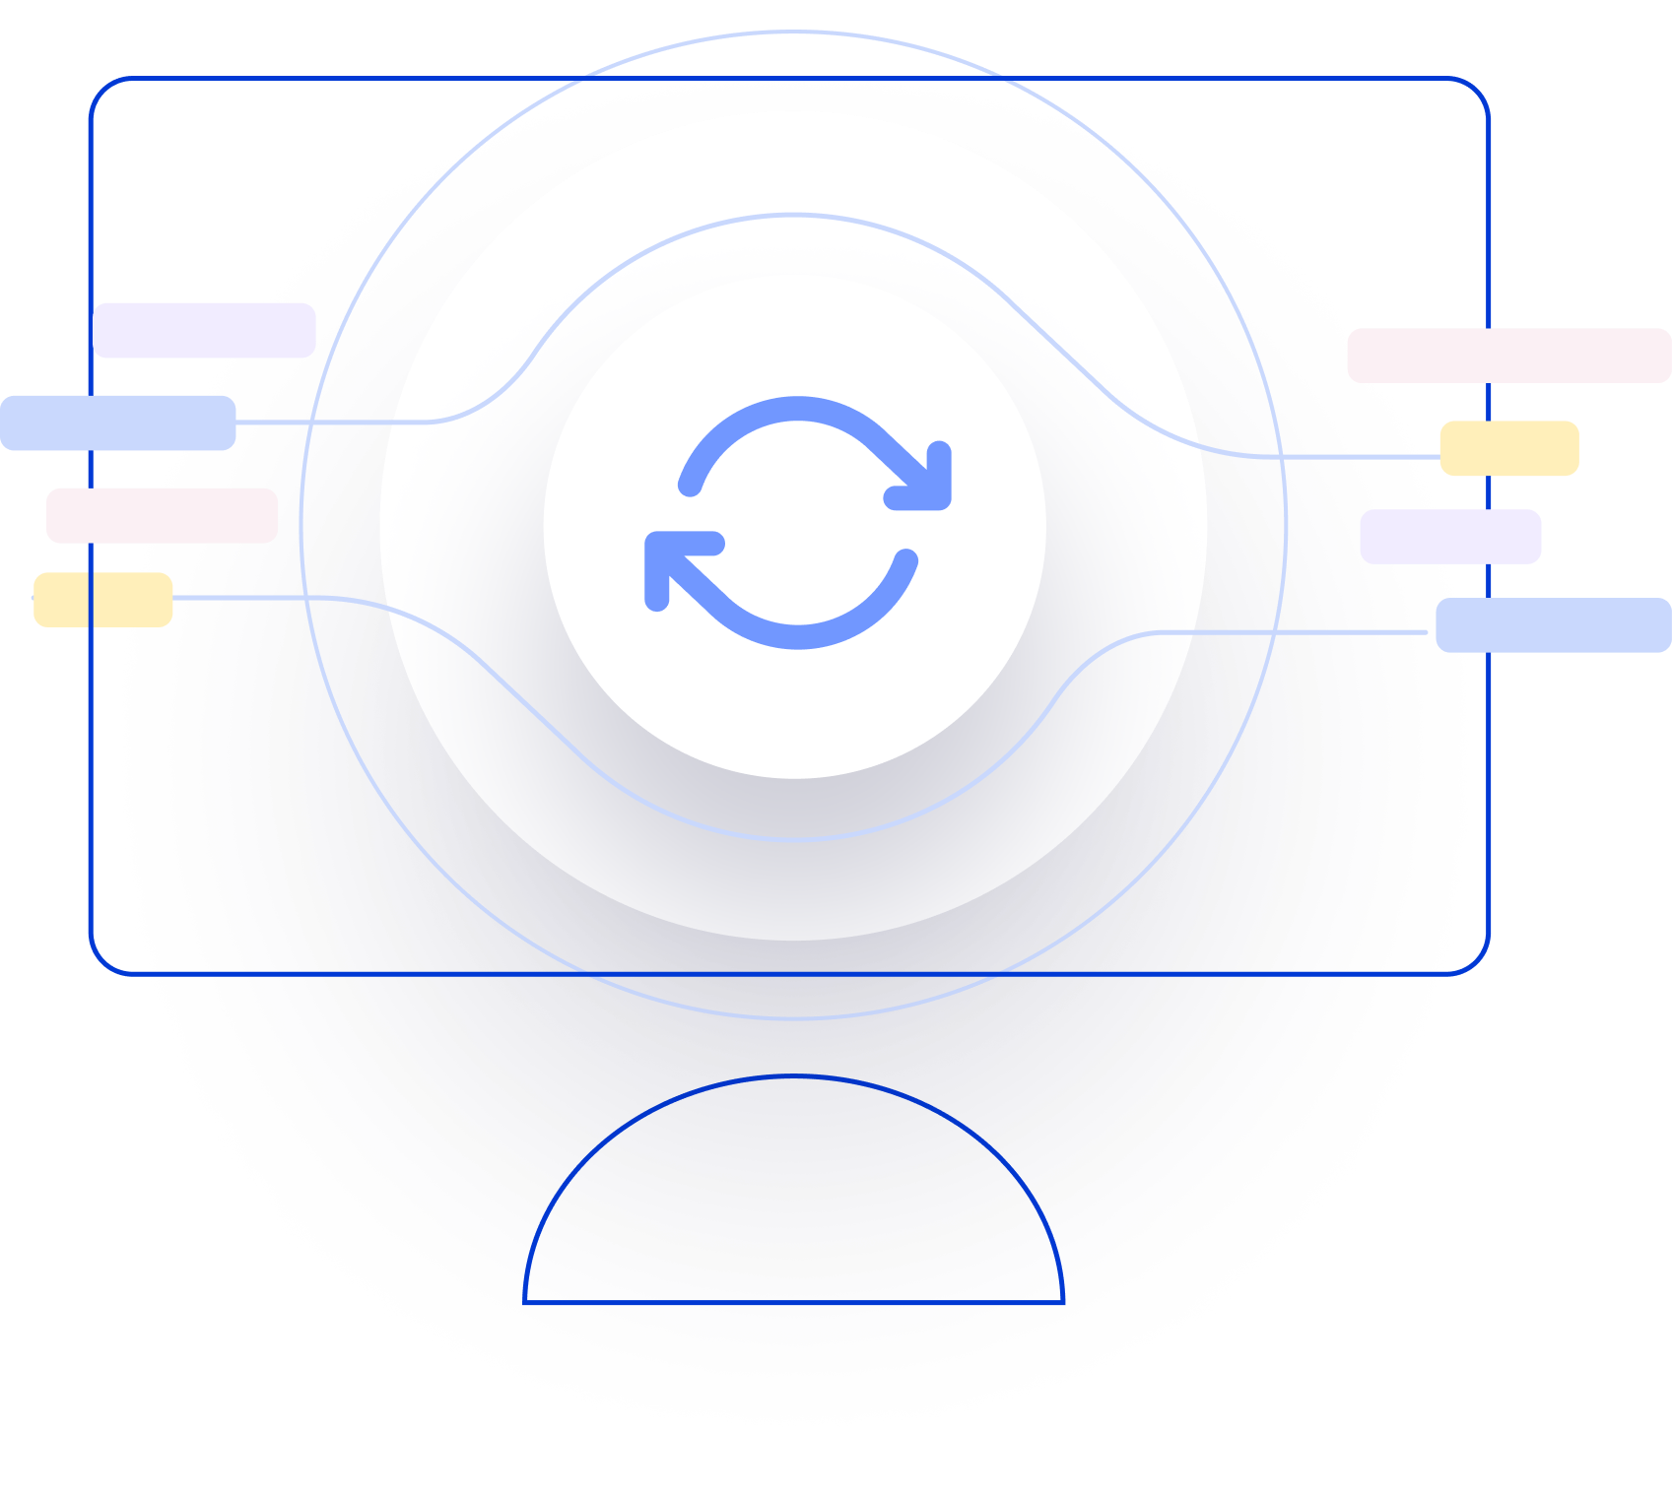
Next Generation AI for Document Automation – Accounts Payables
Pilot - Kick-off
December 2023

Slide 2

Objective of meeting

Slide 3
Slide after the slide – should be at the end

Slide 4
Slide after the slide – should be at the end

Slide 5
Agenda
RAID (Risks, Actions, Issues & Decisions) Follow-up
Project Status & Timeline Review
Highlight Topics

Slide 6
Actions neither related with Risks nor with JIRA Stories
RAID (Risks, Actions, Issues & Decisions) Follow-up
Id | Description | Status | Responsible | Open Date | Est. Close Date | Closed at | Comments
A113 | KP Schedule a call with the Product Owner and rest of the project team regarding how testing will be performed | In Progress | Edward,Alexus | October 13, 2023 | January 5, 2024 |  | Edward to schedule a call with the UAT testing team Alexus /Karen ensure UAT test scripts are finalized and uploaded in Jira beforehand. Edward will schedule the meeting first week of Jan.
A130 | Hy provide feedback regarding Posting data received | In Progress | Steven, Pani | November 29, 2023 | January 5, 2024 |  | KP to repeat posting data test as part of E2E testing. Latest update: Posting data is now visible on Insights. KP is now able to receive ‘ID’ as a response from Hypatos.
A131 | HY set up a new Project in Studio for Performance test | In Progress | Jorge | November 29, 2023 | January 5, 2024 |  | Project Set up by Jorge, 4697 docs were completed by Studio. Awaiting performance testing results that will be executed in Jan 2024.
A132 | HY Review UAT testers list provided by Rich and granted them access to Hy Academy | In Progress | Leticia | December 13, 2023 | January 5, 2023 |  | Enable the UAT testing team on the X-ray (linked to A113) – Karen Calhoun has already access so double-check the user list. Access was granted to UAT users
A133 | Adjust the Studio schemas to boost auto-completion rate and sort out special GL string cases | In Progress | Jorge,Leticia | December 13, 2023 | January 8, 2024 |  | Replace “blank”,”X”,”_” by “0” in the GL Account code. Double check UOM validation rules.
A134 | Update the duplicate detection logic in the KP Composite API and switch to UAT environment (for Coupa & OL) | Closed | Ramesh, Jorge, Fotis | December 13, 2023 | January 8, 2024 | December 20, 2023 | Invoice date was removed from the external validation. Fotis confirmed - endpoint was successfully switched to UAT environment.
A135 | Confirm with the Team – go live date 14th Feb | Open | Leticia, Jorge | December 20, 2023 | January 3, 2024 |  | Make sure that everyone is on the same page
* Update since last week Live Update

Slide 7
Risks – Focus on Open / In Response
RAID (Risks, Actions, Issues & Decisions) Follow-up
Status | Open at | Id | Description | Priority | Action Id | Action Description | Action Responsible | Action Status
* Update since last week Live Update

Slide 8
Issues
RAID (Risks, Actions, Issues & Decisions) Follow-up
Status | Opened at | Closed at | Id | Description | Priority | Risk Id | Risk Description | Action Id | Action Description | Action Status
* Update since last week Live Update

Slide 9
Decisions
RAID (Risks, Actions, Issues & Decisions) Follow-up
Id | Decision Detail | Decision Impact | Decision Date | Proposed by | Approved by | Alternatives Considered
D001​
D002​
D003​
D004​
D005​
D006​
D007
D008
D009
* Update since last week Live Update

Slide 10
Agenda
RAID (Risks, Actions, Issues & Decisions) Follow-up
Project Status & Timeline Review
Highlight Topics

Slide 11


Weekly Report –
Projects Status & Timeline Review
-
G
Achievements
Next Steps
…
…

Slide 12
Indicative Timeline to evaluate Hypatos AccountingGPT potential with target Go Live in April 2024
Scope, Deliverables and Timeline
Dec
Jan
Feb
Mar
Apr
May
Jun
Jul
Activities
CW
50
51
52
01
02
03
04
05
06
07
08
09
10
11
12
13
14
15
16
17
18
19
20
21
22
23
24
25
26
27
28
29
30
Responsible
PMO
Project Management
KTM & HY
SOW Sign Off
User Onboarding & Training
Kickoff 20.12.
KTM & HY
Design
User Onboarding
Leverage User Experience
Go-live Q&A
Providing of training data (images + posting data)
Training data confirmed
KTM
Assessment & Design of New AP Process
Tech Solution confirmed
KTM & HY
Configure AI
ML model training and optimization
HY
Implementation & Validation
Model V1
Model V2
Studio and Insights Configuration
Studio V1
Studio V2
HY
System Integration implementation
KTM & HY
Testing Phase (SIT & UAT)
SIT
SIT Approved
UAT
Go/NoGo
KTM & HY
Pilot Phase in Productive System
Roll-out Go/NoGo
KTM
Deploy & Roll-out
Go-live & Continuous Improvement
KMT & HY
Hypercare
Customer Care Support
Wave 1 (BUKRS xx – xx)
KTM & HY
Wave 2 (BUKRS xx – xx)
KTM & HY
Meeting
Milestone
Assessment Workshop
Functional Workshop
Technical Workshop
Go-live Data decision
Continuation decision
Project Deliverable
Implementation Phase (2-3 months)
SOW = Statement of Work SIT= System Integration Testing
UAT= User Acceptance Testing
Timeline subject to change – pending on Assessment, Functional & Technical Workshops outcomes

Slide 13
Agenda
RAID (Risks, Actions, Issues & Decisions) Follow-up
Project Status & Timeline Review
Highlight Topics

Slide 14
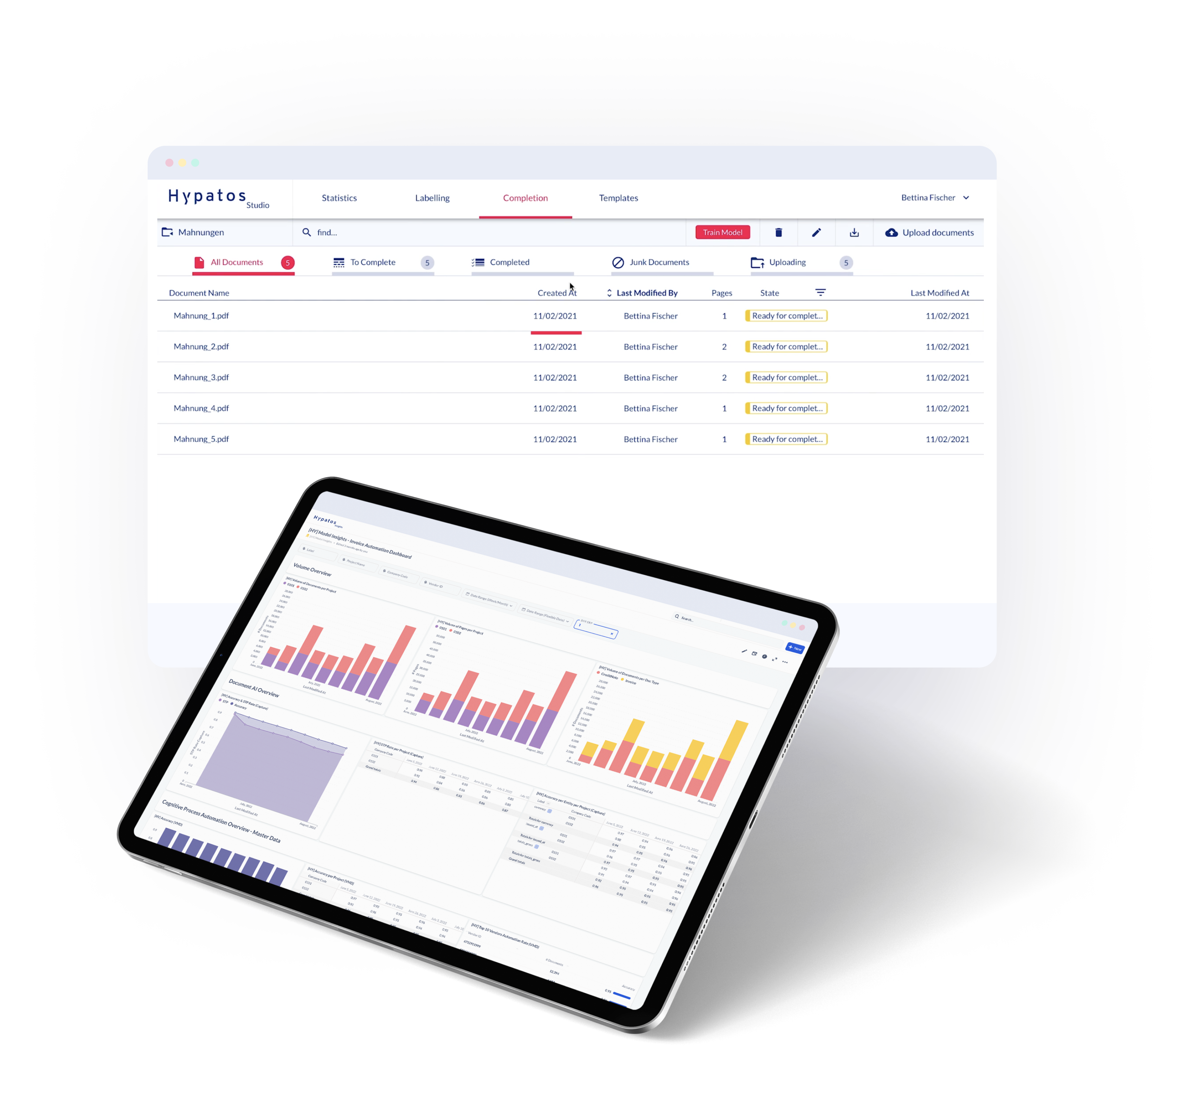
Thank you
Dr. Ulrich Erxleben
Chief Executive Officer
uli.erxleben@hypatos.ai +49 157 736 362 22 hypatos.ai
Stephan Kuche
Sr. Implementation Manager
stephan.kuche@hypatos.ai
+49 179 340 36 49
hypatos.ai
Lucia Ferreiro Martinez
Sr. Customer Success Manager
lucia.ferreiro.martinez@hypatos.ai
+49 176 73573508
hypatos.ai

