Slide 1


Next Generation AI for Document Automation – Accounts Payables
Weekly Report CW
#placeholder
January 2024

Slide 2


Slide 3
Agenda
RAID (Risks, Actions, Issues & Decisions) Follow-up
Project Status & Timeline Review
Highlight Topics

Slide 4
Risks – Focus on Open / In Response
RAID (Risks, Actions, Issues & Decisions) Follow-up
Status | Open at | Id | Description | Priority | Action Id | Action Description | Action Responsible | Action Status
Open | 2024-01-10 | R001 | Data Acquisition dependent on SAP addon release and installation - could break project timeline | High | A001 | FIE SAP DEV Team onboarding for integration implementation. FIE PM to raise ressource request to the respective team and actively following up. |  | Open
Open | 2024-01-10 | R002 | xSuite integration might take more ressources than expected | High | A002 | Discuss Solution Design extensively and support if needed |  | Open
 |  |  |  | High | A003 | Hypatos x FIE to revisit Integration and Project Timelines based on resource onboarding. Dependent on A001. Weekly follow ups. |  | Open
 |  |  |  | High | A004 | Allow a buffer for SIT |  | Open
Open | 2024-01-10 | R003 | PO Matching config and ML Training takes more ressources than expected | High | A005 | Schedule a session with HY SAP and Product Team to |  | Open
Open | 2024-01-10 | R004 | Poor PO Matching Enrichment Quality | Medium | A006 | Ensure that annoation of Line item is done right by providing annotation guideline |  | Open
Open | 2024-01-10 | R005 | Scope of Implementation not clear - customer expectations are not aligned with HY | High | A007 | Create and Sign SoW |  | Open
Open | 2024-01-10 | R006 | Project Closing Date not able to achieve due to vacation of important stakeholders | Medium | A008 | Create Absence Planning and Backups for PMs and Key Stakeholders |  | Open
* Update since last week Live Update

Slide 5
Issues
RAID (Risks, Actions, Issues & Decisions) Follow-up
Status | Opened at | Closed at | Id | Description | Priority | Risk Id | Risk Description | Action Id | Action Description | Action Status
* Update since last week Live Update

Slide 6
Decisions
RAID (Risks, Actions, Issues & Decisions) Follow-up
Id | Decision Detail | Decision Impact | Decision Date | Proposed by | Approved by | Alternatives Considered
D001​
D002​
D003​
D004​
* Update since last week Live Update

Slide 7
Agenda
RAID (Risks, Actions, Issues & Decisions) Follow-up
Project Status & Timeline Review
Highlight Topics

Slide 8


Weekly Report –
Projects Status & Timeline Review
#CWPlaceHolder
-
G
Achievements
Next Steps
…
…

Slide 9
Indicative Timeline to evaluate Hypatos AccountingGPT potential with target Go Live in February 2025
Oct
Nov
Dec
Jan
Feb
Mar
Activity
40
41
42
43
44
45
46
47
48
49
50
51
52
01
02
03
04
05
06
07
08
09
10
11
12
13
Responsible
Initiate & Plan
User Training
User Training Completed
CUS, HY
Project Management
CUS, HY
Assess & Design
Assessment (Requirement + Data Gathering)
Training Data Confirm.
CUS, HY
Design (Technical+Functional)
SoW & Solution Design Sign-off
CUS, HY
Implement & Test
Machine Learning ( Model training + Optimization)
HY
Application Implement (Studio Config.)
HY
Integration Implementation
CUS, HY
Testing (FT & SIT & UAT)
UAT approved & Go Live decision
CUS, HY
Deploy & Roll-out
Delivery (GoLive & Hypercare)
Hypercare Closing & Handover Cus. Care
CUS, HY
Wave 1,2,n (CompCode xx-xx)
CUS, HY
Kickof WS
Tech.WS
Ass. WS
Func.WS
Today
Workshop
SOW = Statement of Work FT= Functional Testing
SIT= System Integration Testing
UAT= User Acceptance Testing
SteerCo Meeting
Project Milestone
Timeline subject to change – Assuming that Machine Learning Trainingdata is available on time.
Go Live

Slide 10
Agenda
RAID (Risks, Actions, Issues & Decisions) Follow-up
Project Status & Timeline Review
Highlight Topics

Slide 11
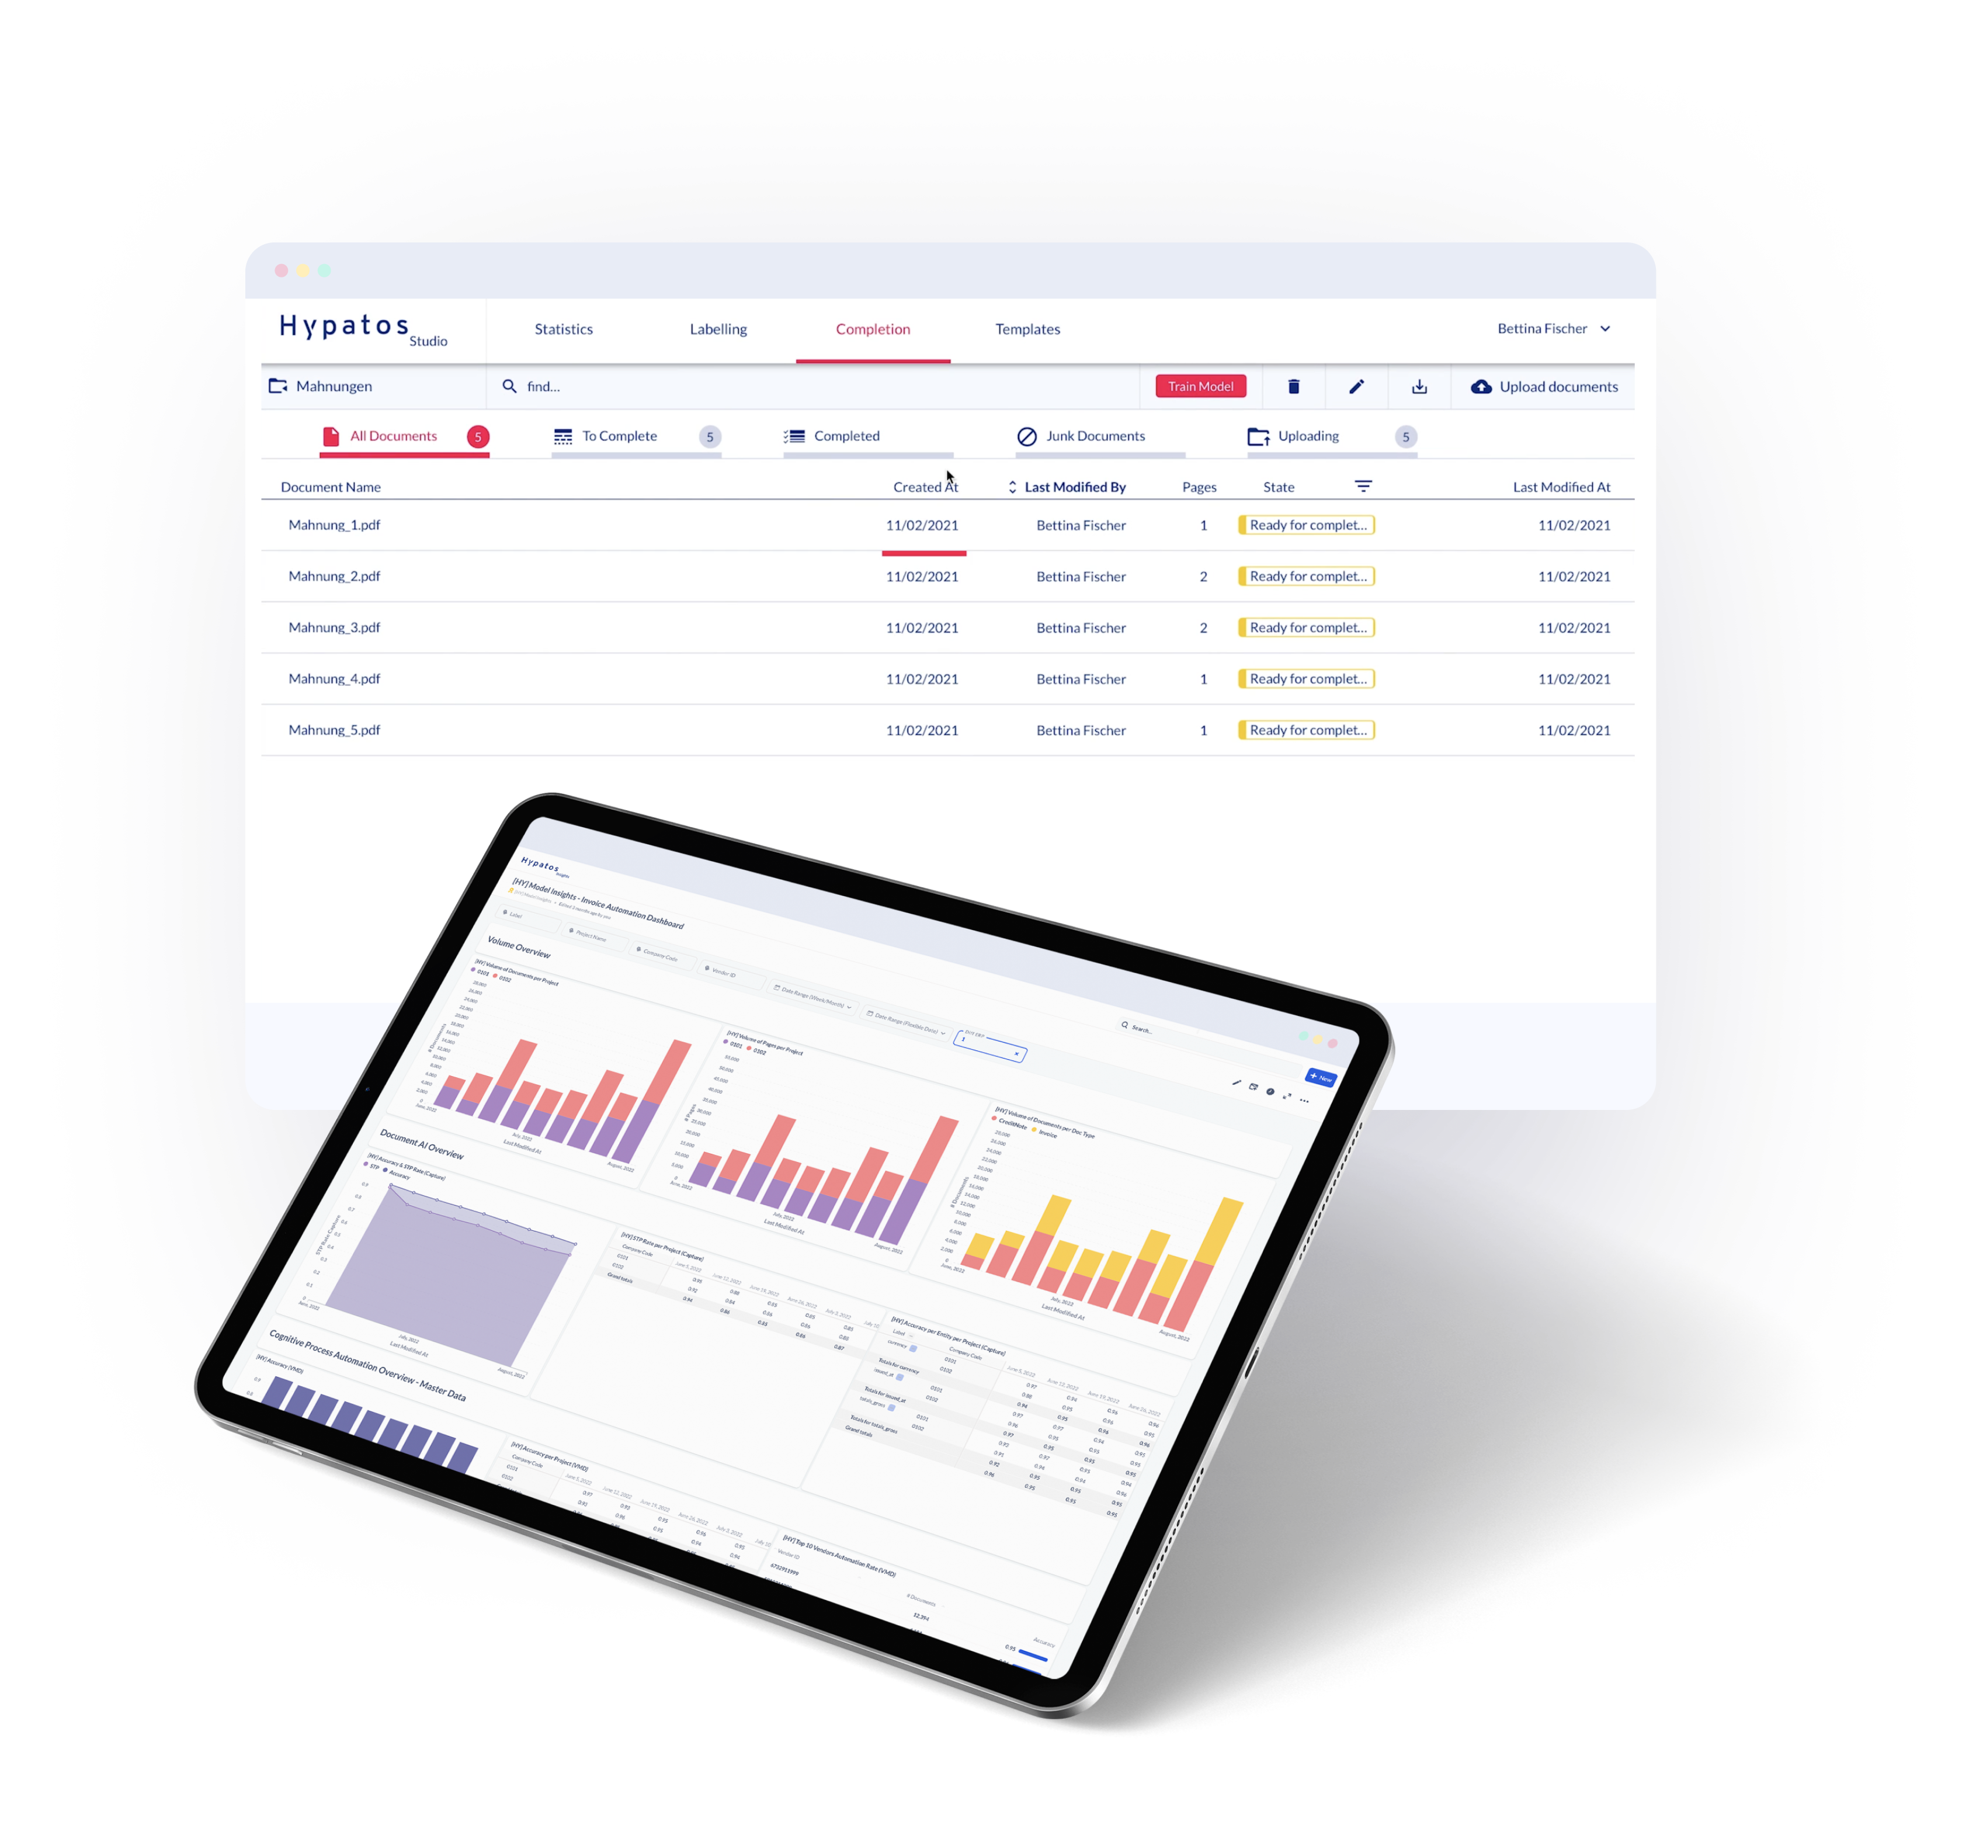
Thank you
Dr. Ulrich Erxleben
Chief Executive Officer
uli.erxleben@hypatos.ai +49 157 736 362 22 hypatos.ai
Melinda Braun
Project Manager
Melinda.braun@hypatos.ai
hypatos.ai
Danail Delchev
Solution Manager
danail.delchev@hypatos.ai
hypatos.ai

