Slide 1


Next Generation AI for Document Automation – Accounts Payables
Weekly Report CW
#placeholder
January 2024

Slide 2


Slide 3
Agenda
RAID (Risks, Actions, Issues & Decisions) Follow-up
Project Status & Timeline Review
Highlight Topics

Slide 4
Risks – Focus on Open / In Response
RAID (Risks, Actions, Issues & Decisions) Follow-up
Status | Open at | Id | Description | Priority | Action Id | Action Description | Action Responsible | Action Status
* Update since last week Live Update

Slide 5
Issues
RAID (Risks, Actions, Issues & Decisions) Follow-up
Status | Opened at | Closed at | Id | Description | Priority | Risk Id | Risk Description | Action Id | Action Description | Action Status
* Update since last week Live Update

Slide 6
Decisions
RAID (Risks, Actions, Issues & Decisions) Follow-up
Id | Decision Detail | Decision Impact | Decision Date | Proposed by | Approved by | Alternatives Considered
D001​
D002​
D003​
D004​
* Update since last week Live Update

Slide 7
Agenda
RAID (Risks, Actions, Issues & Decisions) Follow-up
Project Status & Timeline Review
Highlight Topics

Slide 8


Weekly Report –
Projects Status & Timeline Review
#CWPlaceHolder
-
G
Achievements
Next Steps
…
…

Slide 9
Pilot High Level Project Plan
2024
Resources KWS/PWC
Activities
Jul
Aug
Sep
Oct
Nov
Dec
Responsible
PMO
Project Management
KWS/PWC & Hy
Business & IT
Pilot
Solution, integration design, SAP
connector installation
Pilot solution design approved
KWS/PWC & Hy
PMO + Tax & SME
Prompt design and AI model training
Hy & KWS/PWC
PMO + Tax & SME
Hypatos Studio & Insights configuration
Hy
System integration & technical in test system
Hy
IT
User training and UAT
Go-live decision
KWS/PWC & Hy
Business & IT
Roll-out
Productive pilot test phase
KWS/PWC & Hy
PMO
Expansion
Hypercare
Hy
Pilot
Kick-off
Today
Technical
Workshop
Functional
Workshops
Requirements
Gathering
Roll-out Decision

Slide 10
Agenda
RAID (Risks, Actions, Issues & Decisions) Follow-up
Project Status & Timeline Review
Highlight Topics

Slide 11
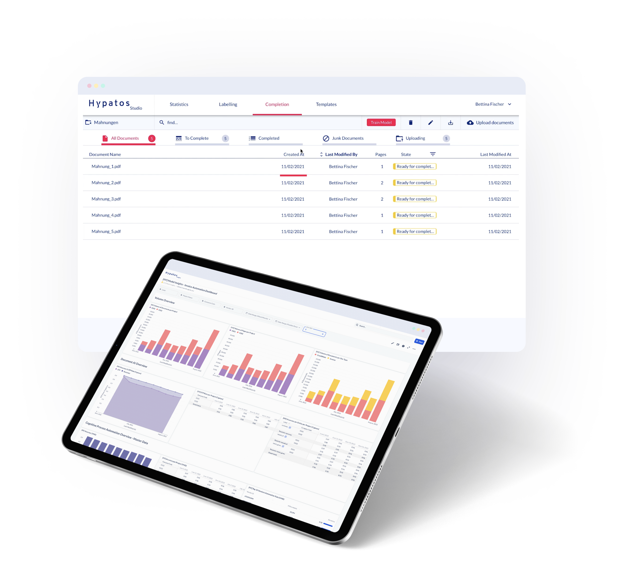
Thank you
Yavuz Güney
Implementation Manager
yavuz.guney@hypatos.ai
+49 155 666 80146
hypatos.ai

