Slide 1

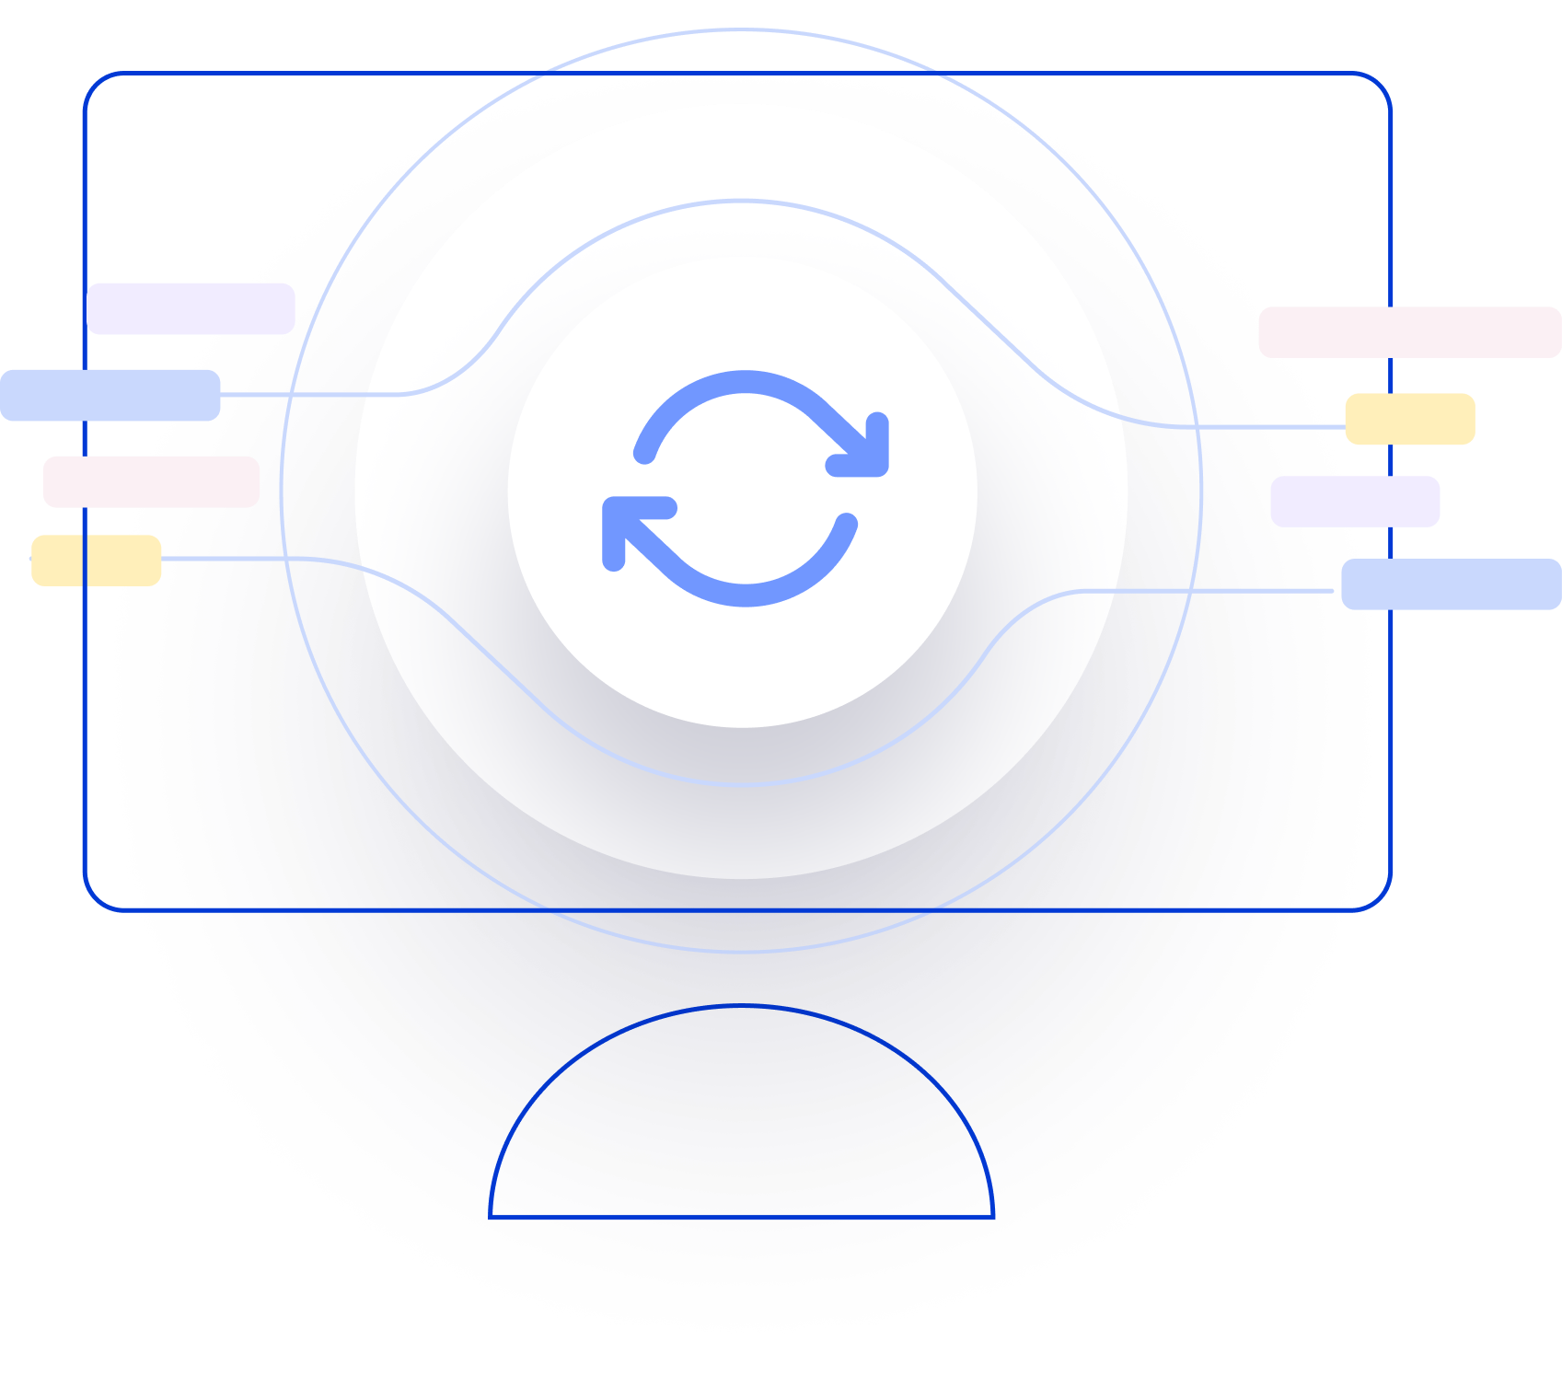
Next Generation AI for Document Automation – Accounts Payables
Weekly Report CW
#placeholder
January 2024

Slide 2


Slide 3
Agenda
RAID (Risks, Actions, Issues & Decisions) Follow-up
Project Status & Timeline Review
Highlight Topics

Slide 4
Risks – Focus on Open / In Response
RAID (Risks, Actions, Issues & Decisions) Follow-up
Status | Open at | Id | Description | Priority | Action Id | Action Description | Action Responsible | Action Status
Open | 2024-01-10 | R001 | Data Acquisition dependent on SAP addon release and installation - could break project timeline | High | A001 | KTM SAP DEV Team onboarding for integration implementation. KTM PM to raise ressource request to the respective team and actively following up. |  | Open
Open | 2024-01-10 | R002 | xSuite integration might take more ressources than expected | High | A002 | Discuss Solution Design extensively and support if needed |  | Open
 |  |  |  | High | A003 | Hypatos x KTM to revisit Integration and Project Timelines based on resource onboarding. Dependent on A001. Bi-Weekly follow ups. |  | Open
 |  |  |  | High | A004 | Allow a buffer for SIT |  | Open
Open | 2024-01-10 | R003 | PO Matching config and ML Training takes more ressources than expected | High | A005 | Schedule a session with HY SAP and Product Team to |  | Open
Open | 2024-01-10 | R004 | Poor PO Matching Enrichment Quality | Medium | A006 | Ensure that annoation of Line item is done right by providing annotation guideline |  | Open
Open | 2024-01-10 | R005 | Scope of Implementation not clear - customer expectations are not aligned with HY | High | A007 | Create and Sign SoW |  | Open
Open | 2024-01-10 | R006 | Projekt Closing Date not able to achieve due to vacation of important stakeholders | Medium | A008 | Create Absence Planning and Backups for PMs and Key Stakeholders |  | Open
* Update since last week Live Update

Slide 5
Issues
RAID (Risks, Actions, Issues & Decisions) Follow-up
Status | Opened at | Closed at | Id | Description | Priority | Risk Id | Risk Description | Action Id | Action Description | Action Status
* Update since last week Live Update

Slide 6
Decisions
RAID (Risks, Actions, Issues & Decisions) Follow-up
Id | Decision Detail | Decision Impact | Decision Date | Proposed by | Approved by | Alternatives Considered
D001​
D002​
D003​
D004​
* Update since last week Live Update

Slide 7
Agenda
RAID (Risks, Actions, Issues & Decisions) Follow-up
Project Status & Timeline Review
Highlight Topics

Slide 8


Weekly Report –
Projects Status & Timeline Review
#CWPlaceHolder
-
G
Achievements
Next Steps
…
…

Slide 9
Indicative Timeline to evaluate Hypatos AccountingGPT potential with target Go Live in April 2024
Scope, Deliverables and Timeline
Dec
Jan
Feb
Mar
Apr
May
Jun
Jul
Activities
CW
50
51
52
01
02
03
04
05
06
07
08
09
10
11
12
13
14
15
16
17
18
19
20
21
22
23
24
25
26
27
28
29
30
Responsible
PMO
Project Management
KTM & HY
SOW Sign Off
User Onboarding & Training
Kickoff 20.12.
KTM & HY
Design
User Onboarding
Leverage User Experience
Go-live Q&A
Providing of training data (images + posting data)
Training data confirmed
KTM
Assessment & Design of New AP Process
Tech Solution confirmed
KTM & HY
Configure AI
ML model training and optimization
HY
Implementation & Validation
Model V1
Model V2
Studio and Insights Configuration
Studio V1
Studio V2
HY
System Integration implementation
KTM & HY
Testing Phase (SIT & UAT)
SIT
SIT Approved
UAT
Go/NoGo
KTM & HY
Pilot Phase in Productive System
Roll-out Go/NoGo
KTM
Deploy & Roll-out
Go-live & Continuous Improvement
KMT & HY
Hypercare
Customer Care Support
Wave 1 (BUKRS xx – xx)
KTM & HY
Wave 2 (BUKRS xx – xx)
KTM & HY
Meeting
Milestone
Assessment Workshop
Functional Workshop
Technical Workshop
Today 30.01.
Go-live Data decision
Continuation decision
Project Deliverable
Implementation Phase (2-3 months)
SOW = Statement of Work SIT= System Integration Testing
UAT= User Acceptance Testing
Timeline subject to change – pending on Assessment, Functional & Technical Workshops outcomes

Slide 10
Agenda
RAID (Risks, Actions, Issues & Decisions) Follow-up
Project Status & Timeline Review
Highlight Topics

Slide 11
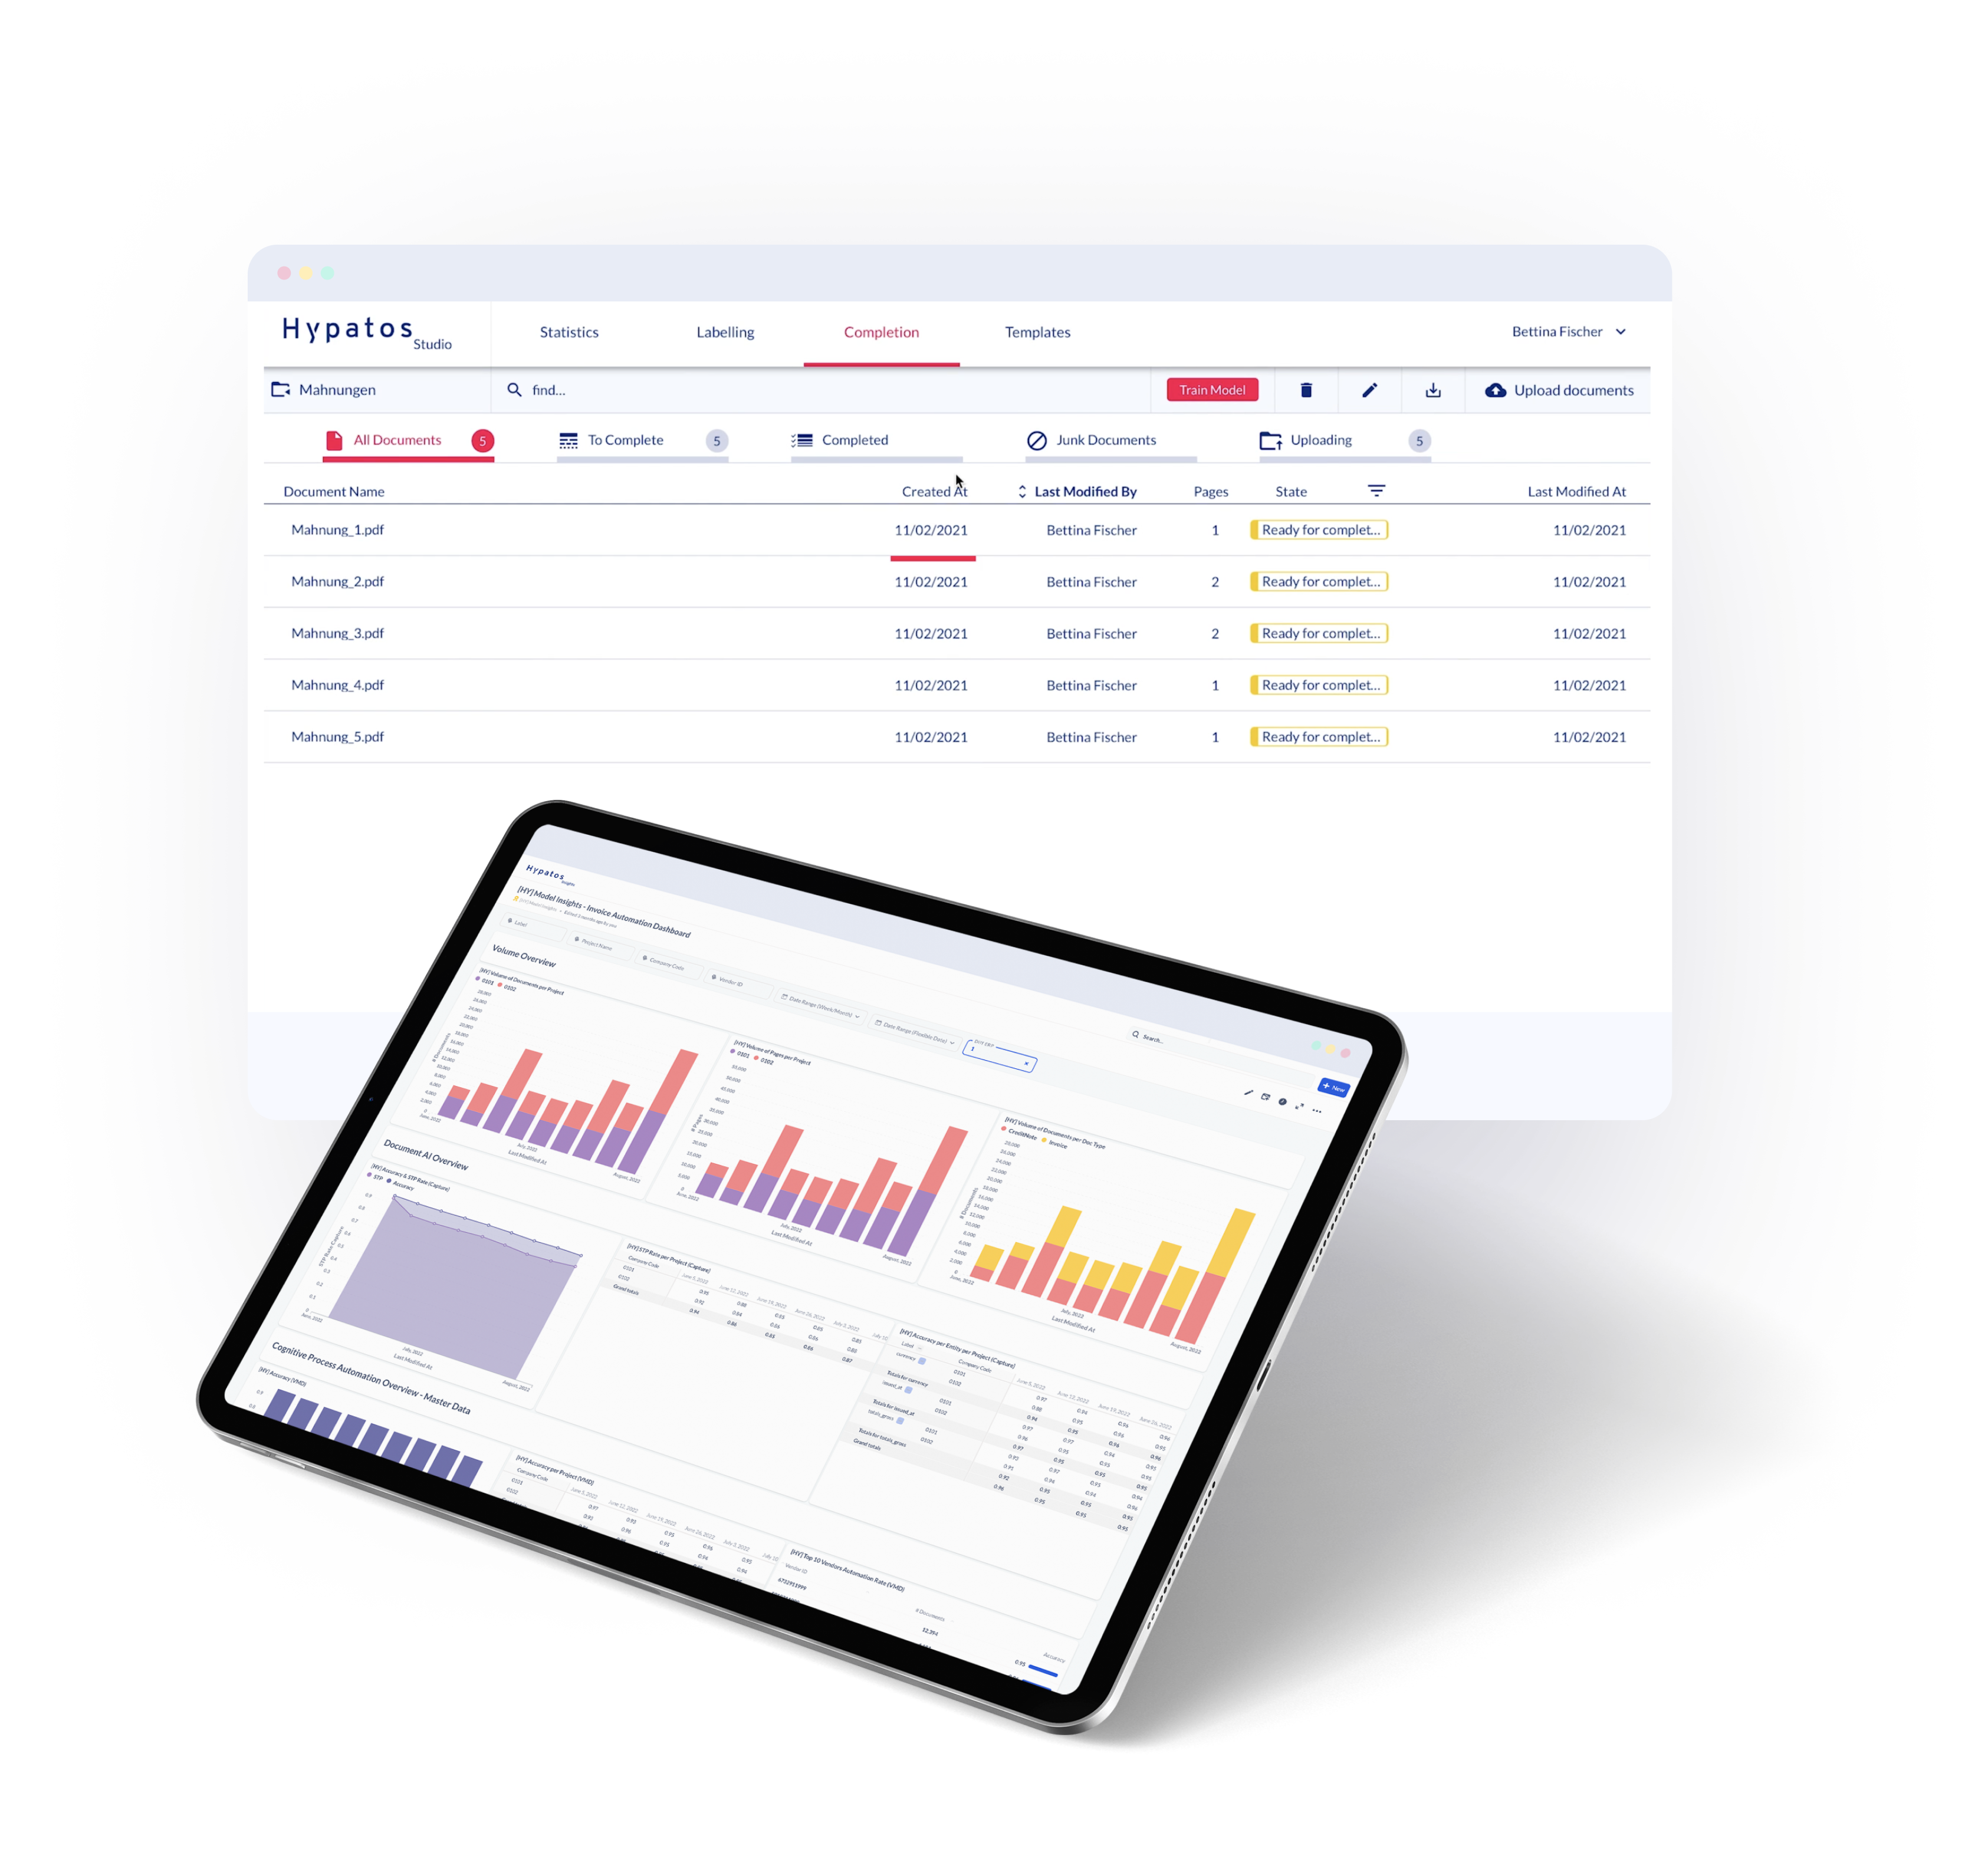
Thank you
Dr. Ulrich Erxleben
Chief Executive Officer
uli.erxleben@hypatos.ai +49 157 736 362 22 hypatos.ai
Stephan Kuche
Sr. Implementation Manager
stephan.kuche@hypatos.ai
+49 179 340 36 49
hypatos.ai
Lucia Ferreiro Martinez
Sr. Customer Success Manager
lucia.ferreiro.martinez@hypatos.ai
+49 176 73573508
hypatos.ai

