Slide 1

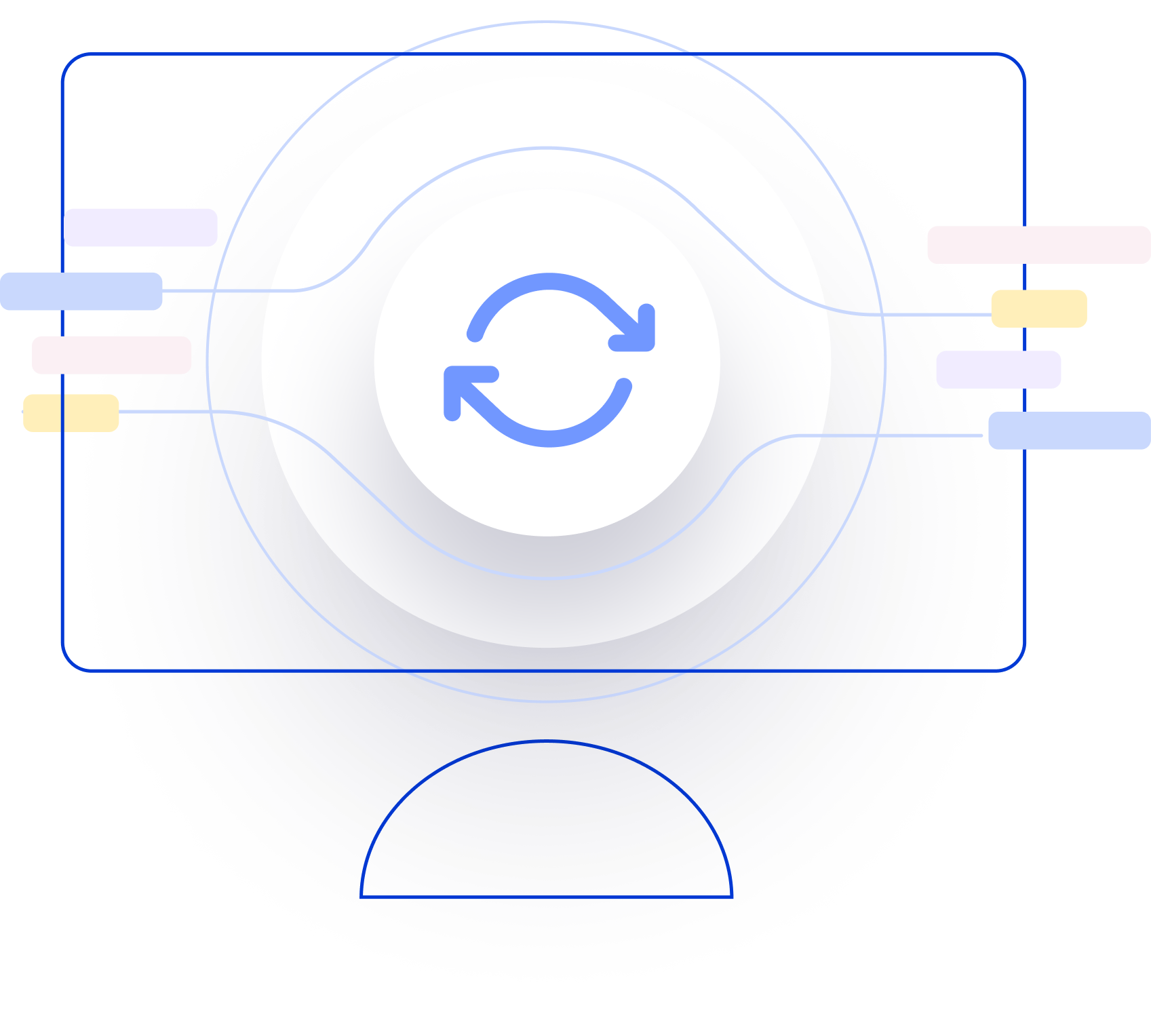
Next Generation AI for Document Automation – Accounts Payables
Weekly Report CW
#placeholder
January 2024

Slide 2


Slide 3
Agenda
RAID (Risks, Actions, Issues & Decisions) Follow-up
Project Status & Timeline Review
Highlight Topics

Slide 4
Risks – Focus on Open / In Response
RAID (Risks, Actions, Issues & Decisions) Follow-up
Status | Open at | Id | Description | Priority | Action Id | Action Description | Action Responsible | Action Status
Open | 2024-08-28 | R002 | Initial historical documents and data transfer is taking more time than expected | High | A001 | Escalate on KWS technical teams to resolve the issues Help team to enable integration | KWS/HY | Closed
Open | 2024-08-28 | R002 | xSuite integration might take more time than expected | High | A002 | Discuss Solution Design extensively and support if needed |  | Open
 |  |  |  | High | A003 | Hypatos x KWS to revisit Integration and Project Timelines based on resource onboarding. |  | Open
 |  |  |  | High | A004 | Allow a buffer for SIT |  | Open
Open | 2024-08-28 | R003 | PO Matching config and ML Training takes more resources than expected | High | A005 | Schedule a session with HY SAP and Product Team to expedite the process |  | Open
Open | 2024-08-28 | R004 | Poor PO Matching Enrichment Quality | Medium | A006 | Ensure that annotation of Line item is done right by providing annotation guideline |  | Open
Open | 2024-08-28 | R005 | Scope of Implementation not clear - customer expectations are not aligned with HY | High | A007 | Create and Sign SoW |  | Open
Open | 2024-08-28 | R006 | Project Closing Date not able to achieve due to vacation of important stakeholders | Medium | A008 | Create Absence Planning and Backups for PMs and Key Stakeholders |  | Open
* Update since last week Live Update

Slide 5
Issues
RAID (Risks, Actions, Issues & Decisions) Follow-up
Status | Opened at | Closed at | Id | Description | Priority | Risk Id | Risk Description | Action Id | Action Description | Action Status
* Update since last week Live Update

Slide 6
Decisions
RAID (Risks, Actions, Issues & Decisions) Follow-up
Id | Decision Detail | Decision Impact | Decision Date | Proposed by | Approved by | Alternatives Considered
D001​
D002​
D003​
D004​
* Update since last week Live Update

Slide 7
Agenda
RAID (Risks, Actions, Issues & Decisions) Follow-up
Project Status & Timeline Review
Highlight Topics

Slide 8


Weekly Report –
Projects Status & Timeline Review
#CWPlaceHolder
-
G
Achievements
Next Steps
…
…

Slide 9





xSuite – Hypatos Solution Design
Hypatos SAP Connector periodically collects master, PO and posting data (including archive images for initial model training) required for master data enrichment and attribute prediction in Hypatos Studio
Retrieved data is sent to Hypatos cloud via Hypatos REST API
Emailed and scanned invoices are inserted into Hypatos Studio for processing
Hypatos Studio extracts, enriches and completes the documents
Hypatos SAP Connector regularly triggers Hypatos REST API to fetch document data and invoice image from Hypatos Studio
Hypatos SAP Connector calls SAP BADI implementation passing in and mapping document data
BADI implementation calls xSuite function module for creation and archiving of invoice
KWS Matrix ticketing system calls HY API to get dunning letter/other documents information and images
1
Archive
Master Data
Posting Data
PO Data
Attributes
7
Invoices
xSuite: Create document
Emailed invoices
Paper based invoices (scanned)
2
6
Hypatos SAP Connector³
1
3
BADI implementation
Email Inbox
Matrix
2
5
Document data and archive document
4
5
Hypatos REST API²
6
3
Email Service¹
4
Extract
Enrich
7
8
Complete
Validate
8
¹ https://studio-docs.hypatos.ai/user-guide/document-upload/email-service
² https://hypatos.redoc.ly/#section/Introduction
³ https://studio-docs.hypatos.ai/integrations/sap-integration
Hypatos cloud
Customer premise

Slide 10
Pilot High Level Project Plan
2024
Resources KWS/PWC
Activities
Jul
Aug
Sep
Oct
Nov
Dec
Responsible
PMO
Project Management
KWS/PWC & Hy
Business & IT
Pilot
Solution, integration design, SAP
connector installation
Pilot solution design approved
KWS/PWC & Hy
PMO + Tax & SME
Prompt design and AI model training
Hy & KWS/PWC
PMO + Tax & SME
Hypatos Studio & Insights configuration
Hy
System integration & technical in test system
Hy
IT
User training and UAT
Go-live decision
KWS/PWC & Hy
Business & IT
Roll-out
Productive pilot test phase
KWS/PWC & Hy
PMO
Expansion
Hypercare
Hy
Pilot
Kick-off
Today
Technical
Workshop
Functional
Workshops
Requirements
Gathering
Roll-out Decision

Slide 11
Agenda
RAID (Risks, Actions, Issues & Decisions) Follow-up
Project Status & Timeline Review
Highlight Topics

Slide 12
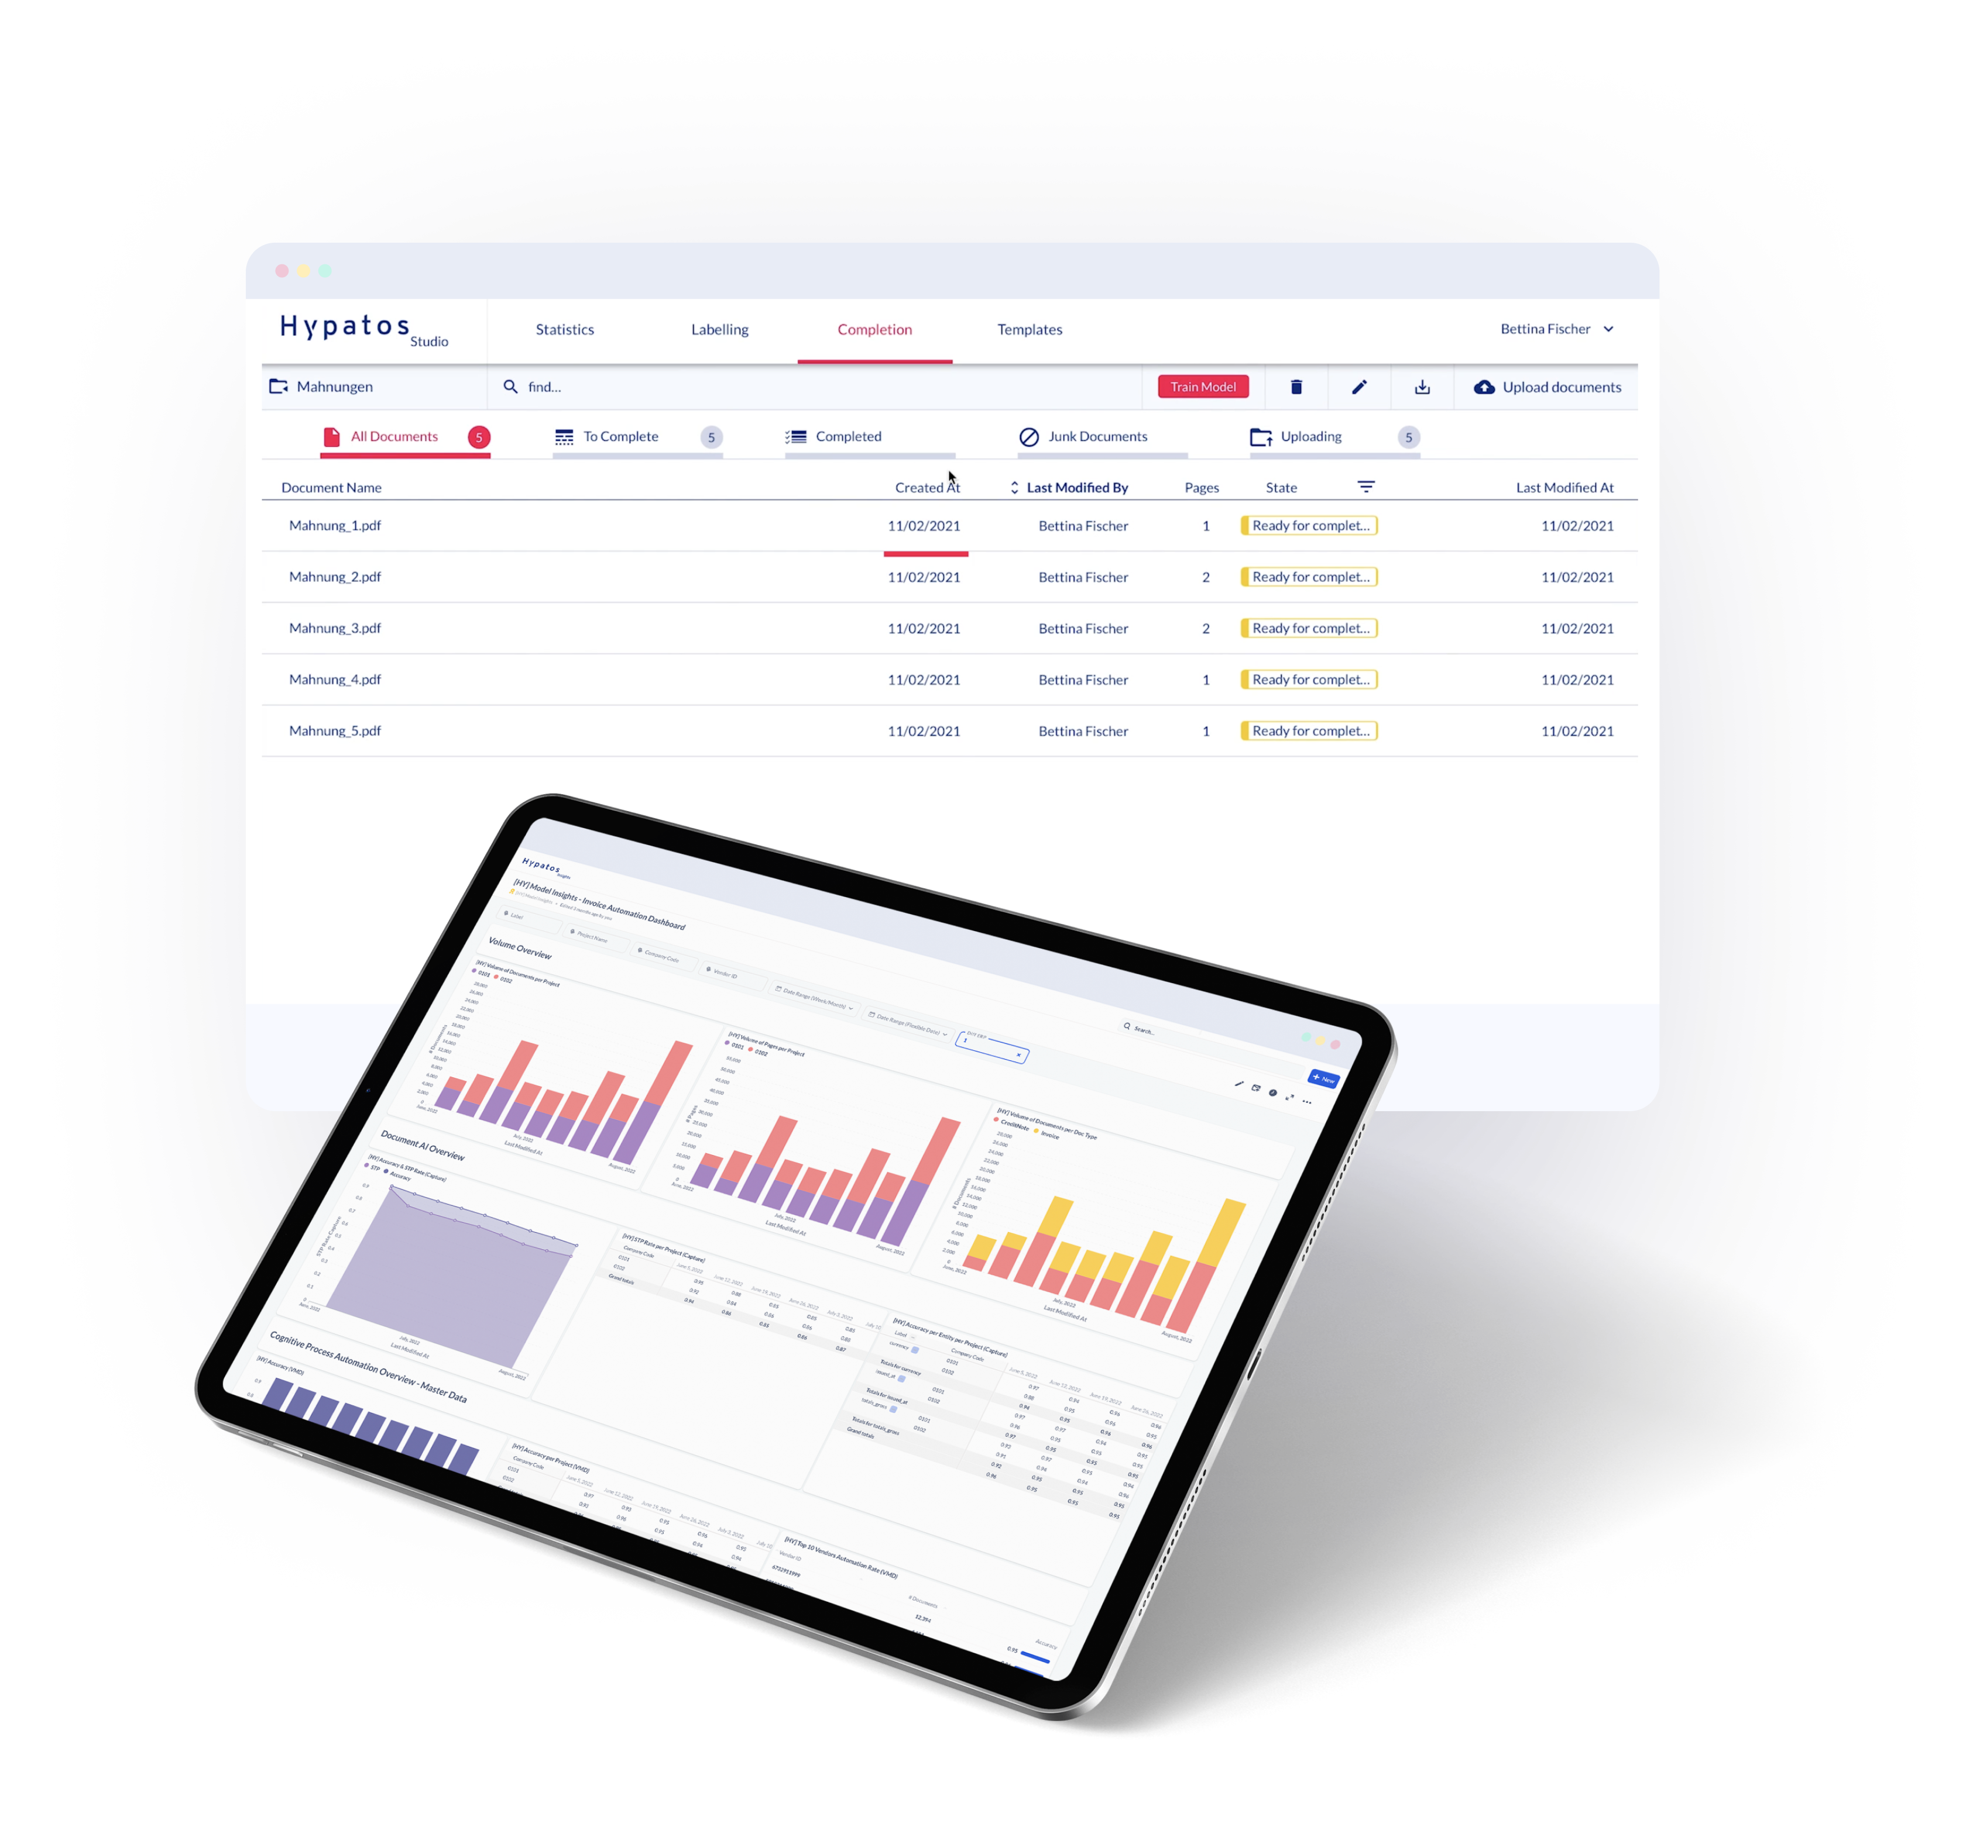
Thank you
Yavuz Güney
Implementation Manager
yavuz.guney@hypatos.ai
+49 155 666 80146
hypatos.ai
Melinda Braun
Project Manager
melinda.braun@hypatos.ai
hypatos.ai
Elena Kuhn
Customer Success Manager
elena.kuhn@hypatos.ai
hypatos.ai

