Slide 1

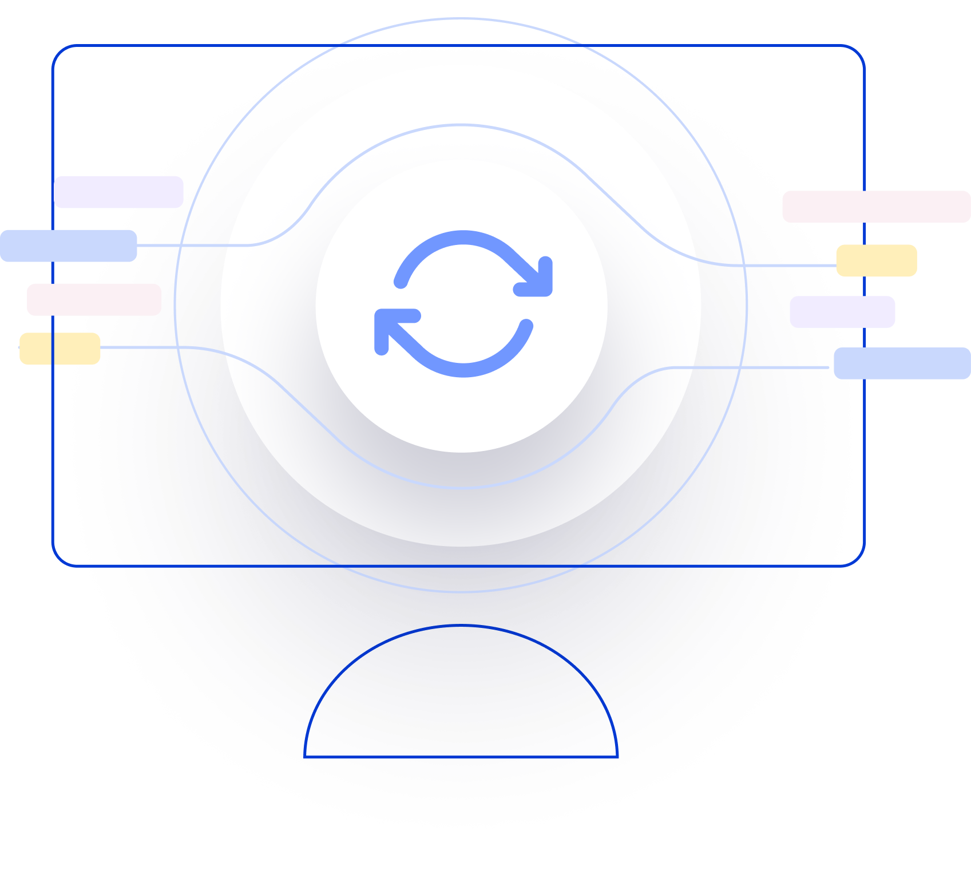
Next Generation AI for Document Automation – Order To Cash
Weekly Report CW
#placeholder
January 2024

Slide 2


Slide 3
Agenda
RAID (Risks, Actions, Issues & Decisions) Follow-up
Project Status & Timeline Review
Highlight Topics

Slide 4
Risks – Focus on Open / In Response
RAID (Risks, Actions, Issues & Decisions) Follow-up
Status | Open at | Id | Description | Priority | Action Id | Action Description | Action Responsible | Action Status
* Update since last week Live Update

Slide 5
Issues
RAID (Risks, Actions, Issues & Decisions) Follow-up
Status | Opened at | Closed at | Id | Description | Priority | Risk Id | Risk Description | Action Id | Action Description | Action Status
* Update since last week Live Update

Slide 6
Decisions
RAID (Risks, Actions, Issues & Decisions) Follow-up
Id | Decision Detail | Decision Impact | Decision Date | Proposed by | Approved by | Alternatives Considered
D001​
D002​
D003​
D004​
* Update since last week Live Update

Slide 7
Agenda
RAID (Risks, Actions, Issues & Decisions) Follow-up
Project Status & Timeline Review
Highlight Topics

Slide 8


Weekly Report –
Projects Status & Timeline Review
#CWPlaceHolder
-
G
Achievements
Next Steps
…
…

Slide 9
Agenda
RAID (Risks, Actions, Issues & Decisions) Follow-up
Project Status & Timeline Review
Highlight Topics

Slide 10

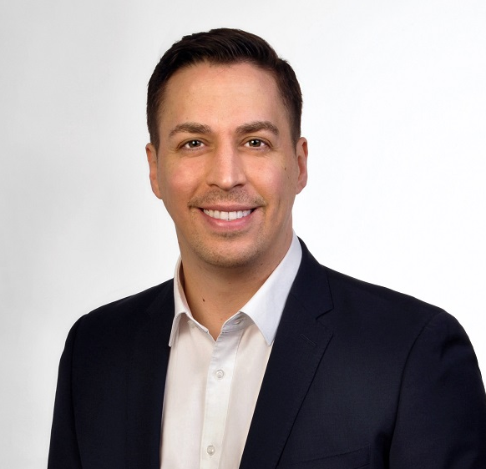
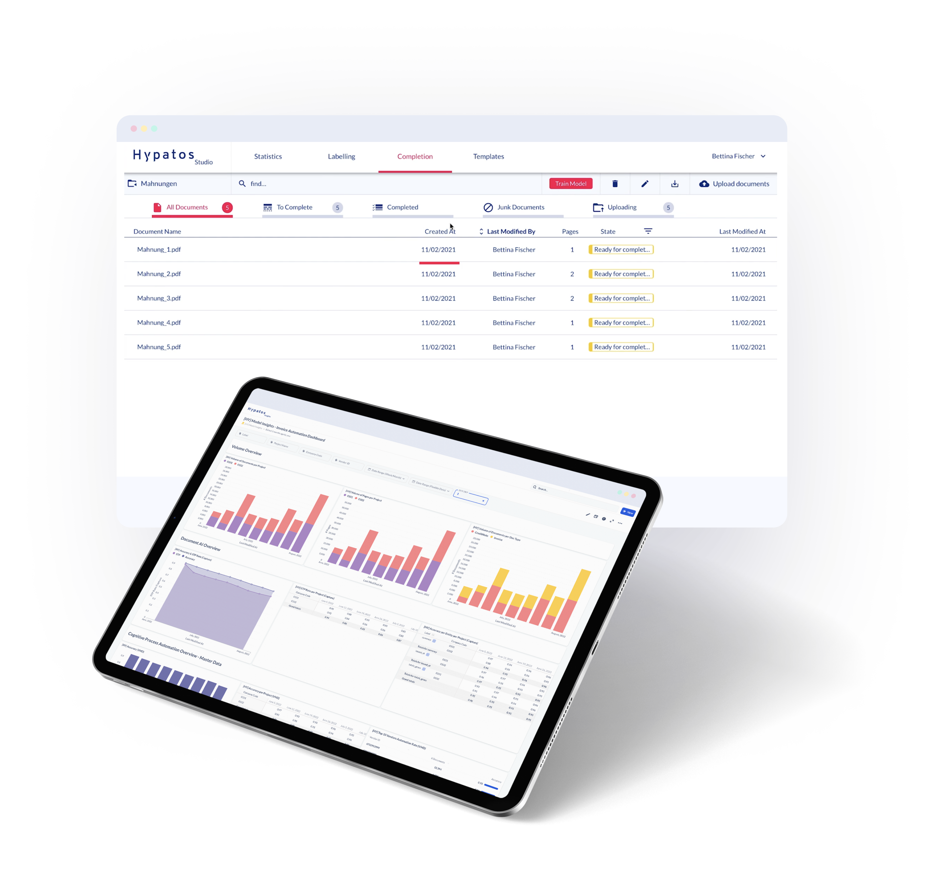
Thank you
Stephan Kuche
Lead Solution Architect
stephan.kuche@hypatos.ai
+49 (0) 179 340 36 49
hypatos.ai
Andreas Schummer
Project Manager
andreas.moesinger@de.ey.com
+49 (0) 160 939 21104

