Slide 1

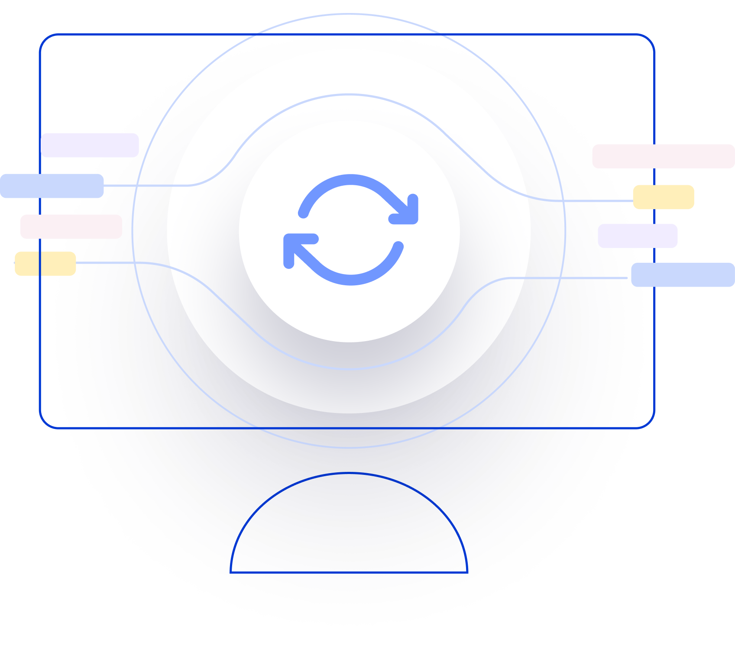
Next Generation AI for Document Automation – Accounts Payables 8713
Weekly Report CW
#placeholder
January 2024

Slide 2


Slide 3
Agenda
RAID (Risks, Actions, Issues & Decisions) Follow-up
Project Status & Timeline Review
Highlight Topics

Slide 4
Risks – Focus on Open / In Response
RAID (Risks, Actions, Issues & Decisions) Follow-up
Status | Open at | Id | Description | Priority | Action Id | Action Description | Action Responsible | Action Status
Open | 2024-01-10 | R001 | Data Acquisition dependent on SAP addon release and installation - could break project timeline | High | A001 | KTM SAP DEV Team onboarding for integration implementation. KTM PM to raise ressource request to the respective team and actively following up. |  | Open
Open | 2024-01-10 | R002 | xSuite integration might take more ressources than expected | High | A002 | Discuss Solution Design extensively and support if needed |  | Open
 |  |  |  | High | A003 | Hypatos x KTM to revisit Integration and Project Timelines based on resource onboarding. Dependent on A001. Bi-Weekly follow ups. |  | Open
 |  |  |  | High | A004 | Allow a buffer for SIT |  | Open
Open | 2024-01-10 | R003 | PO Matching config and ML Training takes more ressources than expected | High | A005 | Schedule a session with HY SAP and Product Team to |  | Open
Open | 2024-01-10 | R004 | Poor PO Matching Enrichment Quality | Medium | A006 | Ensure that annoation of Line item is done right by providing annotation guideline |  | Open
Open | 2024-01-10 | R005 | Scope of Implementation not clear - customer expectations are not aligned with HY | High | A007 | Create and Sign SoW |  | Open
Open | 2024-01-10 | R006 | Projekt Closing Date not able to achieve due to vacation of important stakeholders | Medium | A008 | Create Absence Planning and Backups for PMs and Key Stakeholders |  | Open
* Update since last week Live Update

Slide 5
Issues
RAID (Risks, Actions, Issues & Decisions) Follow-up
Status | Opened at | Closed at | Id | Description | Priority | Risk Id | Risk Description | Action Id | Action Description | Action Status
* Update since last week Live Update

Slide 6
Decisions
RAID (Risks, Actions, Issues & Decisions) Follow-up
Id | Decision Detail | Decision Impact | Decision Date | Proposed by | Approved by | Alternatives Considered
D001​
D002​
D003​
D004​
* Update since last week Live Update

Slide 7
Agenda
RAID (Risks, Actions, Issues & Decisions) Follow-up
Project Status & Timeline Review
Highlight Topics

Slide 8


Weekly Report –
Projects Status & Timeline Review
#CWPlaceHolder
-
G
Achievements
Next Steps
…
…

Slide 9
Indicative Timeline to evaluate Hypatos AccountingGPT potential with target Go Live in April 2024
Project Status & Timeline Review
Dec
Jan
Feb
Mar
Apr
May
Jun
Jul
Activities
CW
50
51
52
01
02
03
04
05
06
07
08
09
10
11
12
13
14
15
16
17
18
19
20
21
22
23
24
25
26
27
28
29
30
Responsible
PMO & User Training
Project Setup & Mgmt
Kickoff 20.12.
CUS & HY
User Onboarding
User Onboarding
Leverage User Experience
Go-live Q&A
CUS & HY
Design & Assessment
Data Acquisition & Requirement Analysis
Training Data Confirmation
Label
Design of New AP Process
SoW & Solution Design Confirmation
CUS & HY
Configure AI
ML Model Training & Optimization
HY
Implementation
Application Implement. (Studio Configuration)
HY
System Integration Implementation
CUS & HY
Testing
Testing (FT & SIT & UAT)
UAT approved
GO Live Decision
CUS & HY
Deployment
& Roll-out
SIT Approved
Hypercare Closing
Handover Customer Care
Go-live & Hypercare & Continuous Improvement
Go Live
CUS & HY
Wave 1 (CompCode xx – xx)
CUS & HY
Wave 2 (CompCode xx – xx)
Label
Meeting
Milestone
Assessment Workshop
Functional Workshop
Technical Workshop
Today 09.02.
Go-live Data decision
Continuation decision
Implementation Phase (2-3 months)
SOW = Statement of Work FT= Functional Testing
SIT= System Integration Testing
UAT= User Acceptance Testing
Timeline subject to change – pending on Assessment, Functional & Technical Workshops outcomes

Slide 10
Agenda
RAID (Risks, Actions, Issues & Decisions) Follow-up
Project Status & Timeline Review
Highlight Topics

Slide 11
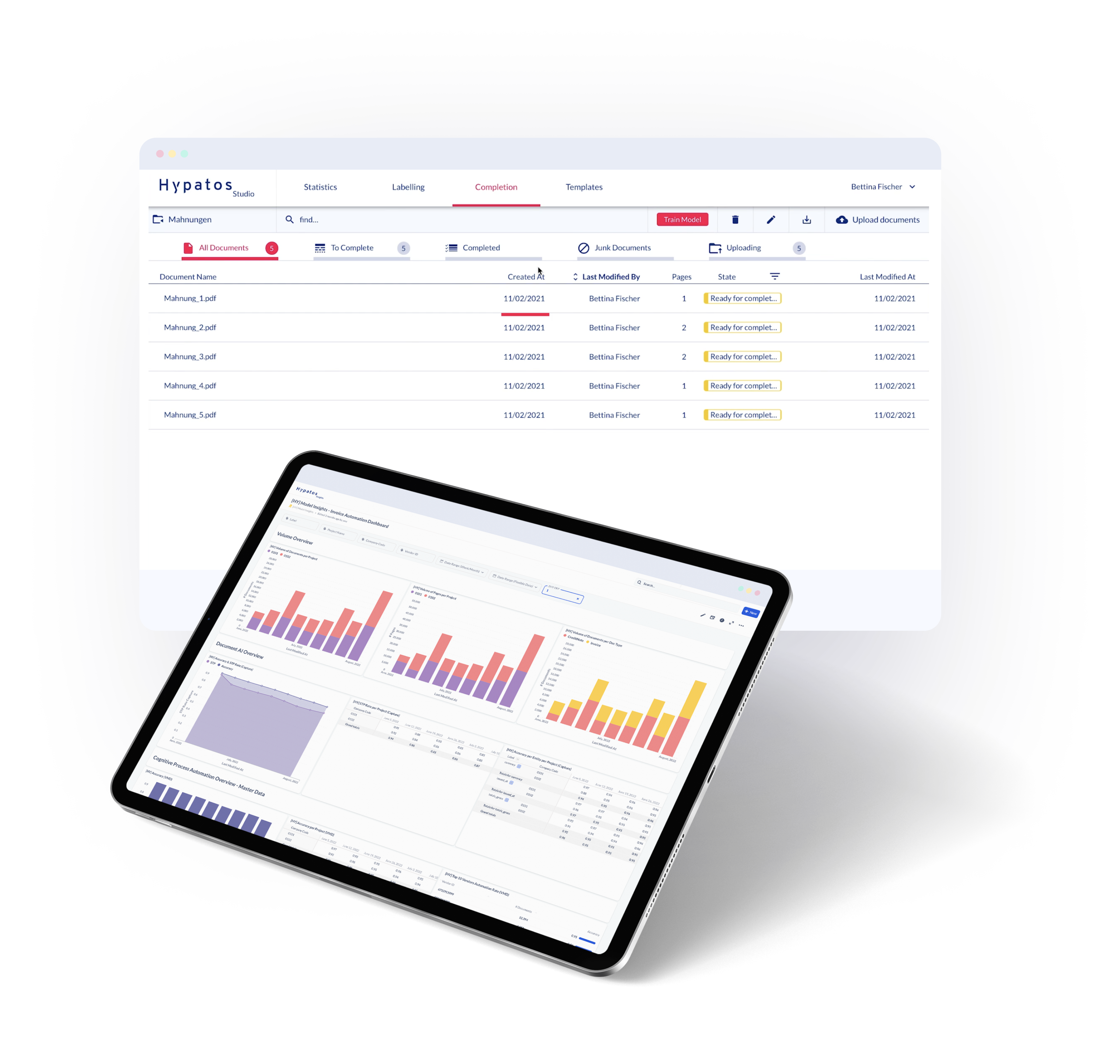
Thank you
Dr. Ulrich Erxleben
Chief Executive Officer
uli.erxleben@hypatos.ai +49 157 736 362 22 hypatos.ai
Stephan Kuche
Sr. Implementation Manager
stephan.kuche@hypatos.ai
+49 179 340 36 49
hypatos.ai
Lucia Ferreiro Martinez
Sr. Customer Success Manager
lucia.ferreiro.martinez@hypatos.ai
+49 176 73573508
hypatos.ai

