Slide 1
DCF255
Lecture 3 | Physical Layer

Slide 2
Agenda
Electricity and Magnetism in Brief
Characteristics of Signals
Types of Signals
Transferring Data with Signals
Relationship between Bit Rate and Frequency
Programming with Analog Signals v Digital Signals
Types of Cables
DSL Cable Modem and Bell Fibe
Notes:
May require more than one slide

Slide 3
Electricity & Magnetism
In Brief

Slide 4
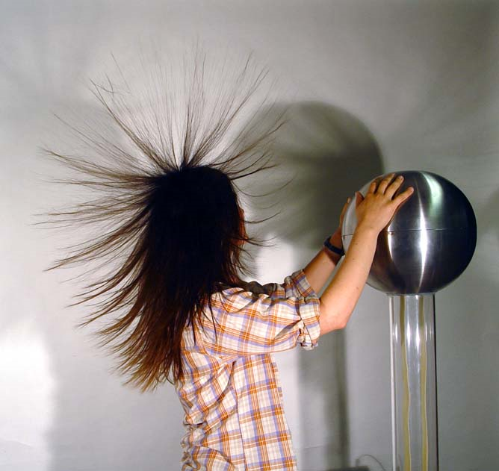
Electricity & Magnetism
All familiar with static electricity which stays in one place and zaps you when you touch a door knob
Electrical current flows around a circuit and we use its power to run household appliances and electrical motors.
Notes:
Electricity and magnetism are important aspects of human life. We are all familiar with walking across a carpet in the winter time and getting zapped when you touch the door knob. This is an example of static electricity. Static electricity stays in one place. An electrical current, on the other hand, flows and we use that movement to power our households.

Slide 5
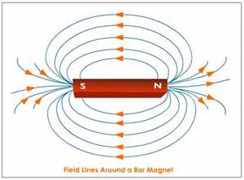
Electricity & Magnetism
In school you probably experimented with bar magnets which have a north and south pole. By placing fine iron particles around the magnet, you can actually see the magnetic forces
Years ago it was thought that electricity and magnetism were 2 different phenomena. Today we know that they 2 two characteristics of the same phenomenon:
Electromagnetic Field
A moving magnet will generate an electrical charge and an electrical current will generate a magnetic field.
Notes:
We are also familiar with a bar magnet which has a north and south poles. In school, you may have poured fine iron particles around a bar magnet to see the “magnetic field”. Like poles will repel and unlike poles (north, south) attract. Today we know that electricity and magnetism are two aspects of the signal force an “electromagnetic field”. A moving magnet will generate electricity and an electrical current will generate a magnetic field. To understand these properties we need to look at the atom.

Slide 6
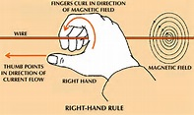
Electricity & Magnetism
All material is composed of atoms which contain a nucleus of positively charged elements and electrons which are negatively charged
Materials which have a lot of electrons which flow easily, when an electrical charge is introduced, are called conductors
Materials which have few electrons which do not flow, when an electrical charge is introduced, are called insulators.
The right hand rule – dictates that if the thumb is pointing in the direction of electron flow, then the curled fingers will indicate the direction of the magnetic field
Notes:
Figure 1: Right Hand Rule
Any material is a collection of atoms which have nucleus (positively charged) and orbiting electrons (negatively charged). Some material such as glass, wood and rubber are very stable because their atoms have no free electrons. We call these materials insulators. On the other hand, materials like, gold, copper and silver are called conductors because they possess free electrons; when an electrical force comes near, these free electrons will move from atom to atom creating an electrical current. The flow of electrons, however, generates an electromagnetic field. In school, you may have learned the “right hand rule”. Hold you right hand up and if the current is flowing in the direction that your thumb is pointing, the magnetic field is generated in the direction of your curled fingers.
Right hand rule image from http://media.web.britannica.com/eb-media/79/63079-004-F04BAA10.gif

Slide 7
Electricity & Magnetism
As electrons move down the medium, the electromagnetic field will tend to “pull” electrons from the middle of the medium to the outside
Thus as an electrical current flows, it loses strength called attenuation.
If the attenuation is severe the receiving computer will not be able to distinguish a zero from a one and a retransmission will be required
To avoid errors, each type of cable has strict rules for how long the signal can flow without regeneration.
UTP max distance is 100 meters
Notes:
This magnetic field will tend to “pull” electrons away from the center of the current to the outside edge. Thus, as the current flows, its’ strength is continually weakened. This loss is called attenuation. If the signal gets too weak, then the receiving computer can’t differentiate between a zero or a one and a retransmission will be required. Consequently, the IEEE has established strict rules on how far a signal can travel before it needs to be repeated. For example, the maximum distance of UTP cable is 100 meters (which is the primary reason by LANs are confined to a small geographical area).

Slide 8
Characteristics of Signals
Amplitude Frequency Period Phase

Slide 9
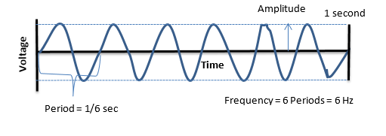
Amplitude Frequency and Period
All signals have 3 attributes Amplitude Frequency and Phase
Amplitude refers to the height of the waveform, measured in volts or watts .
Frequency refers to the number of waveforms completed in a second, measured in hertz.
Period is the time it takes to complete 1 complete cycle of the waveform
Frequency and Period are inverse values
If the frequency is 6, the period is 1/6 of a second.
Notes:
Amplitude is the height of the signal measured from the horizontal axis. The height of the wave indicates a higher voltage or amperes or watts depending on what is being measured. Frequency refers to how many periods of the signal are completed in a second, measured in Hertz. A period is the amount of time it takes to complete one cycle. Frequency and period are inverse values. In the diagram below, there are 6 completed periods, or cycles of the waveform in 1 second. This gives a frequency of 6 Hz. If the frequency is 6 Hz, then the period is 1/6 of a second

Slide 10
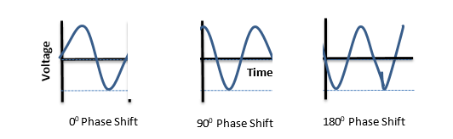
Phase
Phase refers to the position of the waveform relative to a point in time
Technology exists to start a signal with a “phase shift”
The signals in the last slide all had a phase shift of “0”
Common phase degrees used in data communications are 90⁰ and 180º
Notes:
The phase of a signal describes the position of the waveform relative to time zero. If you think of a compass with 360⁰ of rotation. The waveform can be manipulated to shift it forward or backward along the time axis. Phase is measured in degrees. Common phrase degrees are 180⁰ and 90⁰ .

Slide 11
Types of Signals
Analog Digital

Slide 12
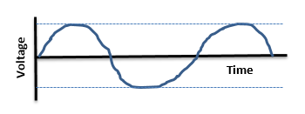
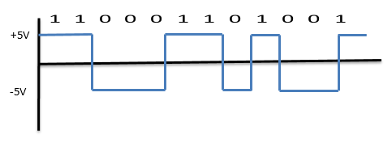
Types of Signals
Analog
A sine waveform created with a continuous rising and falling of electromagnetic signal
Digital
A square waveform created with discrete states in the electromagnetic signal representing a zero or a one
Notes:
Human speech and music from your CD player are all analog waveforms with a continuous rising and falling of electromagnetic signals, usually voltage, between some given minimum and maximum value. Technically called a sine wave, there are an infinite number of values along the waveform over time. Analog signals are used for wireless communication and some high speed Internet trunk lines.
A digital signal is represented as a square wave with two discrete states representing “0s” and “1s”. In the example below, positive voltage represents a 1 and negative voltage a 0. The discrete states combined with a square wave form make it easier to distinguish noise from the signal. Let’s look at a programming example using analog and digital signals
No change in voltage at the beginning of the clock cycle is a “1”, and a change in voltage at the beginning of the clock cycle is a “0”

Slide 13

Types of Signals
The physical layer can produce either analog or digital depending on the type of cable and encoding used
Transmitting Data
Analog Data carried by an Analog Signal
Digital Data carried by an Analog Signal
Digital Data carried by a Digital Signal
Analog Data carried by a Digital Signal

Slide 14
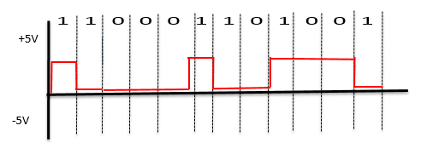
Digital Data carried by a Digital Signal
The physical layer converts the digital data to the proper physical form to be transitted over a wire or airwave
NRZI (non return to zero –inverted)
NRZI – a change in voltage at the beginning of a bit period represents a 1 and no change represents a 0
Long strings of zeros can cause two remote computers to “drift” apart creating errors – because the voltage is kept constant
Notes:
110001101001
To transmit digital data using digital signals the 1s and 0s must be converted to the proper physical form to be transmitted over a wire or airwave. The 2 most popular schemes are NRZI and 4B/5B. NRZI stands for Non-return to zero inverted. A change in voltage at the beginning of bit period represents a 1 and no change represents a zero.
An inherent problem with digital encoding is that long strings of 0s in the data produce a signal that never changes. The receiving computer needs a signal change to reset its internal clock to keep in synch with the incoming bit stream. However, long strings of 0s keep the voltage constant and the receiving computer could “drift” out of synch. . To avoid this problem, an encoding system called Manchester was developed which deliberately changed the voltage twice for each bit. This prevented the receiving computer from drifting out of synch, but created a very inefficient scheme with the voltage changing twice per bit period. Nevertheless, Manchester was the encoding scheme for Ethernet up to 10 Mbps. Faster speeds lead to a new encoding scheme used in Gigabit Ethernet called 4B/5B which is used in fiber optic cables.

Slide 15
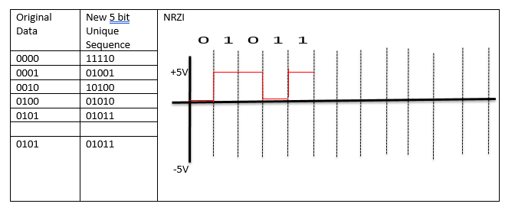
Digital Data carried by a Digital Signal
4B/5B originally developed for fiber optic cable is now used on many phones and gigabit Ethernet
The original 4 bits of data are converted into a unique 5 bit transmission code with no more than 2 consecutive zero.
2⁵ = 32 possibilities, but only 16 5 bit sequences are used
The 5 bit transmission code is encoded using NRZI – preventing 2 remote computers from drifting apart
Notes:
This scheme tries to solve the synchronization problem by encoding 4 bits of original data in to a unique 5 bit sequence using NRZI encoding. Five bits gives 32 possibilities (2⁵ = 32), however, only 16 combinations are used to ensure that there are no more than 2 consecutive zeros in the sequence. This ensures using NRZI encoding that signal changes will occur regularly preventing the receiving computer from drifting out of synchronization.

Slide 16
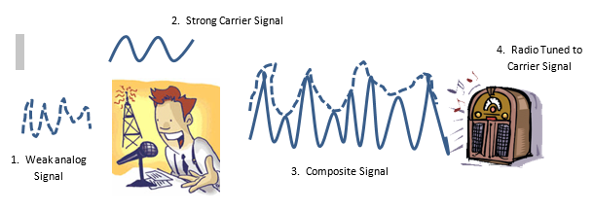
Analog Data carried by an Analog Signal
For example AM radio station playing music creates a weak signal
This weak signal is combined with a powerful carrier signal, creating a composite signal
Tune radio dial to carrier signal frequency to hear the music
Notes:
1. Weak analog Signal
2. Strong Carrier Signal
3. Composite Signal
4. Radio Tuned to Carrier Signal
For example, AM and FM radio is an example of analog data being carried by an analog signal. The music program produced at the 740 AM radio station is a weak analog signal. Every radio station applies for a federal license to broadcast a strong carrier signal at a specific frequency, in this case 740 kHz. Technology, overlays the weak signal with the carrier wave to create a “composite signal”. To hear the program, you tune the radio dial to the 740 kHz band.

Slide 17
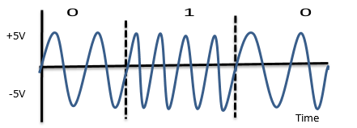
Digital Data carried by an Analog Signal
Amplitude Shift-Keying (ASK) used to represent discrete states of digital data
Low amplitude = 0 High amplitude = 1
Frequency Shift-Keying (FSK) used to represent discrete states of digital data
2 Hz = 0 4Hz = 1
Phase Shift-Keying (PSK) used to represent discrete states of digital data
0 phase shift = 0 180 Degree phase shift = 1
Notes:
Your cable TV and modem are examples of digital data being carried by an analog signal. Each television station and Internet access is reserved a specific frequency. Within each frequency band digital data is sent using modulation techniques (called shift-keying). For example, the digital data “010” can be represented by analog signals. Amplitude Shift-keying is represented by two different amplitudes a low amplitude for a “0” and a high amplitude for a “1”. The amplitude is kept constant during each bit period. Or, keeping frequency constant during each bit period, 2 Hz could represent a “0” and 4 Hz could represent a “1”. This is called frequency shift-keying In the example, we areshowing one bit being sent per bit period. This does not necessarily be the case. Each bit period can represent more than one bit,such as 00, 01, 10, 11 that would incorporate four different amplitude levels and each level could represent 2 bits. With Phase Shift-Keying no phase shift could represent a “0” and an 180⁰ shift could represent a “1”. Phase shift-keying is the least susceptible to noise and is very accurate. The types of modulation discussed are not used in isolation but can be combined. For example, 256-QAM ( 256-Quadrapture Amplitude modulation IEEE 802.11ac) which is used commonly used in contemporary modems and in cable TV setup boxes, uses 4 phase shift keying degrees, combined with 2 different amplitudes to send 8 bits per cycle. This gives exception high data rates needed for high-definition TV and high speed modems

Slide 18
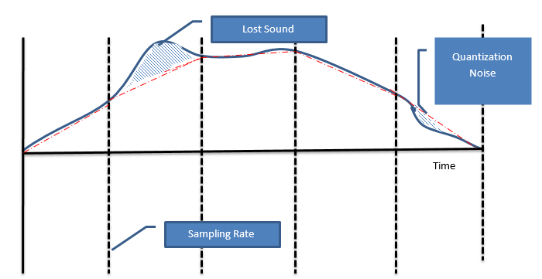
Analog Data carried by Digital Signals
Analog Data is a continuous wave form, in order to be carried by digital signals it must be converted into digital data
The waveform is “Sampled” at discrete intervals and the amplitude is measured
The sample waveform is “Quantized” by converted to a 7 bit digital value
To convert the digital value back to an analog waveform a special chip called “PAM” is used (Pulse Code Modulation) which converts the 7 bit value to an electromagnetic signal to represent the original waveform
This can introduce errors (noise not in original waveform or lost of sound that was in the original waveform
Sampling is a compromise between sound quality and performance. CD quality is 2X the highest frequency (Nyquist Theorem). For example 3700 Hz would require a sampling rate of 7400 times per second to get a good representation of the waveform
Notes:
Suppose we wanted to call a friend by telephone. When we speak into a telephone, a small diaphragm vibrates to the intensity of our voice and an electrical signal is generated which is analogous to our voice. This analog signal is sent over copper wire to the nearest telephone switching station. There the signal is “sampled” and converted into a digital signal to travel over the telephone systems trunk lines. At the other end, the digital signal is converted back to analog to travel the last link between your friend’s nearest switching station and his/her home. This conversion process is called Pulse Code Modulation which involves 3 steps.
Sample the Analog waveform at fixed intervals
Quantitize the amplitude to a 7 bit binary value
Using PAM (Pulse Amplitude Modulation) convert the 7 bit binary value back to an electrical signal which represents the original waveform.
Sampling involves taking a snapshot of the waveform at fixed intervals. For CD quality this is 2 X the highest frequency. For example, suppose a waveform had a high frequency of 3700 Hz. We would need to sample at 7,400 times per second to get a good representation of that waveform. Based on the height of the wave, the amplitude is converted to a fixed binary value using a codec. The sampling is a compromise between performance and quality. Sampling more frequently will generate a closer representation of the waveform, but would require more processing power and a longer binary value (2⁷ = 128 quantitation levels). This binary value can now be transmitted using a digital encoding format.
When the digital value needs to be converted back to an analog waveform, a special hardware chip called PAM, converts the discrete binary value back to an electrical pulse that represents the original amplitude. As you can see in the diagram below. The rebuilt waveform is similar to the original (most users can’t hear the difference) but is not an exact replica of the original. In fact, parts of the original waveform may be removed and quantization noise could be introduced.
Harry Nyquist’s Theorem
Image taken from http://www.tvdictionary.com/sample_diagrams/ag_Cable_Modem_Overview_low_res.jpg
So what is the optimal compromise between performance and sound quality. According to Nyquist, the sampling rate using pulse code modulation must be at least twice the highest frequency of the original analog waveform to ensure a reasonable reproduction. We call this reasonable reproduction CD quality today.

Slide 19
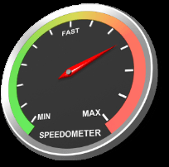
Relationship between frequency and Bit Rate
Faster network speed can only be created in one of 2 ways:
Increase the bit rate by sending more bits per bit cycle and keep the frequency the same, or
Increase the frequency of the signal and keep the bit rate the same
Notes:
When network users complain that the network is too slow, it seems easy for them to fix: “Just send the data faster”. However, getting a faster data rate can only be done in one of two ways:
Send more bits per bit cycle at the same frequency, or
Keep the bit rate the same and increase the frequency of the signal

Slide 20
Increase the bit rate – Keep Frequency the same
Baud rate is how many times the signal changes per second
Bit Rate is how many bits are sent per second
Baud rate = 4 Bit rate = 8
By creating more amplitude levels in a second each amplitude level can represent 2 bits
This increases throughput, but can increase errors if signal has noise
Notes:
When network users complain that the network is too slow, it seems easy for them to fix: “Just send the data faster”. However, getting a faster data rate can only be done in one of two ways:
Send more bits per bit cycle at the same frequency, or
Keep the bit rate the same and increase the frequency of the signal

Slide 21
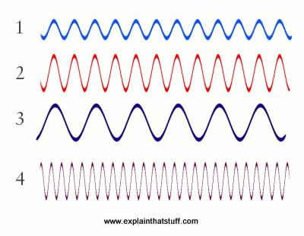
Increase the frequency – Keep the bit rate the same
Increasing the frequency sends more bits per second which increases throughput, but can increase errors if signal has noise
For example, 6 Hz signal sending 1 bit per bit period sends 6 bits per second
12 Hz signal would send 12 bits per second doubling throughput
Medium must be able to support the frequency
Increasing the frequency also increases noise and electromagnetic interference (EMI)
Notes:
The higher the frequency, the higher the bit rate per second. For example, if an analog signal sent one bit per completed bit period, then a 6Hz signal would send 6 bits per second. If the frequency is doubled to 12Hz then 12 bits would be sent per second. While this may seem a simple solution, increasing the frequency also increases noise and EMI and the cable could interfere with adjacent cables. For this reason, the wattage using in a cable is strictly controlled by Federal regulation.

Slide 22
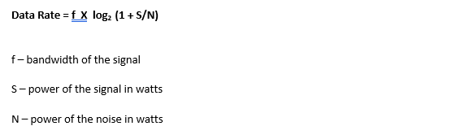
Shannon’s Theorem - Data Rate = f X log₂ (1 + S/N)
Shannon’s Theorem gives the maximum data rate for an analog signal with any number of signal levels and takes noise into account
f - Bandwidth is the difference between the highest frequency and the lowest frequency
S – is the power of the signal in watts
N – is the noise of the signal in watts

Slide 23

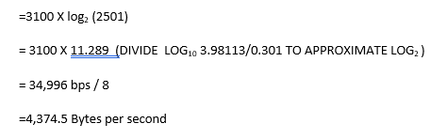
Shannon’s Theorem - Data Rate = f X log₂ (1 + S/N)
. Suppose you were writing an application which will use a dial up modem. If the power of the signal was .5 watts and the noise is .0002 watts. What is the maximum bit rate in bytes per second?
Telephone system designed for frequencies of the human voice
High 3400 Hz and low 300 Hz
Bandwidth = 3400 -300 = 3100 Hz

Slide 24
Programming
Analog v Digital Signals

Slide 25
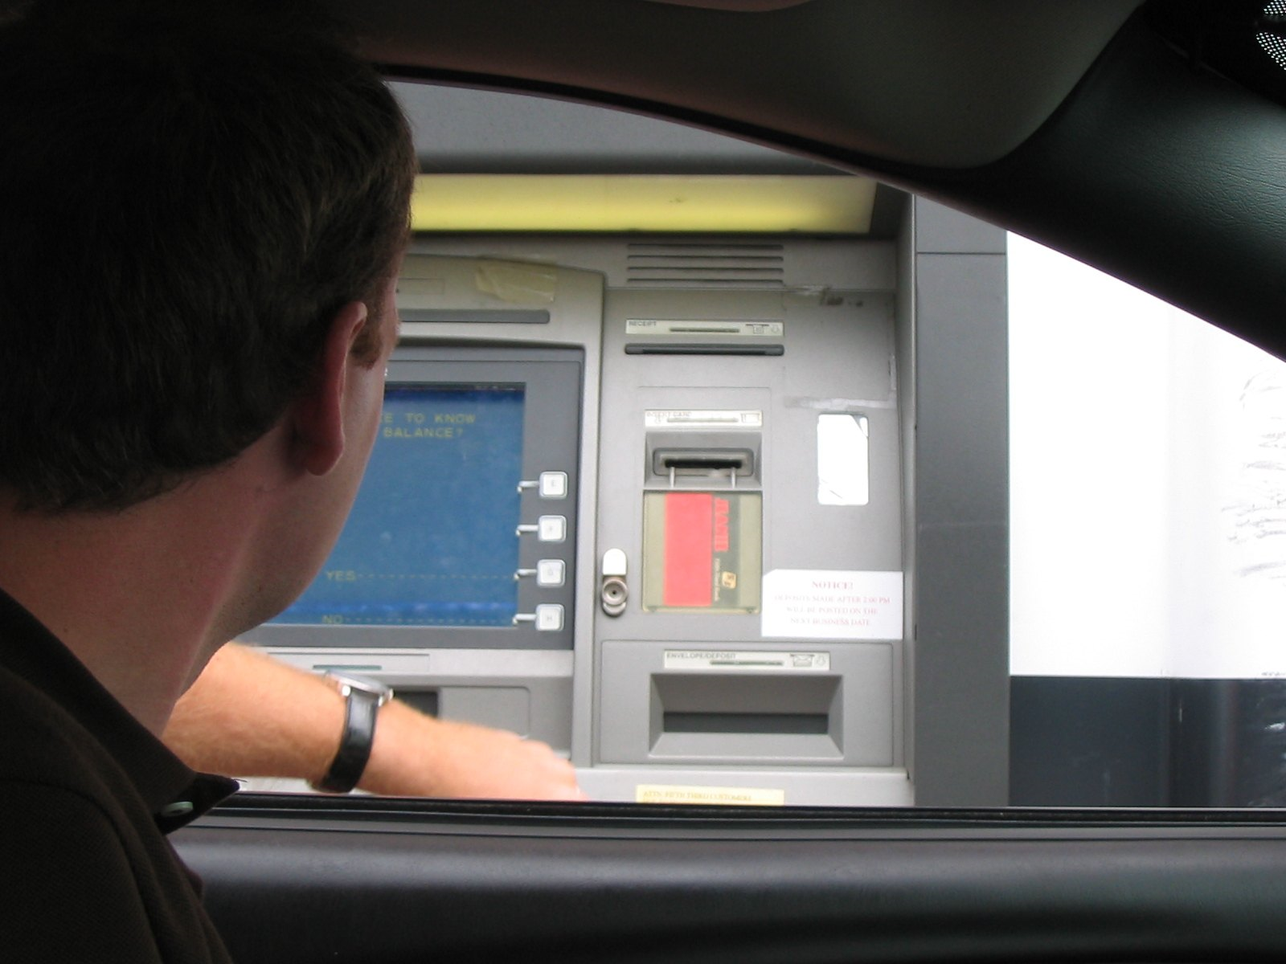
Programming with Analog Signals
Suppose you wrote a simple ATM application using analog signal
Amplitude of 2 volts = 0
Amplitude of 4 volts = 1
Flags
Enter Pin – 00 – Authenticate user
Success message -01 – Proceed
Pushes $100 button – 10 – check account balance
If money in account success message -11 returned and $100 dispensed
Notes:
Suppose you wanted to create a software program to run an ATM machine and you decided to use analog signals. For simplicity, the ATM program will check if the user has an account using a pin, and has only one button to dispense $100 of cash based on how many times the user pushes the button. Since analog signals are a continuous rising and falling of voltage, you decide to use 2 frequency ranges. An amplitude of 2 volts will represent a “0” and an amplitude of 4 will represent a “1”. The user comes to the ATM and inserts their card. They are asked to enter their pin. Their pin is encoded in a frame that begins with “00”. This is a “flag” to the server to authenticate the user. A success message is returned to the ATM with the tag “01” and the ATM displays the message “Proceed”. The user then pushes the $100 button to get cash and a “10” signal is sent to the server to check the user’s account balance. If the user can withdraw $100 a success message “11” is returned to the ATM and $100 is dispensed.

Slide 26
Programming with Analog Signals
Same scenario, but suppose lightning hit the line, and the voltage spiked to 8 volts, just after the user hit the cash button and before the account balance was checked
Server would interpret the 8 voltages as a success message of 11 and dispense $100.00, even if the user did not have the money in the account. Why?
The major problem with analog signals is that noise is also an analog signal and can be misinterpreted by the receiving computer.
Same scenario using digital signal. Digital signal uses discrete levels. Therefore, even if the voltage spiked to above 4 volts, it would still be interpreted as a “1”, or if the voltage was less than 2 volts, it would still be interpreted as a “0”
Digital signals less susceptible to noise
Notes:
Now with the same scenario, suppose that just after the user pushed the cash button, lightning hit the line and a spike in voltage of 8 volts travels to the server. The server would interpret this as a success message and dispense $100.00 even if the user did not have sufficient funds!

Slide 27
Metric Notation
Proper Syntax
Notes:
Many network parameters, such as speed are measured in metric units. It is essential that you understand the metric system and write values in metric notation correctly. A metric prefix of “k” for kilo, meaning 1000 , “M” for mega, meaning 1,000,000 , “G” for giga, meaning 1,000,000,000 , “T for tera, meaning 1,000,000,000,000 and “P” for peta, meaning 1,000,000,000,000,000. Notice that all of the prefixes are capital letters, except kilo. (capital K is reversed for measuring temperate in Kelvins)
Prefix
Name
Value
Example
Description
P
Peta
1015
1,000,000,000,000,000
One thousand trillion
T
Tera
1012
1,000,000,000,000
One trillion
G
Giga
109
1,000,000,000
One billion
M
Mega
106
1,000,000
One million
K
kilo
103
1,000
One thousand
Because the metric system is based on multiples of ten, converting within the system is simple. Here's a shortcut: If you are converting from a smaller unit to a larger unit (moving upward in the table shown above), move the decimal place to the left in the number you are converting (dividing by 1000). If you are converting from a larger unit to a smaller unit (moving down in the table), move the decimal to the right (multiple by 1000). The number of places you move the decimal corresponds to the number of rows you are crossing in the table. For example, let's say you want to convert 8,500 ,000 bps to Mbps. Mega is two rows up so the decimal should be moved six places to the left to create 8.5 Mbps.
Proper notation should always have one to three digits before the decimal point. So 8.5Mbps is good (1 place), but 8,500.0 kbps is bad (4 places.). Or, the value 0.085 Tbps is also bad (no places before the decimal) because the leading zero does not count. Since Tera is one row above mega, you would move the decimal place to the right by 3 places to properly write the speed as 8.5 Mbps.
There is one more rule in writing metric notation. You place a space between the number and the metric prefix, but not between the metric prefix and the based unit. For example, writing 8.5 Mbps is good, but writing 8.5M bps or 8.5Mbps is improper.

Slide 28
Understanding Metric Notation
Prefix | Name | Example | Description
P | Peta | 1,000,000,000,000,000 | One thousand trillion
T | Tera | 1,000,000,000,000 | One trillion
G | Giga | 1,000,000,000 | One billion
M | Mega | 1,000,000 | One million
K | kilo | 1,000 | One thousand
Many network parameters, such as speed are measured in metric units.
Notice that all the Prefixes are capitalized, except kilo. (capital K is reserved for measuring Kelvins)
Petra is one thousand trillion with 15 zeros, Tera is one trillion with 12 zeros, Giga is one billion with 9 zeros and Mega is one million with 6 zeros and kilo is a thousand with 3 zeros.
Notes:
Many network parameters, such as speed are measured in metric units. It is essential that you understand the metric system and write values in metric notation correctly. A metric prefix of “k” for kilo, meaning 1000 , “M” for mega, meaning 1,000,000 , “G” for giga, meaning 1,000,000,000 , “T for tera, meaning 1,000,000,000,000 and “P” for peta, meaning 1,000,000,000,000,000. Notice that all of the prefixes are capital letters, except kilo. (capital K is reserved for measuring temperate in Kelvins)
Because the metric system is based on multiples of ten, converting within the system is simple. Here's a shortcut: If you are converting from a smaller unit to a larger unit (moving upward in the table shown above), move the decimal place to the left in the number you are converting (dividing by 1000). If you are converting from a larger unit to a smaller unit (moving down in the table), move the decimal to the right (multiple by 1000). The number of places you move the decimal corresponds to the number of rows you are crossing in the table. For example, let's say you want to convert 8,500 ,000 bps to Mbps. Mega is two rows up so the decimal should be moved six places to the left to create 8.5 Mbps.

Slide 29
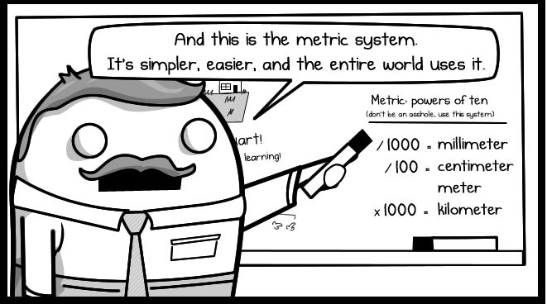
Writing Metric Notation
Proper notation is that there must be 1-3 digits before the decimal point
8.5 Mbps is good
8500.0 kbps is bad
0.085 Tbps is bad (leading zeros don’t count)
Import Rule:
You can place a space between the number and the metric prefix, but not between the metrix prefix and the base unit
8.5 Mbps – is good
8.5 M bps – is bad
Notes:
Proper notation should always have one to three digits before the decimal point. So 8.5Mbps is good (1 place), but 8,500.0 kbps is bad (4 places.). Or, the value 0.085 Tbps is also bad (no places before the decimal) because the leading zero does not count. Since Tera is one row above mega, you would move the decimal place to the right by 3 places to properly write the speed as 8.5 Mbps.
There is one more rule in writing metric notation. You place a space between the number and the metric prefix, but not between the metric prefix and the based unit. For example, writing 8.5 Mbps is good, but writing 8.5M bps or 8.5Mbps is improper.

Slide 30
Types of Cable
STP/UTP Coaxial Fiber Optic

Slide 31
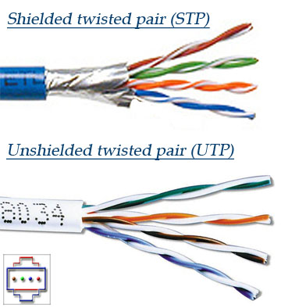
STP/UTP
UTP - “Unshielded Twisted Pair” cable.
Four pairs of wires each twisted around the other, inside a PVC protective jacket. Two wires carry equal but opposite signals; with the cables twisted, the flow of electrons generates opposite electro-magnetic fields minimizing crosstalk.
STP - “Shielded Twisted Pair”
the wires are wrapped in a shielding which protects the signal from external EMI and increases attenuation by having electrons bounce back to the center of the cable.
The most popular network cables today are CAT5e and CAT6 cables which are specially designed to reduce noise so that they can send information at high speeds(CAT5e -1 Gbps,CAT6- 10G

Slide 32
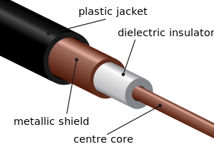
Coaxial
Coaxial cable conducts electrical signal using a solid copper wire surrounded by an insulating layer and all enclosed by a shield of woven metallic braid which are soldered at the ends to the BNC connectors.
The shield protects the signal from outside EMI and preventing electron leakage from the centre of the cable.
This property makes coaxial cable a good choice for carrying weak signals that cannot tolerate interference from the environment or for stronger electrical signals that must not be allowed to radiate or couple into adjacent structures or circuits.
Coaxial cable is commonly used in CATV and RF installations.

Slide 33
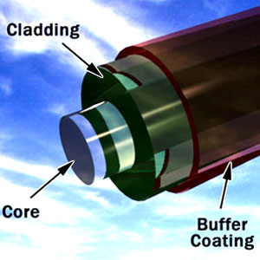
Fiber Optic
Fiber optic cables are bundles of glass fibers, smaller than a human hair, which are combined into a single cable
Core - Thin glass center of the fiber where the light travels
Cladding - Outer optical material surrounding the core that reflects the light back into the core
Buffer coating - Plastic coating that protects the fiber from damage and moisture
Light travels in a straight line and only in one direction at a time.
The inside of the cable is like a mirror; so that light can travel down the core. Because the cladding does not absorb any light from the core, the light wave can travel great distances.
Another advantage of fiber optic cables is that it is impervious to EMI and wire tapping.
Notes:
A single fiber optic cable can carry about 90,000 TV stations, or 3 million full duplex telephone conversation
. If the hallway had a 450 angle, however, you would have to place a mirror at the end of the hall and angle it in the direction you wanted the light to travel. If another user wanted to shine a light your way, he/she would have to wait until you finished or use an adjacent hallway to send light in the opposite direction. This is basically how fiber optic cables work.

Slide 34
Types of Connections
DSL Cable Modem Bell Fibe

Slide 35
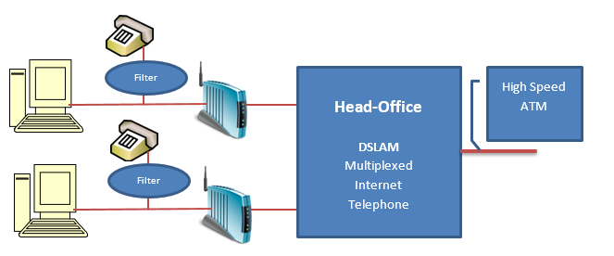
DSL
UTP used to connect home to telephone switching station (physical limit of copper is 3 miles)
DSL Modem creates a permanent connection – always on
DSL Modem divides the frequencies above 3400 Hz into downstream and upstream channels which is why if you have a land line, there must be a splitter on the line to split the telephone frequencies
DSL uses discrete analog signals to send digital data. At the head office a DSLAM (DSL Access Multiplexer) is installed to convert many DSL transmissions onto one trunk line
Notes:
Digital Subscriber Line is a family of technologies developed by telephone companies to transmit multimedia content over the “local loop”; the latter is a pair of twisted copper wires that connects each home to the telephone companies switching station. The physical limit of copper is 3 miles; each home must be connected to the switching station within that distance due to attenuation. The DSL modem uses the extra bandwidth above 3400 Hz which is used for voice. It creates extra channels and then divides them into upstream and downstream. The most popular technology is ADSL, Asymmetric Digital Subscriber Line; it has a fast downstream transmission speed and a slower upstream transmission speed. This is ideal for an Internet connection where a small outgoing message returns a large web page. Once the channel groups have been established, the DSL modem monitors them for usability. The modem converts digital signals from the computer into discrete analog signals. Because DSL frequencies are very high, the closer you are to the switching station the faster the speed.
Users can also use the same line for the home phone, if splitters are used on each phone output to separate the phone frequency from the Internet. DSL is always on meaning that you don’t have to dial a connection. The DSL uses a permanent circuit which is setup by the service provider; the latter usually tries to sell a tiered program to the user based on download volume. On the customer side, the DSL Transceiver, or more commonly known as a DSL modem, is hooked up to a phone line converting digial computer signals to discrete analog signals. The other end of the DSL circuit is connected to a DSLAM, DSL Access Multiplexer) which concentrates a large number of individual DSL connections into a single trunk line such as ATM, Asynchronous Transfer Mode. The location of the DSLAM depends on the telco, but must be with the limits of the local loop due to attenuation;

Slide 36
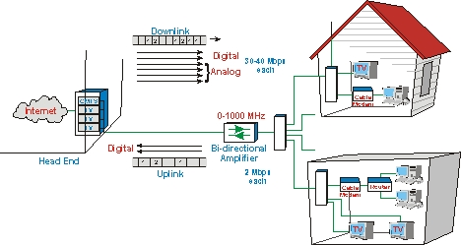
Cable Modem
CATV divides each TV channel into a 5 MHz channel. The bandwidth is a shared with all other users in the neighbourhood
Cable modem uses Ethernet to connect to the local network and provides DHCP services to local hosts
At the head office a CMTS (Cable Modem Termination system) is responsible for connecting a group of customers to an ISP
Downloaded content is modulated using QAM (Quadrapture Amplitude Modulation) converting 4 bits at a time to discrete digital values.
Upstream content uses Quadrapture PSK sending 2 bits at a time. QPSK is used because it is least affected by noise
Notes:
In a cable TV system, each TV channel is given a 6-MHz slice of the cable's available bandwidth and then sent down the cable to your house. Roger’s cable uses fiber optic cable from the head office and coaxial cable from the neighbourhood switching centre to the user’s home. The broadband signal comes to the cable modem which splits of the CATV channels from the Internet channel. Like DSL, cable modems are asymmetric with fast download speeds and slower upload speeds. Unlike DSL, cable modem users in a neighbourhood share the bandwidth. As traffic increases overall throughput decreases. Each cable modem uses Ethernet to connect to the local network providing DHCP services to local hosts. The cable modem works with the service provider’s cable modem termination system (CMTS) at the head office. The CMTS is responsible for connecting a group of customers to an Internet Service Provider (ISP) for connection to the internet. Downloaded Internet content is demodulated using QAM converting the radio frequency into a unique binary value. The upstream content is modulated using Quadrapture Phase Shift-Keying (QPSK). This modulation technique moves 2 bits at a time. A zero is represented as a 90 degree shift change and a 1 is the same waveform
Upstream data flows from the modem to the CMTS, but requires only a smaller channel – 2 MHz portion of the bandwidth. The assumption is that people download far more data than they upload. The downstream channel is very fast and efficient; QAM64 provides up to 36 Mbps speed. The upstream channel, however, is tricky. This smaller channel operates in the 5 to 40Mhz range. Home appliances, loose connectors, and poor cabling can introduce noise into the channel and since cable modems bandwidth is shared, this noise is increased when other signals are combined. Due to this problem, most manufacturers will be using QPSK or a similar modulation scheme in the upstream direction, because QPSK is more robust scheme than higher order modulation techniques in a noisy environment. The drawback is that QPSK is "slower" than QAM.

Slide 37
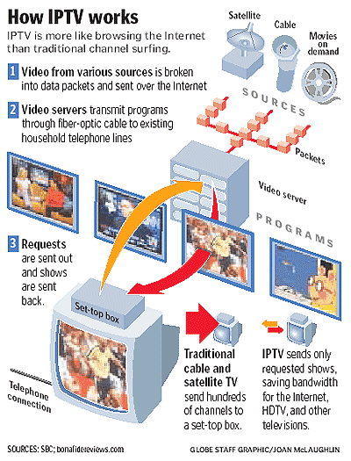
Bell Fibe
Bell Fibe is a “streaming service” using IP multicasting. Each packet leaves the server only once, but is sent simultaneously to many different destinations using the IGMP (IP Group Membership Protocol.
One server can send information to many clients as easily as to a single client using the RTSP (Real-Time Streaming Protocol).
IP multicasting is more efficient in bandwidth because it sends only the selected channel to the appropriate IP group.
To avoid latency and buffering, caching server farms , known as CDNs, maintain mirrored copies of program content
Notes:
Bell Fibe is a “streaming service”. When you stream a program, you're not downloading it like an ordinary file. Instead, you're downloading a bit of a file, playing it, and, while it's playing, simultaneously downloading the next part of the file ready to play in a moment or two. Many streaming clients put a large strain on server resources which could cause unacceptable delays and buffering. To avoid this problem streaming uses a different kind of downloading called IP multicasting. Using the latter, each packet leaves the server only once, but is sent simultaneously to many different destinations using the IGMP (IP Group Membership Protocol). For example, assume that a million people are watching a Rolling Stones concert in real time. This means one server can send information to many clients as easily as to a single client using the RTSP (Real-Time Streaming Protocol). So if a million people are watching the concert, the single video packet from the server is multicasted over the Internt to the IP group. If the same TV provider is simultaneously offering an episode of the Big Bang Theory and some of the original group decide to "switch channels" to watch it, effectively they switch over from one IP multicast group to another and start receiving a different video stream.
Unlike Cable TV which sends the entire TV spectrum to the setup box which decodes appropriate channels, IP multicasting is more efficient in bandwidth because it sends only the selected channel to the appropriate IP group.
The nature of the World Wide Web, however, makes it difficult for service providers to maintain an equal and reliable service to all subscribers. To avoid latency and buffering, all streaming service providers’ partner with content providers who maintain caching server farms around the world, known as CDNs. which keep "mirror" copies of the same data; this is one of the main reasons NetFlix partnered with Amazon Services to provide realiable content worldwide.then people in the northern Ontario might stream programs from Ottawa, while those in Europe might get them from Frankfurt, Germany

Slide 38
Summary
Electricity and Magnetism are two attributes of an electromagnetic field. A moving magnet will generate an electrical current and an electrical current will generate a magnetic field. The latter will pull electrons from the centre of the medium weakening the signal
All signals have phase, amplitude and frequency. Each of these attributes can be used to send discrete digital values. Analog signals are more susceptible to noise than digital signals.
It is important to convert metric values correctly. Convention states that there must be 1-3 digits in front of the metric prefix and that there should not be a space between the metric prefix and the base unit.
There are 3 types of cables used today in data communications: UTP/STP,. Coaxial and fiber optic. Each of these cables are used in common home connections. DSL uses UTP cable and is an always on circuit to the teleco. Cable modems use coaxial cable and is a shared connection using Ethernet to connect local hosts to the network. Fiber optic cable is used with Bell Fibe. The latter is based on IP multicasting and RSTP protocols.

