Slide 1
CDE Reborn iconset
October 18, 2022

Slide 2
Spirit of my review
Legend
Take advantage as much as possible of CDE icons, even if it can make the appearance a little bit older - for firefox for example -
Between two relevant icons, I have preferred the more CDE-ish one, in the way it’s more like CDE in the years 2000,
Sometimes there is no good solution or no better solution, and the choices which have been made are OK anyway,
Considering my contribution, it’s only suggestions, I can have missed something and I consider the last word is to you.
☺ and green arrows : I like it a lot, nothing to change
☺ and orange arrows : It’s ok, but I would do differently, I can give suggestions on the slide,
☹ and red arrows, I think it should be improved, I can give suggestions on the slide.

Slide 3
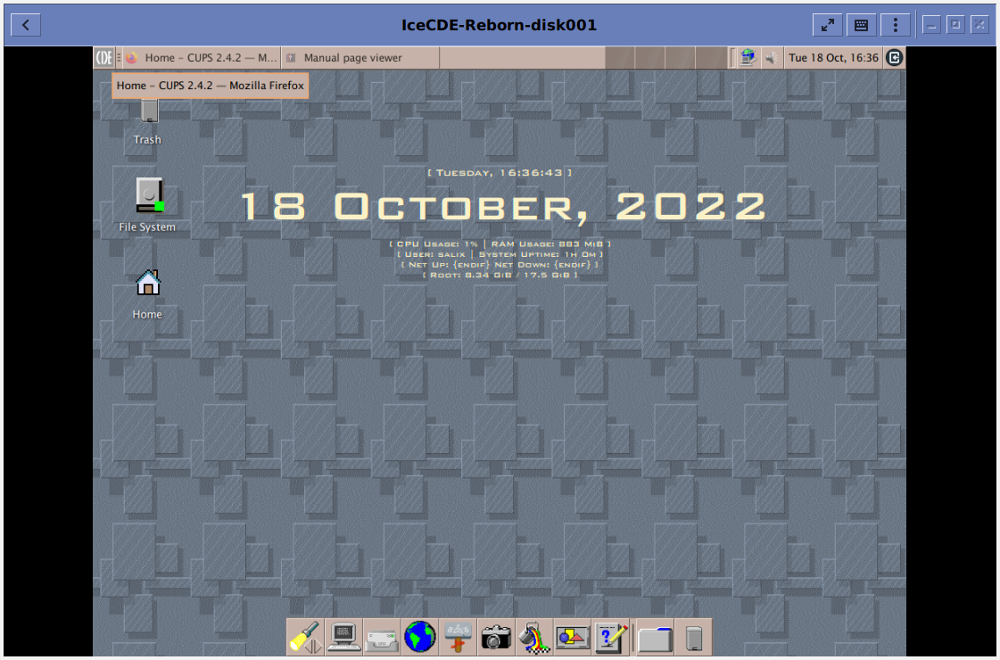



Overall view
CDE picture as menu icon : ☺
File system icon : ☺
Conky theme if conky wanted : ☺
Why not put the CDE icon in the bottom panel : ☺
Geany icon : put the same as leafpad ? ☺
Icon for web browser and email client : ☺
Home icon : ☹
Exit icon : ☹
However redondancy between home and thunar icons : ☹

Slide 4
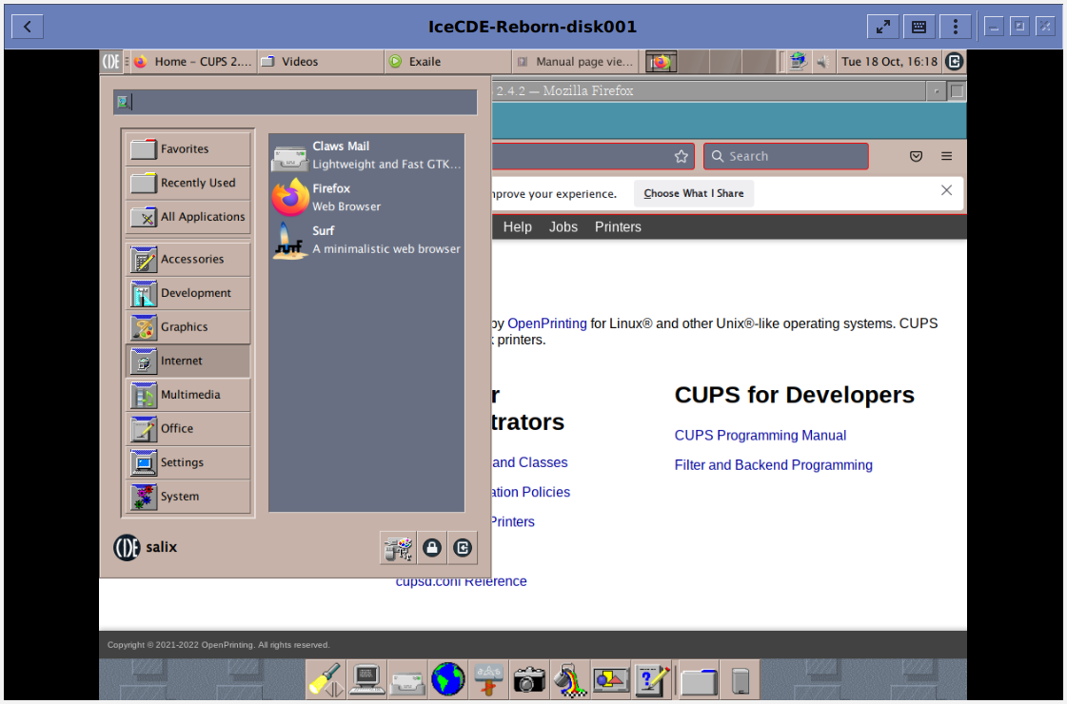
Menu view : menu categories
Perfect : ☺

Slide 5
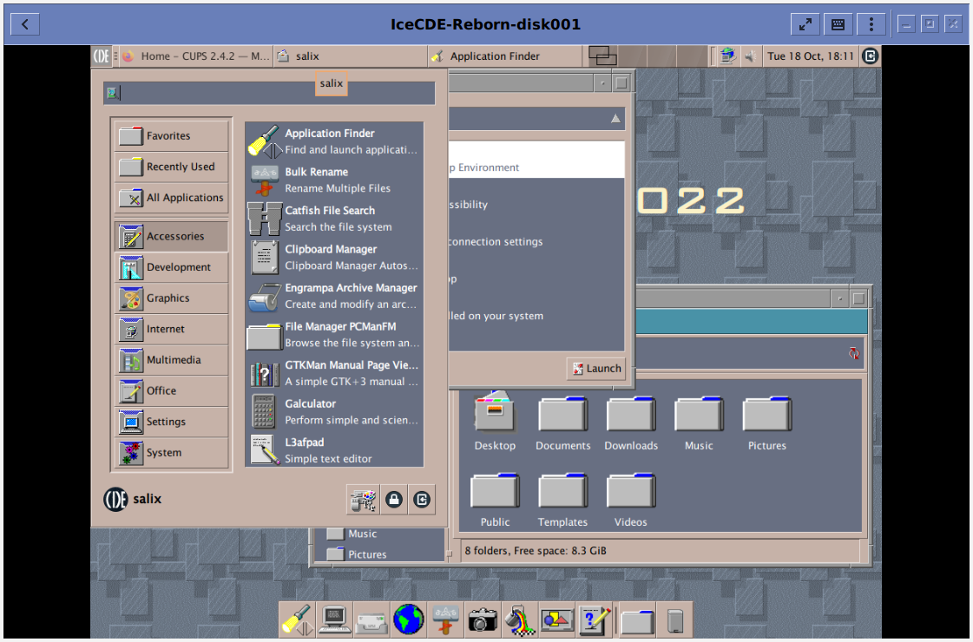
Menu view : Accessories
Perfect, maybe the thunar icon to think about, but it’s ok if it stays like that : ☺

Slide 6




Menu view : internet
Claw mail icon : ☺
File system icon : ☺
Surf icon, put the same as firefox as in bottom panel ? ☺
All applications icon, put the CDE app box icon ? ☹
Firefox icon : ☹
Lock-screen icon : ☹
Exit icon : ☹

Slide 7
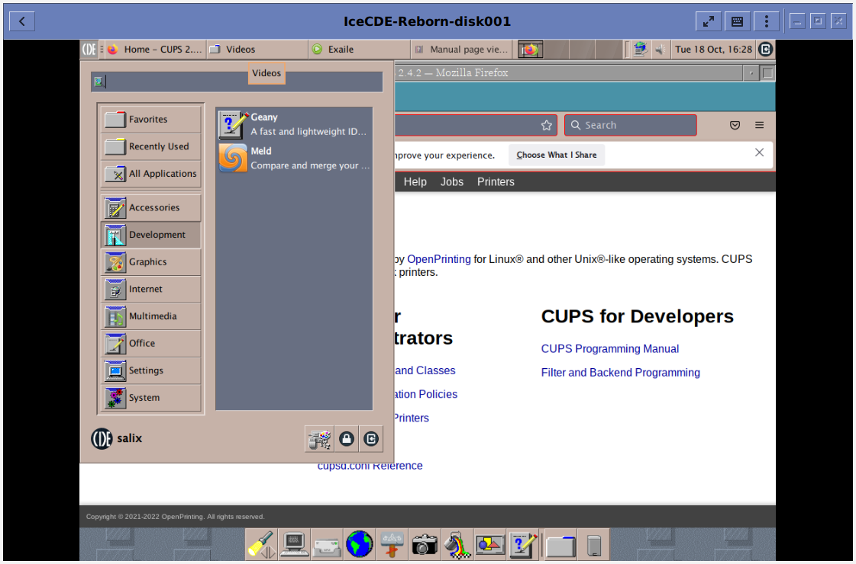
Menu view : Development
Geany icon two suggestions same as leafpad or geany icon: ☺

Slide 8
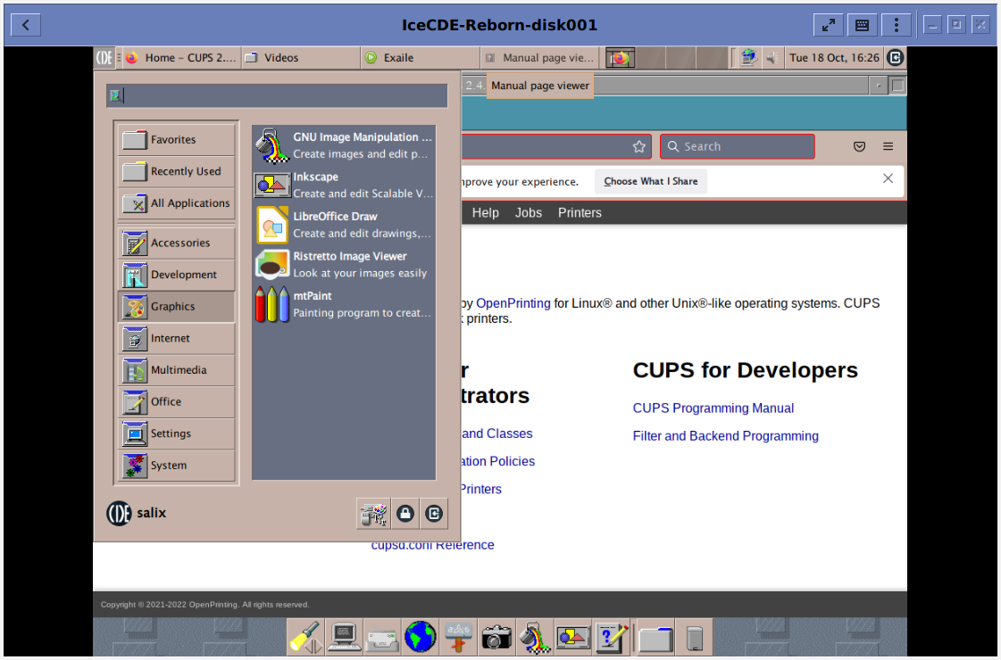
Menu view : Graphics
Gimp icon : ☺
Inkscape icon : ☺

Slide 9
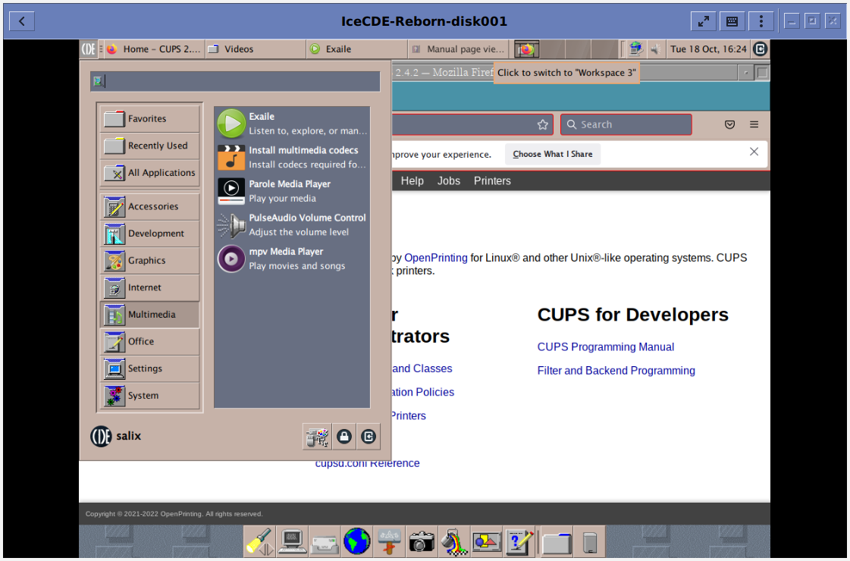
Menu view : Multimedia
Pulse-audio icon : ☺

Slide 10

Menu view : Multimedia
Appearance icon : ☺
Desktop icon : ☺
Display icon : ☺
Keyboard and mouse icons, etc. : ☺
Default applications icon, not really satisfied by my suggestion : ☺
File manager settings, not sure my suggestion is very good due to the redundancies that it can make : ☺

Slide 11
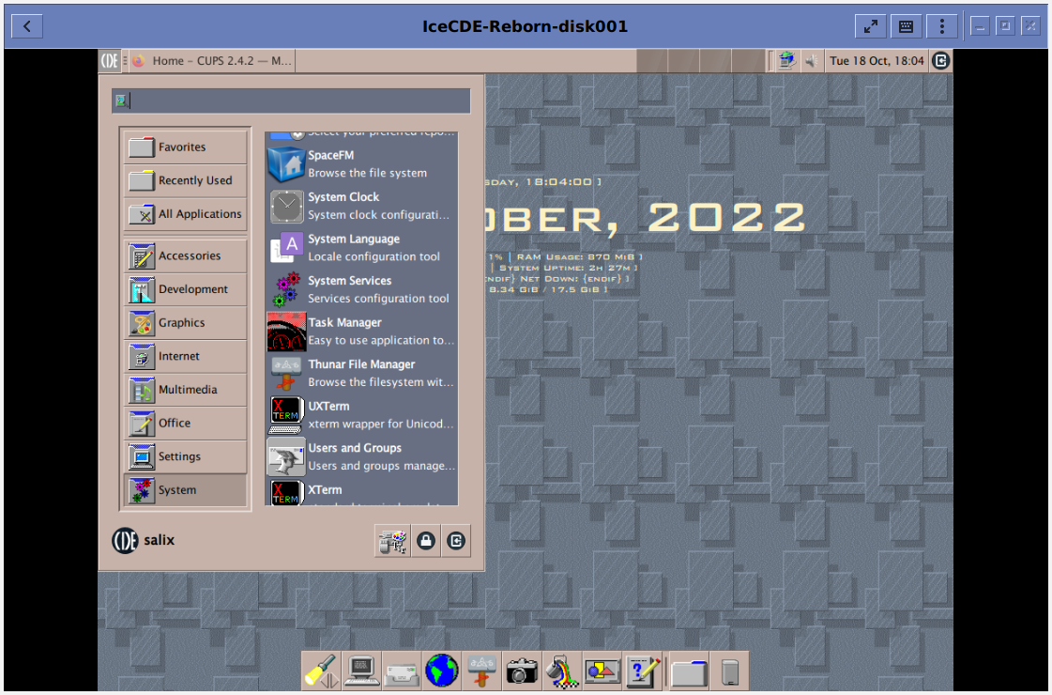
Menu view : System
System clock icon, funny to finally take advantage of the clock icon : ☺
Task manager icon : ☺
System services icon : ☺
Keyboard and mouse icons, etc. : ☺
User and group icon, seems to me it’s more another mailing icon but I don’t have a better idea : ☺
XTerm and UXTerm icons, ok it can be different from the xfce4 icon : ☺

Slide 12
Good surprises
But
Sound and videos work in the virtual machine,
System clock, Catfish icon, Task manager icon, these are good inspired choices to me,
Relevant icons even in the apps menus,
The new tab icon in applications like pcmanfm, the use of little actions icons like + and - for zooming, use full screen and so on.
Maybe it’s little overkill to use the « Exit » button in applications menus, it should be used to exit Xfce session only,
And it seems difficult to get perfect navigating arrows, but as far as I have experienced, scaling those triangle pixmaps can lead to little distorsions.

Slide 13
Finally
GREAT WORK !!! ☺ ☺ ☺

Slide 14
This work is licensed under a Creative Commons Attribution-ShareAlike 3.0 Unported License.
It makes use of the works of Mateus Machado Luna.

