Slide 1


BabyShark Online Shop Database Project
Louise BOUREY, Owen BURGAUD, Paul DORFFER, Stéphane DUC©HEMIN

Slide 2
The Main Interrogations
What are the closest Withdrawal points ?
How can the client easily reach the Supplier ?
What are the best products regarding to the sales ?
Louise BOUREY, Owen BURGAUD, Paul DORFFER, Stéphane DUCHEMIN

Slide 3
You can have data without information, but you cannot have information without data.” – Daniel Keys Moran
Louise BOUREY, Owen BURGAUD, Paul DORFFER, Stéphane DUCHEMIN

Slide 4
The Database Diagram

Slide 5
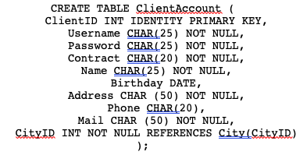
The Data Base Creation
12 table
10 data per table
Louise BOUREY, Owen BURGAUD, Paul DORFFER, Stéphane DUC©HEMIN

Slide 6
Insertion of the Data
The Query
INSERT INTO ClientAccount (Username, Password, Contract, Name, Birthday, Address, Phone, Mail, CityID) VALUES ('banban2001', 'J+p8jN,77', 'Prime', 'John Doe', '20010410', '78 avenue des Champs Elysées', '+1 (240) 783-2983', 'johnnydoe@gmail.com', 1);
The Result
Louise BOUREY, Owen BURGAUD, Paul DORFFER, Stéphane DUC©HEMIN

Slide 7
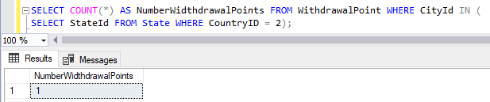
The Queries
Number of Withdrawal Point in Canada
The Query
The Result

Slide 8
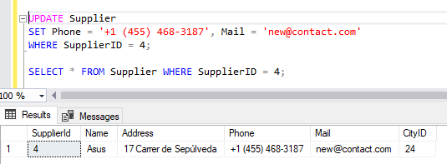
The Queries
Change Contact information of Supplier
The Query
The Result

Slide 9
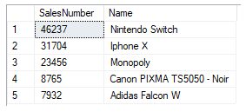

The Queries
Top Sales
The Result
The Query

Slide 10
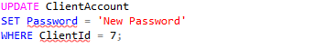
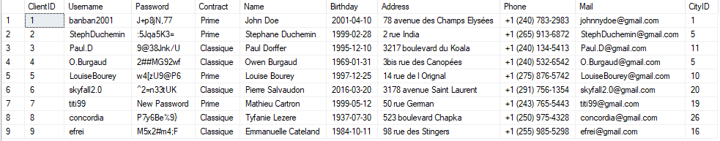
The Queries
Change Password
The Query
The Result
Louise BOUREY, Owen BURGAUD, Paul DORFFER, Stéphane DUCHEMIN

Slide 11
The Queries
Add Client
The Query
The Result
Louise BOUREY, Owen BURGAUD, Paul DORFFER, Stéphane DUCHEMIN

Slide 12

The Queries
Change Contract
The Query
The Result
Louise BOUREY, Owen BURGAUD, Paul DORFFER, Stéphane DUCHEMIN

Slide 13
Thanks
For your attention !
Louise BOUREY, Owen BURGAUD, Paul DORFFER, Stéphane DUC©HEMIN

