Slide 1
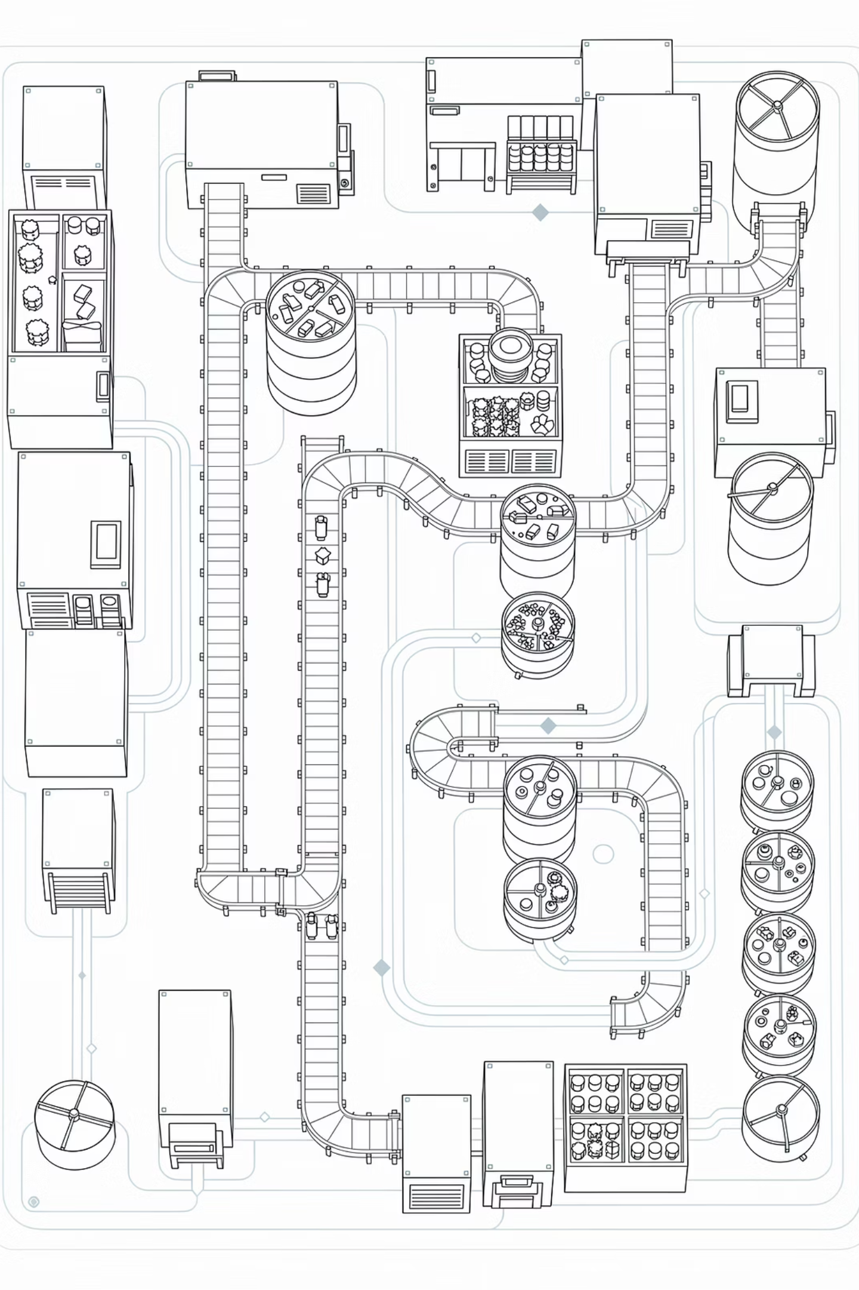
Urban Rig Europe
Business Plan — March 2026
The first European deployment of a patented, continuous superheated-steam pyrolysis system — converting mixed, unsorted waste into marketable oil, biochar, and metals, with zero dioxin emissions.
BUSINESS PLAN

Slide 2
Table of Contents
1
When Waste Becomes a Crisis: The Global Challenge
2
The Solution: Transforming Waste with Urban Rig Technology
3
Versatility: Managing Non-Recyclable and Composite Materials
4
Market Opportunities and Business Cases
5
Business Model and Revenues
6
Deployment Economics & Financial Returns
7
Appendix: Awards and Credentials

Slide 3
Executive Summary
The Opportunity
The Business Model
Urban Rig Europe presents the first European deployment of Urban Rig — a patented pyrolysis system converting mixed waste into four marketable oil fractions, biochar, and recoverable metals. Urban Rig Europe manages regional sales and programme delivery; OneWorld Corporation (Osaka) is the R&D headquarters. This business plan details the technology, market, and financial case.
The model is open by design. Site, feedstock strategy, scale, operating team, and capital structure are the investor's design space. Urban Rig brings the technology, the IP, and a configurable financial model.
The One Non-Negotiable
Urban Rig remains the technology partner and equipment supplier.
Financial Outlook
Projected financials include a CAPEX of €63.8M, generating €16.1M in annual revenue across five streams. With an EBITDA of €8.9M (55% margin), the model targets a 17.6% ROI and a simple payback period of approximately 7 years.

Slide 4
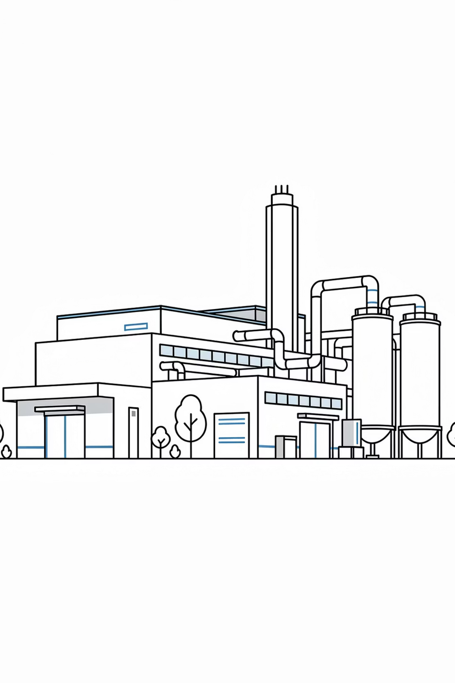
Proven Technology at Industrial Scale
Tested 2022
Asada Shokai, Noda, Japan — industrial-scale trial across nine resin types.
70–82% Oil Yield
From pure plastics. NKKK-certified oil quality at 43.27 MJ/kg — comparable to fossil diesel.
5–50× Below Limits
Emissions verified by KANSO Technos — 5 to 50 times below French incineration standards.
Modular & Deployable
Ships in 7 truck sections. URC-2000 (200 T/day nominal) operates with ~15 staff.

Slide 5

Illustrative Economics — URC-2000, France Base Case
€63.8M
€16.1M
Revenue Breakdown
Based on 46,200 T/year throughput (330 operating days, 140 T/day actual weight at 0.7 T/m³ MSW bulk density).
CAPEX
Annual Revenue
Gate fees: 33% of revenue
Fuel oil sales: 39% of revenue
Char/biochar: 9% of revenue
Recovered metals: 4% of revenue
Carbon credits: 15% of revenue
55%
~7yr
EBITDA Margin
Simple Payback
€8.9M/year
Equity payback ~12 years
Inputs — feedstock, tipping fees, oil price (€480–895/T), geography, and scale — are fully adjustable in the configurable financial model.

Slide 6
Why Now
EU Circular Economy Mandates
Strong Oil Market
Ready for Deployment
EU regulations mandate 65% recycling and a maximum 10% landfilling rate by 2035—targets currently unmet by member states. France currently incinerates 38% and landfills 18% of MSW, creating a significant regulatory gap.
ICIS plastic pyrolysis oil reached €670/T in 2024–25. Market demand is supported by expanding ISCC-certified premiums as circular economy compliance requirements continue to tighten.
The Urban Rig technology is commercially mature, fully manufactured, and validated. The system is verified and field-proven at an industrial scale, minimizing technical risk for immediate deployment.

Slide 7

Investment Process
Discovery
Independent Validation
Manufacture & Commission
Align objectives (2–4 weeks)
Technical review (2–4 months)
Build to operations (12–18 months)
Joint Scenario Dev
Commercial Structuring
Co-create options (4–8 weeks)
Negotiate terms and close
The investment process is structured in five stages, each designed to build technical and commercial confidence progressively — from initial assessment through to operational launch.

Slide 8
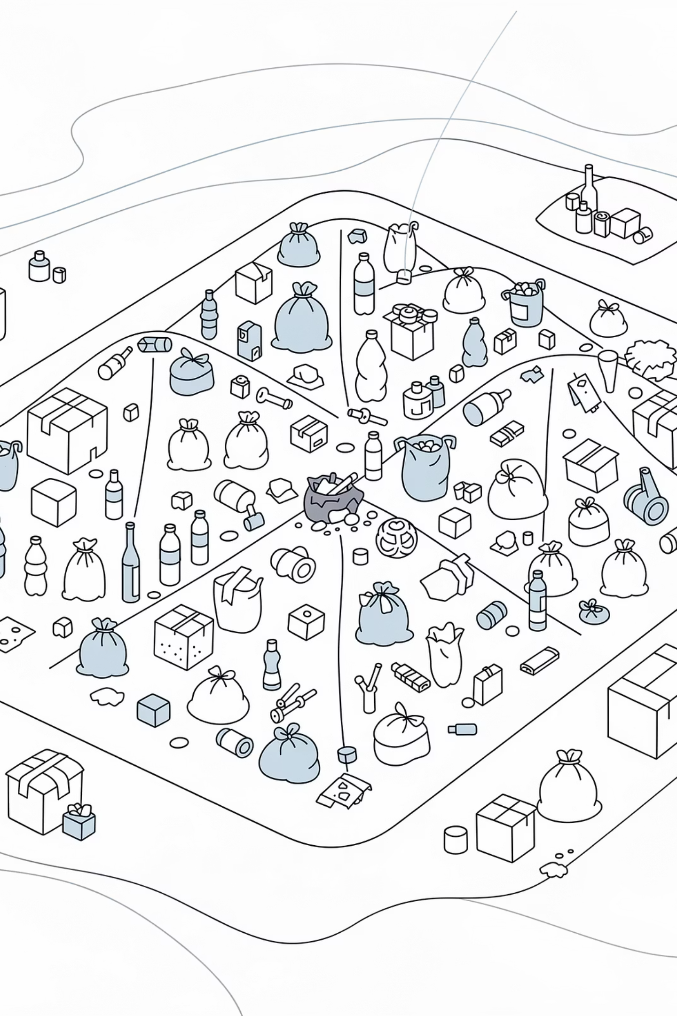
CHAPTER 1
The Problem: A Global Waste Crisis
2.01B
225M
22.9%
Tonnes MSW (2016)
Tonnes in Europe
Still Landfilled (EU)
Projected to reach 3.4 billion tonnes by 2050. Source: World Bank "What a Waste 2.0"
513 kg per capita annually. Only 49.6% recycled or composted. Source: Eurostat 2023
27.5% incinerated; the remainder recycled or composted.

Slide 9
The French Context
National Picture
The Regulatory Gap
France generates 38.5 million tonnes of MSW annually (580 kg per capita — above the EU-27 average of 505 kg). Treatment relies heavily on incineration (38.1%) and landfilling (18.1%), with recycling at only 26.9%. Source: ADEME 2022.
The EU Circular Economy Package mandates 65% recycling by 2035 and a maximum of 10% landfilling — targets France is far from meeting. This creates urgent demand for technologies that can process mixed residual waste into valuable resources.
The Limits of Incineration
Île-de-France
Conventional incineration generates dioxins, CO₂, and toxic bottom ash (machefer) requiring controlled landfilling. Material recovery is only 5–10%. Safe incineration plants are prohibitively expensive, making waste management a pure cost centre. Source: Annex A.
The region alone produces 6.2 million tonnes/year (17,000 T/day), with 37% going to incineration and 18% to landfill. Source: ORDIF.

Slide 10
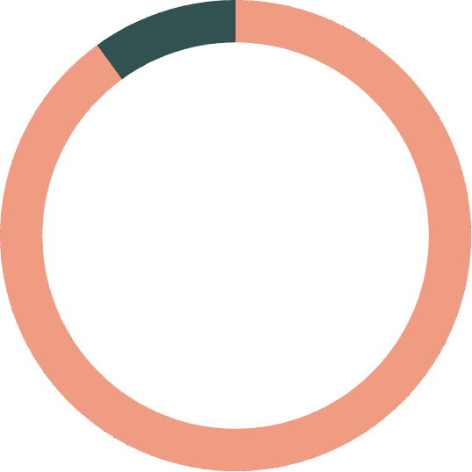


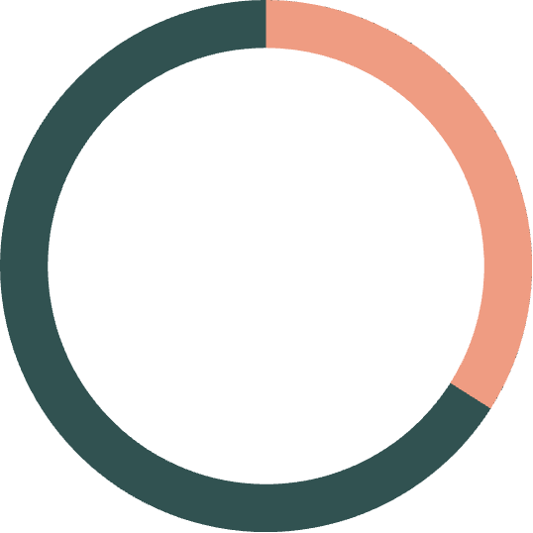
The Limits of Mechanical Recycling
Mechanical recycling cannot address the majority of plastic waste in French MSW. 76% of plastics are either not recycled or have very low recyclability.
90%
95%
PP Non-Recycling Rate
PS Non-Recycling Rate
Polypropylene — one of the most common plastics — is almost entirely unrecycled.
Polystyrene faces near-total non-recycling in France.
100%
34%
Composite Non-Recycling
PET to Landfill/Incin.
Composite and multi-layer plastics are entirely unrecycled by conventional means.
Even PET — the most recycled plastic — sees 34% go to incineration or landfill.

Slide 11

CHAPTER 2
The Solution: Urban Rig Technology
Urban Rig is a patented superheated-steam pyrolysis and carbonisation system that transforms waste management from cost centre to profit centre. Operating in a completely anoxic (oxygen-free) reactor, it converts mixed, unsorted waste directly into four marketable oil fractions, industrial-grade charcoal, and recoverable metals and glass.
No Sorting Required
Handles Any Condition
PVC & All Halogens
Mixed waste — including mud, metals, pesticides, and food residue — loaded directly. One day of storage to reduce surface moisture is the only preparation.
Processes muddy, wet, and contaminated feedstock including sludge, food waste, and agricultural residues — a challenge conventional pyrolysis cannot handle.
Catalytic layer adsorbs chlorine; steam neutralises HCl. Extends to all brominated and fluorinated plastics — waste streams no other technology can safely handle.

Slide 12

Four Marketable Oil Fractions
The 7-zone continuous process separates recovered oil into four distinct fractions by temperature-controlled condensation. At 90% resin content, total liquefied oil recovery reaches 76.5% of input. NKKK-certified calorific value: 43.27 MJ/kg — comparable to fossil diesel at 42.6 MJ/kg.
Zone
Temp.
Yield
Oil Type
Key Uses
Zone 1
150°C
~10%
Light Naphtha (C5–C8)
Petrochemical feedstock; industrial solvent
Zone 2
300°C
~80%
Gas/Diesel Oil (C8–C20)
Recycled diesel; SAF co-processing; industrial boiler
Zone 3
450°C
~10%
Heavy Oil (C20+)
Industrial heavy fuel; bitumen/asphalt feedstock
Zone 4
600°C
Traces
Asphaltenes
Solid fuel (carbide); soil amendment (biochar)
Only non-condensable gas is recycled to fuel the machine after startup. All condensed oil fractions (Zones 1–4) are collected for commercial use or resale.

Slide 13
Patented Technology & Precision Automation
Patented Thermal Transfer System
Minimal Staffing Through Automation
Urban Rig's patented system delivers superior conductivity and heat transfer via ultra-fine particle technology — achieving combined spread, convective, and condensation heat transfer that exceeds conventional pyrolysis. The result: finer temperature control and measurably better yields across all feedstock types.
The entire 7-process cycle — drying, heating, carbonisation, oil extraction, and three-stage cooling — is automatically operated by microcomputer control. Three buckets move as one batch through seven zones every 90 minutes, enabling 24-hour continuous throughput of 48 batches/day. A 200 T/day plant operates with ~15 staff.

Slide 14
Environmental Performance
Zero Dioxin & CO₂ Emissions
Optional PRIMO Exhaust Upgrade
Because the reactor operates in a completely anoxic state, dioxins and CO₂ are simply not generated — unlike incineration where oxygen reacts with carbon and chlorine. This is a fundamental process advantage, not a filtration afterthought.
The PRIMO (PUREM 30.8) module performs DeNOx, DeSOx, dust removal, and odour removal — using the same technology standard at thermal power plants worldwide — enabling near-zero atmospheric impact in sensitive urban or airport environments.
Emissions Far Below Regulatory Limits
Integrated Water Purification (SEA CORAL)
Independent exhaust analysis by KANSO Technos confirms Urban Rig emissions are 5 to 50 times lower than French incineration standards:
The URC-2000 includes an integrated SEA CORAL ceramic purification system, enabling closed-loop water management and eliminating wastewater discharge.
Pollutant
Measured
Factor Below Limit
Low Noise & No Explosion Risk
HCl
<1 ppm
>10×
Thermal decomposition occurs entirely inside enclosed equipment. Operating noise is comparable to a cooling tower. With no oxygen in the reactor, there is no risk of explosion or ignition at any point in the process.
SOₓ
<1 ppm
>50×
NOₓ
15 ppm
>13×
Particulates
<0.002 g/m³
>5×

Slide 15
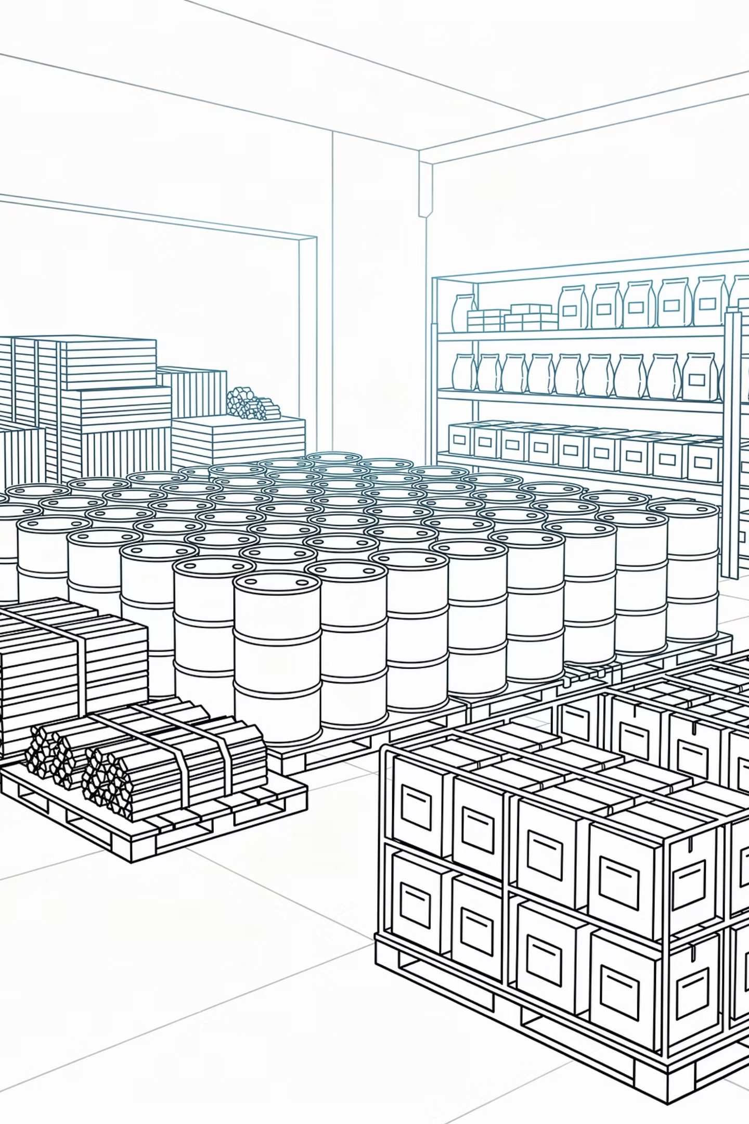
All Outputs Are Marketable
Every output from the Urban Rig process is a saleable resource — in sharp contrast to conventional incineration, which produces toxic bottom ash (machefer) and fly ash requiring expensive hazardous landfilling.
Fuel Oil (4 Fractions)
NKKK-certified; 43.27 MJ/kg calorific value. Qualifies for ISCC sustainability premium.
Industrial Charcoal (Carbide)
~25 MJ/kg calorific value — comparable to coal (23–30 MJ/kg). Sold as solid fuel or certified agricultural biochar.
Recovered Metals & Glass
Extracted in non-oxidised condition, yielding high-purity copper and other materials for direct recycling.
Massive Volume Reduction
Carbonisation reduces input to ~25% of original volume. Unlike incineration residue, the vast majority is reusable.

Slide 16
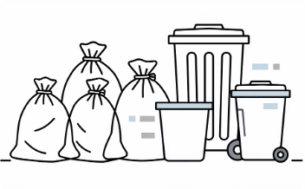
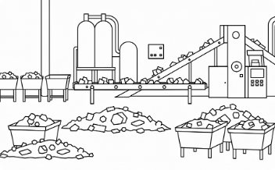
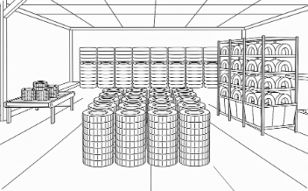
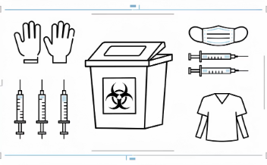
CHAPTER 3
Versatility: Processing Hard-to-Recycle Waste
Urban Rig's anoxic superheated steam process is feedstock-agnostic — safely and profitably treating waste streams considered difficult or impossible to recycle through conventional means.
Municipal & Household Waste (MSW)
Industrial Plastics & Manufacturing
Tyres & Rubber Waste
Medical, ICAO & Sanitary Waste
40–50% oil yield. ~1 billion waste tyres generated globally each year. Recovers oil, carbon black, and steel — three saleable outputs per tonne.
20–66% oil yield. Gate fees: €80–180/T. Baseload feedstock for continuous operations. Unsorted, mixed, no pre-sorting required.
70–82% oil yield from pure polymers. Automotive shredder residue (ASR): 35–50% yield. Multi-layer and composite packaging: 40–60% yield. Highest oil recovery per tonne.
30–50% oil yield. Gate fees: €800–1,500/T for medical/DASRI. Aircraft cabin waste (ICAO/EU Reg 1069/2009): €120–200/T. Complete thermal sanitisation in anoxic environment.

Slide 17
Further Hard-to-Recycle Streams
Sanitation-Regulated Waste (ICAO)
Other Streams
Aircraft cabin waste from international flights must be sanitised or incinerated under ICAO and EU Regulation 1069/2009. Urban Rig meets sanitation requirements while simultaneously recovering valuable oil and charcoal — replacing high-cost incineration with zero resource recovery.
Wire cord waste — with non-oxidised copper recovery
Deposition film waste (aluminium/PE composites)
Textile waste, synthetic leather, and carpet
Electronic waste plastics (brominated WEEE casings)
Mattresses and furniture foam (polyurethane)
Nappies and absorbent hygiene products (~4% of household waste)
Marine and fishing waste — nets, ropes, ocean plastics
Agricultural & Organic Waste
Livestock waste — yielding animal-derived oil
Agricultural film and silage wrap (contaminated LDPE)
Pesticide-contaminated containers and packaging

Slide 18
FORCE 9 Companion Technology & Scalability
FORCE 9 Far-Infrared Detoxification
Full Product Line — 1 to 200 T/day
For specialised applications, the FORCE 9 catalytic reduction facility detoxifies incinerated ash and carbide containing heavy metals at ~400°C. Treated waste becomes usable as fertilisers, soil conditioners, and construction materials. Can even treat radioactively contaminated soil.
Model
Capacity
Type
Notes
URB-10
1 T/day
Batch
Fits 40-ft container
URT-10
1 T/day
Mobile
10-tonne truck
URB-50
5 T/day
Batch
Small industrial site
URC-400
40 T/day
Continuous
2,700 m² building
URC-1000
100 T/day
Continuous
Mid-scale municipal
URC-2000
200 T/day
Continuous
4,650 m² building
Multiple URC-2000 plants can be combined — 5× URC-2000 yields 1,000 T/day on a 28,900 m² site. Manufacturing lead time: ~10 months (continuous), ~6 months (batch).

Slide 19

CHAPTER 4
The Market Opportunity
2.01B
225M
21.6M
Tonnes Global MSW
Tonnes in Europe/yr
Tonnes Redirectable (France)
Projected to reach 3.4B tonnes by 2050.
EU mandates 65% recycling by 2035 — no member state currently meets this.
Currently incinerated or landfilled — addressable by Urban Rig.
€670
Pyrolysis Oil Price/T
ICIS index 2024–25, with growing ISCC-certified premiums.

Slide 20
Addressable Feedstock Segments — France
Urban Rig's anoxic steam cracking process is feedstock-agnostic. The optimal strategy is a blended portfolio: MSW or airport waste as baseload, supplemented by high-margin batches of industrial plastics, tyres, and medical waste.
Feedstock Segment
France Volume/yr
Oil Yield
Gate Fee
Supply Concentration
Industrial Pure Plastics
~2.2 MT
70–82%
€60–120/T
Excellent — industrial parks; contractable
MSW (residual)
~21.6 MT
20–66%
€80–180/T
Excellent — daily municipal collection
End-of-Life Tyres
~530,000 T
40–50%
€0–50/T
Moderate — best as supplementary batch
Aircraft & Quarantine
~80–100,000 T (CDG)
25–40%
€120–200/T
Excellent at CDG — single site, captive
Medical / DASRI
~700,000 T
30–50%
€800–1,500/T
Good — urban hospitals; ÎdF highest density
Automotive Shredder Residue
~200–350,000 T
35–50%
€100–200/T
Good — ~40 shredder sites
Composite & Multi-Layer
~500,000 T+
40–60%
€80–150/T
Moderate — via sorting centres

Slide 21
Reference Deployment: CDG Airport
Why CDG?
MSW Yield Scenarios
Paris-Charles de Gaulle Airport exemplifies a strong candidate site: concentrated waste flows, plastics-rich feedstock, premium ICAO-regulated gate fees, proximity to industrial offtake markets, and a site operator under sustainability pressure.
Scenario
Oil Yield
Description
A: Full OMR (mixed MSW)
23%
As received
Waste Composition
B: Plastic-like fraction
65%
Pre-sorted plastic-rich stream
CDG generates an estimated 80,000–100,000 T/year of mixed waste:
C: PE+PP polyolefins only
78%
High-value polyolefin stream
Aircraft cabin waste: 40% (ICAO-regulated)
Terminal waste: 30%
Catering/quarantine waste: 15%
Cargo and logistics: 10%
MSW Feedstock Composition
Food & Organic: 38.4% → Charcoal (carbide)
Paper, Card, Wood & Cotton: 37.9% → Charcoal + off-gas
Plastics & Synthetic Polymers: 23.7% → Fuel oil (4 fractions)
Source: Annex F — ADEME MODECOM 2017 full 13-category decomposition.

Slide 22
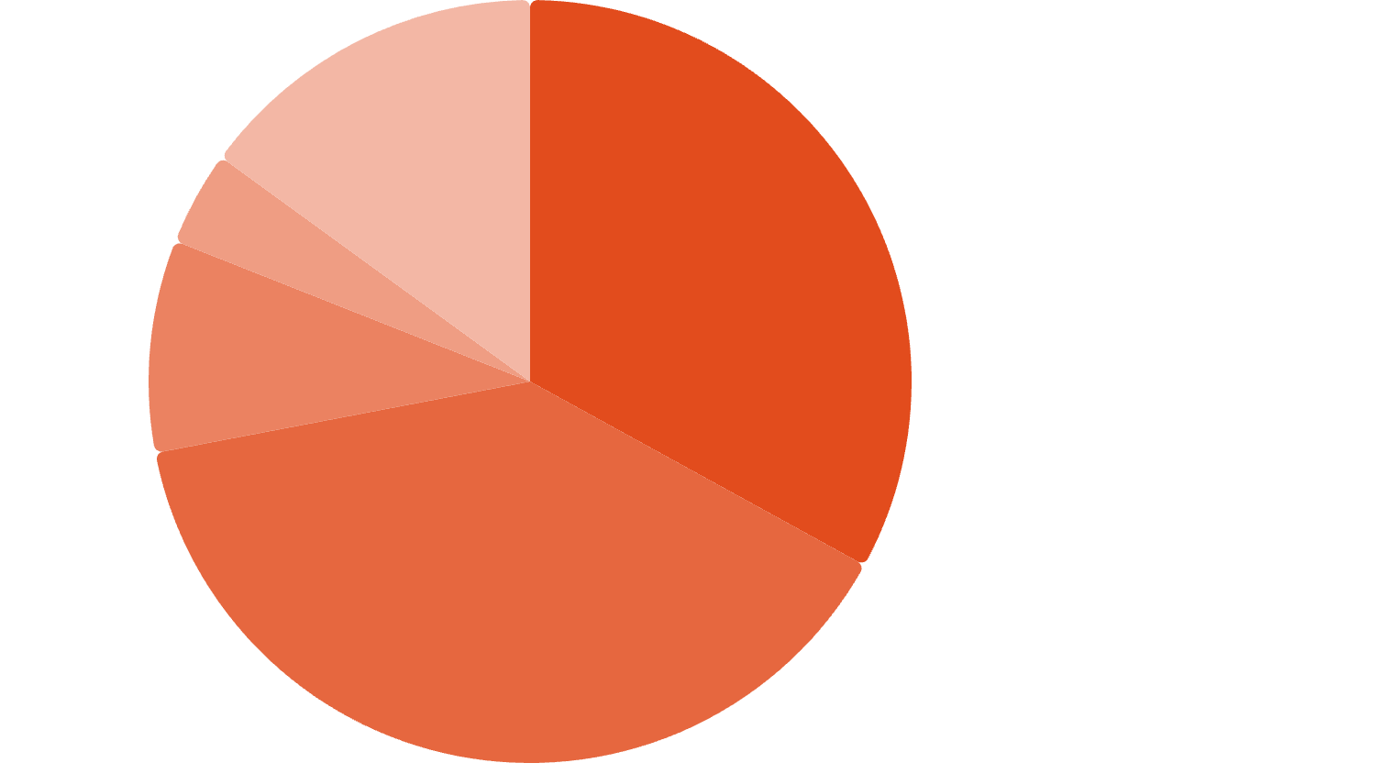
CHAPTER 5
The Business Model: Four Revenue Streams
Annual Revenue Breakdown (Year 3)
Based on URC-2000 reference deployment: 46,200 T/year at 330 operating days.
Gate Fees·33%
·33%
·
Stream
Annual
%
Fuel Oil Sales·39%
·39%
·
Char/Biochar·9%
·9%
·
Gate fees
€5.3M
33%
Recovered Metals·4%
·4%
·
Carbon Credits·15%
·15%
·
Fuel oil sales
€6.3M
39%
Char/biochar
€1.4M
9%
Recovered metals
€0.6M
4%
Carbon credits
€2.5M
15%
TOTAL
€16.1M
100%

Slide 23
Oil Pricing Scenarios
Oil pricing is modelled at three scenarios based on current market benchmarks (ICIS plastic pyrolysis oil index, NWE naphtha, fossil gasoil). Urban Rig's waste-derived oil qualifies under EU sustainability frameworks and commands an ISCC-certified premium over conventional fossil equivalents — expected to widen as circular economy regulations tighten.
Conservative
Base Case
Optimistic (ISCC Premium)
€480/T (€0.41/L)
€641/T (€0.55/L)
€895/T (€0.76/L)
Annual oil revenue: ~€4.7M
Annual oil revenue: ~€6.3M
Annual oil revenue: ~€8.8M
Source: Annex G — Oil Fraction Pricing Model; ICIS (2024–2025). ISCC = International Sustainability and Carbon Certification.

Slide 24
Energy Supply Model
V2: Purchased Heating Oil
By-Product Value
The V2 model uses purchased heavy fuel oil for heating, ensuring reliable and consistent operations independent of feedstock composition.
Char/biochar (~41.4 T/day at full capacity, 13,673 T/year): all char sold commercially.
€100/T as fuel briquettes → €1.4M/year (base case)
€350/T as certified agricultural biochar → €4.8M/year
Heating demand: 2,714 MJ per tonne processed
Annual cost: ~€1.0M at full capacity (€0.40/L, HFO Rotterdam benchmark)
Ensures steady-state operations and predictable costs
Off-gas: Monitored for composition and energy content — provides valuable data on process efficiency. Not used for internal heating (recovery too variable).

Slide 25
CHAPTER 6
Deployment Economics & Financial Returns
Illustrative CAPEX — URC-2000
Illustrative Return Profile
Item
Cost
EBITDA
Simple Payback
URC-2000 equipment
€50.0M
€8.9M/year (55% margin) at full capacity
~7 years (CAPEX ÷ steady-state EBITDA)
Building & site preparation
€5.0M
Installation, freight & training
€0.9M
Equity Payback
Debt-Service Breakeven
Accessories, spares & monitoring
€2.0M
~12 years (cumulative free cash flow net of equity investment)
Year 6 — cumulative cash flow after debt service turns positive
Pre-sorting equipment
€1.1M
Post-sorting equipment
€0.4M
Compliance & engineering
€1.4M
Annualised ROI on Equity
Contingency (5%)
€3.0M
~17.6%
TOTAL
€63.8M
Financing: 70% bank debt (€44.6M at 12% over 10 years) / 30% equity (€19.1M).

Slide 26
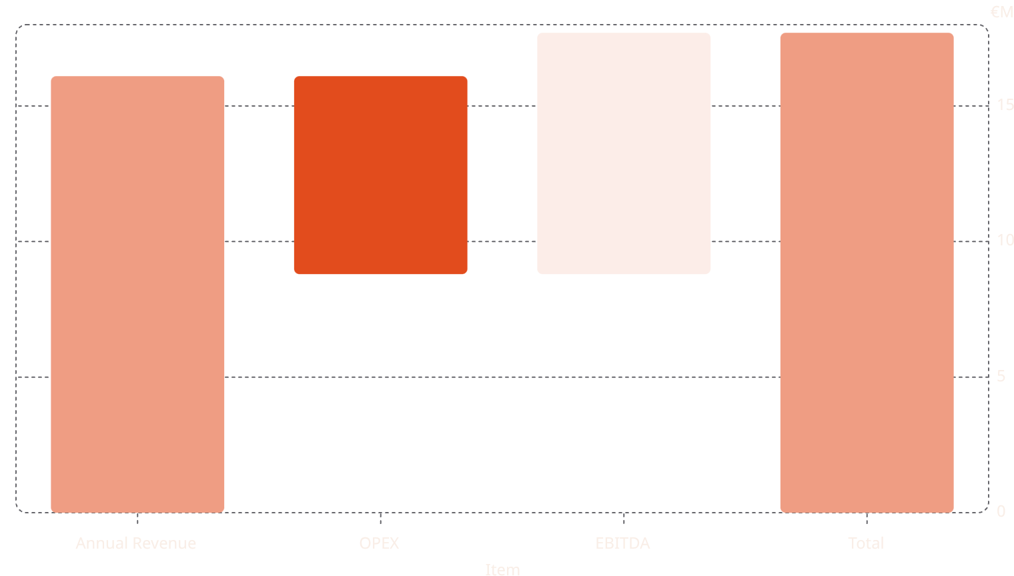
Full Financial Summary (France, URC-2000)
Metric
Value (Year 3, full capacity)
CAPEX
€63.8M
Annual Throughput
46,200 T/year (140 T/day × 330 days)
Annual Revenue
€16.1M
Annual OPEX
€7.3M
EBITDA
€8.9M (55% margin)
Simple Payback
~7 years
Equity Payback
~12 years
Debt-Service Breakeven
Year 6

Slide 27
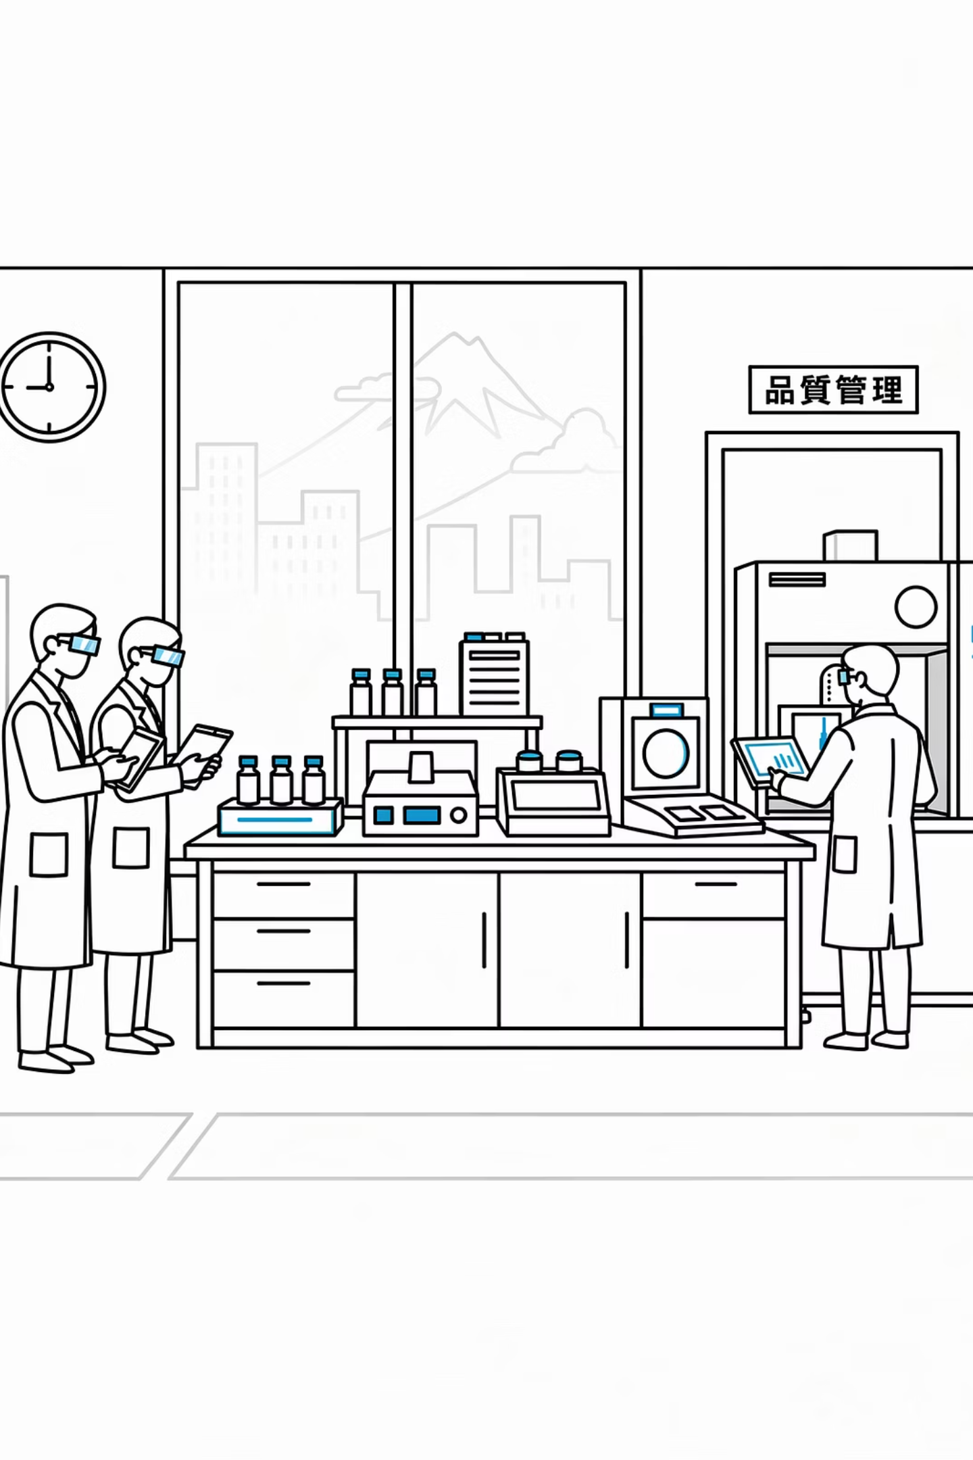
CHAPTER 7
Proven Technology: Validation & Awards
Asada Shokai Industrial Test Programme
Noda factory, Chiba Prefecture, 2022 — independent measurement by Land Brain Co., Ltd. Oil yields 70–82% from pure plastics across nine resin types.
KANSO Technos & NKKK Certification
Independent exhaust gas analysis confirming emissions 5–50× below French standards. NKKK (Japan Marine Survey Association) certified oil quality: 43.27 MJ/kg, flashpoint 46°C, sulfur <0.2%.
Field-Proven Operations & Awards
Processing plant operational in Shandong Qufu, China. Sea Waste Zero Award — Innovation category, Japan Foundation / Ministry of the Environment (June 2019). "Plastics Smart" designation — Ministry of Economy, Trade and Industry, Japan.

Slide 28

CONFIDENTIAL | MARCH 2026
Contact
Stephane Husser
Managing Director, Urban Rig Europe
stephane.husser@urban-rig.eu
Urban Rig Europe is the exclusive regional deployment partner for Urban Rig pyrolysis technology. All enquiries are handled directly by the Managing Director.

