Slide 1

Study of the web site VIE DE MERDE
VDM Group

Slide 2
WGET
wget http://www.viedemerde.fr
# Permits to get the code of the homepage of the web site in a file.
Wget -r http://www.viedemerde.fr
# Permits to get the code of the whole web site.

Slide 3
Curl
curl http://www.viedemerde.fr
# permits to see the contains of the page in the terminal
curl http://www.viedemerde.fr | grep "<b> ”
# permits to see the contains of the lines where there is the patterns " <b> "

Slide 4
SED
sed is a very powerfull command ! It is used to read specified files, and to modify the input.
sed -e 's/ StringToReplace/NewString/g' FileName
# s/ call back the function sed
# g => the modifications are globaly applied in our file

Slide 5
Erasing tags
# in our case, we need to delete all tags in our index.html file previously created.
sed -e 's/<[^>]*>//g' index.html
# the flag -e allows us to add the request : s/<[^>]*>//g
# [^>]* anything except the character >
#

Slide 6
Questions
We will get the number of post for category love
wget -np http://www.viedemerde.fr/amour | grep "tu l'as bien mérité" | wc -l^C
# to not go in the parents folders
But that don’t work.

Slide 7
New Goals
Count the number of « VDM » published
Find the number of posts by category by hour

Slide 8
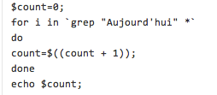
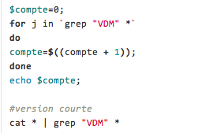
Count the number of « VDM » published
Two ways to count « vdm » in all the files
cat or grep
We also can count the number of word « Aujourd’hui »
Because this word is in all the « VDM »

Slide 9
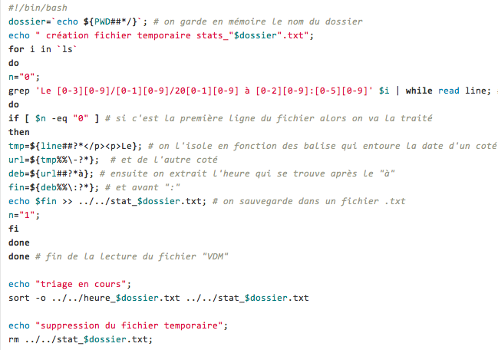
Find the number of post by category by hour
First we have to place in a Repository of one category

