Slide 1
Onyx Café
2026, the year in review
Board meeting · 14 January 2027
Notes:
Welcome. Twenty minutes: the figures, the best sellers, the terrace, and what we plan for 2027.

Slide 2
Agenda
Takings in 2026
84,455 € — the best year so far
Best sellers
what sold, what did not
The new terrace
opened in June
Plans for 2027
four steps, one per quarter
Notes:
Four parts. Questions at the end, please.

Slide 3
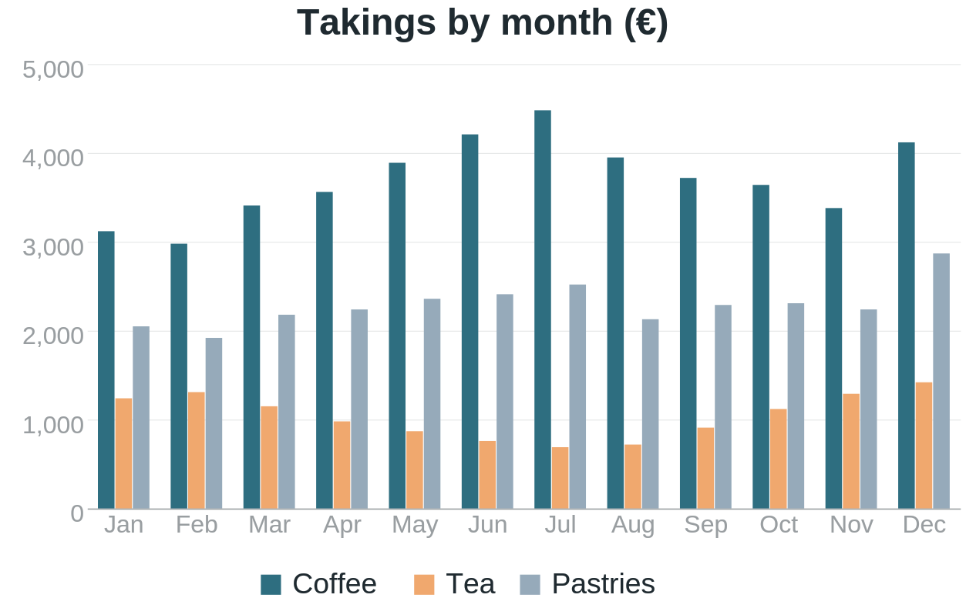
Takings by month
84,455 €
takings in 2026
▲ +31.2 %
over 2025
Best month
December: 8,411 €
Notes:
Say first: the best year since we opened (2019). Thank the team.
Point to December: the Christmas menu (+22 % on the month).
Then the summer: the terrace — next slide.

Slide 4
Best sellers
Product | Units | Takings | vs 2025
Flat white | 6,412 | 22,442 € | +18 %
Croissant | 5,980 | 11,960 € | +9 %
Espresso | 5,104 | 12,760 € | +4 %
Chai latte | 2,233 | 8,932 € | +41 %
Carrot cake | 1,876 | 7,504 € | +12 %
Iced tea | 1,140 | 3,420 € | −6 %
Notes:
The flat white leads again. The chai latte: +41 %, the surprise of the year.

Slide 5

The new terrace
Opened on 12 June
40 seats, facing the sea
+22 % takings in summer
Open until 23:00 in July and August
Notes:
The terrace paid for itself in one summer.

Slide 6
Plans for 2027
Loyalty card
on the phone app
A second shop
near the station
Q1
Q2
Q3
Q4
Brunch menu
weekends, 9:00–14:00
Roast our own
a small roaster, 5 kg
Notes:
Four steps, one per quarter. The second shop depends on the bank (decision in March).

Slide 7
What our customers say
“
The best flat white in town, and now with a view of the sea.
— Marie L., a regular since 2021
★★★★★ 4.8 / 5 on 1,204 reviews
Notes:
Read it slowly. Then the score.

Slide 8
Thank you
Questions?
Notes:
Thank everyone; the coffee is on us.

