Slide 1
Contact Information
Stephan Heinemann
SMS: +1 (250) 891-5446
Email: stephan.heinemann@hotmail.com
Bookings, Questions

Slide 2
Illusions Created by Drift
Review Slow Flight and Slipping
Definition and Motivation
Visual Illusions – Low Flying
Summary and Questions
Preflight Briefing

Slide 3
Review Slow Flight and Slipping
Mentally perform a recovery from slow flight and state all observations and required actions.
What actions have to be completed before initiating a take-off?
Describe the take-off phases line-up, run and initial climb.
What are the criteria for a normal take-off?
Mentally perform a normal take-off and state all observations and actions.
What causes wake-turbulence and how does it affect your take-off?

Slide 4
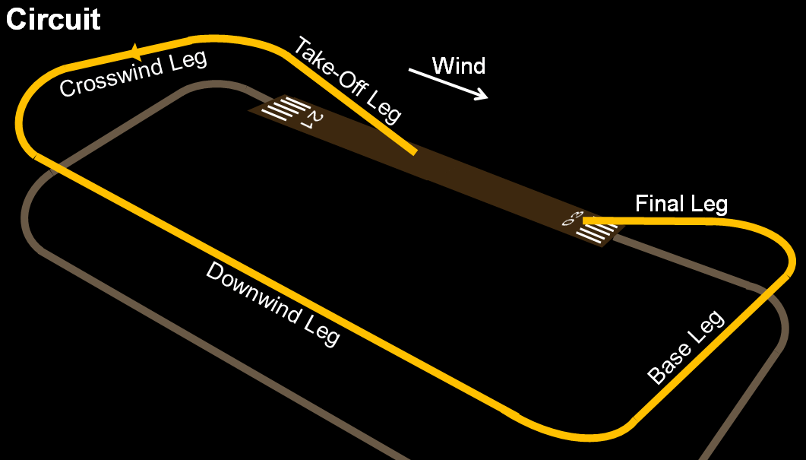
Definition and Motivation
Standardized rectangular traffic circuit at aerodromes
Ordered and organized flow of traffic to avoid conflicts
Safety and traffic separation, stabilized approaches
Types: controlled and uncontrolled aerodrome circuit
Applications: low-level flight → circuits, arrivals and departures, low ceilings (Special VFR), forced / precautionary landing (later)

Slide 5
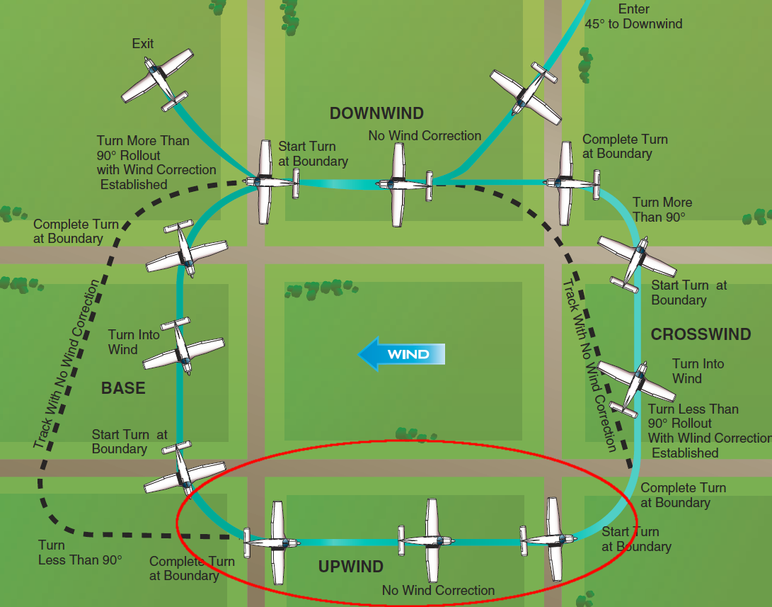
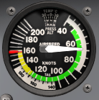
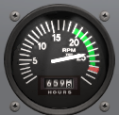
Upwind Flight
Illusion of being to slow, false desire to increase power
Trust your airspeed, tachometer and engine sound
Avoid exceeding any limitations (red lines)

Slide 6
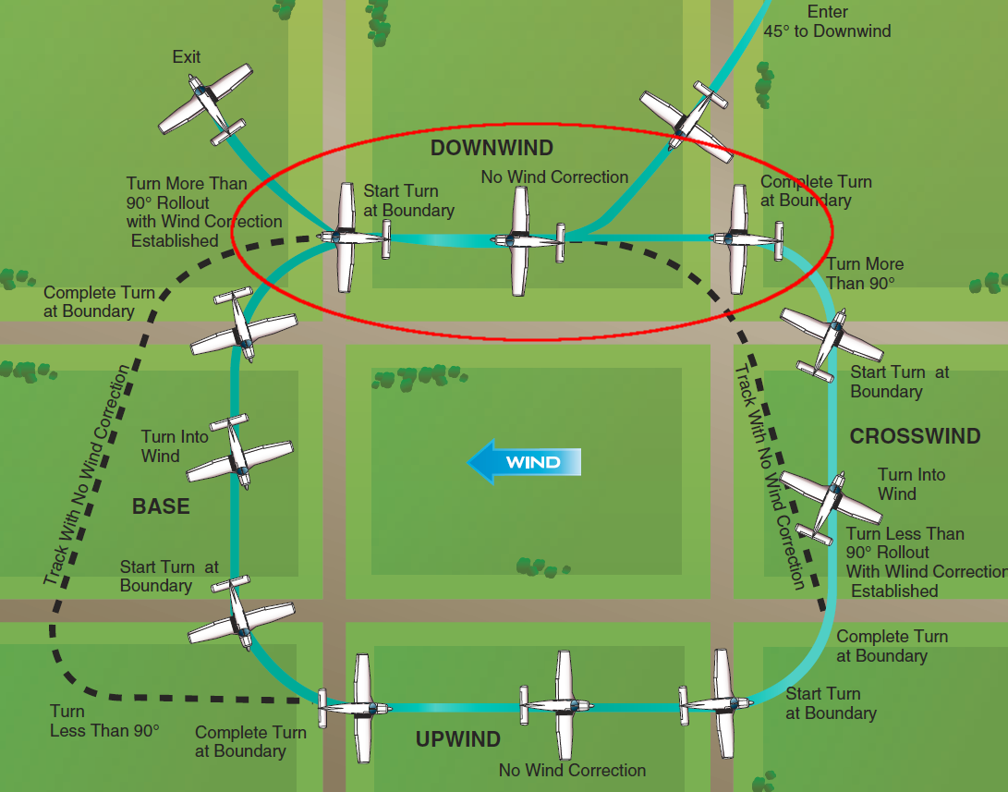
Downwind Flight
Illusion of being to fast, false desire to decrease power
Trust your airspeed, tachometer and engine sound
Avoid inadvertent entry to slow flight or stall (bottom of arcs)

Slide 7
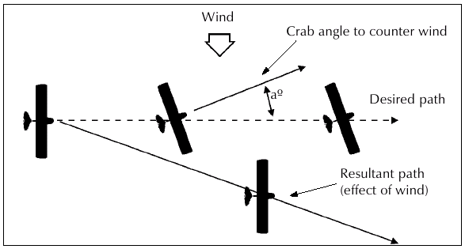
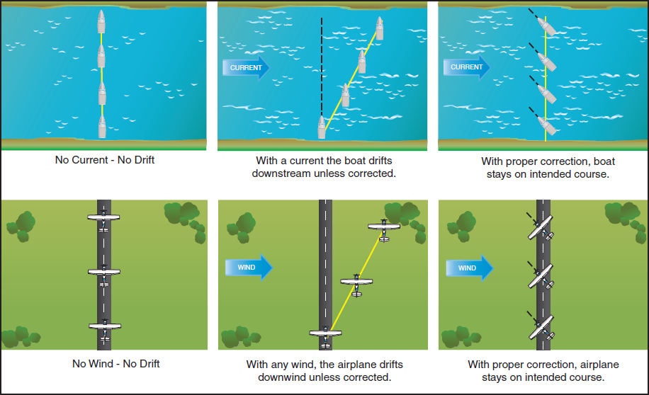
Crosswind Flight
Illusion of incorrect track, false desire to adjust heading
Trust your path over ground, verify landmarks and chart
Avoid inadvertent drift off-course

Slide 8
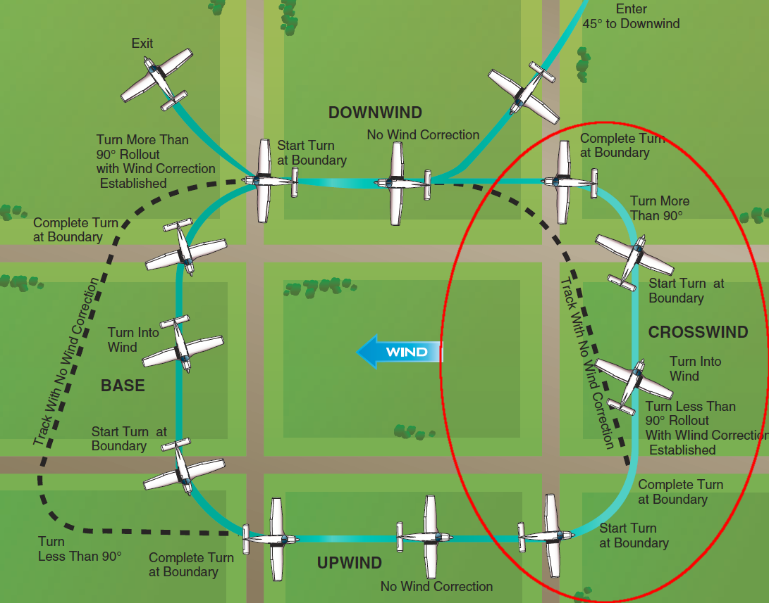
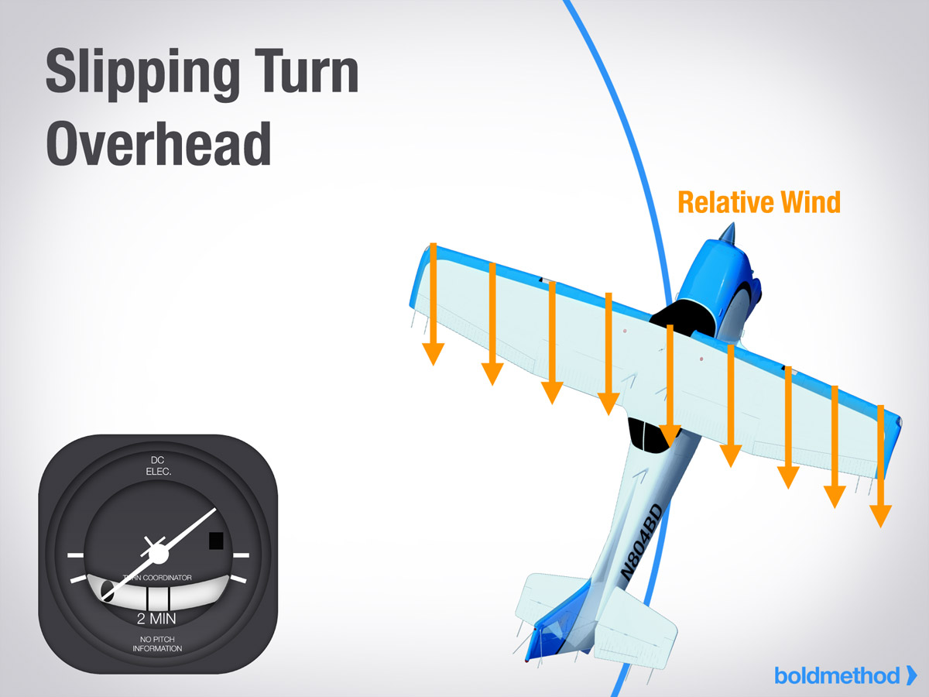
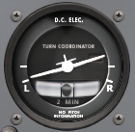
Turn – Upwind to Downwind
Illusion of slipping into the turn, false desire to apply rudder
Trust your turn coordinator and resulting ground track
Avoid inadvertent skid

Slide 9
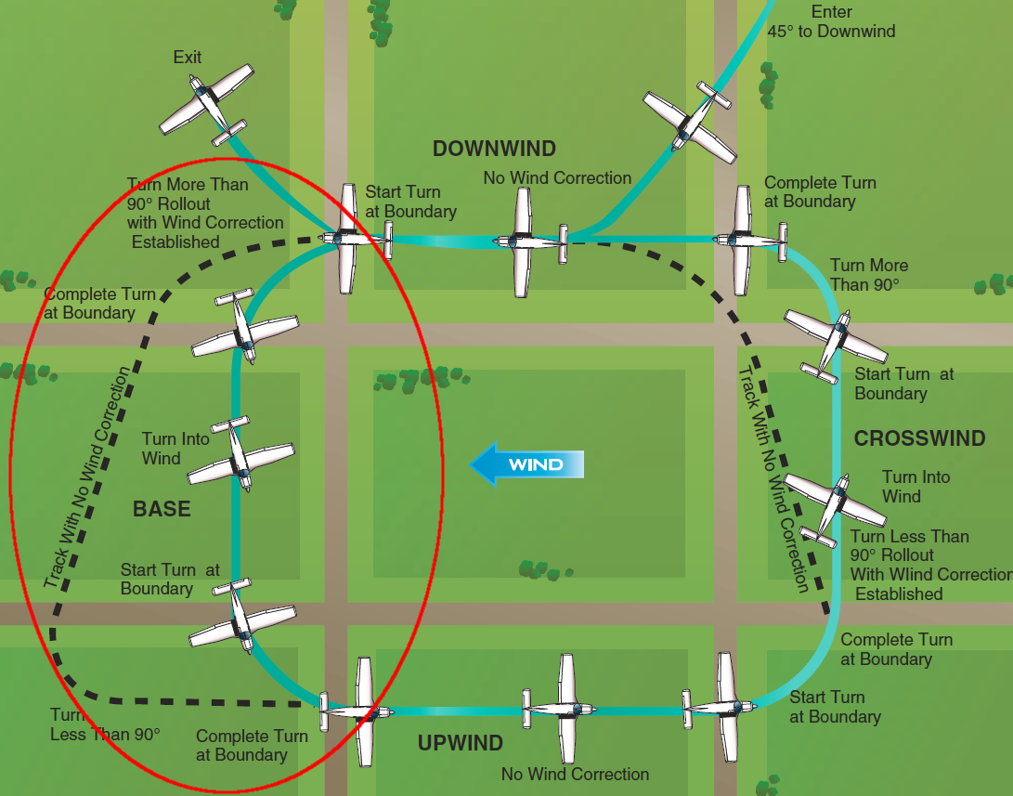
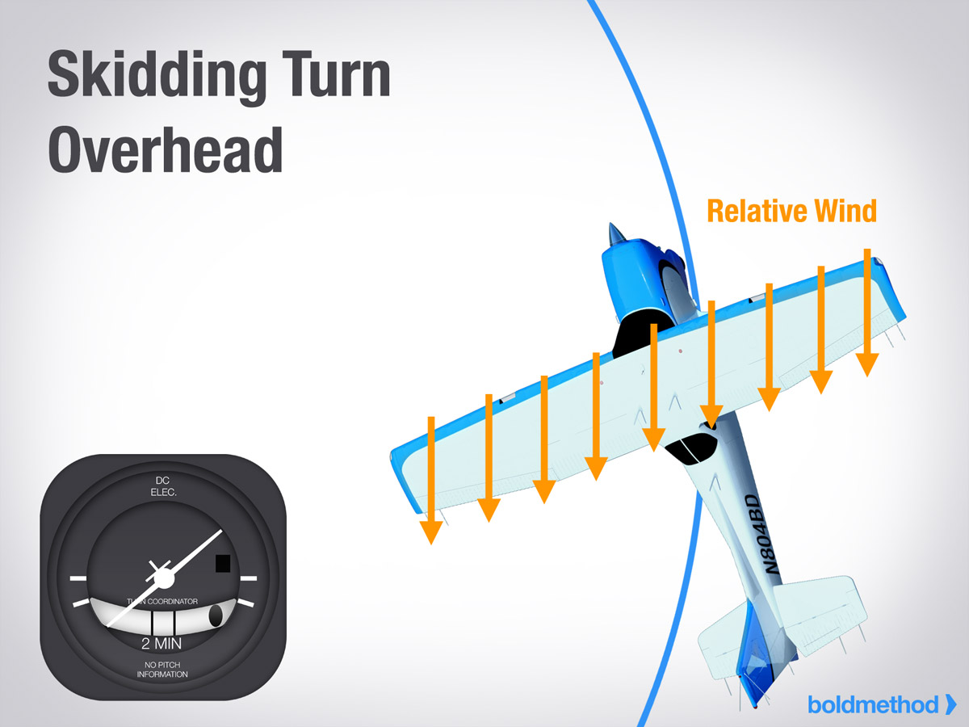
Turn – Downwind to Upwind
Illusion of skidding into the turn, false desire to apply rudder
Trust your turn coordinator and resulting ground track
Avoid inadvertent slip

Slide 10
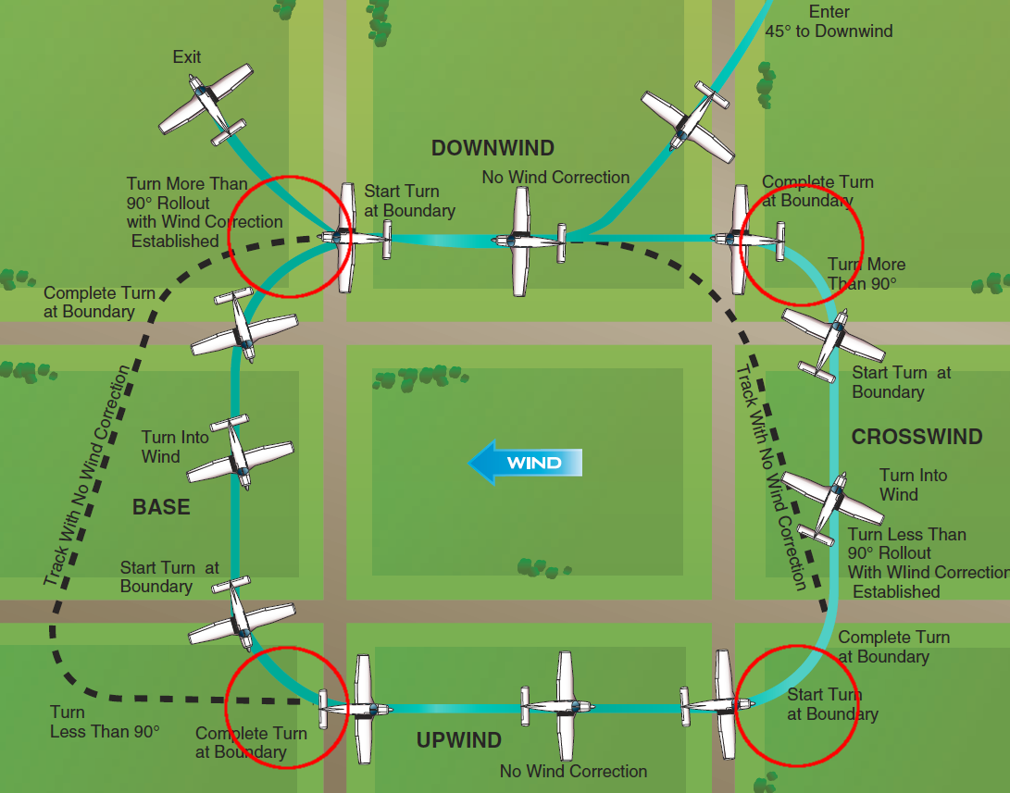
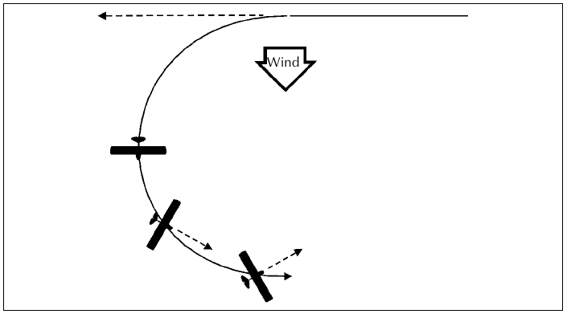
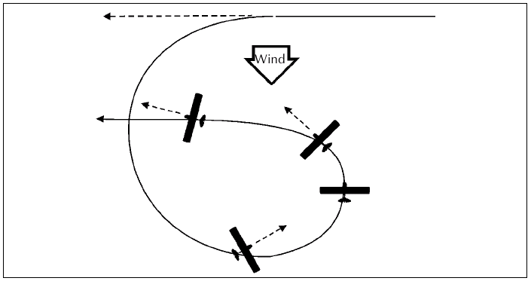
Turn – Crosswind
Anticipate drift over ground
Anticipate turns with wind and use crabbing on legs
Avoid overbanking and skidding particularly turning to final

Slide 11
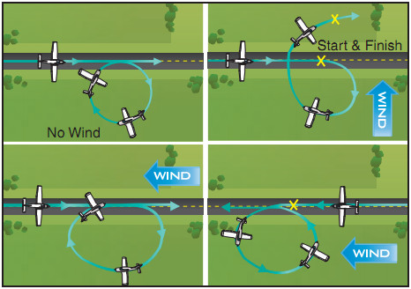
Turn – 360°

Slide 12
Forward Visibility – Speed and Flaps

Slide 13
Summary / Quiz
What are the two main types of circuits and how do they differ?
Describe the standard circuit with respect to legs, sides, directions and heights.
Where do you find what particular circuit and procedure applies to an aerodrome?
Assume you want to join the Nanaimo traffic circuit approaching from Victoria. The ATIS informs you that the weather is VFR and the active runway is 34. Mentally perform the procedure and state all observations and required actions.

Slide 14
Pre-Flight Briefing
Exercise
Training Area
Departure and Arrival Procedures
Weather Briefing / NOTAMs
Aircraft and Documents

Slide 15
Illusions (Ex. 20, LP. 24)
Objective
Review
Motivation
Howto
Summary / Questions
Preflight Briefing

Slide 16
Climbing and Descending with Wind

