Slide 1
Contact Information
Stephan Heinemann
SMS: +1 (250) 891-5446
Email: stephan.heinemann@hotmail.com
Bookings, Questions

Slide 2
Part I – Basic Climbing and Descending
Review Attitudes and Movements
Basic Climbs and Leveling Off
  Attitude, Power, Trim (APT)
Basic Power-off Descents and Leveling Off
  Power, Attitude, Trim (PAT)
Instruments
Summary and Questions
Pre-Flight Briefing
Notes:
- include motivation statement

Slide 3
Review
How do we establish a nose-up/down attitude?
What external references change how?
Which instruments change how?
How do we maintain heading in straight flight?
How do we maintain altitude in level flight?

Slide 4




Establishing a Basic Straight Climb
Attitude
Power
Trim
In cruise-attitude lookout ahead and above
Establish a nose-up attitude
Apply full power maintaining selected nose-up attitude
Keep straight and control yaw with rudder
Trim and continue to monitor heading, airspeed and altitude
Notes:
- what are the cockpit checks to be performed
- nose-up tendency during power application
- forward pressure required to maintain attitude
- rudder required to prevent yaw (slipstream, p-factor)

Slide 5

Maintaining a Basic Straight Climb
Attitude
Airspeed
Adjust attitude to attain desired climb airspeed
Re-trim after complete attitude adjustment
Continue to lookout and monitor heading, airspeed and altitude
Notes:
- use external references and instruments
- don't fly with trim but adjust trim after stabilizing
- ask how to adjust attitude

Slide 6

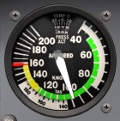
Leveling Off from a Basic Straight Climb
Attitude
Power
Trim
Establish cruise attitude at desired target altitude
Accelerate to cruise airspeed
Reduce power maintaining cruise attitude
Keep straight and control yaw with rudder
Trim and continue to monitor heading, airspeed and altitude
Notes:
- never exceed the RPM red line limit
- decreasing power may require backward pressure
- rudder required to prevent yaw (slipstream, p-factor)

Slide 7
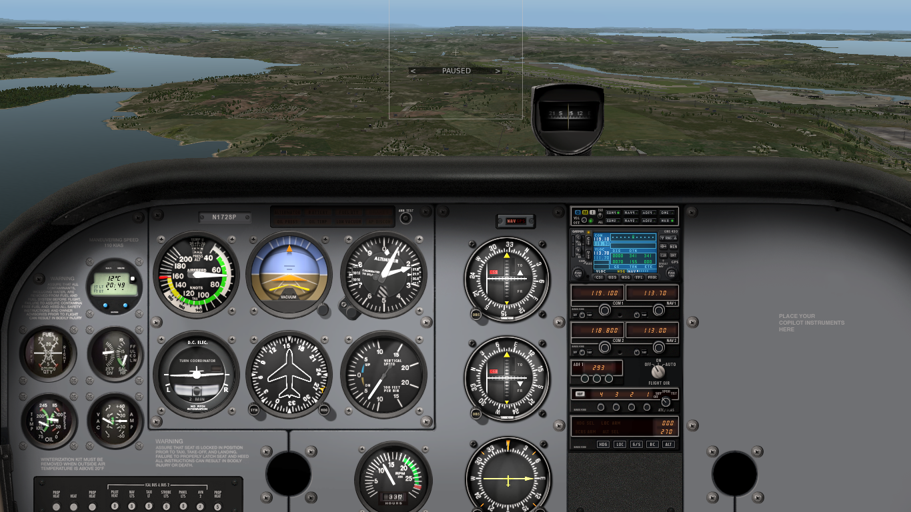
Establishing a Basic Straight Descent
Power
Attitude
Trim
In cruise attitude lookout ahead and below
Reduce power to idle (power-off descent)
Keep straight and control yaw with rudder
Decelerate to descent airspeed maintaining cruise attitude
Establish nose-down attitude and trim
Notes:
- what are the cockpit checks to be performed
- backward pressure is required to maintain attitude
- use nose-down attitude picture with proper airspeed
- use carburetor heat if applicable
- highlight that descent attitude actually depends on airspeed and a best glide attitude is actually a nose-up attitude at 68 KIAS
- similar for climbs, at high speeds a more nose-down attitude can result in a climb
- the required attitude for climbs or descents depends on the desired airspeed (more in the advanced climbs and descents slides)

Slide 8

Maintaining a Basic Straight Descent
Attitude
Airspeed
Adjust attitude to attain desired descent airspeed
Re-trim after complete attitude adjustment
Continue to lookout and monitor heading, airspeed and altitude
Notes:
- ask how to adjust attitude

Slide 9
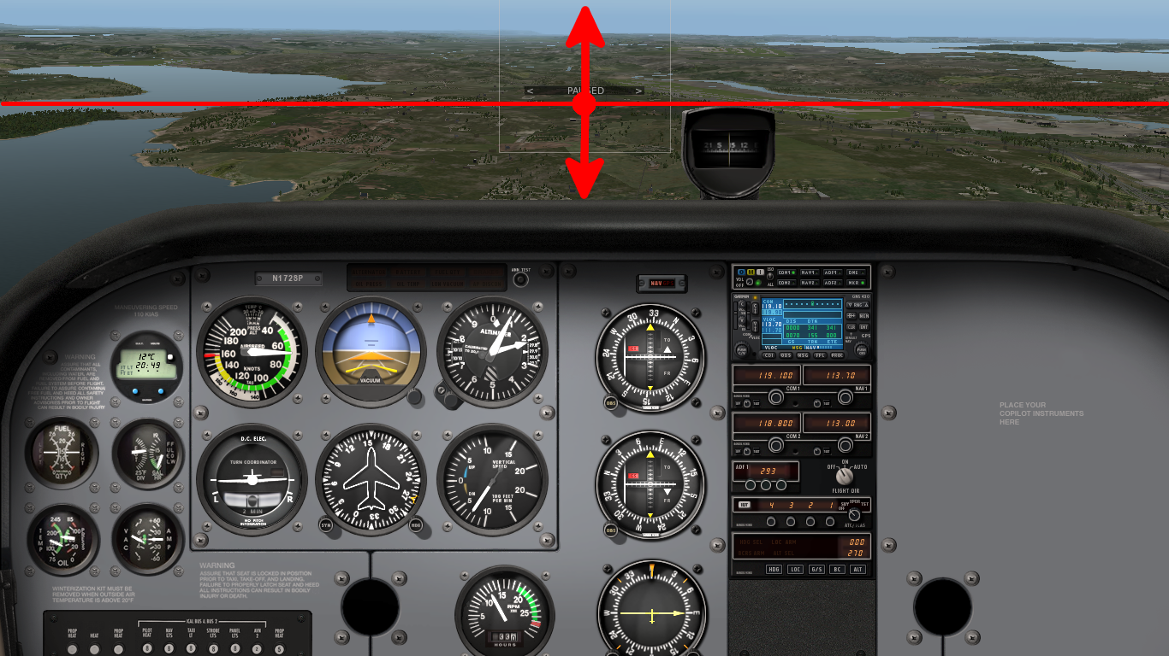
Estimating the Power-Off Glide Path
References that move up cannot be overflown
References that move down can be overflown
References that remain steady are on glide path
Farthest glide is achieved at best glide speed 68 KIAS
Notes:
Ask interesting what if question to (re)-establish a glide-path.

Slide 10
Leveling Off from a Basic Straight Descent
Power
Attitude
Trim
In nose-down attitude lookout ahead and above
Increase power to cruise power setting
Establish cruise attitude and accelerate to cruise airspeed
Keep straight and control yaw with rudder
Trim and continue to monitor heading, airspeed and altitude
Notes:
- power application results in nose-up tendency

Slide 11
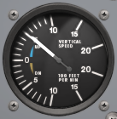
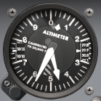
Instruments
Airspeed Indicator
Vertical Speed Indicator
Altimeter
Airspeed indicator is the main reference instrument
Monitor airspeed, vertical speed and altitude

Slide 12
Summary / Quiz
Mentally perform a basic climb and level off and state all required actions. (APT)
Mentally perform a basic power-off descent and level off and state all required actions. (PAT)
How can we confirm the correct glide-path during a descent visually?

Slide 13
Pre-Flight Briefing
Exercise
Training Area
Departure and Arrival Procedures
Weather Briefing / NOTAMs
Aircraft and Documents
Time and Fuel Requirements
Safety Considerations and Responsibilities

Slide 14
Additional Materials
Additional materials for climbing and descending
Flight Instructor Guide – Exercises 7 and 8
Flight Instructor Guide – Lesson Plans 2, 3 and 4

Slide 15
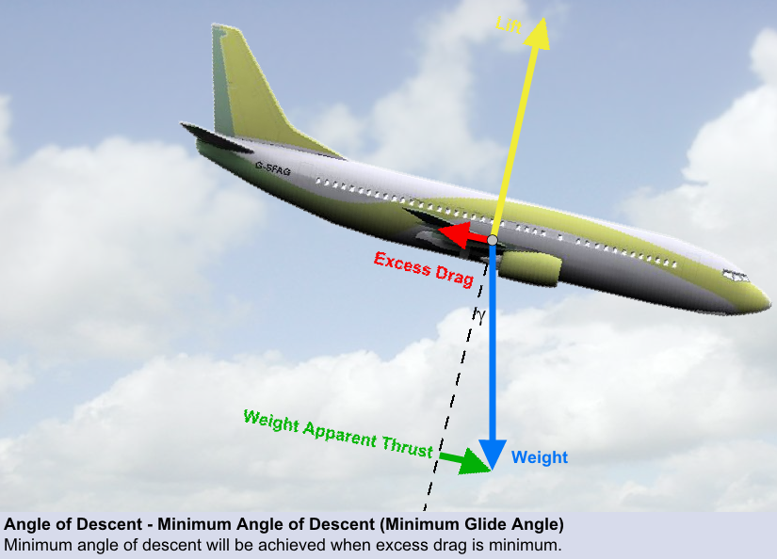
Minimum Glide Angle

Slide 16
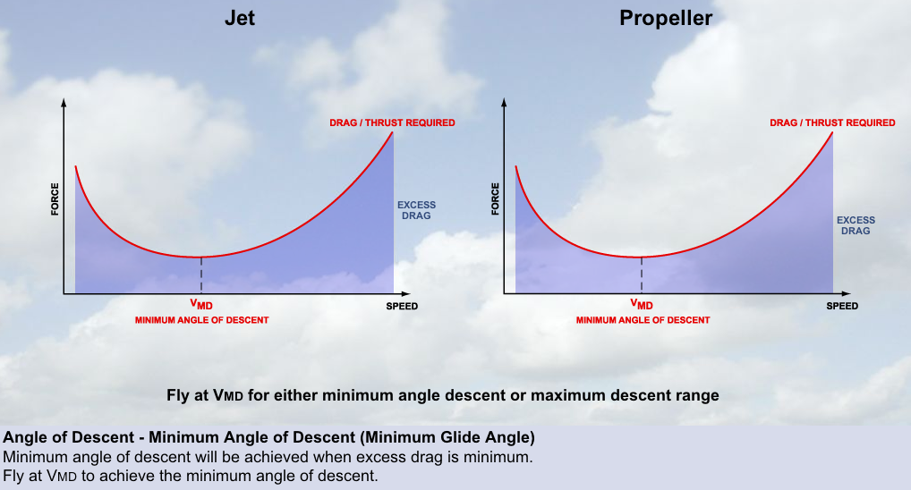
Minimum Drag

Slide 17
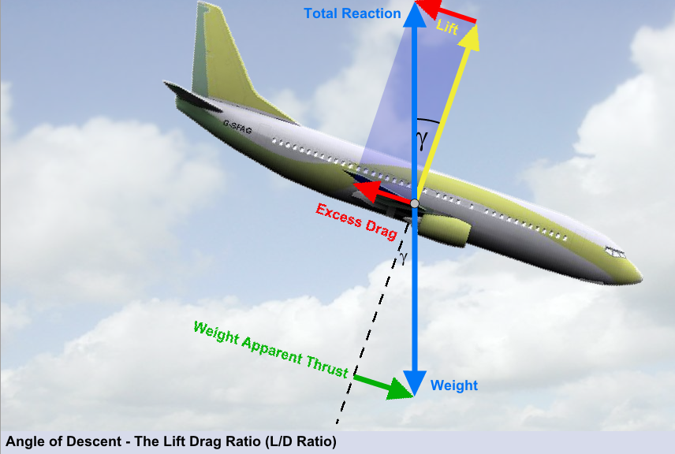
Lift to Drag Ratio

Slide 18
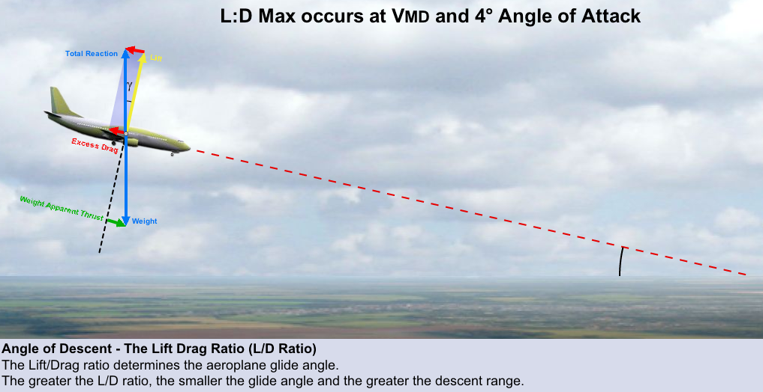
Maximum Lift to Drag Ratio
γ

