Slide 1
Contact Information
Stephan Heinemann
SMS: +1 (250) 891-5446
Email: stephan.heinemann@hotmail.com
Bookings, Questions

Slide 2
Part II – Climbing and Descending
Review Basic Climbing and Descending
Departure and Approach Climbs and Descents
V-Speeds (POH)
Flaps
Balked Landings – Power, Attitude, Trim
Summary and Questions
Pre-Flight Briefing
Notes:
- gear and carburetor heat are not applicable

Slide 3
Review Basic Climbing and Descending
Mentally perform a basic climb and level off and state all required actions. (APT)
Mentally perform a basic power-off descent and level off and state all required actions. (PAT)
How do we maintain our airspeed during a climb with set power?
How do we estimate our glide path during a descent?

Slide 4
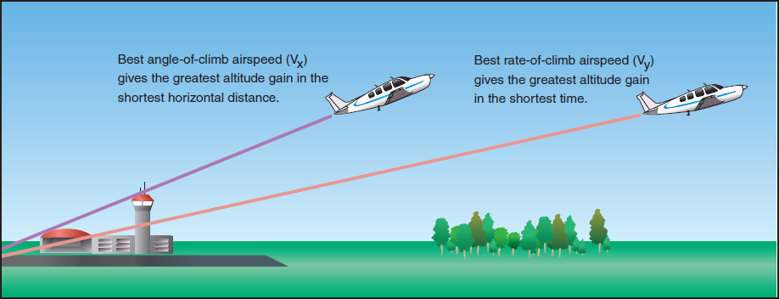
Departure and Cruise Climbs
Best angle / gradient (Vx) – ensures best obstacle clearance
Best rate (Vy)– minimizes climbing time
Normal – improves forward visibility and engine cooling
En-Route – addresses ground speed, economics, convenience and comfort (Vcc = Vy + (Vy - Vx))
Notes:
- explain why different speeds achieve different performance goals
- Vcc = Vy + (Vy – Vx) = 74 + (74 – 62) = 86

Slide 5
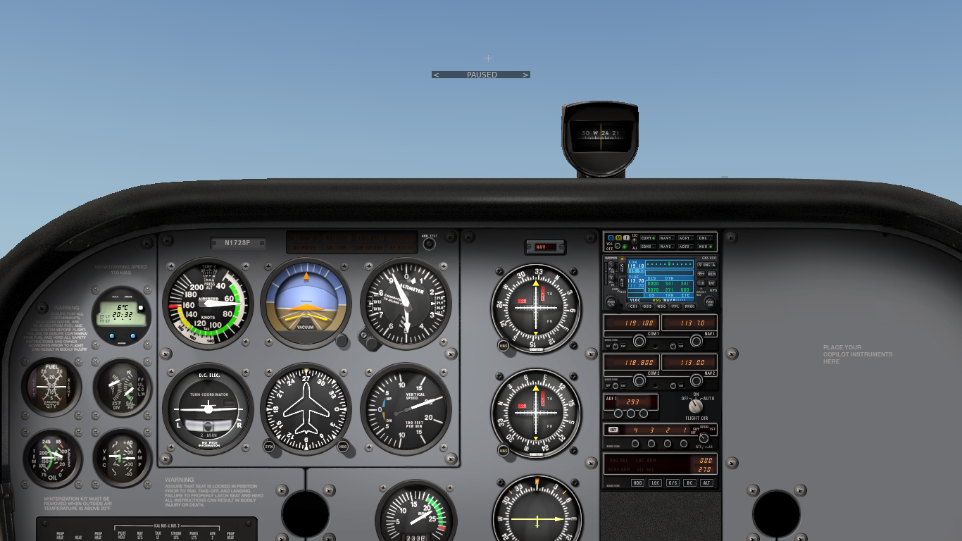

Climb Attitudes
Prolonged climbs may require attitude changes for lookout
En-Route climbs improve visibility, engine cooling and economics
Mixture can be leaned during climbs passing an altitude of 3000 ft
Control airspeed with pitch attitude at full power
More nose-up attitude requires more rudder input and vice versa

Slide 6
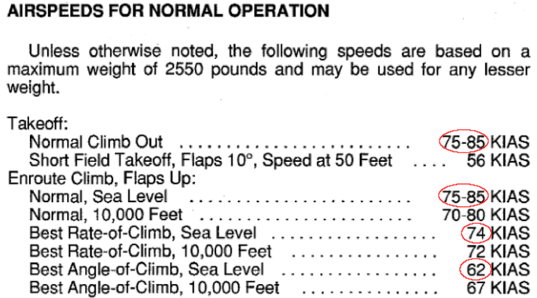
Reference Climb Airspeeds
Reference climb airspeeds can be found in the POH under Section 4 Normal Procedures
Notes:
- full power at 74 KIAS → 1200 FPM climb rate
- full power at 62 KIAS → 900 (750) FPM climb rate
- Vx and Vy change with air density (altitude)
- Vx in terms of IAS can increase with altitude (for piston engine aircraft) – why?
- Vy in terms of IAS decreases in terms of IAS but increases in terms of TAS
- Vx corresponds to maximum excess thrust
- Vy corresponds to maximum excess power
- Thrust and power curves (available, required) can be discussed as required
- Performance curves are affected by mass and air density

Slide 7

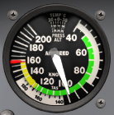
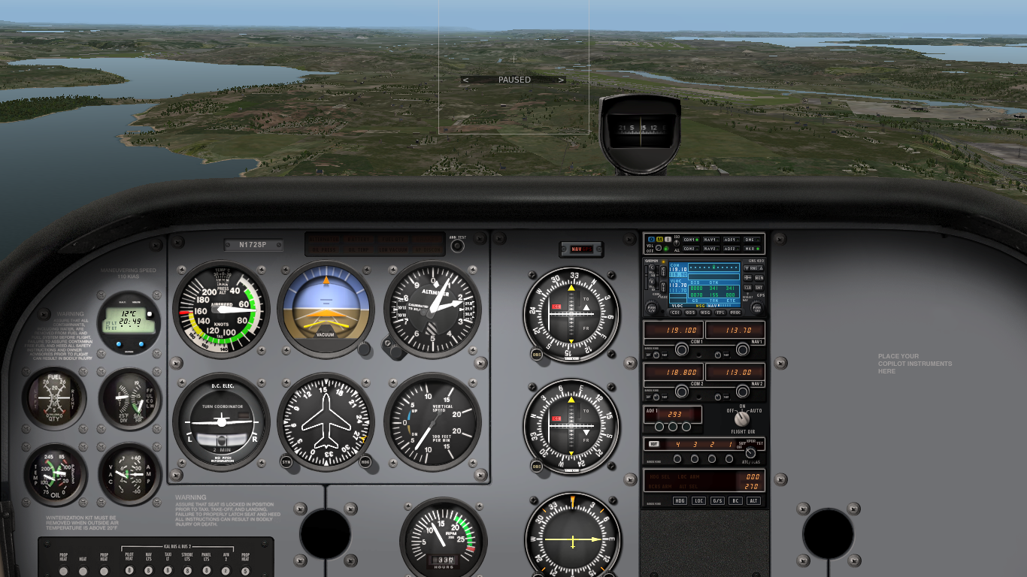

Establishing a Power-on Descent
Power
Attitude
Trim
In cruise attitude lookout ahead and below
Reduce power for estimated descent airspeed
Keep straight and control yaw with rudder
Decelerate to descent airspeed maintaining cruise attitude
Establish required pitch attitude and trim
Notes:
- estimated power setting:
100 RPM → 100 FPM or 5-6 KIAS
100 KIAS → 1800 – 1900 RPM
- pitch attitude depends on airspeed
- at 68 KIAS a nose-up attitude is required

Slide 8
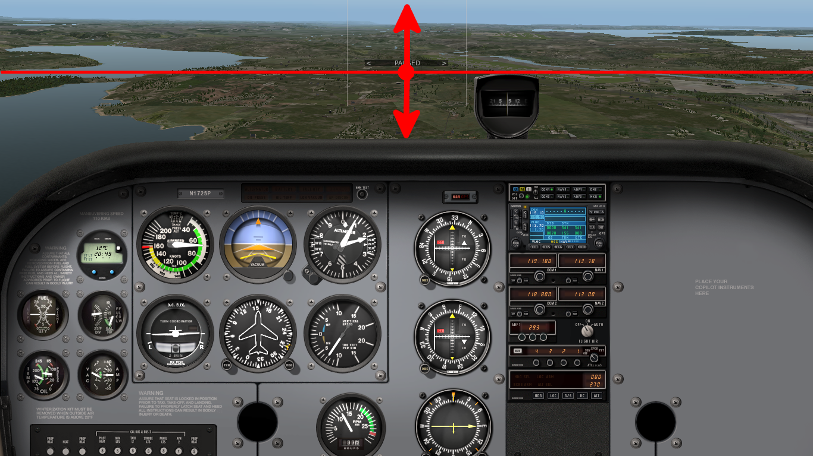
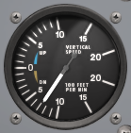
Maintaining a Power-On Descent
Adjust power and attitude to attain desired descent airspeed and rate of descent
Re-trim after power and attitude adjustments
Continue lookout and monitor external references, heading, descent airspeed and rate of descent
Notes:
during approach:
- power to control rate of descent
- attitude to control airspeed
Examples: (?!)
- airspeed correct, rate of descent too high → increase power, adjust attitude
- airspeed correct, rate of descent too low → decrease power, adjust attitude
- airspeed too low, rate of descent correct → lower nose, adjust power
- airspeed too high, rate of descent correct → raise nose, adjust power

Slide 9
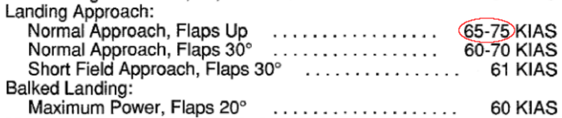
Reference Descent Airspeeds
Reference descent airspeeds can be found in the POH under Section 4 Normal Procedures
Notes:
- 60 KIAS full flap idle
- 70 KIAS 10 deg idle

Slide 10
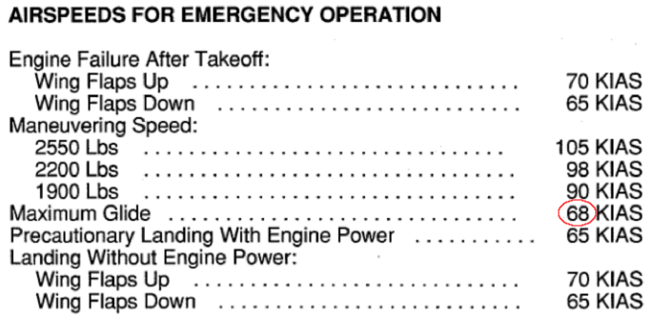
Best Glide Airspeed
Best glide airspeed for power-off descents can be found in the POH under Section 3 Emergency Procedures
Notes:
- load factor = lift / weight
- if the weight is higher, higher airspeed can generate more lift for a reduced load factor

Slide 11





Operating Flaps
Operate flaps conservatively while airspeed in white arc
Flaps permit lower airspeeds and steeper descent angles
Flaps support obstacle clearance approaches
Retract flaps in stages within white arc (above 48 KIAS)
Notes:
- operating flaps should be more of an howto
- 2.5 limitations (check speeds and placard)
- stages to 20 according to POH, stages to 10 in practice for balked landing / slow flight recovery
- why do flaps allow steeper angles?

Slide 12
Balked Landings
Power
Attitude
Trim
Apply full power and keep straight controlling yaw
Establish and maintain slight nose-up attitude
Control airspeed with attitude and retract flaps in stages
Trim and continue to monitor climb airspeed
Consider ground effect during go around
Notes:
- control yaw
- flaps to 20 deg as per POH
- flaps up after terrain clearance (at safe altitude)
- include stalk settings!

Slide 13
Summary / Quiz
Why do we use different airspeeds for climbs and descents?
Where can we find the Vx and Vy airspeeds?
Where can we find the best glide airspeed?
Mentally perform a power-on descent and level-off describing all required actions. (PAT)
Mentally perform a balked approach describing all required actions – remember the flaps. (PAT)

Slide 14
Pre-Flight Briefing
Exercise
Training Area
Departure and Arrival Procedures
Weather Briefing / NOTAMs
Aircraft and Documents
Time and Fuel Requirements
Safety Considerations and Responsibilities

Slide 15
Additional Materials
Additional Materials for Climbing and Descending
Flight Instructor Guide – Exercises 7 and 8
Flight Instructor Guide – Lesson Plans 2, 3 and 4

Slide 16
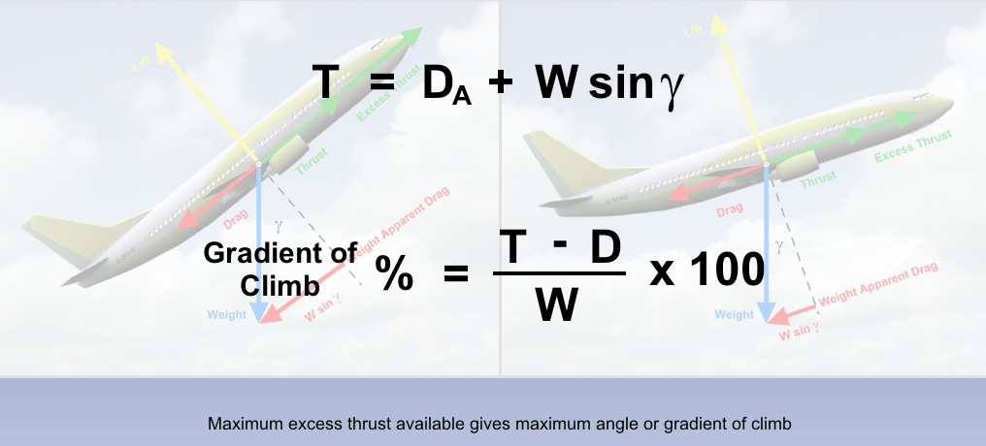
Angle or Gradient of Climb
Weight increases weight apparent drag and excess thrust required
Weight increases lift required and lift induced drag

Slide 17
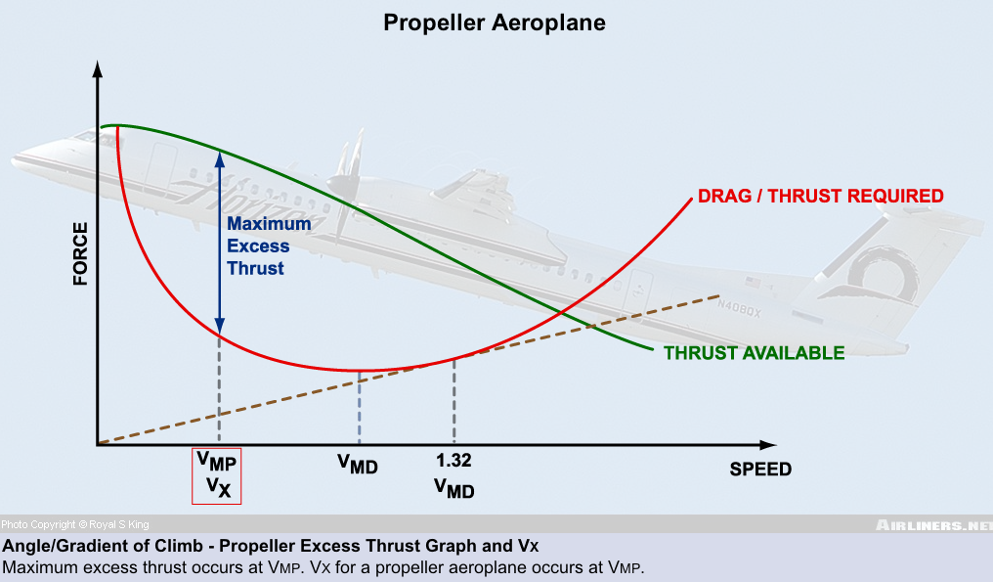
Maximum Excess Thrust

Slide 18
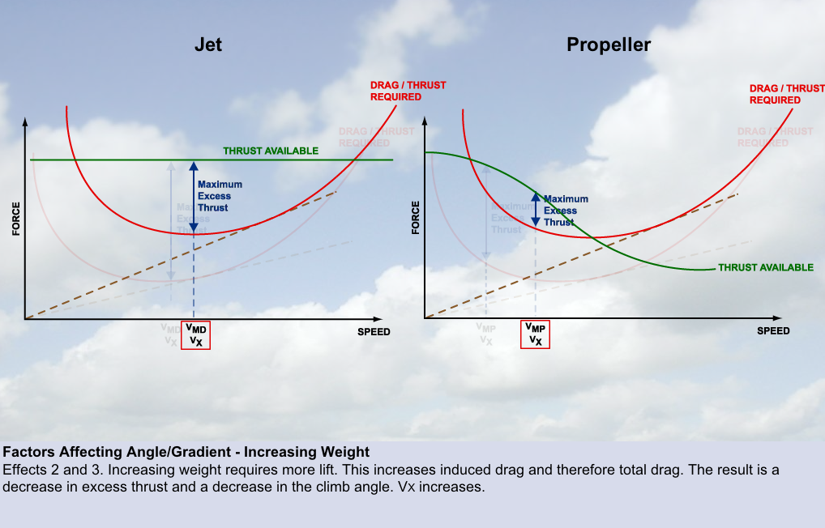
Weight and Excess Thrust

Slide 19
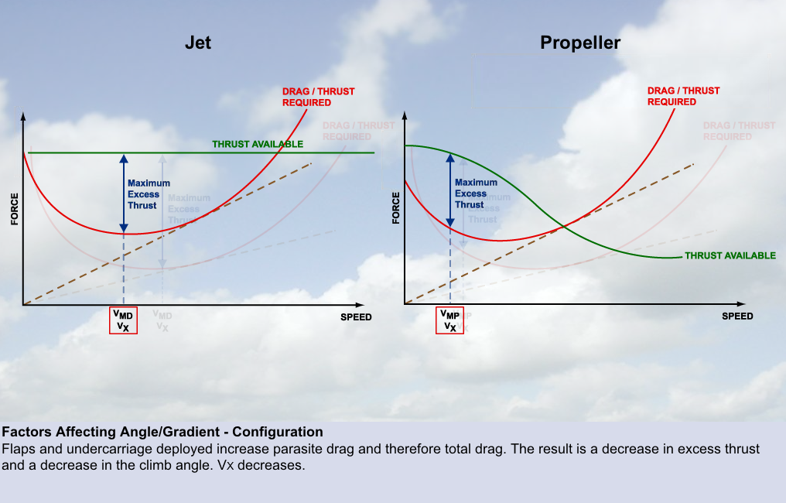
Configuration and Excess Thrust

Slide 20
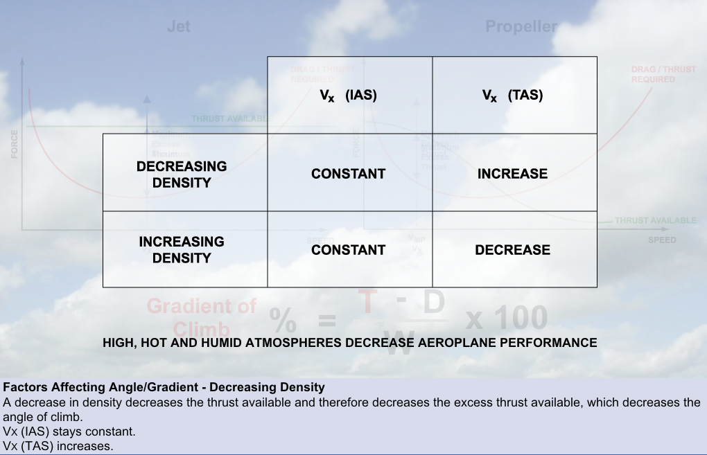
Air Density and Excess Thrust
Vx remains essentially constant (IAS) for thrust-rated engines (jet)
Vx may increase (IAS) for power-rated engines (prop)

Slide 21
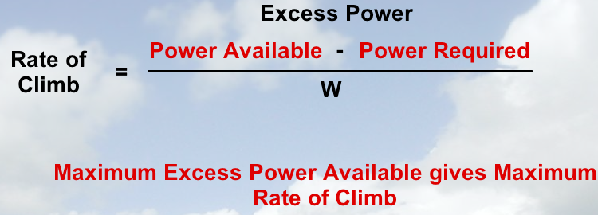
Rate of Climb
Rate of climb depends on both angle of climb and airspeed
Forces multiplied with speeds give powers
F * v = F * s / t = W / t = P

Slide 22
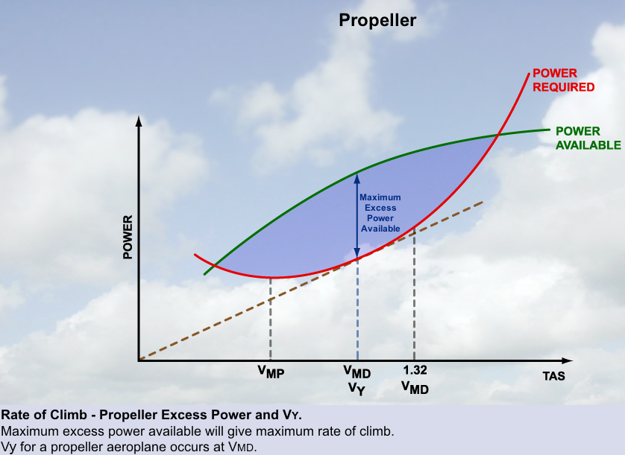
Maximum Excess Power

Slide 23
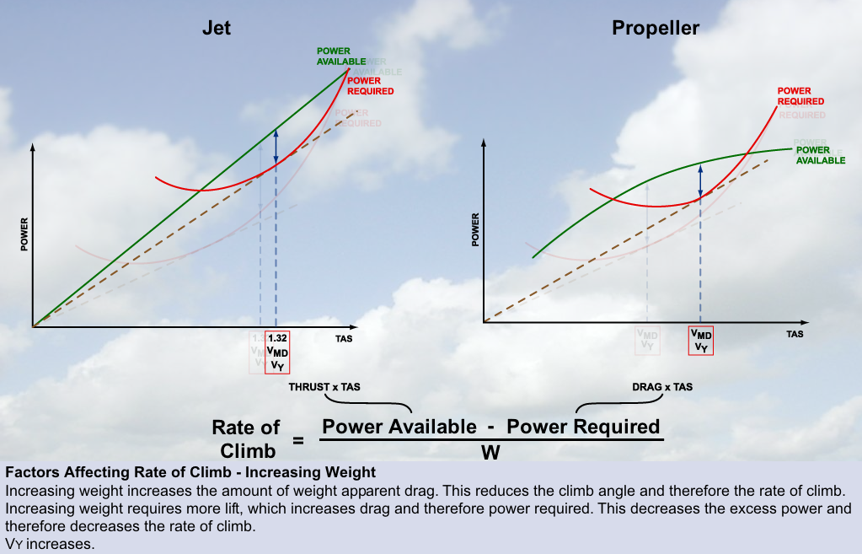
Weight and Excess Power

Slide 24
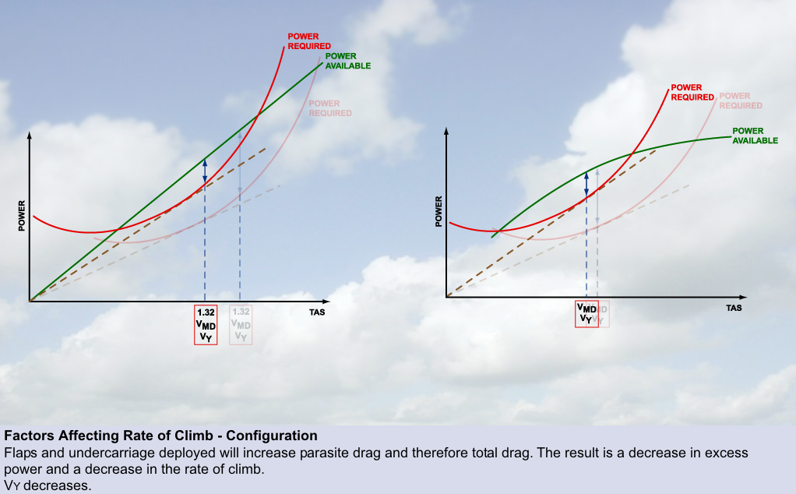
Configuration and Excess Power

Slide 25
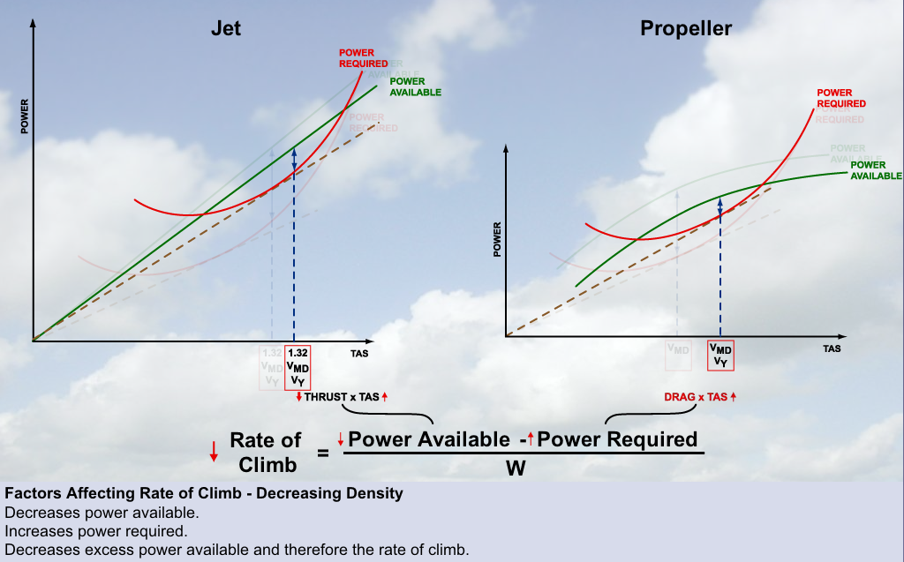
Air Density and Excess Power

Slide 26
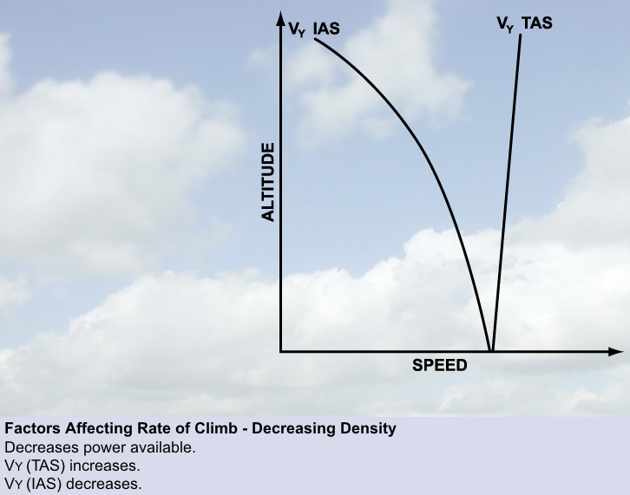
Vy – True versus Indicated Airspeed

Slide 27
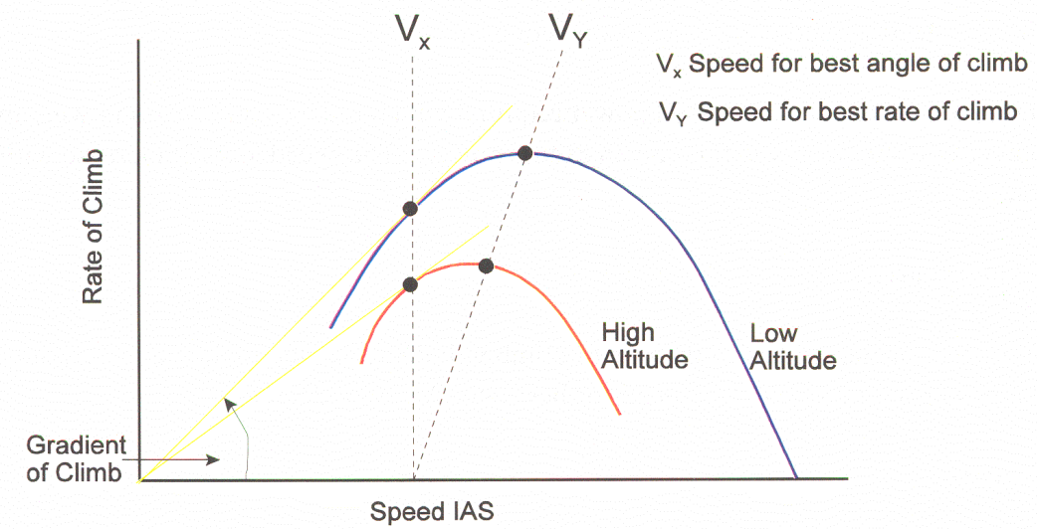
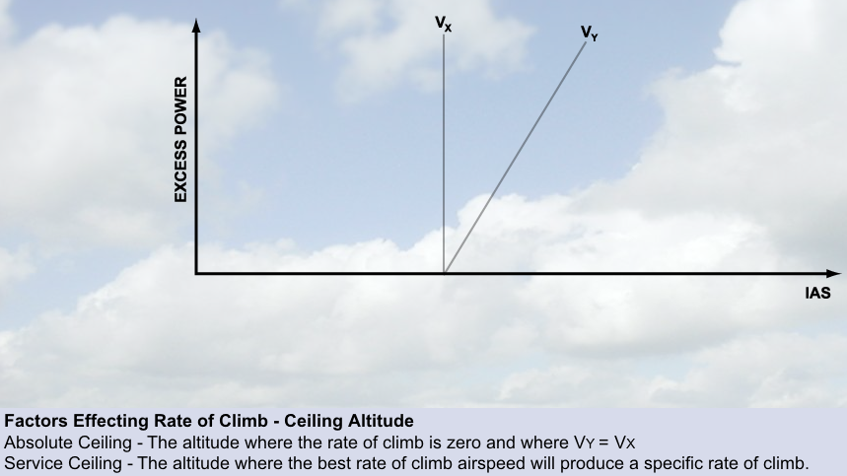
Absolute and Service Ceiling

