Slide 1
Contact Information
Stephan Heinemann
SMS: +1 (250) 891-5446
Email: stephan.heinemann@hotmail.com
Bookings, Questions

Slide 2
Straight-and-Level Flight
Review Attitudes and Movements
Definition and Motivation
Straight Flight
Level Flight
Magnetic Compass
Summary and Questions
Pre-Flight Briefing

Slide 3




Attitudes and Movements Review
What attitudes are displayed and how can they be established, maintained and recovered?
Notes:
- What attitudes are displayed and how can they be established, maintained and recovered?

Slide 4
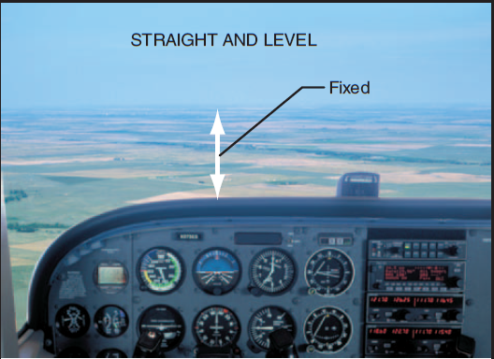
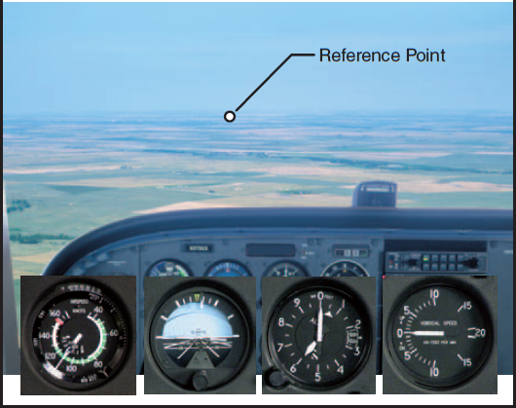
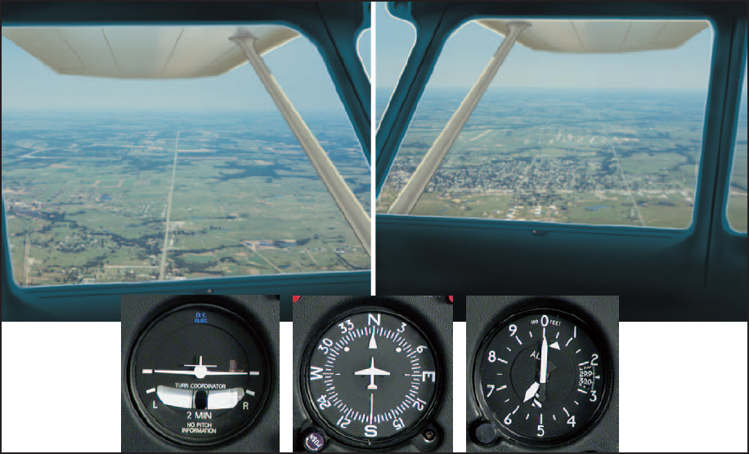
Straight-and-Level Flight

Slide 5
Straight Flight
Maintain constant heading (horizon and reference point)
Control roll and yaw to keep wings level in coordinated flight
Check attitude indicator (bank attitude), heading indicator and turn coordinator
Straight flight is not necessarily level flight (variable altitude)
Notes:
- Outside references first, cross-check instruments second

Slide 6

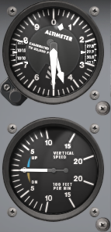
Level Flight
Maintain constant altitude (attitude and power)
Control pitch and power to maintain altitude in coordinated flight
Check attitude indicator (pitch attitude), tachometer (power setting), altitude indicator and vertical speed indicator
Level flight is not necessarily straight flight (variable heading)

Slide 7
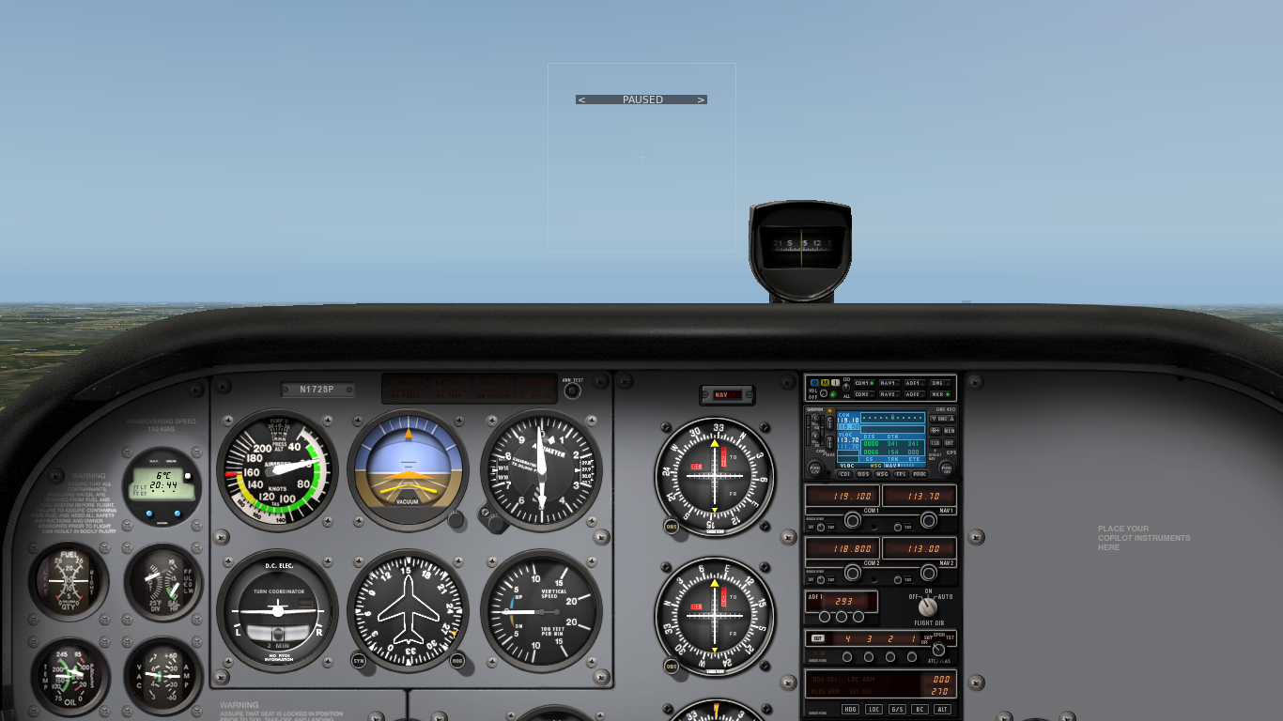
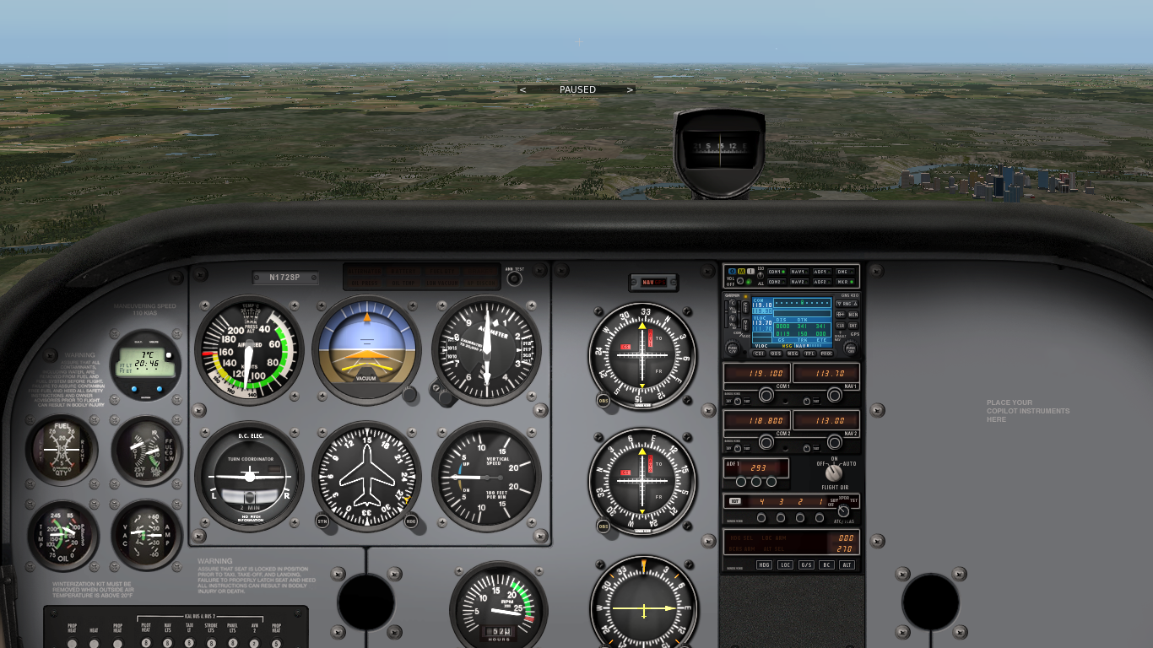
Level Flight – Attitude and Power
Attitude plus power equals performance
Less power requires more nose-up (less nose-down) attitude (and vice versa) to maintain altitude at lower constant airspeed
More power requires less nose-up (more nose-down) attitude (and vice versa) to maintain altitude at higher constant airspeed
Trim is used to compensate control forces at different settings
Notes:
Level flight can be achieved by different combinations of attitude and power

Slide 8

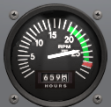

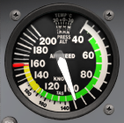
Power Changes
Decrease Power / Reducing Airspeed:
  Throttle back smoothly to estimated setting
  Anticipate and prevent yaw
  Pitch back to raise nose
  Readjust power setting
  Trim to eliminate control forces
Increase Power / Increasing Airspeed:
  Advance throttle smoothly to estimated setting
  Anticipate and prevent yaw
  Pitch forward to lower nose
  Readjust power setting
  Trim to eliminate control forces
Notes:
- 100 RPM = 5 KIAS
- 100 RPM = 100 FPM

Slide 9
Straight-and-Level Flight
Maintain heading and altitude in close tolerances
Restrained use of all three flight controls
Control roll and yaw to maintain heading: straight
Control pitch and power to maintain altitude: level
Maintain coordinated flight
Level flight at different power settings (airspeeds) is required for separation with other traffic
Pitch and power affect the aerodynamic and economic performance of the aircraft (range and endurance)

Slide 10

Magnetic Compass
Acceleration Error
  Accelerate North Decelerate South (ANDS)
Turning Error
  Undershoot North Overshoot South (UNOS)
Reliable only in straight non-accelerated flight
Readings in straight-and-level, straight-climbing or straight-descending provided constant airspeed
Average readings in turbulent air
Adjust heading indicator every 15 min (OPS check)

Slide 11
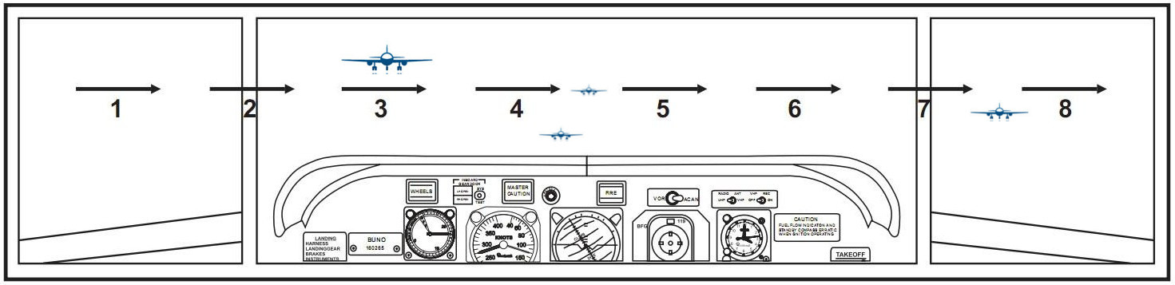
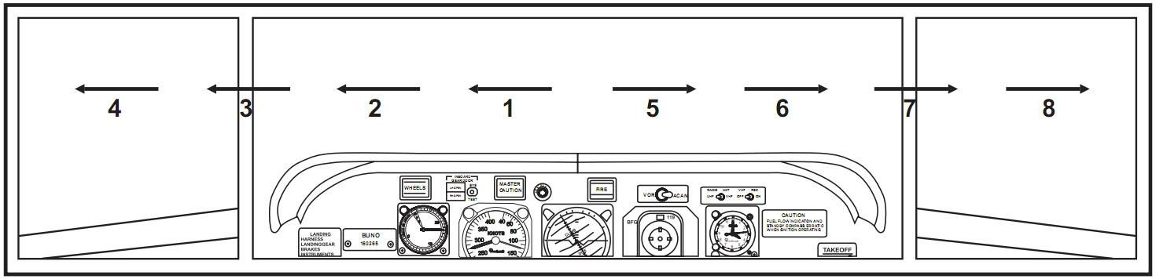

Lookout
Conflicts:
  Head-On, Converging, Climbing, Descending
Blind Spots:
  Below the Aircraft (above and behind depending on the cockpit)
Scanning:
  Side to Side, Middle to Side

Slide 12
Summary / Quiz
What parameter is to be kept constant in straight flight?
What references and instruments are available to maintain straight flight?
How is straight flight maintained using the flight controls?
What parameter is to be kept constant in level flight?
What references and instruments are available to maintain level flight?
How is level flight maintained using the flight controls?
How do power changes affect straight-and-level flight?
What are the errors of the magnetic compass?

Slide 13
Pre-Flight Briefing
Exercise
Training Area
Departure and Arrival Procedures
Weather Briefing / NOTAMs
Aircraft and Documents
Time and Fuel Requirements
Safety Considerations and Responsibilities

Slide 14
Additional Materials
Additional Materials for Straight and Level Flight
Flight Instructor Guide – Exercise 6, Lesson Plans 2, 3, 4

Slide 15
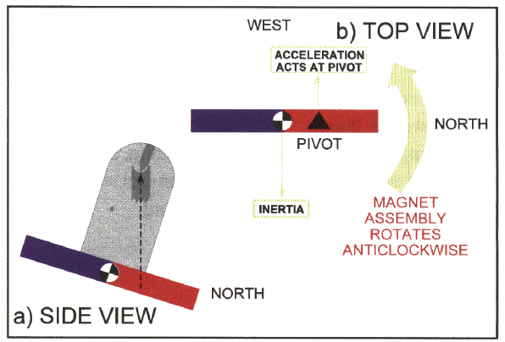
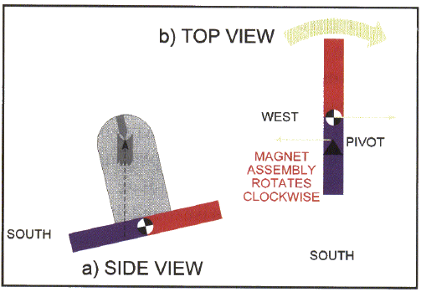
Magnetic Dip
Magnetic dip is the reason for dip errors (acceleration / deceleration, turning)
Magnetic dip shifts the pivot point away from the magnet's center of gravity

Slide 16
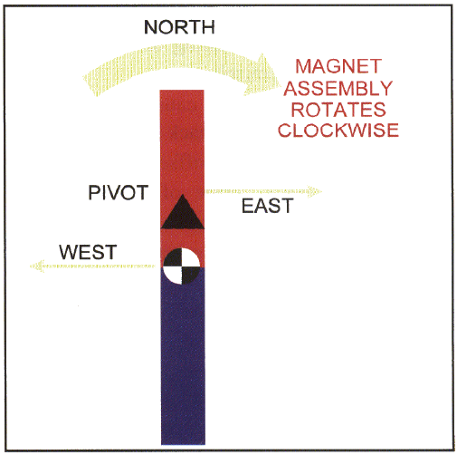
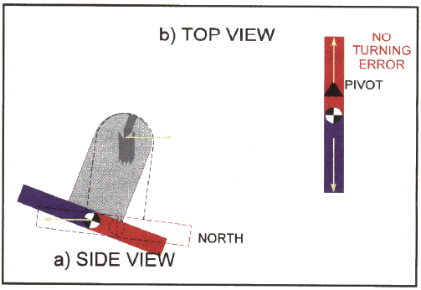
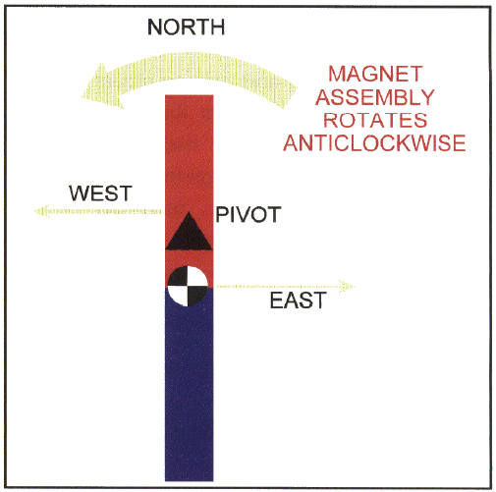
Acceleration/Deceleration Errors
Accelerate North Decelerate South (ANDS)
Opposite behavior on the southern hemisphere
More pronounced on easterly / westerly headings
Less pronounced on northerly / southerly headings

Slide 17
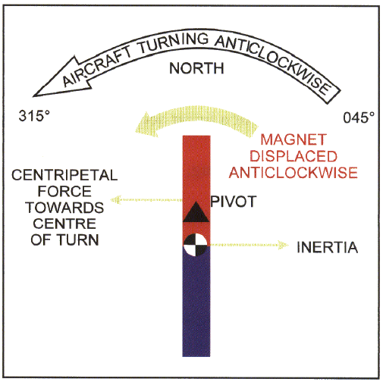
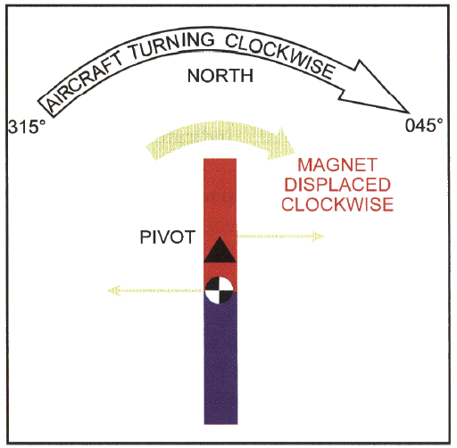
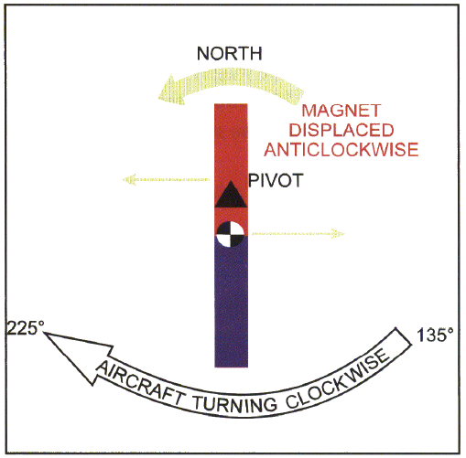
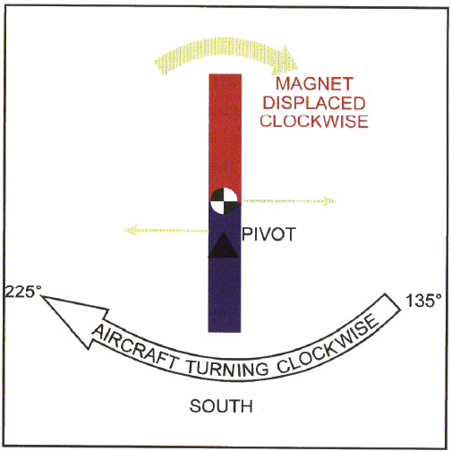
Turning Errors
Undershoot North Overshoot South (UNOS)
Opposite behavior on the southern hemisphere
More pronounced on northerly / southerly turns
Less pronounced on easterly / westerly turns

