Slide 1
Contact Information
Stephan Heinemann
SMS: +1 (250) 891-5446
Email: stephan.heinemann@hotmail.com
Bookings, Questions

Slide 2
Part II – Climbing and Descending Turns, Steep Turns
Review Basic Turns, Climbs and Descents
Definition and Motivation
Initiating, Maintaining and Recovering Coordinated Climbing and Descending Turns
Initiating, Maintaining and Recovering Coordinated Steep Turns
Summary and Questions
Pre-Flight Briefing
Notes:
- gear and carburetor heat are not applicable

Slide 3
Review Basic Turns, Climbs and Descents
What controls are to be used to maintain a coordinated level turn and what do they achieve individually?
Mentally perform a medium (30° bank angle) coordinated level turn describing all required actions.
Describe overbanking and how it has to be corrected for during a medium level turn.
Mentally perform a basic climb and level off and state all required actions. (APT)
Mentally perform a basic power-off descent and level off and state all required actions. (PAT)
How do we establish and maintain a combined nose-up and left-banked attitude?

Slide 4


Climbing and Descending Turns
Climbing Left Turn
Descending Right Turn
Turning while climbing or descending
Heading and altitude change simultaneously
Applications: Departures, Arrivals, Circuits

Slide 5
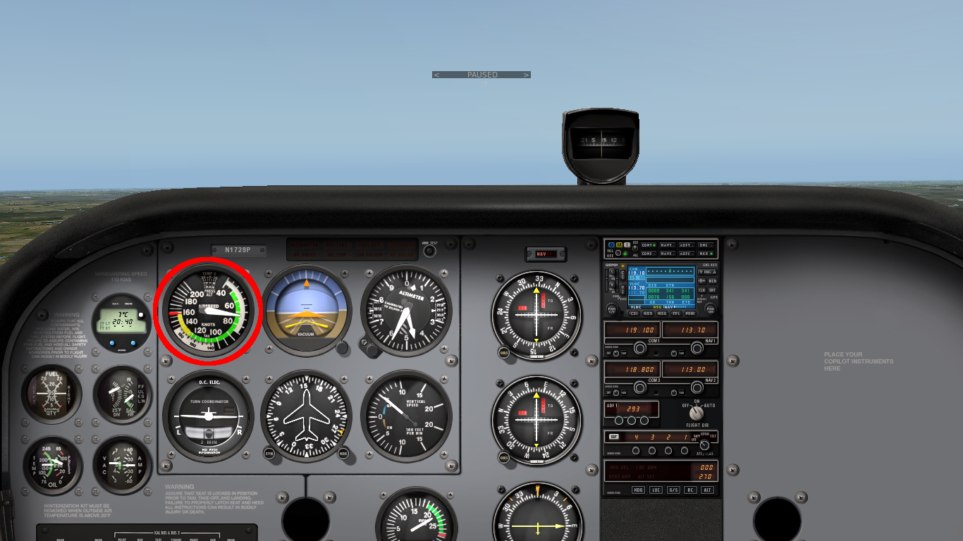

Initiating a Climbing Turn
Constant Speed Climb
Constant Rate Turn
In cruise-attitude lookout ahead and above in turn direction
Establish a stable constant speed climb first – APT
Establish a coordinated constant rate turn second
Climbing turns will be established simultaneously later
Notes:
- Basic climbs, descents and turns are already known
- Use developmental teaching for climbing and descending turns

Slide 6
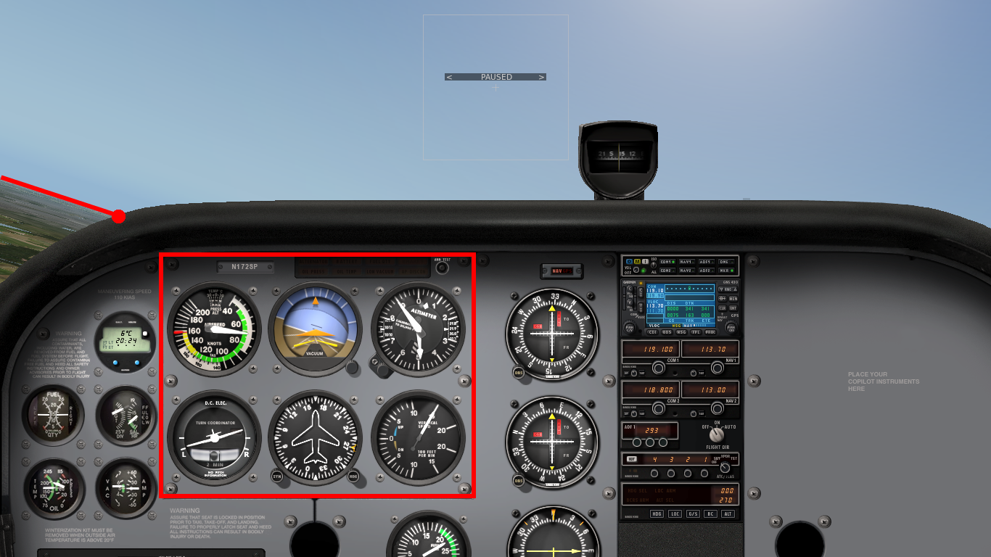


Maintaining a Climbing Turn
Corrections
References
Lookout
Instruments
Apply elevator as required to maintain pitch attitude and airspeed
Apply aileron as required to maintain bank attitude while correcting overbanking tendencies
Apply rudder as required to maintain coordinated constant rate turn
Continue lookout and monitor outside references and instruments

Slide 7
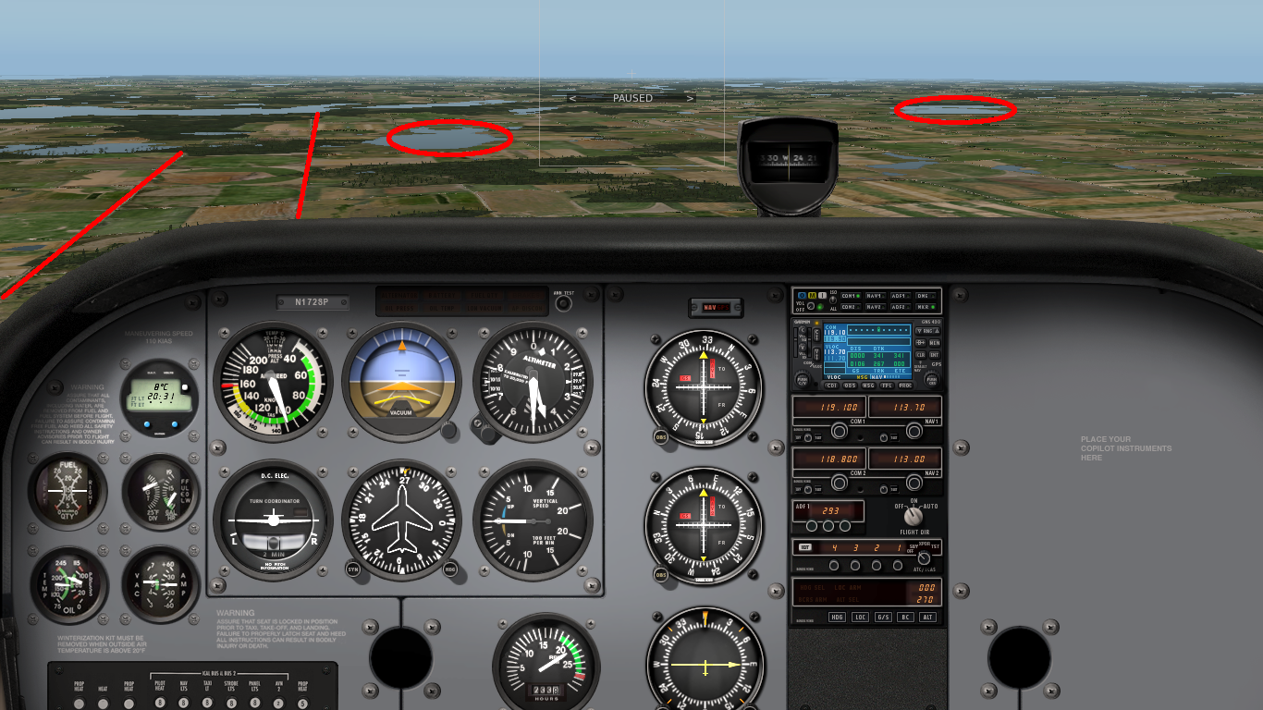
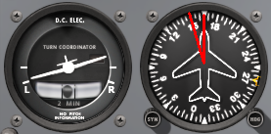
Recovering a Climbing Turn
Anticipation
Landmarks
Continue to lookout observing references during recovery
Recovery order depends on achieved target (heading or altitude) and may require simultaneous control inputs
Anticipate turn recovery to establish desired heading – half bank angle
Anticipate climb recovery to establish desired altitude – 10% VSI
Remain coordinated using rudder and apply APT to recover climb
Notes:
- half bank angle to anticipate turn recovery
- 10% VSI to anticipate climb recovery

Slide 8
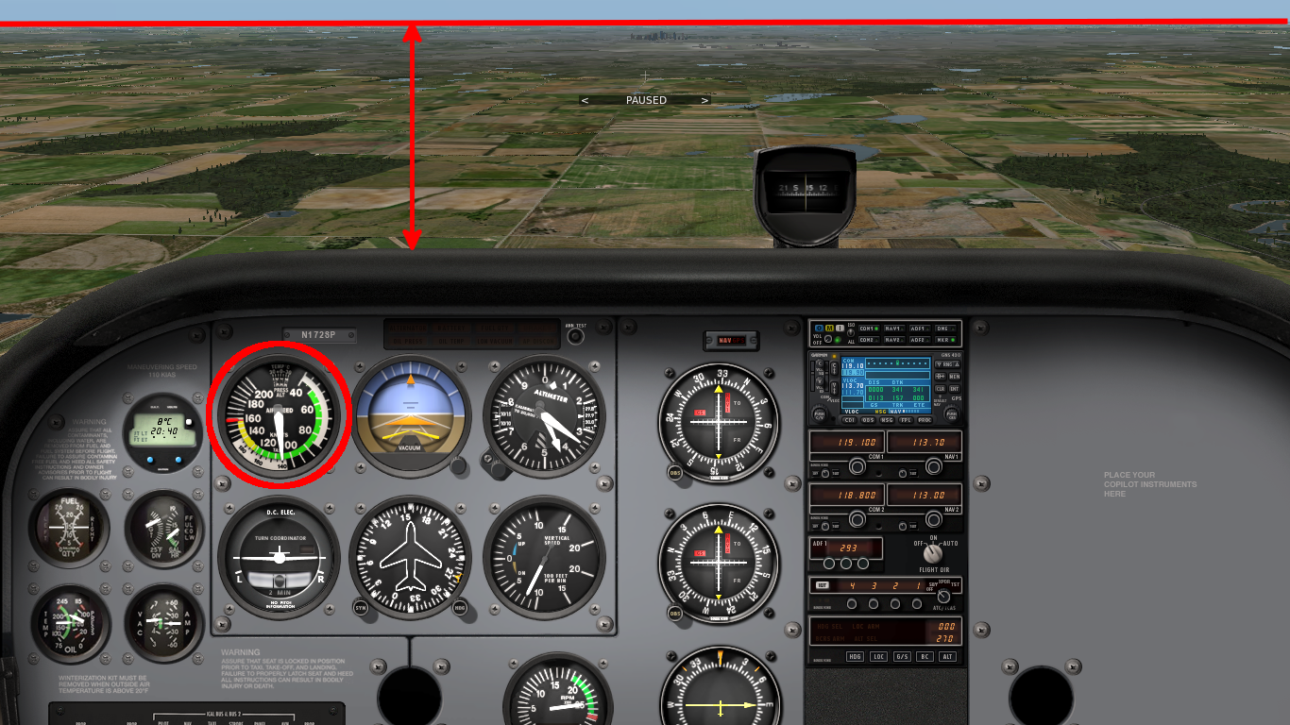
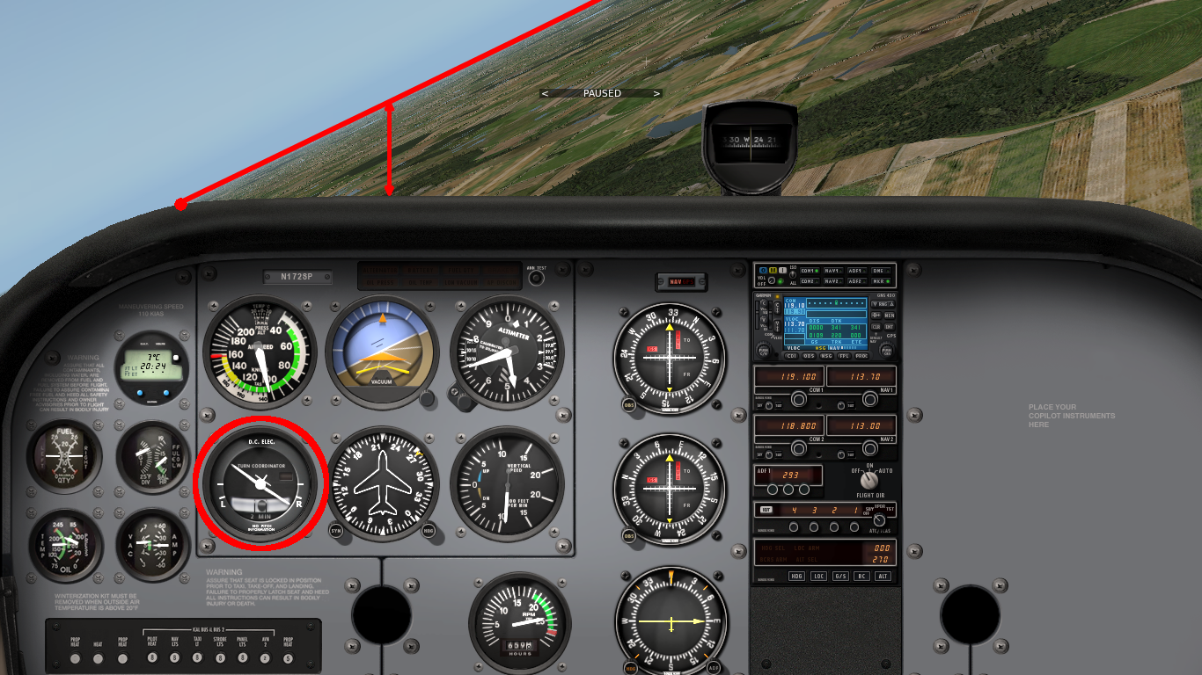
Initiating a Descending Turn
Constant Speed Descent
Constant Rate Turn
In cruise-attitude lookout ahead and below in turn direction
Establish a stable constant speed descent first – PAT
Establish a coordinated constant rate turn second
Descending turns will be established simultaneously later
Notes:
Establish Descent
PAT
P-Factor
Establish Turn
Adverse yaw, Coordination, Underbanking
Power-Off Descending Turns (SFL)
Steep Descending Turn / Avoid Sprial Dive

Slide 9

Maintaining a Descending Turn
Corrections
Lookout
References
Instruments
Apply elevator as required to maintain pitch attitude and airspeed
Apply aileron as required to maintain bank attitude while correcting underbanking tendencies
Apply rudder as required to maintain coordinated constant rate turn
Continue lookout and monitor outside references and instruments
Notes:
References
Coordination
Constant Bank Angle / Underbanking
Higher Outside Wing Speed
Lower Outside AoA

Slide 10
Recovering a Descending Turn
Anticipation
Landmarks
Continue to lookout observing references during recovery
Recovery order depends on achieved target (heading or altitude) and may require simultaneous control inputs
Anticipate turn recovery to establish desired heading – half bank angle
Anticipate climb recovery to establish desired altitude – 10% VSI
Remain coordinated using rudder and use PAT to recover climb

Slide 11
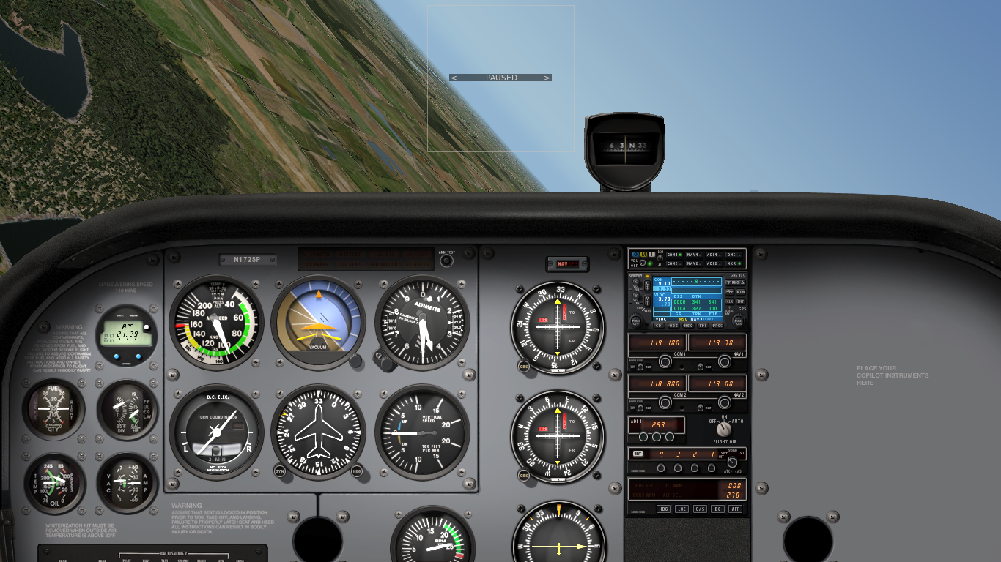
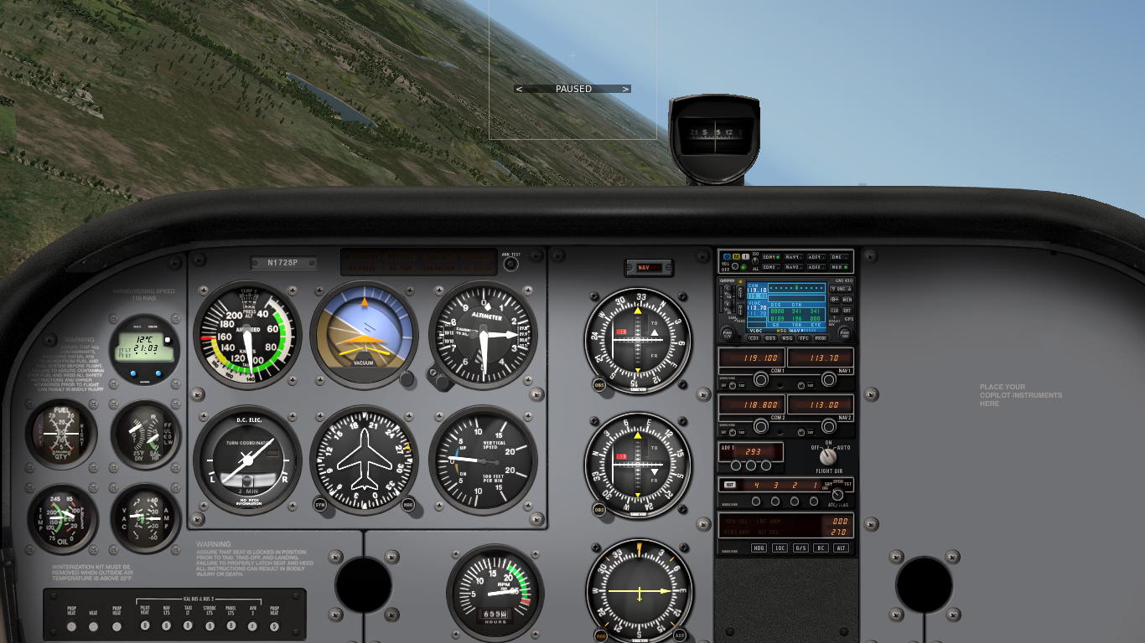
Steep Turns
45° Steep Turn
30° Medium Turn
Steep turns – beyond 30° bank angle
Evasive actions and collision avoidance (consider climbs and descents), canyon turns, steep descending turns
Control coordination practice
Higher load factor, stall speed and required power
Notes:
- left steep turn: almost no rudder, less back-pressure
- right steep turn: more rudder during entry, more back-pressure during turn
- additional power and yaw have a significant effect on turn characteristics
- vertical evasive maneuvers more effective for head-on and close conflicts
(i) use of power to maintain constant pre-selected airspeed — constant altitude;
(ii) consequences of
not
adding power — loss of airspeed;
(iii) bank and power limitations;
(iv) relationship between speed and radius of turn — minimum radius — entry
speed — use of power — use of flaps;
(v) co-ordination and technique for evasive action or collision avoidance;
(vi) attitude and speed control during steep power-off descending turns — use of flaps;
(vii) instrument indications.
NOTE: Stress attitude control to avoid spir
al entry — how to monitor instruments.

Slide 12
Performing a Steep Level Turn
Initiate steep level turn like medium level turn
Increase power slightly beyond 30° bank angle to maintain safe airspeed above increased stall speed
Correct as required to maintain pitch and bank attitude
Remain coordinated and correct overbanking tendencies
Left and right turns require different control inputs
Reduce power smoothly during recovery
Transition from left to right requires smooth control and power adjustments
Notes:
- add power simultaneously when initiating the turn
- add power as required by bank angle to maintain airspeed (sound or RPM value)
- instructor:
left turn reference – upper right glareshield aligns with horizon, almost no left rudder or additional back-pressure
right turn reference – right rivet row on the cowling aligns with horizon, significant right rudder and additional back-pressure

Slide 13
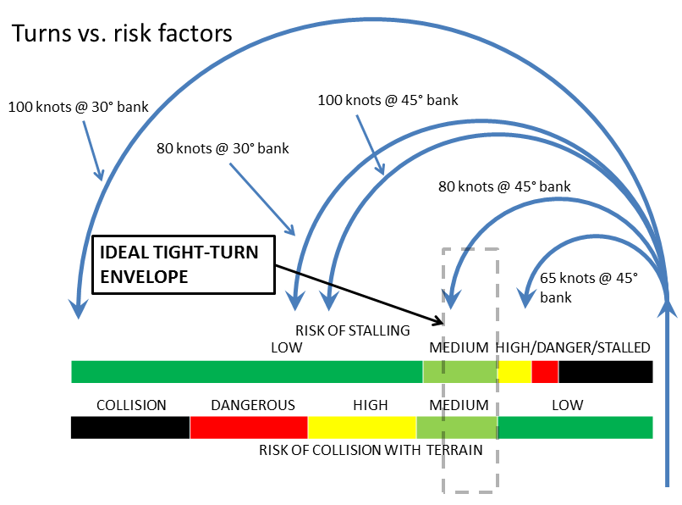
Minimum Radius Turn - Entry Speeds

Slide 14
Performing a Safe Radius Turn
Perform lookout before safe radius turn
Consider wind for minimum radius over ground
Operational use of power and configuration
Slow down to safe airspeed (Ve = 80 KIAS >= Vy = 74 KIAS) and extend flaps to 10° (partial flaps)
Establish a coordinated steep level turn adding power as required to maintain safe airspeed
Recover and accelerate to cruise airspeed
Retract flaps conservatively at the top of white arc
Notes:
- required training according to FI refresher

Slide 15
Performing a Minimum Radius Turn
Perform lookout before minimum radius turn
Consider wind for minimum radius over ground
Operational use of power and configuration
Slow down to minimum airspeed (Ve = 60 KIAS) and extend flaps in stages to 30° (full flaps)
Establish a coordinated steep level turn adding full power to maintain minimum airspeed
Recover and accelerate to cruise airspeed
Retract flaps to 10° immediately and to 0° conservatively at the top of white arc

Slide 16
Performing a Steep Descending Turn
Perform lookout before steep descending turn
Reduce power to idle maintaining safe airspeed (Ve = 70 KIAS >= 68 KIAS (best glide))
Initiate steep descending turn like descending turn
Operational / situational use of configuration (clean flaps)
Correct as necessary to maintain pitch and bank attitude
Remain coordinated and correct underbanking tendencies
Avoid spiral dive and monitor safe airspeed
Recover like descending turn adding power first – PAT
Notes:
- required training according to FI refresher
- additional power only required to control descent

Slide 17
Summary / Quiz
Mentally perform a coordinated climbing (2000' to 3000') medium (30° bank angle) turn to the right (270° to 090°) describing all required actions.
Mentally perform a coordinated descending (3000' to 2800') gentle (15° bank angle) turn to the left (090° to 270°) describing all required actions.
Mentally perform a coordinated steep (45° bank angle) level turn to the left (090° to 270°) describing all required actions.

Slide 18
Pre-Flight Briefing
Exercise
Training Area
Departure and Arrival Procedures
Weather Briefing / NOTAMs
Aircraft and Documents
Time and Fuel Requirements
Safety Considerations and Responsibilities

Slide 19
Additional Materials
Additional materials for turns
Flight Instructor Guide – Exercise 9, Lesson Plans 2, 7, 8

Slide 20
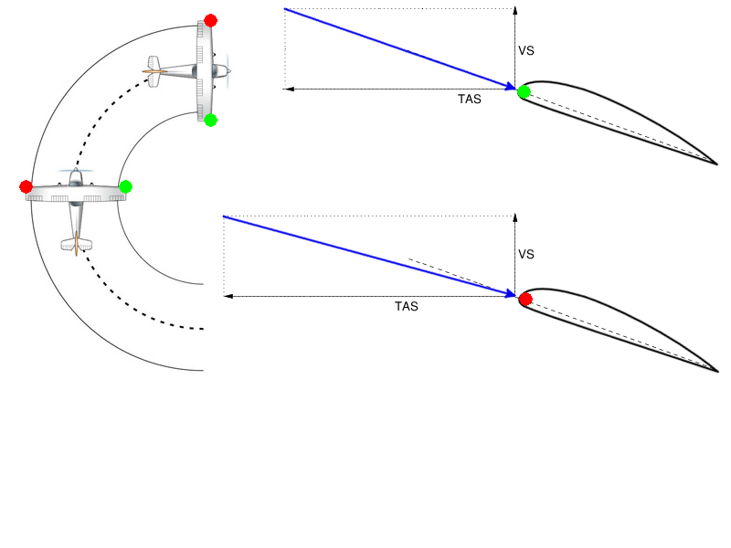
Climbing Turn – Overbanking
Notes:
- improve overbanking picture: no negative AoA
- increase TAS vector

Slide 21
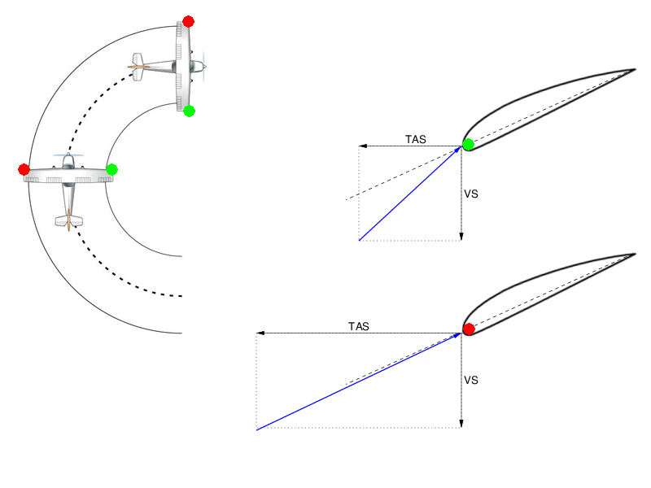
Descending Turn – Underbanking

Slide 22
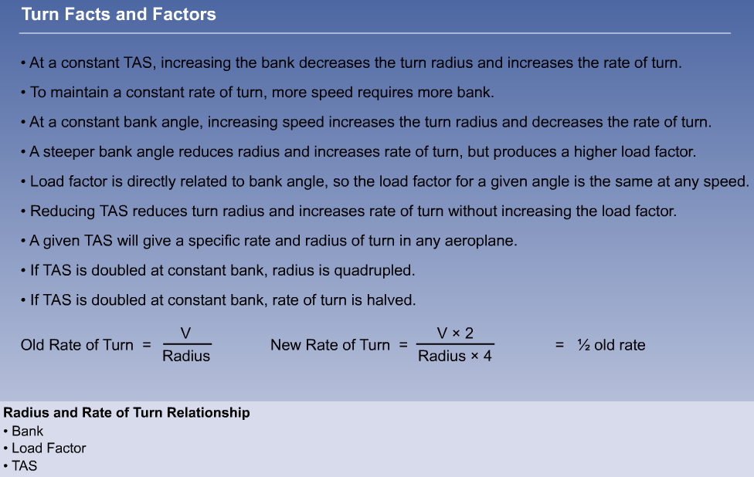
Turn Factors
Circle Circumference C = 2πr = πd
Derive standard turn radius with given TAS
Assumption: no wind

