Slide 1
Contact Information
Stephan Heinemann
SMS: +1 (250) 891-5446
Email: stephan.heinemann@hotmail.com
Bookings, Questions

Slide 2
Part I – Gentle and Medium Turns
Review Banked Attitudes
Motivation and Definition
Initiating, Maintaining and Recovering Coordinated Gentle and Medium Level Turns
Summary and Questions
Pre-Flight Briefing
Notes:
- gear and carburetor heat are not applicable

Slide 3
Review Banked Attitudes
Mentally establish a banked attitude and state all required actions.
How do we maintain coordinated flight while in a banked attitude?
What is adverse yaw and how is it caused?
Notes:
- emphasize the difference between left and right banked attitudes with respect to rudder control
- slip stream, torque, asymmetric thrust, precession, aileron drag

Slide 4
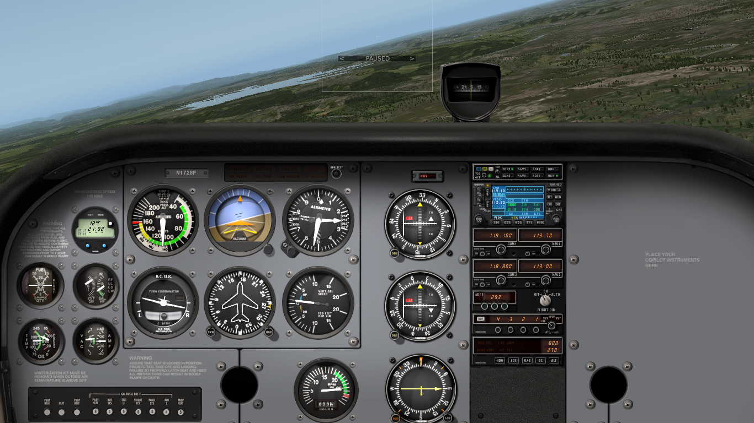
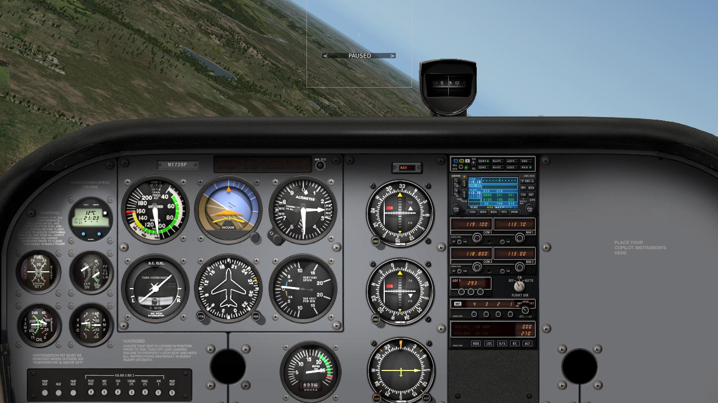
Gentle and Medium Level Turns
Gentle level turns – up to 15° bank angle
Medium level turns – 15° up to 30° bank angle
Heading changes maintaining a constant altitude

Slide 5

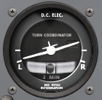
Initiating a Coordinated Level Turn
Lookout
Banked Attitude
Coordination
Perform lookout in cruise attitude before initiating a turn
Establish (roll into) a banked attitude using aileron
Apply rudder as required to remain coordinated
Center aileron after banked attitude is established
Notes:
- select appropriate yoke angle for rate of roll
- left turns require way less rudder than right turns

Slide 6
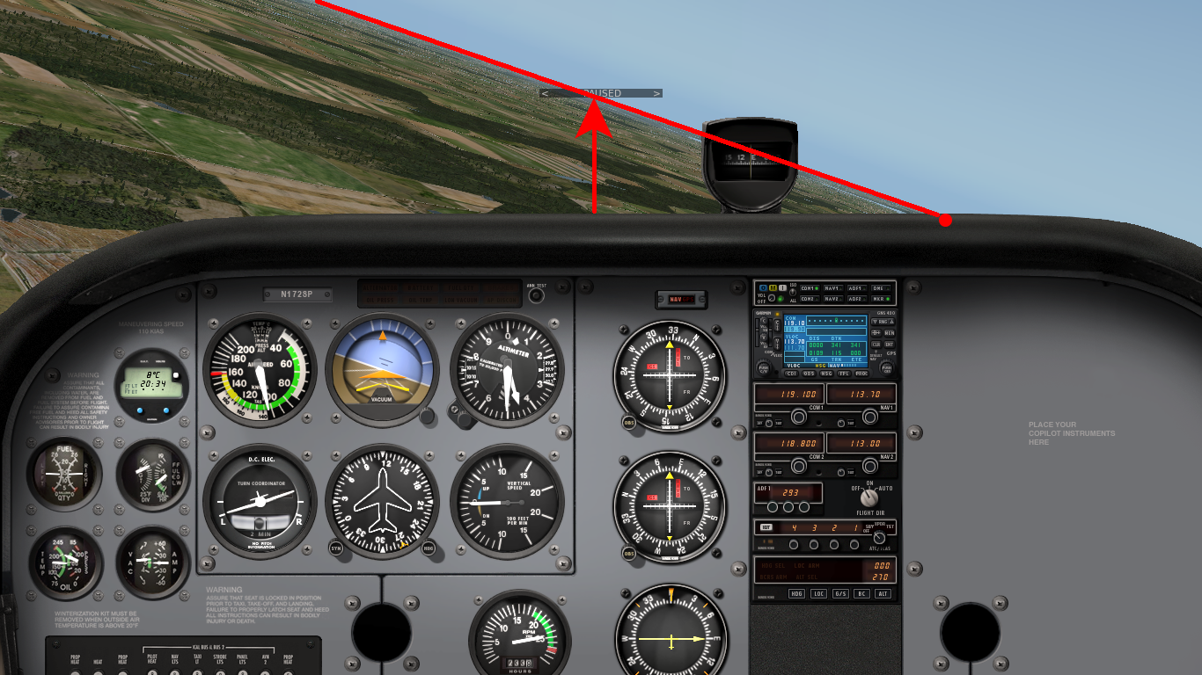


Maintaining a Coordinated Level Turn
Corrections
References
Lookout
Apply elevator as required to maintain constant pitch attitude
Apply aileron as required to maintain constant bank attitude
Apply rudder as required to maintain coordinated turn
Establish cockpit references for distances and intersections
Notes:
- really focus on nose / horizon references / intersection (glare shield, rivets...)
- only crosscheck instruments for confirmation

Slide 7
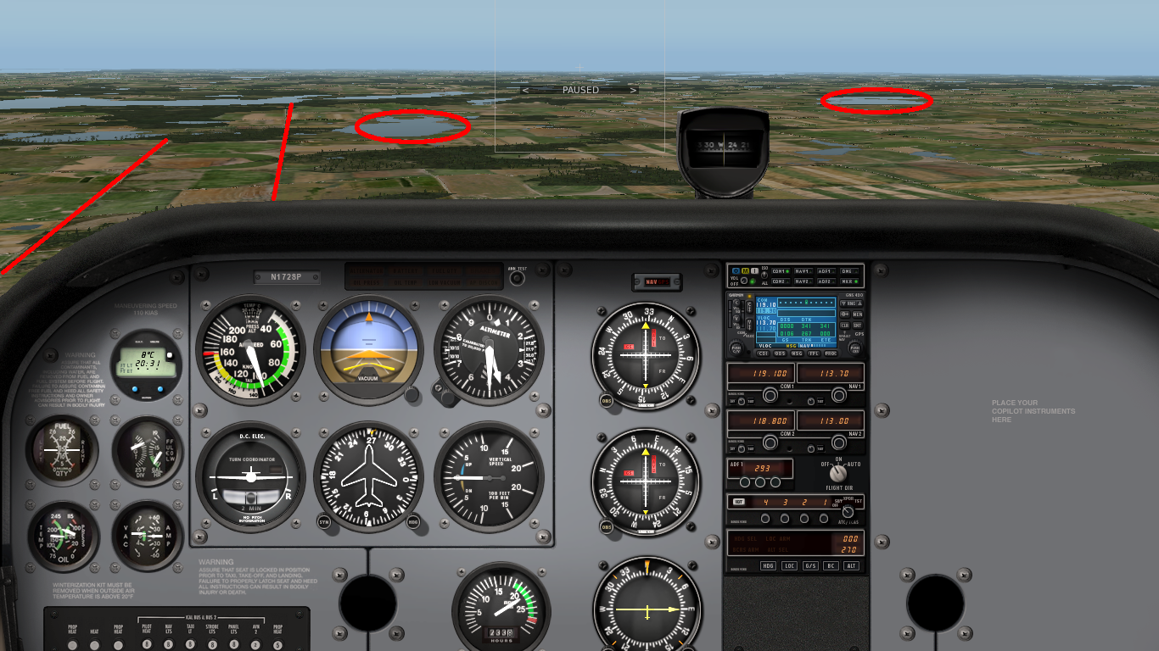
External References
References
Landmarks
Continue to lookout and observe references during turn
Horizon remains the primary attitude reference
Nose moves steadily along the horizon neither rising or falling
Landmarks can be used to establish headings

Slide 8
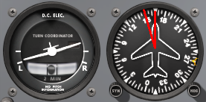
Recovering a Coordinated Level Turn
Landmarks
Anticipation
Continue to lookout observing references during recovery
Turns need to be recovered anticipatory – half the bank angle
Establish (roll back into) cruise attitude using aileron
Control yaw with rudder as required to remain coordinated
Adjust cruise attitude and trim

Slide 9
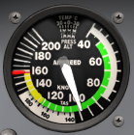
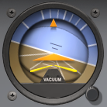
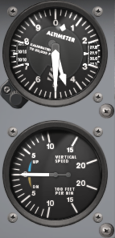

Instruments
Attitude Indicator
Airspeed Indicator
Altitude Indicator
Turn Coordinator
Vertical Speed Indicator
Heading Indicator
Turn coordinator and heading indicator indicate turning
Vertical speed indicator and altimeter remain steady
Airspeed indicator decreases slightly
Attitude indicator confirms outside reference (angle markings)
Notes:
- magnetic compass, attitude indicator
- airspeed decreases slightly
- include attitude indicator marks

Slide 10
Summary / Quiz
What controls are to be used to maintain a coordinated level turn and what do they achieve individually?
Mentally perform the entry to a medium (30° bank angle) coordinated level turn describing all required actions.
Mentally perform the recovery from a medium (30° bank angle) coordinated turn describing all required actions.
Why does the amount of rudder application change depending on the angle of bank during turns?

Slide 11
Pre-Flight Briefing
Exercise
Training Area
Departure and Arrival Procedures
Weather Briefing / NOTAMs
Aircraft and Documents
Time and Fuel Requirements
Safety Considerations and Responsibilities

Slide 12
Additional Materials
Additional materials for turns
Flight Instructor Guide – Exercise 9, Lesson Plans 2, 7, 8

Slide 13
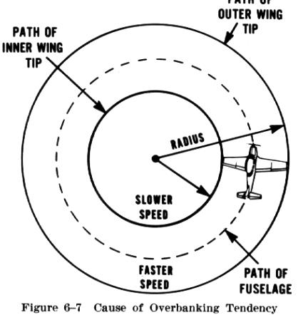
Overbanking

