Slide 1
Contact Information
Stephan Heinemann
SMS: +1 (250) 891-5446
Email: stephan.heinemann@hotmail.com
Bookings, Questions

Slide 2
Night Flying
Review Instrument Flying and Human Limitations
Definition and Motivation
Night Flying
Summary and Questions
Pre-Flight Briefing
Notes:
- transport canada presentation:
https://www.tc.gc.ca/eng/civilaviation/publications/tp14112-hazards-ppt-6035.htm

Slide 3
Review Instrument Flying

Slide 4
Definition and Motivation

Slide 5
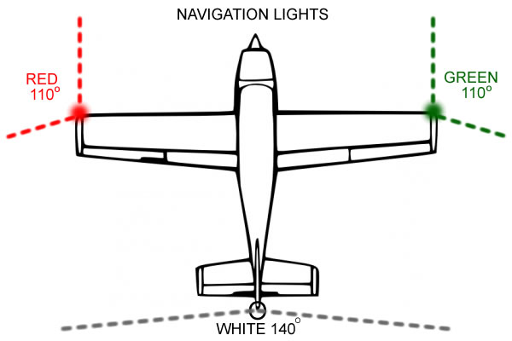
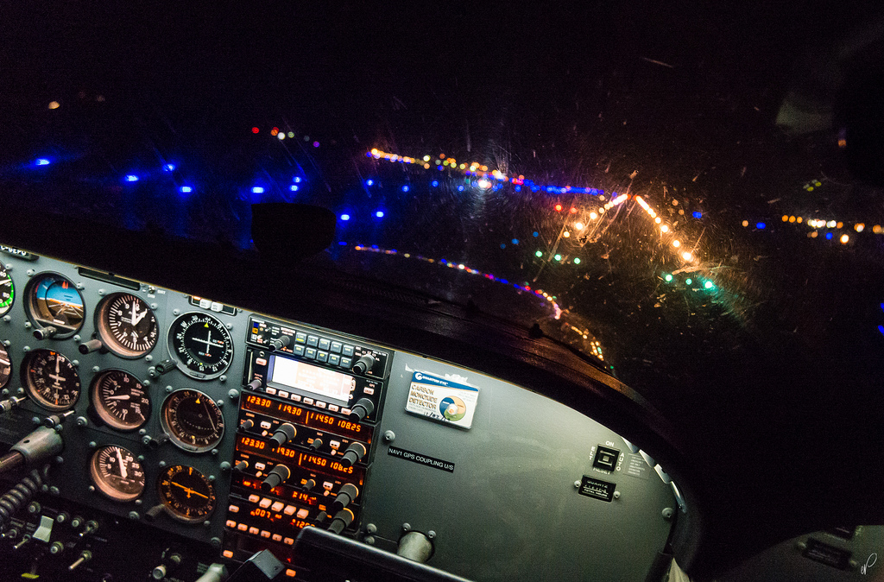
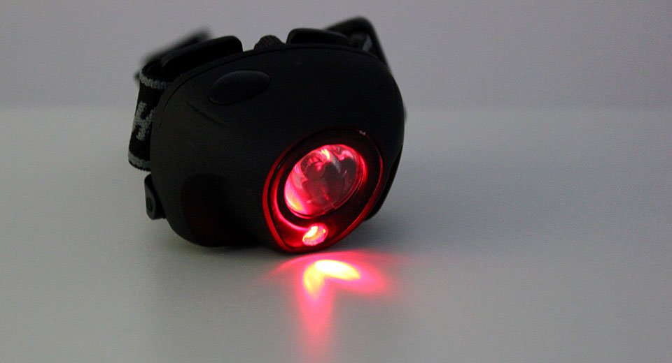
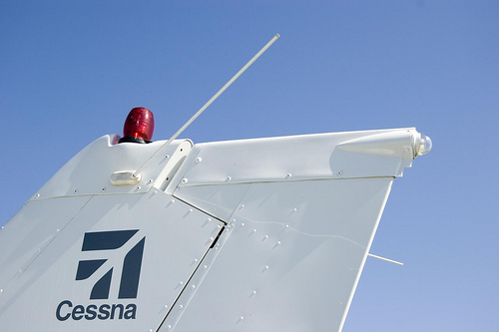
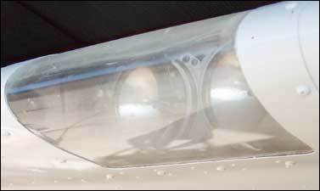
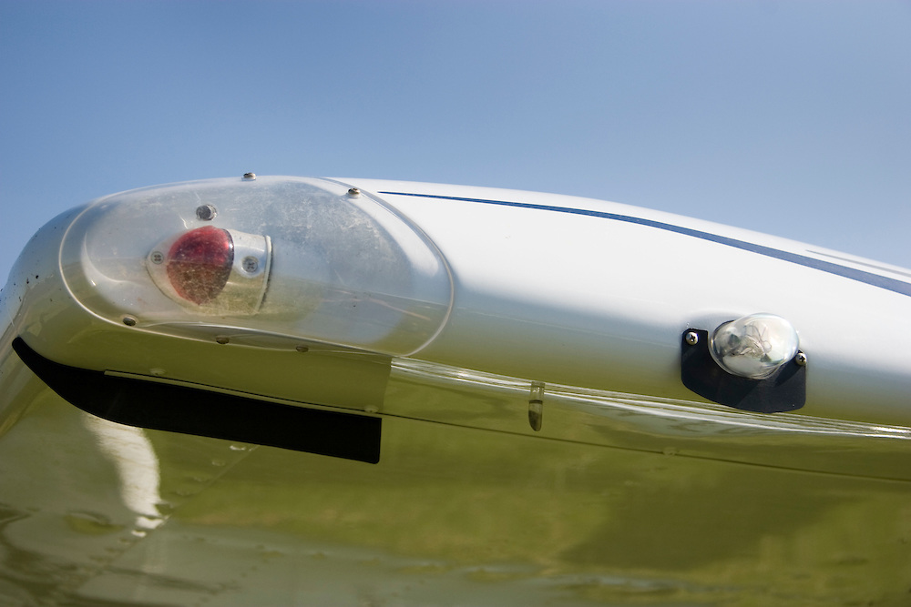
Aircraft and Equipment Requirements
Interior Lighting – cabin, panel, instruments, screens
Exterior lighting – beacon, position, landing, taxi, strobe
Flashlight – reading and backup light, dimmable red
Notes:
- spare fuses 50% if applicable
- spare flashlight (batteries, bulbs)

Slide 6
Instrumentation Requirements
Airspeed Indicator, Magnetic Compass, Tachometer, Oil Pressure and Temperature, Fuel
Altimeter, Turn and Slip Indicator
Spare Fuses 50%
Outside Aerodrome Circuit: Stabilized Magnetic or Gyroscopic Direction Indicator
Notes:
- attitude indicator is not required for night VFR

Slide 7
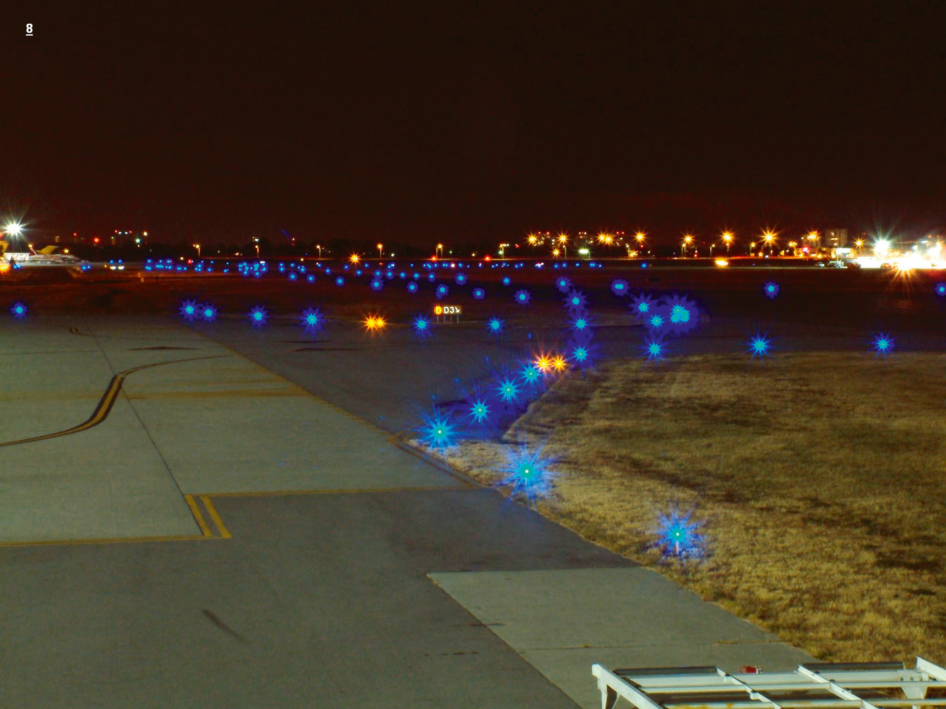
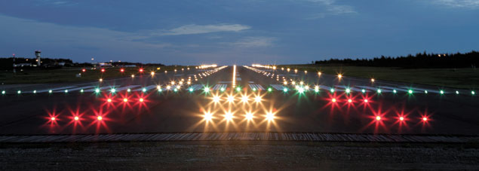
Airport Lighting
Approach – different types depending on category
Runway – threshold, edge, center, landing zone
Taxiway – edge, center, protection, holding
Obstructions – steady, flashing
ARCAL, Reflectors – check CFS for airport lighting

Slide 8
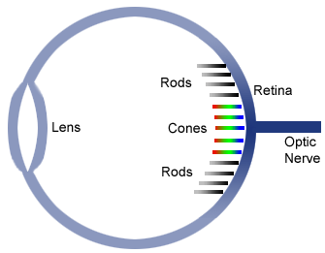
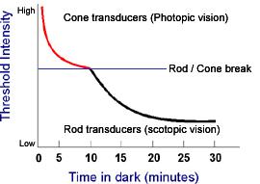
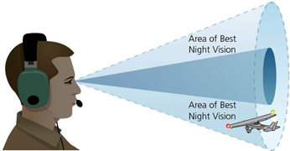
Human Limitations
Darkness adaptation takes approximately 30 min
Red light helps to preserve adaption
Strobe, landing and apron lighting may interfere
Sensory Illusions and vertigo may occur
Corriolis, head-up, head-down, black hole, autokinetic ...
Notes:
- leans
- graveyard spin/spiral
- corriolis
- inversion
- head-up/down
- linear perspective
- black hole
- autokinetic
- fase visual references
- vection
- pattern
- IMSAFE
- night hypoxia
- night myopia and blindness (lack of vitamin A)
- night adaptation depending on age
- 10-15° off focus, peripheral vision

Slide 9
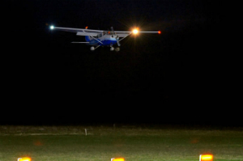

Traffic and Evironment
Peripheral scanning for effective traffic avoidance
Strobe and position lights for recognition and orientation
Inadvertant flight into clouds – maintain VMC at night

Slide 10
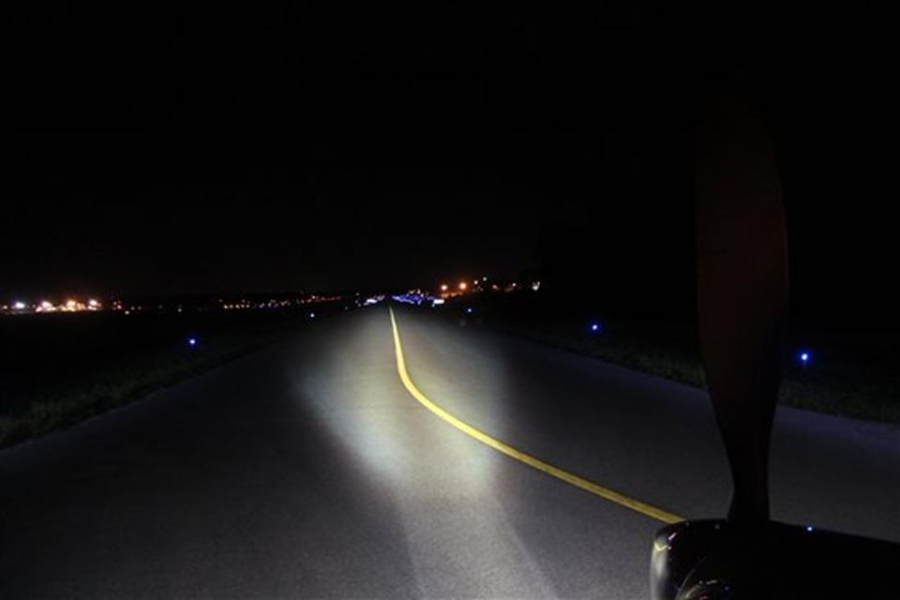
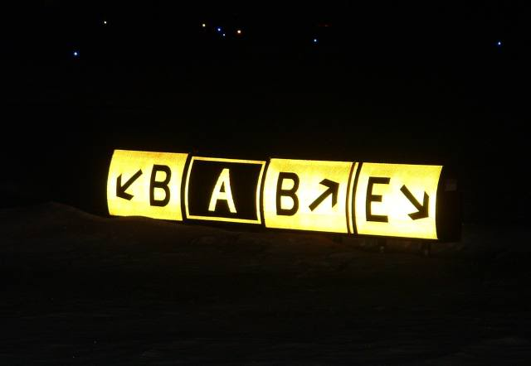
Taxiing at Night
Taxi lights on during taxi and off when holding
Strobe lights remain off before take-off and after landing
Beacon and position lights remain on at all times
Follow lighted signs and observe clearance limits
Blue edge, green and yellow center, red holding lights
Use light distance as reference for appropriate taxi speed
Notes:
- reduced depth perception
- lights are nearer than they appear to be
- danger of taxiing too fast

Slide 11
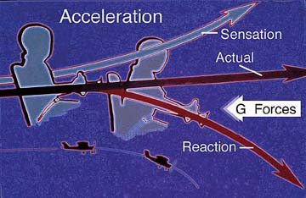
Take-Off at Night
Sparse references and possible sensory illusions
Head-up illusion may lead to wrong pitch attitude
Strobe light and head movements may lead to vertigo
Trust attitude and airspeed indicator during initial climb
Crosscheck any visual references with instruments
Notes:
- maintain positive rate of climb, reference VSI

Slide 12
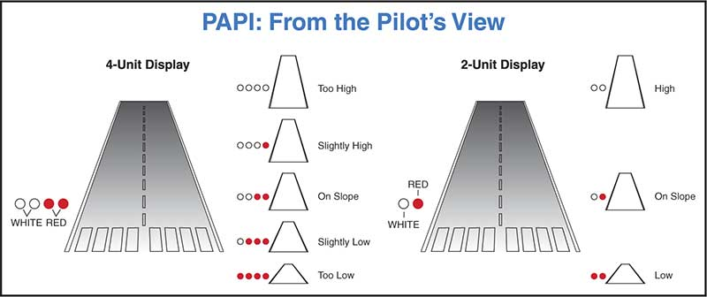
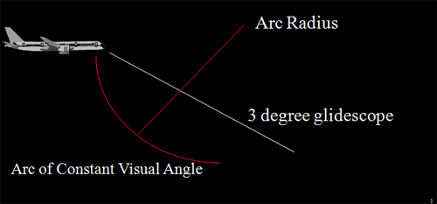
Approach and Landing at Night
Black hole illusion and reduced depth perception
Crosscheck any visual references with instruments
Employ approach lighting, PAPI / VASI and ILS
Request or adjust (ARCAL) appropriate intensity
Reduced depth perception and lights may lead to higher flare
Notes:
- reduced depth perception (rod vision)

Slide 13
Circuit at Night

Slide 14
Cross Country at Night
CFIT, inadvertant flight into IMC
Night myopia – periodically change focus distance, visual hypoxia
Reduced night vision at 5000' and above
Night VFR minima – 3 SM visibility, 1000' obstacle clearance
Always plan for alternate (or be prepared for diversion)
Include all means of navigation – NDB, VOR, GPS

Slide 15
Summary / Quiz

Slide 16
Pre-Flight Briefing
Exercise
Training Area
Departure and Arrival Procedures
Weather Briefing / NOTAMs
Aircraft and Documents
Time and Fuel Requirements

Slide 17
Night Flying (Ex. 25, LP. )
Objective
Review
Motivation
Howto
Summary / Questions
Preflight Briefing

