Slide 1
Contact Information
Stephan Heinemann
SMS: +1 (250) 891-5446
Email: stephan.heinemann@hotmail.com
Bookings, Questions

Slide 2
Flight for Range and Endurance
Review Straight and Level Flight
Definition and Motivation
Flight for Range
  Diagrams, Maximum Range (Experimental)
Flight for Endurance
  Diagrams, Maximum Endurance (Experimental)
Summary and Questions
Pre-Flight Briefing
Notes:
- gear and carbutettor heat are not applicable

Slide 3
Review Straight and Level Flight
Attitude plus power equals performance!
Mentally perform a power reduction from the cruise power setting while maintaining straight and level flight.
What effect does the power reduction have on the airspeed and the fuel consumption?
What effect does the power reduction have on the estimated time of arrival?
Notes:
Until what point can the power be reduced while maintaining straight and level flight?

Slide 4
Definition and Motivation
Airspeed and fuel flow can be traded off
Range – achievable distance per fuel unit (air/ground range): destinations, alternates
Endurance – achievable time per fuel unit: holding procedures, cockpit management / decision making, economy
Maximum range – best achievable distance
Maximum endurance – best achievable time
Notes:
SFC = FF / BHP = FF n / Pa

Slide 5
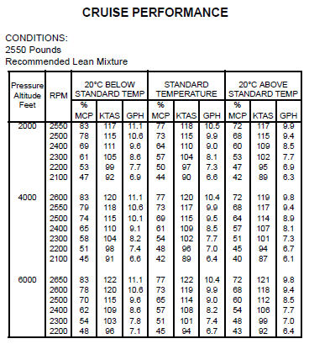
Cruise Performance
POH Section 5
Consider conditions
Select pressure altitude
Select temperature
Select power setting
Interpolate as required
Determine airspeed and fuel flow
Notes:
Derive power curve from table!
2550 - 118
2500 - 115 : 3
2400 - 110 : 5 (non-linear)
2300 - 104 : 6 (best range)
2100 - 97 : 7 (linear)
2000 - 90 : 7

Slide 6
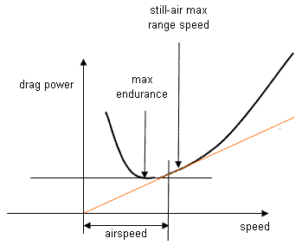
Flight for Endurance
Power Required
Min Power
Max Endurance
D * V
Notes:
- Experimental Method
- POH
- Mixture, Flaps, Altitude (Factors → Turbulence)
- Reduced Control Response
- SL for reciprocating engines (air density)

Slide 7
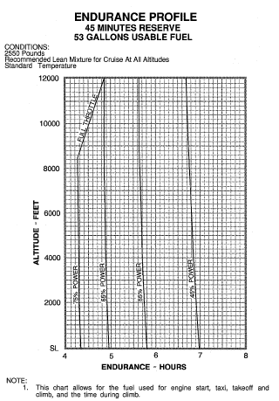
Endurance Profile
POH Section 5
Consider conditions
Select pressure altitude
Select power
Determine endurance
Notes:
- put cruise power table next to it...

Slide 8
Flight for Maximum Endurance (Experimental)
Reduce power in 100 RPM steps maintaining level flight with stable airspeed and trim
Unstable decreasing airspeed indicates slow flight range – more power required
Reset cruise power and then decrease power to slightly higher stable setting to compensate for turbulence and required turns
Lean mixture as recommended
Notice reduced control responses
Notes:
www.eaa1000.av.org/technicl/perfspds/perfspds.htm
- approximately 1700 RPM for max. endurance
Familarization Demo ?
- 1700 RPM → 3 GPH → 80 KIAS
30 USG → 10 H → 800 NM

Slide 9
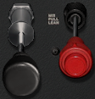
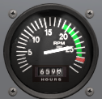

Leaning
Slowly turn mixture knob out / anticlockwise until a drop in RPM can be observed
Turn the mixture knob back in / clockwise until the RPM has increased again (2-3 turns)
Check fuel flow and exhaust gas temperature

Slide 10
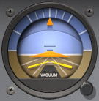
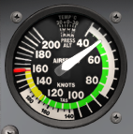
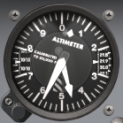
Endurance - Instruments
Control
Performance
Attitude
Power
Airspeed
Altitude
Throttle
Mixture
EGT / FF
Attitude, Power → Airspeed (about 50-60 KIAS), Altitude
Mixture → Exaust Gas Temperature, Fuel Flow
Notes:
www.eaa1000.av.org/technicl/perfspds/perfspds.htm

Slide 11
Flight for Range
Power Required
Min Drag
Max Range
D * V
Notes:
- parasite drag: form, skin friction, interference
- induced drag, wave drag (trans-/supersonic)
- thrust curve: jet aircraft
- power curve: propeller aircraft (reciprocating engine)
- engine and propeller efficiency
- Experimental Method
- POH
- Wind, Mixture, Altitude (Factors)
- Power (W) = Force (N) * Distance (m) / Time (s)
= Force (N) * Velocity (m/s)
= Drag (N) * Velocity (m/s)
- D = Cd * ½ r * S * v²
- P = Cd * ½ r * S * v³

Slide 12
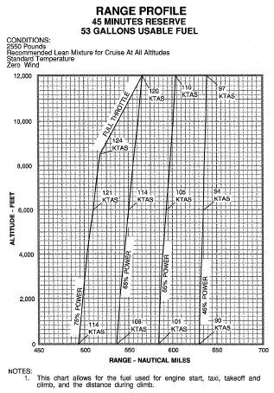
Range Profile
POH Section 5
Consider conditions
Select pressure altitude
Select power setting
Determine range
Notes:
- Notice almost linear dependency between power setting and airspeed
- Linear dependency will eventually change to a much lower airspeed for a lower power setting

Slide 13
Flight for Maximum Range
Min Drag
Max Range
D * V
Increase power in 100 RPM steps until a non-linear increase in airspeed can be observed
Maintain level flight, trim and lean mixture as recommended (rich of peak)
Notes:
- can be decreased in 100 RPM steps as well
- approximately 2000 RPM for max. range
Familarization Demo
- 2000 RPM → 5 GPH → 100 KIAS
30 USG → 6 H → 600 NM
- 2400 RPM → 10 GPH → 120 KIAS
30 USG → 3 H → 360 NM

Slide 14
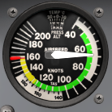
Range – Instruments
Control
Performance
Attitude
Power
Airspeed
Altitude
Throttle
Mixture
EGT / FF
Attitude, Power → Airspeed (about 70-80 KIAS), Altitude
Mixture → Exhaust Gas Temperature, Fuel Flow

Slide 15
Factors Affecting Range and Endurance
Endurance: power setting, fuel available, flap setting, angle of attack, airspeed, weight, centre of gravity, altitude, mixture, turbulence
Range: power setting, fuel available, flap setting, angle of attack, airspeed, weight, centre of gravity, altitude, mixture, wind

Slide 16
Summary / Quiz
Define range, maximum range, endurance and maximum endurance.
Give examples for when flight for range or endurance is preferable.
What are the main factors that influence range and endurance and how do they affect them?
Mentally configure the airplane for best range and endurance and state all required actions, respectively.

Slide 17
Pre-Flight Briefing
Exercise
Training Area
Departure and Arrival Procedures
Weather Briefing / NOTAMs
Aircraft and Documents
Time and Fuel Requirements
Safety Considerations and Responsibilities
Notes:
- Safety: nose-high, poor forward visibility, engine cooling...

Slide 18
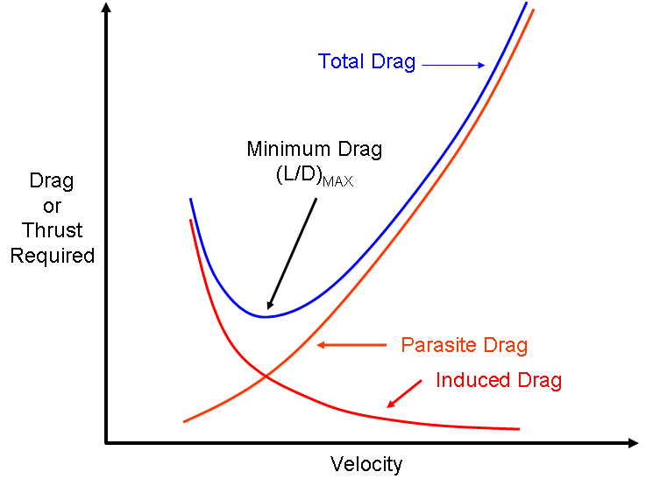
Flight for Endurance
Thrust Required
Power Required
Min Power
Vbe
Min Drag
Vbr
D * V
Notes:
- Experimental Method
- POH
- Mixture, Flaps, Altitude (Factors → Turbulence)
- Reduced Control Response
- SL for reciprocating engines (air density)

Slide 19
Flight for Range
Thrust Required
Power Required
Min Power
Vbe
Min Drag
Vbr
D * V
Notes:
- parasite drag: form, skin friction, interference
- induced drag, wave drag (trans-/supersonic)
- thrust curve: jet aircraft
- power curve: propeller aircraft (reciprocating engine)
- engine and propeller efficiency
- Experimental Method
- POH
- Wind, Mixture, Altitude (Factors)
- Power (W) = Force (N) * Distance (m) / Time (s)
= Force (N) * Velocity (m/s)
= Drag (N) * Velocity (m/s)
- D = Cd * ½ r * S * v²
- P = Cd * ½ r * S * v³

Slide 20
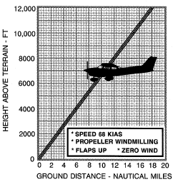
Flight for Maximum Range (Derived)
Reduce power to establish best glide airspeed
Maintain level flight and trim accordingly
Lean mixture as recommended (rich of peak)
Notes:
Experimental: ground references during glide
- propeller efficiency is a factor

Slide 21
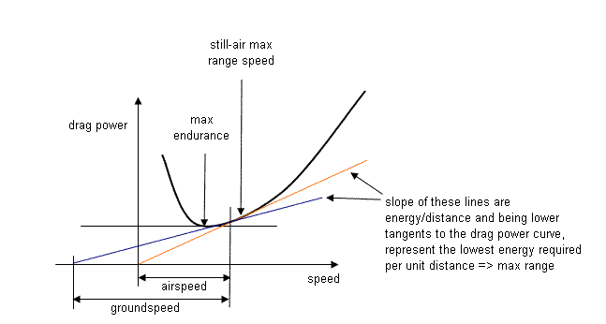
Flight for Maximum Endurance (Derived)
Reduce power to lowest setting (above slow flight) to maintain altitude (about best glide / 1.3 = 52 KIAS)
Maintain level flight and trim accordingly
Lean mixture as recommended (rich of peak)

Slide 22
Familiarization Demonstration
Employ an obvious and dramatic example
Slow Flight: 2000 RPM, increase nose-up attitude, demonstrate slower airspeed while maintaining straight-and-level

