Slide 1
Contact Information
Stephan Heinemann
SMS: +1 (250) 891-5446
Email: stephan.heinemann@hotmail.com
Bookings, Questions

Slide 2
Spirals
Definition and Motivation
Spiral Dives

Slide 3
Review Turns and Spins
How is the angle of attack of the inner wing different from the angle of attack of the outer wing during a level turn? Explain why.
What is the effect of the difference in angle of attack between inner and outer wing and what corrections need to be applied?
What are the phases of a spin?
Mentally perform a spin entry and recovery.

Slide 4
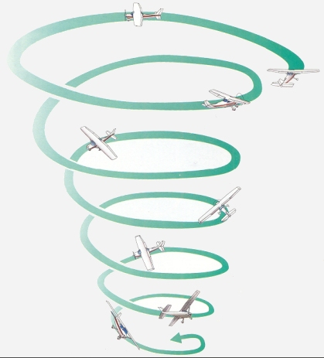
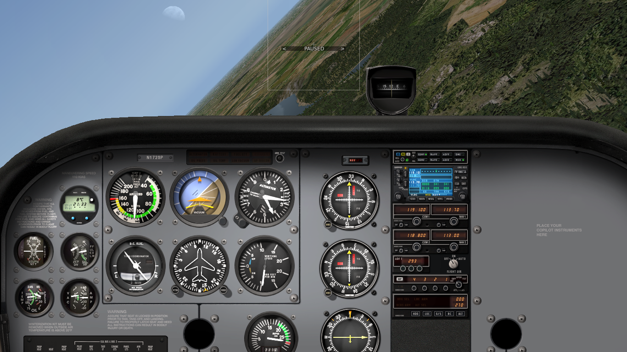
Definition and Motivation
Descending turn with increasing angle of bank
Increasing airspeed and rate of descent
High load factor during recovery

Slide 5
Safety Considerations
HASEL, lookout ahead and below
Significant loss of altitude
Significant acceleration and gain in airspeed
Recovery above 2000' AGL

Slide 6
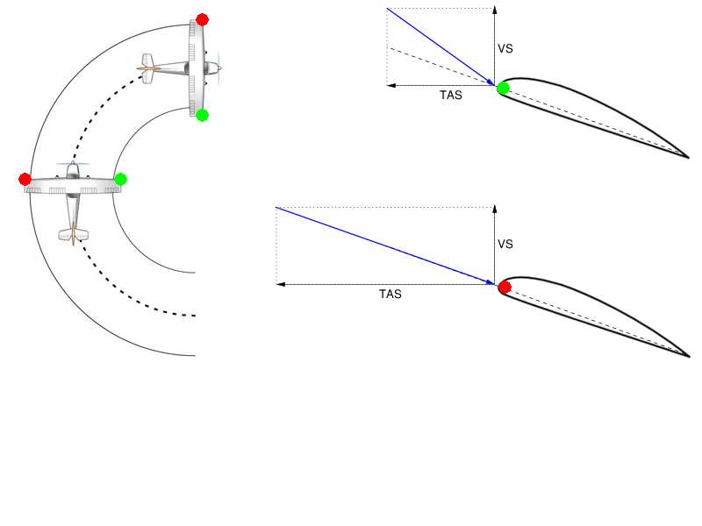
Spiral Entry – Turn
Establish a level turn
Apply only elevator back-pressure in the attempt to hold altitude
Do not correct any overbanking tendency

Slide 7
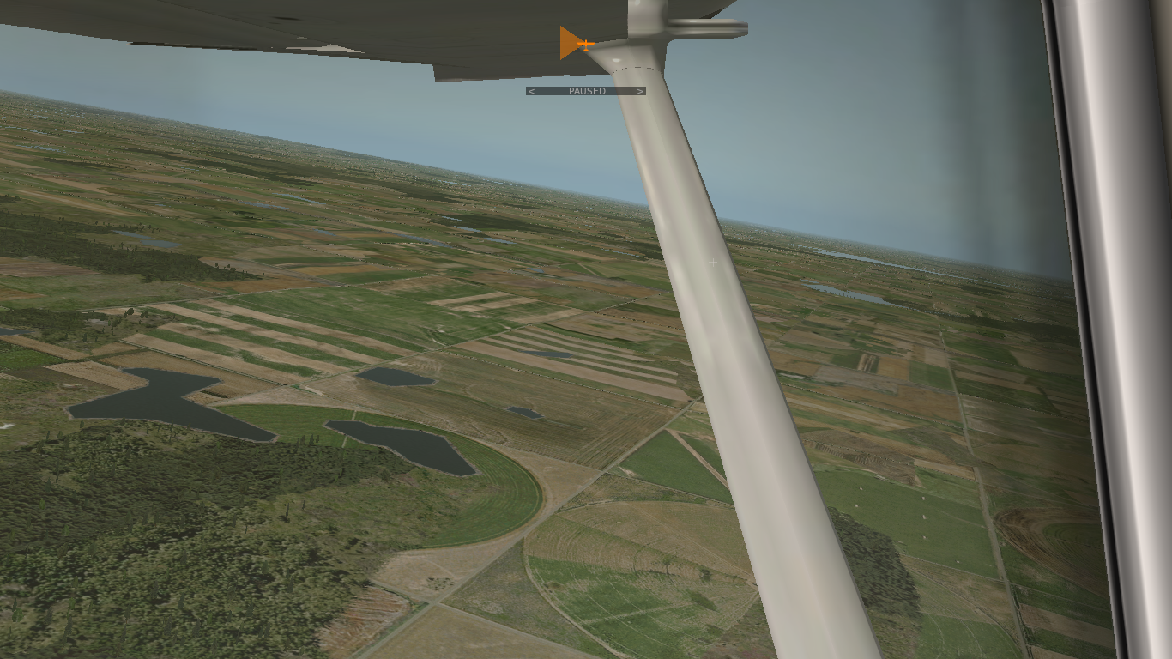
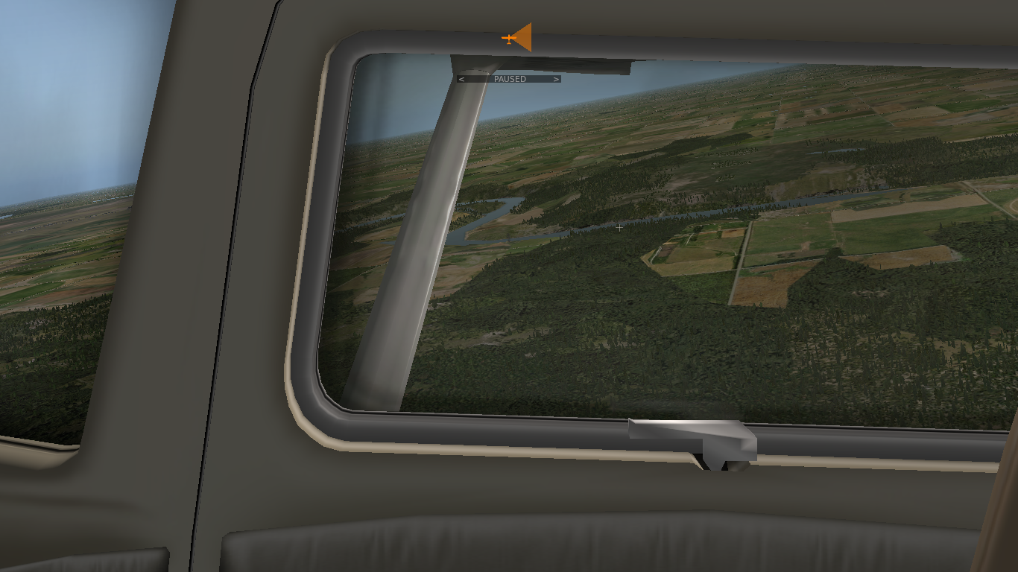
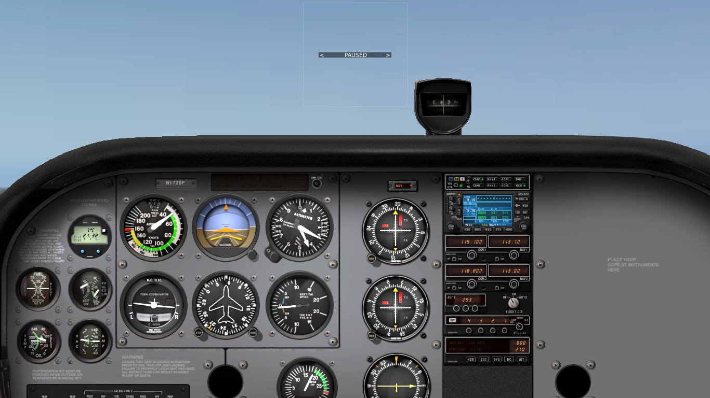
Spiral Entry – Spin
Enter slow flight without imminent stall
Perform an attempt to enter a spin

Slide 8


Spiral Recovery
Power
Idle
Wings Level
Ease Out
Reduce power to idle
Roll wings level (opposite spiral direction)
Ease out of dive
Establish climb attitude and set power to regain altitude
Establish cruise attitude, set cruise power and trim

Slide 9
Spiral Dive

Slide 10

Instruments
Turn coordinator may help to determine direction of spiral
Airspeed increases significantly
Rate of descent increases significantly

Slide 11
Summary / Quiz
Define a spiral and explain the difference between a spin and a spiral.
Mentally perform a spiral entry and recovery and state all observations and required actions.
Why are ailerons used to establish wings level first and not simultaneously with elevator?
What situations can potentially lead to an inadvertent spiral?

Slide 12
Pre-Flight Briefing
Exercise
Training Area
Departure and Arrival Procedures
Weather Briefing / NOTAMs
Aircraft and Documents

