Slide 1
Contact Information
Stephan Heinemann
SMS: +1 (250) 891-5446
Email: stephan.heinemann@hotmail.com
Bookings, Questions

Slide 2
Take-Off
Review Climbing and Slipping
Definition and Motivation
Take-Offs
  Normal, Short-Field, Soft-Field, Crosswind
  Factors
Summary and Questions
Pre-Flight Briefing

Slide 3
Review Climbing
Define and state the two important reference speeds for climbing.
Where do we find the relevant performance data?
How do we maintain a selected climb airspeed given a fix power setting?
What factors affect climb performance?
How do we maintain coordinated flight during a climbing turn?

Slide 4
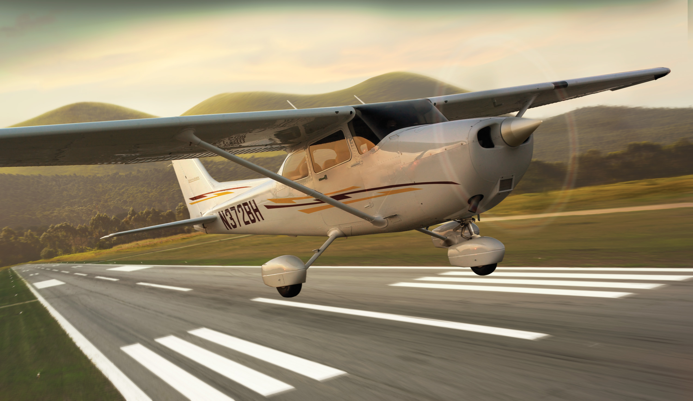
Definition and Motivation
Act of leaving a supporting surface including the immediately preceding and following acts
Leaving the ground and becoming airborne
Essential maneuver used in every single flight

Slide 5
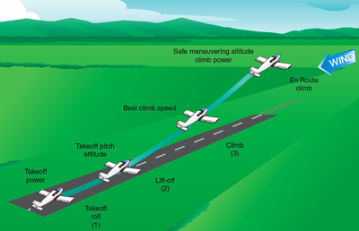
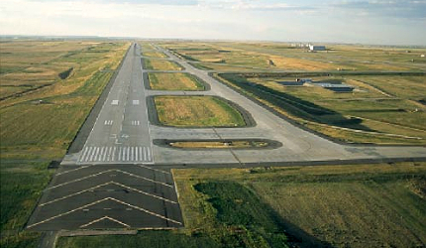
Normal Take-Off
Criteria: hard uncontaminated surface, long runway, no obstacles, low density altitude, no or steady headwind
Check environment and consult performance data in POH
Pre-take-off checks according to checklists in POH
Mixture full rich, lean for maximum RPM above 3000 ft DALT
Conduct passenger, crew departure and emergency briefings
Notes:
- low density altitude = higher air density
- align with runway centerline / centered nose wheel
- avoid brakes if possible, use rudder for directional control
- outside references (end of runway)
- rpm / airspeed check
- develop feel for the controls
- rotation speed check
- climb speed check
Abort Criteria, Decision Point, Briefings
Departure briefings not necessarily for passengers

Slide 6
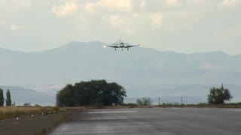
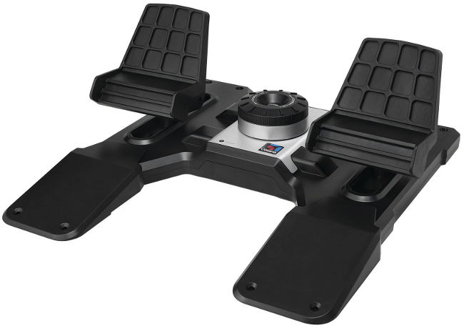

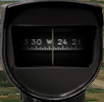
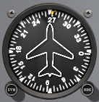
Normal Take-Off – Line Up
Check
Approach Sector
Align
Centerline
Crosscheck
Instruments
Check approach sector and callout Approach Sector Clear
Align with runway centerline using power, rudder and brakes
Keep nose-wheel centered and ideally stop before take-off run
Crosscheck runway heading, magnetic compass, heading indicator
Notes:
- clearance, transponder, lights, time... (keep it simple)
- sometimes a rolling take-off might be necessary

Slide 7

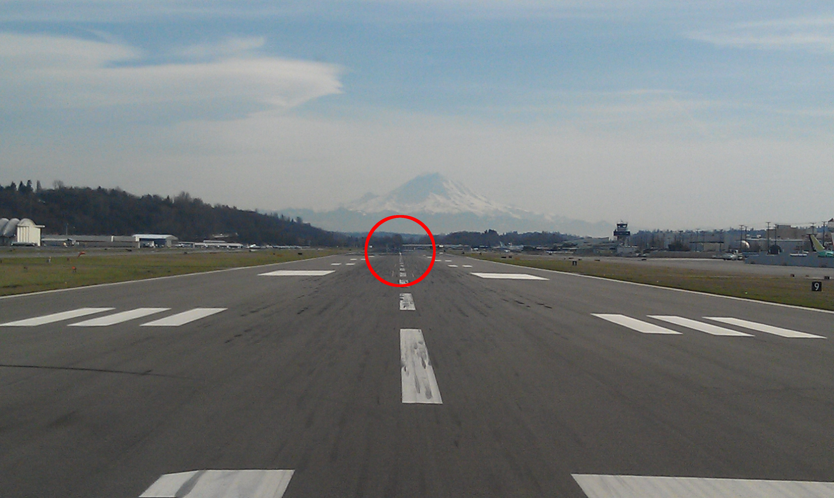

Normal Take-Off – Run
Full
Power
Keep
Straight
Runway End
Lift Off
Callout Take-Off before initiating take-off run
Smoothly apply full power keeping straight with rudder
Use runway end as reference for directional control
Check RPM/ASI and callout RPM Checked, Airspeed Alive
Continue to accelerate to rotation speed (Vr = 55 KIAS)
Gently apply elevator back-pressure to lift off nose-wheel
Notes:
- keep ailerons and elevator neutral during initial phase
- gradually increase elevator back-pressure to lighten nose-wheel weight

Slide 8
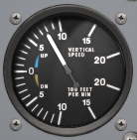
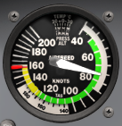
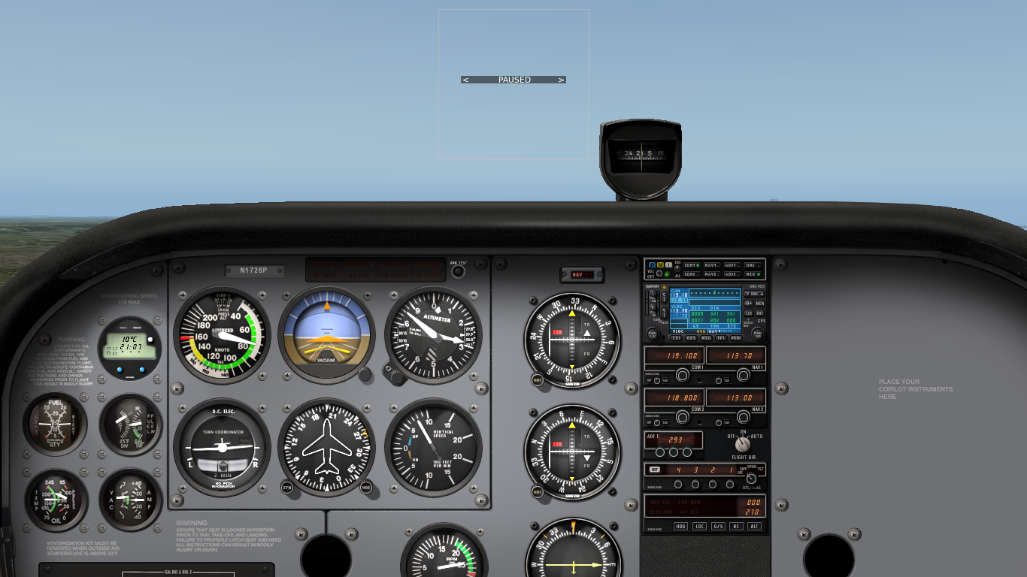
Normal Take-Off – Initial Climb
Positive Rate
Adjust Attitude
Maintain Airspeed
Vy
Control Direction
Establish nose-up attitude aligning nose with horizon
Check altitude and VSI and callout Positive Rate
Accelerate to normal climb airspeed (80 KIAS)
Adjust and maintain nose-up attitude for climb airspeed
Trim to eliminate elevator control pressure as required
Maintain directional control and control yaw with rudder

Slide 9
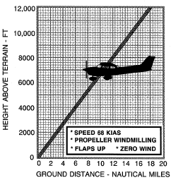
Aborted / Rejected Take-Off
Power Idle
Apply Brakes
Best Glide
Avoid Obstacles
Reasons: failures, traffic, animals, humans
During take-off run: power idle, apply brakes, keep straight
Immediately after take-off with sufficient runway: power idle, flaps as required, land straight ahead
Immediately after take-off without sufficient runway: establish best glide airspeed (68 KIAS), avoid major turns and obstacles
Notes:
- V1, TODA, ASDA?

Slide 10
Safety Considerations
Continue lookout and maintain situational awareness
Remain within ATC clearance limits (line-up, take-off)
Comply with ATC instructions (hold short)
Inform ATC if unable to follow instructions
Consider leaving ground effect: induced versus effective angle of attack

Slide 11
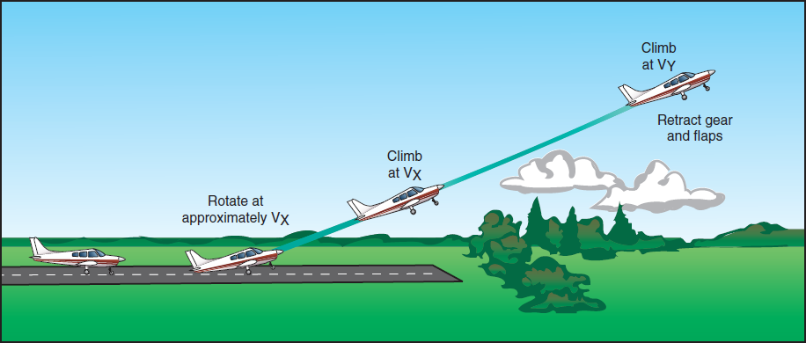
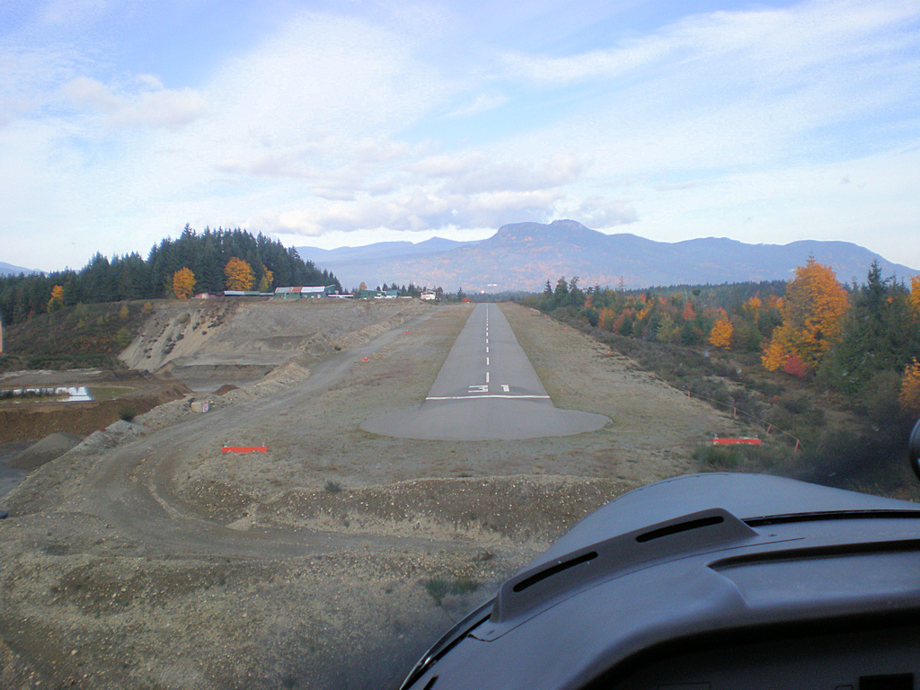
Short-Field Take-Off
Criteria: hard uncontaminated surface, short runway, obstacles, high density altitude, no or steady headwind
Check environment and consult performance data in POH
Pre-take-off checks according to checklists in POH
Mixture full rich, lean for maximum RPM above 3000 ft DALT
Conduct passenger, crew departure and emergency briefings
Notes:
- high density altitude = lower air density

Slide 12
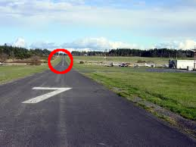
Short-Field Take-Off – Line Up
Check
Approach Sector
Align
Centerline
Crosscheck
Instruments
Check approach sector and callout Approach Sector Clear
Align with runway centerline using power, rudder and brakes
Keep nose-wheel centered and stop before take-off run
Crosscheck runway heading, magnetic compass, heading indicator

Slide 13

Short-Field Take-Off – Run
Flaps 10°
Hold Brakes
Full Power
Release Brakes
Set flaps 10°, apply and hold brakes
Smoothly apply full power and check static RPM (2300-2400)
Callout Take-Off before initiating take-off run
Release brakes to initiate take-off run
Apply slight elevator back-pressure
Check RPM/ASI and callout RPM Checked, Airspeed Alive
Keep straight with rudder accelerating to lift-off (Vr = 44..51 KIAS)
Slight Back-Pressure
Notes:
- Vr = 44, 48, 51 KIAS depending on weight
- 2300-2400 RPM check POH
- lean mixture as required to obtain static RPM

Slide 14
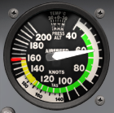
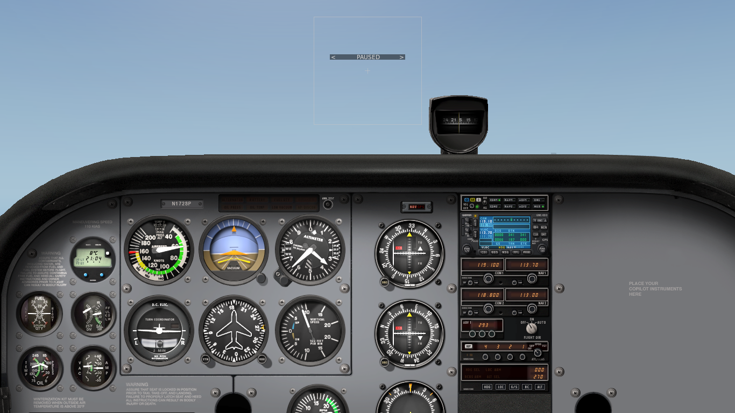
Short-Field Take-Off – Initial Climb
Positive Rate
Adjust Attitude
Maintain Vx
Vx
Clear Obstacles, Vy
Check altitude and VSI and callout Positive Rate
Accelerate to best angle of climb airspeed (Vx = 62 KIAS)
Adjust and maintain nose-up attitude for airspeed and trim
Maintain directional control and control yaw with rudder
Transition to best rate of climb airspeed (Vy = 74 KIAS) after obstacles are cleared and trim
Retract flaps at safe altitude (400 ft AGL) in white arc
Notes:
Vc = 56 KIAS (with flaps until obstacle clearance)
Look at IAS in POH Vy decreases by 1..2 knots
Vx increases with altitude

Slide 15
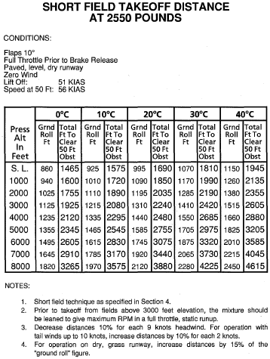
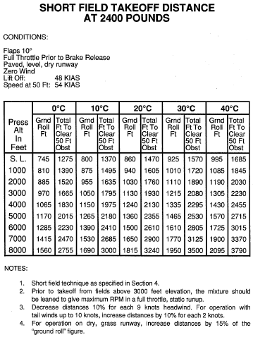
Take-Off Performance
Notes:
- 56 KIAS versus 62 KIAS clean Vx
- aim for Vx, explain if necessary

Slide 16
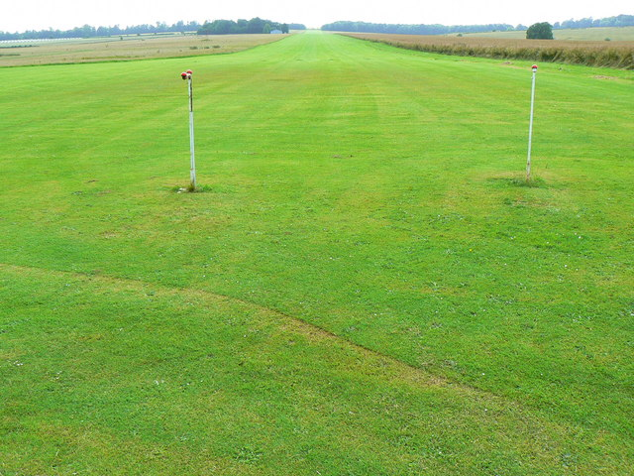
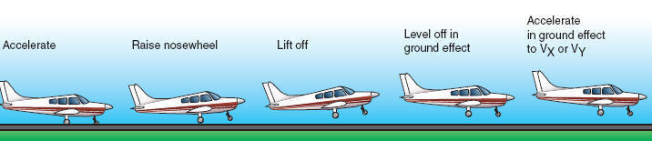
Soft-Field Take-Off
Criteria: soft, rough or contaminated surface, long runway, no obstacles, low density altitude, no or steady headwind
Check environment and consult performance data in POH
Pre-take-off checks according to checklists in POH
Mixture full rich, lean for maximum RPM above 3000 ft DALT
Conduct passenger, departure and emergency briefings
Notes:
Criteria, Procedure, Performance Tables
Surface, Contamination
Ground Effect

Slide 17
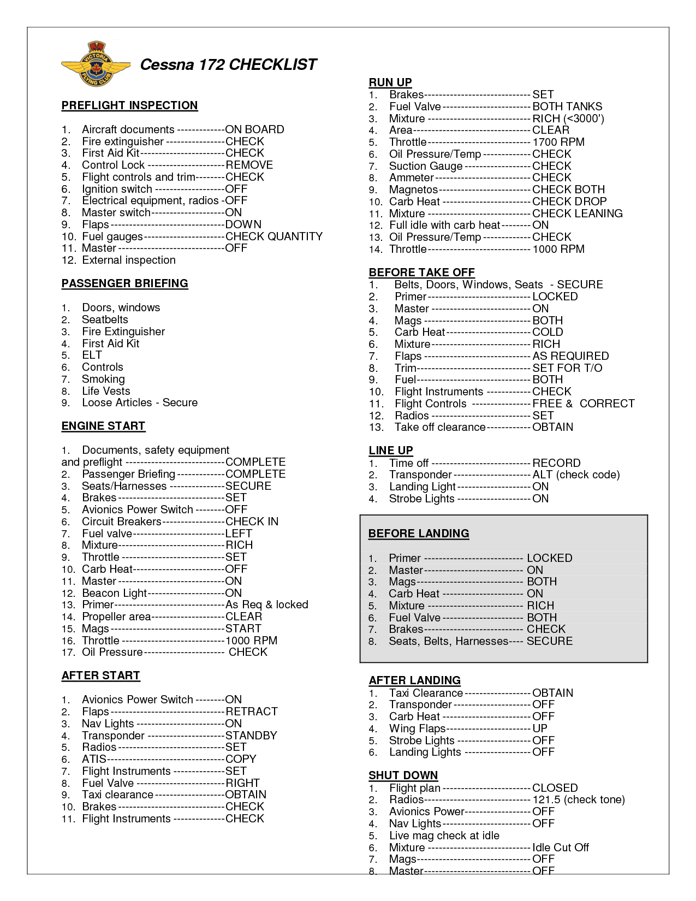


Soft-Field Pre-Take-Off
Checks
Briefings
Mixture
Flaps 10°
Complete pre-take-off checks and briefings on supporting surface
Conduct passenger, crew departure and emergency briefings
Set flaps (10°) and lean mixture as required on supporting surface
Setup aircraft for rolling take-off on soft surface
Observe ATC clearances and instructions

Slide 18
Soft-Field Take-Off – Line Up
Relieve Nose-Wheel and Keep Rolling
Check
Approach Sector
Align
Centerline
Crosscheck
Instruments
Apply and hold elevator back-pressure to relieve nose-wheel
Check approach sector and callout Approach Sector Clear
Perform rolling take-off – ideally do not stop after centerline alignment
Crosscheck runway heading, magnetic compass, heading indicator
Notes:
- full back-pressure at the beginning of the take-off roll, lift and keep nose-wheel off the ground
- slightly release back-pressure to improve forward visibility
- keep straight with rudder
- immediately after lift off, lower nose and stay in ground effect
- accelerate for climb (62 KIAS / 74 KIAS)

Slide 19
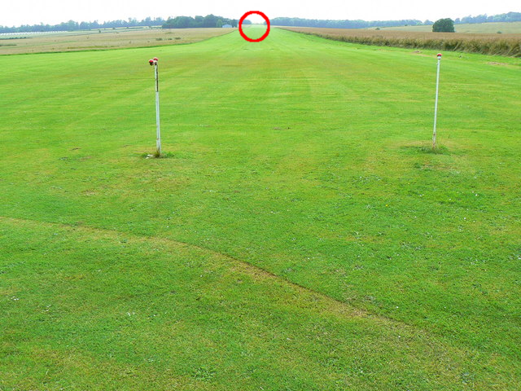
Soft-Field Take-Off – Run
Full
Power
Keep
Straight
Lift Off
Runway End
Callout Take-Off before initiating take-off run
Smoothly apply full power keeping straight with rudder
Use runway end as reference for directional control
Apply slight elevator back-pressure to raise nose-wheel
Check RPM/ASI and callout RPM Checked, Airspeed Alive
Lift off at slowest airspeed possible commensurate
Notes:
Maintain nose on horizon during acceleration
Accelerate in ground effect to best angle or rate of climb (Vx = 62 KIAS, Vy = 74 KIAS)
Peripheral view, nose-up attitude and visibility
(Vr = 43 KIAS) different rotation speeds

Slide 20
Soft-Field Take-Off – Initial Climb
Level-off and remain in ground effect immediately after lift-off
Accelerate in ground effect to desired climb airspeed (Vx, Vy)
If best angle of climb (Vx = 62 KIAS) is used for initial climb, then
Transition to best rate of climb (Vy = 74 KIAS) after clearing obstacles
Retract flaps at safe altitude (400 ft AGL) in white arc

Slide 21
Review Slipping
Define a slip and explain the difference between a side and a forward slip and their applications.
Mentally perform a side slip and state all observations and actions.

Slide 22
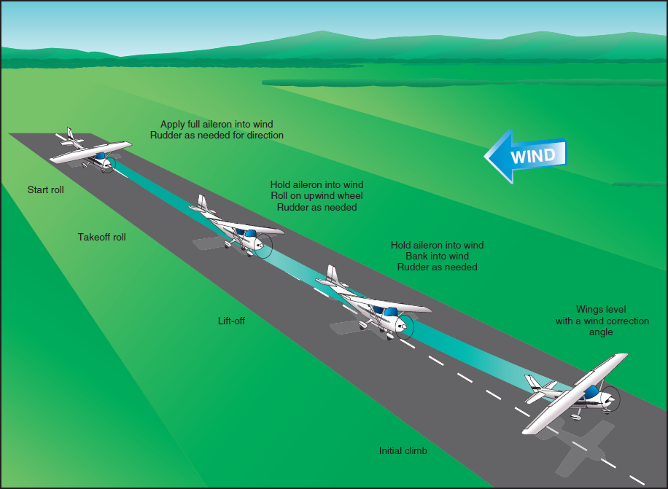
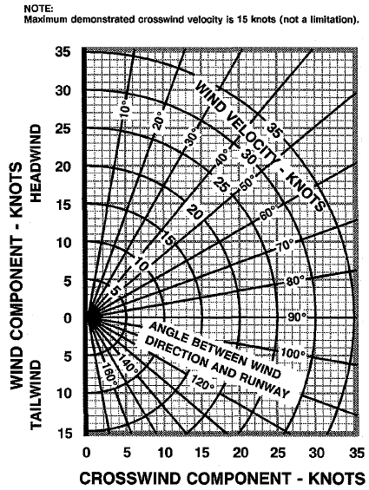
Crosswind Take-Off
Criteria: steady or changing gusty crosswind component
Check environment and consult performance data in POH
Pre-take-off checks according to checklists in POH
Maximum demonstrated crosswind component 15 knots
Mixture full rich, lean for maximum RPM above 3000 ft DALT
Conduct passenger, departure and emergency briefings
Notes:
Criteria, Procedure, Performance Tables
Limitations, Vmxwc (20% Vs / Vs0), 15 knots
Gusts and Windshear

Slide 23

Crosswind Take-Off – Run
Full Aileron
Into Wind
Reduce Aileron,
Briskly Lift Off
Minimum
Flaps
Keep Straight
Use minimum flap setting required and hold full ailerons into the wind
Callout Take-Off before initiating take-off run
Smoothly apply full power keeping straight with rudder
Use runway end as reference for directional control
Check RPM/ASI and callout RPM Checked, Airspeed Alive
Continue to accelerate to slightly higher lift-off speed in gusty conditions
Gradually reduce aileron input keeping wings level during lift-off
Briskly apply elevator back-pressure to lift off
Notes:
- weather cocking
- rubber drifting
- more lift on the windward side
- positive dihidral increases lift on the windward side

Slide 24
Crosswind Take-Off – Initial Climb
Level Wings
Coordinated Turn into Wind
Check altitude and VSI and callout Positive Rate
Perform coordinated turn into the wind to establish a crab while maintaining runway track
Accelerate to desired climb airspeed (Vx, Vy) and transition to higher climb airspeed as applicable after clearing obstacles
Adjust and maintain nose-up attitude for climb airspeed and trim
Retract flaps at safe altitude (400 ft AGL) in white arc
Notes:
- maybe just slight kick of rudder required to initiate crabbing

Slide 25
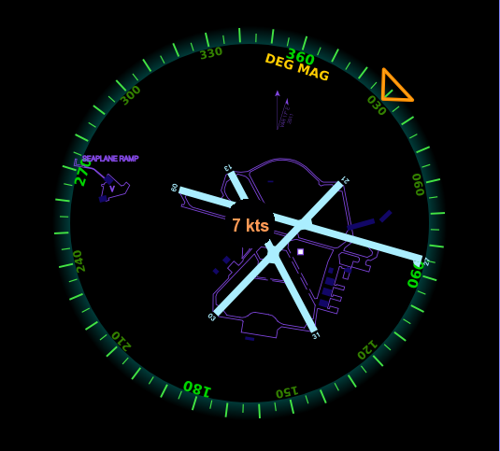
Crosswind Component

Slide 26
Take-Off Factors
Runways and aerodrome environment
Surface material (hard, soft, rough) and slope
Surface contamination (wet, dry, slush, snow, ice)
Air density (altitude, pressure, temperature, humidity)
Wind and turbulence (head-/tailwind, gusts, windshear)
Wake turbulence
Obstacles
Weight and balance
Ground effect, wheelbarrowing, weathercocking

Slide 27
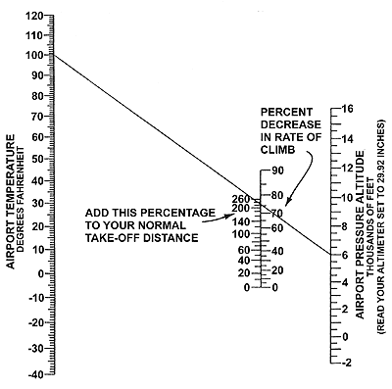
Density Altitude – Koch Chart

Slide 28
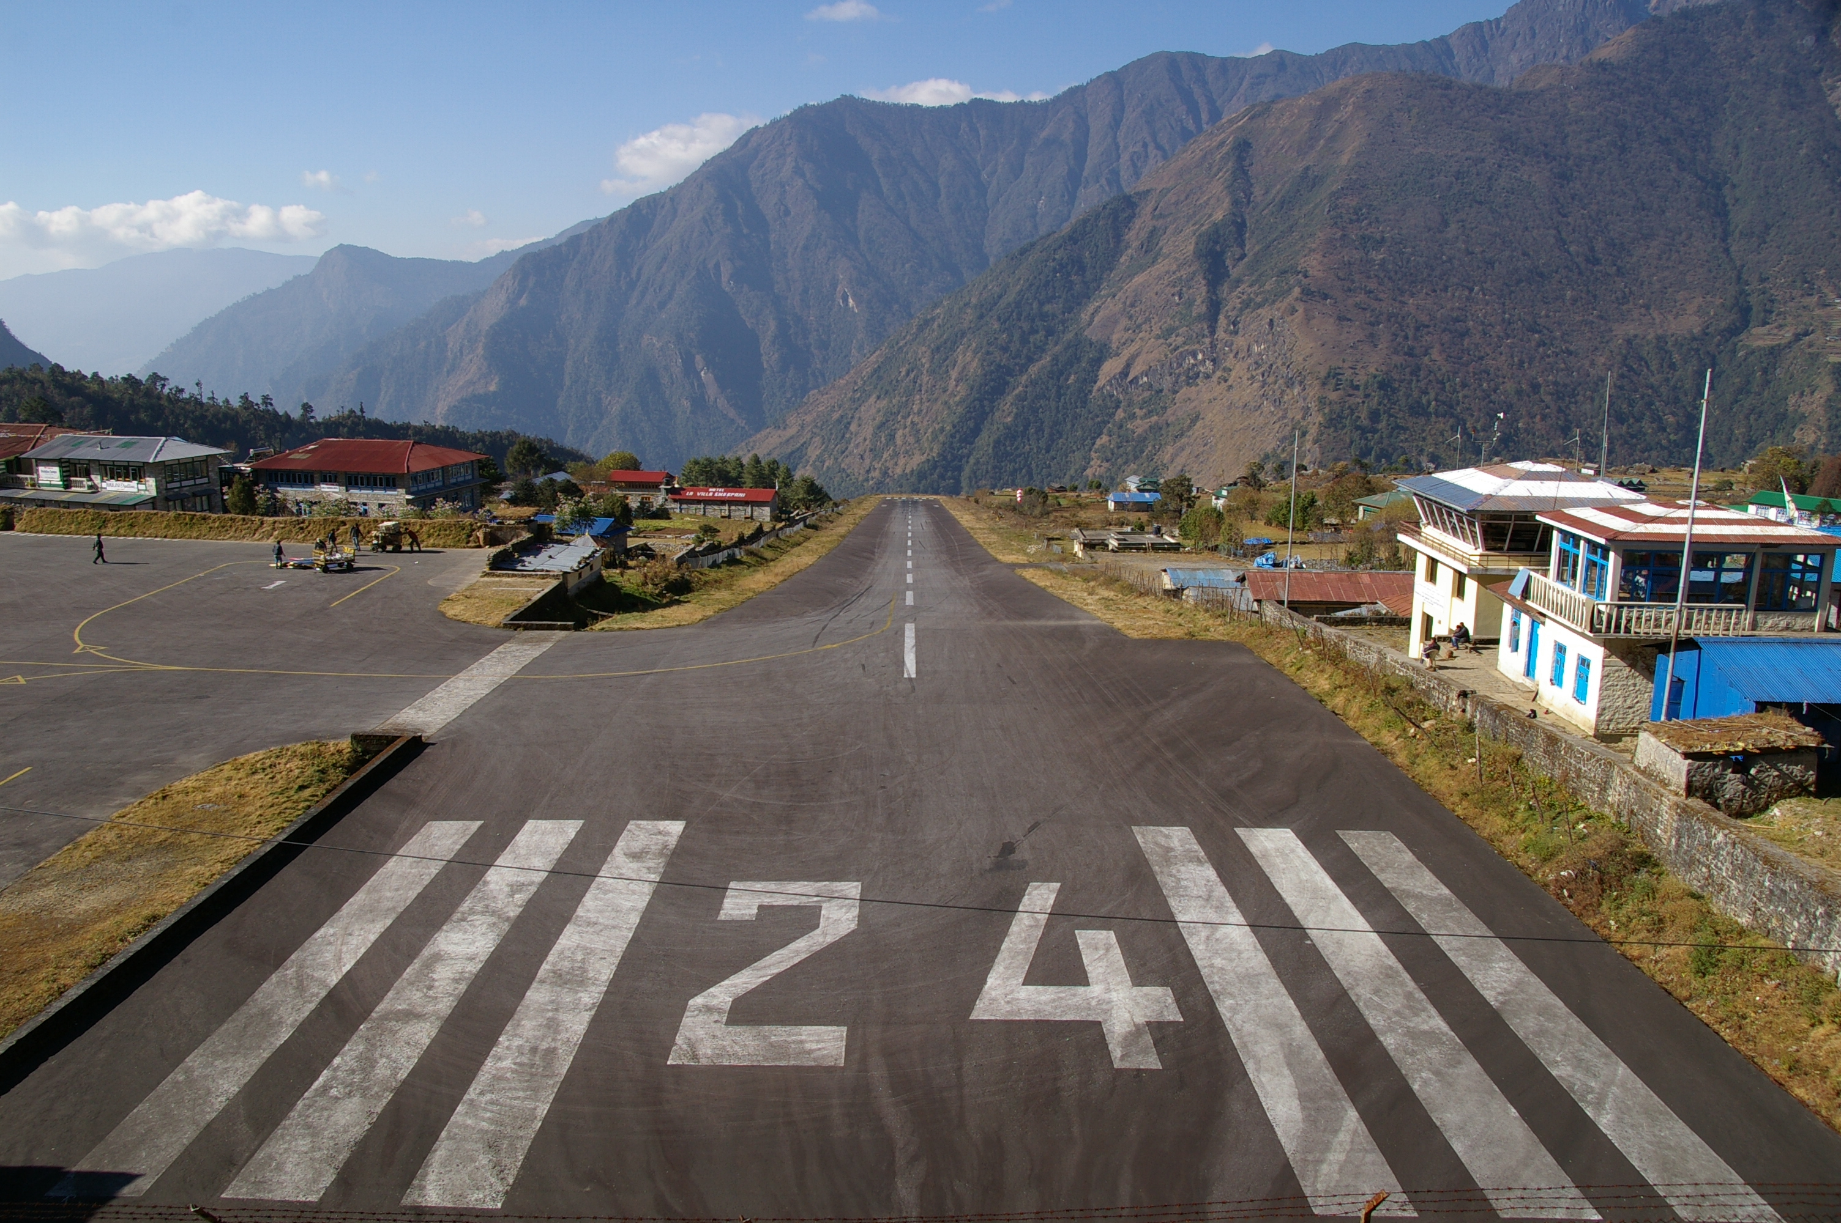
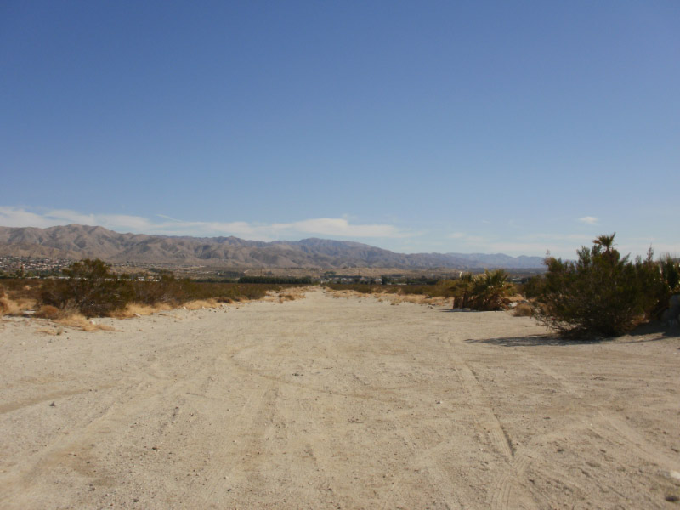
High Density Altitude Operations
Check environment and consult performance data in POH
Pre-take-off checks according to checklists in POH
Lean for maximum RPM above 3000 ft DALT
High (high density altitude = low air density), hot, humid

Slide 29
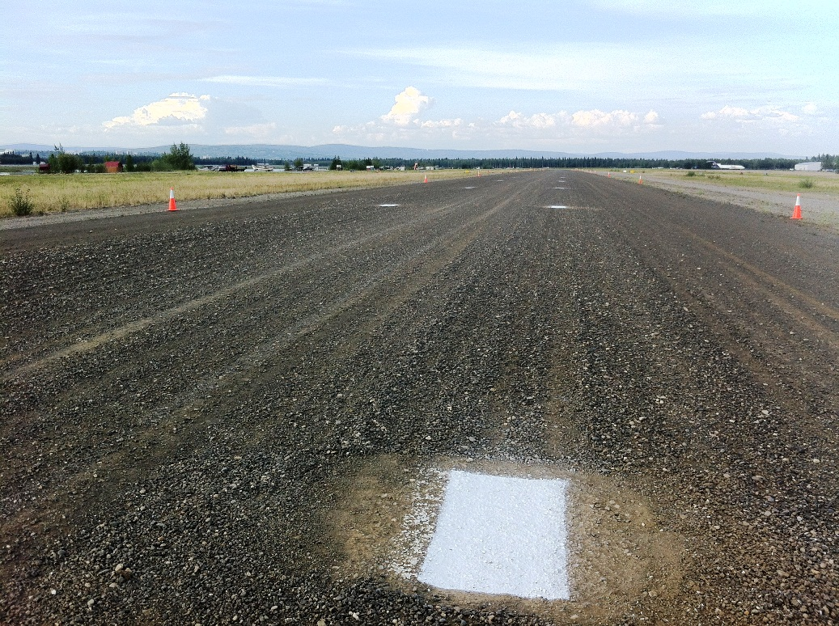
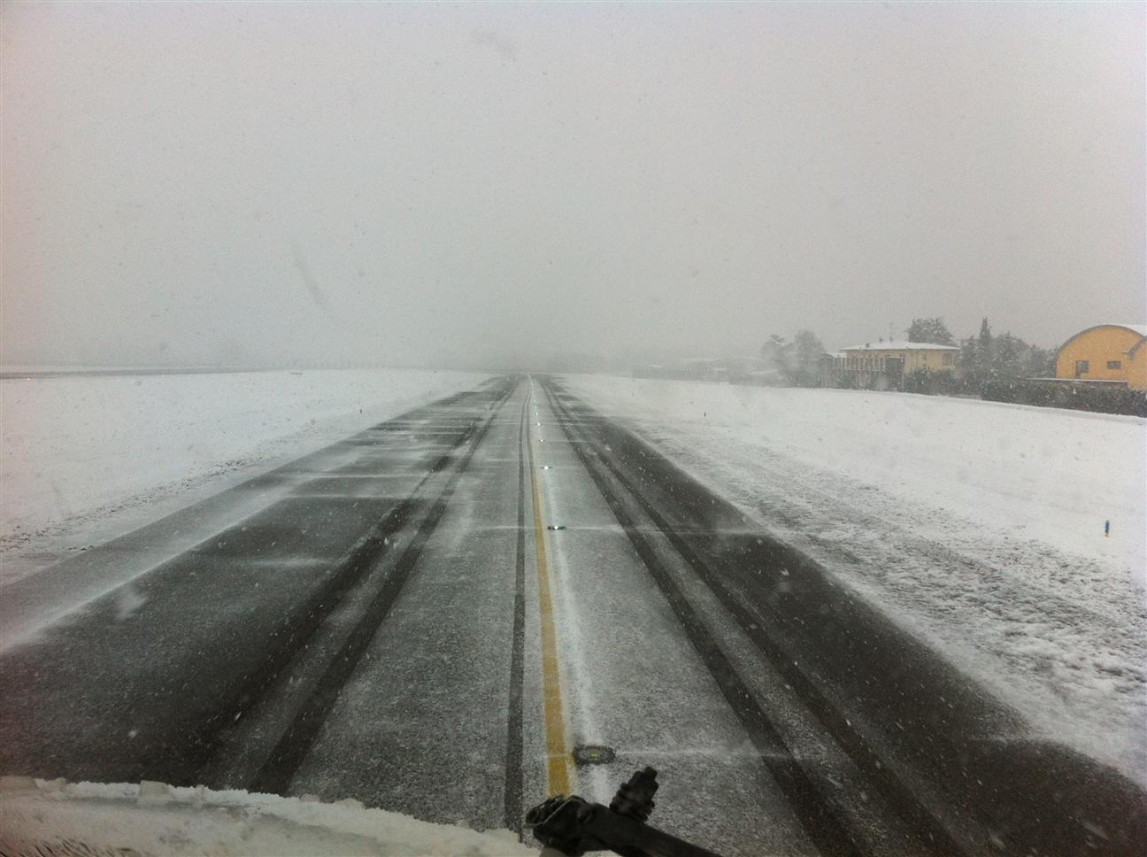
Special Take-Offs
Take-offs featuring combined factors
Soft, short, high, hot, gusty, heavy, contaminated...

Slide 30
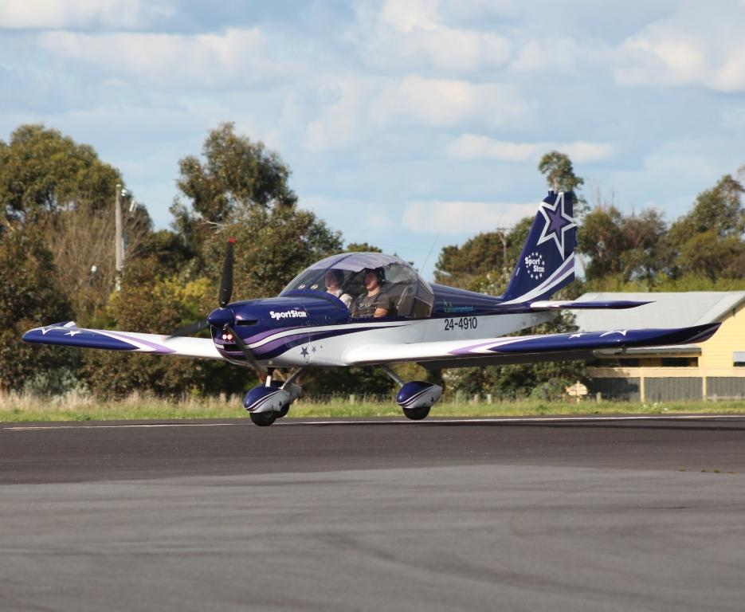
Wheelbarrowing
Higher load on the nose-wheel compared to main wheels
Tendency to pivot about the nose wheel may result in ground loop
Before pivoting: ease back elevator to reduce weight on nose wheel
After pivoting: relax forward elevator and abort if not stopped

Slide 31
Summary / Quiz
What are the factors affecting take-offs and the selection of a take-off type?
Mentally perform a short-field take-off and state all observations and actions.
Mentally perform a soft-field take-off and state all observations and actions.
Mentally perform a crosswind take-off and state all observations and actions.

Slide 32
Pre-Flight Briefing
Exercise
Training Area
Departure and Arrival Procedures
Weather Briefing / NOTAMs
Aircraft and Documents
Time and Fuel Requirements
Safety Considerations and Responsibilities

Slide 33
Additional Materials
Additional materials for Take-Off
Flight Instructor Guide – Exercise 16
Flight Instructor Guide – Lesson Plans 3, 4, 12, 14, 16, 18

Slide 34
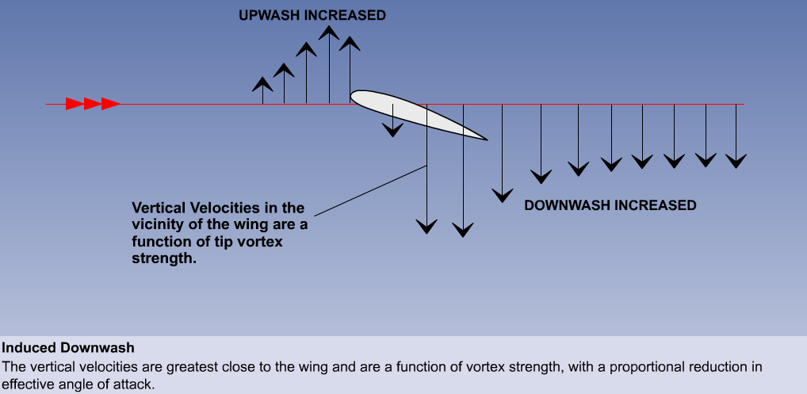
Induced AoA – Upwash and Downwash

Slide 35
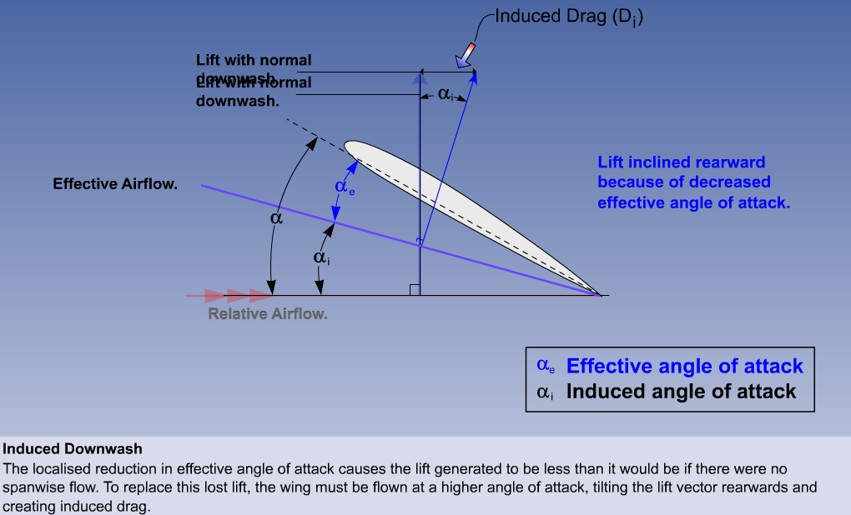
Effective Angle of Attack

Slide 36
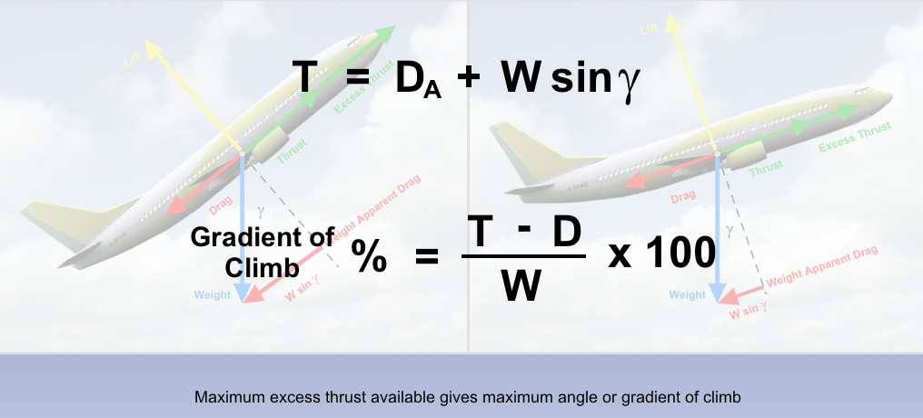
Angle or Gradient of Climb
Weight increases weight apparent drag and excess thrust required
Weight increases lift required and lift induced drag

Slide 37
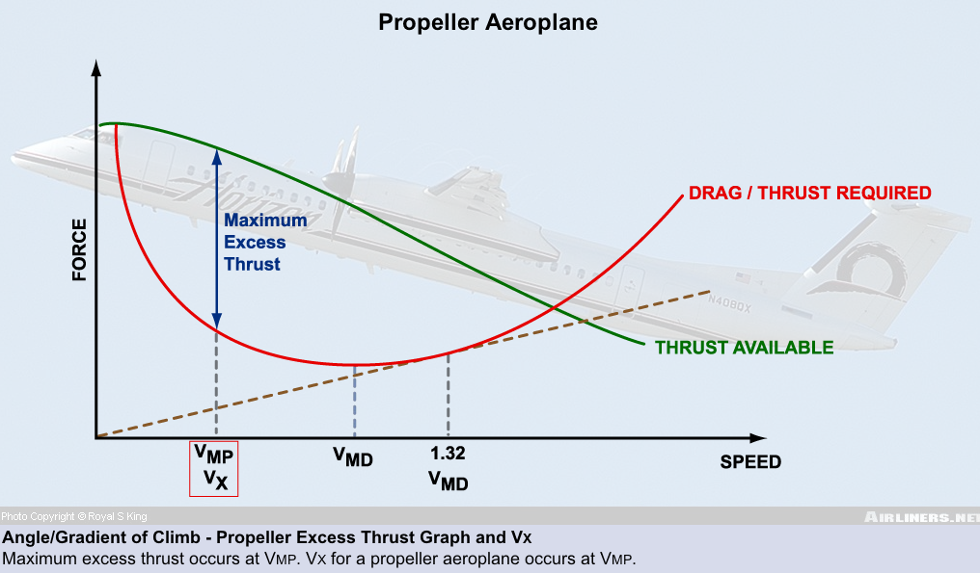
Maximum Excess Thrust

Slide 38
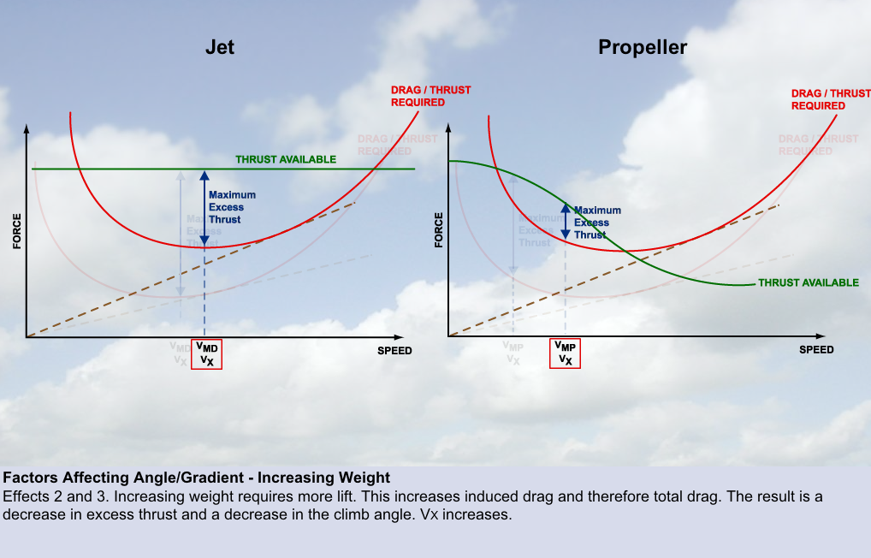
Weight and Excess Thrust

Slide 39
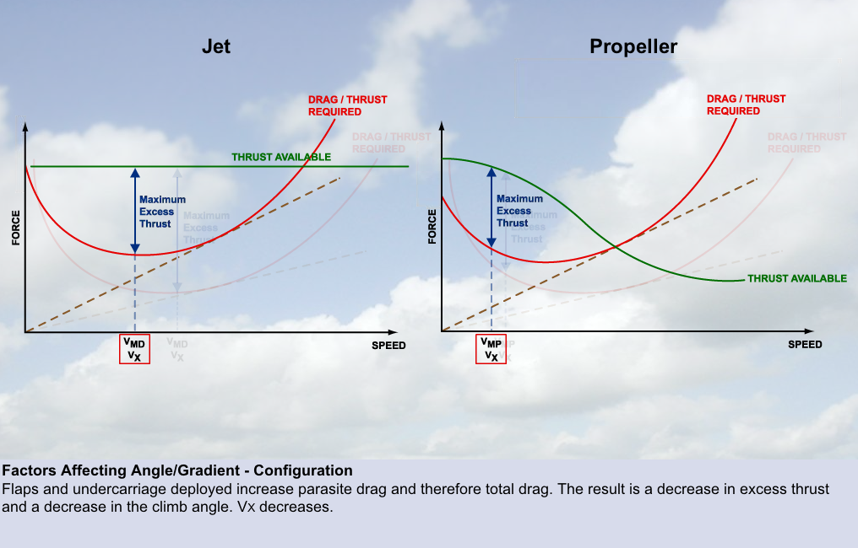
Configuration and Excess Thrust

Slide 40
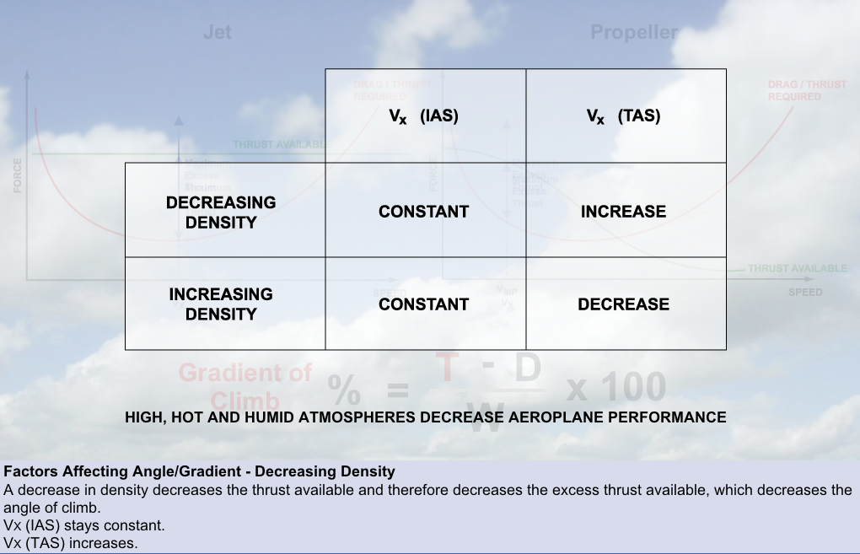
Air Density and Excess Thrust
Vx remains essentially constant (IAS) for thrust-rated engines (jet)
Vx may increase (IAS) for power-rated engines (piston propeller)

Slide 41
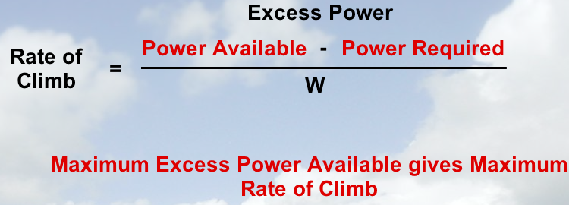
Rate of Climb
Rate of climb depends on both angle of climb and airspeed
Forces multiplied with speeds give powers
F * v = F * s / t = W / t = P

Slide 42
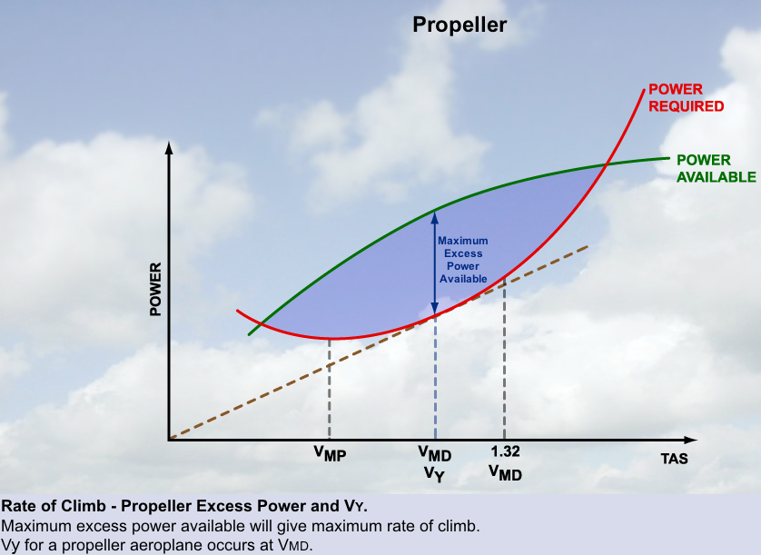
Maximum Excess Power

Slide 43
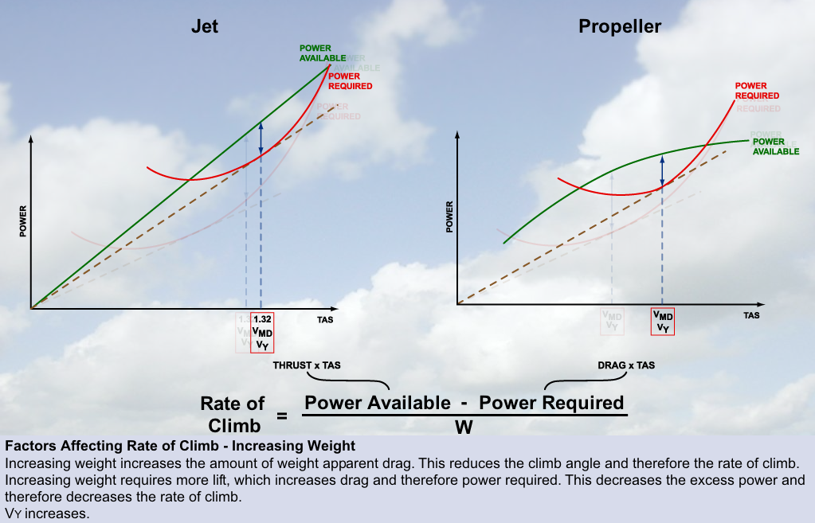
Weight and Excess Power

Slide 44
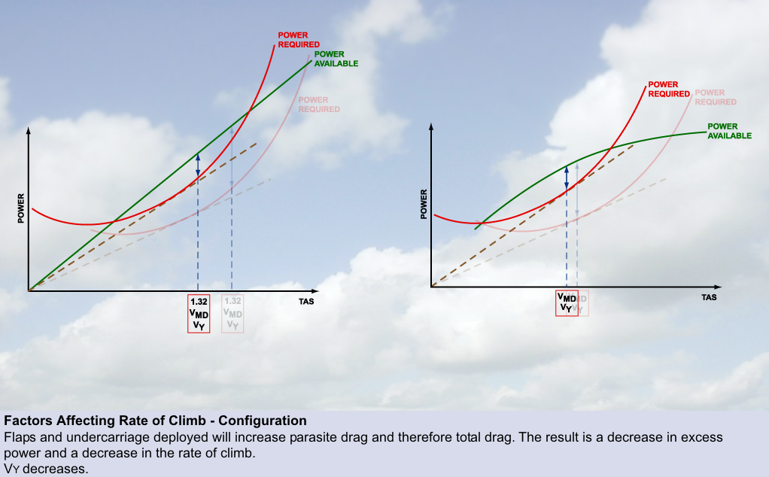
Configuration and Excess Power

Slide 45
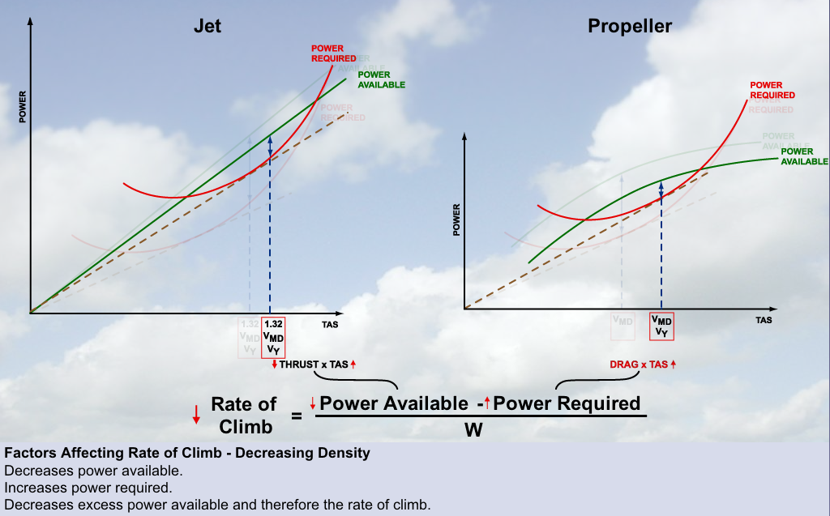
Air Density and Excess Power

Slide 46
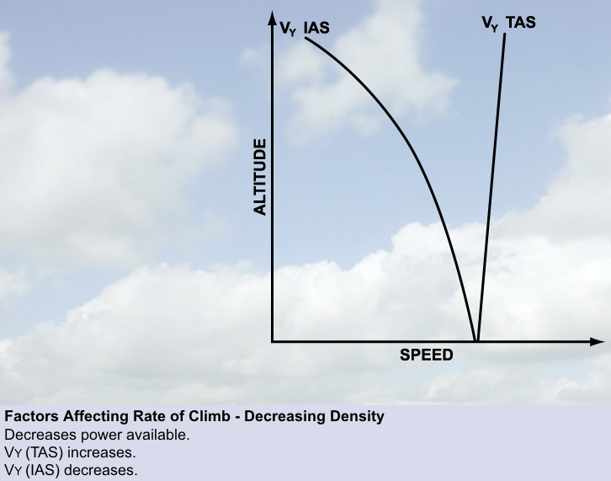
Vy – True versus Indicated Airspeed

Slide 47
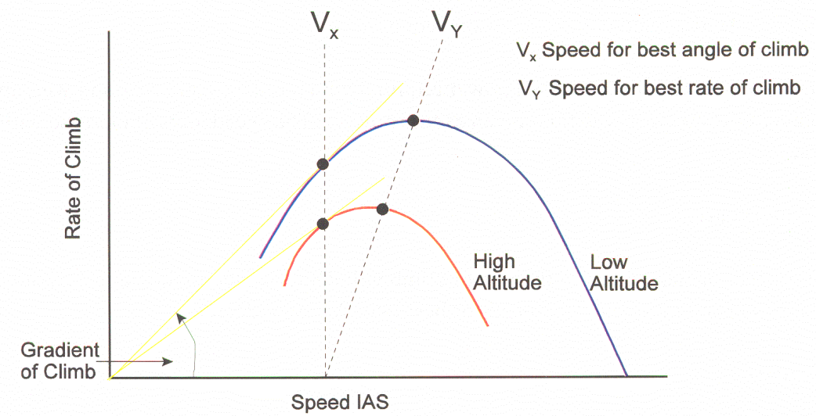
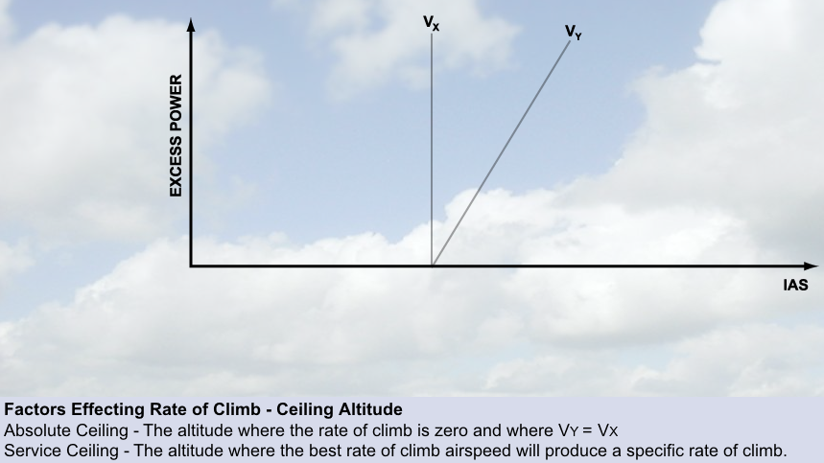
Absolute and Service Ceiling

