Slide 1
Contact Information
Stephan Heinemann
SMS: +1 (250) 891-5446
Email: stephan.heinemann@hotmail.com
Bookings, Questions

Slide 2
Slow Flight
Review Flight for Endurance
Definition and Motivation
Slow Flight in Clean and Landing Configuration
Slow Flight Climbs, Descents and Turns
Summary and Questions
Pre-Flight Briefing
Notes:
- make sure you can divide this into different lesson plans such as 5 and 6
- always look at the previous and next lesson plans (context) to
- read the lesson plan description
- confirm the progress of previous lesson plans

Slide 3
Review Flight for Endurance
Attitude plus power equals performance!
Mentally configure the aircraft for maximum endurance flight and state all observations and required actions.
What particular observation applies to the control inputs compared to normal cruise flight?

Slide 4
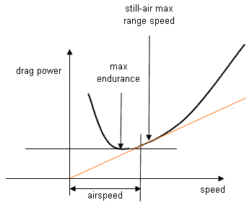
Definition and Motivation
Min Power
Max Endurance
Flight at airspeeds in the range below the maximum endurance speed down to just above the stalling speed
Dominating induced drag requires more thrust and power
Control surfaces are less effective at slower airspeeds
(Soft Field) Take-offs, Landings and Go-Arounds
Notes:
The total lift in slow flight remains the same but the lift coefficient of the airfoil is increased by the increased angle of attack. The lift coefficient has to be increase to compensate for the slower CAS. As the lift coefficient increases, so does the induced drag coefficient by the square which results in higher total drag:
c_id = c_l^2 / (Pi AR e)
- Applications:
Soft Field Take-Offs and Landings
Approaches to Stall (Exercise)
- Higher fuel consumption, less engine cooling, instrument errors
- Safety factors: lookout, engine cooling, altitude, sluggish controls
- Simplify diagram
- highlight small slow flight range for C172: 48-55 KIAS
(best endurance lies in between 50 and 60 KIAS)
- highlight precise control of attitude, power and rudder

Slide 5
Safety Considerations
High nose-up attitude maneuver
Limited forward visibility
HASEL, recovery at or above 2000 ft AGL
Maintain good lookout during maneuver
Attitude and power are to be controlled precisely
Yaw is to be controlled precisely with rudder
Remain coordinated at all times

Slide 6
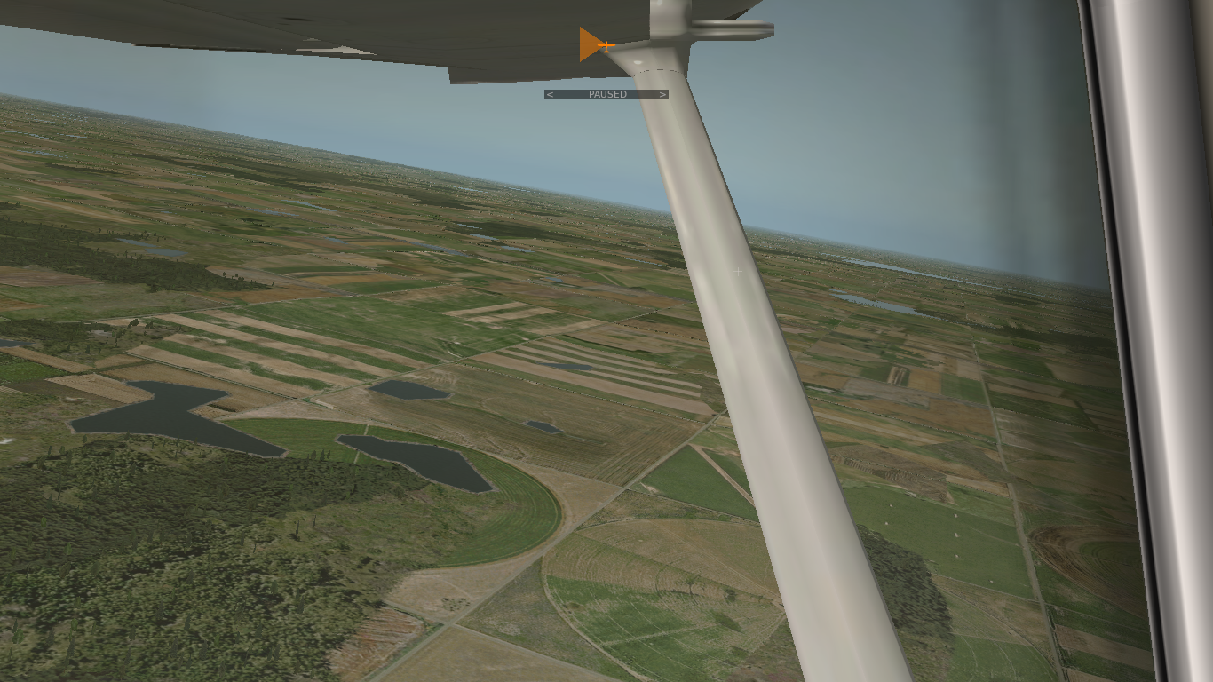
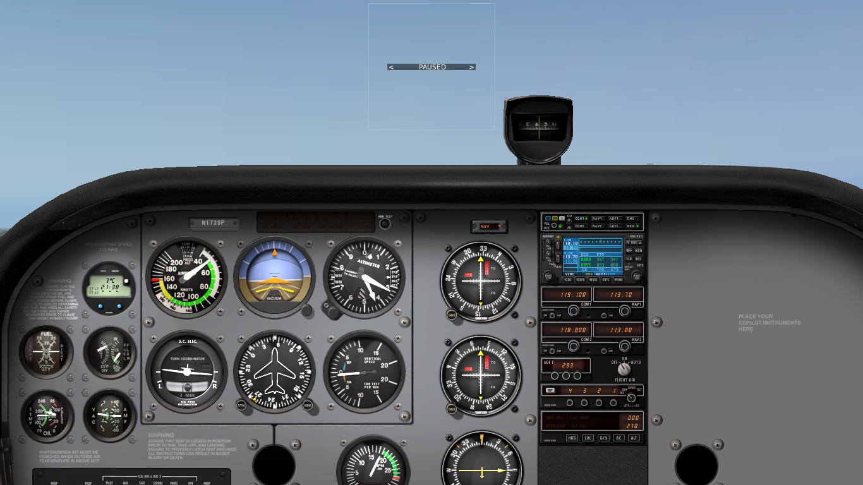
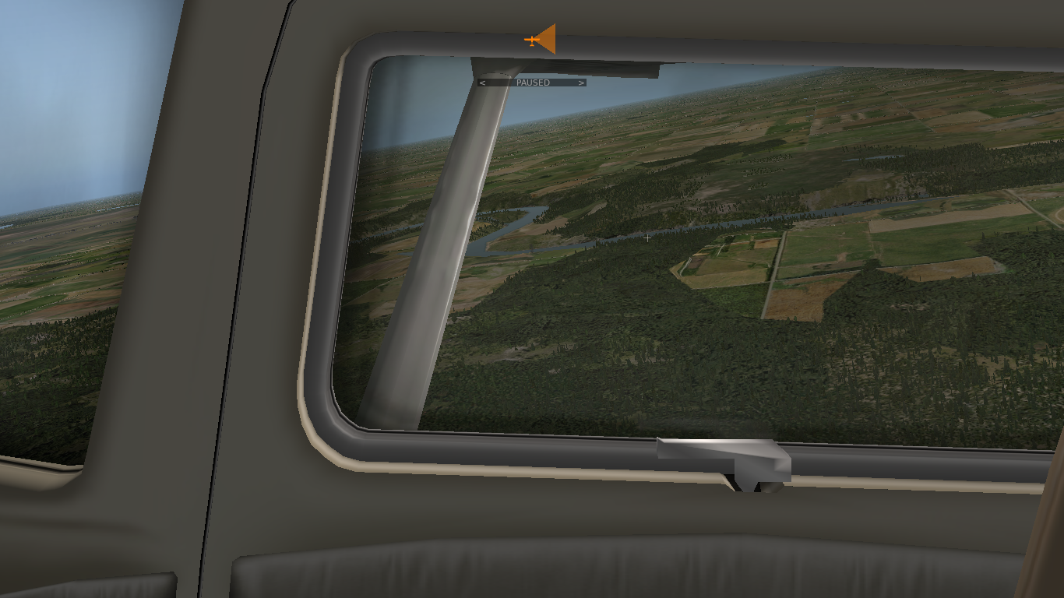
Entering Slow Flight (Clean) from Flight for Maximum Endurance
Attitude
Perform HASEL checks and continue lookout during the maneuver
Configure the aircraft for maximum endurance flight first, then
Apply elevator back-pressure to establish a slightly more nose-up attitude to decelerate into the slow flight range
Increase power as required to keep the airspeed stable controlling yaw with rudder maintaining altitude and finally trim
Notes:
- HASEL (lookout at all times) / HASEL
- lookout ahead and below
- trim airspeed (not below 60 KIAS?)
- additional elevator back-pressure required at full aft trim
- carburetor heat not applicable
- initially higher range of slow flight
- TODO: remove arc references
Stable / at the bottom of the green arc
- TODO: think about pictures / side views

Slide 7
Entering Slow Flight (Clean)
Attitude
Perform HASEL checks and continue lookout during the maneuver
Reduce power and decelerate into slow flight range
Apply elevator back-pressure and increase nose-up attitude gradually as required to maintain altitude
Increase power as required to keep the airspeed stable controlling yaw with rudder maintaining altitude and finally trim
Notes:
- HASEL (lookout at all times) / CALL
- lookout ahead and below
- reduce power to about 1600 RPM
- power reduction to 2000 RPM is also sufficient, then raise the nose and maintain straight and level (good for familiarization and demo)
- Point out loss of airspeed
- Point out loss of altitude if no power was added
- initially higher range of slow flight
- trim airspeed (not below 60 KIAS?)
- additional elevator back-pressure required at full aft trim
- carburetor heat not applicable
- forward and side views to show attitude
- controls and instruments images to highlight actions
Stable / at the bottom of the green arc

Slide 8
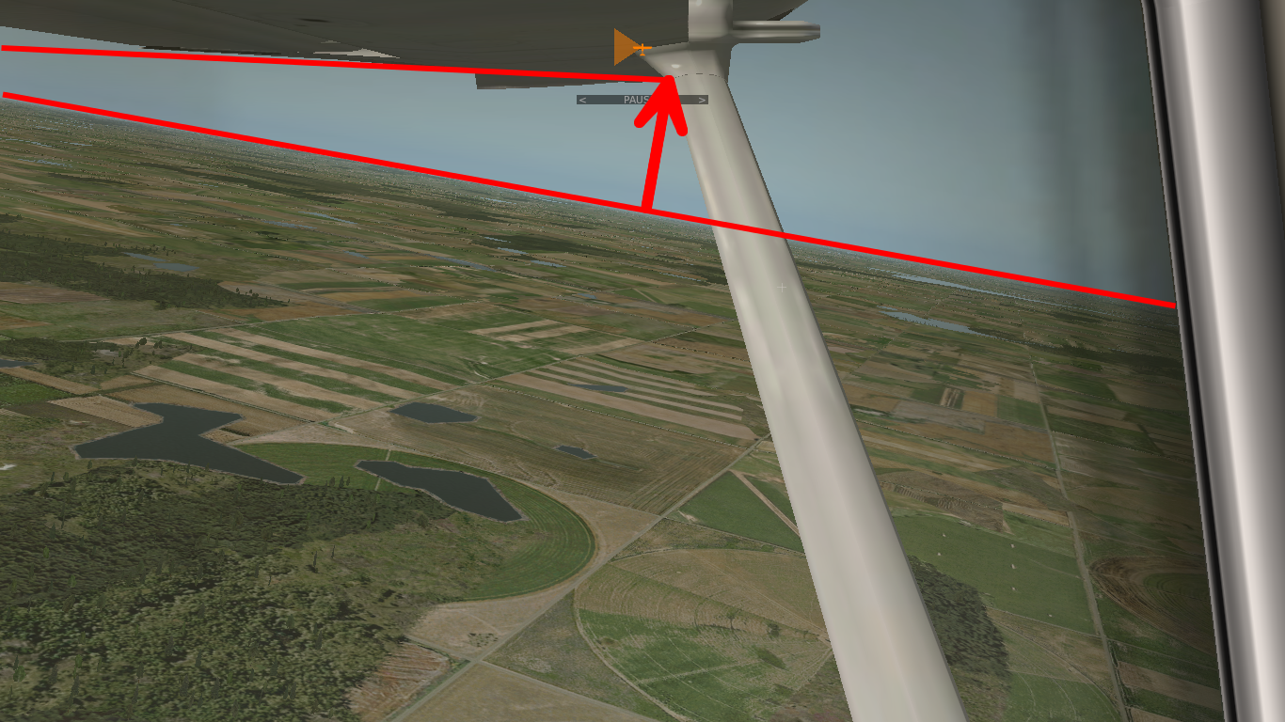
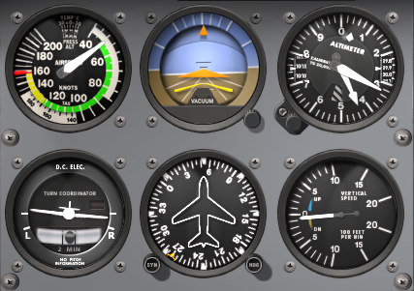
Maintaining Slow Flight (Clean)
Lookout
Green Arc
References
Instruments
Stall warning audible and ailerons are much less responsive
More power in slow flight produces more yaw and requires continuous rudder input to remain coordinated
Attitude plus power equals performance!
Pitch controls airspeed, power controls altitude in practice
Notes:
- Increased slipstream produces more yaw
- Increased torque produces slightly more roll (ailerons are less effective)
- Instrument indications
- Vs = 48 KIAS
- stall warning sounds 5-10 KIAS above the stall
- higher airspeeds in turbulent air acceptable
- maintain heading (references)
- maintain bank attitude (wings and AI)

Slide 9


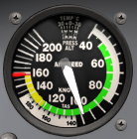


Recovering Slow Flight (Clean)
Forward
Pressure
Full
Power
Cruise
Airspeed
Cruise
Power
Trim
Control Yaw
Apply full power controlling yaw with rudder to remain coordinated
Apply elevator forward pressure to lower the pitch attitude gradually while maintaining altitude
Establish cruise attitude and accelerate to cruise airspeed
Reduce power to cruise power setting and finally trim

Slide 10
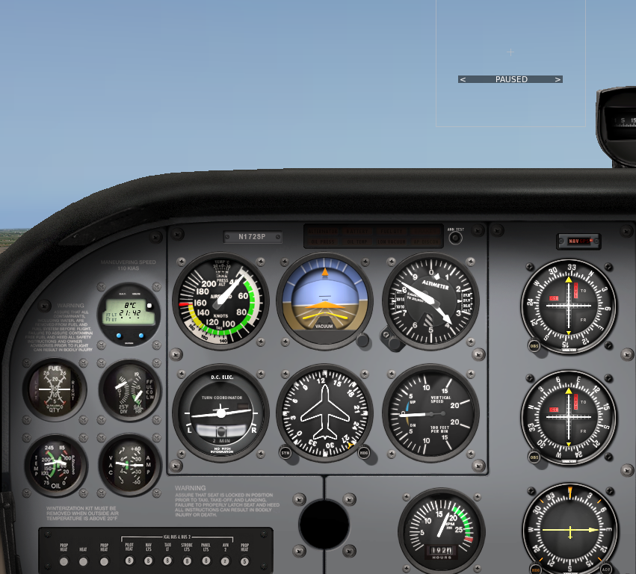


Entering Slow Flight (Flaps)
Reduce
Power
Attitude
White Arc
Flaps
Increase
Power
Perform HASEL checks and continue lookout during the maneuver
Reduce power and decelerate into slow flight range
Apply elevator back-pressure to increase nose-up attitude gradually as required to maintain altitude
Extend flaps in stages to desired setting while decelerating in white arc
Increase power as required to keep the airspeed at the bottom of the white arc controlling yaw with rudder maintaining altitude and finally trim
Notes:
- Extend flaps to different degrees
- Less nose-up attitude due to more lift (images to compare)
- Instrument indications (compare to clean)
- higher airspeeds in turbulent air acceptable

Slide 11
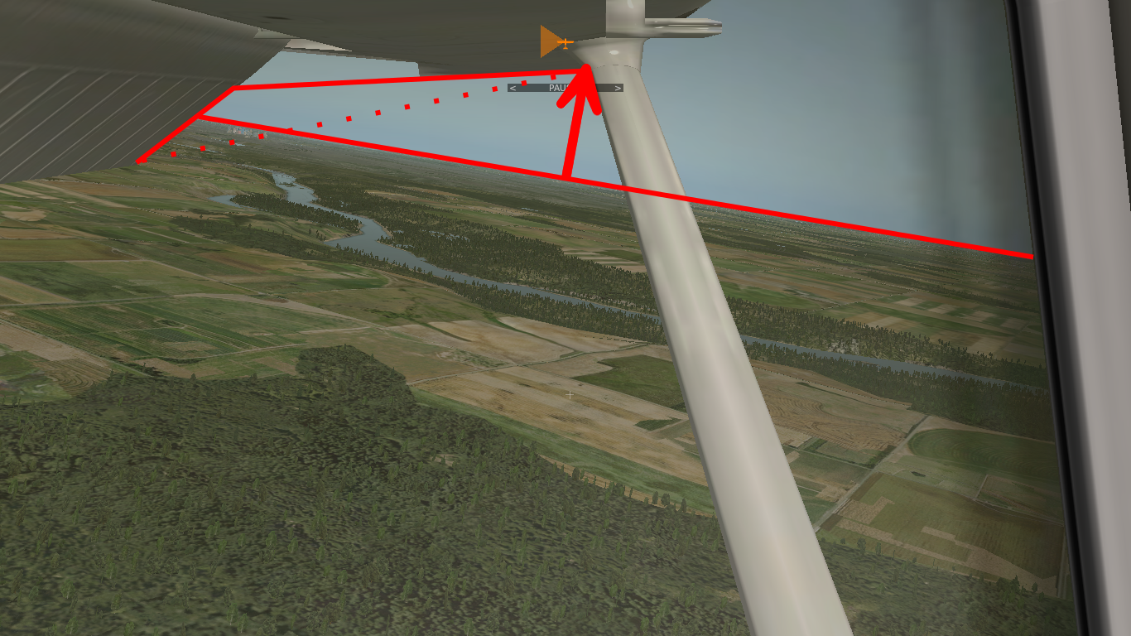

Maintaining Slow Flight (Flaps)
Lookout
White Arc
References
Instruments
Additional flaps create more drag and require more thrust and power
Stall warning audible and ailerons are much less responsive
More power in slow flight produces more yaw and requires continuous rudder input to remain coordinated
Attitude plus power equals performance!
Pitch controls airspeed, power controls altitude in practice
Notes:
- Vso = 40 KIAS
- stall warning sounds 5-10 KIAS above the stall
- maintain heading (references)
- maintain bank attitude (wings and AI)
- TODO: remove white arc

Slide 12

Recovering Slow Flight (Flaps)
Full
Power
Forward
Pressure
White Arc
Cruise
Airspeed
Cruise
Power
Control Yaw
Flaps
Trim
Apply full power controlling yaw with rudder to remain coordinated
Apply elevator forward pressure to lower the pitch attitude gradually while maintaining altitude
Raise flaps in stages to up while accelerating in white arc
Establish cruise attitude and accelerate to cruise airspeed
Reduce power to cruise power setting and finally trim
Notes:
- some control pressure can be removed by early trim during recovery especially for full flaps

Slide 13
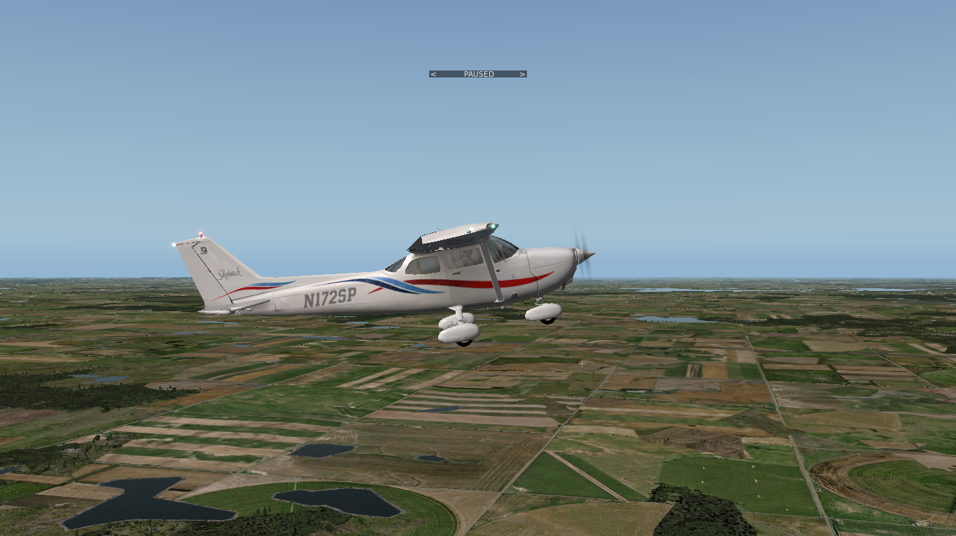
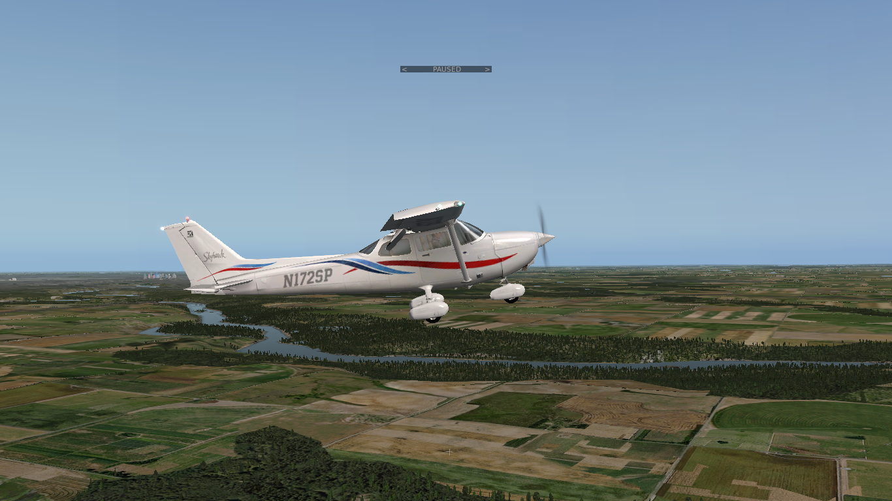
Climbs and Descents in Slow Flight
Slow Flight Clean
Slow Flight Flaps
Attitude plus power equals performance!
Increase power as required to initiate climb in practice
Reduce power as required to initiate descent in practice
Adjust attitude to maintain (slow flight) airspeed in practice

Slide 14
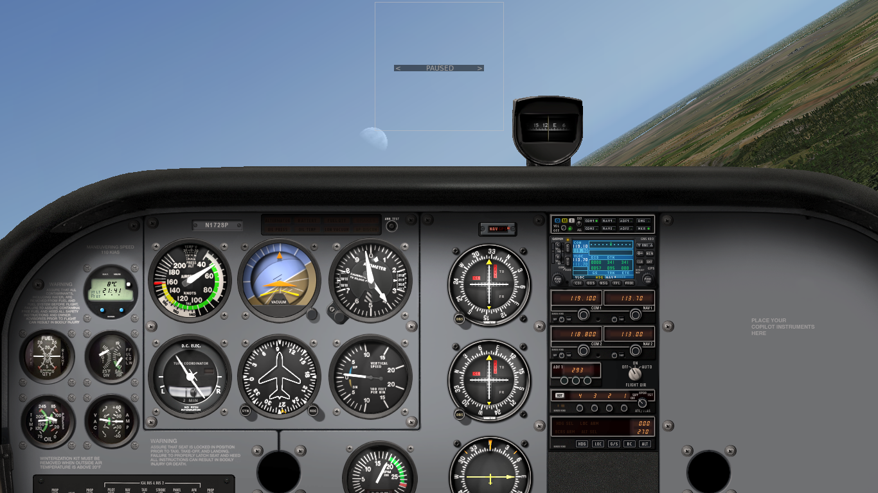
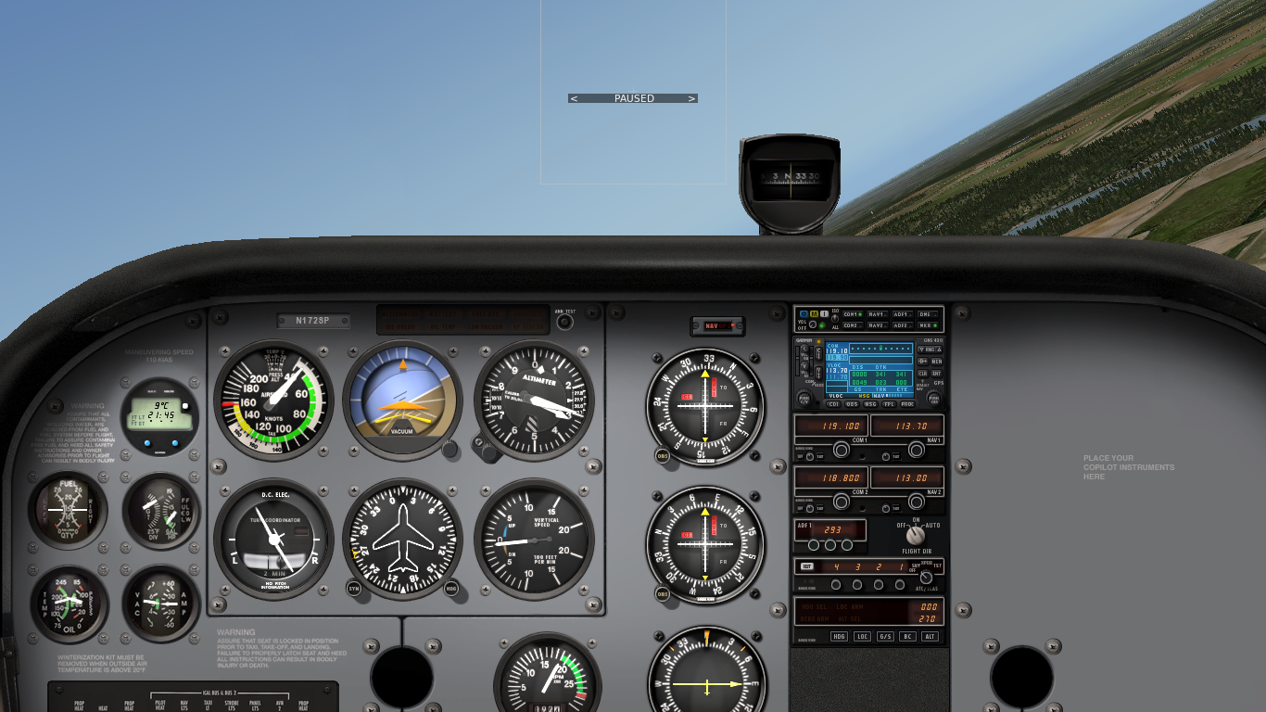
Turns in Slow Flight
Slow Flight Clean Turn
Slow Flight Flaps Turn
Ailerons are less responsive and expect more adverse yaw
Different rudder inputs are required to compensate yaw and support turns while remaining coordinated
Establish and maintain banked attitude (up to 30°) with ailerons and continuous rudder support
Right turns require more rudder than left turns
Notes:
- Aileron drag in slow flight (opposite yaw)
- increased power in turns to compensate higher load factor
- increased P-factor with higher thrust
- difference between left and right turns

Slide 15
Summary / Quiz
Define slow flight and give examples for when slow flight is applicable.
Mentally enter a slow flight in landing configuration from cruise flight and state all observations and required actions.
Mentally perform a turn to the right in slow flight and state all observations and required actions.
Mentally recover from a slow flight in landing configuration and state all observations and required actions.

Slide 16
Pre-Flight Briefing
Exercise
Training Area
Departure and Arrival Procedures
Weather Briefing / NOTAMs
Aircraft and Documents
Time and Fuel Requirements
Safety Considerations and Responsibilities
Notes:
Page 39 FIG

Slide 17
Additional Materials
Additional materials for Slow Flight
Flight Instructor Guide – Exercise 11, Lesson Plans 5, 6, 7
Notes:
- shorter points for the howtos
- remove bottom of arcs

Slide 18
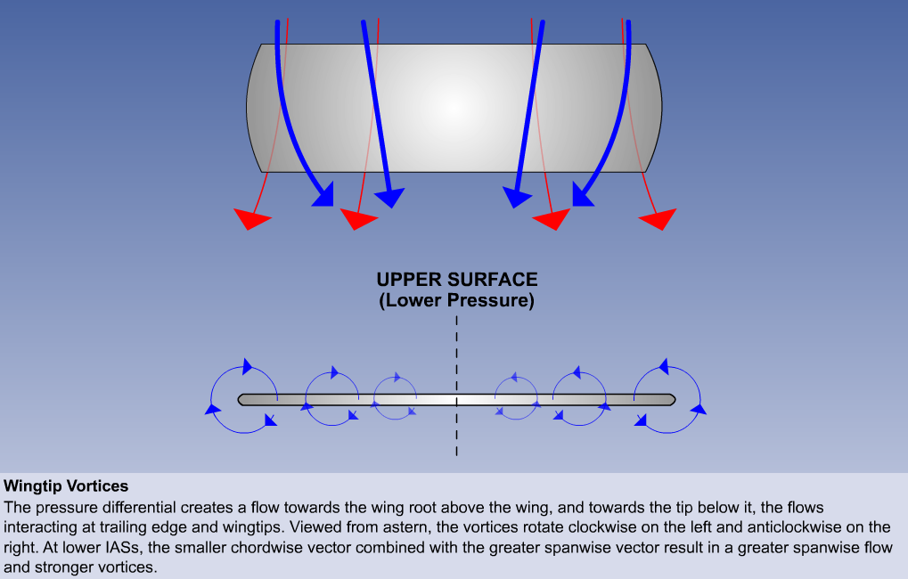
Wingtip Vortices

Slide 19
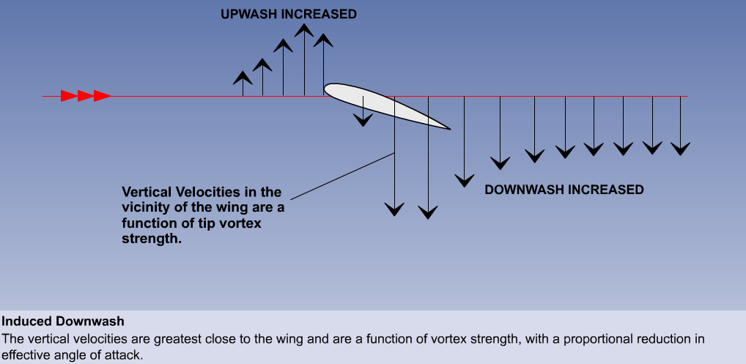
Induced AoA – Upwash and Downwash

Slide 20
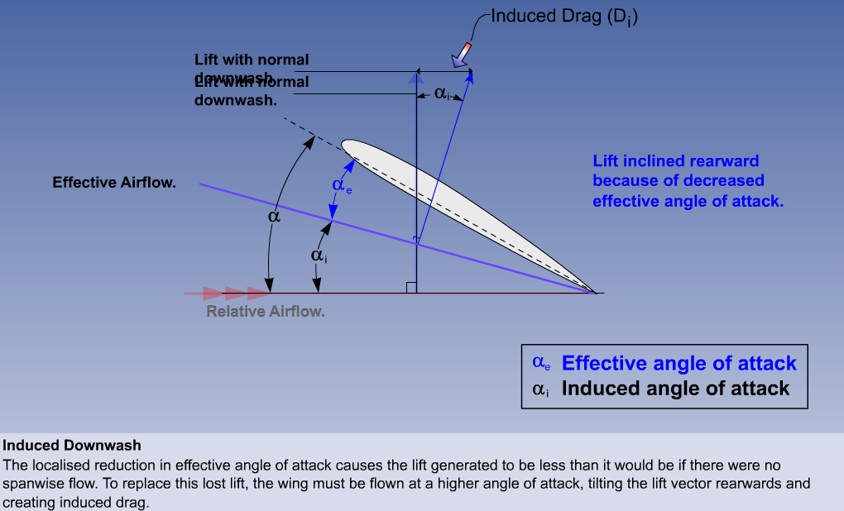
Effective Angle of Attack

Slide 21
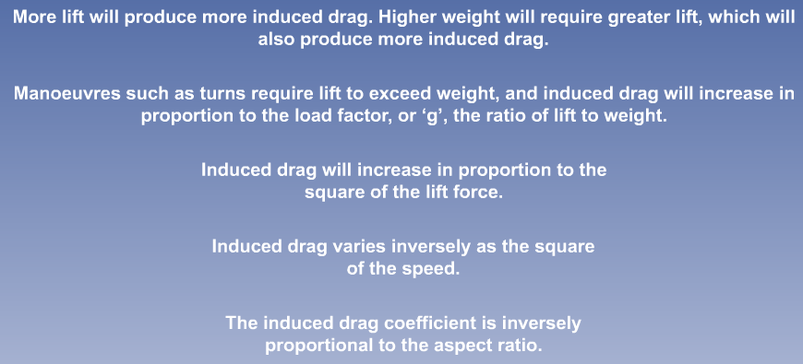
Induced Drag Factors

Slide 22
Familiarization Demonstration
Employ an obvious and dramatic example
Stall: Power Idle, increase nose-up attitude while maintaining straight-and-level, control yaw and demonstrate falling leaf / nose-drop

