Slide 1
Contact Information
Stephan Heinemann
SMS: +1 (250) 891-5446
Email: stephan.heinemann@hotmail.com
Bookings, Questions

Slide 2
Attitudes and Movements
Review Aircraft Familiarization
Definition and Motivation
Normal Aircraft Attitudes
Rotational Movements
Summary and Questions
Pre-Flight Briefing

Slide 3
Review Aircraft Familiarization
What are the primary control surfaces of an aircraft?
What flight control inputs cause which reaction of the primary control surfaces?
What information do the basic flight instruments provide?

Slide 4

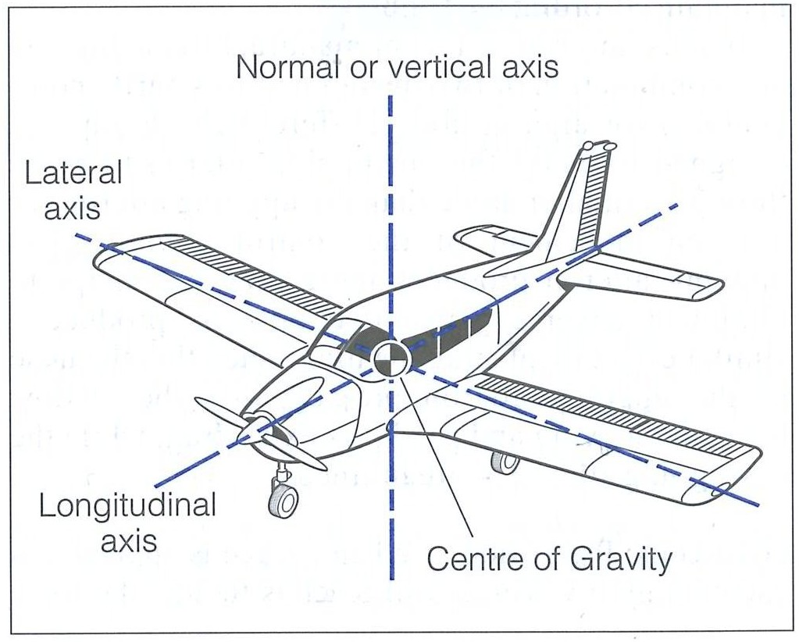
Attitudes and Movements

Slide 5

Cruise Attitude

Slide 6
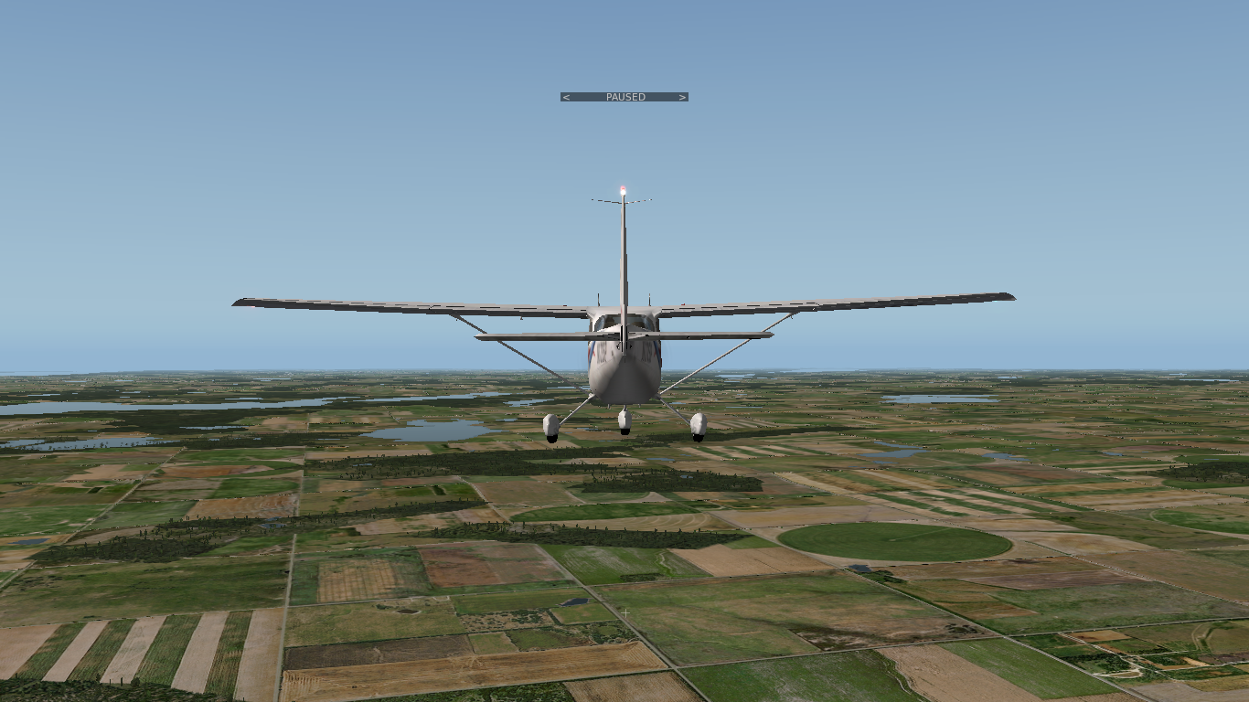
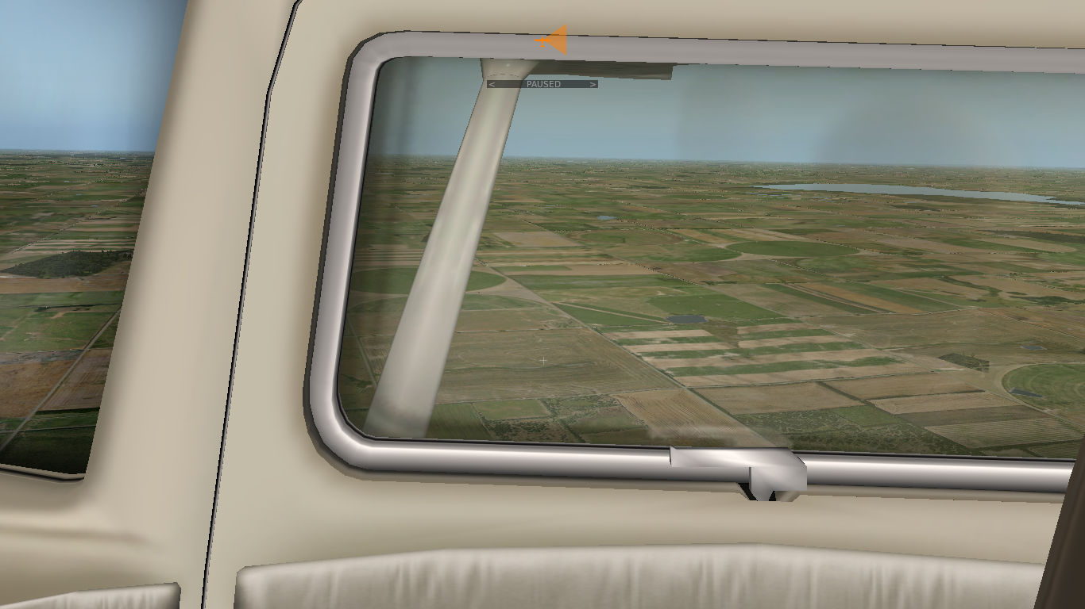
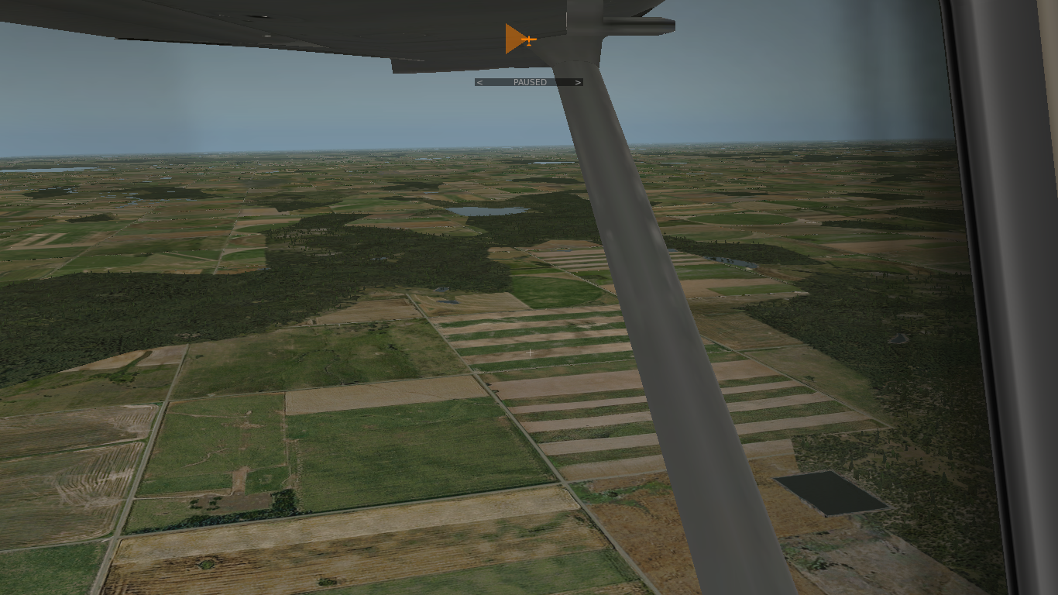
Cruise Attitude

Slide 7

Pitch Attitudes: Nose-Up Attitude
Normal Nose-Up Attitude Range to +15°
Notes:
- mention only a couple of millimeters back-movement to change attitude significantly

Slide 8
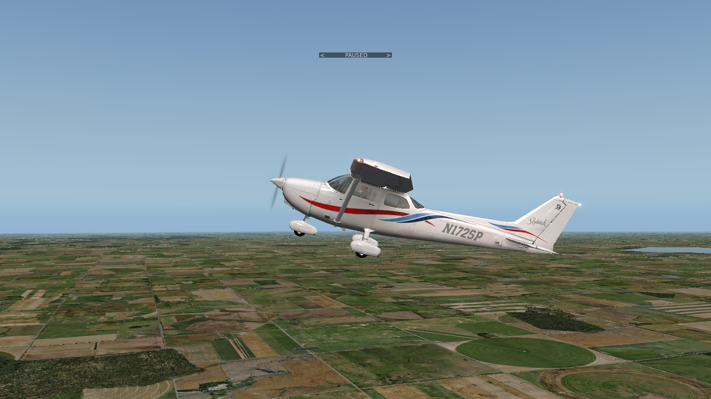
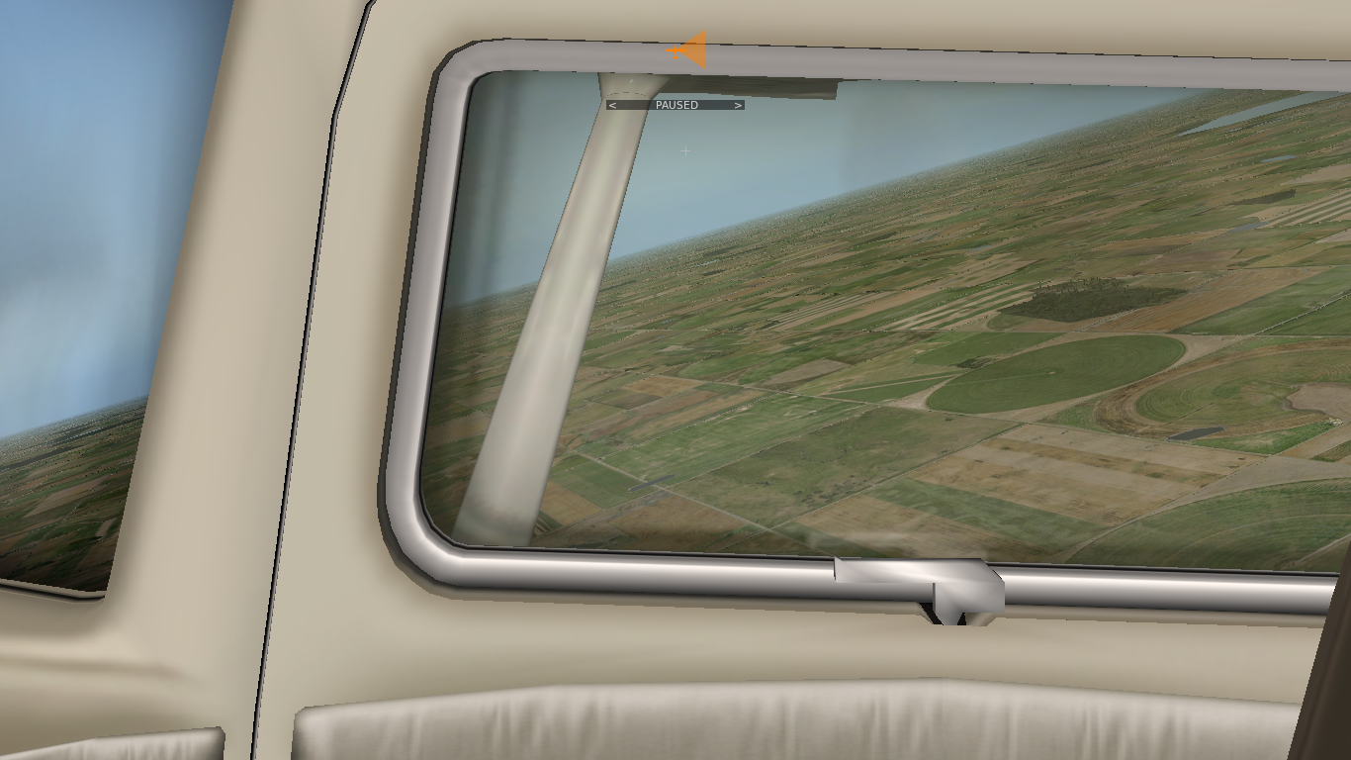

Pitch Attitudes: Nose-Up Attitude

Slide 9
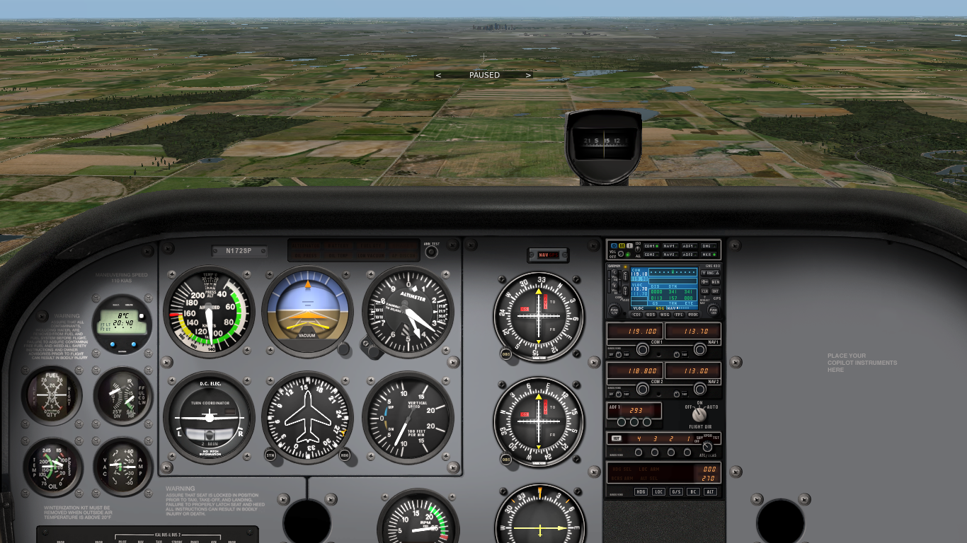
Pitch Attitudes: Nose-Down Attitude
Normal Nose-Down Attitude Range to -10°

Slide 10
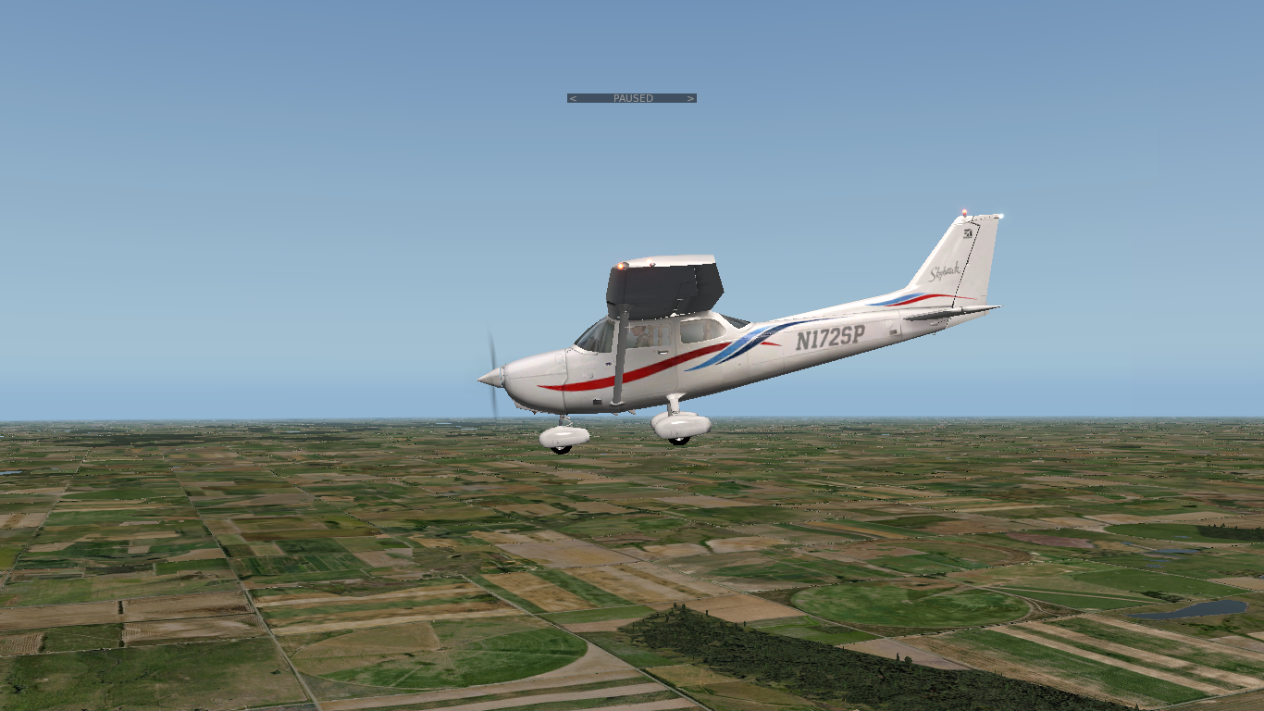
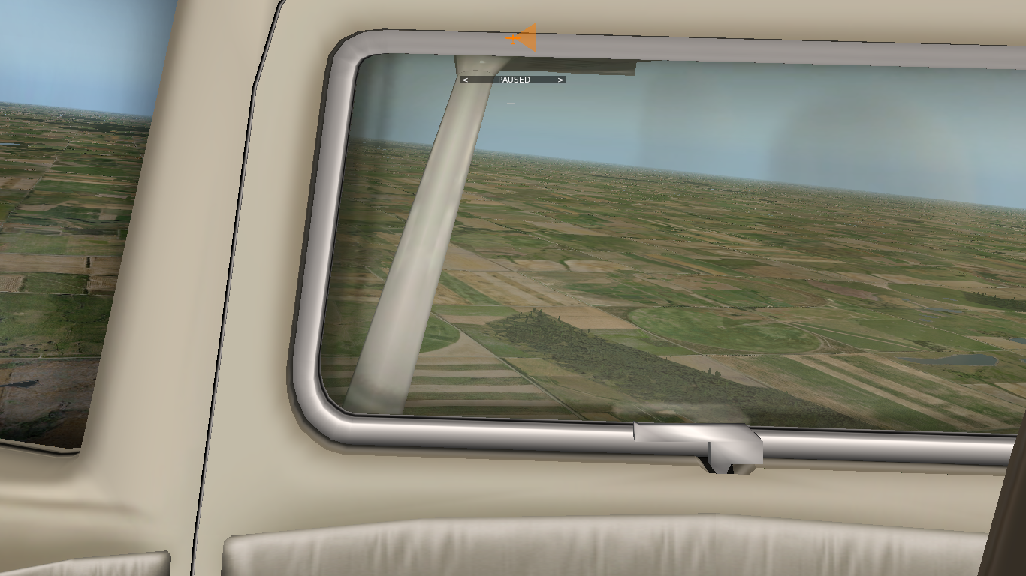

Pitch Attitudes: Nose-Down Attitude

Slide 11
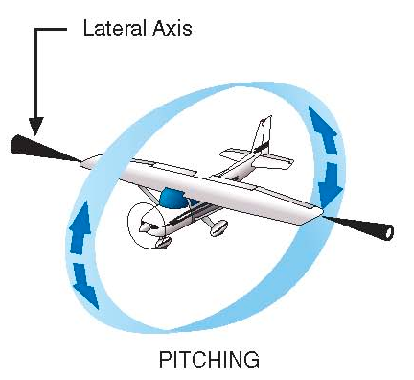
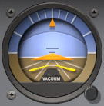

Movements - Pitching
Pitching is a rotational movement about the lateral axis
Pitching changes the pitch attitude of the aircraft (nose-up/down)
Pitch is primarily controlled with the yoke (control column, stick)
Pushing or pulling the yoke results in elevator deflection
Trim is used to reduce control forces while maintaining attitude
Real and artificial horizon reference (attitude indicator) change

Slide 12


Establishing and Recovering a Pitch Attitude
Push / Pull, Adjust Pressure
Very small movements required (millimeters)
Control pressures change gradually after establishing and holding new pitch attitude
Trim may help to relieve control pressures
Notes:
- explain howto carefully and precisely
- emphasize changing control pressures and forces required to hold attitude if power and trim remain unchanged

Slide 13

Bank Attitudes: Left-Banked Attitude
Normal Left-Banked Attitude Range to -30°

Slide 14
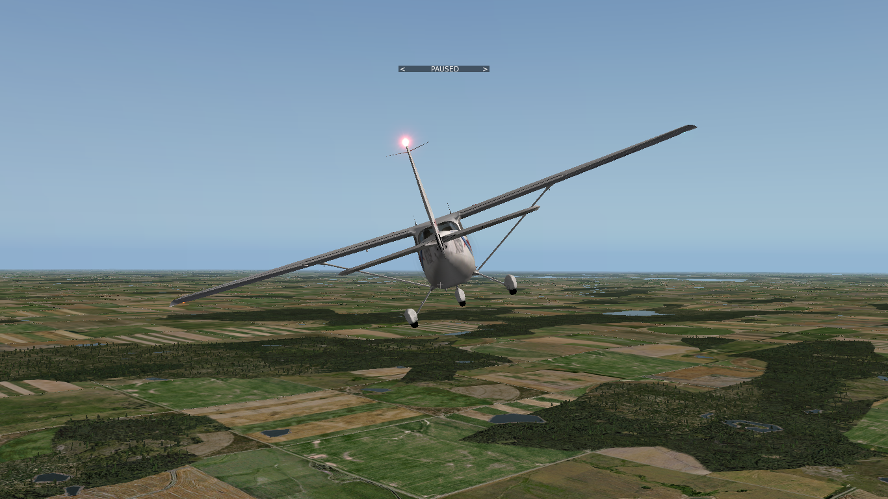
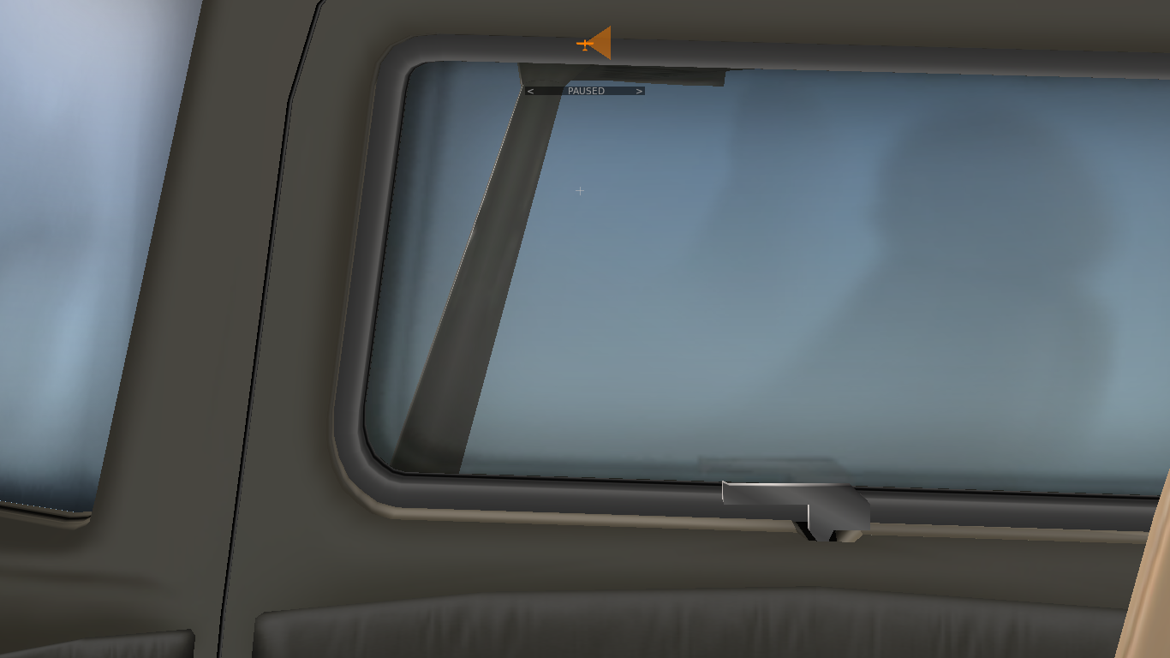
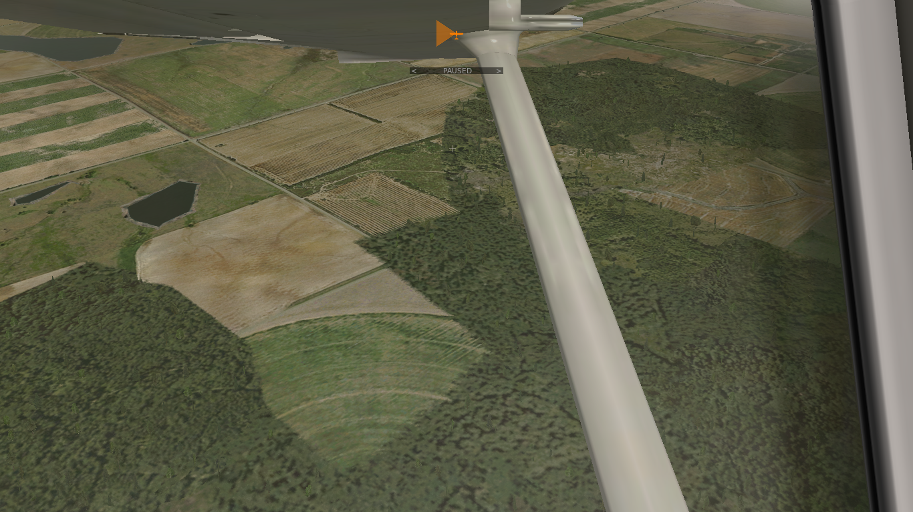
Bank Attitudes: Left-Banked Attitude

Slide 15
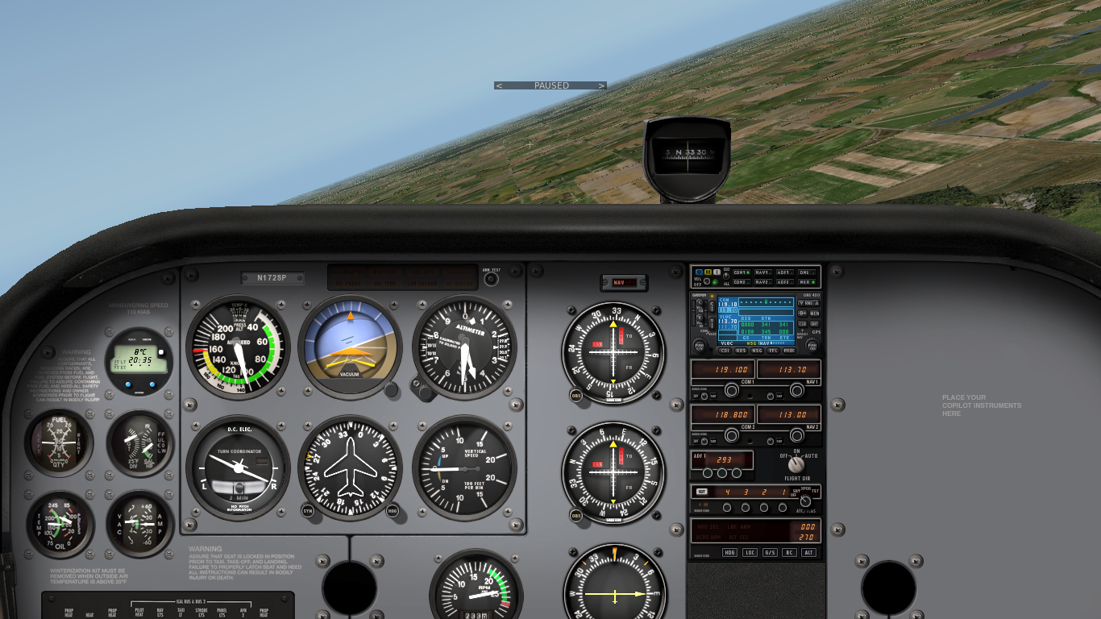
Bank Attitudes: Right-Banked Attitude
Normal Right-Banked Attitude Range to +30°

Slide 16
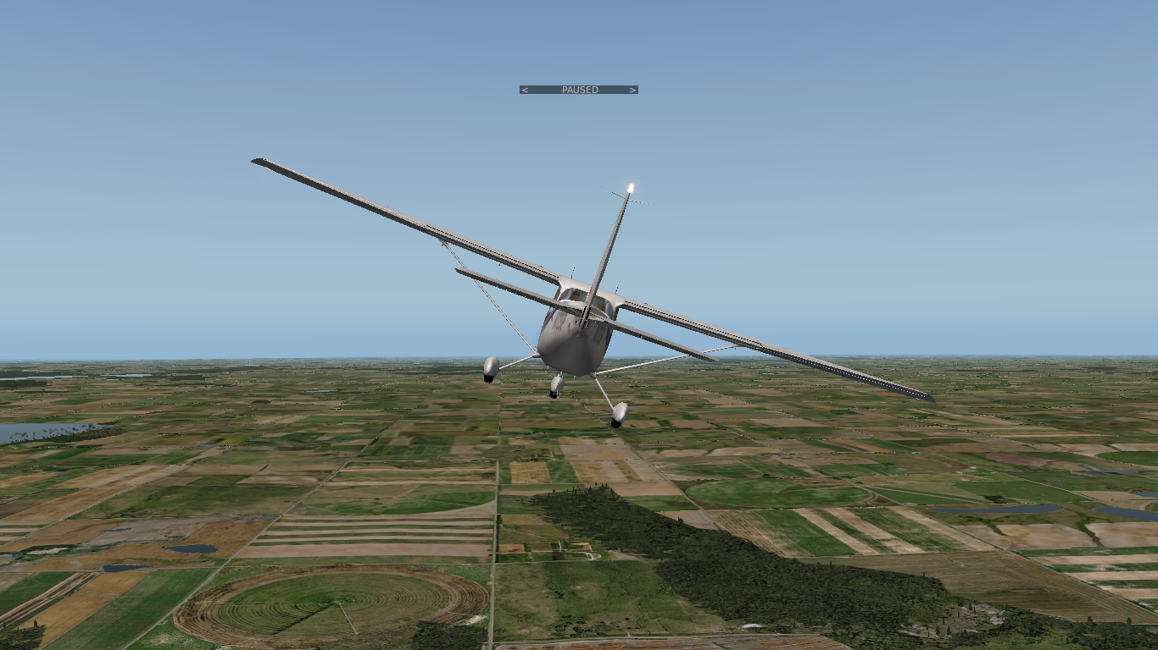
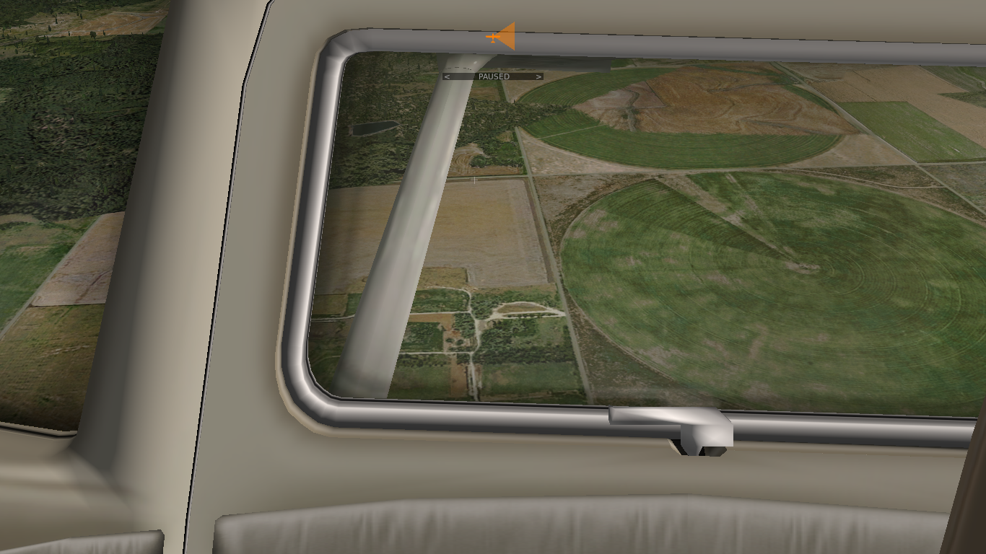
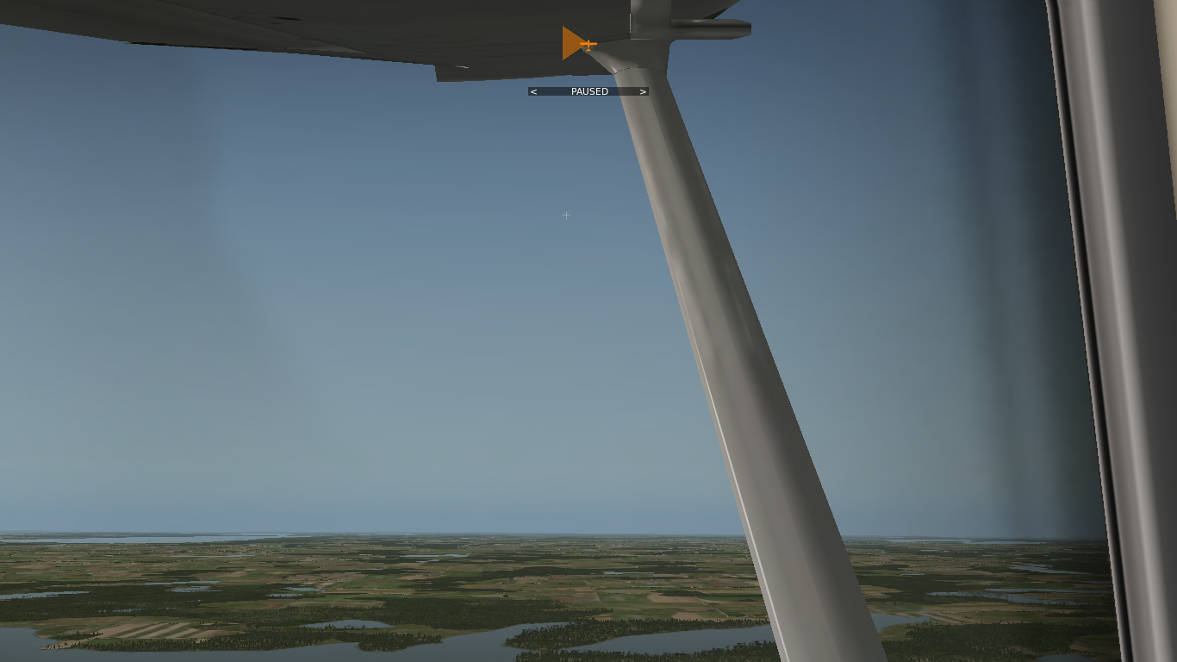
Bank Attitudes: Right-Banked Attitude

Slide 17
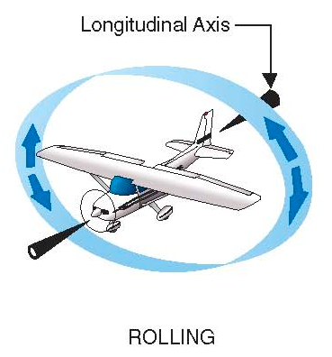
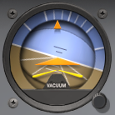
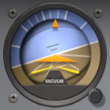
Movements - Rolling
Rolling is a rotational movement about the longitudinal axis
Rolling changes the bank attitude of the aircraft (left-/right banked)
Bank is primarily controlled with the yoke (control column, stick)
Rotating the yoke left or right results in aileron deflection
Real and artificial horizon reference (attitude indicator) change

Slide 18
Establishing and Recovering a Banked Attitude
Select
Neutralize
Rotation angle controls rate of roll
Select rotation angle until banked attitude is established
Neutralize yoke to maintain banked attitude
Select opposite rotation angle until cruise attitude is established
Neutralize yoke to maintain cruise attitude
Notes:
- explain howto carefully and precisely
- emphasize a continuous rotation to a selected yoke orientation for a certain rate of roll
- emphasize maintaining selected yoke orientation until banked attitude is achieved
- emphasize neutralizing yoke to maintain attitude

Slide 19


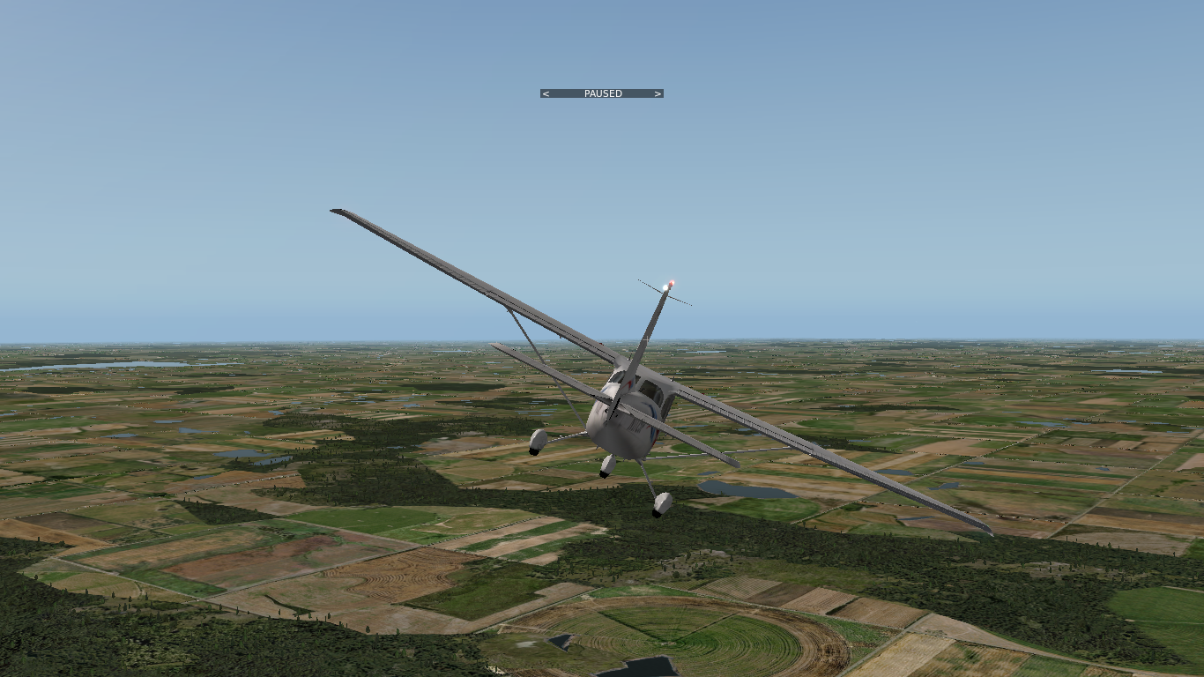
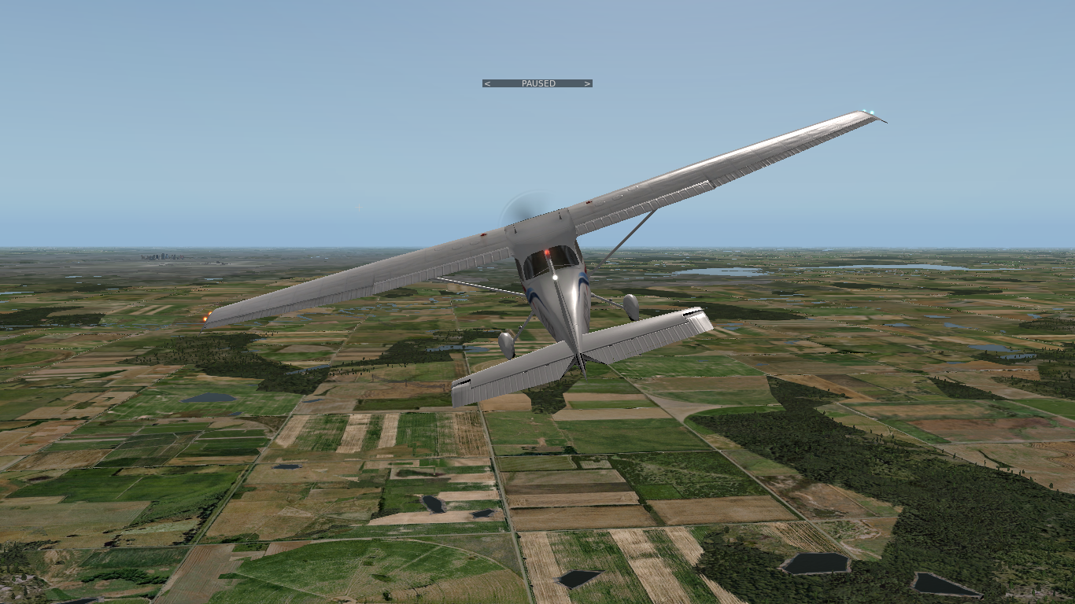
Combined Attitudes

Slide 20
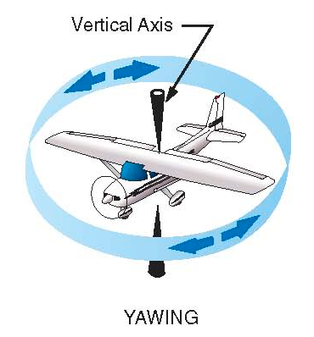


Movements - Yawing
Yawing is a rotational movement about the vertical (normal) axis
Yawing changes the heading of the aircraft (left, right)
Yawing is primarily controlled with the rudder pedals
Coordinated flight is desired in most situations (kick and center the ball)
Real and indicated heading change (heading indicator, turn coordinator)
Notes:
- turn coordinator indicates rate of turn (speed of yaw) and coordinated flight (radial force equals centrifugal force / overcomes inertia)
- on the ground turn coordinator indicates turn without a bank angle (skidding turn)
- turn coordinator gyros are driven electrically
- heading and attitude indicator gyros are driven pneumatically (by vacuum)

Slide 21
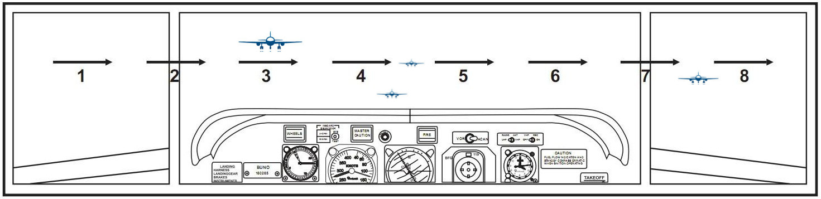
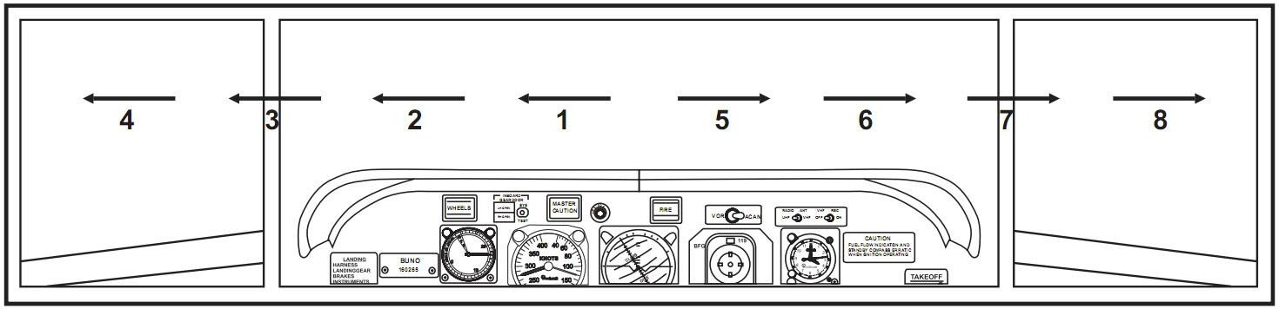

Lookout
Conflicts:
  Head-On, Converging, Climbing, Descending
Blind Spots:
  Below the Aircraft (above and behind depending on the cockpit)
Scanning:
  Side to Side, Middle to Side

Slide 22
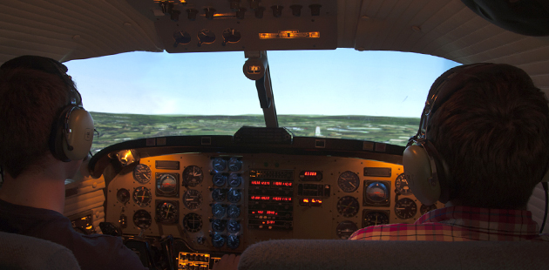
Control Transfer
Instructor: “You have control”, Student: “I have control”
Instructor: “I have control”, Student: “You have control”

Slide 23
Summary / Quiz
What types of aircraft attitudes exist?
What is the main reference for the aircraft attitude outside and inside the cockpit?
How does this reference appear from inside the cockpit for different attitudes?
What is the range of normal attitudes?
What kinds of control inputs and movements change the aircraft attitude and which way?
How do flight instruments indicate attitudes and movements?
What movement changes the heading of the aircraft?
How can scanning be performed to avoid conflicts?

Slide 24
Pre-Flight Briefing
Exercise
Training Area
Departure and Arrival Procedures
Weather Briefing / NOTAMs
Aircraft and Documents
Time and Fuel Requirements
Safety Considerations and Responsibilities
Notes:
- refer to lesson plan and mention other components to be observed during the flight

Slide 25
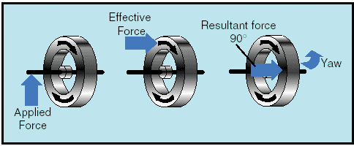
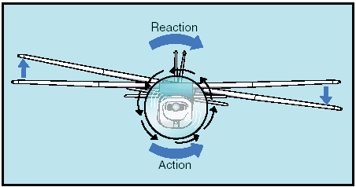
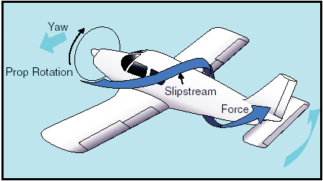
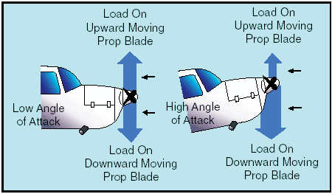
Reasons for Yawing
Aileron Drag / Adverse Yaw
Gyroscopic Precession
Torque
Slipstream
Asymmetric Thrust

