Slide 1
Contact Information
Stephan Heinemann
SMS: +1 (250) 891-5446
Email: stephan.heinemann@hotmail.com
Bookings, Questions

Slide 2
Instrument Flying
Review Instruments and Human Limitations
Definition and Motivation
Basic Instrument Flying
Partial Panel, Unusual Attitudes
Basic Radio and Satellite Navigation
Summary and Questions
Preflight Briefing

Slide 3
Review Instruments and Human Limitations
Magnetic (Electromagnetic) Instruments
Barometric Instruments
Gyroscopic Instruments
Navigational Instruments
Instrument Errors
Sensory Illusions

Slide 4
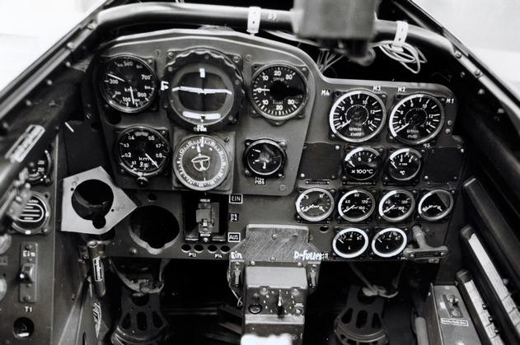

Definition and Motivation
Flying by reference to instruments only
Human senses are prone to miss-interpretation
Instrument flying overcomes human limitations
Essential skill for higher ratings and flight in IMC

Slide 5
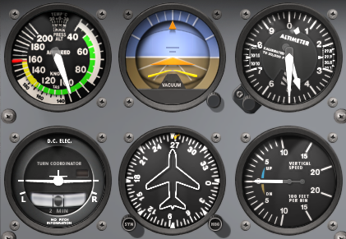
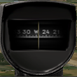
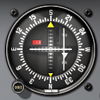
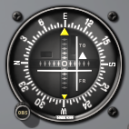
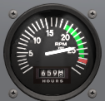
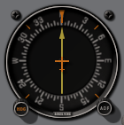
Basic Analog Instruments
ASI
AI
ALT
MC
VOR
ILS
TC
HI
VSI
RPM
ADF
Control Instruments – Pilot Input (Attitude & Power)
Performance Instruments – Aircraft Response
Attitude plus Power equals Performance
Navigation Instruments – Lateral and Vertical
Notes:
- RPM indicator = tachometer

Slide 6
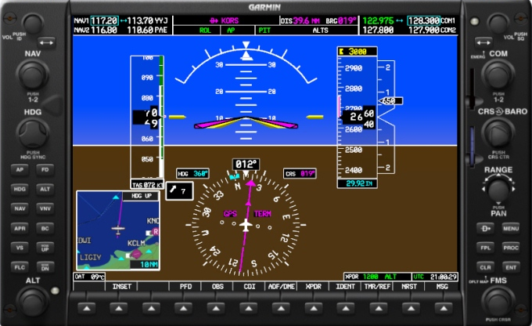
Glass Cockpit Instrumentation

Slide 7
Radial Scan
Adjust attitude and power for estimated performance
Scan performance instruments for actual response
Re-adjust and trim controls, and scan systematically

Slide 8
Selective Radial Scan
Each maneuver requires particular performance
Scanning pattern should prioritize accordingly
Selective scan should not lead to fixation
What information do I need?
Which instruments give me the needed information?
Is the information reliable?
Which instruments need to remain constant?
Which instruments need to change and at what rate?

Slide 9
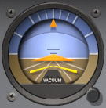
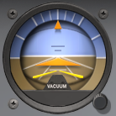
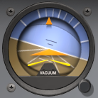
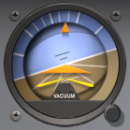
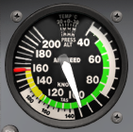
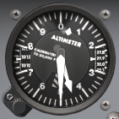
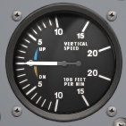
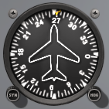
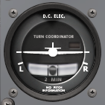
Attitudes and Movements

Slide 10
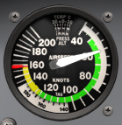
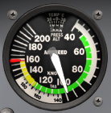
Straight and Level Flight
Attitude plus Power equals Performance
Remember the power curve for adjustments
Scan altimeter and heading indicator more frequently
Notes:
- 100 RPM → 5 KIAS

Slide 11
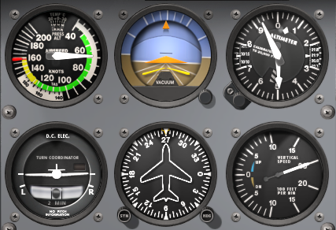
Climbing and Descending
Straight Climb / Descent
Climbing – attitude, power, trim (APT)
Descending – power, attitude, trim (PAT)
Scan airspeed and heading indicator more frequently
Notes:
- more attention to instruments which should remain constant for the flight phase

Slide 12
Levelling Off
Approaching Altitude
Leveling Off
Scan altimeter and heading indicator more frequently when approaching desired altitude
Increase airspeed indicator scan during transition to straight and level flight
Notes:
- 10% VSI to lead in leveling off

Slide 13
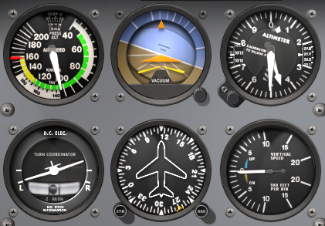
Turns
Turn Entry
Turn Recovery
Perform standard – rate one – turns at 3 °/s
Establish and adjust bank angle at IAS / 10 + 7
Lead the desired heading using half bank angle
Notes:
- Rate one turn – IAS / 10 + 7 bank angle
- lead in heading – half the bank angle

Slide 14
Partial Panel
Attitude and heading indicator not available
Indirect attitude and more attention to TC / TBI and MC
Focus on timing in turns and magnetic dip errors
Notes:
- not available = not fitted or unserviceable

Slide 15
Partial Panel – Straight and Level
Maintain coordinated and straight with TC and crosscheck MC occasionally
Scan altimeter and VSI more frequently (level)

Slide 16
Partial Panel – Climbs and Descents
Straight Climb / Descent
Maintain coordinated and straight with TC
Scan airspeed indicator more frequently (stable)

Slide 17
Partial Panel – Levelling Off
Approaching Altitude
Leveling Off
Maintain coordinated and straight with TC
Scan altimeter more frequently (desired altitude)
Increase airspeed indicator scan during transition

Slide 18
Partial Panel – Turns
Straight Climb / Descent
Scan altimeter and airspeed indicator more frequently
Timed rate one turns – 3 °/s
180° → 60s, 90° → 30s, 45° → 15s

Slide 19
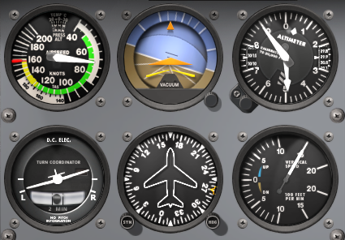
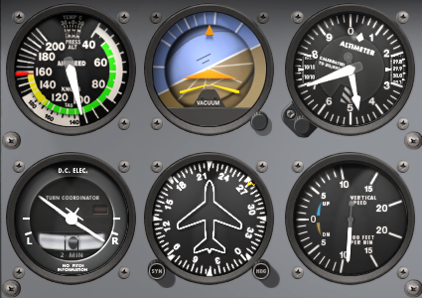
Unusual Attitudes
Nose-Up Attitude
  Full Power
  Forward Pressure
  Wings Level
Nose-Down Attitude
  Power Idle
  Wings Level
  Back Pressure

Slide 20
Instrument Errors

Slide 21
Radio Navigation

Slide 22
Satellite Navigation

Slide 23
Summary / Quiz

Slide 24
Pre-Flight Briefing
Exercise
Training Area
Departure and Arrival Procedures
Weather Briefing / NOTAMs
Aircraft and Documents

Slide 25
Instrument Flying
(Ex. 24, LP. )
Objective
Review
Motivation
Howto
Summary / Questions
Preflight Briefing

