Slide 1
Contact Information
Stephan Heinemann
SMS: +1 (250) 891-5446
Email: stephan.heinemann@hotmail.com
Bookings, Questions

Slide 2
Pilot Navigation
Review Navigation (Groundschool)
Definition and Motivation
Pilot Navigation
Summary and Questions
Pre-Flight Briefing

Slide 3
Review Navigation
What information is required to prepare a cross-country flight and where can it be obtained?
What elements of a navigation log are filled in before and during the flight, respectively.
What is the purpose of flight planning and preparation and how does it relate to the actual flight?
What is a flight plan and itinerary, respectively?
Notes:
- 25 NM from departure aerodrome
- SAR times: 1h after ETA or specified, 24h after ETA or specified

Slide 4

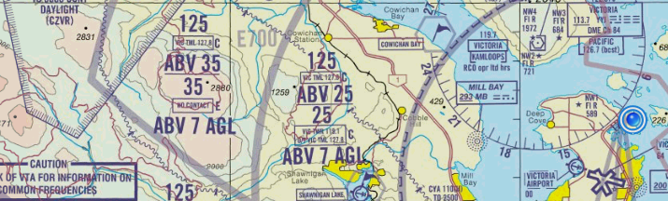
Definition and Motivation
The process or activity of accurately ascertaining one's position and planning while following a route.
Essential skill to safely and efficiently travel from departure to destination
Navigation planning establishes a level of situational awareness including potential options before the flight
Supports decision making during the flight

Slide 5
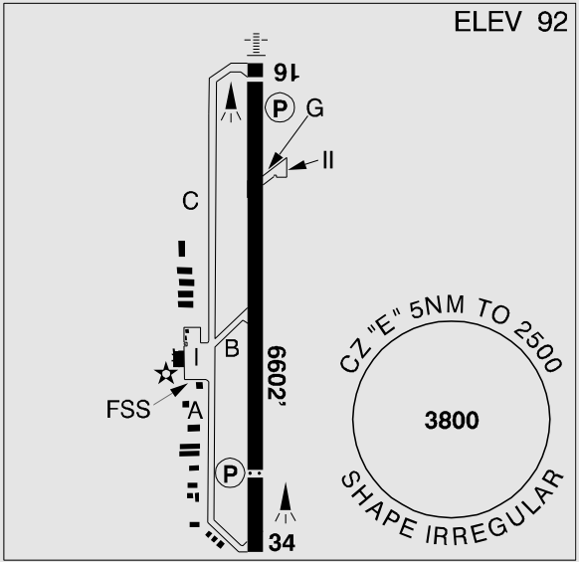
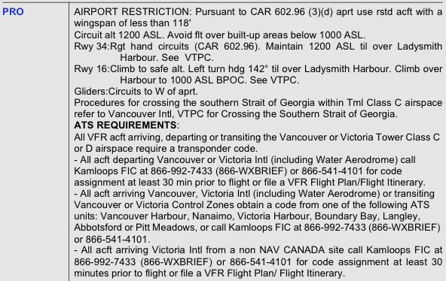
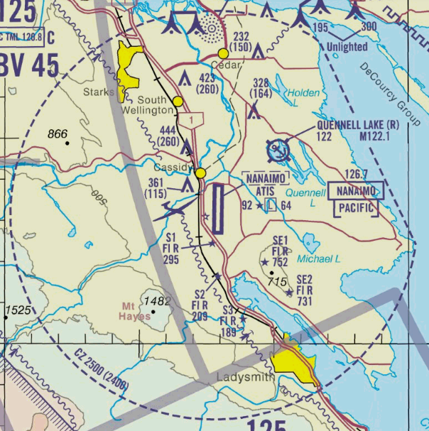
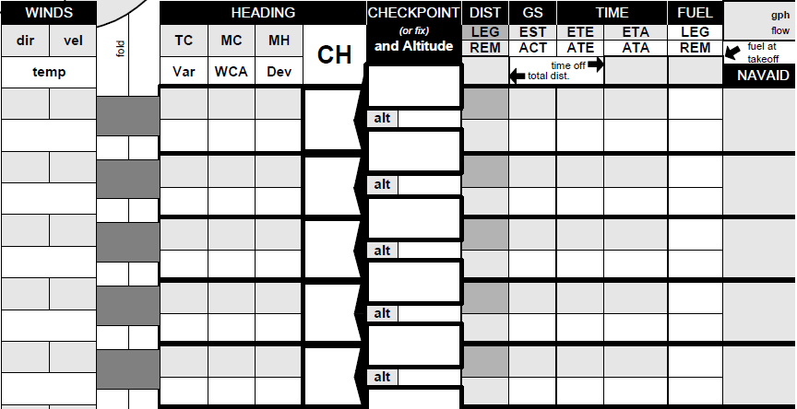
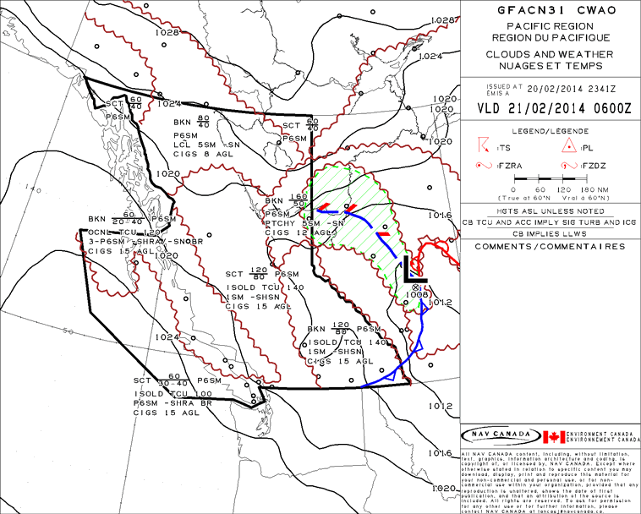
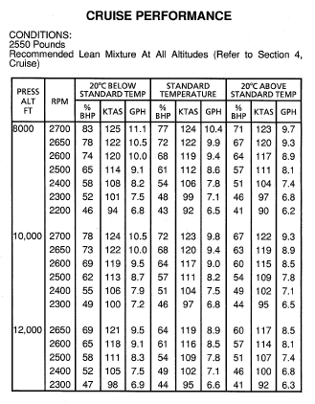
Preparation
Charts, CFS, Weather (SWC, GFA, FD, METAR, TAF, AIRMET, SIGMET, PIREP), NOTAM, W&B, Performance, Navigation Log, Flight Plan, FIC Briefing & Flight Planning
Aircraft (CoR, CoA, W&B, Insurance, Journey Log, POH, Checklists), Survival Equipment
Pilot (License, Ratings, Medical), IMSAFE
Notes:
- Illness, Medication, Stress, Alcohol, Fatique, Eating
- only mention, do not explain in detail

Slide 6
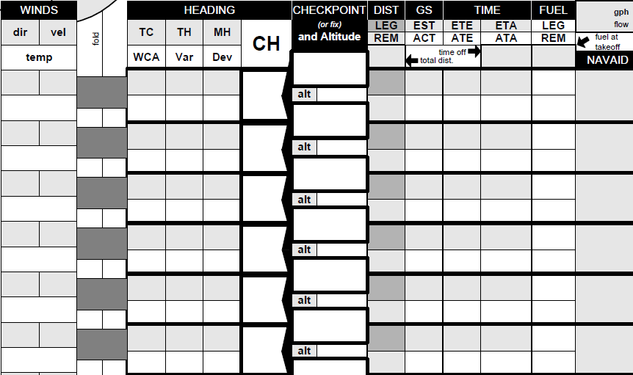
Navigation Log
Notes:
- use the correct wind navlog (vfr1)
- fill in an example during the presentation or prepare values

Slide 7
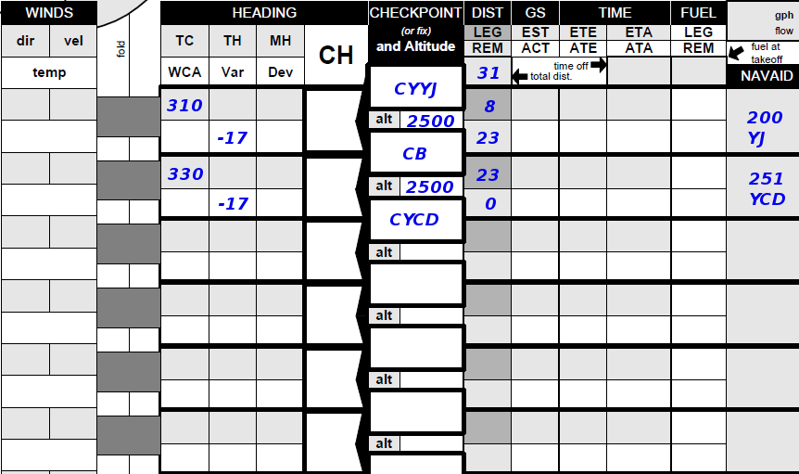
Navigation Log (Route)

Slide 8
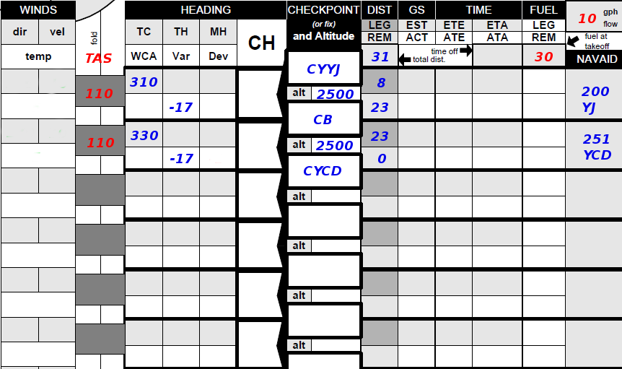
Navigation Log (Aircraft)

Slide 9
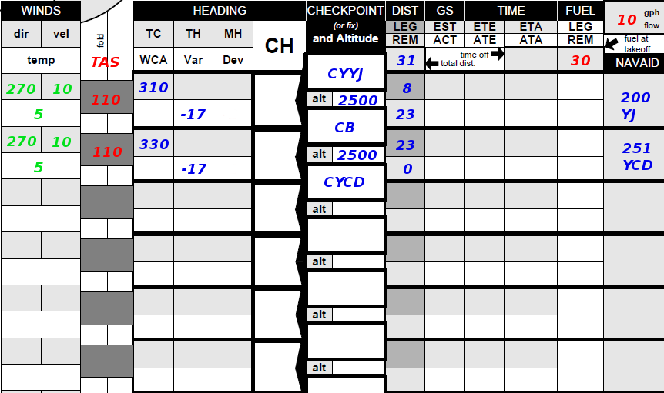
Navigation Log (Weather)

Slide 10
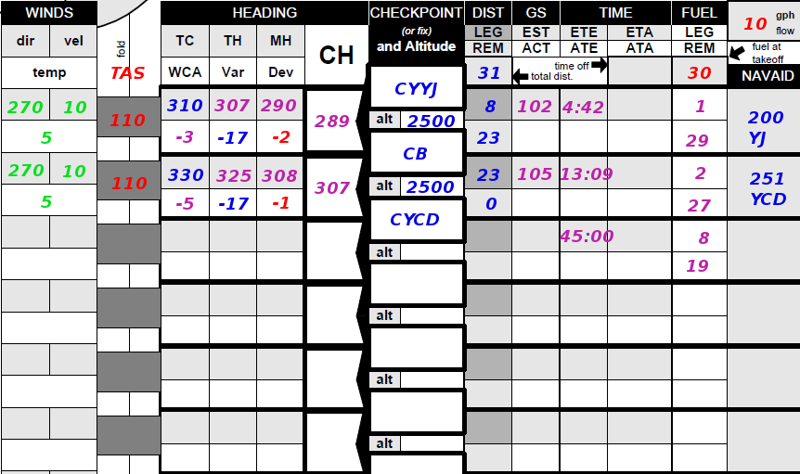
Navigation Log (Calculation)

Slide 11
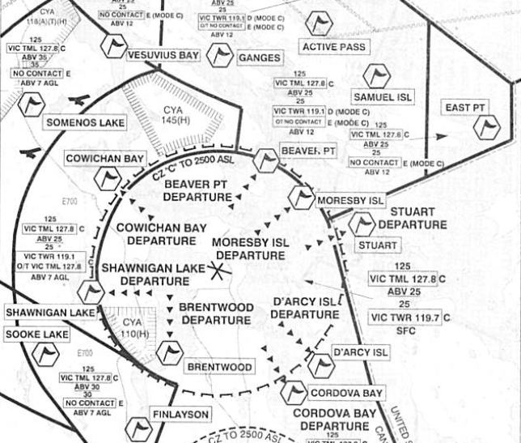
Victoria Standard VFR Departures

Slide 12

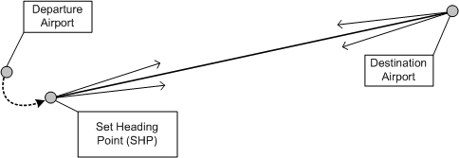
Geographic Point Procedure
Fly departure to Set Heading Point
5 T's – Time, Turn, Throttle (Mixture), Tune, Talk
Enter Actual Time Over (ATO) into navigation log
Establish planned heading – heading indicator
Crosscheck visual angle, chart and navigation log
Notes:
- key points at the beginning

Slide 13
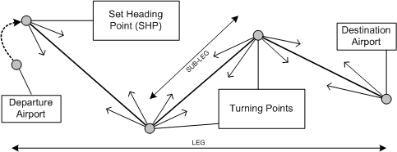
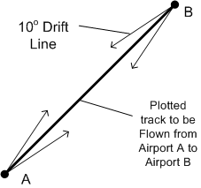
Flying Legs
Update ETA and next ETO at each waypoint
Maintain accurate heading and observe track
Correct drift as required – update heading
Check groundspeed – update ETA and next ETO
Perform OPS / cockpit checks every 15 / 30 min

Slide 14
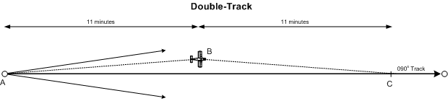
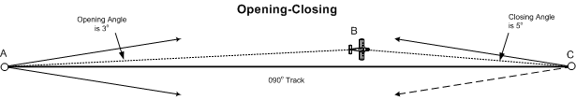
Track Error Corrections
Visual Alteration Method
Double Track Error Method
Opening Closing Angle Method
Drift Compensation Method
Notes:
- all methods require to know the angles using approximate values with help of drift lines
- include 1/60 rule?
- opening-closing angle : add opening and closing angle for intercept heading

Slide 15
1 in 60 Rule

Slide 16

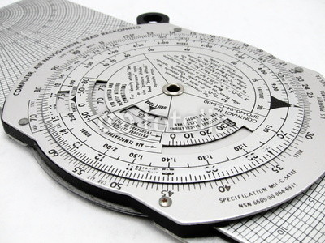
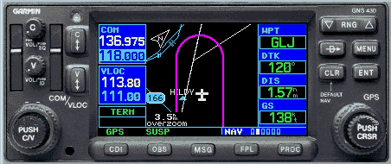
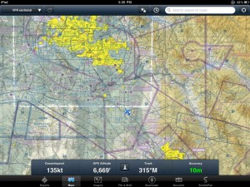
Groundspeed Check
30 NM, 30 min → 60 kts
30 NM, 15 min → 120 kts
30 NM, 20 min → 90 kts
10 NM, 5 min → 120 kts
5 NM, 2.5 min → 120 kts
Notes:
- consider TKT, some tasks with students

Slide 17
E6B GS Check and ETA Update
GS Check:
  Distance in NM on the outside ring over
  Time in min/hours on the inside ring
  Read Speed in knots on the outside ring over 60
ETA / ETO Update:
  Speed in knots on the outside ring over 60
  Read Time in min/hours on the inside ring under
  Distance in NM on the outside ring

Slide 18
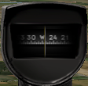
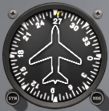
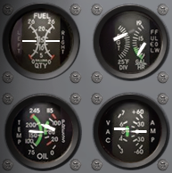
OPS / Cockpit Checks
Magnetic Compass
Fuel, Oil,
Vacuum, Current
Heading Indicator
Assure navigational performance
Check power plant, fuel and electrical systems
Magnetic Compass, Heading Indicator – Cross Check
Engine Instruments (Fuel, Oil) – Check
No Discharge (Ammeter) – Check
Notes:
Suction (Vacuum) – Check
Fuel Selector, Mixture

Slide 19
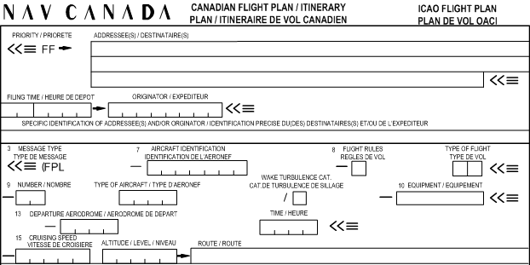

Flight Plan / Itinerary
Required for advisory, control and alerting service
Required for all flights beyond 25 NM of departure
Filing with FIC at least 30 min before departure
Closing with FSS in-flight, control tower or FIC
SAR times (1 / 24 h after ETA or as specified)
Notes:
- Kamloops FIC number

Slide 20
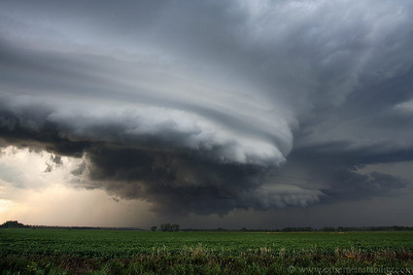

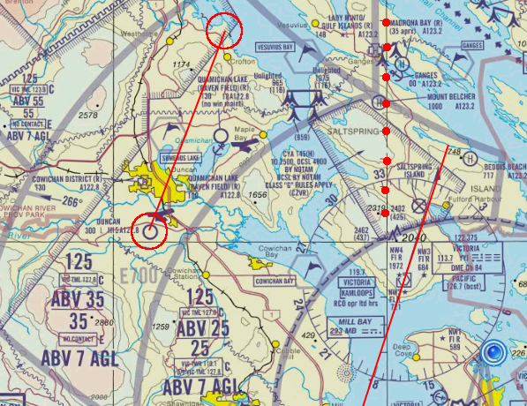
Diversions
Circle, Circle, Line, Heading, Distance, Time
Make a call and you'll be fine
Fuel (reserve) required and weather for alternate
Consider departure aerodrome and reciprocal track
Use physical features for visual navigation (roads, rivers)
Support with all means of navigation (GPS, VOR, NDB)
Notes:
- ccl – hdt above the pictures
- use only the following slides to explain
- 2 part separate presentations: navigation and diversions (with homework for student, prepare navigation log and perform calculations with E6B)

Slide 21
Diversions

Slide 22
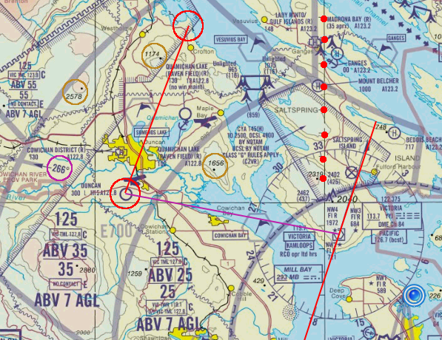
Diversions

Slide 23
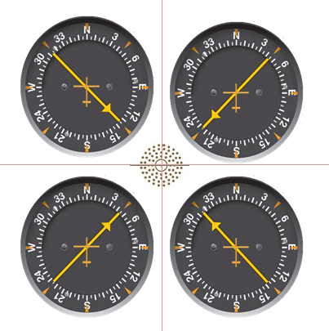
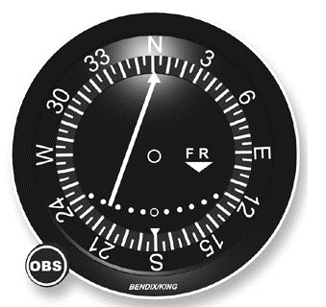
Navigational Aids
GPS – map and direct to (mounted, portable)
VOR – radial inbound or outbound, fix
NDB – bearing to station

Slide 24
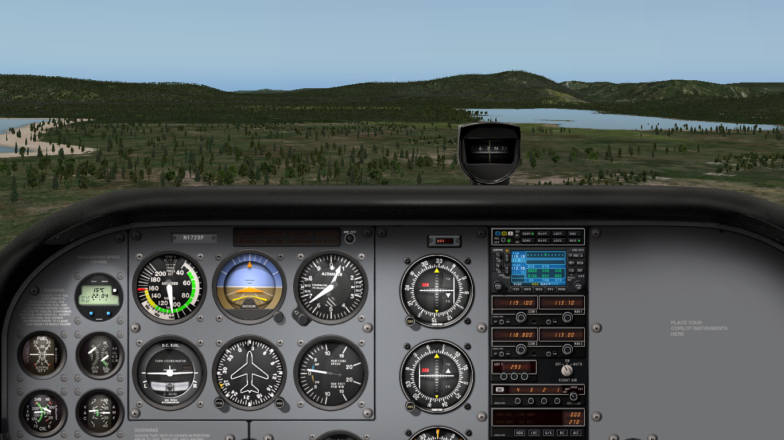
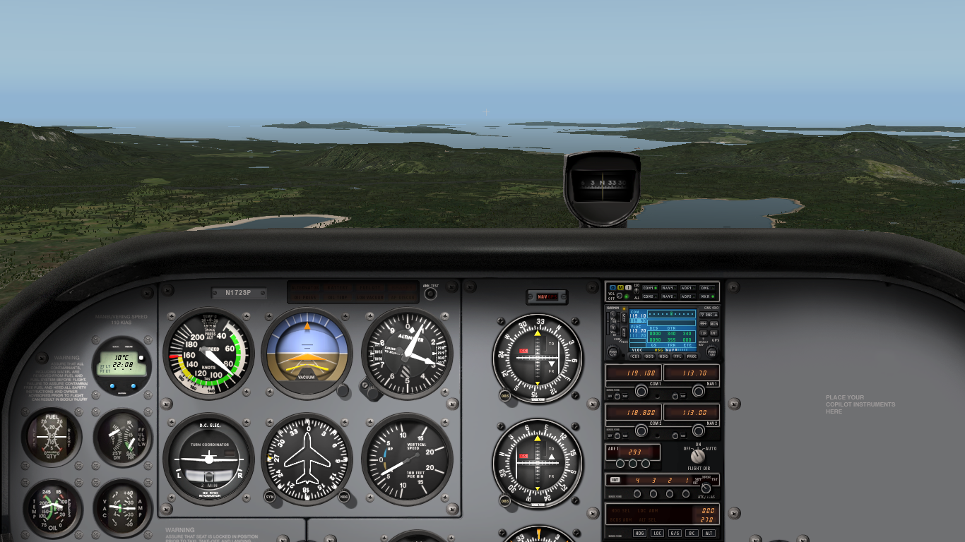
Low-Level Navigation
Restricted field of view and limited navigational cues
Requires accurate tracking and timing
Remain clear of obstacles – look outside
Use shorelines, rivers, roads, railways
Consider precautionary landing or special VFR

Slide 25
Navigational Assistance
Steady heading – crosscheck MC and HI
Navigation errors – heading, drift, landmarks
Circle of uncertainty – last known position
Watch to ground to map versus map to ground
Proceed to major landmarks, consider climb
Request assistance – Vectors, DF Steer
Consider GPS, VOR, NDB for support (CFIT)
Declare emergency if necessary (7700, ELT)
Notes:
- danger of CFIT – look outside!

Slide 26
Summary / Quiz
What preparation items need to be completed before commencing a cross-country flight?
Which elements of a navigation log are filled in during the flight and why is an up-to-date log necessary?
What are the problems associated with attempting to obtain a ground speed check within a few minutes after setting heading?
What track error correction methods are available to you and how can they be used?

Slide 27
Pre-Flight Briefing
Exercise
Training Area
Departure and Arrival Procedures
Weather Briefing / NOTAMs
Aircraft and Documents
Time and Fuel Requirements
Safety Considerations and Responsibilities

Slide 28
Pilot Navigation
(Ex. 23,
LP. 3, (4), 5, (6, 7, 20, 22, 24), 26)
Objective
Review
Motivation
Howto
Summary / Questions
Preflight Briefing
Notes:
- lesson plan 5 demonstrates map reading for the first time, lesson plan 4 supervised map reading already?

Slide 29
Charts
VNC, VTA, WAC
Route Selection, Chart Preparation
Markings and Folding
Drift Lines, Angles

Slide 30
Departure, Destination, Alternate
CFS

Slide 31
Route and Altitude
Distance, Economy, Weather / Wind, Navigation Aids, Comfort, Oxygen, Performance Limitations, Gliding Distance

Slide 32
NOTAM

Slide 33
Weather
GFA, SWC, FD
METAR, TAF, SIGMET, AIRMET, PIREP
Briefing, FIC
Current Situation and Forecast

Slide 34
Navigation Log
Log Keeping
Time Off and Flight Plan Opening Time
Set Heading Time
Compass Headings and Waypoint Times
ETA for Waypoints and Destination
ATA (Time Over) for Waypoints and Destination
Revised GS and ETA

Slide 35
Flight Plan / Itinerary
SAR times (long versus short plans, roundtrips)

Slide 36
Documents
CoR, CoA, W&B, Insurance, Journey Log, MEL
License, Medical, IMSAFE
POH, Checklists, Charts

Slide 37
Departure, Enroute and Arrival
Overhead, Geographic Point, En-Route Climb
GUMPS, OPS Checks, Ground Speed Check
Position Reports, PIREPs
Map/Chart Reading:
  Orientation, Anticipation, Confirmation, Pin-Pointing
Desired, Actual Track / Error, Angles (10-25NM)
Double Track Error Method, Visual Alteration, Opening Closing Angle Method, Drift Compensation Method
Lookout / Scanning and Traffic Awareness (Crew, Systems, Weather)

Slide 38
Diversion
Situational Awareness and Decision Making
Online Planning
Priority: Aviate, Navigate, Communicate, Manage
Circle, Circle, Line, Heading, Distance, Groundspeed, Time – You'll Be Fine (Consider Leg-Size)
Reciprocal Track and Wind Correction
Estimations: Track, Distance, Groundspeed, Time, Heading
Multiples of 60KIAS, Muliples of leg section
Communiction (FSS)
Circle of Uncertainty, Low-Level Navigation
Emergency Procedures, Triangles

