Slide 1
Contact Information
Stephan Heinemann
SMS: +1 (250) 891-5446
Email: stephan.heinemann@hotmail.com
Bookings, Questions

Slide 2
Precautionary Landing
Review Circuits, Illusions Created by Drift and Landings
Definition and Motivation
Precautionary Landing
Summary and Questions
Preflight Briefing

Slide 3
Review Circuits, Illusions Created by Drift and Landings
What are the legs of a standard aerodrome traffic circuit?
What would be the ideal direction of the wind with respect to the circuit and why?
What illusions created by drift do we need to be aware of when flying close to the ground?
What is the proper reaction if the turn to final turns out to be too wide and why?
Mentally perform a short and soft-field landing.

Slide 4
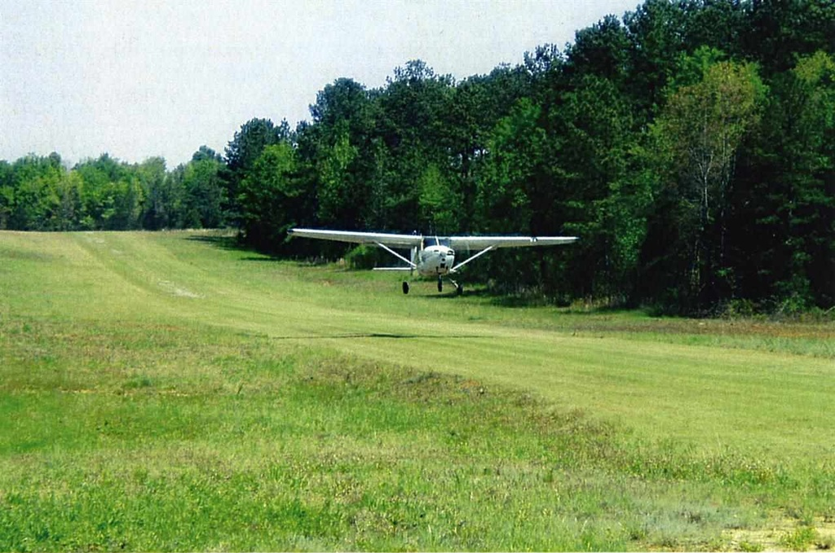
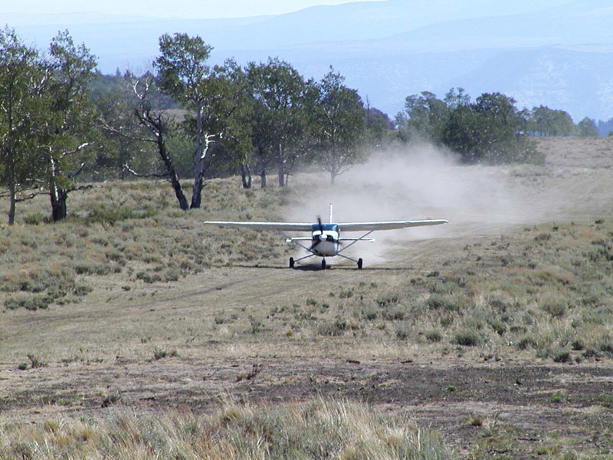
Definition and Motivation
Planned or unplanned landing in unknown terrain or airfield
A plan is only a plan until put to action – dynamic re-planning
Constantly evaluate the operational context and make decisions
Situations: airfield with insufficient data, failed aircraft systems, deteriorating weather, pilot / crew or passenger state, loss of situational awareness

Slide 5
Decision Making – COWLS
Civilization
Obstacles
Wind
Landing Area / Length
Surface
Landing Type Selection: Normal, Short, Soft, Crosswind

Slide 6
Safety Considerations
Maintain a safe airspeed
Maintain a safe height
Maintain a good lookout
Turn accurately and coordinated
Anticipate turns and compensate drift on legs
Do not overbank or skid
Practice exercise only with flight instructor

Slide 7
Summary / Quiz
In what situations and conditions do we have to be particularly aware of visual illusions caused by drift?
When turning from or to the crosswind leg of a circuit, what illusion will most likely be experienced?
When turning from or to the base leg of a circuit, what illusion will most likely be experienced?
What instruments may help to prevent false reactions caused by visual illusions.

Slide 8
Pre-Flight Briefing
Exercise
Training Area
Departure and Arrival Procedures
Weather Briefing / NOTAMs
Aircraft and Documents

Slide 9
Illusions (Ex. 20, LP. 24)
Objective
Review
Motivation
Howto
Summary / Questions
Preflight Briefing

Slide 10
Climbing and Descending with Wind

