Slide 1

Duralumin – Junkers J.I

Slide 2

Wood – Horten 229

Slide 3
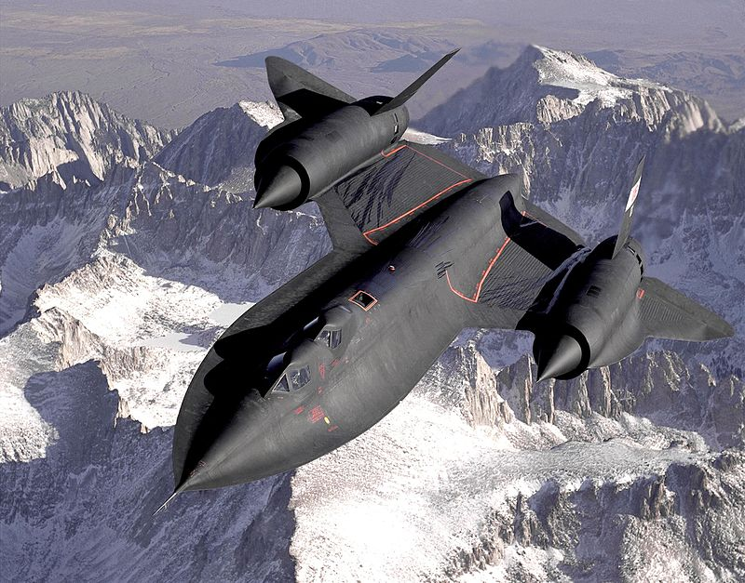
Heat Dissipation/Expansion – SR71

Slide 4
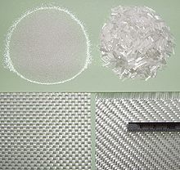
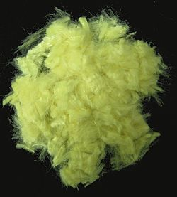
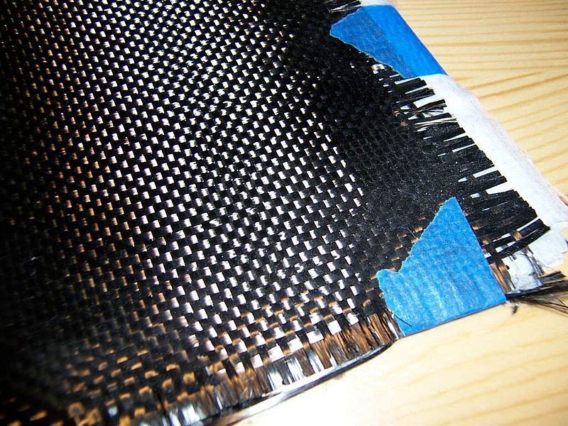
Fiberglass, Kevlar, Carbon Fiber

Slide 5
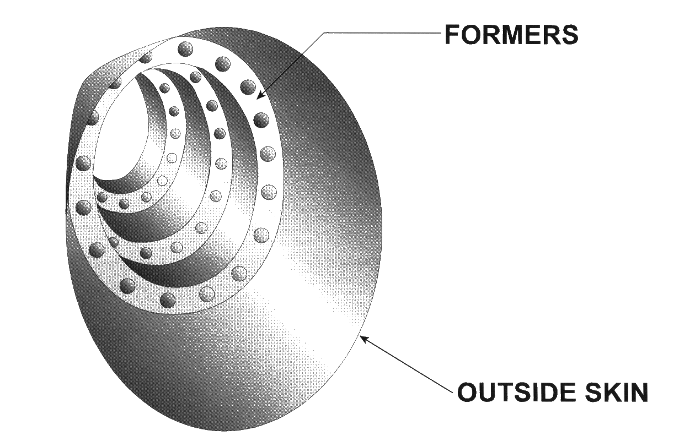
Monocoque

Slide 6
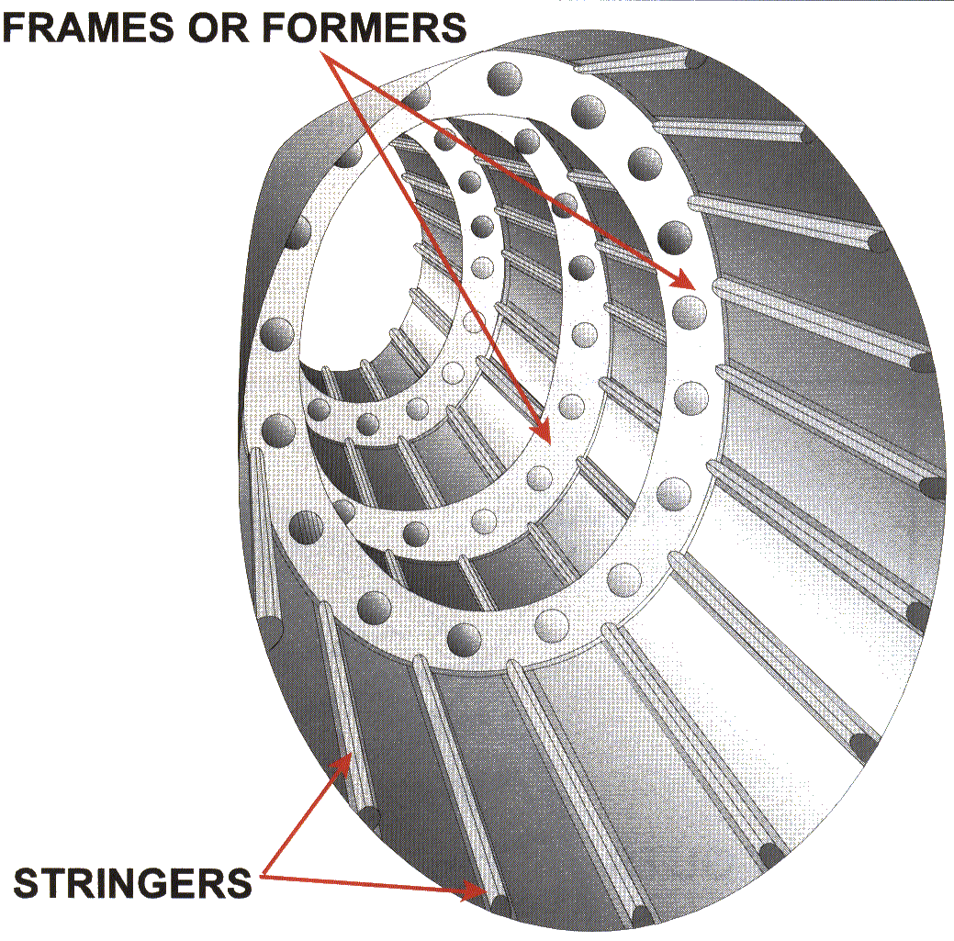
Semi-Monocoque

Slide 7
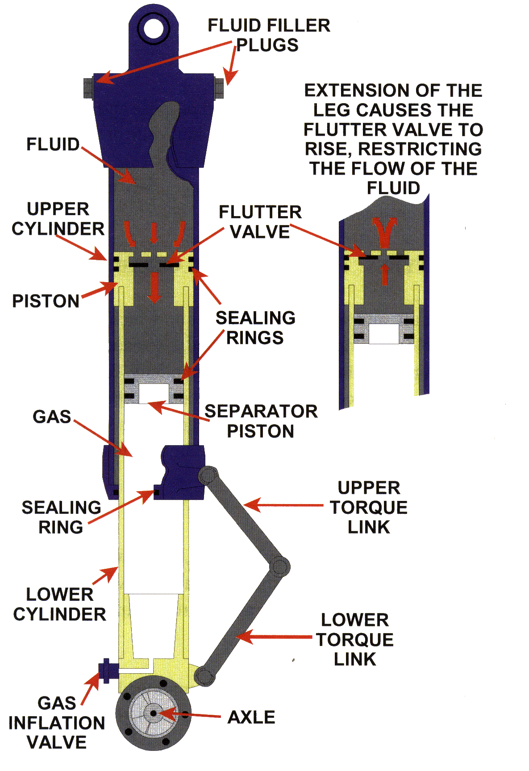
Landing Gear – Oleo Strut

Slide 8
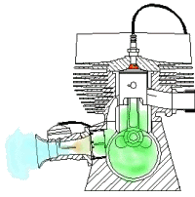
Two-Stroke Engine

Slide 9
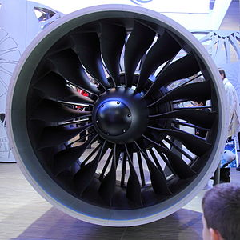
High Bypass Tubofan – PW1000G

Slide 10
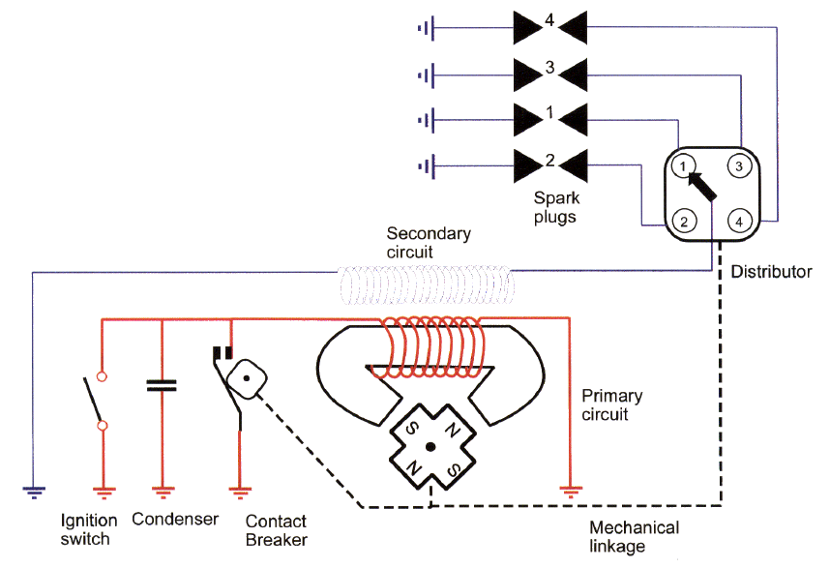
Ignition System – Magnetos

Slide 11
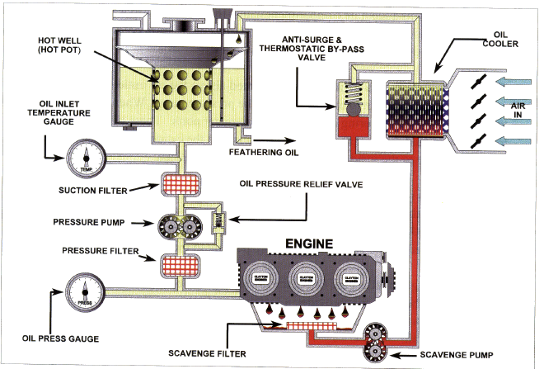
Dry Sump Lubrication

