Slide 1
Contact Information
Stephan Heinemann
SMS: +1 (250) 891-5446
Email: stephan.heinemann@hotmail.com
Bookings, Questions

Slide 2

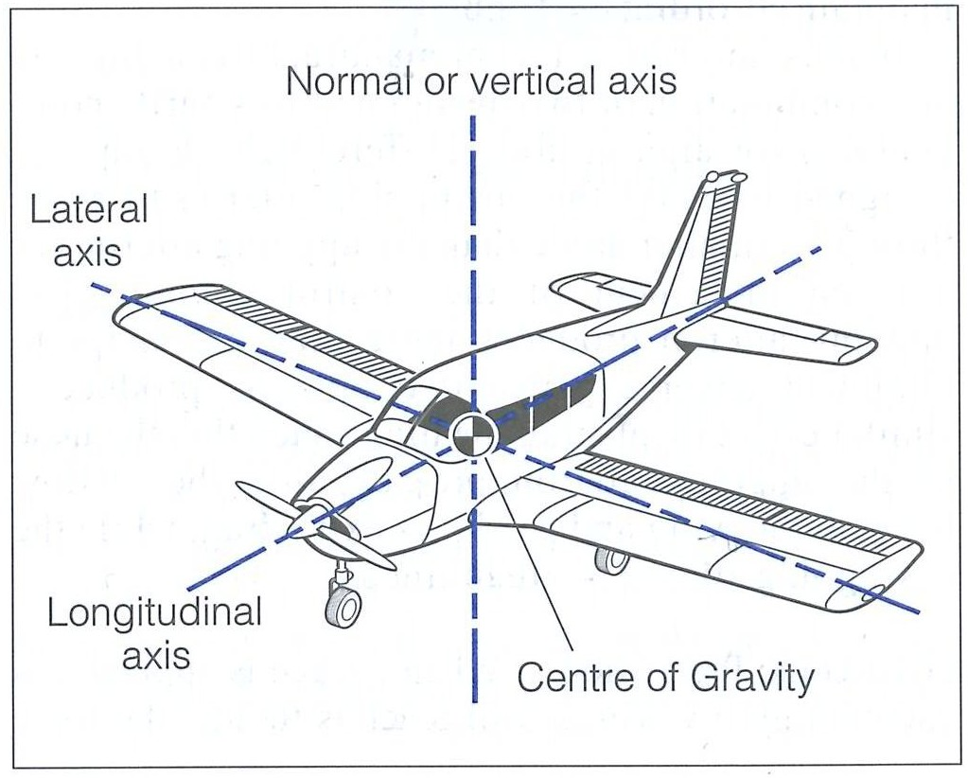
Attitudes and Movements

Slide 3
Outline
Normal Aircraft Attitudes
  Cruise Attitude
  Normal Pitch and Bank Attitudes
  Attitude Reference
Rotational Movements
  Pitching, Rolling, Yawing
  Rotational Movement Axes
  Control Inputs and Surfaces
Instrument Indications

Slide 4

Cruise Attitude

Slide 5
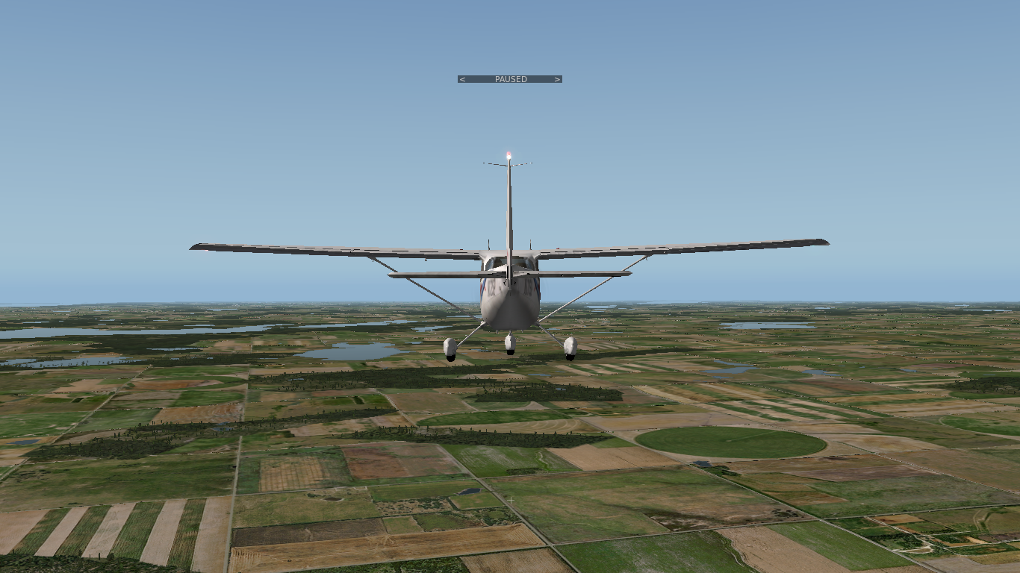
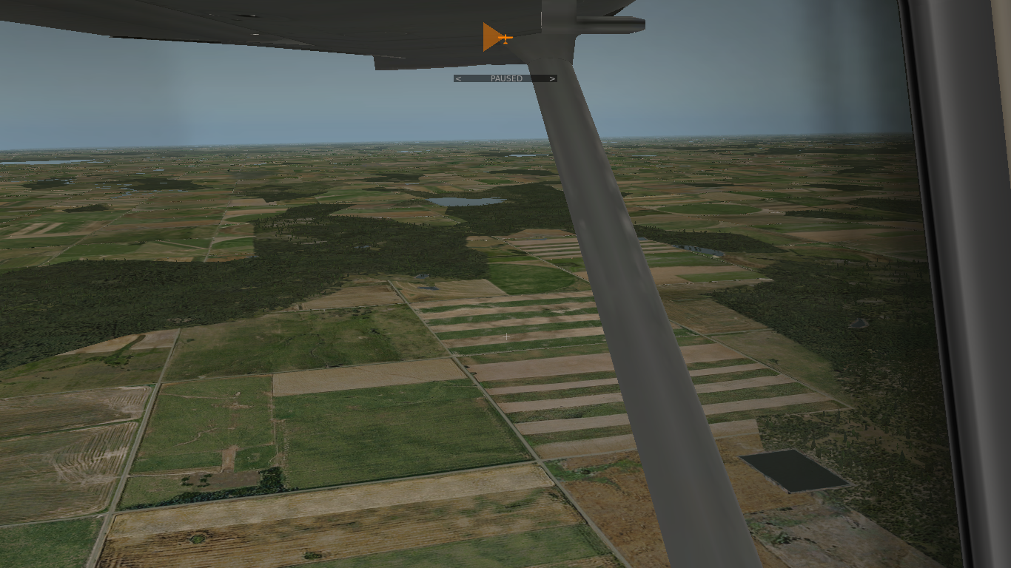
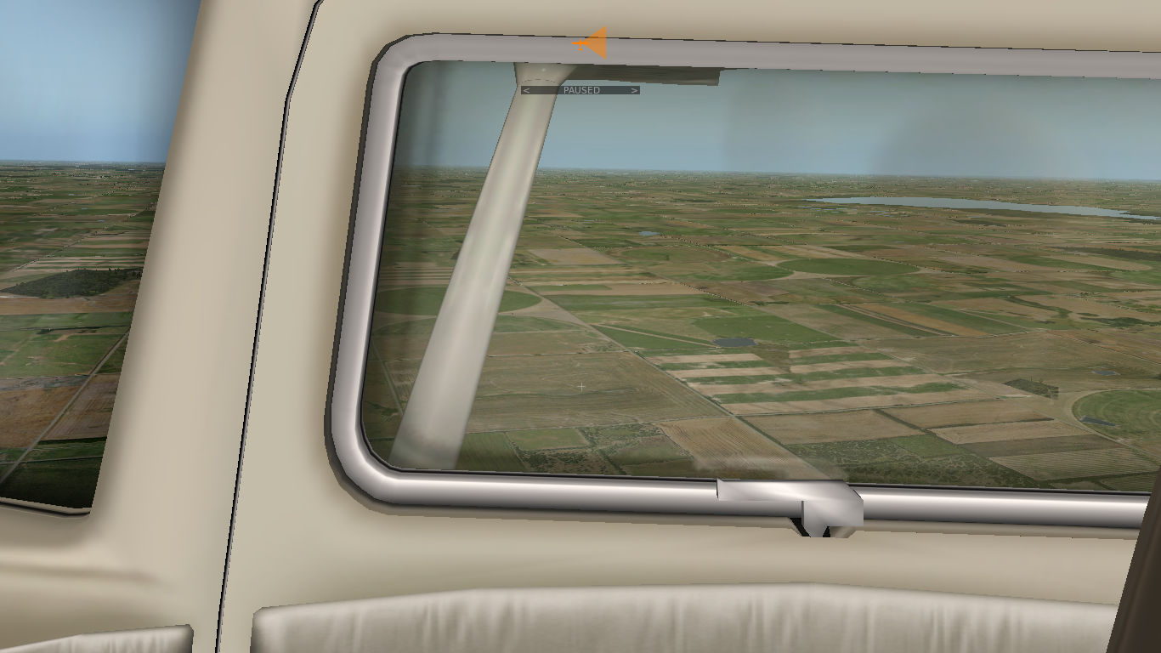
Cruise Attitude

Slide 6

Pitch Attitudes: Nose-Up Attitude
Normal Nose-Up Attitude Range to +15°

Slide 7
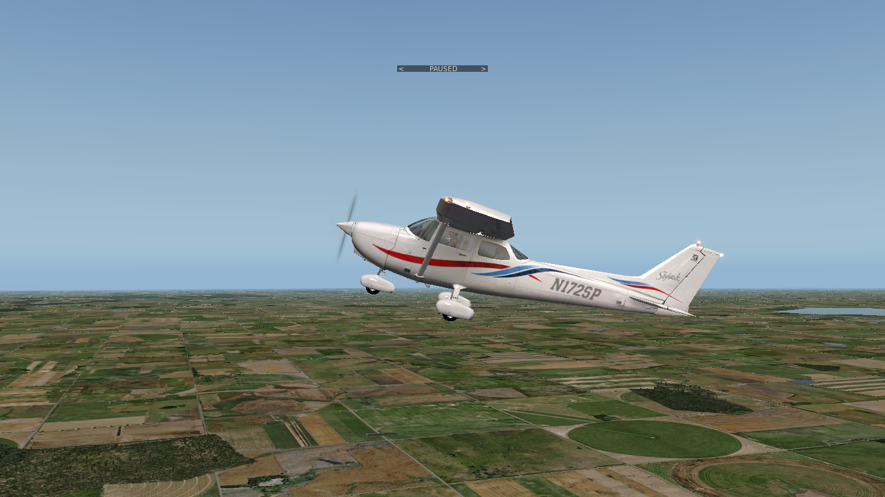

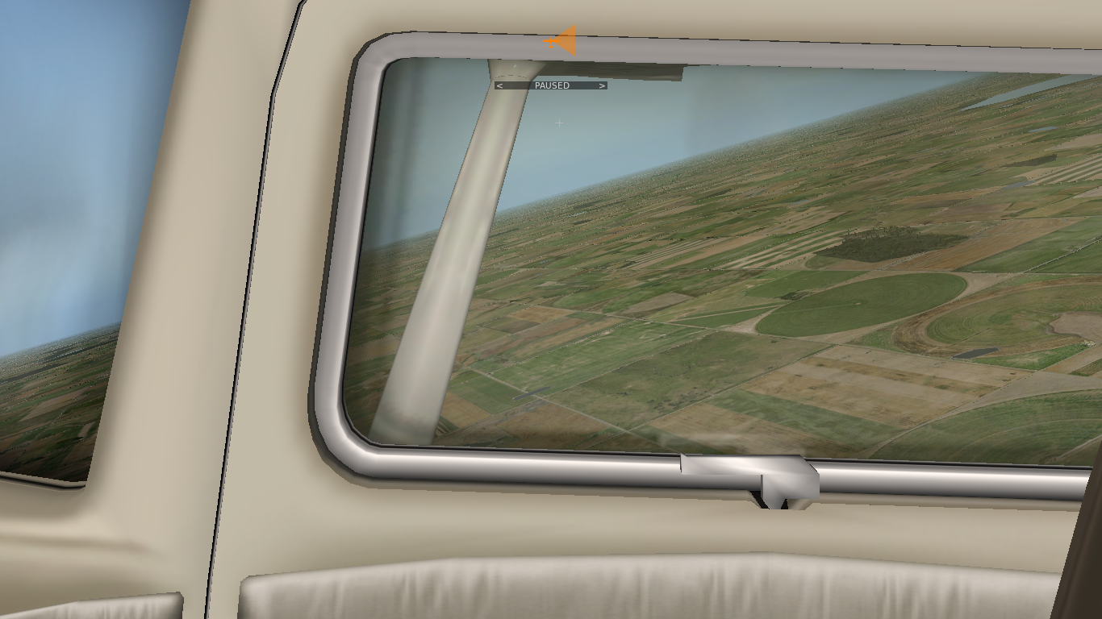
Pitch Attitudes: Nose-Up Attitude

Slide 8
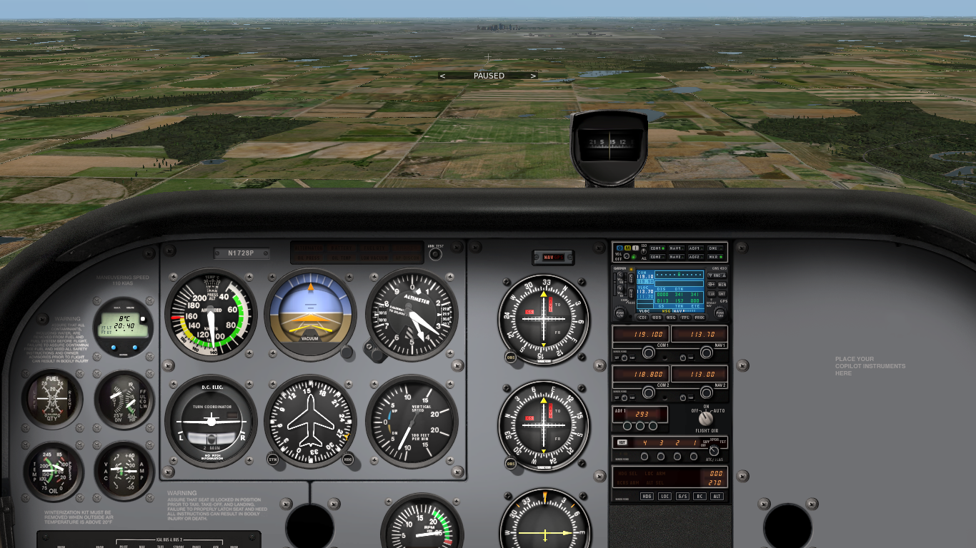
Pitch Attitudes: Nose-Down Attitude
Normal Nose-Down Attitude Range to -10°

Slide 9
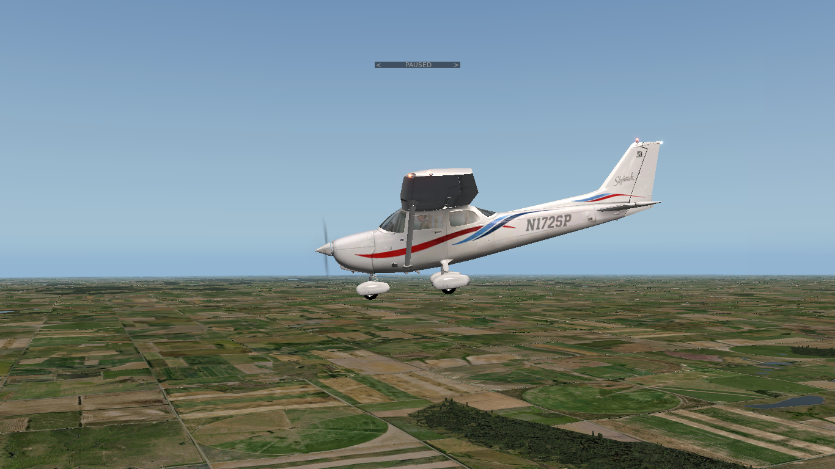

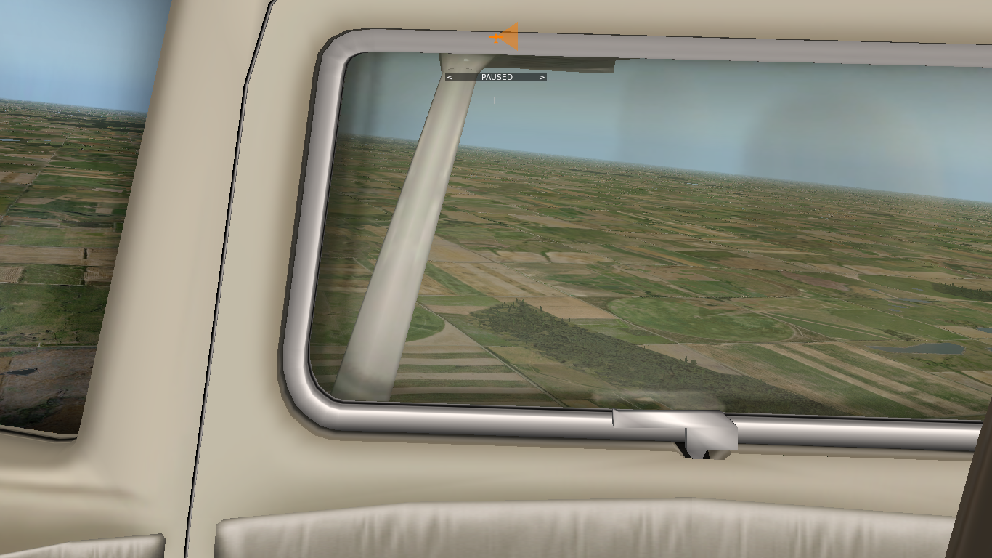
Pitch Attitudes: Nose-Down Attitude

Slide 10
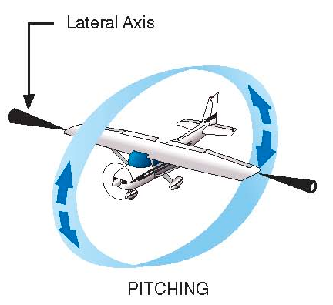
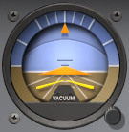

Movements - Pitching
Pitching is a rotational movement about the lateral axis
Pitching changes the pitch attitude of the aircraft (nose-up/down)
Pitch is primarily controlled with the yoke (control column, stick)
Pushing or pulling the yoke results in elevator deflection
Trim is used to reduce control forces while maintaining attitude
Real and artificial horizon reference (attitude indicator) change

Slide 11

Bank Attitudes: Left-Banked Attitude
Normal Left-Banked Attitude Range to -30°

Slide 12
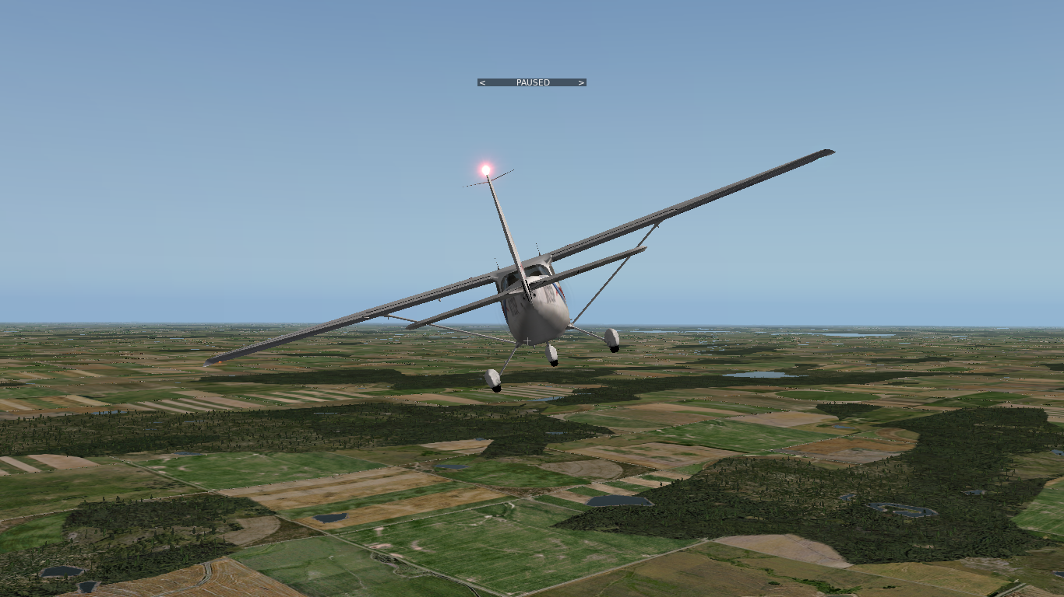
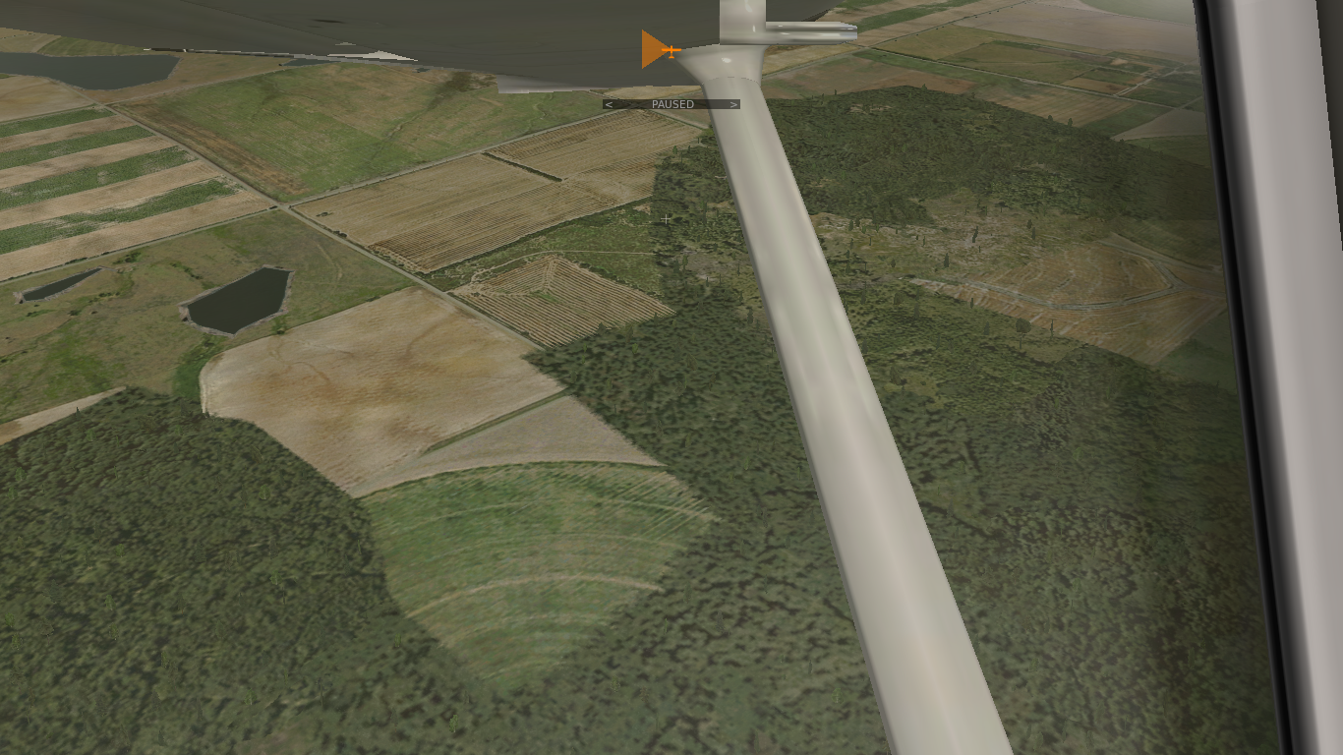
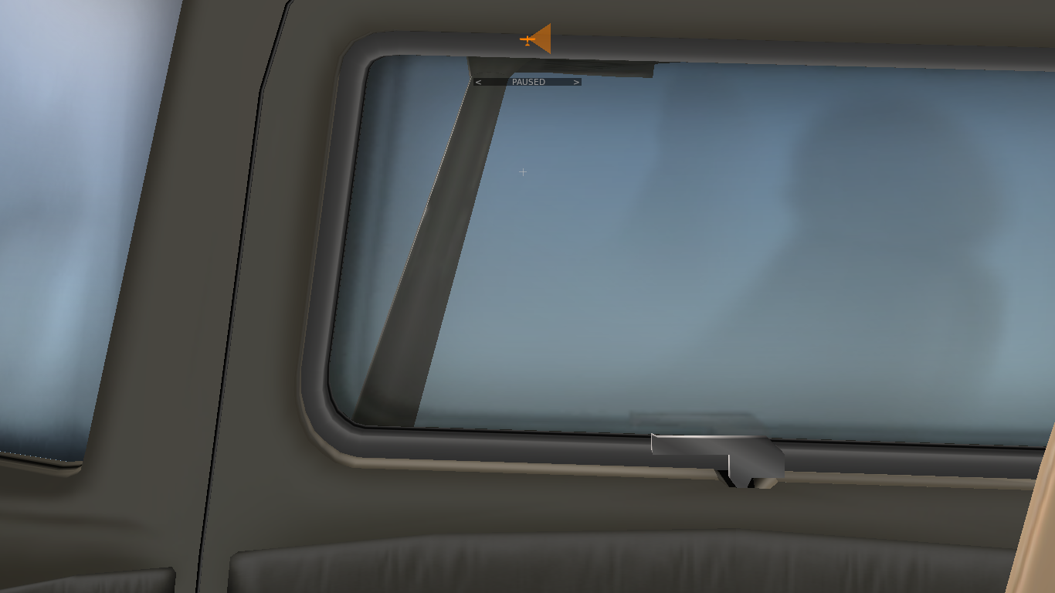
Bank Attitudes: Left-Banked Attitude

Slide 13
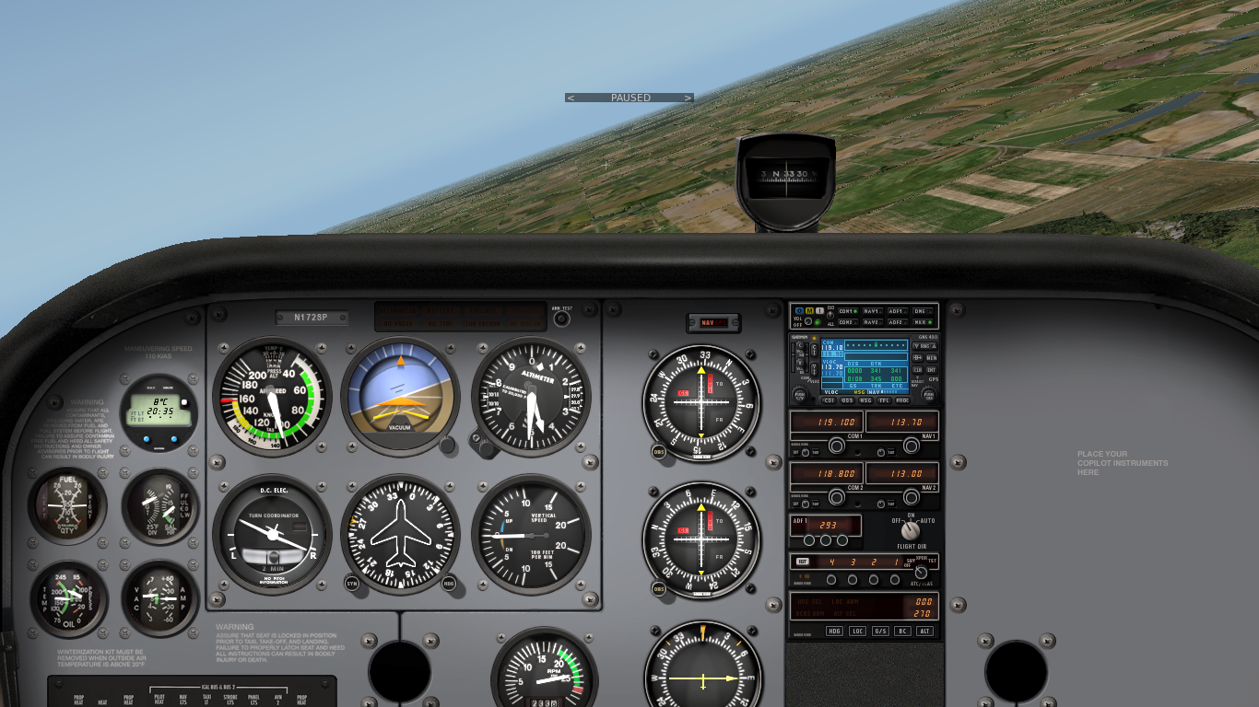
Bank Attitudes: Right-Banked Attitude
Normal Right-Banked Attitude Range to +30°

Slide 14
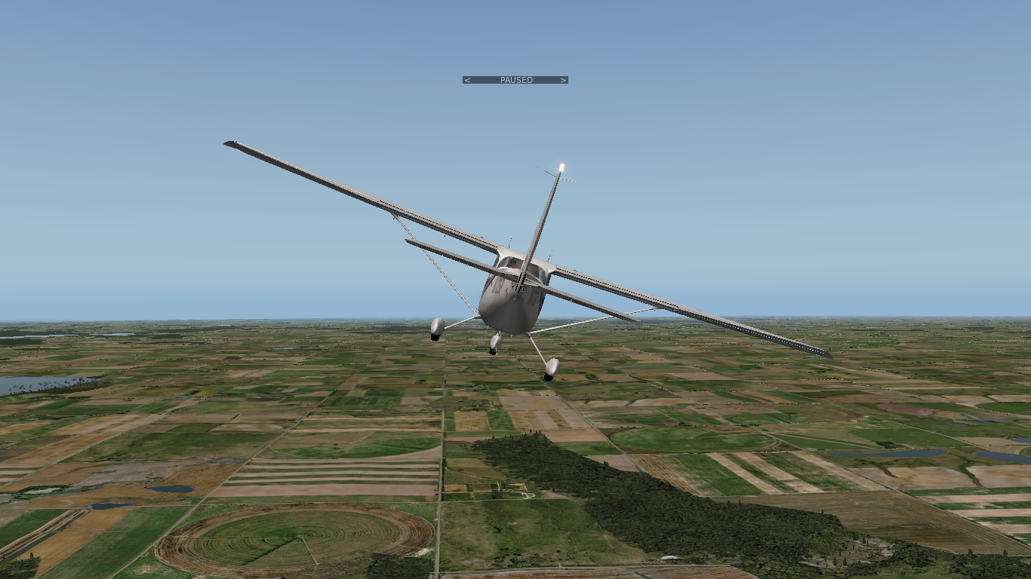
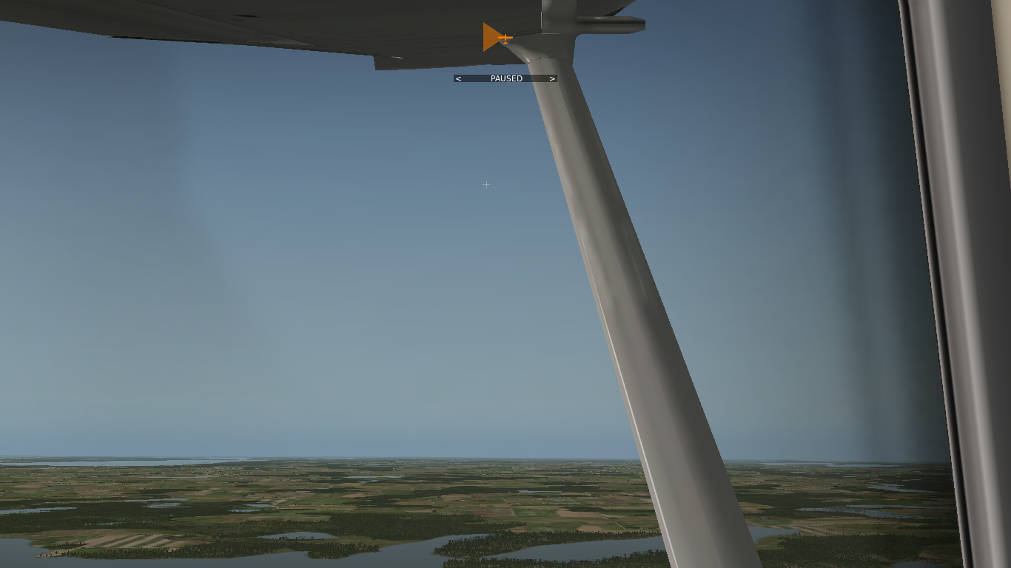
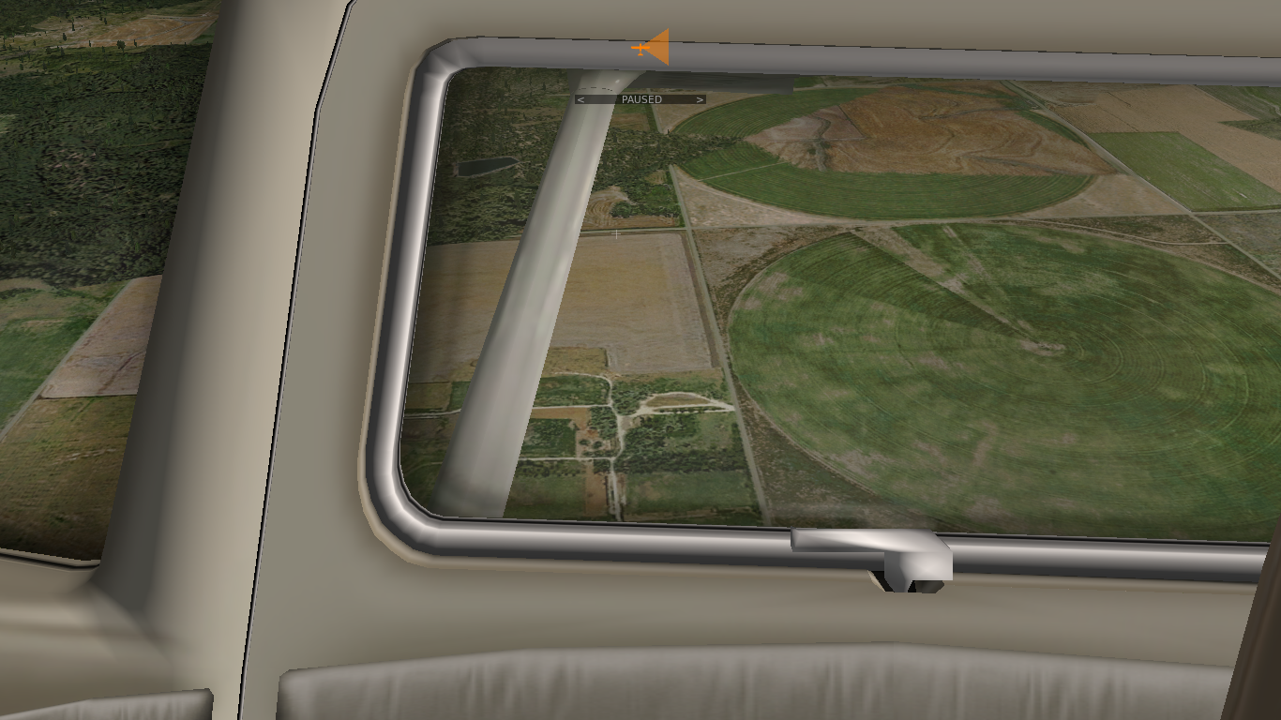
Bank Attitudes: Right-Banked Attitude

Slide 15
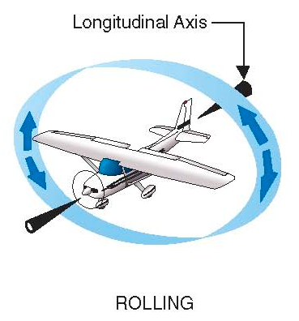
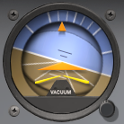
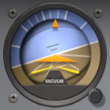
Movements - Rolling
Rolling is a rotational movement about the longitudinal axis
Rolling changes the bank attitude of the aircraft (left-/right banked)
Bank is primarily controlled with the yoke (control column, stick)
Rotating the yoke left or right results in aileron deflection
Real and artificial horizon reference (attitude indicator) change

Slide 16


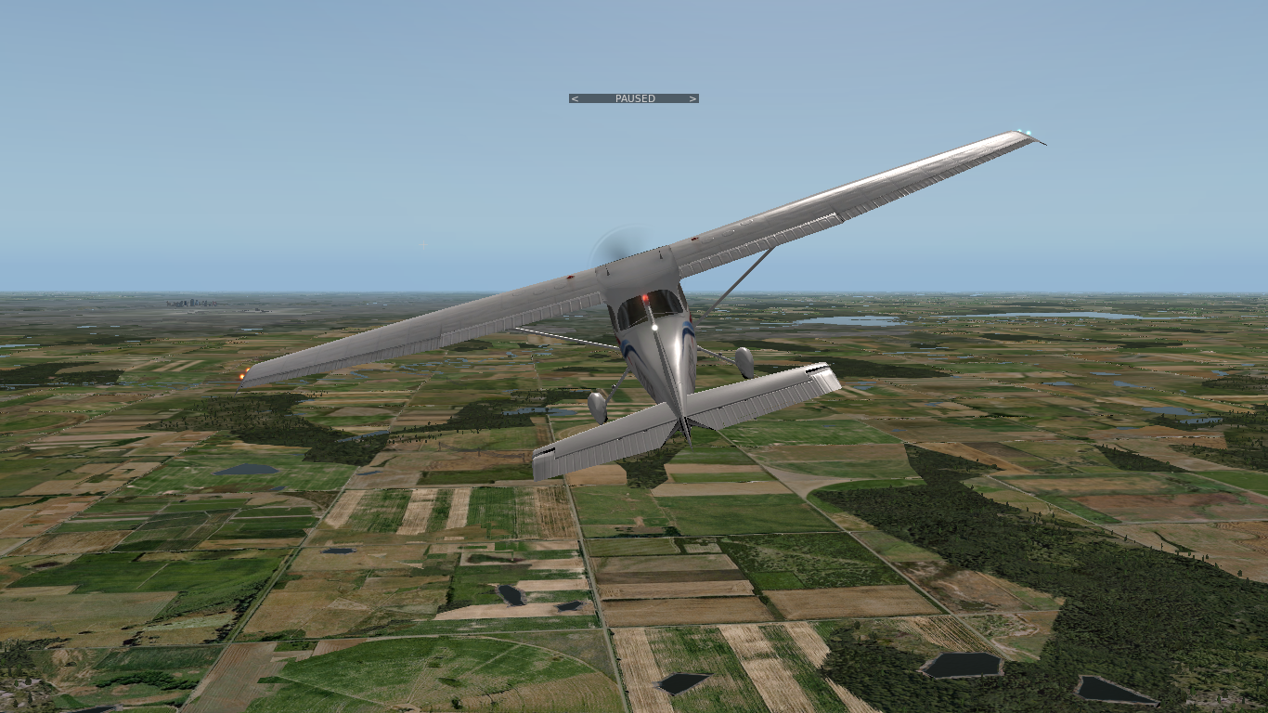
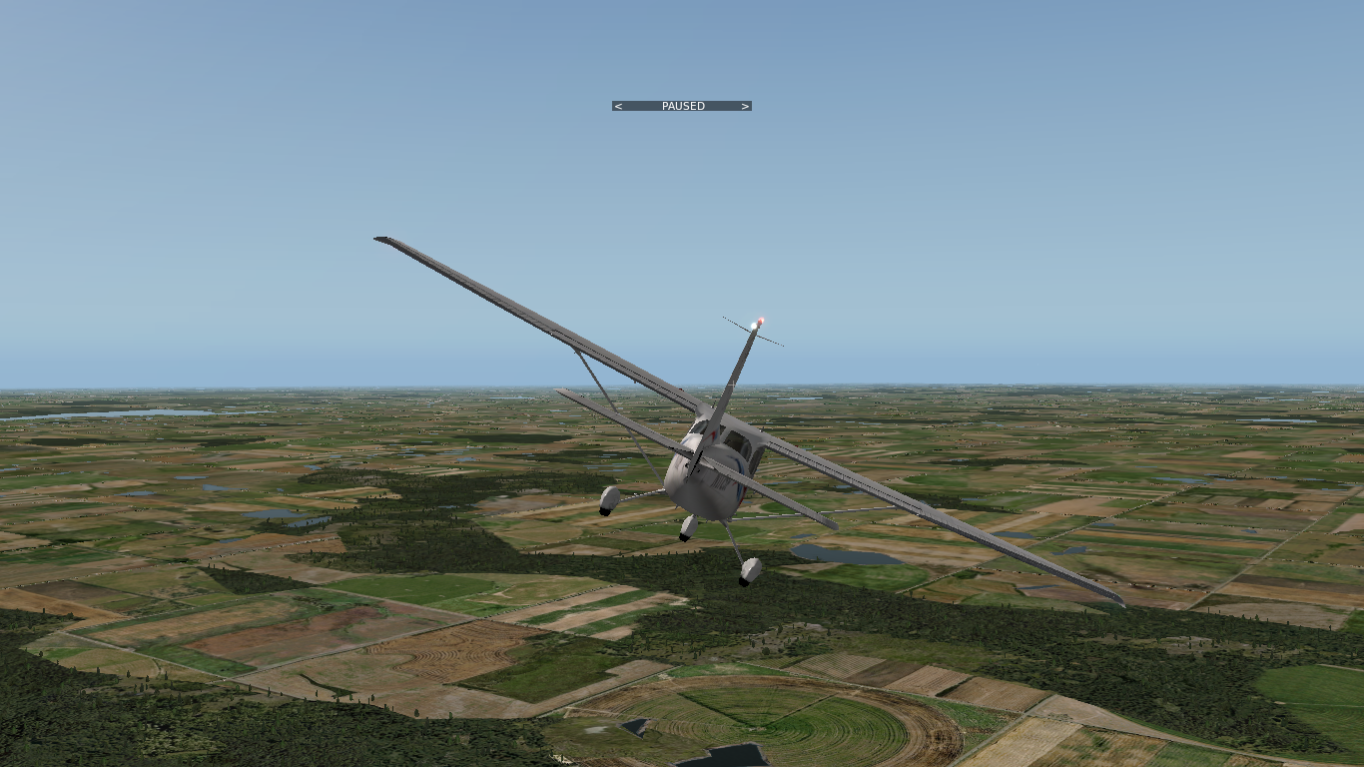
Combined Attitudes

Slide 17
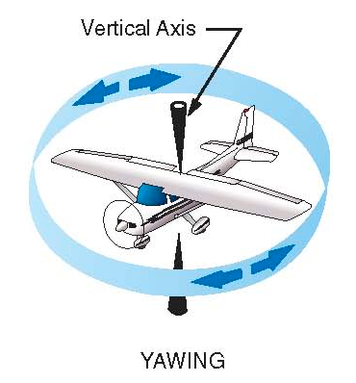


Movements - Yawing
Yawing is a rotational movement about the vertical (yaw) axis
Yawing changes the heading of the aircraft (left, right)
Yawing is primarily controlled with the rudder pedals
Coordinated flight is desired in most situations (kick and center the ball)
Real and indicated heading change (heading indicator, turn coordinator)

Slide 18
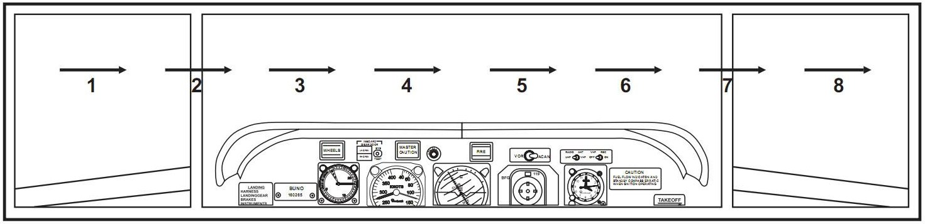
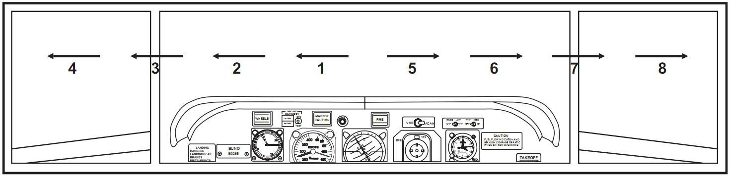
Lookout
Conflicts:
  Head-On, Converging, Climbing, Descending
Blind Spots:
  Below the Aircraft (above and behind depending on the cockpit)
Scanning:
  Side to Side, Middle to Side

Slide 19
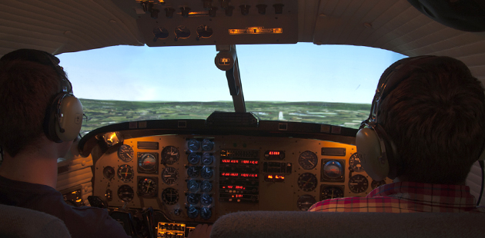
Control Transfer
Instructor: “You have control”, Student: “I have control”
Instructor: “I have control”, Student: “You have control”

Slide 20
Summary / Quiz
What is an aircraft attitude?
What types of aircraft attitudes exist?
What is the reference for the aircraft attitude?
Which attitude is the reference aircraft attitude?
What is the range of normal attitudes?
What kinds of movements change the aircraft attitude?
Which axis corresponds to each of the movements?
What control inputs change the aircraft attitude and how?
How do flight instruments indicate attitudes and movements?
What movement changes the heading of the aircraft?
What control inputs changes the heading of the aircraft?
What effects can cause a yawing movement?
How can scanning be performed to avoid conflicts?

