Slide 1
Contact Information
Stephan Heinemann
SMS: +1 (250) 891-5446
Email: stephan.heinemann@hotmail.com
Bookings, Questions

Slide 2
Straight-and-Level Flight Review
Maintain heading and altitude in close tolerances
Restrained use of all three flight controls
Control roll and yaw to maintain heading
Control pitch and power to maintain altitude
Maintain coordinated flight
Attitude plus power equals performance

Slide 3
Part I – Basic Climbing and Descending
Attitude, Power, Trim
Basic Climbs and Leveling Off
Basic Power-off Descents and Leveling Off

Slide 4




Establishing a Basic Climb
Attitude
Power
Trim
In cruise-attitude lookout ahead and above
Establish nose-up attitude monitoring airspeed
Apply full power maintaining nose-up attitude
Keep straight and control yaw with rudder
Trim and continue to monitor airspeed and altitude
Notes:
- what are the cockpit checks to be performed
- nose-up tendency during power application
- forward pressure required to maintain attitude
- rudder required to prevent yaw (slipstream, p-factor)

Slide 5

Maintaining a Basic Climb
Attitude
Airspeed
Monitor attitude and desired climb airspeed
Airspeed low requires lower nose-up attitude
Airspeed high requires higher nose-up attitude
Re-trim after complete attitude adjustment
Notes:
- use external references and instruments
- don't fly with trim but adjust trim after stabilizing

Slide 6

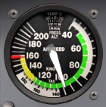
Leveling Off from a Basic Climb
Attitude
Power
Trim
Establish cruise attitude at desired target altitude
Monitor RPM and accelerate to cruise airspeed
Reduce power maintaining cruise attitude
Keep straight and control yaw with rudder
Trim and continue to monitor airspeed and altitude
Notes:
- never exceed the RPM red line limit
- decreasing power may require backward pressure
- rudder required to prevent yaw (slipstream, p-factor)

Slide 7
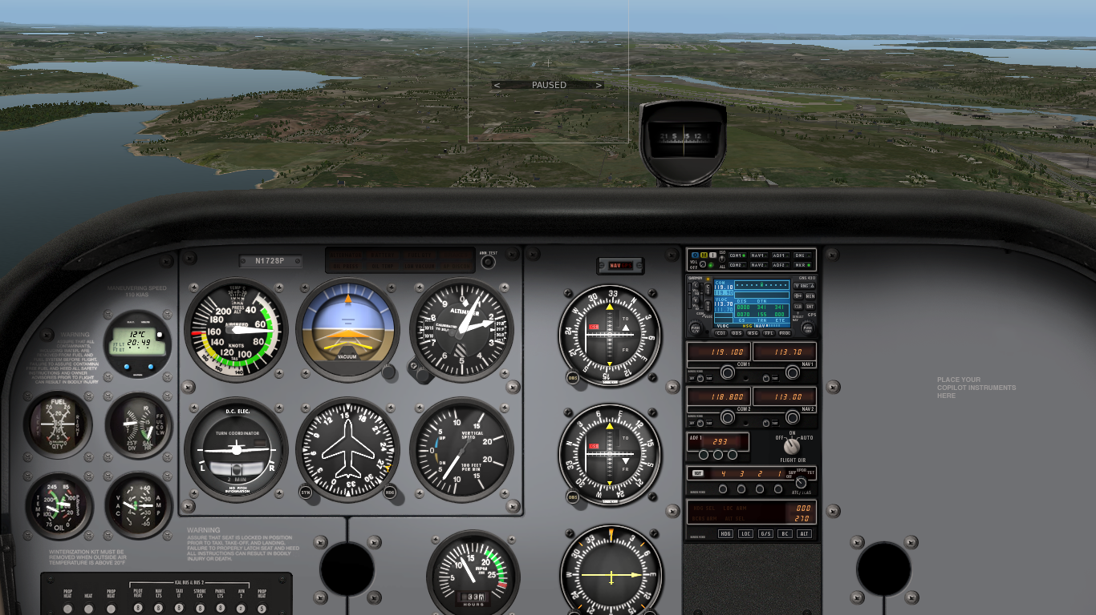
Establishing a Basic Descent
Power
Attitude
Trim
In cruise attitude lookout ahead and below
Reduce power to idle
Keep straight and control yaw with rudder
Decelerate to descent airspeed maintaining attitude
Establish nose-down attitude and trim
Notes:
- what are the cockpit checks to be performed
- backward pressure is required to maintain attitude
- use nose-down attitude picture with proper airspeed
- use carburettor heat if applicable

Slide 8

Maintaining a Basic Descent
Attitude
Airspeed
Monitor attitude and desired descent airspeed
Airspeed low requires lower nose-up attitude
Airspeed high requires higher nose-up attitude
Re-trim after complete attitude adjustment

Slide 9
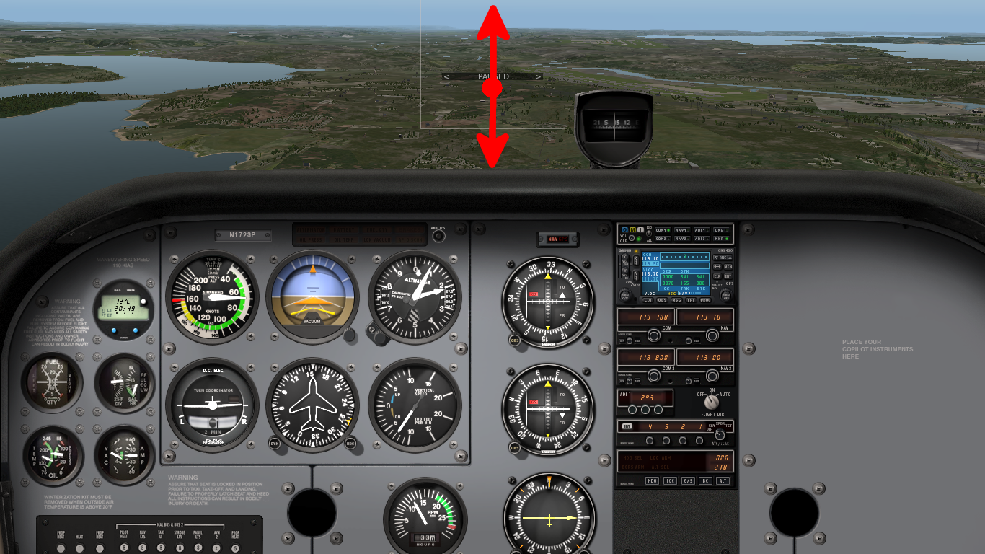
Estimating the Glide Path
References that move up cannot be overflown
References that move down can be overflown
References that remain steady are on glide path

Slide 10
Leveling Off from a Basic Descent
Power
Attitude
Trim
In nose-down attitude lookout ahead and above
Increase power to cruise power setting
Establish cruise attitude and accelerate to cruise airspeed
Keep straight and control yaw with rudder
Trim and continue to monitor airspeed and altitude
Notes:
- power application results in nose-up tendency

Slide 11
Summary / Quiz
Mentally perform a basic climb and level off and state all required actions.
Mentally perform a basic power-off descent and level off and state all required actions.

Slide 12
Pre-Flight Briefing

Slide 13
Part II – Climbing and Descending
Departure and Approach Climbs and Descents
V-Speeds (POH)
Instruments
Flaps and Gear
Balked Approaches – PAT

Slide 14
Review Basic Climbing and Descending
Basic Climbing – Attitude, Power, Trim
Basic Descending – Power, Attitude, Trim
Glide Path Estimation

Slide 15
Part III – Advanced Climbing and Descending
Visibility, Engine Cooling, Carburettor Heat
Environment and Performance Factors (POH)
Normal and Cruise Climbs and Descends
Climbing and Descending Turns

Slide 16
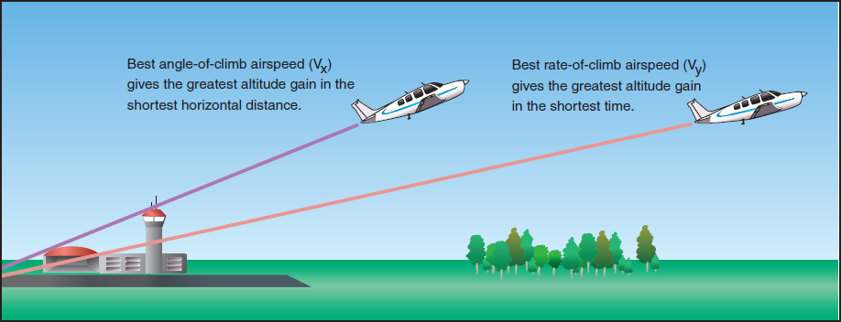
Departure and Cruise Climbs
Best rate (Vx)– minimizes climbing time
Best angle (Vy) – ensures best obstacle clearance
Normal – improves forward visibility and engine cooling
En-Route – targets convenience and comfort

Slide 17
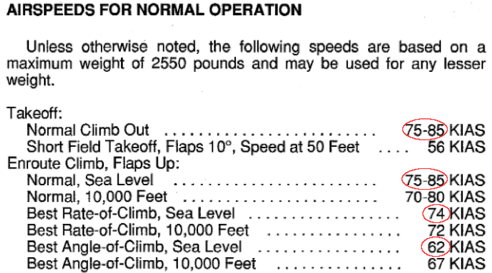
Reference Climb Airspeeds
Reference climb airspeeds can be found in the POH under Section 4 Normal Procedures

Slide 18
Approach and Cruise Descents

Slide 19
Establishing a Power-on Descent
Power
Attitude
Trim
In cruise attitude lookout ahead and below
Reduce power for estimated descent airspeed
Keep straight and control yaw with rudder
Decelerate to descent airspeed maintaining attitude
Establish nose-down attitude and trim

Slide 20
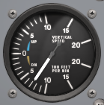
Maintaining a Power-On Descent
Monitor references, descent airspeed and rate of descent
Adjust power and attitude to attain desired descent airspeed and rate of descent
Re-trim after power and attitude adjustments

Slide 21
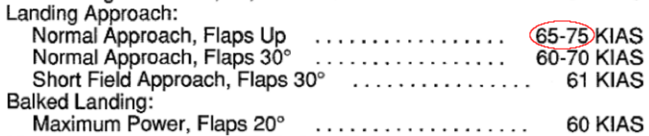
Reference Descent Airspeeds
Reference descent airspeeds can be found in the POH under Section 4 Normal Procedures

Slide 22
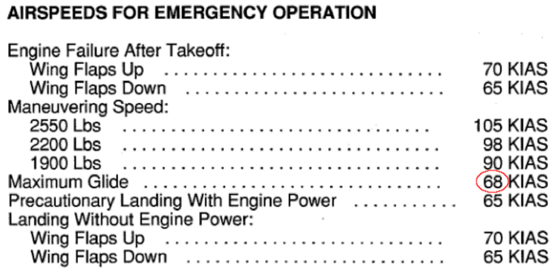
Best Glide Airspeed
Best glide airspeed for power-off descents can be found in the POH under Section 3 Emergency Procedures

Slide 23
Outline
Climbing and Descending
Procedures
References and Instruments
Performance

Slide 24
Climbing and Descending
Increase or decrease altitude
Terrain clearance, airspace requirements, weather, aircraft performance
Forward visibility, airspeed, vertical speed, power

Slide 25
Climbing – Procedure
Perform cockpit checks and lookout
Establish nose-up attitude monitoring airspeed
Increase power for climb airspeed maintaining attitude
Trim and continue to monitor airspeed and altitude
Attitude, Power, Trim (APT)

Slide 26
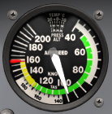
Climbing – Leveling Off
Establish cruise attitude at target altitude
Monitor RPM and accelerate to cruise airspeed
Decrease power for cruise airspeed maintaining altitude
Trim and continue to monitor airspeed and altitude
Attitude, Power, Trim (APT)

Slide 27
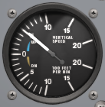
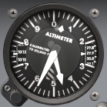
Climbing – References and Instruments
Airspeed is the main reference during climbs
Attitude plus power equals performance
Adjust attitude and set power for airspeed
Monitor airspeed, vertical speed and altitude

Slide 28
Climbing – Performance
Select appropriate airspeed for flight phase from POH
  best angle (62 KIAS), best rate (74 KIAS), normal, en-route
ground effect (accelerate after lift-off)
air density (height, temperature, moisture)
engine cooling, flaps, landing gear, carburettor heat, weight
lookout

Slide 29
Climbing – Performance
Climb performance in ground effect is better than normal
Select appropriate airspeed for flight phase from POH
  best angle (62 KIAS), best rate (74 KIAS), normal, en-route
Environment
  terrain (obstacles), airspace, weather (air density), traffic (lookout)
Aircraft
  weight, thrust (carburettor heat, engine cooling), lift and drag (flaps, gear, contamination), passengers (comfort)

Slide 30
Climbing – Performance
Select appropriate airspeed for flight phase from POH
  best angle (62 KIAS), best rate (74 KIAS), normal, en-route
Air density (height, temperature, moisture)
  high-hot-moist versus low-cold-dry
Lookout, engine cooling, ground effect
Terrain, weather, traffic, airspace, configuration (surfaces and power plant)

Slide 31
Climbing – Climb Performance
Best rate, best angle, normal, en route
Normal: better visibility, better engine cooling
En route: convenience and comfort
Ground effect and climb after take-off

Slide 32
Climbing – Howto
P-factor: control roll and yaw keeping the wings level and maintaining coordinated flight
Lookout before (and during) climb, change heading lower nose intervals
Establish (nose-up) attitude (estimate), increase power (estimate) (later simultaneous), adjust attitude and re-check power (inreasing altitude, climb airspeed), trim → APT
Monitor altitude and vertical speed indicator
Return: establish cruise attitude (allow acceleration, monitor rpm / red line) reduce power, adjust attitude and power (constant altitude and cruise airspeed), trim → APT
Balked approach / landing → PAT, slowly raising flaps (in stages - aircraft)

Slide 33
Climbing – Factors
Air density (height, temperature, moisture)
Example: high altitude, hot and moist day (aerodynamic and power plant performance!)
Example: sea level altitude, cold and dry day
Maybe some performance values of the POH?
Reduced rate of climb with lower air density
Density altitude → POH examples
Aircraft configuration: retractable gear, flaps, contamination, weight (POH), carburettor heat...

Slide 34
Climbing – Instruments
Air density: indicated airspeed != true airspeed
IAS, CAS, EAS, TAS, GS
(1.75) 2kts less per 1000ft
Example: 90kts at 2000ft, 88kts at 3000ft ???
Calibrated airspeed is the important aerodynamic factor not true airspeed!!!
Reduced rate of climbs with lower air density
Rate of climb (VSI)

Slide 35
Descending
Power-on (power assisted) descents
Power-off (glide) descents

Slide 36
Descending – Performance
Best glide speed (lift/drag ratio) → greatest range, approaches forced landings (POH reference)
Glide distances (from height, POH)
Rate of descent depending on airspeed
En route descent: suitable rate of descent maintaining cruise airspeed (engine temperature)
Approach to landing airspeeds

Slide 37
Descending – Howto
Estimating Range – fixed points on windshield
  Moving down (can be reached and overflown)
  Stationary (estimated touchdown point)
  Moving up (cannot be reached)
Power-off (mention carburettor heat) → PAT
  Cockpit checks, altimeter setting, lookout
  Close throttle (smoothly but promptly), control roll and yaw
  Establish attitude, trim (adjust attitude for airspeed and re-trim)
  Monitor altitude and rate of descent (VSI)
  Return: lookout, altimeter setting, power, control roll and yaw, cruise attitude, trim, (adjust attitude and power), re-trim
  Cruising power on longer descents to prevent undercooled engine
Power-on (precise control of rate of descent, most routine descents and approaches)
  Power, airspeed, nose-down attitude, trim, (adjust power and attitude and re-trim)
  Power change will affect attitude already, proper trim is key

Slide 38
Descending – Factors
Wind, weight, lift and drag (air density, speed, aircraft configuration, contamination)
Wind and distance
Lower density → higher TAS/GS
Flaps, landing gear (lift and drag devices)
Obstacle clearance → steeper angles required
Flaps steepen the angle of descent!
Flaps allow for lower airspeed (same lift)

Slide 39
Descending – Instruments
Rate of descent (VSI)
Altitude
Airspeed

Slide 40
Balked Approach
Ground effect
Flaps in stages (reduced lift)

Slide 41
Summary / Quiz

Slide 42
Pre-Flight Briefing

