Slide 1
Contact Information
Stephan Heinemann
SMS: +1 (250) 891-5446
Email: stephan.heinemann@hotmail.com
Bookings, Questions

Slide 2
Straight-and-Level Flight Review
Maintain heading and altitude in close tolerances
Restrained use of all three flight controls
Control roll and yaw to maintain heading
Control pitch and power to maintain altitude
Maintain coordinated flight
Attitude plus power equals performance

Slide 3
Part I – Basic Climbing and Descending
Attitude, Power, Trim
Basic Climbs and Leveling Off
Basic Power-off Descents and Leveling Off

Slide 4




Establishing a Basic Climb
Attitude
Power
Trim
In cruise-attitude lookout ahead and above
Establish nose-up attitude monitoring airspeed
Apply full power maintaining nose-up attitude
Keep straight and control yaw with rudder
Trim and continue to monitor airspeed and altitude
Notes:
- what are the cockpit checks to be performed
- nose-up tendency during power application
- forward pressure required to maintain attitude
- rudder required to prevent yaw (slipstream, p-factor)

Slide 5

Maintaining a Basic Climb
Attitude
Airspeed
Monitor attitude and desired climb airspeed
Airspeed low requires lower nose-up attitude
Airspeed high requires higher nose-up attitude
Re-trim after complete attitude adjustment
Notes:
- use external references and instruments
- don't fly with trim but adjust trim after stabilizing

Slide 6

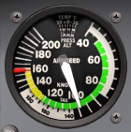
Leveling Off from a Basic Climb
Attitude
Power
Trim
Establish cruise attitude at desired target altitude
Monitor RPM and accelerate to cruise airspeed
Reduce power maintaining cruise attitude
Keep straight and control yaw with rudder
Trim and continue to monitor airspeed and altitude
Notes:
- never exceed the RPM red line limit
- decreasing power may require backward pressure
- rudder required to prevent yaw (slipstream, p-factor)

Slide 7
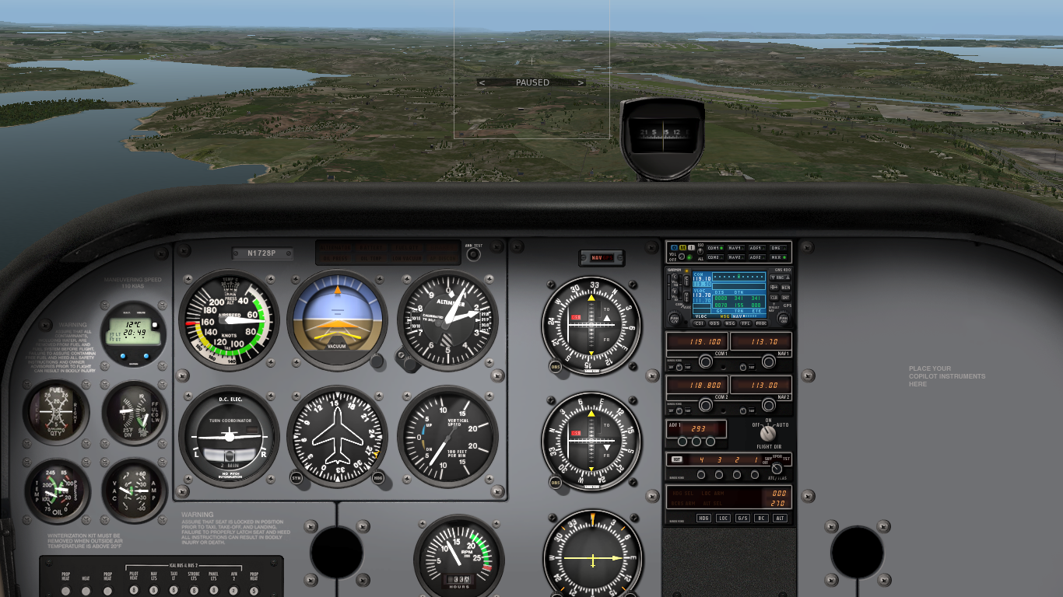
Establishing a Basic Descent
Power
Attitude
Trim
In cruise attitude lookout ahead and below
Reduce power to idle
Keep straight and control yaw with rudder
Decelerate to descent airspeed maintaining attitude
Establish nose-down attitude and trim
Notes:
- what are the cockpit checks to be performed
- backward pressure is required to maintain attitude
- use nose-down attitude picture with proper airspeed
- use carburettor heat if applicable

Slide 8

Maintaining a Basic Descent
Attitude
Airspeed
Monitor attitude and desired descent airspeed
Airspeed low requires lower nose-up attitude
Airspeed high requires higher nose-up attitude
Re-trim after complete attitude adjustment

Slide 9
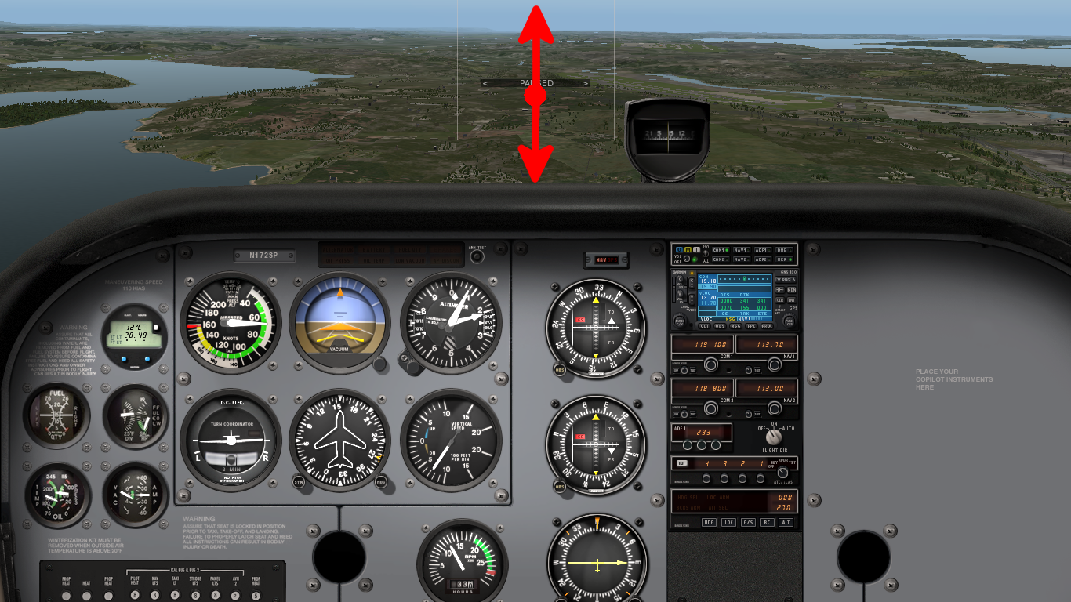
Estimating the Glide Path
References that move up cannot be overflown
References that move down can be overflown
References that remain steady are on glide path

Slide 10
Leveling Off from a Basic Descent
Power
Attitude
Trim
In nose-down attitude lookout ahead and above
Increase power to cruise power setting
Establish cruise attitude and accelerate to cruise airspeed
Keep straight and control yaw with rudder
Trim and continue to monitor airspeed and altitude
Notes:
- power application results in nose-up tendency

Slide 11
Summary / Quiz
Mentally perform a basic climb and level off and state all required actions.
Mentally perform a basic power-off descent and level off and state all required actions.

Slide 12
Pre-Flight Briefing

