Slide 1
Contact Information
Instructor: Stephan Heinemann
SMS: +1 (250) 891-5446
Email: stephanheinemann@flyvfc.com
Bookings, Questions

Slide 2
Stalls
Definition and Motivation
Power-Off and Power-On Stalls
Approach Stalls (Straight / Turning) and
Departure Stalls (Straight / Turning)

Slide 3
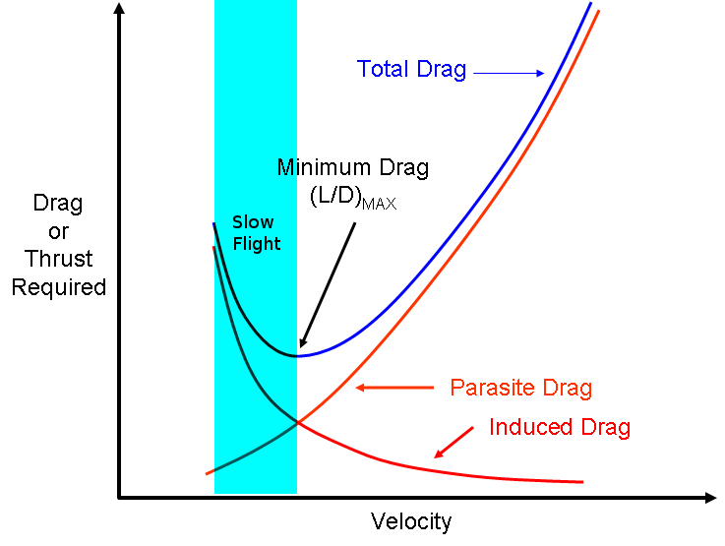
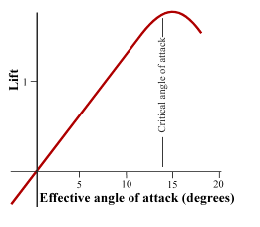
Definition and Motivation
Lower limit of the slow flight range
Any angle of attack beyond the critical angle of attack at which any further increase leads to less lift and more drag
Imminent – stall warning, bottom of arc, buffet
Fully Developed – nose or wing drop
Notes:
- Stall can happen at any attitude and airspeed

Slide 4
Safety Considerations
High nose-up attitude maneuver
Limited forward visibility
HASEL, lookout ahead and below
Maintain good lookout during maneuver
Yaw is to be controlled precisely with rudder
Remain coordinated at all times

Slide 5
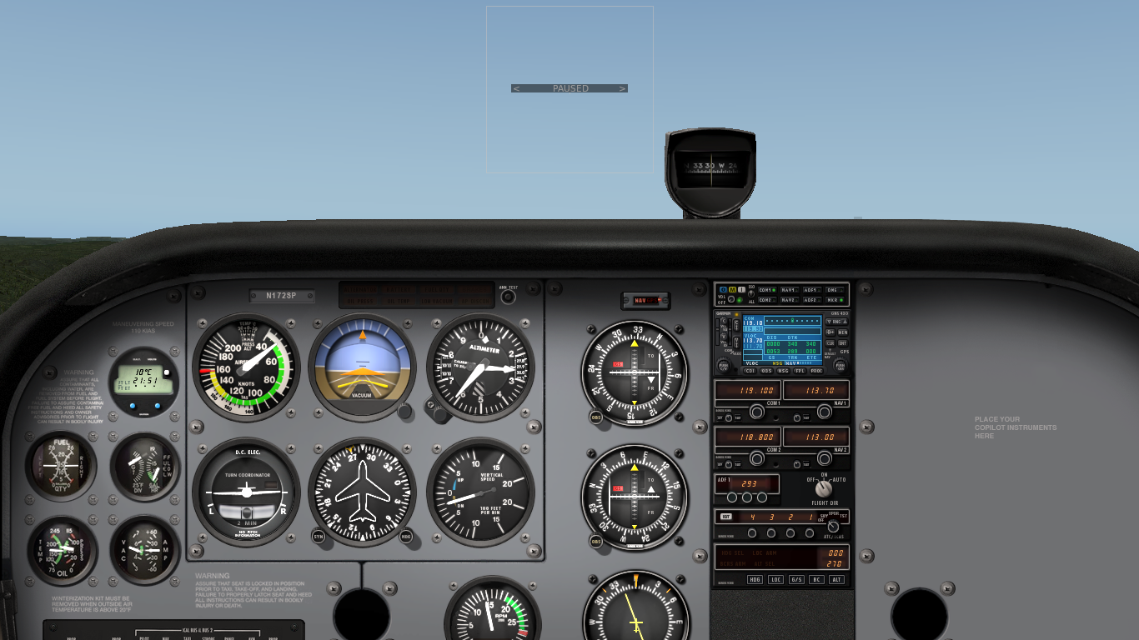
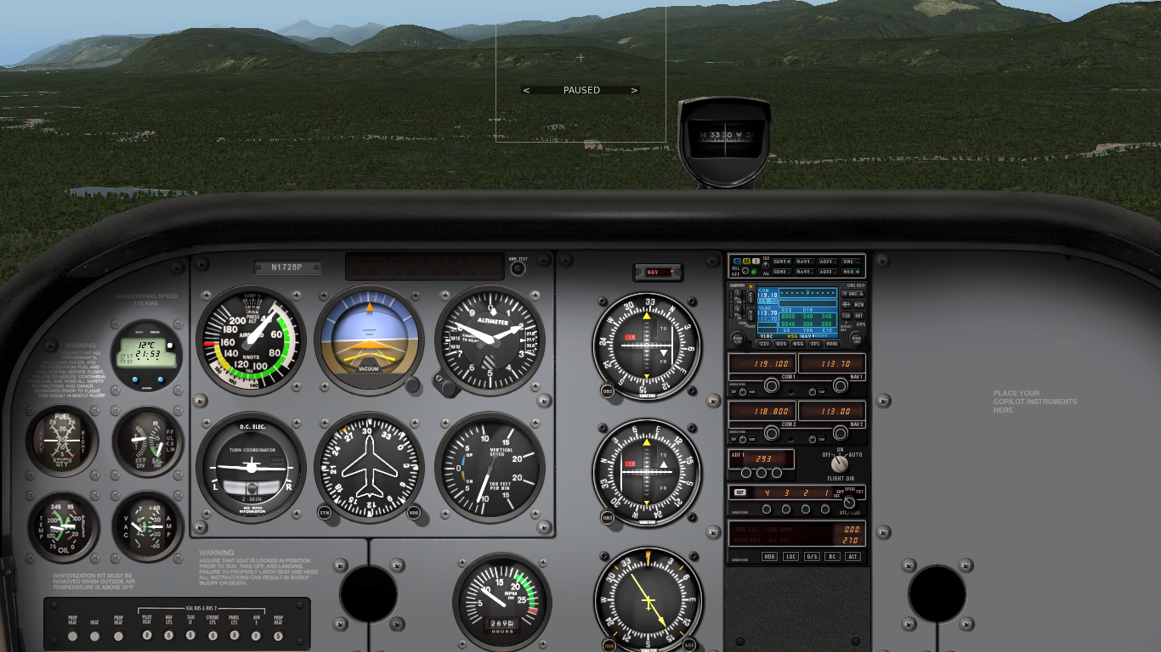
Entering a Power-Off Stall
Reduce power to idle, decelerate and control yaw
Apply elevator back-pressure to increase nose-up attitude controlling yaw with rudder maintaining altitude
Extend flaps in stages to desired degree in white arc

Slide 6




Recovering a Power-Off Stall
Forward
Pressure
Full
Power
Control Yaw
Flaps
Apply elevator forward pressure to lower the nose immediately
Apply full power controlling yaw with rudder to remain coordinated
Accelerate past the slow flight range and regain altitude
Retract flaps in stages to up in white arc
Establish cruise attitude and accelerate to cruise airspeed
Reduce power to cruise power setting and finally trim
Notes:
- Break the stall first (lower nose), then apply power
- Establish best rate of climb airspeed first during recovery
- If the student has problems with the recovery attitude, let him focus on attitude control only without power, repeat stall-check forward sequences until harddeck altitude
- If yaw control is a problem, let student focus on yaw control only, establish different power and attitude settings and let student control the rudder
Establish best rate of climb airspeed to regain altitude

Slide 7
Entering a Power-On Stall
Apply elevator back-pressure to increase and hold nose-up attitude controlling yaw with rudder
Extend flaps in stages to desired degree in white arc
Notes:
- Power-on stall with full power climbing

Slide 8
Recovering a Power-On Stall
Forward
Pressure
Full
Power
Control Yaw
Flaps
Apply elevator forward pressure to lower the nose immediately
Apply full power controlling yaw with rudder to remain coordinated
Accelerate past the slow flight range and regain altitude
Retract flaps in stages to up in white arc
Establish cruise attitude and accelerate to cruise airspeed
Reduce power to cruise power setting and finally trim
Notes:
- Lower stall speed due to power and slipstream
- Higher nose-up attitude
- More yaw to be controlled
- Less effective ailerons
- More sudden and abrupt nose (wing) drop
Establish best rate of climb airspeed to regain altitude

Slide 9
Imminent and Fully Developed Stalls
Stall recovery in normal flight operations should be performed as early as possible – during the imminent stall
Recover at the first indication of stall warning, bottom of arc or buffet
Fully developed stalls are practiced to develop proficiency in recognition and recovery only

Slide 10
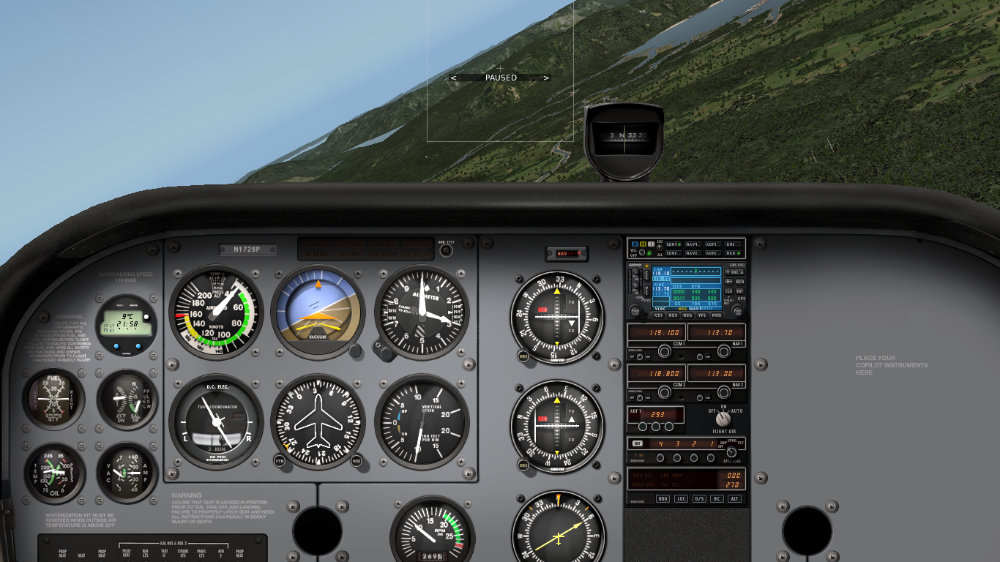
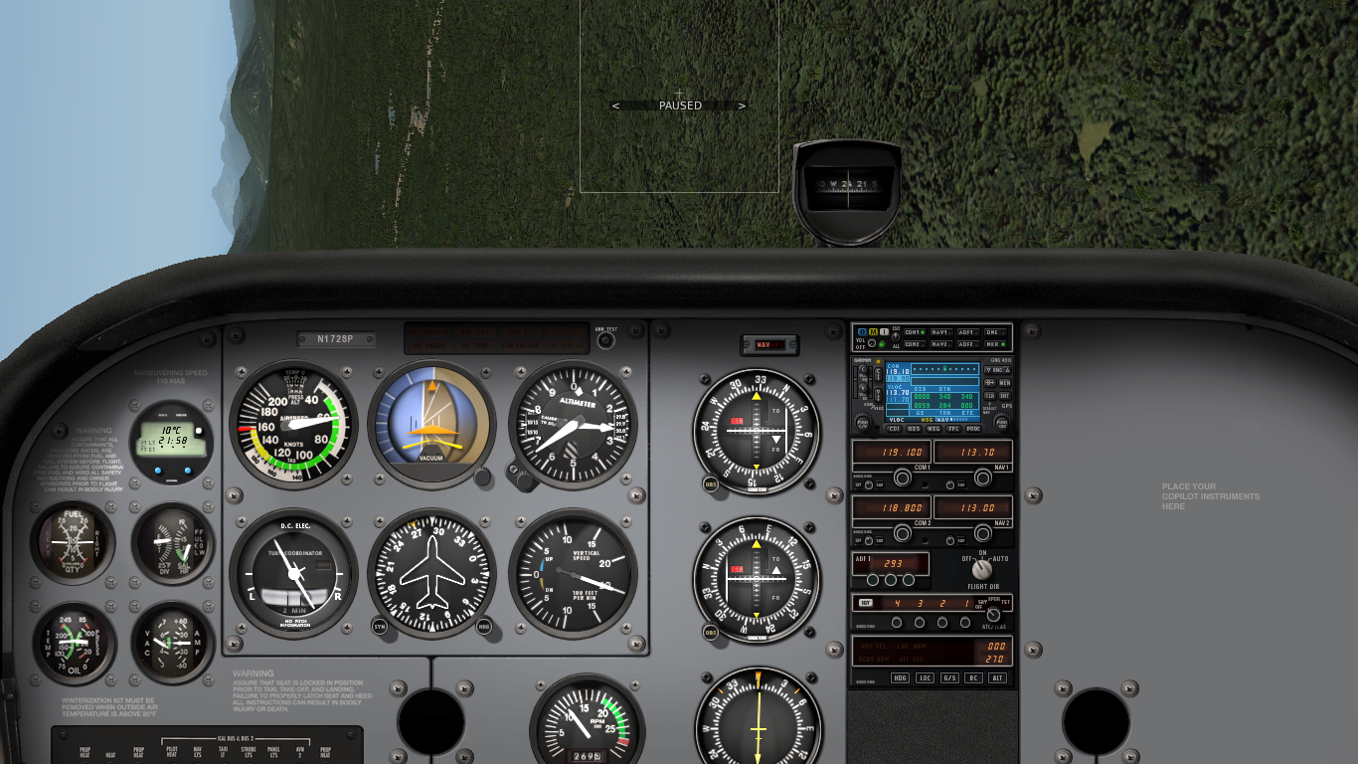
Approach / Turning Stall
Establish a power-off descending turn
Increase bank attitude with high rate of turn
Inner wing may stall first and drop
Release elevator back-pressure lowering nose, apply opposite rudder and ease out of dive applying power
Notes:
- Descending Turn: low airspeed, low rate of descent
- Recovery: lower nose, wings level, ease out of dive

Slide 11
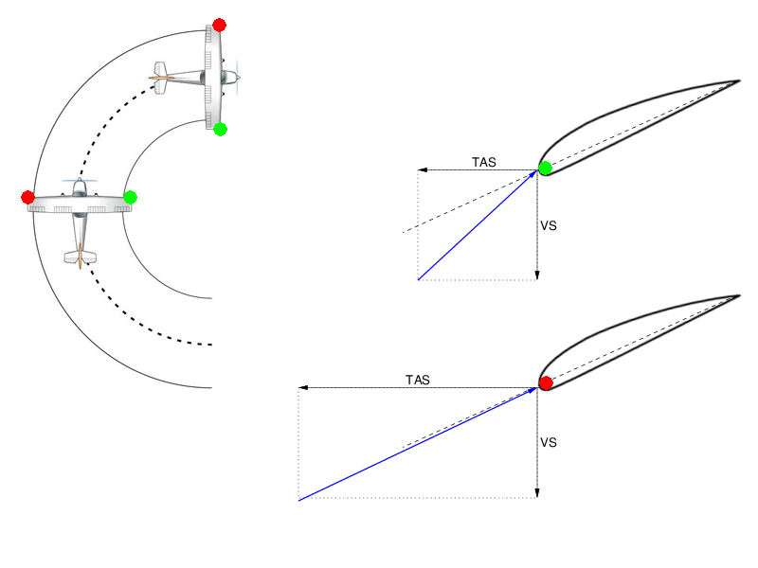
Approach / Turning Stall AoA
Notes:
- highlight speeds and increase outer AoA

Slide 12
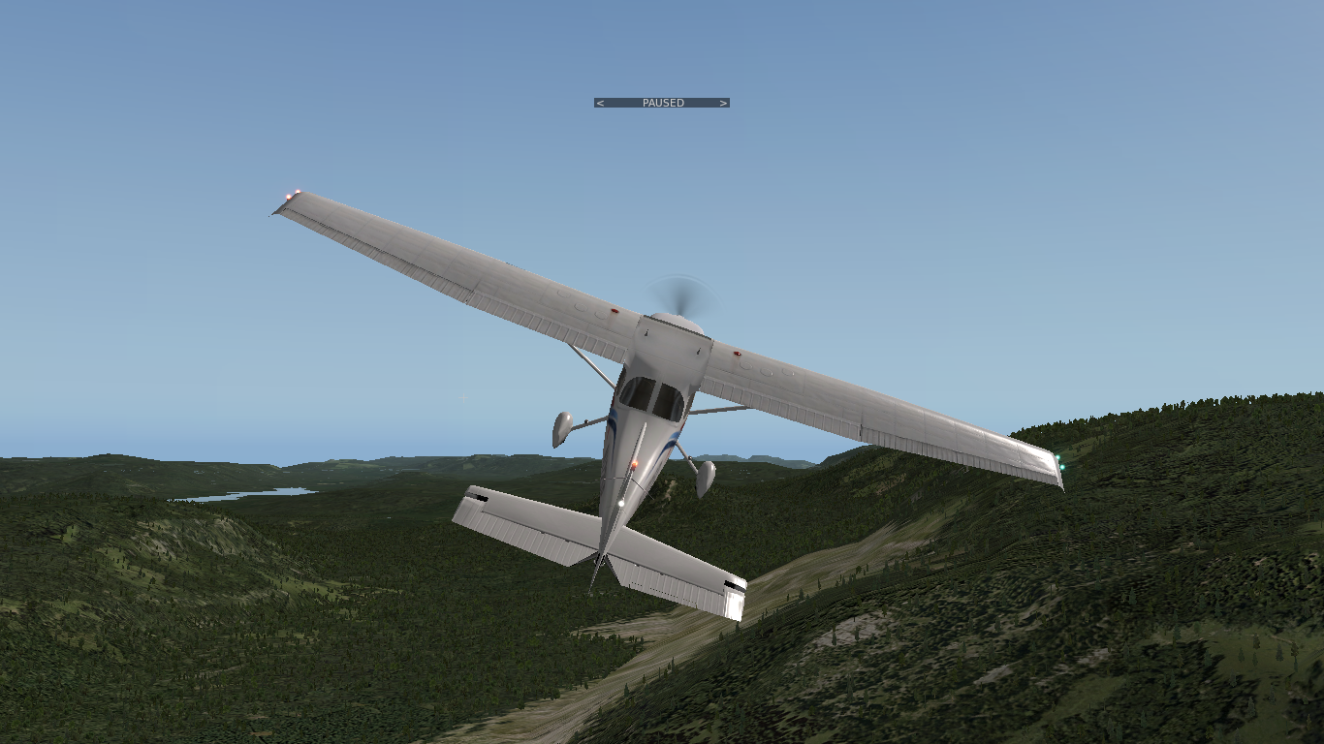
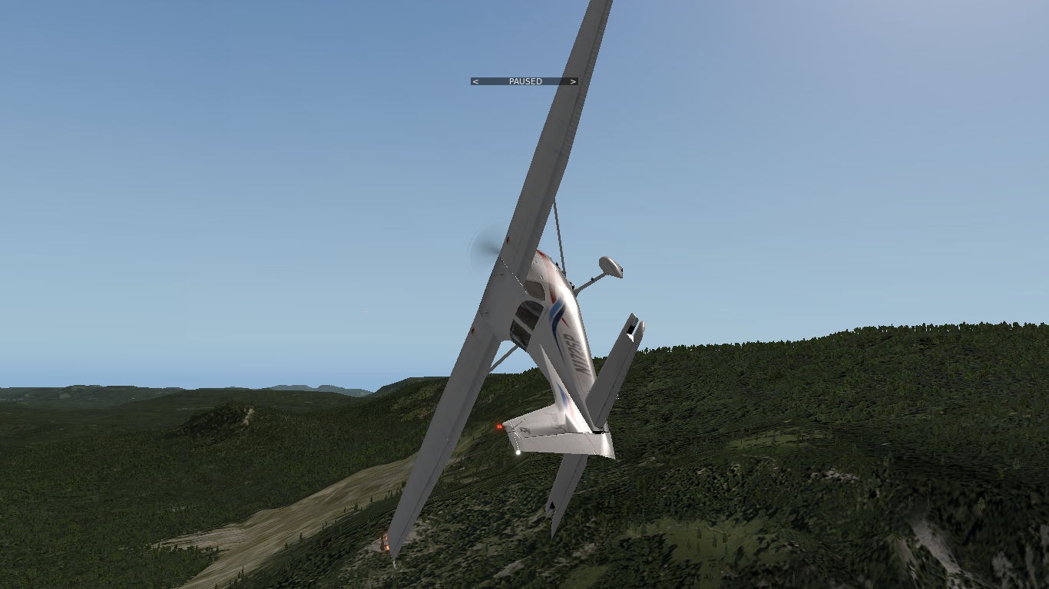
Departure / Turning Stall
Establish a power-on climbing turn
Increase nose-up attitude while turning
Outer wing may stall first and drop – opposite to the turn
Release elevator back-pressure lowering the nose, reduce power, apply opposite rudder, then neutralize, wings level and ease out of dive applying power
Notes:
- Climbing Turn: full power, low airspeed, high pitch attitude
- Recovery: lower nose, wings level, ease out of dive
- TODO: ailerons neutral! Don't use aileron during any stall recovery (before breaking the stall)
- possibly use a little high wing rudder to provoke a wing drop stall for the demonstration

Slide 13
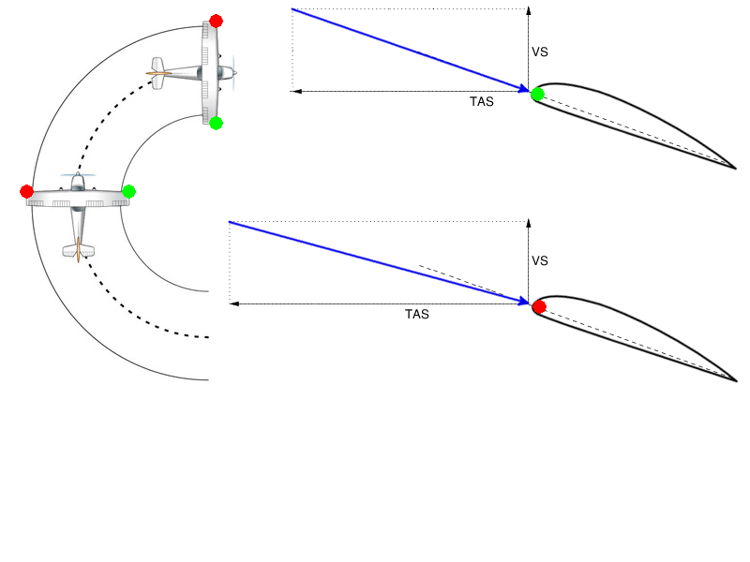
Depature / Turning Stall AoA

Slide 14
Spins
Definition and Motivation
Spinning and Factors

Slide 15
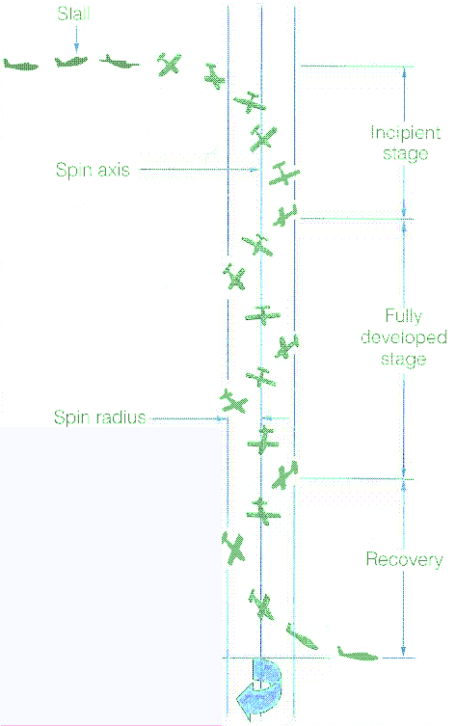
Definition and Motivation
Stall aggravated by yaw
Inner wing has higher angle of attack and drag
No applications – recognition and recovery
Incipient – initial transition into stable rotation
Fully Developed – stable rotation and airspeed
Notes:
Inner wing remains with higher angle of attack
High drag limits the increase in airspeed
Spins can occur at any attitude and airspeed as with a stall

Slide 16
Safety Considerations
High nose-up / nose-down attitude maneuver
Spin can occur at any attitude and airspeed
AFM – utility category is required
HASEL, lookout ahead and below
Significant loss of altitude
Recovery above 2000' AGL

Slide 17
Spin Entry
Enter Imminent Stall
Full Aft Elevator
Full Left Rudder
Reduce power to low power setting (1500 RPM)
Apply elevator back-pressure to increase nose-up attitude controlling yaw with rudder maintaining altitude
During the imminent stall simultaneously apply and hold full elevator back-pressure and full left-rudder
Notes:
- full left-rudder to use the yaw advantage
- enter spin at bottom of green arc for reference (stall warning will come on too early)

Slide 18
Spin Entry
Enter Imminent Stall
Full Aft Elevator
Full Rudder
Reduce power to idle
Apply elevator back-pressure to increase nose-up attitude controlling yaw with rudder maintaining altitude
During the imminent stall simultaneously apply and hold full elevator back-pressure and full rudder
Notes:
- no power during right-hand spins to reduce left-hand yaw

Slide 19
Spin Recovery
Power
Idle
Full Opposite
Rudder
Release
Back-Pressure
Ease Out
Neutralize Rudder
Reduce power to idle and keep ailerons neutral
Apply full opposite rudder (opposite spin direction) and release elevator back-pressure (briskly forward) until turn stops, then neutralize rudder
Ease out of dive and increase power to regain altitude
Establish cruise attitude, set cruise power and trim
Notes:
- release back-pressure versus positively forward, briskly forward (CoG as a factor)
- TODO: neutralize

Slide 20
Spin Recovery – Factors
Incipient versus fully developed spin – rate of turn and recovery time
Power – additional yaw and flatter spin
Flaps – flatter spin, reduced elevator effectiveness and structural damage
Weight and Balance – forward versus rearward center of gravity, load factor and inertia
Altitude – density and control effectiveness
Notes:
- more recovery time during fully developed stage
- more power induces more yaw which aggravates the stall, more power during the spin leads to less nose down, more altitude loss during recovery
- flaps create a higher camber leading to a flatter spin, reduces elevator effectiveness (deflected airflow), potential structural damage → retract flaps
- more weight increases the load factor and more inertia → flatter spin, more difficult recovery
- forward CoG increases stability (more difficult entry, flatter spin (inertia), easier recovery)
- rearward CoG decreases stability (easier entry, flatter spin (inertia), more difficult recovery)
- high altitude → less dense air, more difficult recovery
- include how factors change spin characteristics into slides

Slide 21
Incipient versus Fully Developed Spin

Slide 22

Instruments
Turn coordinator may help to determine direction of spin
Airspeed should not increase significantly
High airspeed (acceleration) could indicate a spiral dive
Rate of descent should be stable – constant altitude loss
Notes:
- Instruments for recovery

